Slide 1
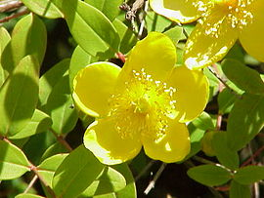
Grow light
Reporter Lazare Osmanov
Team georgia-georgians

Slide 2
problem
Investigate how different types of artificial lights affect plant growth. What is the role of light
spectrum?

Slide 3
plan
What is photosynthesis?
Theoretical model
differential equation of plant growth
Experiments
brassica
wheat
Graphs
height dependence on time
Comparison
Conclusion

Slide 4
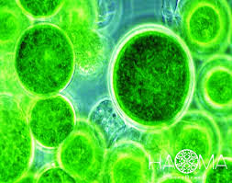
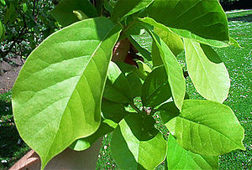
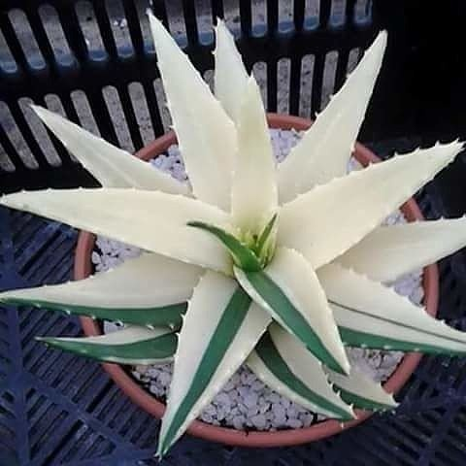
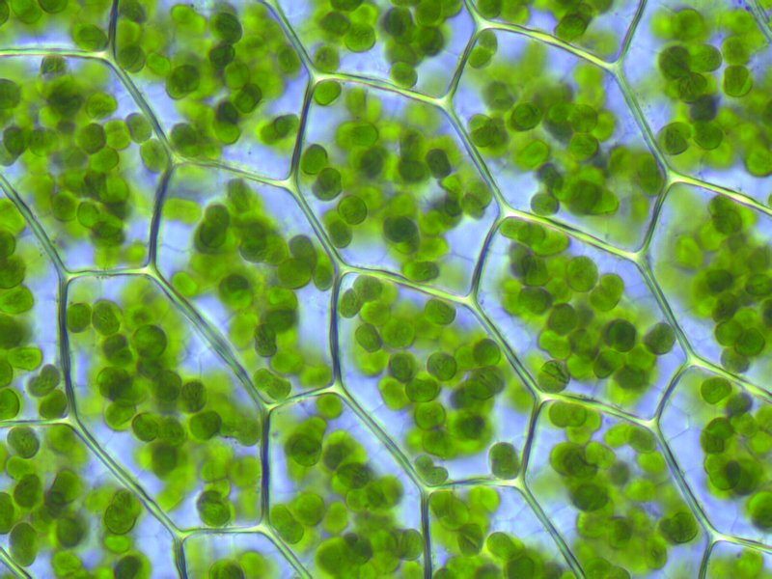
photosynthesis

Slide 5
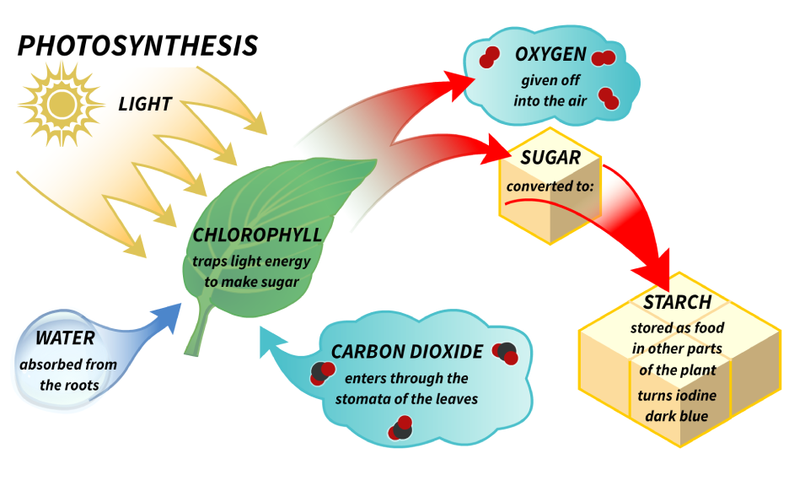
photosynthesis

Slide 6
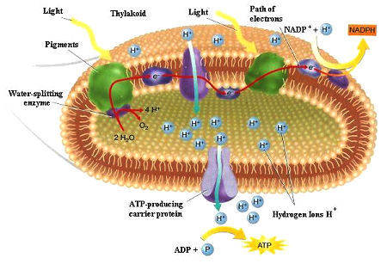
Chlorophylls role in photosynthesis

Slide 7
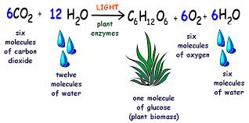
Photosynthesis

Slide 8
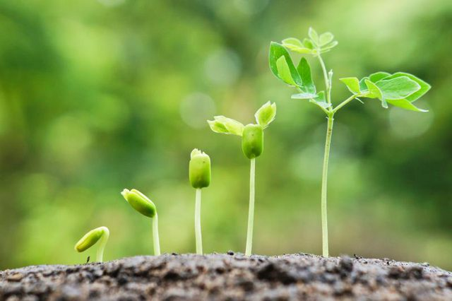
Theoretical model

Slide 9
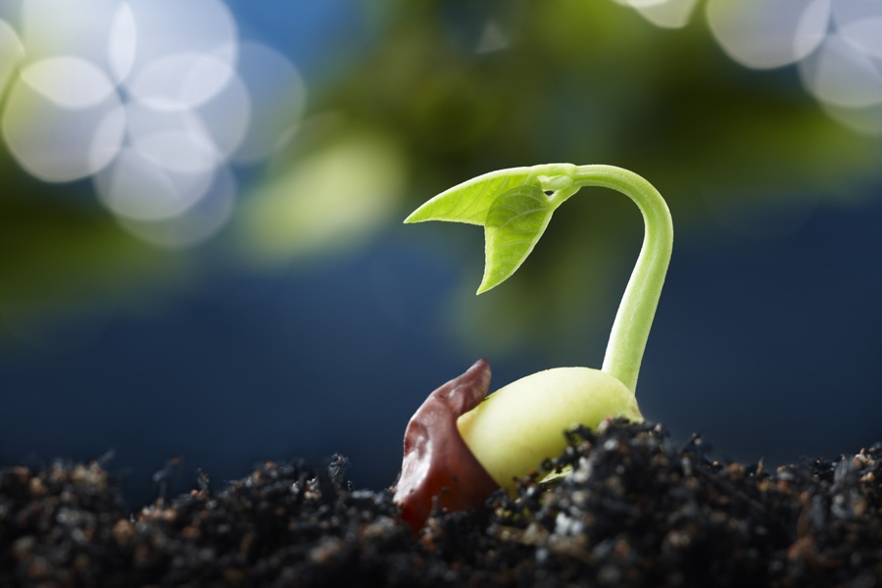
Theoretical model

Slide 10
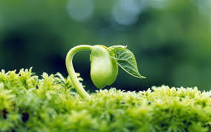
Relative error

Slide 11
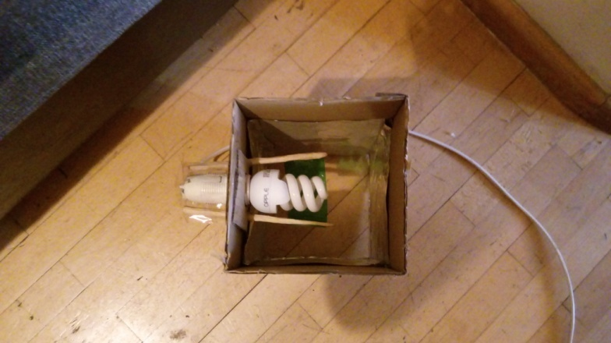
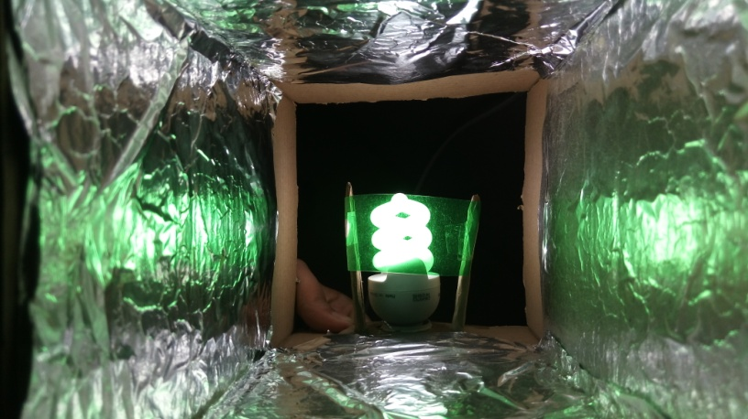
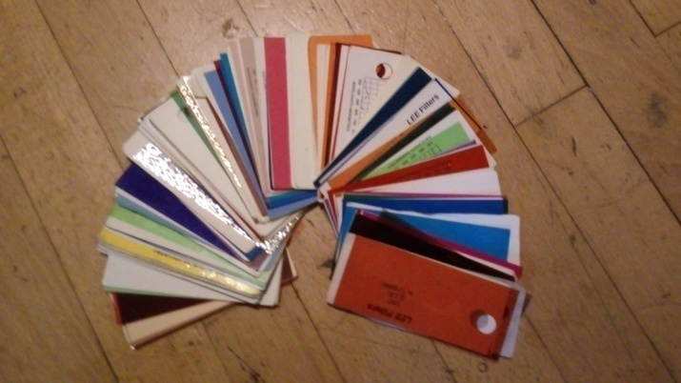
Experimental setup
lamp
spectrum filter

Slide 12
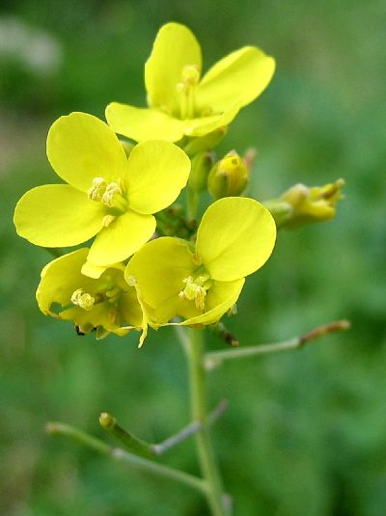
brassica

Slide 13
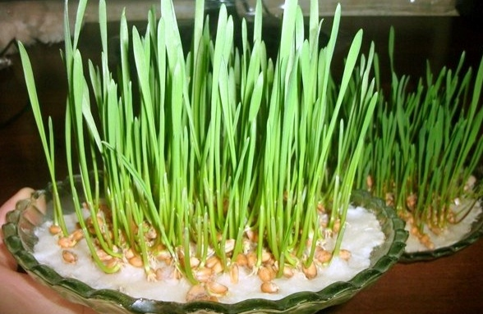
wheat

Slide 14
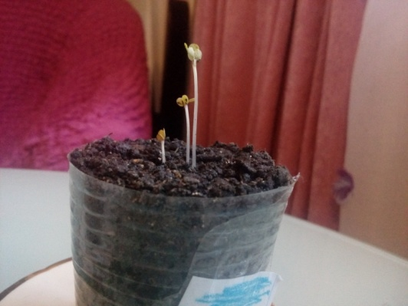
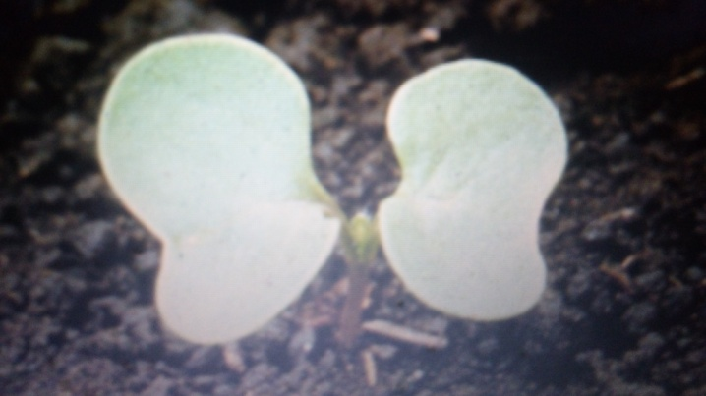
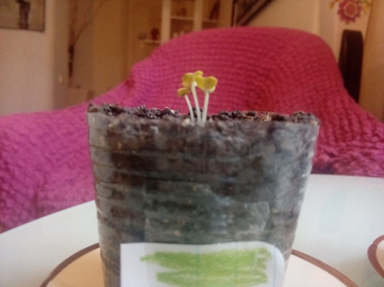
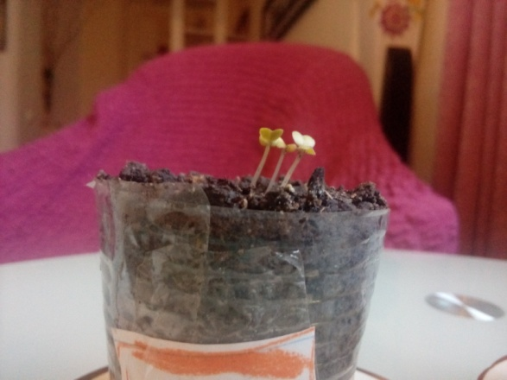
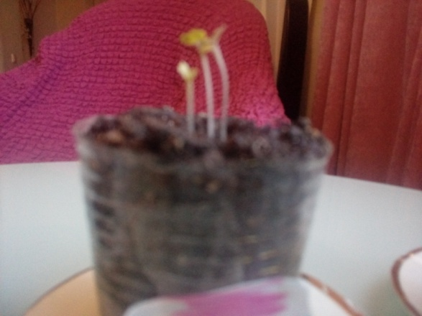
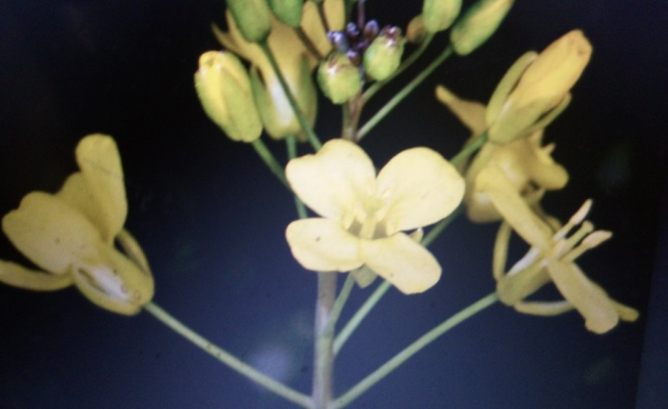
experiment

Slide 15
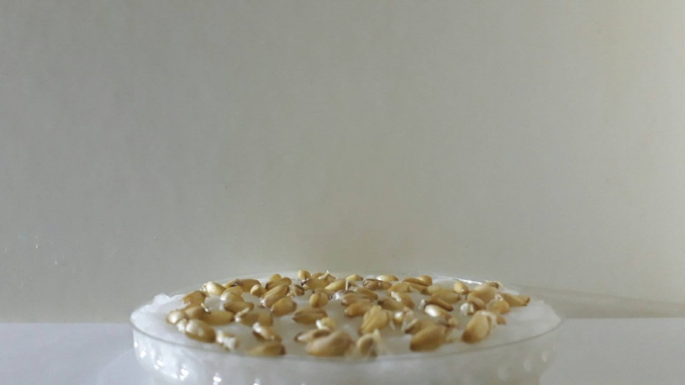
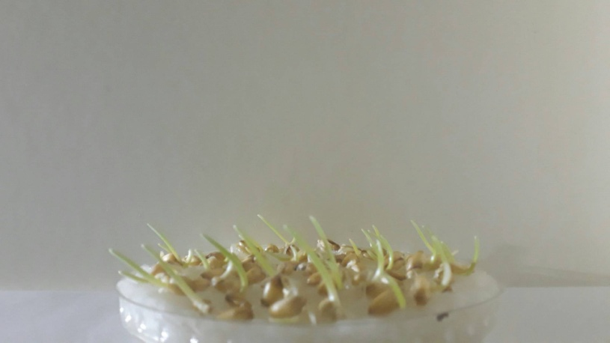
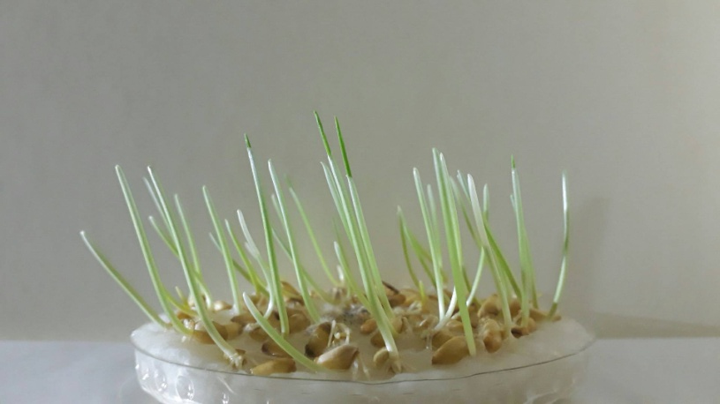
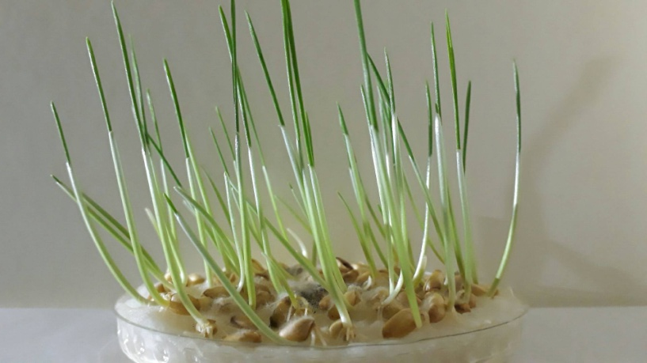
experiment

Slide 16
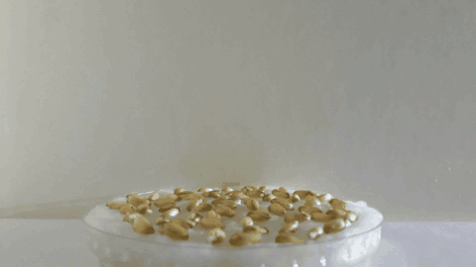
experiment

Slide 17
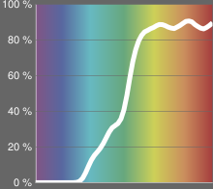
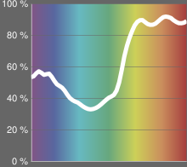
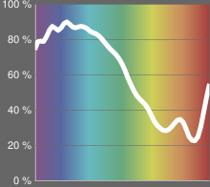
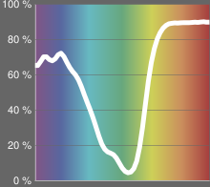
filter
Transmission
54%
Transmission
54.9%
Transmission
54.7%
Transmission
52.4%

Slide 18
Experiment 1

Slide 19
Experiment 2

Slide 20
Experiment 3

Slide 21
Experiment 4

Slide 22
Comparison

Slide 23
comparison
Green | Blue | Pink | Orange
1.2 | 3.6 | 4.6 | 5.8
Green | Blue | Pink | Orange
2.3 | 6.4 | 8.5 | 11.6

Slide 24
Interesting phenomenon

Slide 25
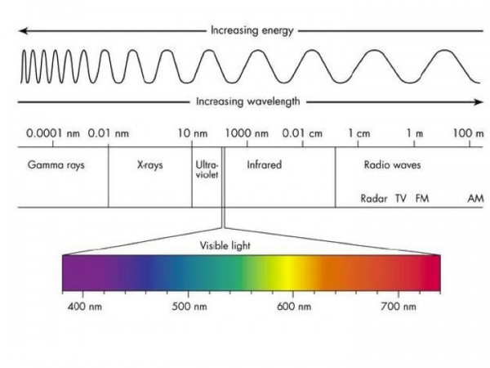
result

Slide 26
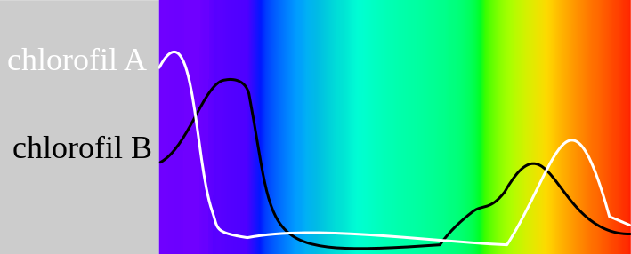
chlorophyll

Slide 27
conclusion
Experiments were conducted
Intensity ,height , time
Theoretical model was written
Generalized differential equation
We have got equation of grow light coefficient
Graphs were made
To see differences between different colors
Compared grow light coefficient
Results
Grow light coefficient for different plants are not the same but ratio is
Two best results orange and pink were at the edges of visible lights

Slide 28
references
https://en.wikipedia.org/wiki/Chlorophyll
https://en.wikipedia.org/wiki/Photosynthesis

Slide 29
Thanks for attention

