Slide 1
Problem № 12 Milk
Reporter: Saba Gogichaishvili
Team: Georgia-Georgians

Slide 2
Problem
Develop simple methods allowing determination of some of the important properties of milk. Suggest an investigation requiring comparison of various milk samples.

Slide 3
Plan
Determine most important properties
Find ways to measure properties
Measurements on different mammals
Cows
Goats
Humans
Conclusion

Slide 4
Most important properties
Nutrients
Lipids
Proteins
Carbohydrates
Energetic value
Acidity
Density
Heat stability
Antibiotics presence

Slide 5
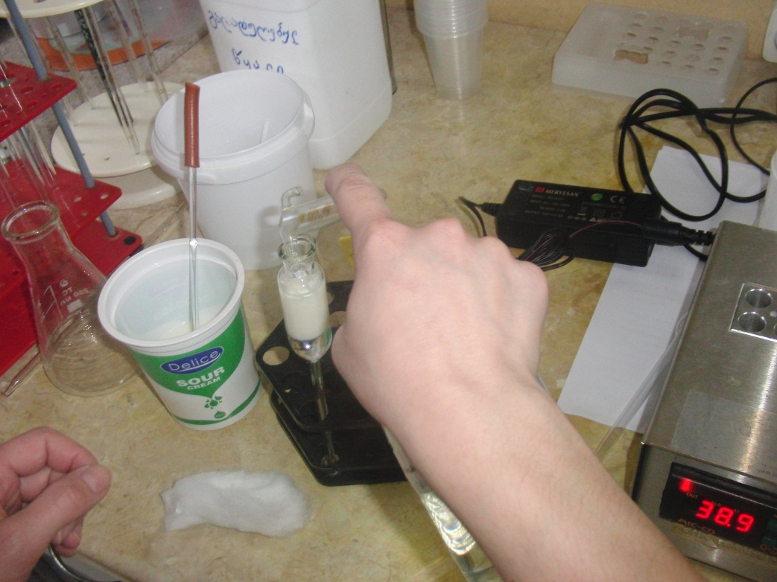
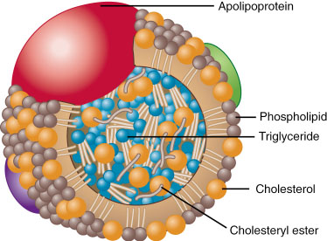
Lipids (Centrifugating)

Slide 6
Proteins

Slide 7
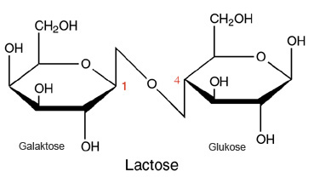
Carbohydrates

Slide 8
Energetic value
Energetic value=Caloricity*Concentration

Slide 9
Acidity
Terner degree = T⁰

Slide 10
Density

Slide 11
Heat resistance
Class | Ethanol concentration %
I | 80
II | 75
III | 72
IV | 70
V | 68

Slide 12
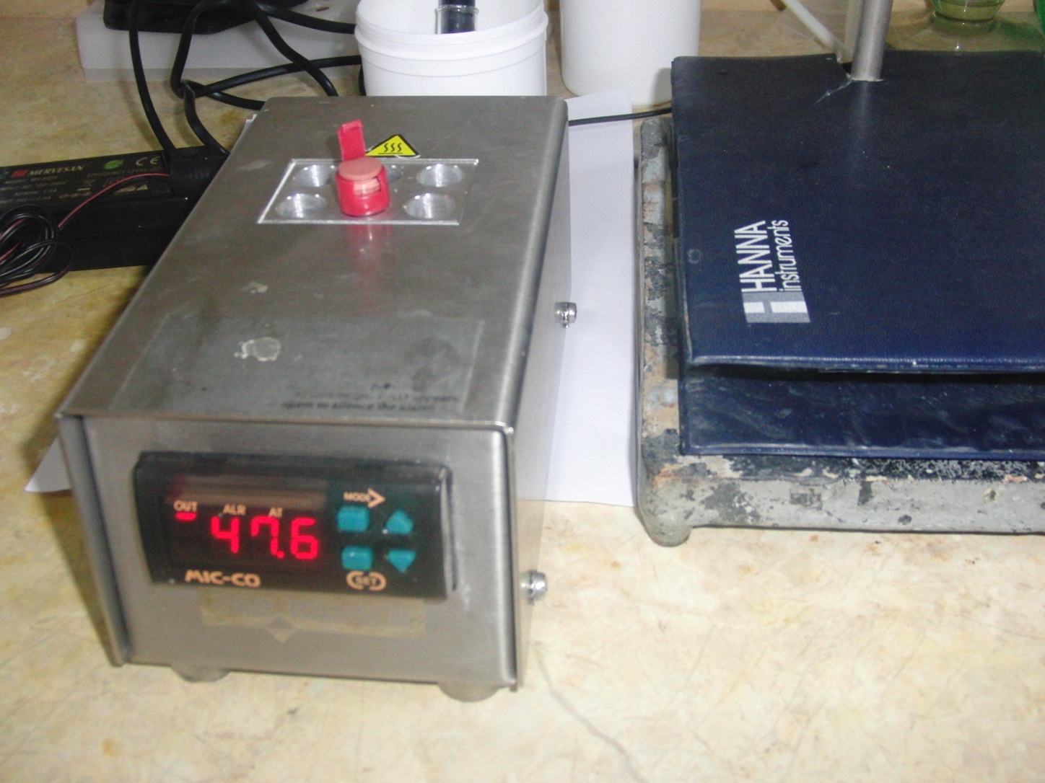
Antibiotics presence

Slide 13
Cows

