Slide 1
IYNT 2017
Team : Georgia
Problem # 16
Paper wrinkle
Reporter : Anastasia kartvelishvili

Slide 2
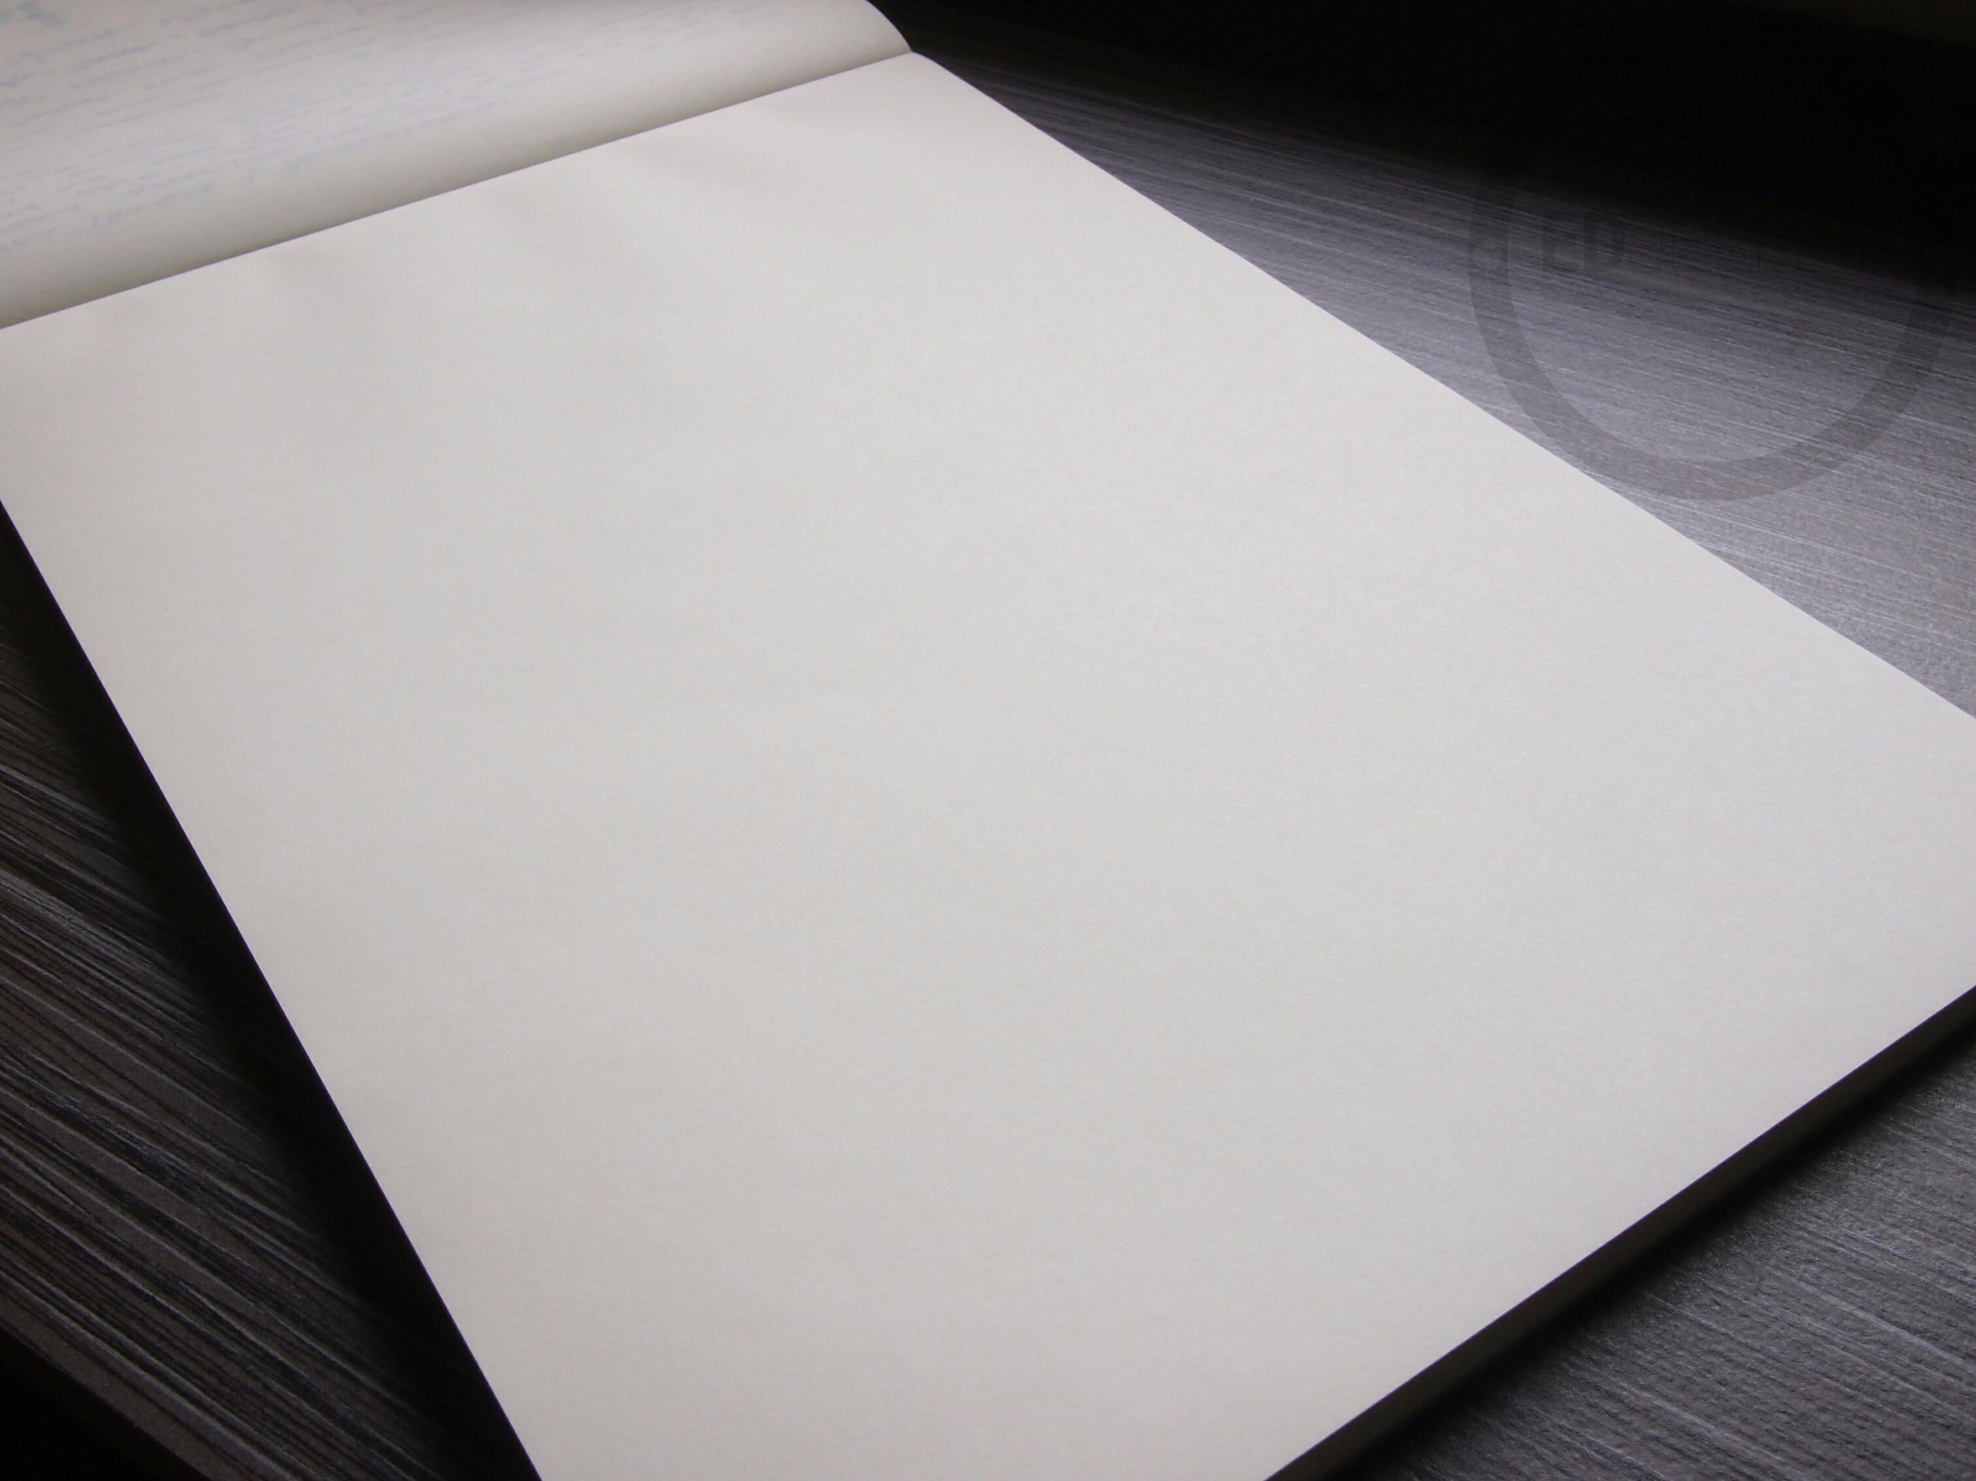
Problem
“ Why does paper get wrinkled when it gets dry after being wet ? “

Slide 3
Plan of presentation
Explanation of the phenomenon
Reaction between paper and water molecules
Evaporation processes
Theoritical model
analytical equation
- wrinkage dependence on temperature , wetting time and kind of liquid.
Experiments
Comparison of theoritical model and experiments
Conclusion

Slide 4
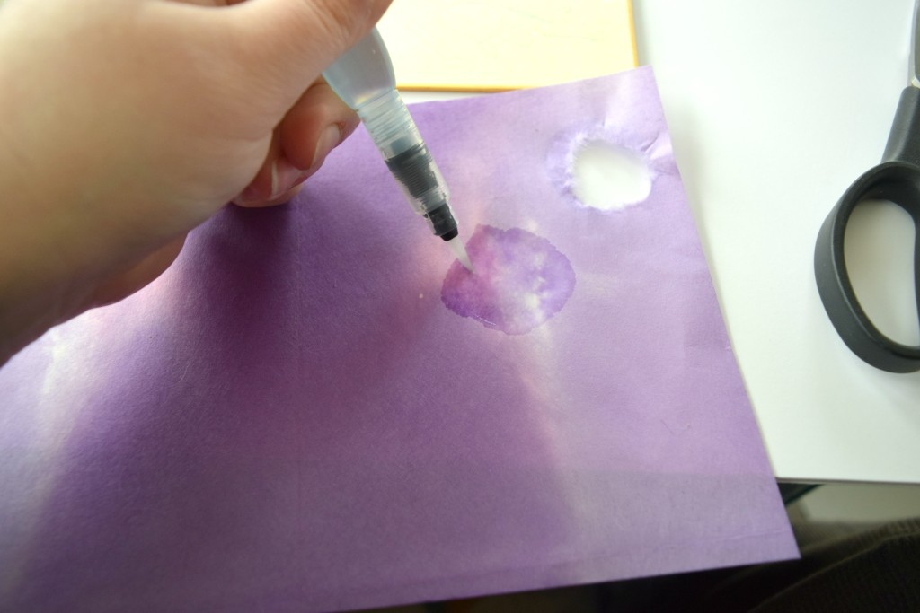
Paper wetting process

Slide 5
Paper – amorphous polymer

Slide 6
Open of polymer structure

Slide 7
Evaporation process

Slide 8
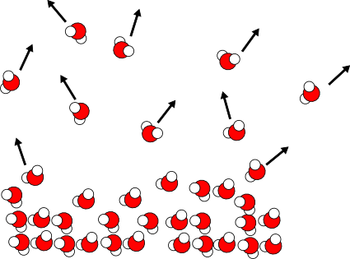
chaotic moving of water molecules

Slide 10
What evaporation is depended on
Temperature
Surface area
Kind of liquid

Slide 11
Experiments
1. Dependence on temperature
2. Dependence on wetting time ( for how long we put paper in the water)
3. Dependence on kind of liquid

Slide 12
How I measure paper wrinkle
First length x width
Final length x width

Slide 13
Different temperatures
T = 1°
T = 1$°C$
T = 10 °C
11.6 cm
11.58 cm
First length – 16 cm
First width - 11.7 cm
15.9 cm
15.87 cm
T = 20 °C
T = 30 °C
11.566 cm
11.52
15.7 cm
15.68 cm

Slide 14
Different temperatures
T = 40°
T = 50°
T = 60°
11.44 cm
11.3 cm
11.12 cm
15.64 cm
15.5 cm
15.36 cm

Slide 15
Wrinkage Dependence on temperature y (Delta length × delta width)
WRINKAGE ${CM}^{2}$
TEMPERATURE $°C$

Slide 16
Dependence on wetting time
Time=3sec
Time = 13sec
First length – 16cm
First width – 11.7cm
11.64cm
11.58cm
15.84 cm
15.710 cm

Slide 17
Time = 31 sec
Time = 44sec
Time =18sec
11.42Cm
11.37Cm
11.371cm
15.589cm
15.425cm
15.422 cm

Slide 18
PAPER WRINKLE Dependence on wetting time
WRINKAGE ${CM}^{2}$
TIME SEC

Slide 19
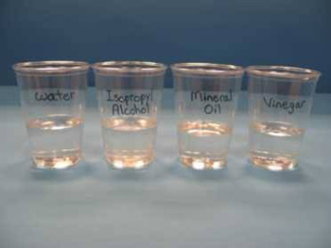
EXPERIMENTS FOR DIFFERENT KINDS OF LIQUIDS

Slide 20
HOW PAPER WRINKLE DEPENDS ON AMOUNT OF A HEAT WHICH IS NESSECARY LIQUID TO START EVAOPORATE
PAPER WRINKLE ${CM}^{2}$
L ($J/{KG} )$

Slide 21
CONCLUSION
PAPER WRINKLE STRONGLY DEPENDS ON EVAPORATION PROCESS
TEMPERATURE
SURFACE AREA
CONCENTRATION OF WATER
KIND OF LIQUID
AS WE RISE TEMPERATURE OF LIQUID PAPER WRINKLES MORE
IF PAPER STAYS IN THE WATER FOR A LONGER TIME IT WRINKLES MORE
IF L RISES PAPER WRINKLE BECOMES LESS.

Slide 22
THANK YOU FOR ATTENTION

