Slide 1
Team Georgia Problem #10 Rijke's tube
IYNT 2017
Reporter Luka Dvaladze

Slide 2
Problem
If air inside a vertical cylindrical tube open at both ends is heated, the tube produces sound. Study this effect.

Slide 3
Plan of presentation
Explanation of the phenomenon
Waves inside the tube
Theoretical model
Standing wave
Sound producing time dependence on variable parameters
Experiments
Different lengths
Different angle
Comparison of theoretical model and experiments
Conclusion

Slide 4
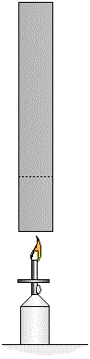
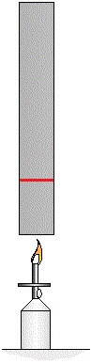
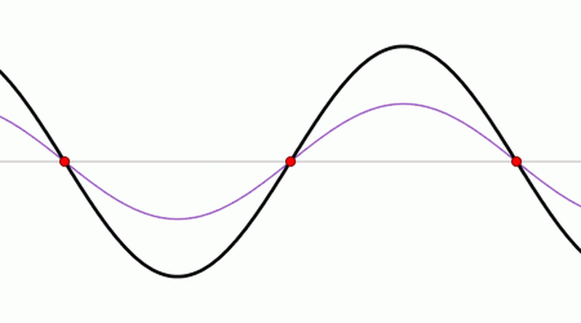
Waves inside the tube
tube
Metal mesh
Bunsen burner

Slide 5
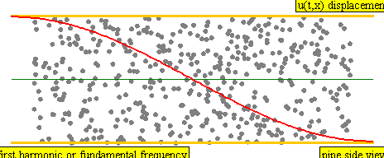
Waves inside the tube

Slide 6
Experiment

Slide 7
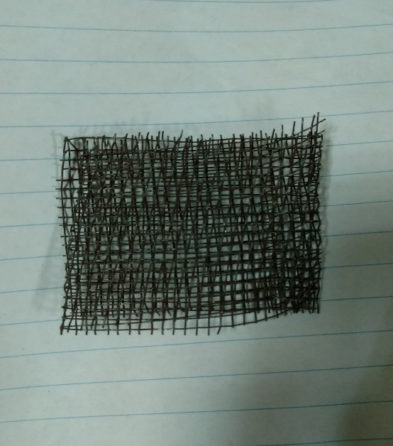
Experiment
mesh

Slide 8
Standing wave
$$y1=Asin(kx+ωt)$$
$$y2=Asin(kx−ωt)$$
$$y=y1+y2$$
$y1$-entered wave
$y2$- deflected wave
$y$ -standing wave
$$y=2Acos\left(ωt\right)sin⁡(kx)$$

Slide 9
Theoretical model
$λ$-wavelength
$f$-frequency
$c$-speed of sound
$l$-length of tube
$n$-number of nodes
$$λ=\frac{2L}{n}$$
$$f=\frac{c}{λ}$$
$$f=\frac{nc}{2L}$$
$$f=\frac{nc}{2L}$$

Slide 10
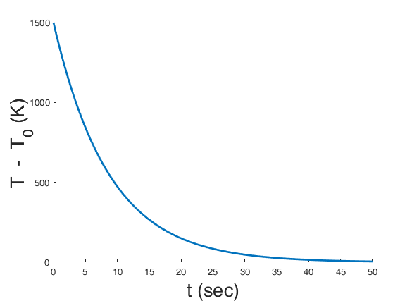
Time dependence on temperature
$$−cmdT=\text{k}\left(T−T0\right)Sdt$$
$$\frac{dT}{T−T0}=−\frac{\text{k}S}{cm}dt$$
$m$-mass of mesh
$T$-temperature of mesh
$T_{0}$-temperature of air

Slide 11
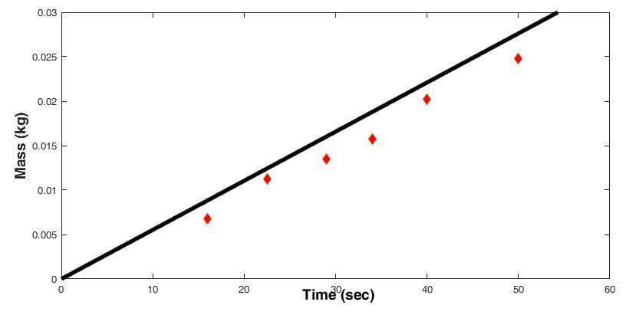
Time dependence on mass

Slide 12
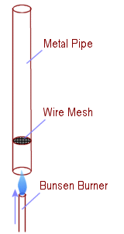
Theoretical model
$$A_{m}=A_{0}sin\frac{π}{L}x$$
$$A_{+}=\frac{L−x}{L}A_{1}$$
$$A_{−}=\frac{x}{L}A_{1}$$
$$A=A_{+}−A_{−}$$
$$A=A_{1}\left(\frac{L−2x}{L}\right)$$
$$\frac{L}{2}$$
Metal tube
$$L$$
Metal mesh
$$x$$
Bunsen burner
$$A=A_{0}sin\frac{π}{L}x\left(1−\frac{2x}{L}\right)$$

Slide 13
Theoretical model
$$A=A_{0}sin\frac{π}{L}x\left(1−\frac{2x}{L}\right)$$
amplitude
Length

Slide 14
Experiments
experiments:
Different lengths
Different angles
Different masses of mesh
Different positions of mesh
Metal tube
Metal mesh
Bunsen burner

Slide 15
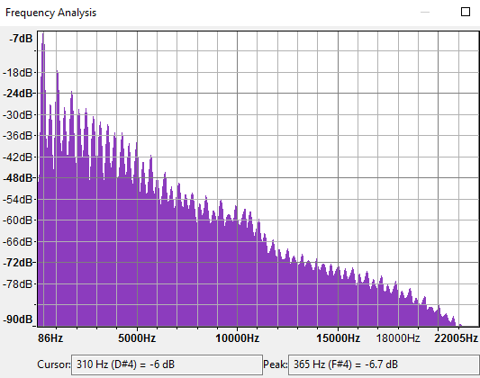
Experiments (fast furious transform)

Slide 16
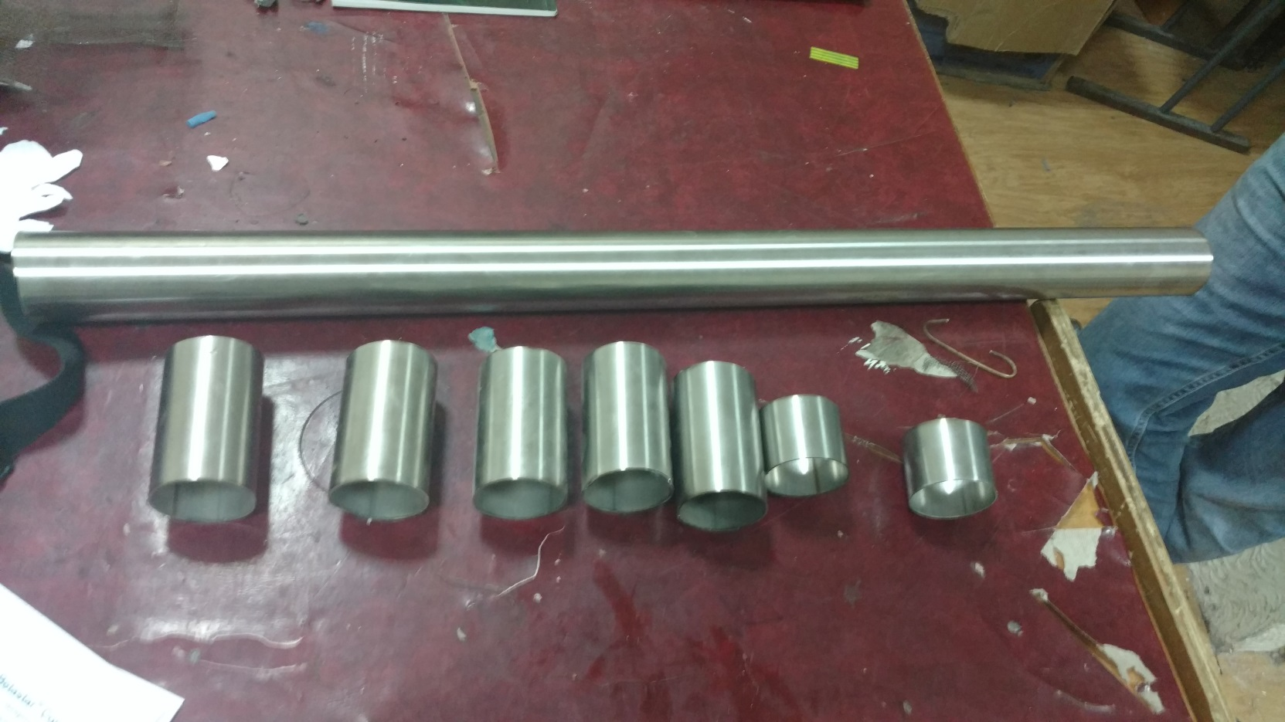
Experiments with different length of tube

Slide 17
Comparison of theoretical model and experiments
frequency
Length

Slide 18
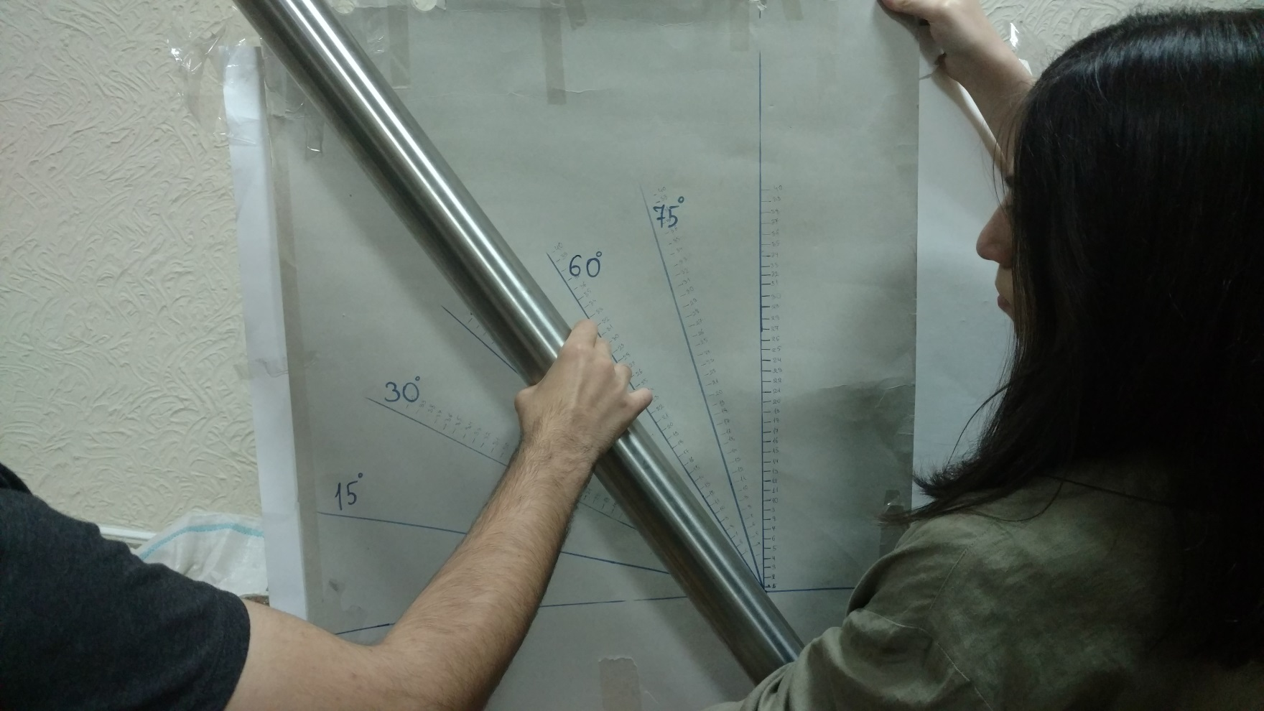
Amplitude dependence on angle

Slide 19
Amplitude dependence on angle

Slide 20
conclusion
By heating the metal mesh, tube produces sound
Wavelength of the standing wave depends on length of the tube
By increasing length of the tube wavelength of the standing wave decreases
Amplitude of the wave depends on width of the tube
Tube produce sound when ratio of length of tube and diameter of tube is less than 0.14(conclusion made by experiments)
Time of producing sound depends on temperature and mass of the mesh
Amplitude depends on angle between x axis and tube

Slide 21
Thank you for your attention

Slide 22
Interesting facts

Slide 23
Interesting facts

