Slide 1
Problem № 9 Salt Production
Reporter: Saba Gogichaishvili
Team: Georgia

Slide 2
Problem
Solar evaporation of seawater or salt mining are common methods to produce common salt (NaCl). Propose a method to extract salt from natural source and determine both productive capacity of your method and purity of the product. Demonstrate an amount of salt produced by your method.

Slide 3
Plan
Theoretical model
Seawater composition
Samples theoretical composition
Theoretical salt quantity
Experiments
Measuring samples composition
Extracting salt
Determining obtained salt quantity
Conclusion

Slide 4
Theoretical model

Slide 5
Seawater composition

Slide 6
Samples theoretical composition (based on salinity measurements in nature)
C(E) = ω(E) * salinity‰ * 10 mg/L
C(E) – Element concentration in sample
ω(E) – Percentage of element in salt

Slide 7
Sample № 7

Slide 8
Sample № 8

Slide 9
Sample № 9

Slide 10
Measuring samples composition
Component | Measurement method
Na⁺, K⁺ | Flame emission spectroscopy
Ca²⁺, Mg²⁺ | Complexometric titration
Cl – | Silver nitrate titration with chromate indicator (Mohr’s method)
HCO₃– | Alkalimetric titration
SO₄^{2–} | Turbidimetry
Sedimented particles | Turbidimetry

Slide 11
Flame emission spectroscopy (Na⁺, K⁺)

Slide 12
Na
K

Slide 13
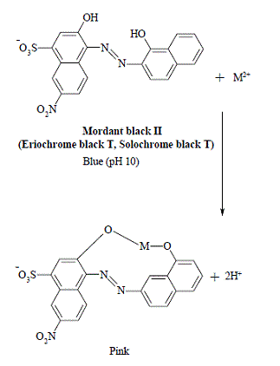
Complexometric titration Ca²⁺, Mg²⁺
$Mure$xide-Calcium complex Red (pH=11.3)
+ M²⁺
$Mure$xide Blue purple (pH=11.3)
$$Mordant black II$$
(Eriochrome black T, Solochrome black T) Blue (pH=10)
$$EDTA$$
+ H⁺
$$Pink$$

Slide 14
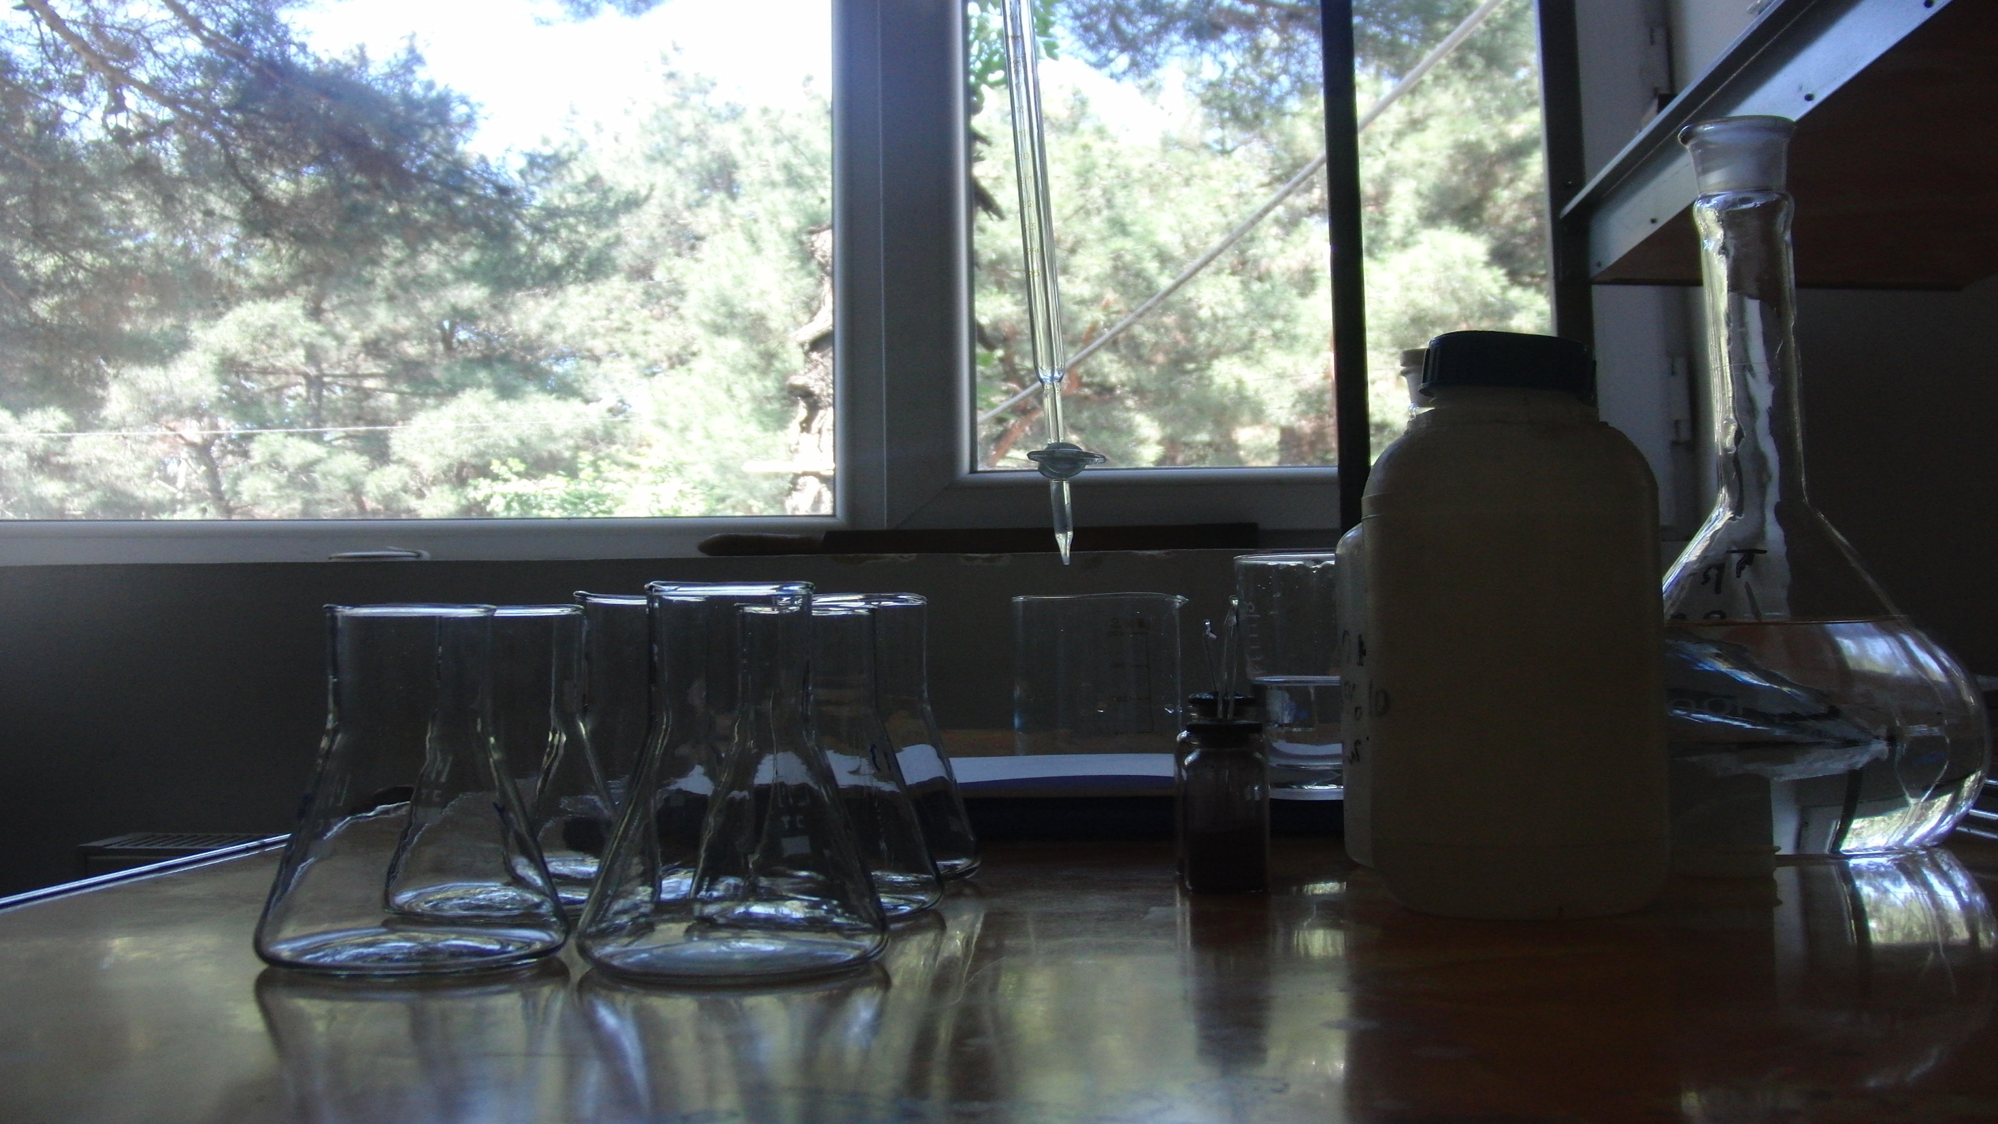

Slide 15
$$C(Mg)=\frac{α\left(Mg\right)∗C\left(EDTA\right)\left(V2−V1\right)∗1000}{V}$$
$$C\left(Ca\right)=\frac{α\left(Ca\right)∗C\left(EDTA\right)∗V1∗1000}{V}$$
Sample № | V (ml) | V₁ (ml) | V₂ (ml) | C (Ca) mg/l | C (Mg) mg/l
7 | 5 | 4,3 | 23,2 | 172 | 454
8 | 5 | 4,2 | 21,5 | 168 | 415
9 | 5 | 5 | 27,4 | 200 | 538

Slide 16
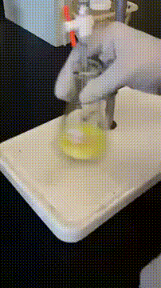
Silver nitrate titration with chromate indicator (Mohr's method) (Cl –)
Cl– + Ag⁺ → AgCl↓
2Ag⁺ + CrO₄^{2–} → Ag2CrO4↓(Orange)

Slide 17
$$C(Cl)=\frac{α\left(Cl\right)∗C(AgNO3)∗V1∗1000}{V}$$
Sample № | V (ml) | V₁ (ml) | C (Cl) mg/l
7 | 1 | 2,00 | 7 100
8 | 1 | 1,92 | 6 816
9 | 1 | 2,36 | 8 378

Slide 18
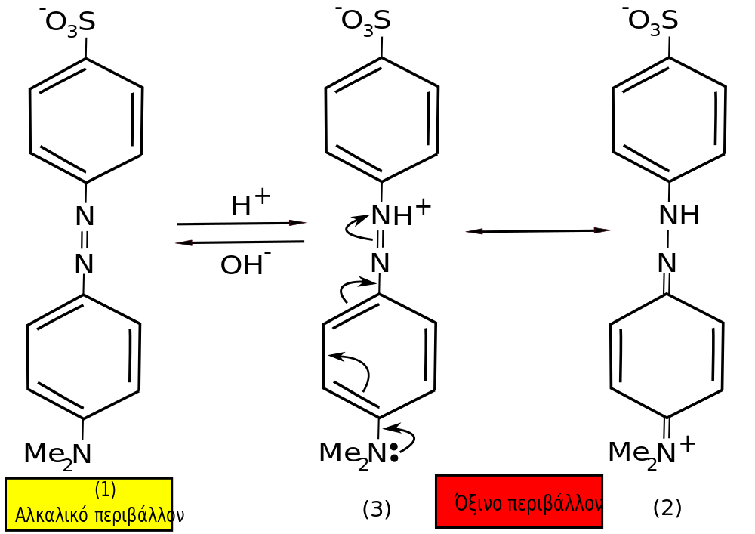
Alcalimetric titration (HCO₃–)
H⁺ + $HCO3$–→ H₂O + CO₂↑
$$Yellow form of Methylorange$$
$$Red form of Methylorange$$

Slide 19
$$C(HCO3)=\frac{α\left(HCO3\right)∗C(HCl)∗V1∗1000}{V}$$
Sample № | V (ml) | V₁ (ml) | C ($HCO3$) mg/l
7 | 100 | 2,86 | 174
8 | 100 | 2,78 | 169
9 | 100 | 3,04 | 185

Slide 20
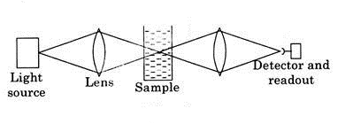
Turbidimetry (Sedimented particles & SO₄^{2–})
Ba²⁺ + SO₄^{2–} → BaSO₄↓
Also, some Etilenglicol (CH₂OH)₂ is added for even distribution of precipitate

Slide 21
Results
Sample № | C (SO4) mg/l
7 | 1 540
8 | 1 400
9 | 2 100

Slide 22
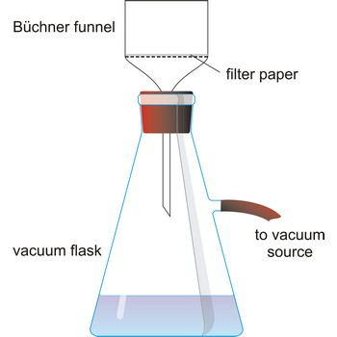
T₀,C₀ – Before filtration T , C – After filtration
Sample № | T₀ FTU | T FTU | C₀ mg/l | C mg/l
7 | 644 | 110 | 412.16 | 70.4
8 | 466 | 66 | 298.24 | 42.24
9 | 548 | 137 | 350.72 | 87.68
Samples were filtrated by 0.45μ filter
FTU - Formazin Turbidity Unit

Slide 23
Sample №7

Slide 24
Sample №8

Slide 25
Sample №9

Slide 26
Extracting salt
Bringing crucibles to constant weight & weighting them
Taking 100ml of each water sample & evaporating them
Bringing obtained salt to constant weight

Slide 27
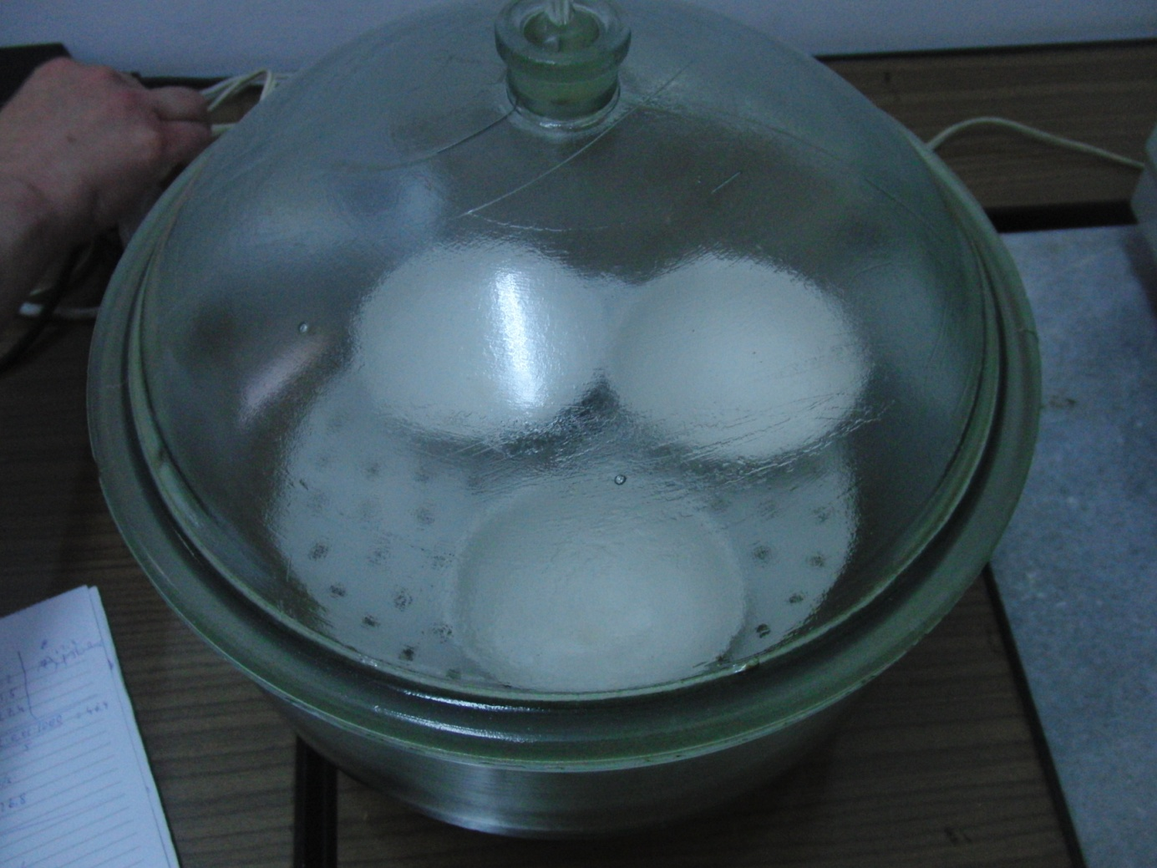
Bringing crucibles to constant weight & weighting them

Slide 28
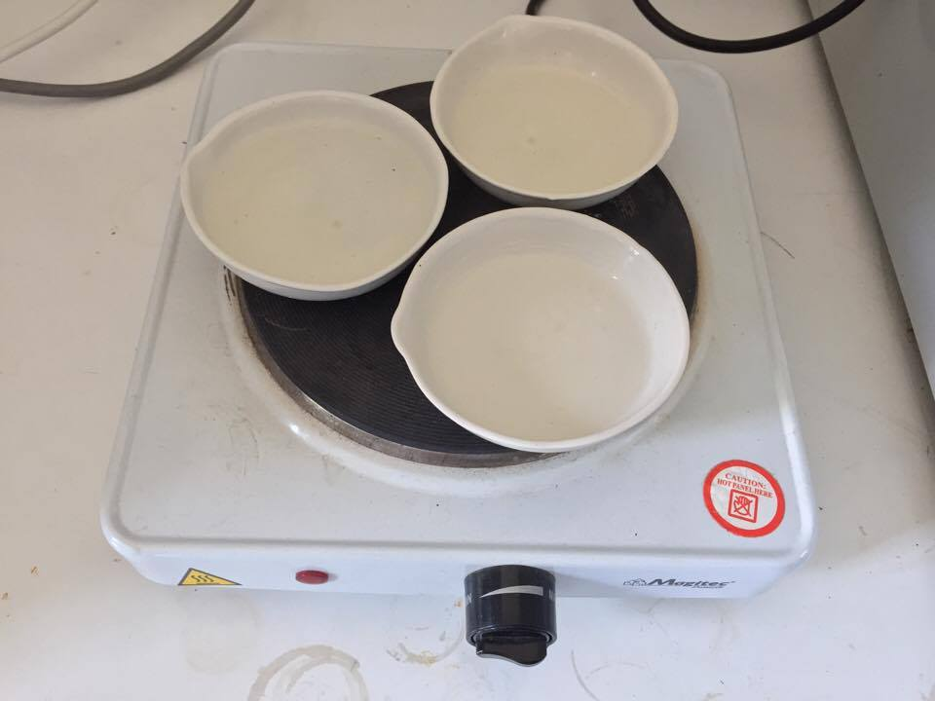
Taking 100ml of each water sample & evaporating them

Slide 30
Determining obtained salt quantity M (salt) = M - M₀
Sample № | M₀ g | M g | M (salt) g
7 | 69,4158 | 70,7116 | 1,2958
8 | 69,6125 | 70,8504 | 1,2379
9 | 68,1200 | 69,7627 | 1,6427

Slide 31
Conclusion
Comparing theoretical and experimental salt quantities
Comparing theoretical and experimental salt compositions

Slide 32
Comparing theoretical and experimental salt quantities

Slide 33
Sample №7 Element concentrations

Slide 34
Sample №8 Element concentrations

Slide 35
Sample №9 Element concentrations

Slide 36
References
Na, K determination – ISO 9964-3:1993
Ca, Mg determination – ISO 6058-84, ГОСТ 23268.5-78
Cl determination – ISO 9297-89
SO4 determination – ГОСТ 4389-72
HCO3 determination – ГОСТ 23268.3-78
Sedimented particles – ISO 7027-99
Evaporation – ГОСТ 18164-72

Slide 37
Thanks for your attention

