Slide 1
Tornado machine
REPORTER:LAZARE OSMANOV
TEAM: GEORGI-GEORGIANS

Slide 2
problem
Build a machine to produce an indoor air tornado. Investigate the properties and stability of the
tornado. Is the machine portative enough to be demonstrated at a Science Fight room of the 5th
IYNT?

Slide 3
plan
Explanation
Experiments
with four hair dryers
propeller
Turbulent flow
Reynolds number
Theoretical model
Force equation
Relative error
Result
Conclusion

Slide 4
explanation

Slide 5
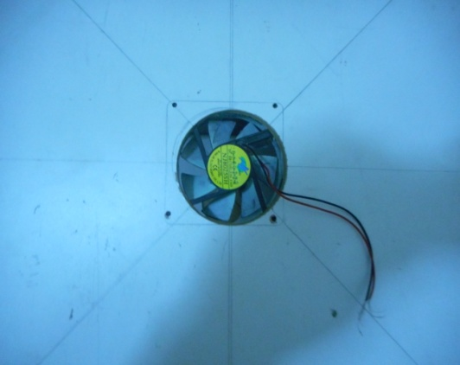
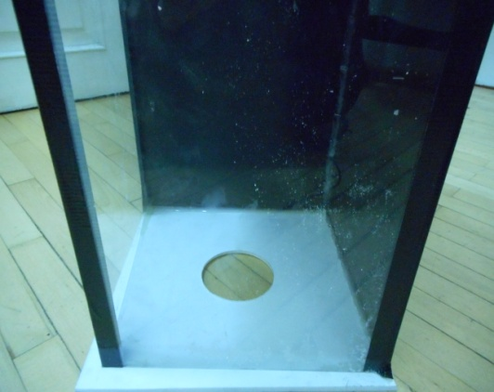
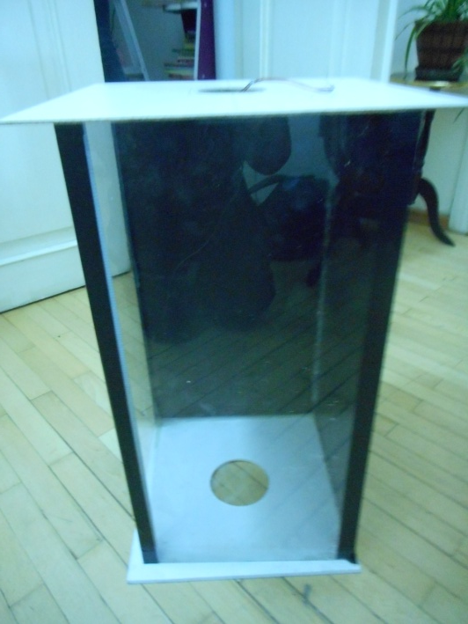
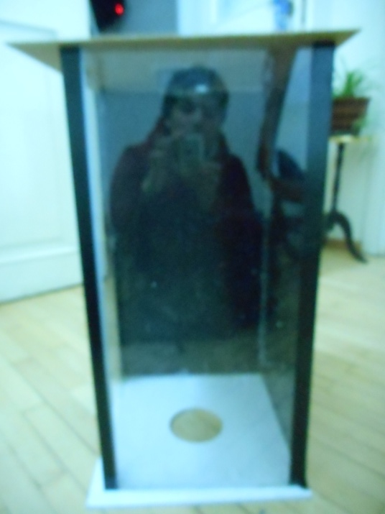
EXPERIMENTS

Slide 6
experiment

Slide 7
experiment

Slide 8
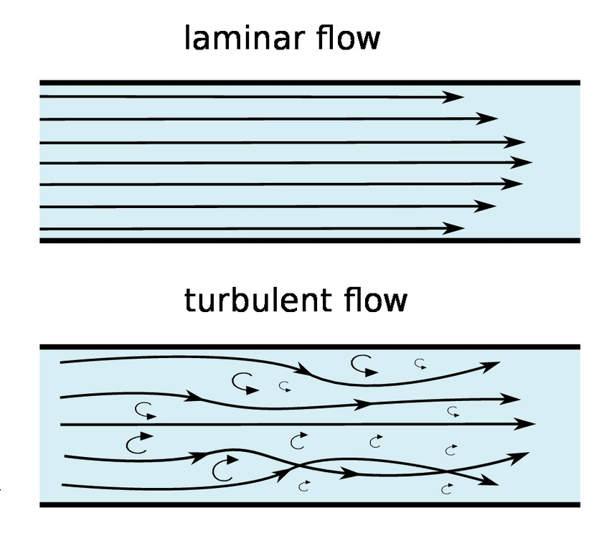
turbulence

Slide 9
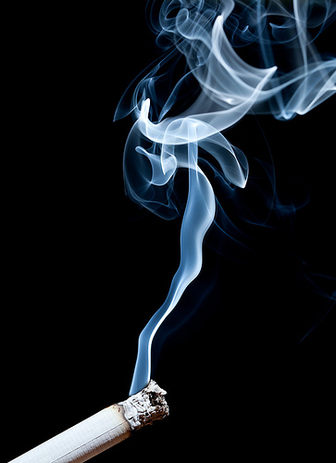
CRITICAL REYNOLDS

Slide 10
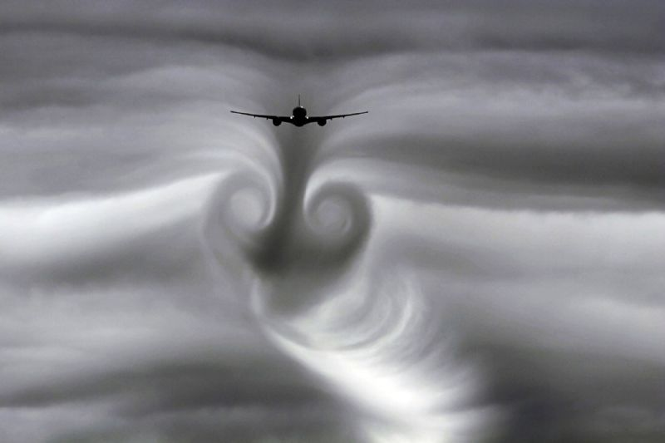
TURBULANCE FLOW

Slide 11
THEORETICAL MODEL

Slide 12
RELATIVE ERROR

Slide 13
conclusion
Experiments were conducted
Propeller ,four hair dryers
Different properties were calculated
Angular velocity
Critical Reynolds number
Viscosity
pressure
Relative errors
Result
We calculated pressure difference
We talked about stability

Slide 14
Thanks for attention

