Slide 1
IYNT 2017 Georgia

Slide 2
WATER FROM THE AIR 15th problem for the 5th IYNT 2017
Design and construct a device allowing collection of water by condensing moisture from air. Determine if the water obtained with your device is suitable for drinking. What amount of water is possible to collect during one Science Fight?

Slide 3
Plan of presentation
Theoretical model
Construct device
Relevant theoretical model
Experiments
Comparison
Conclusion

Slide 4
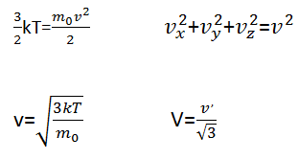
Theoretical model

Slide 6
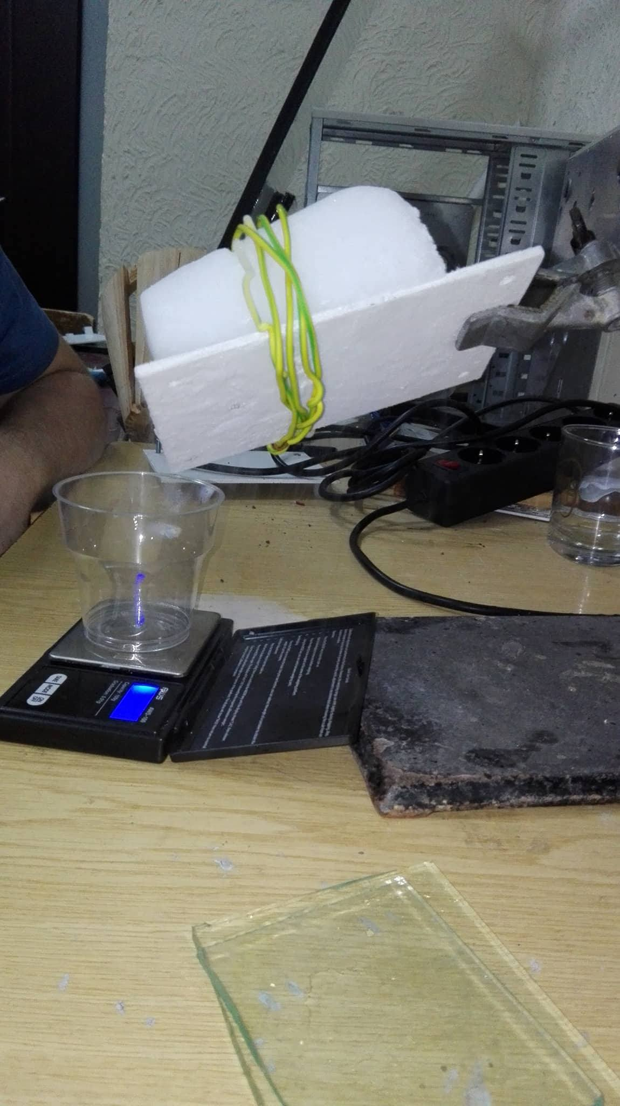
Construct device

Slide 7
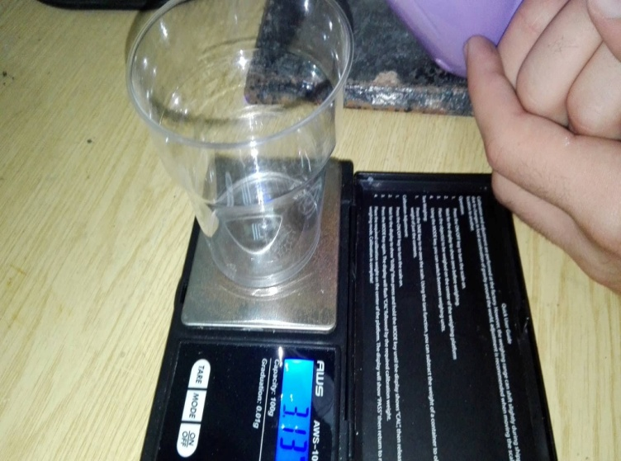
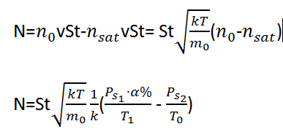
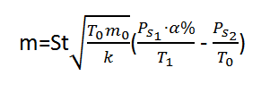
Relevant theoretical model

Slide 8
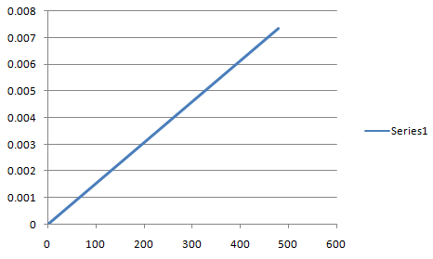
Relevant theoretical model
Mass of water, kg
Time , sec

Slide 9
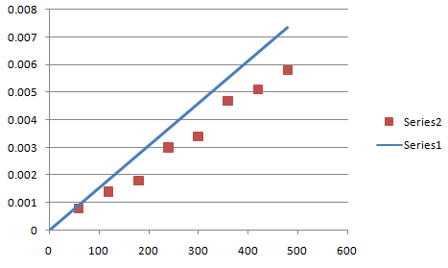
Comparison
Mass of water, kg
Time, sec

Slide 10
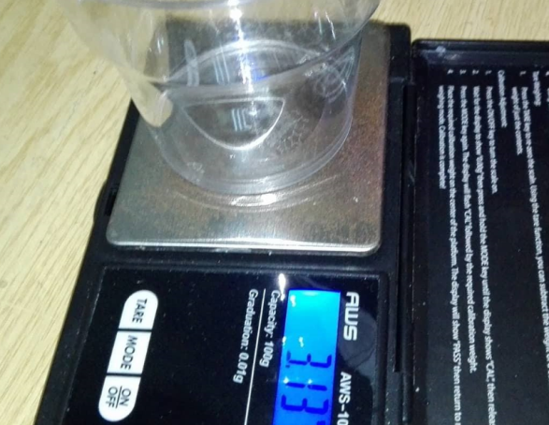
Potable or not
Considering international standarts avarage concentration of ions mustn’t be more than 1000mg/l
pH must be from 6 to 9.
Cloudness must be less than 2,6FTU
The total amount of bacteria under 50 million/ml

Slide 11
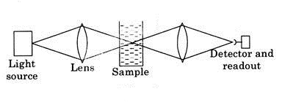
Turbidimetry

Slide 12
Conclusion
The graph of how water mass is depended on time is theoretically linear
We got water from air with the construction made by dry ice, iron plate, hair dryer and cotton
the difference between theory and experiments wasn’t big
The water was potable

Slide 13
Thank you for your attention

