Slide 1
No. 13 Allometry
Anna Liu
Wellington High School
New Zealand
IYNT 2017

Slide 2
The Problem
How do length and thickness of bones scale with overall size and weight of animal?

Slide 3
Clarifications
The Problem
Biological Factors
How do length and thickness of bones scale with overall size and weight of animal?
Respiration
Circulation
Digestion
Body temperature regulation
Water balance
Etc.
Locomotion will be included
Notes:
Now before we begin, I would just like to note that as the problem does not state for me to explore other biological factors such as respiration and blood circulation, I will mostly be ignoring these in the presentation and focusing only on bone allometry. And due to time and simplicity’s sake, I will mostly be talking about scaling of terrestrial animals.

Slide 4
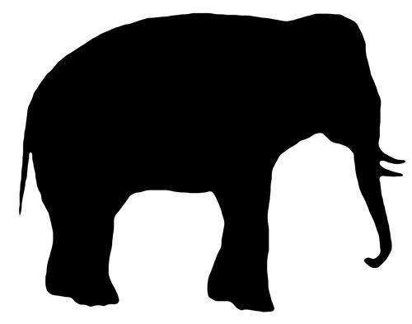
Notes:
Basically, the problem asks how do the shape of bones change as an animal increases in dimensions of weight and size?

Slide 5
1 : 4
width : length
20cm
40cm
5cm
geometric similarity
10cm
Notes:
If the bone didn’t change shape and merely scaled up, which is what is called geometric similarity, where the ratio of its dimensions (length to width, etc.) remains the same regardless of enlargement, they wouldn’t be able to support an animal’s increase in weight/size and is therefore not what happens in biological scaling.

Slide 6
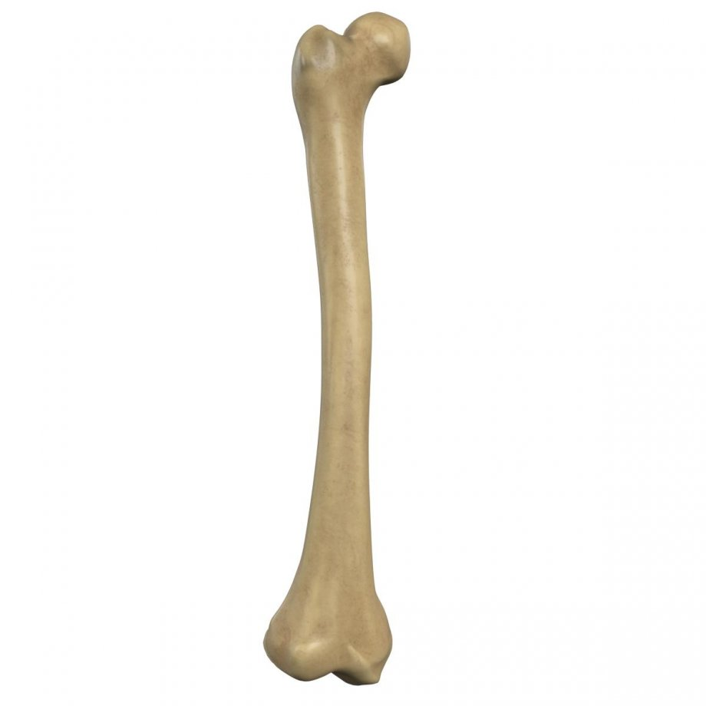
Notes:
A bone is, in the most basic of terms, a three-dimensional shape as it has dimensions of length, width and height.

Slide 7
Length x 2
Width x 2
Depth x2
Bone Dimensions
Weight bearing capacity x 2
weight x 2
h x 2
weight
h
w
w x 2
l
l x 2
Notes:
If you wanted to, for example, double an animal’s body size and therefore assumingly double its weight, it would seem that you would only have to double all of an animal’s bone dimensions.
This application of geometric similarity, however, is incorrect.

Slide 8
isometric growth
Notes:
This is what is called isometric growth, where all of the body parts grow at approximately the same rate. This may be true in some body parts and animals, but not in this specific scenario.

Slide 9
2³
8
weight x 8
h x 2
weight
h
w
w x 2
l
l x 2
Notes:
Doubling an animal’s body size would mean that its weight would increase not by double, but by around eightfold because 2³=8.

Slide 10
v
l
w
h
2³ x (l x w x h)
100³
100³
l x 2
h
l x 2
w
100³
100³
l x 2
l
Notes:
If we take a cube, or any three-dimensional shape, its volume is equal to the product of the length multiplied by the width multiplied by the height – the linear dimensions multiplied to the power of 3 if they are all the same value. Therefore, if we multiply all of its linear dimensions by the same value in order to change its size, the new volume would be equal to the previous volume multiplied by the cube of the scale value.

Slide 11
Size factor ³ x Weight₁
Weight₂
Scaling value³ x Volume₁
Volume₂
Bone weight-bearing capacity₁ x (e.g.)2³
Bone weight-bearing capacity₂
h x 2
h
w x 2
w
l
l x 2
Notes:
So if we doubled an animal’s body size, and therefore all of its linear dimensions, we would be multiplying the weight by the size factor (e.g. 2) to the power of 3 to get the resultant weight which would be eightfold as volume increases at a rate of 3 times the length, which is true for any three-dimensional shape. This means that a bone’s weight bearing capacity would have to increase by eightfold as well in order to support the increased weight.

Slide 12
Bone size not sufficient to support increased weight
2 x 100cm
Area = weight bearing capacity
Area = length x width
Area = (2 x 10)²
Volume = weight
Volume = length x width x height
2 x 10cm
If animal’s dimensions were 10:
2 x 10cm
Volume = (2 x 10)³
Notes:
However, a bone’s weight-bearing capacity is not dependent on its length or height - it is dependent on the bone’s cross-sectional area. Doubling all of the bone’s linear dimensions (excluding height) will only increase its cross-sectional area, hence its weight-bearing capacity, by fourfold as area is the square of the linear dimensions, not the cube. Therefore, it will not be enough to support the eightfold increase in weight.

Slide 13
Bone size sufficient to support increased weight
Area = 89.4427191²
If animal’s dimensions were 10:
Volume = (2 x 10)³
89.44 cm
89.4427191² = (2 x 10)³
89.44 cm
Notes:
For this reason, a considerably thicker bone would be needed than that given by just doubling the bone’s dimensions.

Slide 14
89.44 cm
2 x 10cm
2 x 10cm
89.44 cm
Notes:
The rate at which the cross-sectional area increases is greater than that of the linear dimensions.

Slide 15
allometric growth
Notes:
This is what is called allometric growth, where body parts grow at different rates or disproportionately to each other, as allometry literally means ‘different growth’.

Slide 16
Linear dimensions = x or l,w,h
Surface Area = x² or lh
Weight = x³ or lwh
h x 2
h
w x 2
w
l
l x 2
Notes:
So as an animal increases in size, its weight grows at a much faster rate, or the cube, to its linear dimensions and surface area.

Slide 17
Linear Dimensions
= l, w, h
Surface Area
= Linear Dimensions²
h
h
Cross-sectional Area
= Linear Dimensions³
w
w
l
l
Notes:
And as a bone increases in size its cross-sectional area, or thickness, becomes disproportionately larger to its length and area because although areas are the squares of linear dimensions, the cross-sectional area will have to be enlarged at approximately the cube of the linear dimensions, equal to the mass or volume of the animal. Of course, this is assuming that all animals are perfectly geometrical with no other factors affecting it, such as locomotion or body styles.

Slide 18
Differential Growth
y = ax^{b}
log(y) = log(a) + b(log(x))
y is the quantity we want to study
x is the quantity y varies with
a is the coefficient or y-intercept
b is the exponent or slope of the line
Notes:
As allometry refers to different rates of growth, theoretically differential growth can be modelled using this equation. Or alternatively…
Where…

Slide 19
y = ax^{b} log(y) = log(a) + b(log(x))
b is the exponent or slope of the line
Log (y)
b = <1
Growth is hypometric/negative allometry
Please no…
b = >1
Growth is hypermetric/positive allometry
b = 1
Growth is isometric
Log (x)
Notes:
Because b gives you the relative rate of growth, if b equals 1, growth is isometric and the variables grow at equal proportions/rates. If b equals less than 1, growth of y is hypometric/negative allometry and grows at a slower rate than x. And if b equals more than 1, growth of y is hypermetric/positive allometry and grows at a faster rate than x. The equation is general in the sense that it can be used to find out whether any y-variable scales with any x-variable, and a and b can be any numerical value the data requires, regardless if any of them are geometric quantities or not. However, this equation excludes locomotion factors that could affect the scaling, therefore the square-cube law won’t apply. And this is also theoretical – if I wanted to prove it for myself I’d have to get lots of real animals and weigh them, before killing them just to measure their bones. Of course, for ethical reasons I was unable to do that. So instead, I will be borrowing raw data collected by BioMed Central in a research article written by Nicholas E Campione and David C Evans.

Slide 20
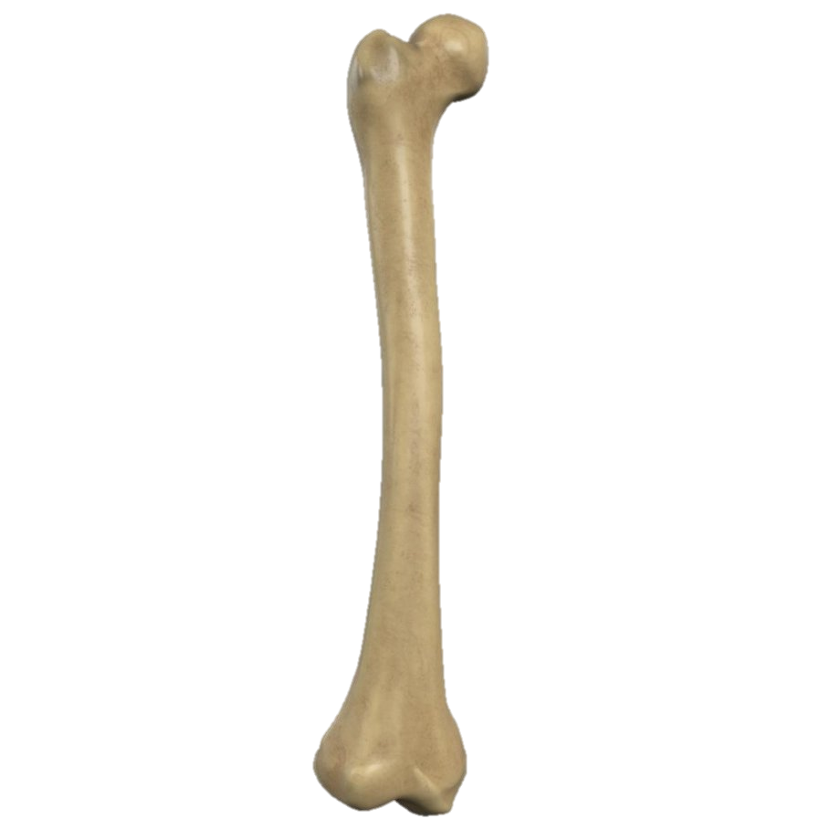
BM = y-intercept x C_{F}^{line gradient}
Notes:
As a bone’s weight-bearing capacity is dependent on its cross-sectional area, or diaphyseal circumference, there must exist a relationship between animal body mass and the circumference of proximal limb bones – that is, bone attachments situated from the torso, therefore supporting it, i.e. arms and legs, or in this case, the femur and/or humerus bones. In other words: body mass = y-intercept times femur circumference to the power of the line gradient. But in order to find a and b, data must first be plotted. This graph shows mammal femur circumference plotted against body mass, and we can see that there is an indirect relationship between the two - not what we want to see. However, if we were to plot the same data on a log-log graph, there results a linear relationship, showing that the log femur circumference and log animal body mass are directly related. In mammals, that is. But what about for reptiles – all crawling around on their almost sprawled-out limbs?
From this, we can see that there is an evident relationship between log femur circumference and body mass even in reptiles and amphibians, and if we compare these with mammals, the relationship is almost in differentiable, showing that the body mass to femur circumference relationship is highly conserved between terrestrial mammals and reptiles, suggesting that the weight-bearing bones are influenced little by locomotion factors. This allows for the possibility of the differential growth equation to be universal.

Slide 21
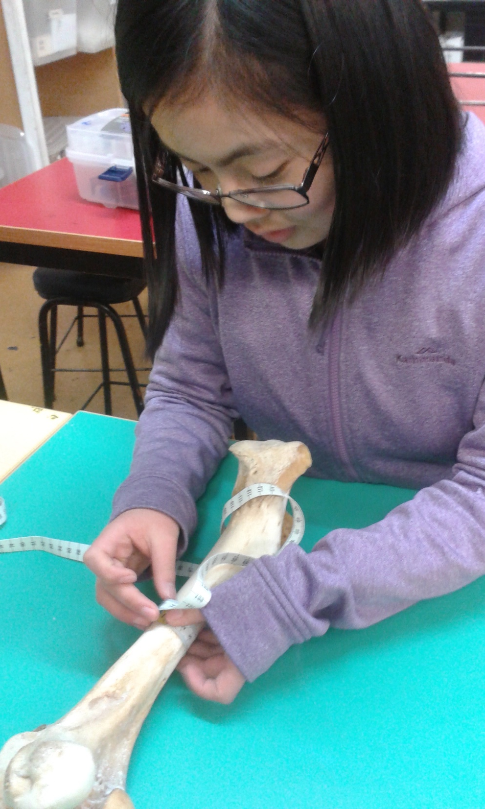
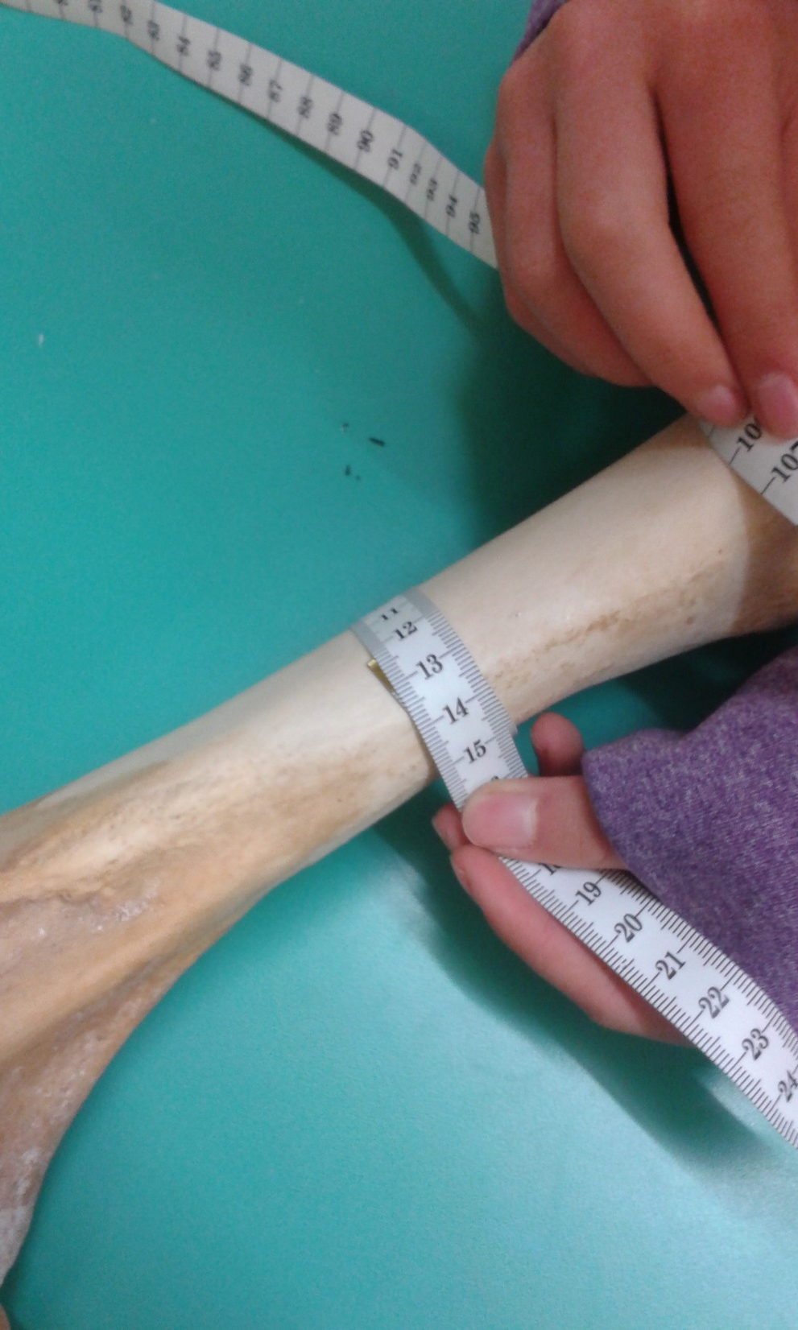
Steer average BM = 640 kg
BM = 0.5615 (123)^{2.8977}
Steer C_{F} = 123mm
= 639000 g
b = 2.8977
a = 0.5615
= 639 kg
Notes:
I managed to get a hold of a Steer femur, and measured its circumference in order to see whether the equation would still apply. On average, Steers weigh 640 kg, and from the mammalia data, the y-intercept is 0.5615 and the line gradient is 2.8977.
So according to the aforementioned equation, body mass is equal to the mammalia y-intercept multiplied by the diaphyseal femur circumference in millimetres to the power of the line gradient. From that, we end up with 639 kg after conversion, showing that this equation is applicable to find animal body mass from the circumference of the femur bones.

Slide 22
Conclusion
As an animal increases in weight and size, their bones must grow disproportionately thicker to its linear dimensions.
Weight-bearing capacity is dependent on a proximal limb bone’s cross-sectional area/circumference.
The relationship between animal body mass and femur circumference is highly conserved in terrestrial mammals and reptiles.
The aforementioned relationship can be modelled using y = ax^{b}
For mammals: BM = 0.56(C_{F})^{2.90}
Notes:
In conclusion…
…in order to support the cubed-increase in weight.
…
…
…

Slide 23
Bibliography
http://scienceline.ucsb.edu/getkey.php?key=428
https://www.boundless.com/biology/textbooks/boundless-biology-textbook/the-animal-body-basic-form-and-function-33/animal-form-and-function-192/limits-on-animal-size-and-shape-733-11963/
https://www.sciencedaily.com/releases/2010/03/100322112103.htm
http://physics.stackexchange.com/questions/72641/why-is-there-a-size-limitation-on-animals
http://www.sciencedirect.com/science/article/pii/S0960982208014115
https://www.ncbi.nlm.nih.gov/pubmed/9951716
http://www.nature.com/scitable/knowledge/library/allometry-the-study-of-biological-scaling-13228439
https://www.britannica.com/science/allometry
https://www.britannica.com/science/bone-anatomy/Chemical-composition-and-physical-properties
http://www.sciencedirect.com/science/article/pii/S1571064506000212
http://journals.plos.org/plosone/article?id=10.1371/journal.pone.0004742
http://scienceblogs.com/pharyngula/2007/06/03/basics-allometry/
http://www.livescience.com/24122-why-insects-are-not-bigger.html
http://galileoandeinstein.physics.virginia.edu/lectures/scaling.html
http://galileo.phys.virginia.edu/classes/609.ral5q.fall04/LecturePDF/L14-GALILEOSCALING.pdf
http://www.ableweb.org/volumes/vol-20/1-colton/scalingtutorial/geometric.html
https://www.nobraintoosmall.co.nz/students/biology/NCEA_Level2/pdfs/bio2_91156_satovolume.pdf
https://prezi.com/fo3r0no5mpwb/isometric-vs-allometric-growth/
https://www.geol.umd.edu/~jmerck/bsci393/lab5/allometry.html
https://bmcbiol.biomedcentral.com/articles/10.1186/1741-7007-10-60

Slide 24
Acknowledgments
Our FABULOUS physics teachers: Kerry Parker and Murray Chisholm
Some AWESOME biology teachers: Jackson Martin and Tony Cairns
Curator of Natural History at Whanganui Regional Museum and an all-round awesome guy: Dr. Mike Dickison
My FABULOUS comrades: Ethan Wu (Translator), Luke Roeven (Excel Extraordinaire, Maths Man, Carb King, Sex God, Sharp Abs), Sai August (In Control), Tristan Harris (Pleb), Zuni Prius (Team Captain)
Our FABULOUS helpers (minions), because without them we wouldn’t have been able to have gotten as far as we did: Ella Blakely, Riley Rillstone, Ryan Bright, Zoe Ioannou
Honorary Super-Cool Dude and NZYPT & IYPT WHS Champ: Jack Trigonometry
DJ Nomeme
Nicholas E Campione and David C Evans at BioMed Central.

Slide 25
Notes:
From this, we can see that relationships between femur length and body mass in mammals and reptiles and amphibians are a lot less direct in comparison to with femur circumferences. As the correlation between the two shows a lesser direct relationship, it suggests that due to large differences in gait and limb posture, in reptiles especially, other biological demands interfere with the relationship. And as aforementioned earlier, weight-bearing capacity is not dependent on a bone’s length - due to such reasons. Therefore, correlating bone length with animal body mass is not the most ideal nor is it universal if finding how they scale with each other, as such a relationship is not conserved.

Slide 26
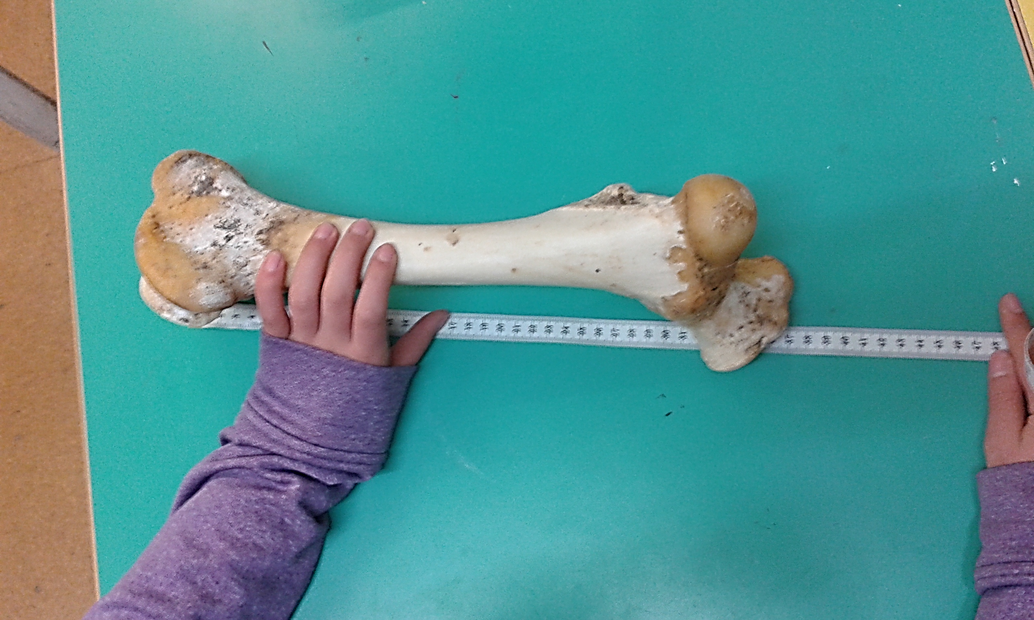
Steer average BM = 639 kg
Steer L_{F} = 373mm
BM = 2.34(373)^{2.993}
= 116553668.5 g
b = 2.993
a = 2.341
= 116553.668 kg
Notes:
Again, we can test it out with the same cow bone but using its length instead. So, as already done, we substitute a, x and b into y=axb, which for mammalia femur length: x is 373mm, b is 2.993 and a is 2.34. After formulating the new equation and working it out, it comes to a much larger mass than the known mass, compounding the indirect correlations between femur length and animal body mass.

Slide 27
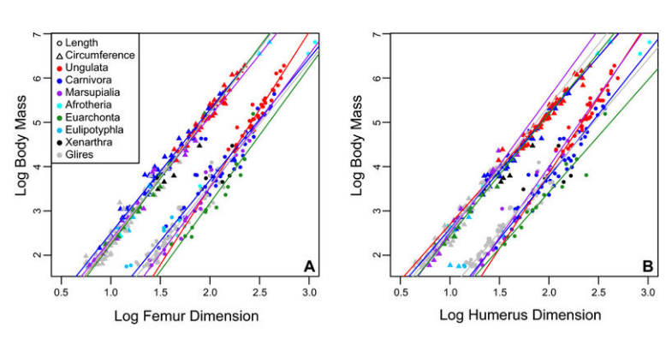
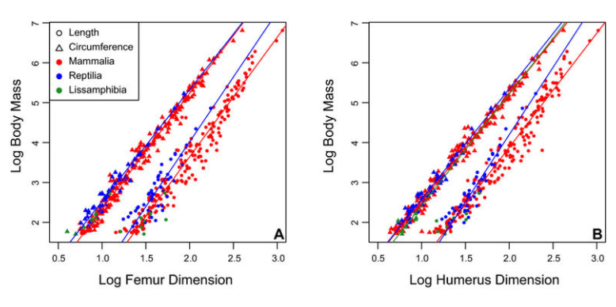
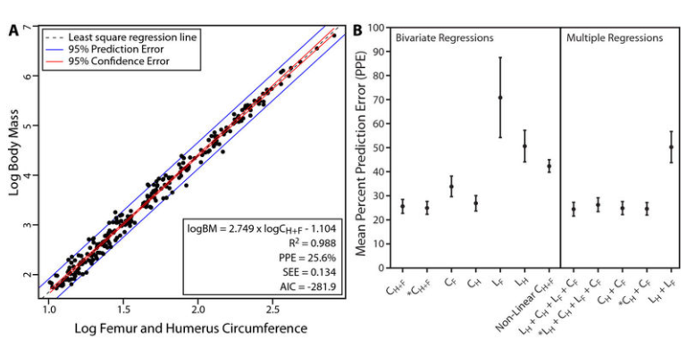
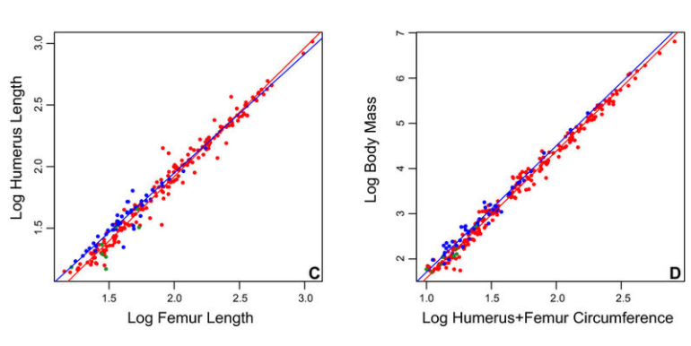
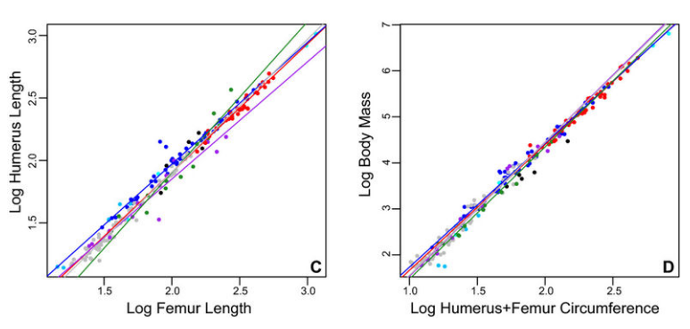

Slide 28
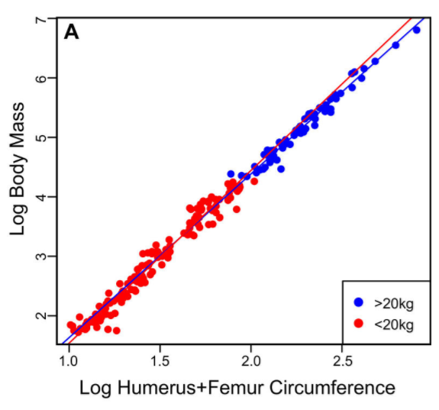
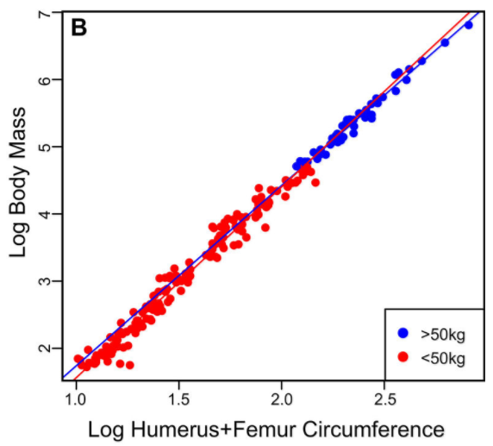
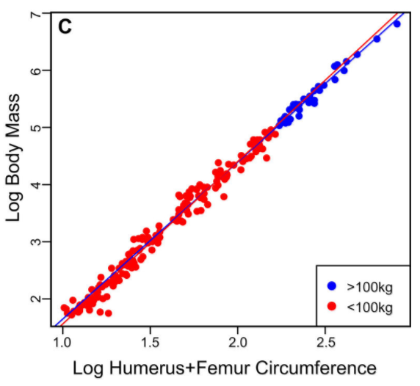
Notes:
As a bone’s weight-bearing capacity is dependent on its cross-sectional area, or diaphyseal circumference, there must exist a relationship between animal body weight and the circumference of proximal limb bones – that is, bone attachments situated from the torso, therefore supporting it, i.e. arms and legs.
Limb scaling patterns in different mammalian classes.

Slide 29
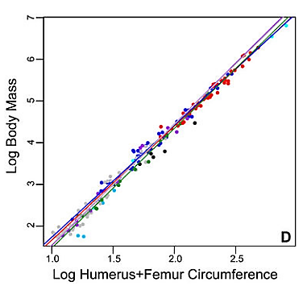
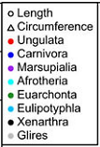

Slide 30
Aquatic animals notes
Notes:
Aquatic mammals are fully supported by water and have less physical constraints on maximum body mass than terrestrial species. This explains why the Blue Whale is larger than any sauropod (the largest dinosaurs - plant eaters, such as Argentinosaurus) because the animal doesn’t have to support its own body weight with bones. Most likely, whale skeletons scale more geometrically than land animals’ since the bones don’t need to grow thicker in order to support a larger mass. There isn’t exactly a bone that could be compared with terrestrial animals for weight-bearing capacity as aquatic animals don’t have one when their weight is supported by water.

Slide 31
Endoskeletons notes
Notes:
An animal with an endoskeleton has its size determined by the amount of skeletal system it needs in order to support the other tissues and the amount of muscle it needs for movement and are more efficient because muscles are attached on the outside, making it easier to compensate for increased mass. As the body size increases, both bone and muscle mass increase. The speed achievable by the animal is a balance between its overall size and the bone and muscle that provide support and movement.

Slide 32
Solving allometry problems by being very long notes
Notes:
In large animals, having longer legs isn’t so bad because if you can get a little bit of muscle movement at the end of the leg it gives you a much longer stride. This is why giraffes have a relatively slow stride. But they cover as much ground as an antelope running really fast. So being larger you can solve problems involved with allometry by being really long. Suggestions have been made that really tall animals aren’t that way because they can reach the tops of trees but because their long legs gives them a very long stride which saves energy but still travel fast. And they have to have a long neck, or else they can’t reach the ground. Other animals include camels, llamas, etc.

Slide 33
Surface area vs. body volume ratio notes
Notes:
Surface area to volume/body mass ratio problem – as mass increases at the cube instead of the square of the linear dimensions, enlargement of animals makes it difficult for the exchangement of biological materials; single cells, for example, have a hard time growing large because their metabolism goes as the cube of the size, but their ability to transport nutrients across their outer membranes only scales as the area of those membranes.

Slide 34
Exoskeletons/invertebrate, insects notes
Notes:
Because exoskeletons are rigid, insects need molt their old skin and grow a new one. Scientists have suggested this vulnerable time puts a ceiling on size: Larger animals, particularly those without protective skeletons, would make for more attractive meals to a predator.
Another possibility: Insects have open circulatory systems, where blood and bodily fluids aren't bound up in vessels, as is the case with most vertebrates. This makes it more difficult to move blood throughout a large body, as circulation would be hampered by gravity, which pulls blood downward.

Slide 35
Exoskeletons/invertebrate, insects notes
Notes:
Insects "breathe" via tiny tubes called trachea, which passively transport oxygen from the atmosphere to bodily cells. Once insects reach a certain size, the theory goes, the insect will require more oxygen than can be shuttled through its trachea.
Support for this theory comes from the fact that about 300 million years ago, many insects were much larger than they are today. There were, for example, dragonflies the size of hawks, with wingspans of about 6 feet (1.8 meters. Around that time, the oxygen content in the atmosphere was about 35 percent, versus 21 percent today.
Bulky insects also seem to need more space for their enlarged trachea. And there's only so much room — an animal needs room for other organs, muscles and the like.

Slide 36
Birds notes
Notes:
Flying birds have more physical constraints on their body size due to the demands for flight, therefore flightless birds who don’t need to expend so much energy on being light to fly are able to grow much larger in comparison and scale similarly to land animals.
Animals that can’t control their body heat easily have a surface area issue. But many animals can get around those problems by upping their metabolism. Hummingbirds are tiny and therefore cannot risking cooling or they’d lose too much heat because they have no way of conserving it. They get by this by literally eating all day - they eat sugar all day and their heartbeat goes at an extremely fast rate - and huddle together for warmth at night and even hibernate at cold climates. Their number one priority in life is to not freeze to death. This is also why bats huddle together, but they have other problems because they need to be lightweight in order to fly. This is why flightless birds get much bigger much faster because being small, in order to compensate for the rapid heat loss, they’d have to use almost all of their energy flying with the majority of their lives spent feeding. When birds end up in an environment where flying is unnecessary they can afford to lose their flying ability and grow much larger. Whereas flying birds have an upper size limit of around, currently, 15kg, as lots of extinct animals break the conventional rules of today’s size limits.

