Slide 1
An investigation into the oxidation of apples
Question No. 6
Yucen (Ethan) Wu
-----------------------------------------------
5th IYNT 2017
Wellington High School
Notes:
Hi, my name is Ethan Wu and I’m going to present the question 6. My topic is an investigation into the oxidation of apples.

Slide 2
Question No.6
Why do apple slices turn brown after being cut? Investigate the speed of this process and test methods that prevent browning of apple slices.
2

Slide 3
Why do apple slices turn brown after been cut?
-----------------------------------------------
5th IYNT 2017
Wellington High School
3
Notes:
So here we come our question.

Slide 4
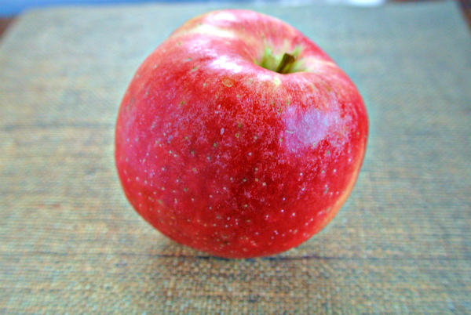
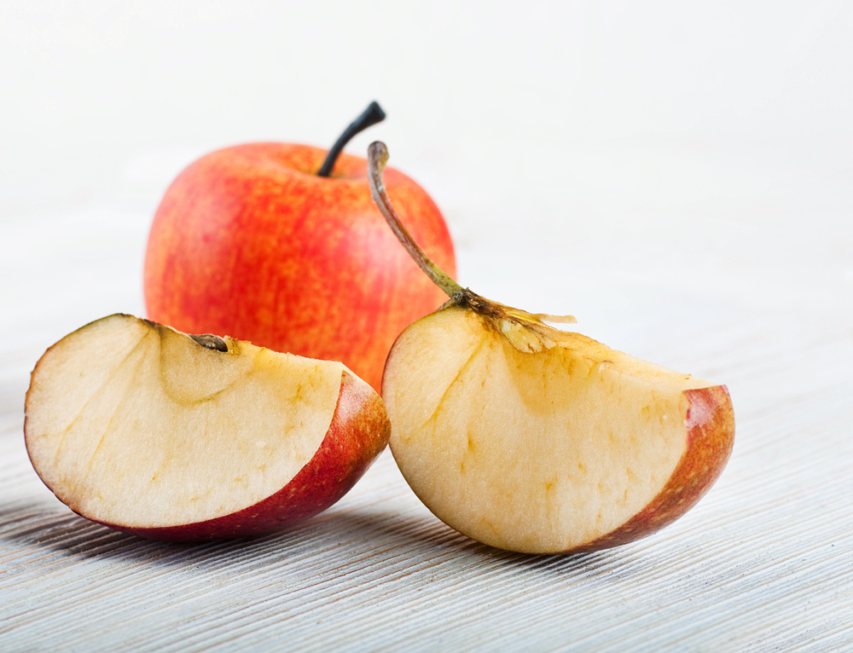
Enzyme, Oxygen and Cofactor
Polyphenol Oxidase (PPO), Catechol Oxidase came in the injured plants tissues
4
Notes:
This is caused by an enzyme (polyphenol oxidase and catechol oxidase are two common examples) that reacts with oxygen in the air and an iron or copper cofactor in the apple. A cofactor is a component that is necessary for a certain enzymatic reactions to happen. /The fruit starts to oxidize, when electrons are lost to another molecule (in this case the air), and the food turns brown.\

Slide 5
Experiments
-----------------------------------------------
5th IYNT 2017
Wellington High School

Slide 6
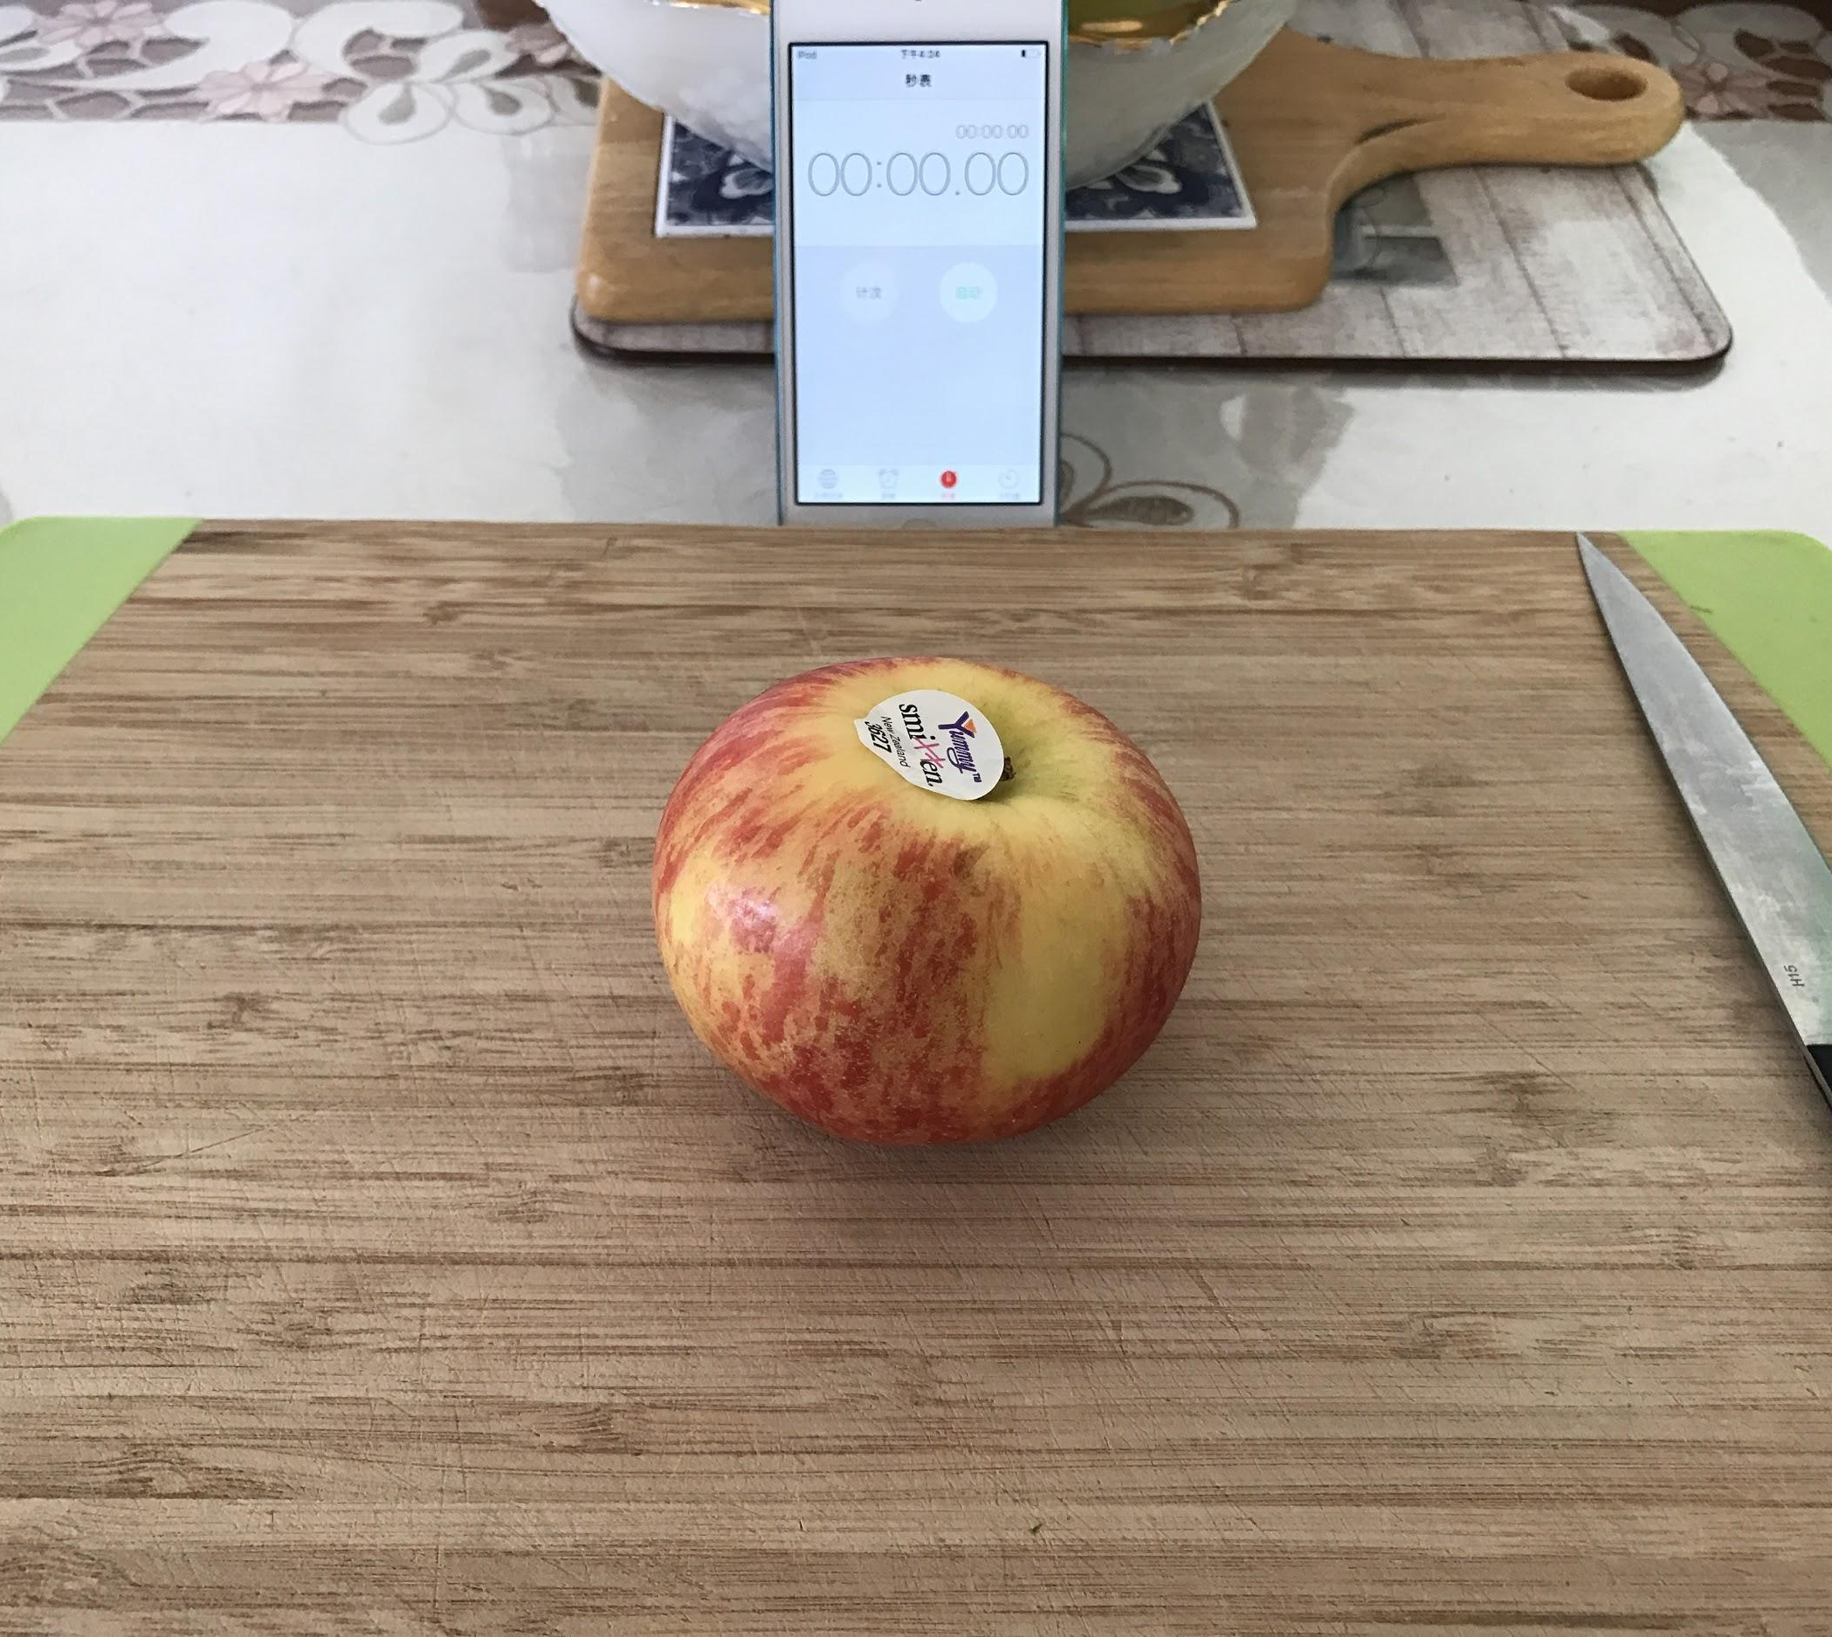
The Surface Area With the Speed Of Browning
-----------------------------------------------
5th IYNT 2017
Wellington High School
6
Notes:
(In this experiment I was finding the relationships between the surface area and the speed of the browning.)

Slide 7
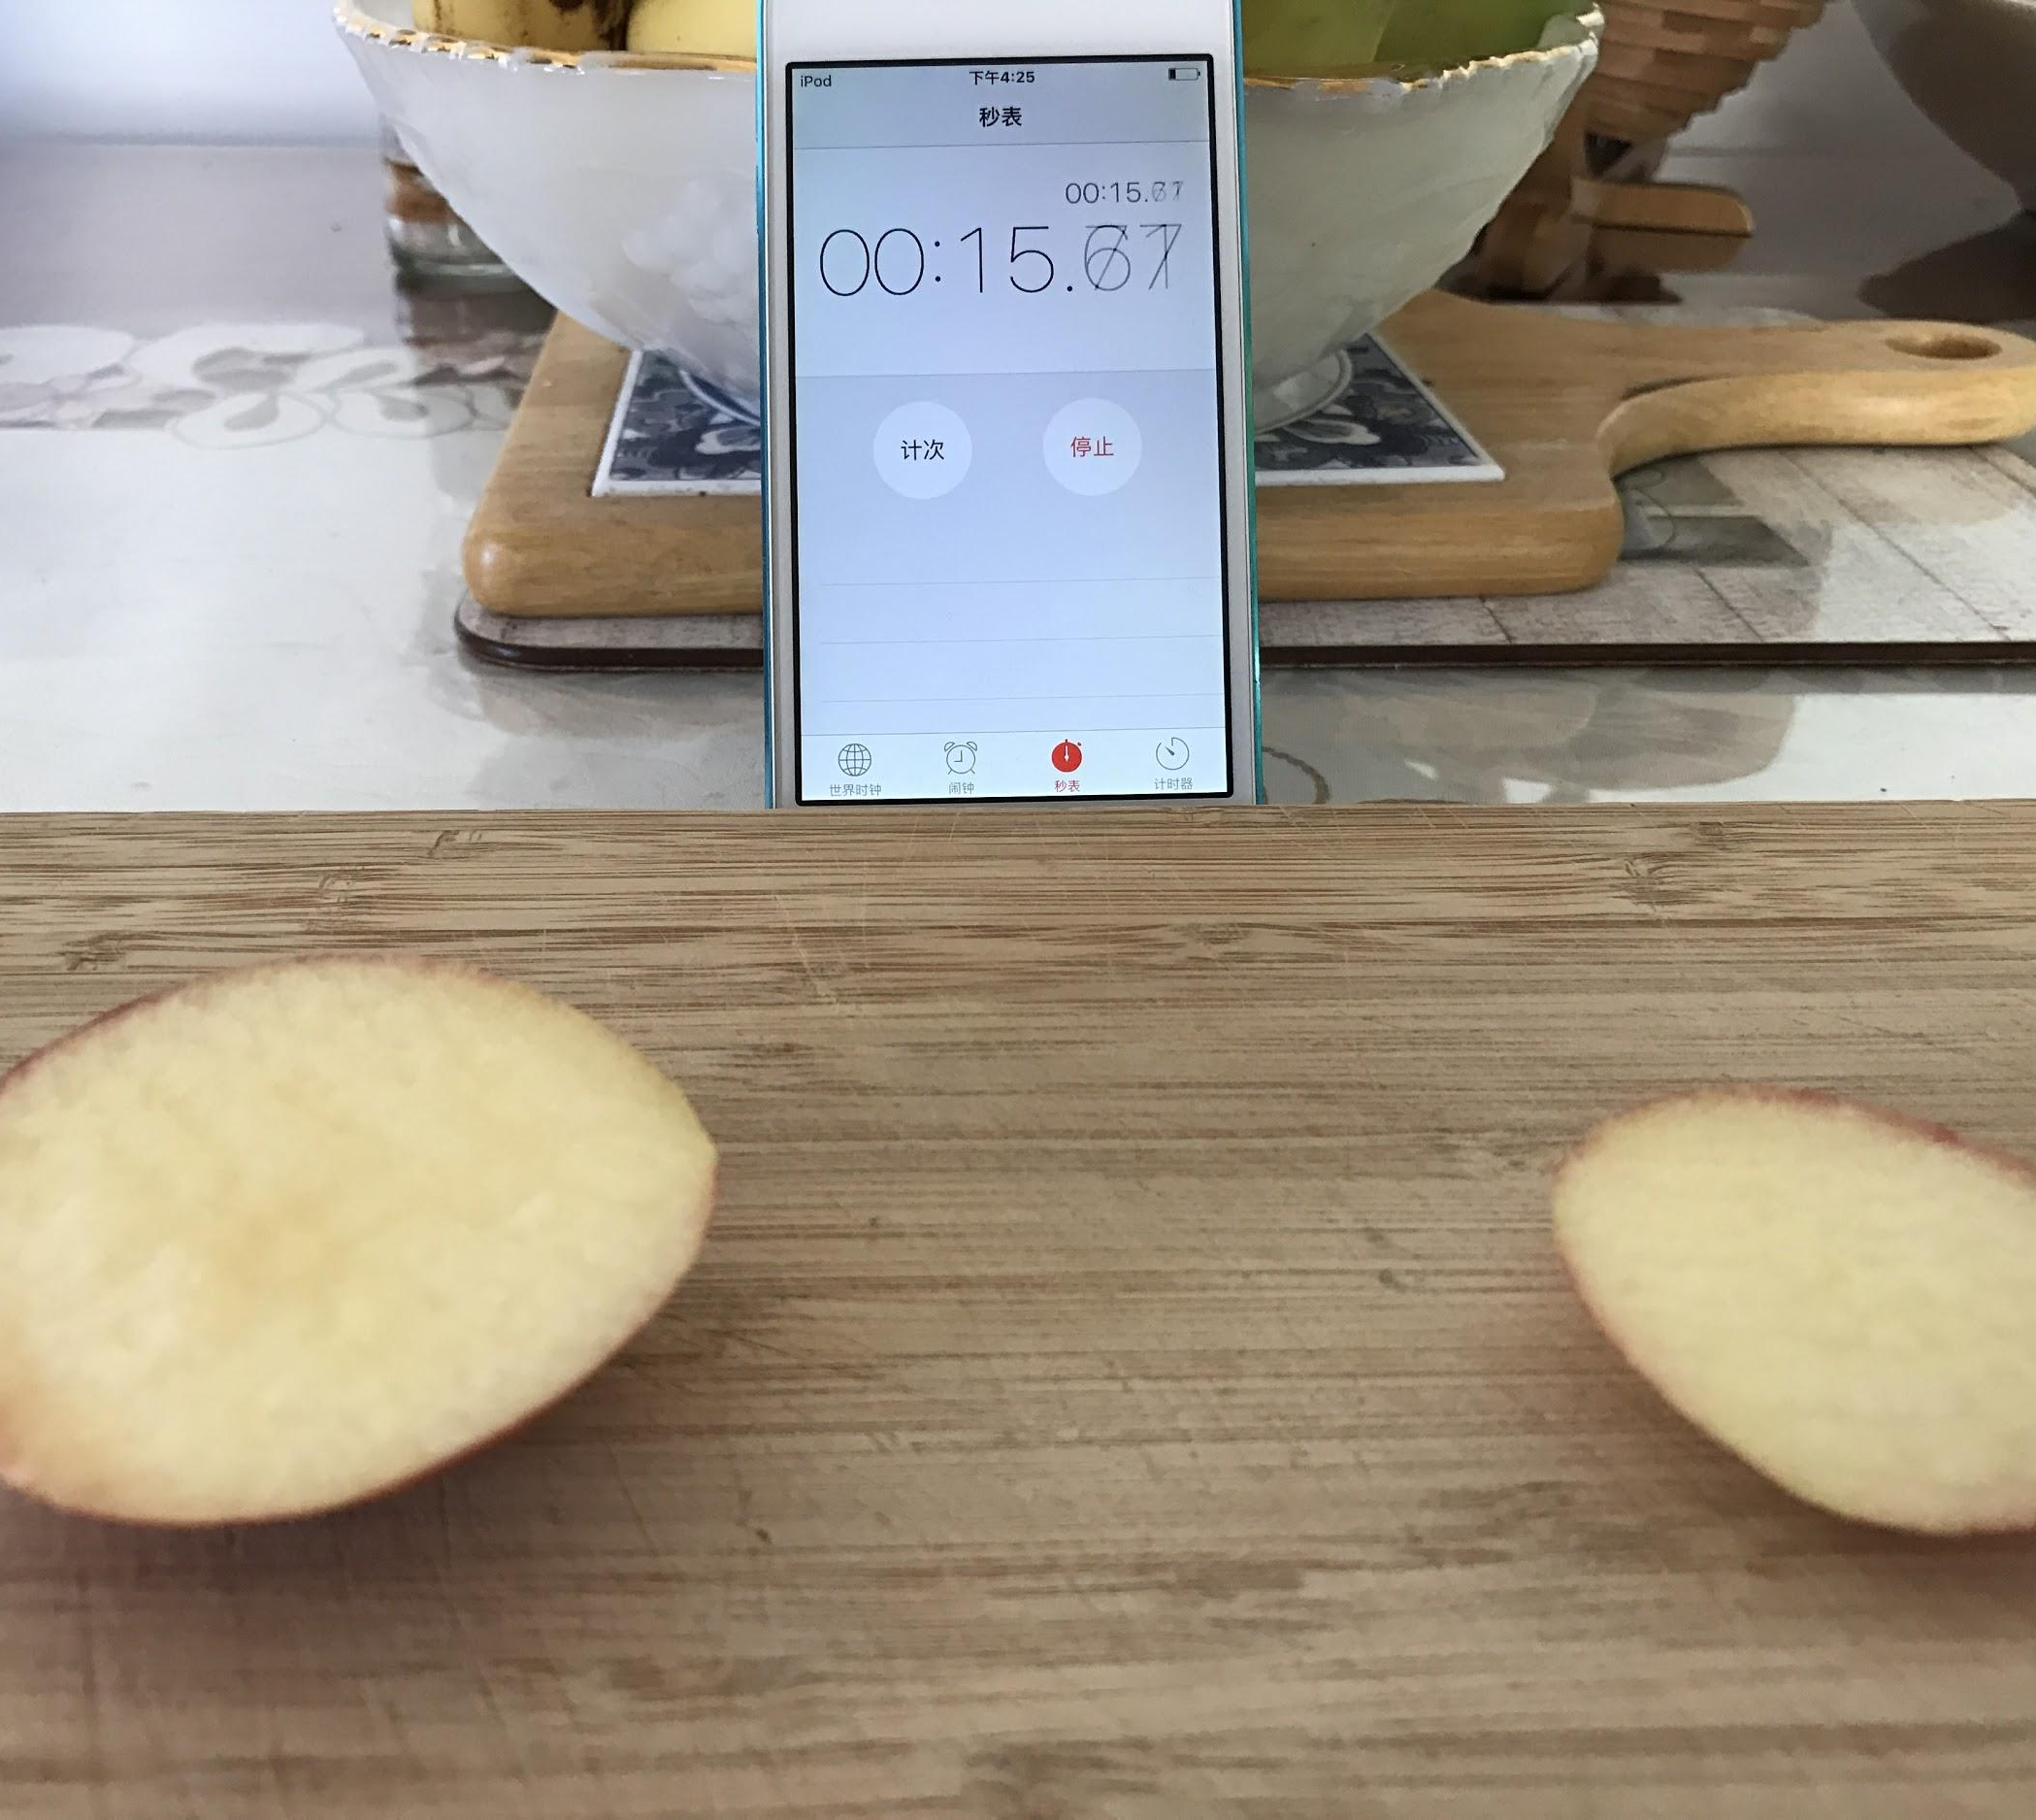
Step 1
Different Surface Area
-----------------------------------------------
5th IYNT 2017
Wellington High School
7

Slide 8
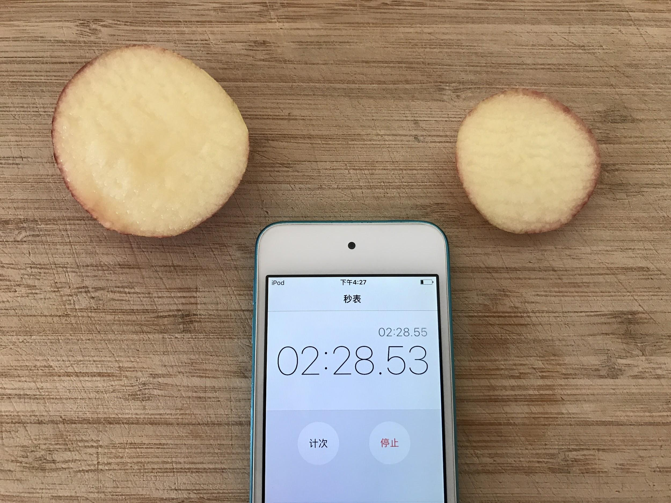
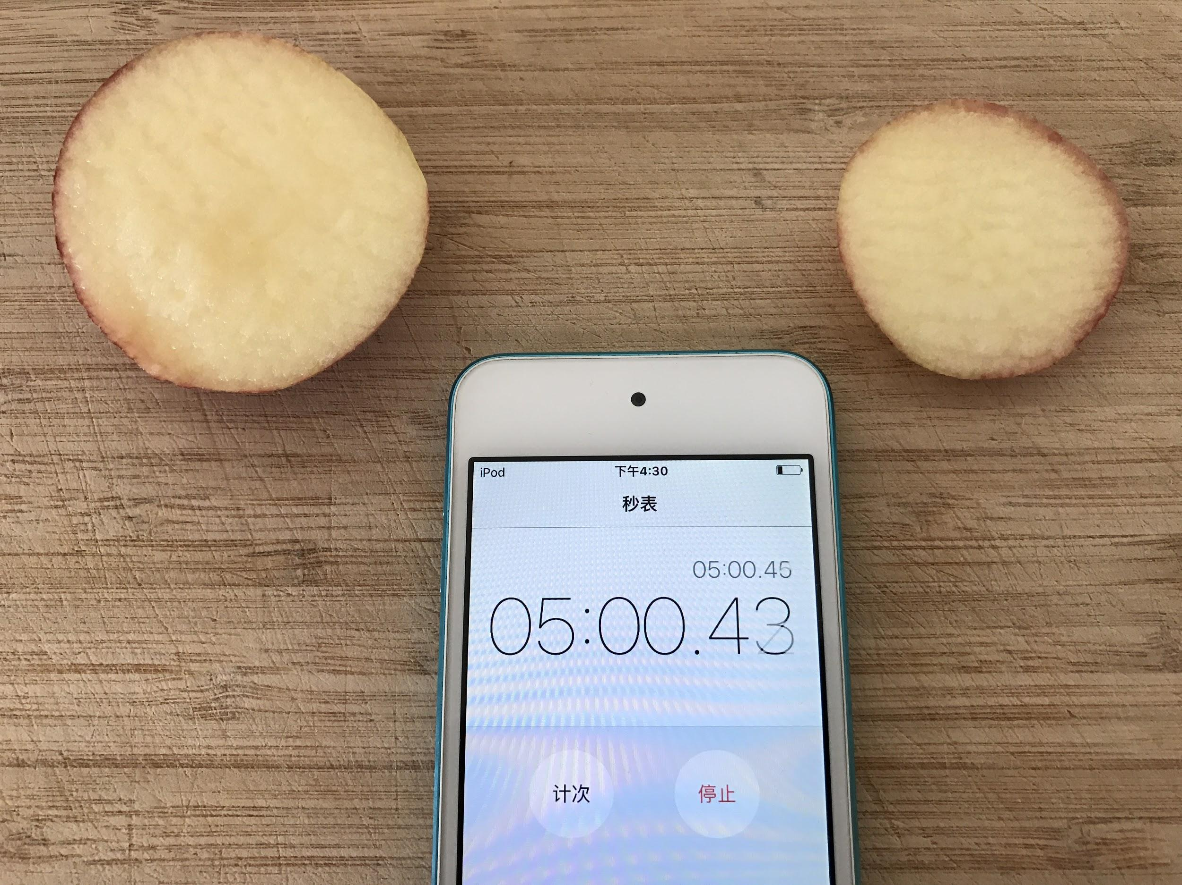
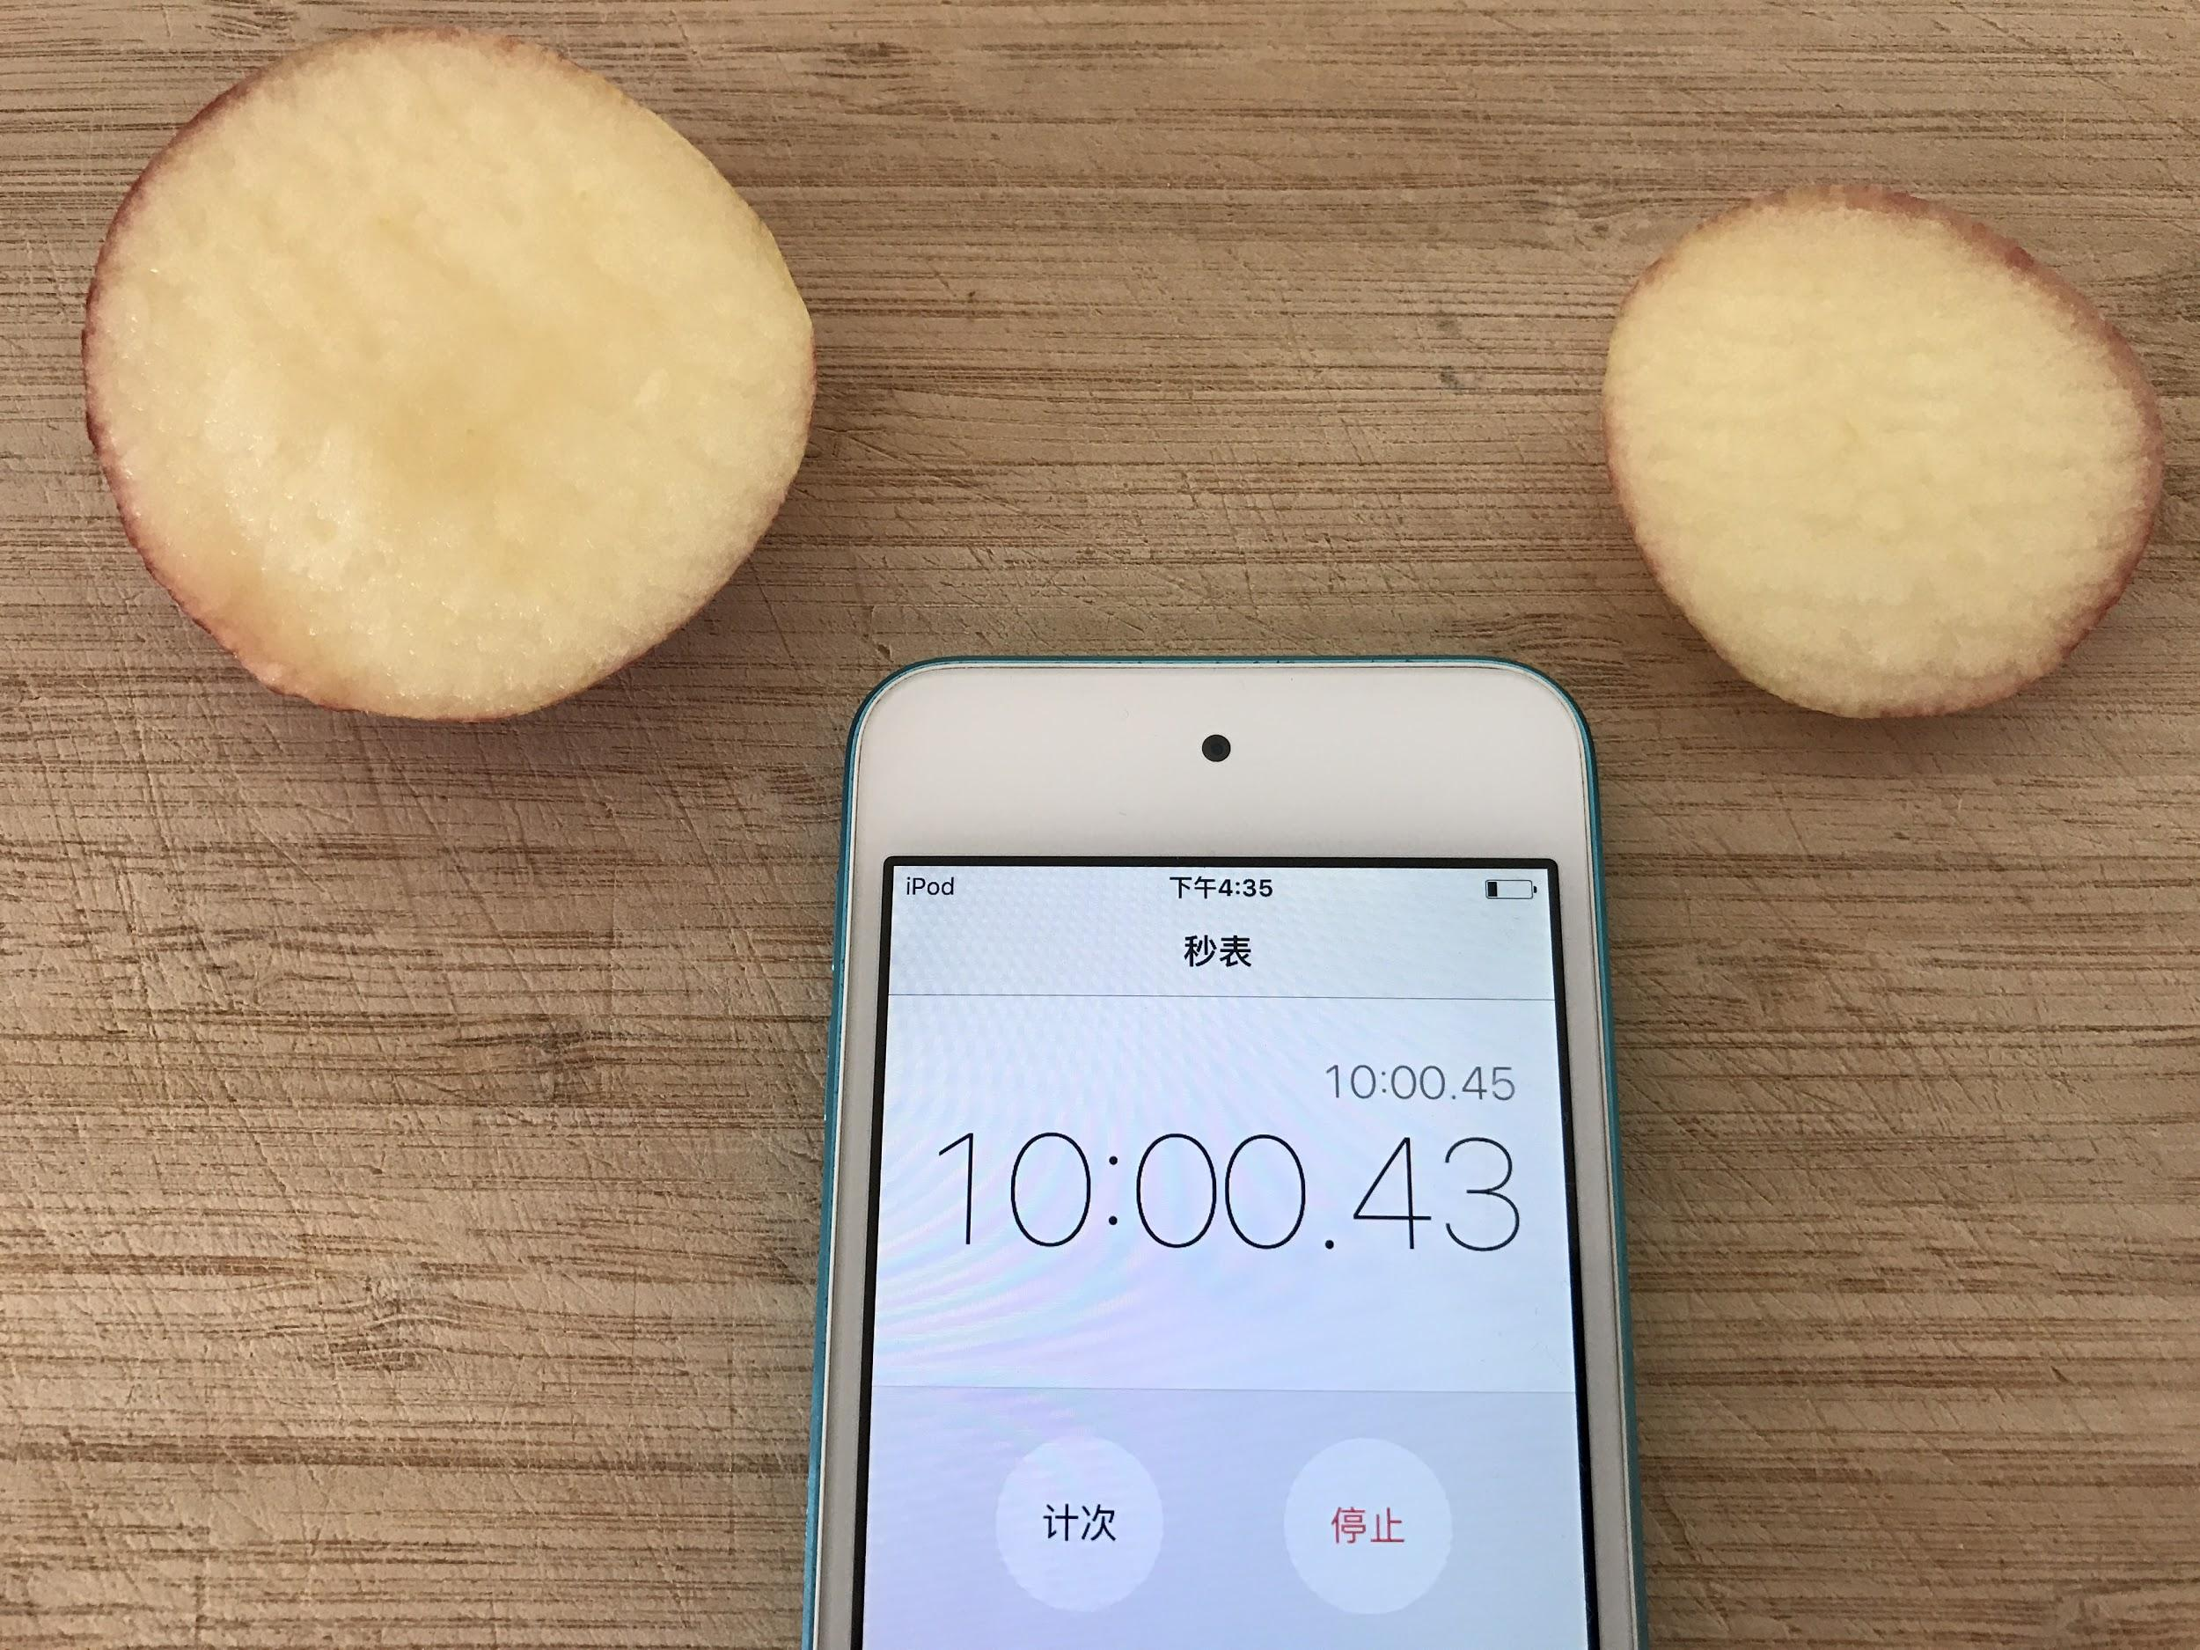
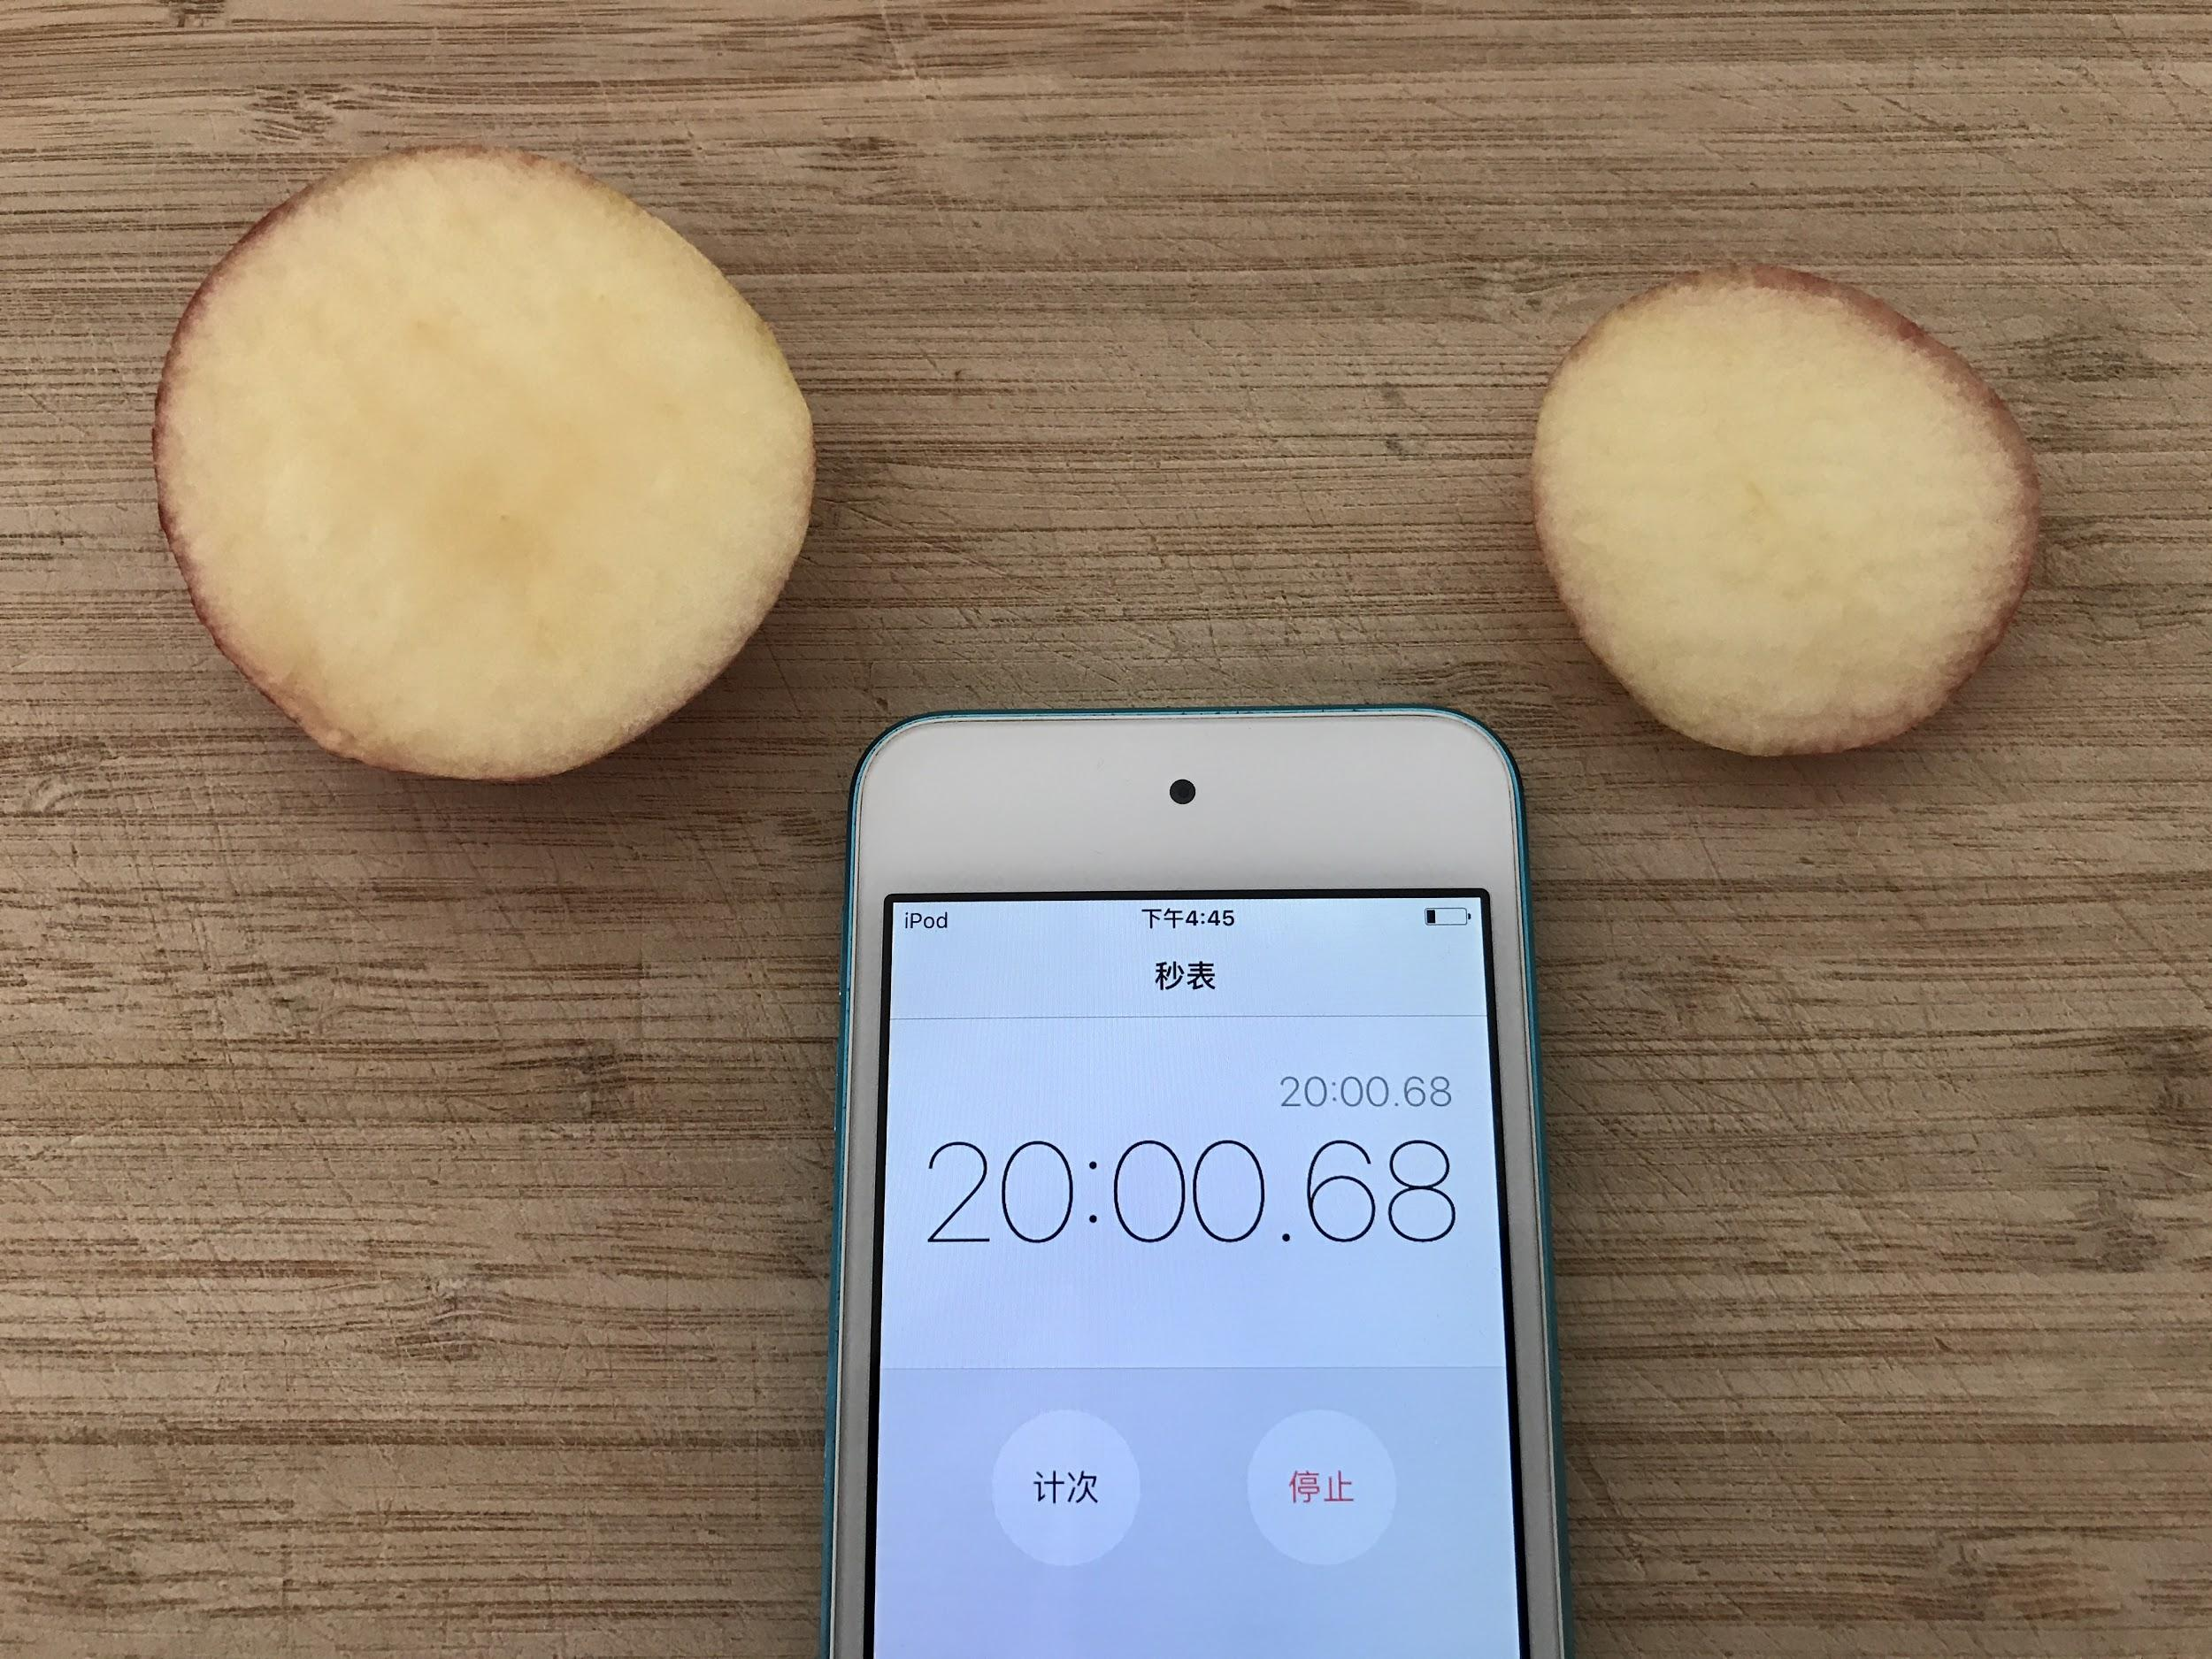
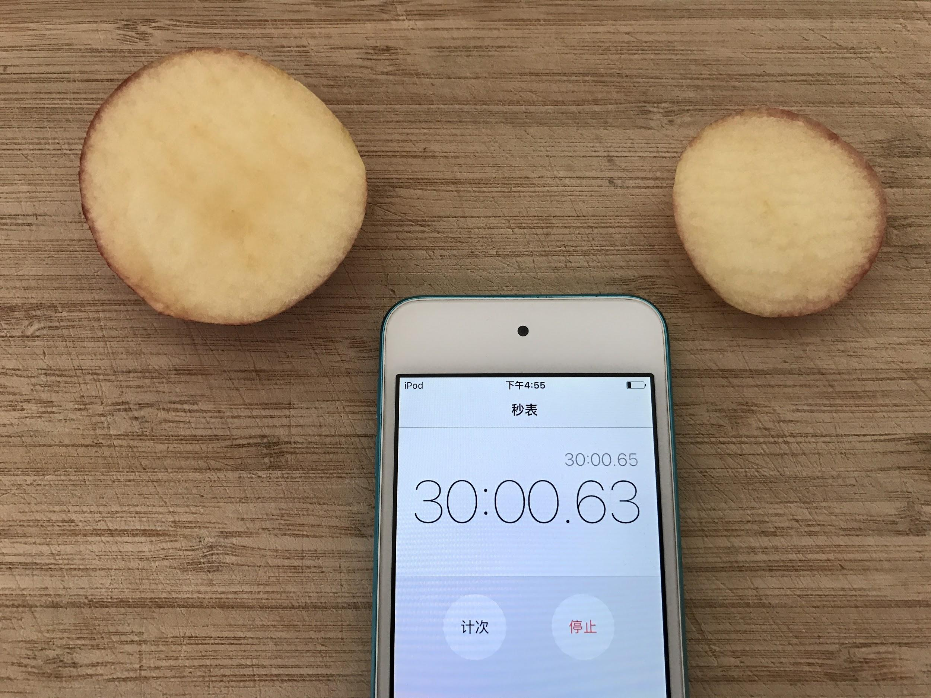
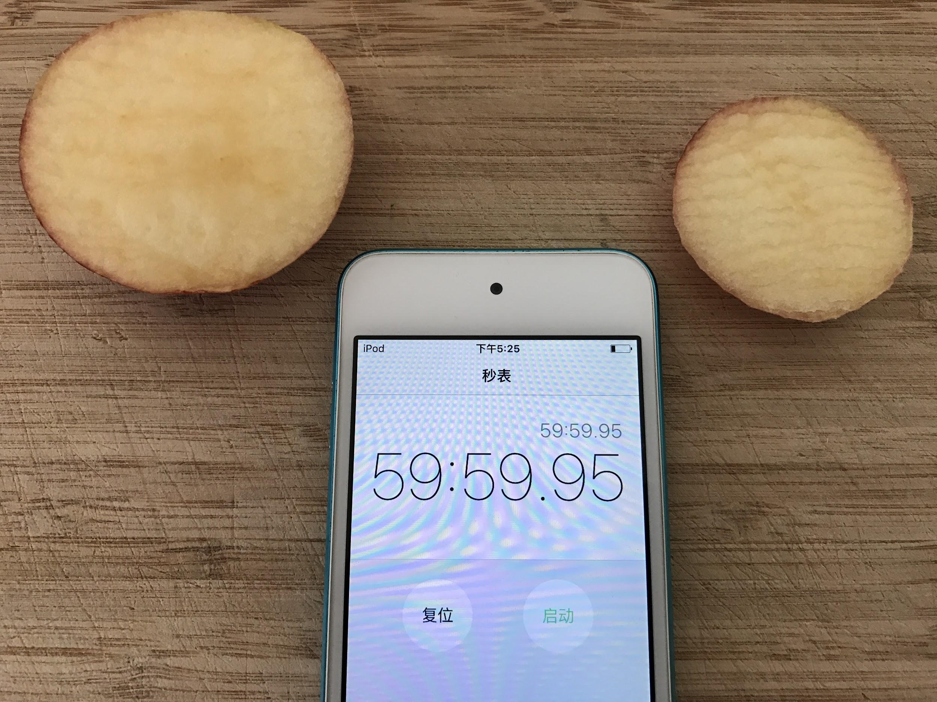
Step 2
8

Slide 9
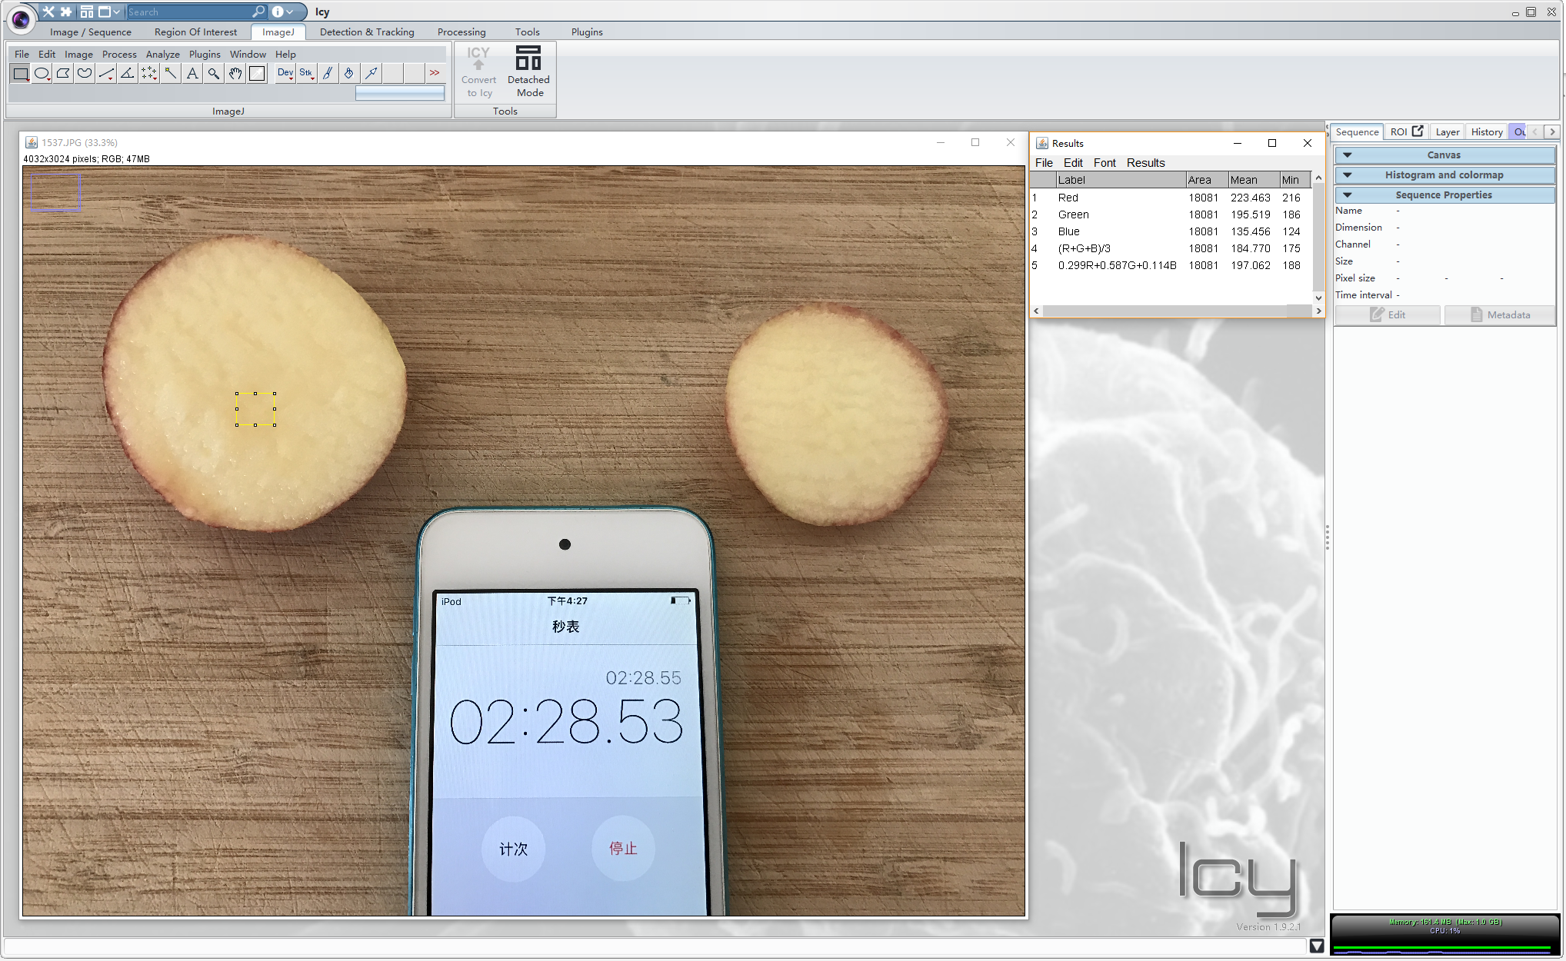
9
Notes:
For more accurate results, I used a software called ICY to analyze the photos. ICY can gave me the RGB values of the surface that I had selected.

Slide 10
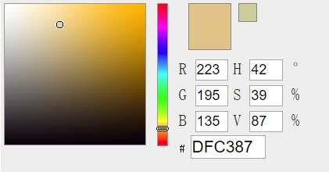
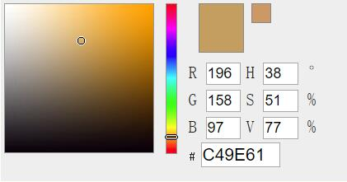
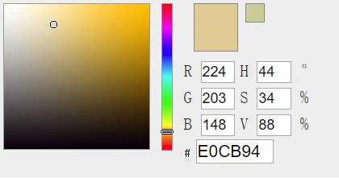
10
Notes:
The colors stand for there values. The dark blue line is the value of the mean of the addition of the R, G, B values. The X-axis stands for the times and the Y-axis stands for the RGB values. As we see from the color pad here, the lower RGB values it have, the browner it will be.

Slide 11
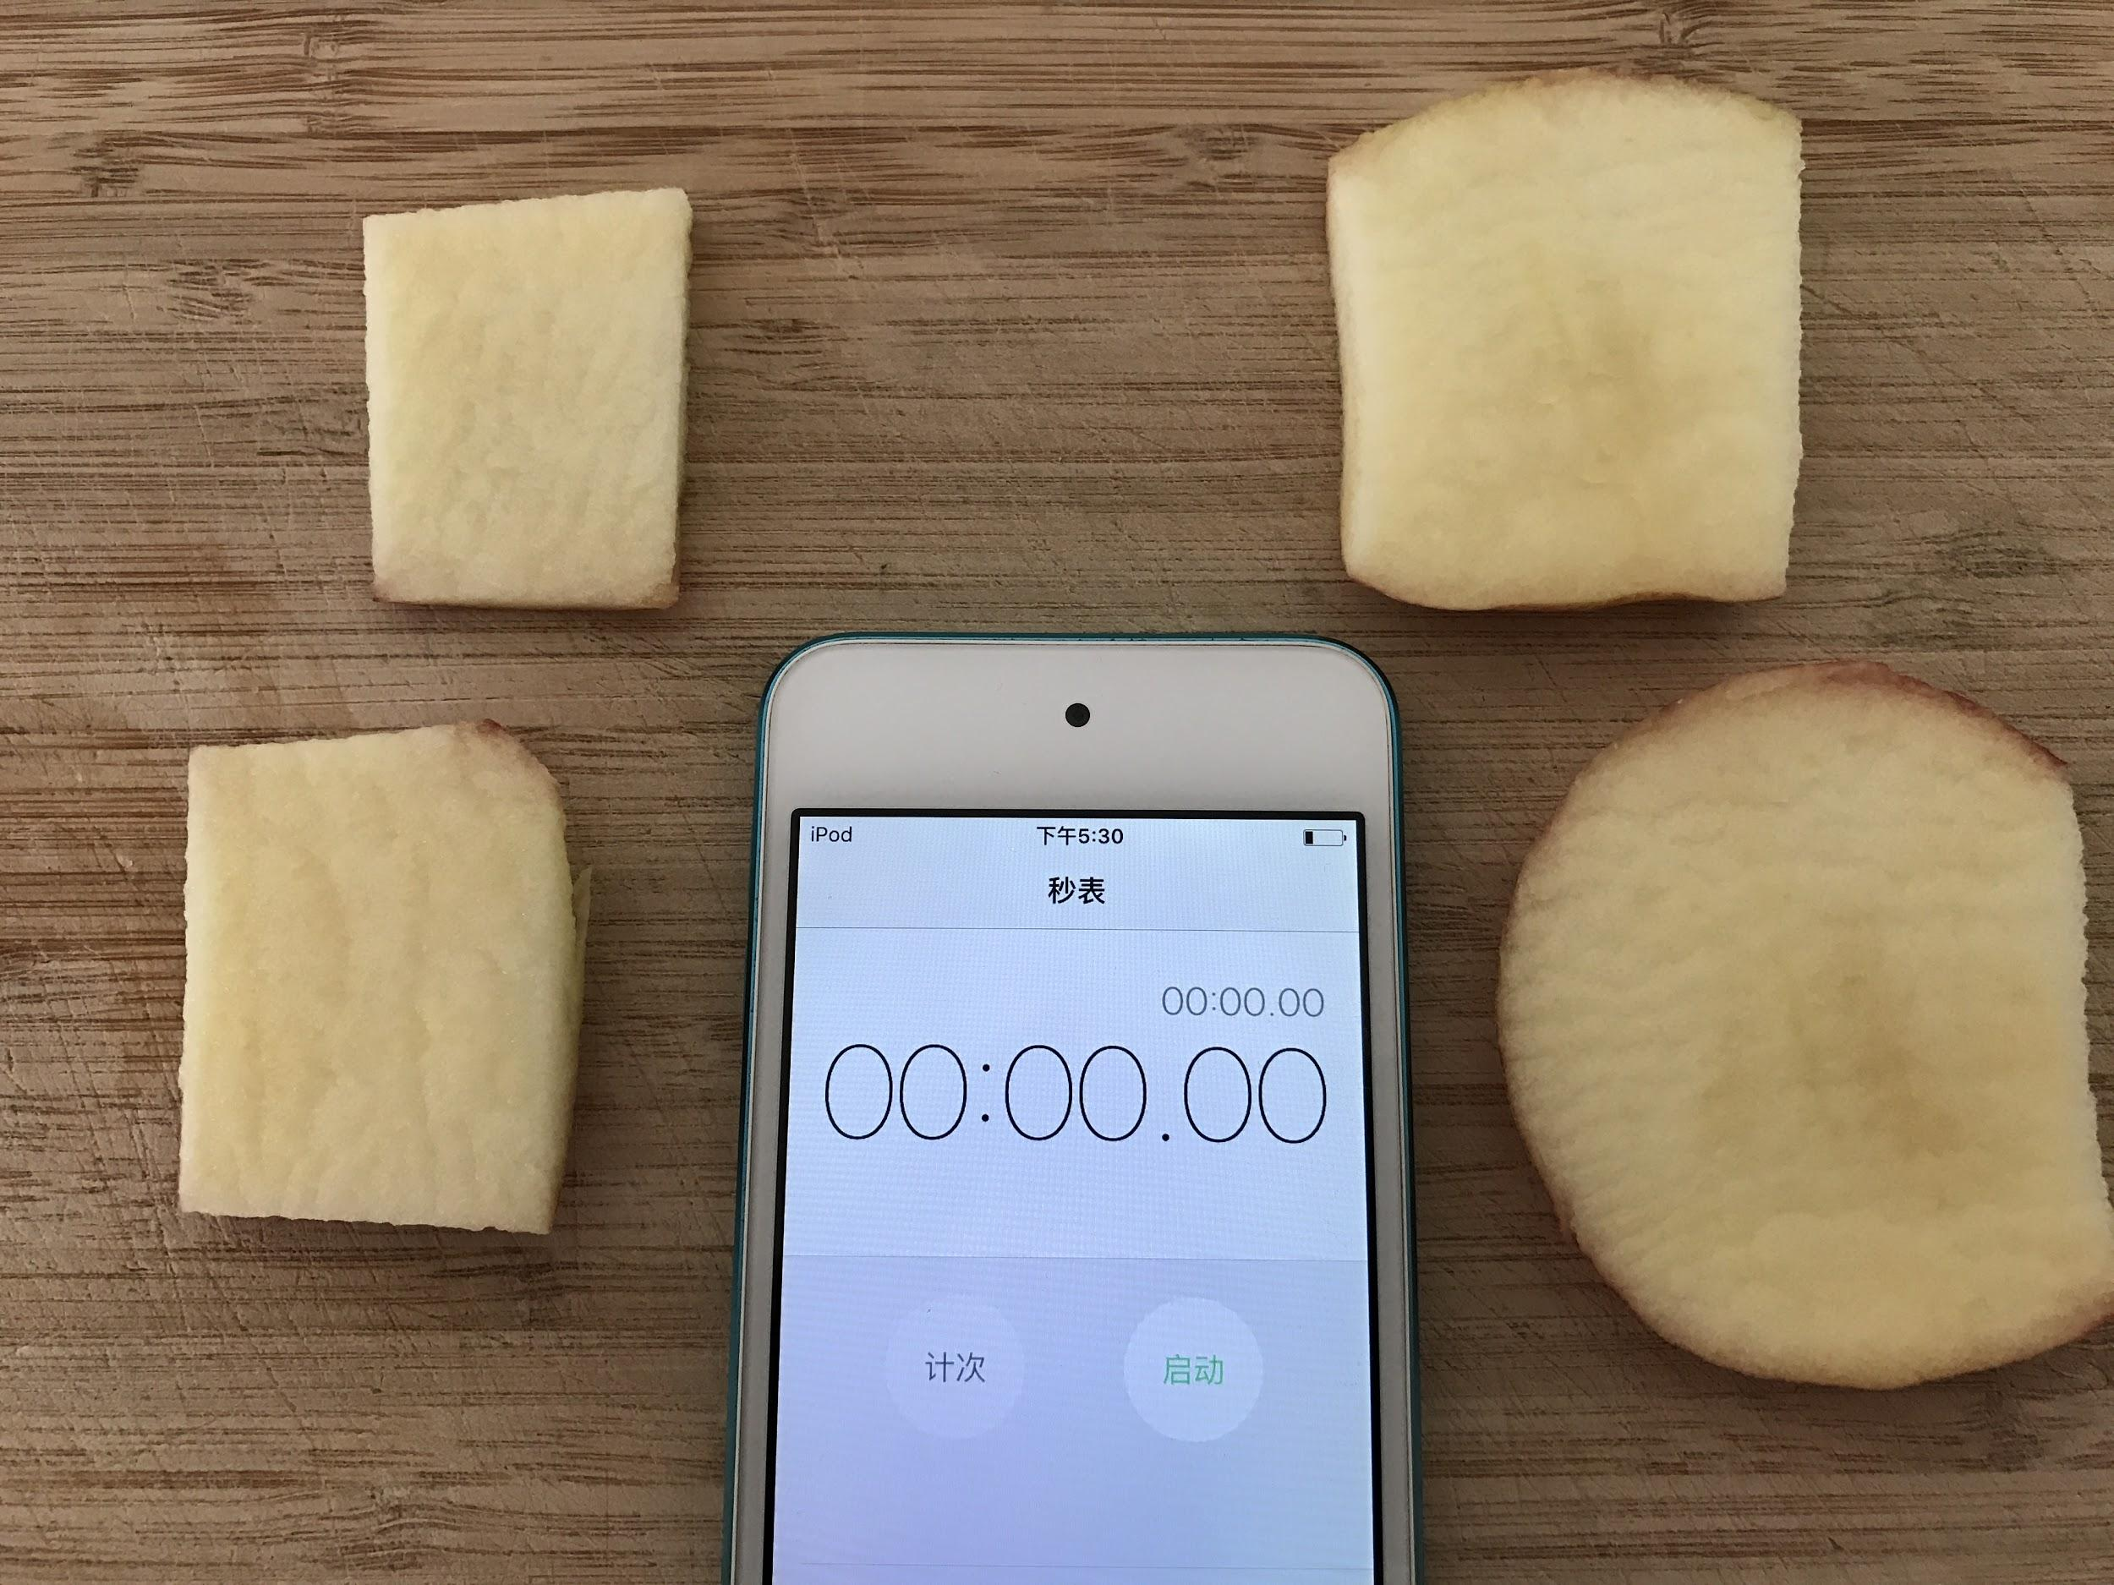
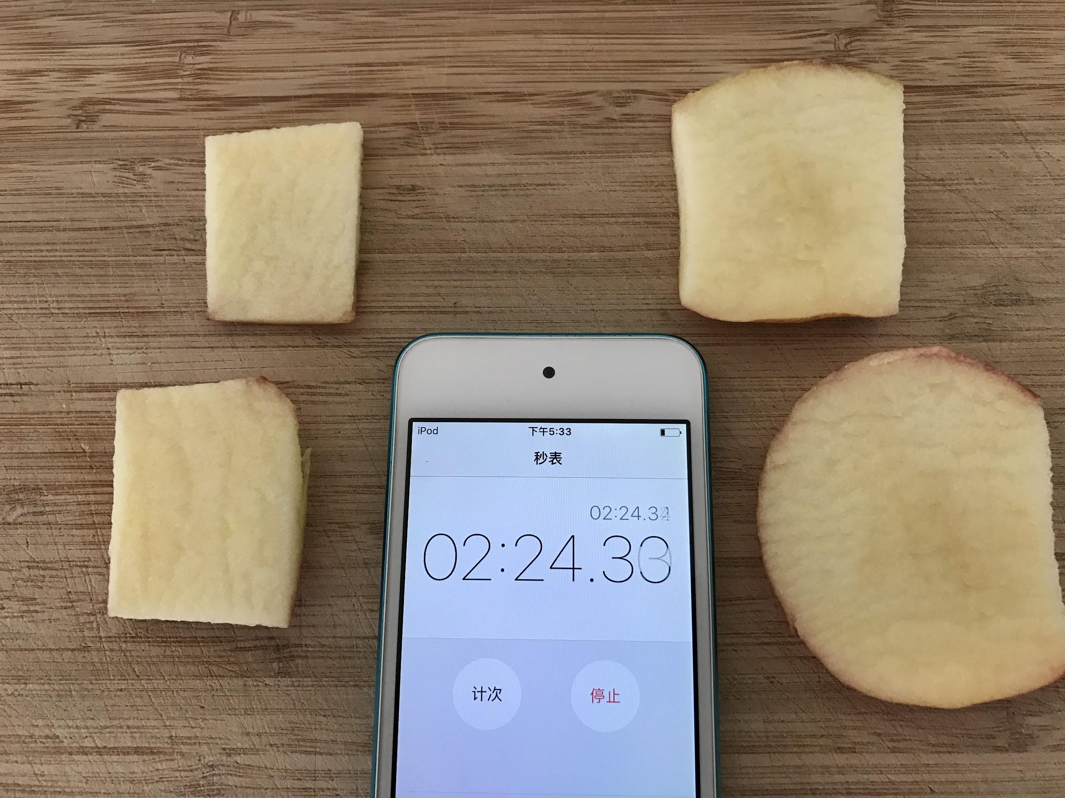
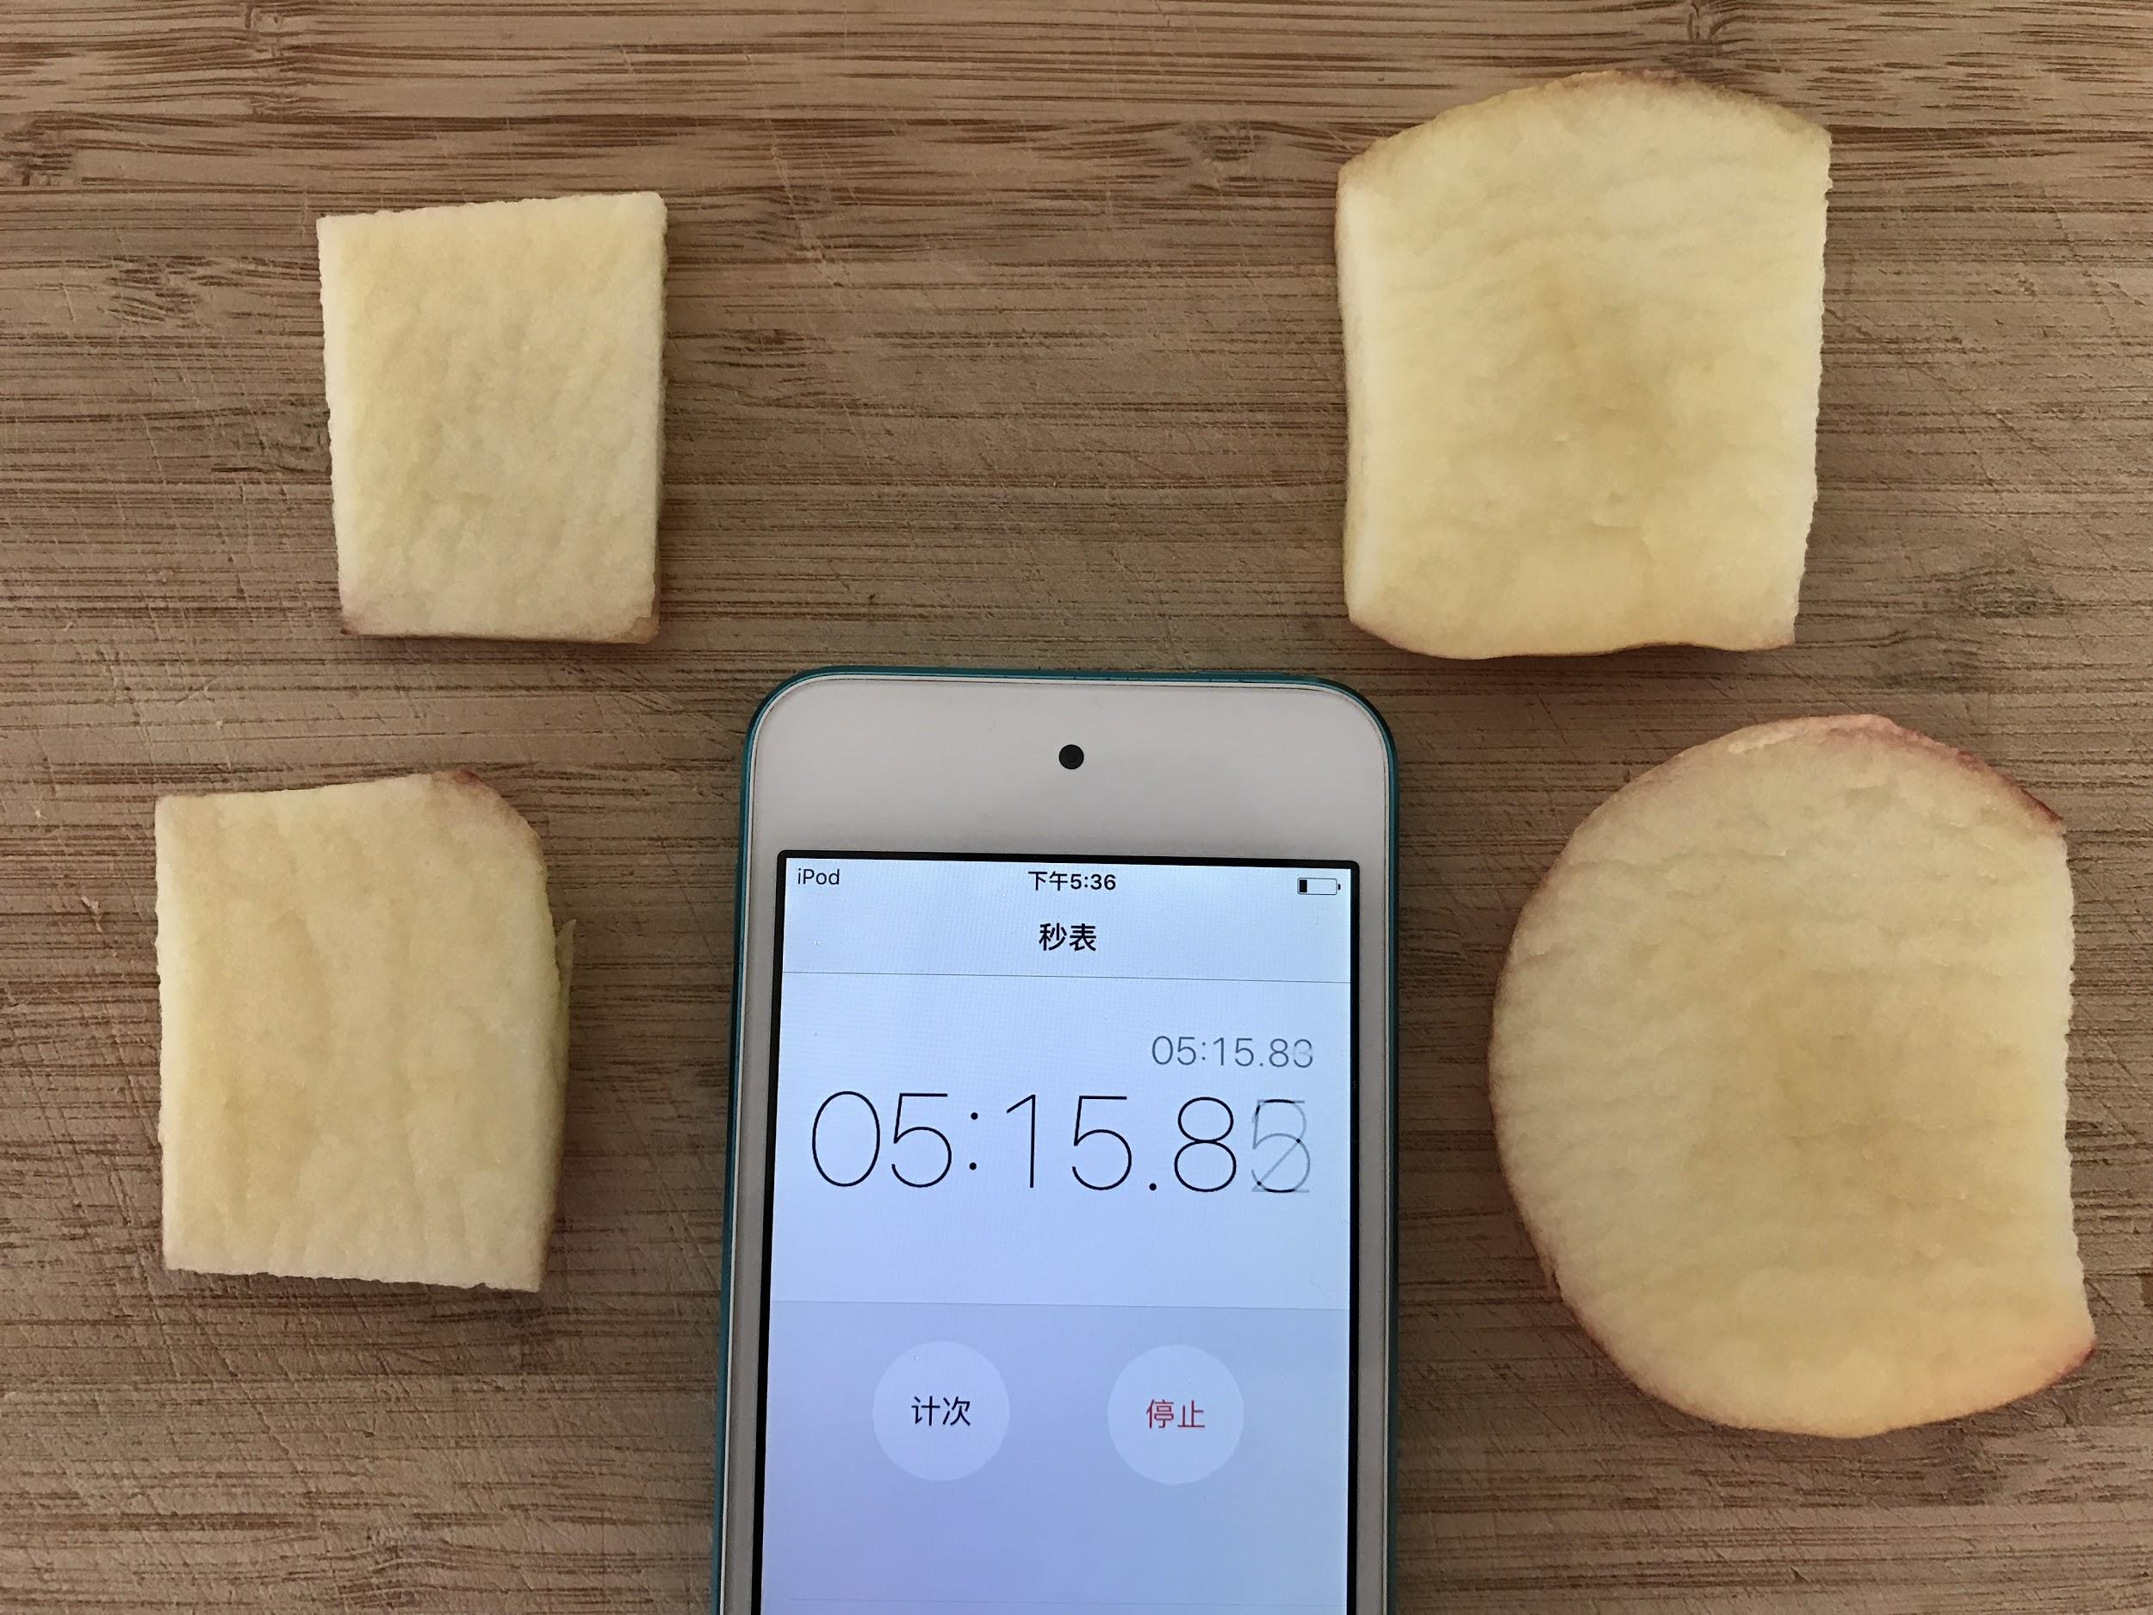
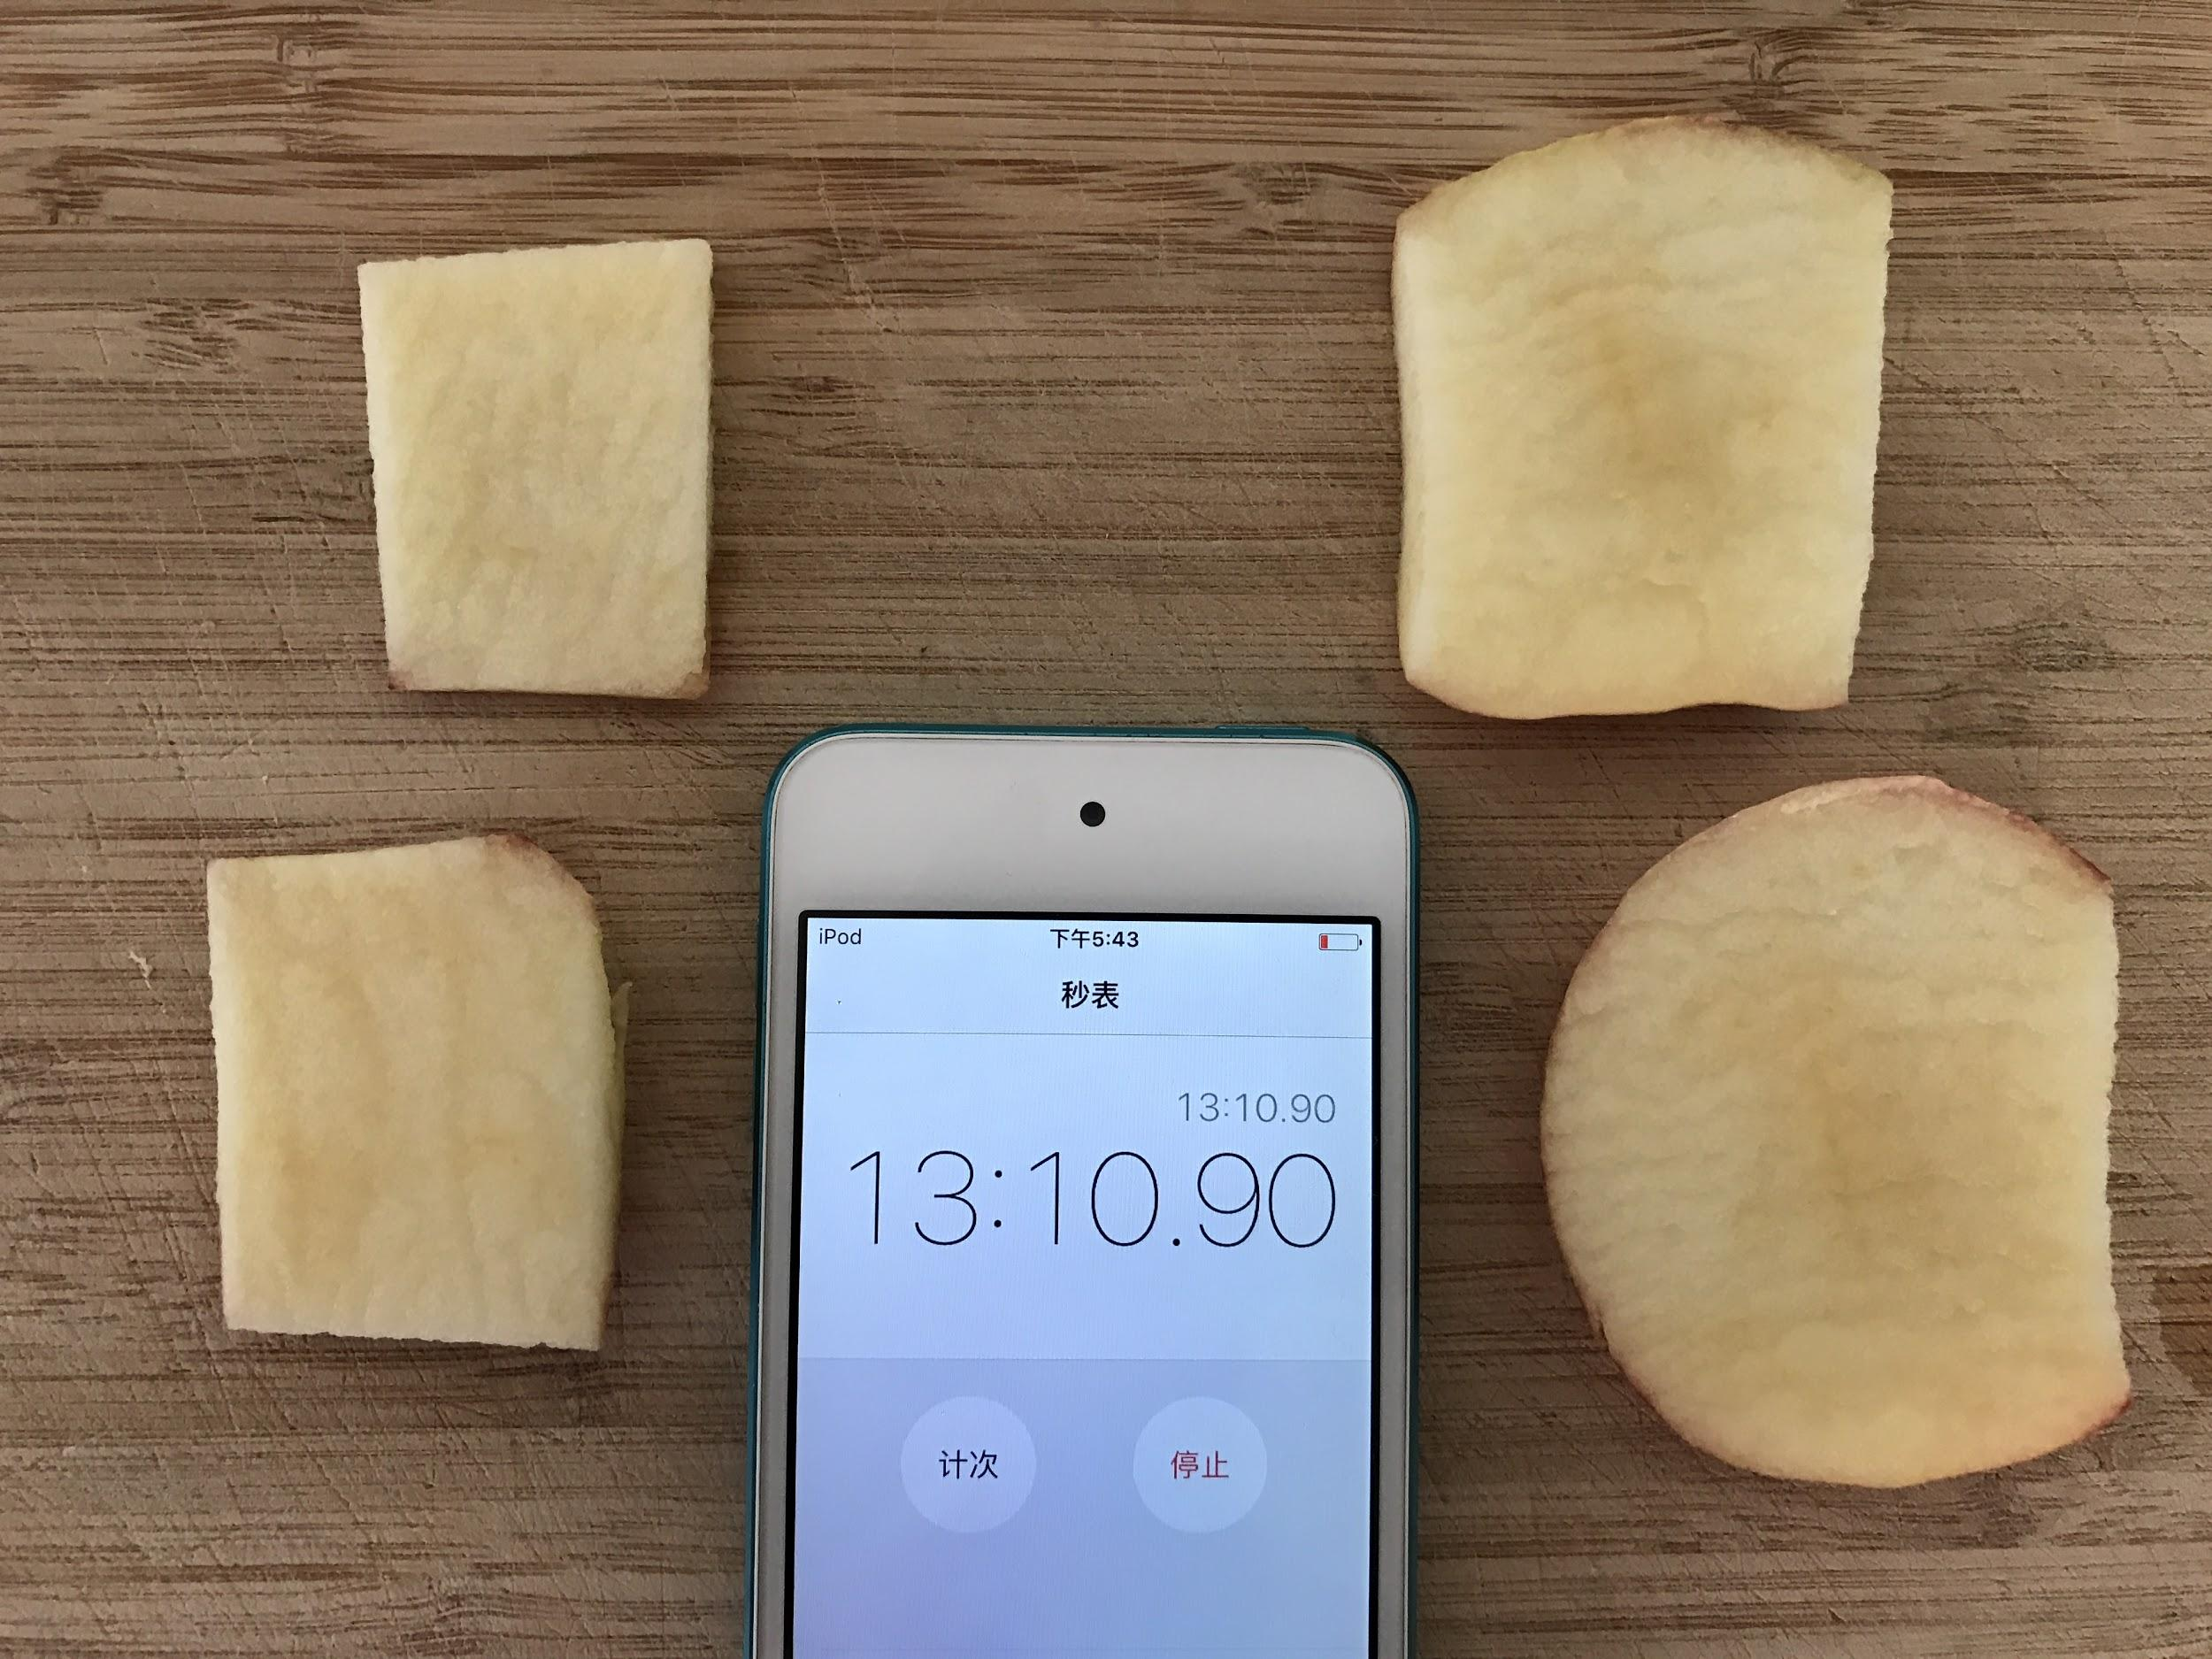
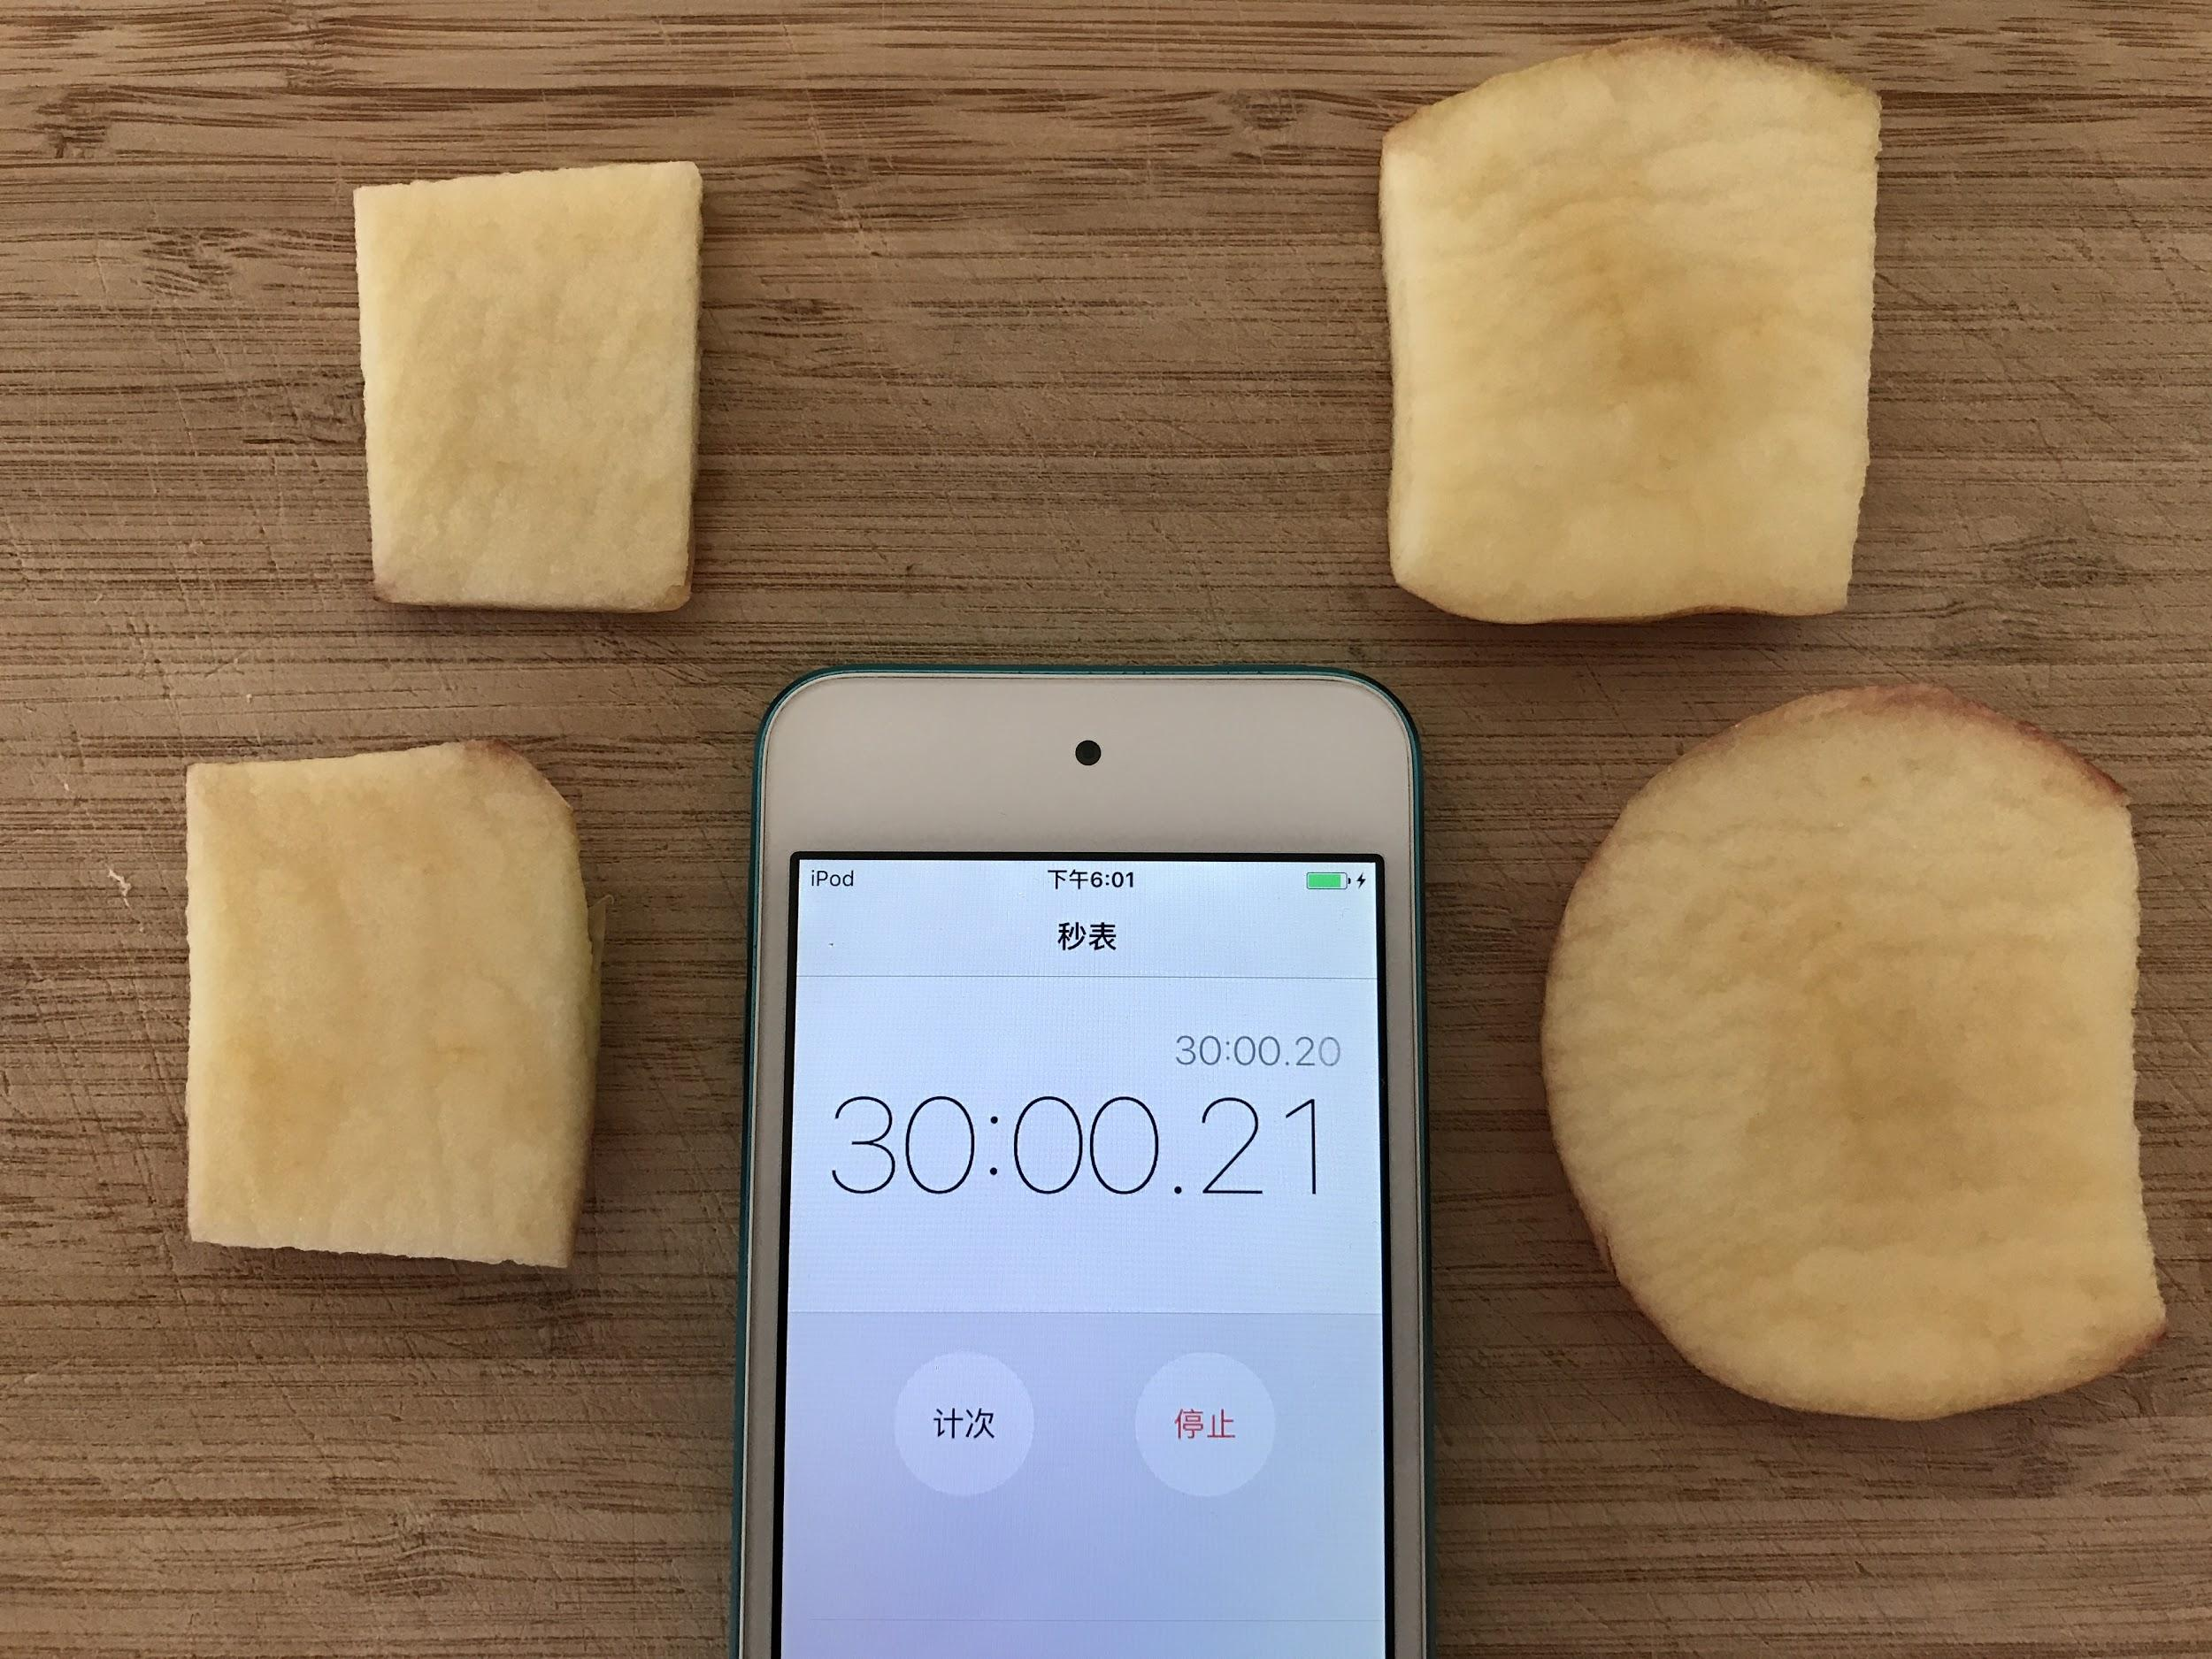
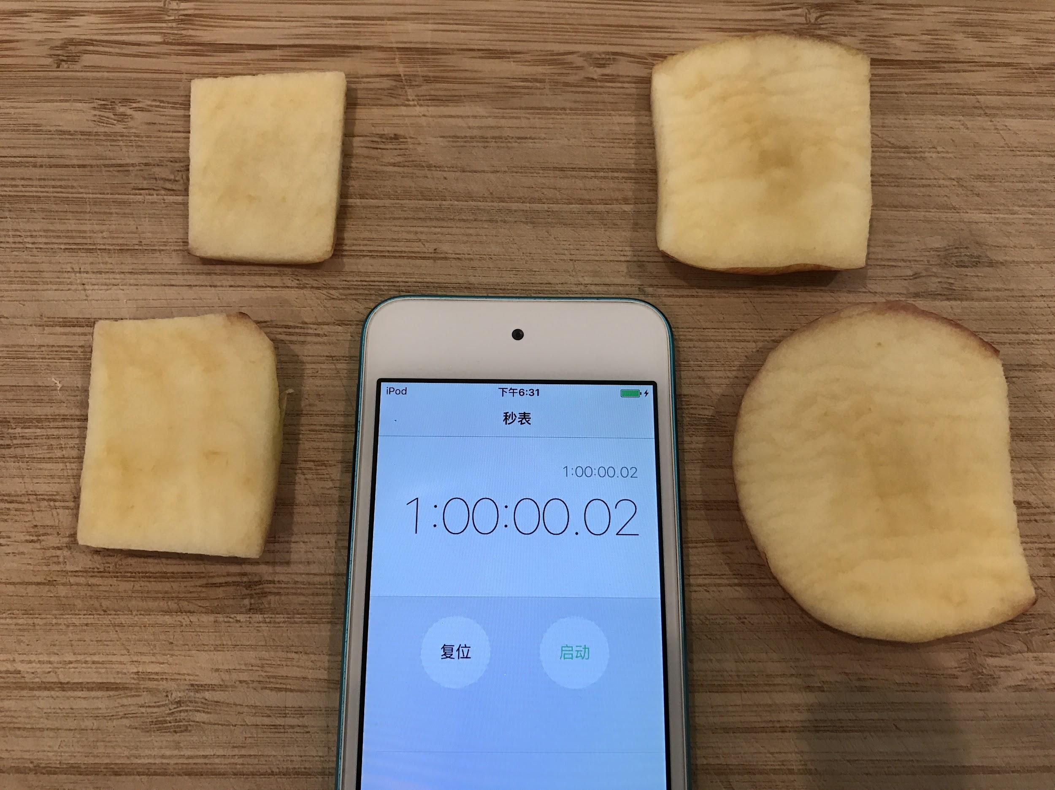
The Second and Third time
11

Slide 12
12

Slide 13
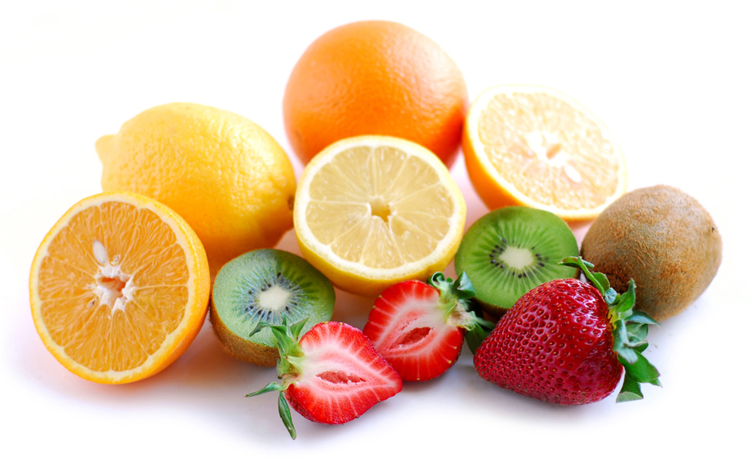
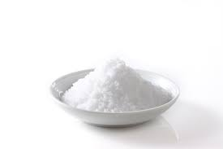
Antioxidants
Lemon juice or other acidic things can prevent browning.
-----------------------------------------------
5th IYNT 2017
Wellington High School
13
Notes:
Acids can prevent browning because they react with the oxygen that comes into contact with the surface of the sample. Once all the acid (or whatever else is covering the surface) has reacted with the oxygen or the acid has degraded or washed off, then the sample will start to brown again. Stronger acids, like lemon juice, can even denature the enzyme. This means that the enzyme can no longer perform its original function because of its environment. So the reaction will be much longer than the apple without any covers.

Slide 14
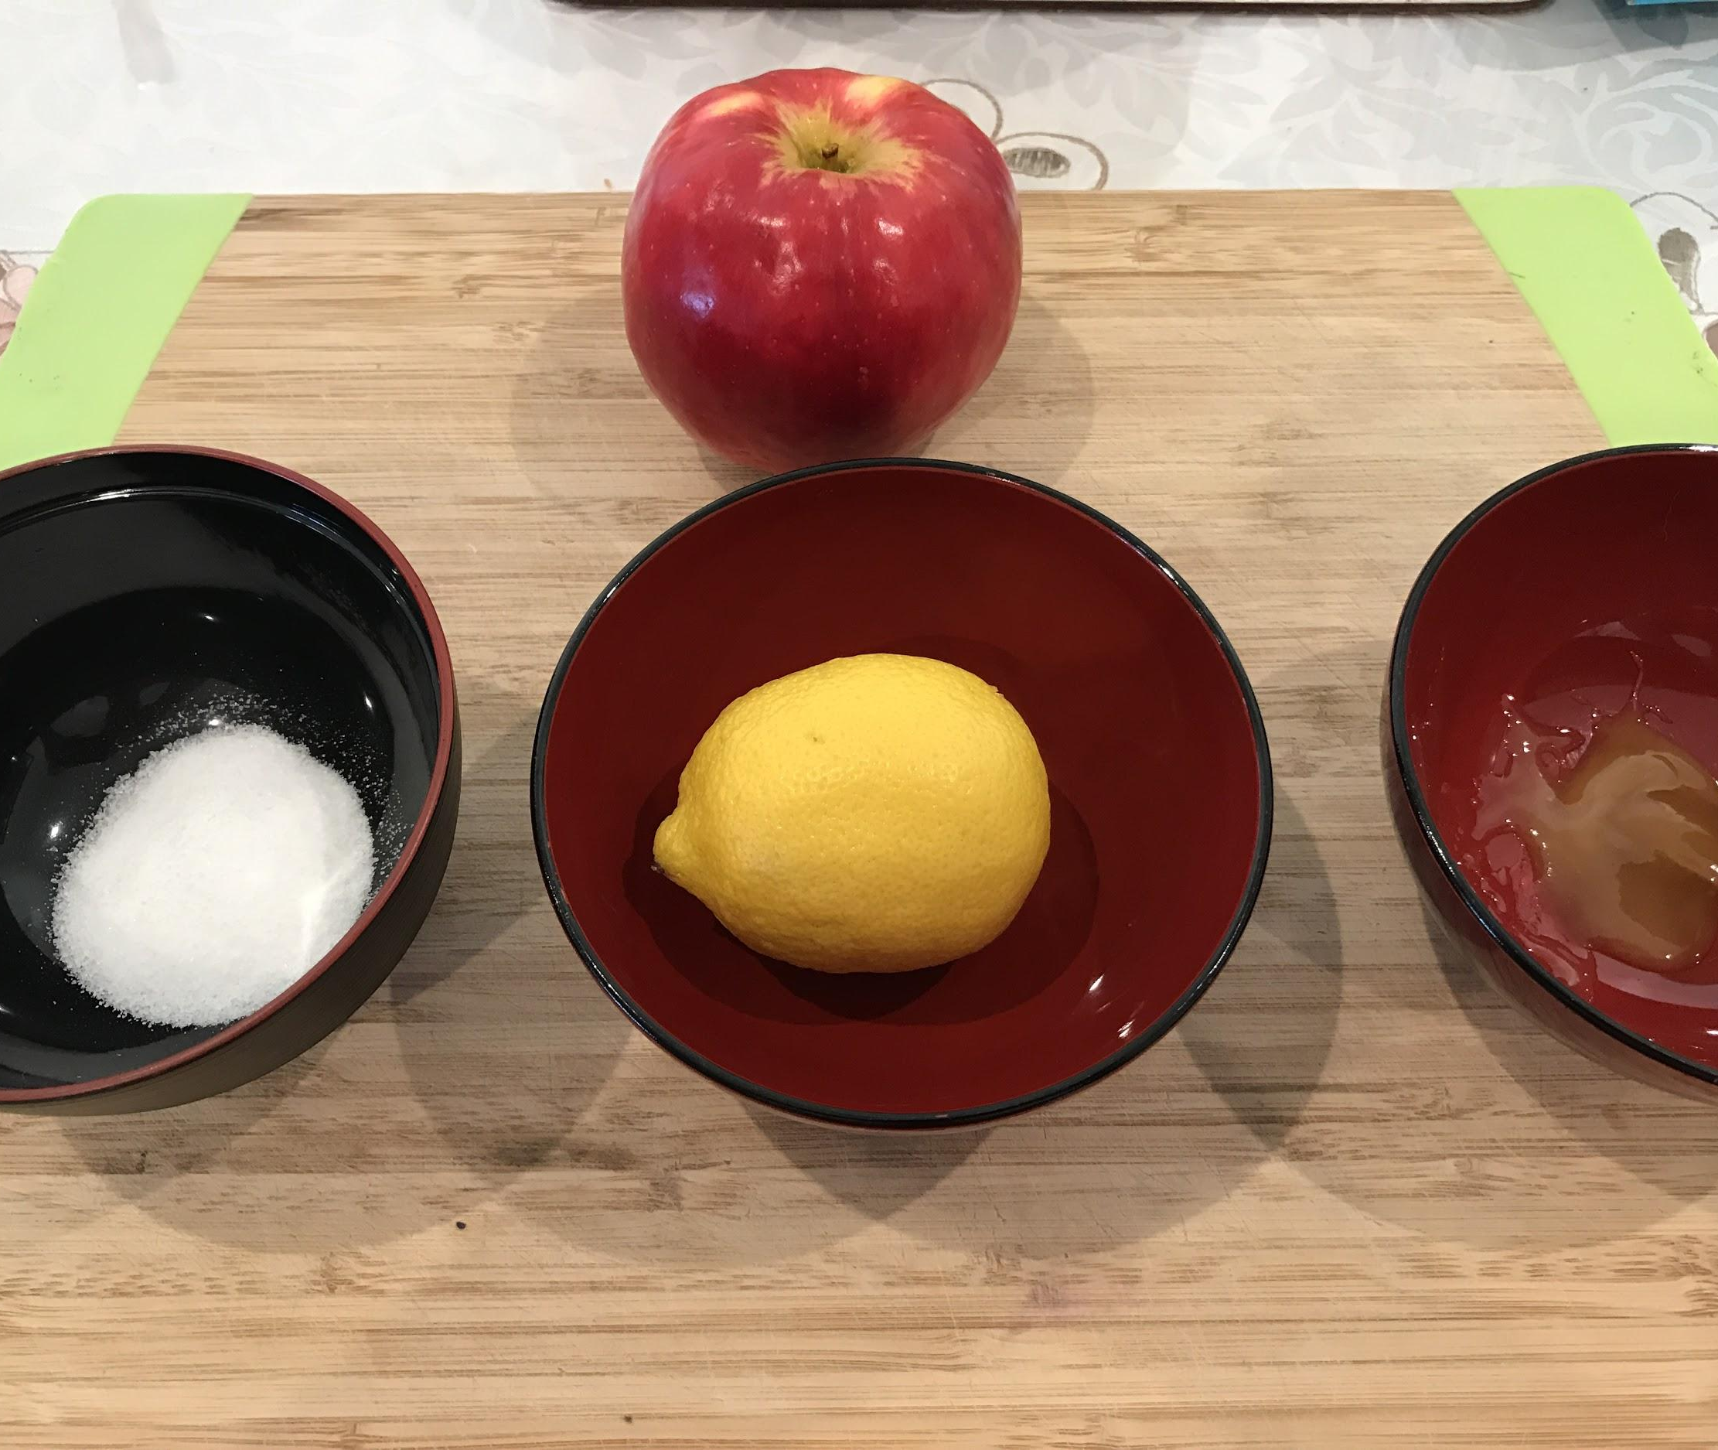
Different Antioxidants
-----------------------------------------------
5th IYNT 2017
Wellington High School
14
Notes:
(In this experiment I was finding the relationships between the antioxidants and the speed of browning.)

Slide 15
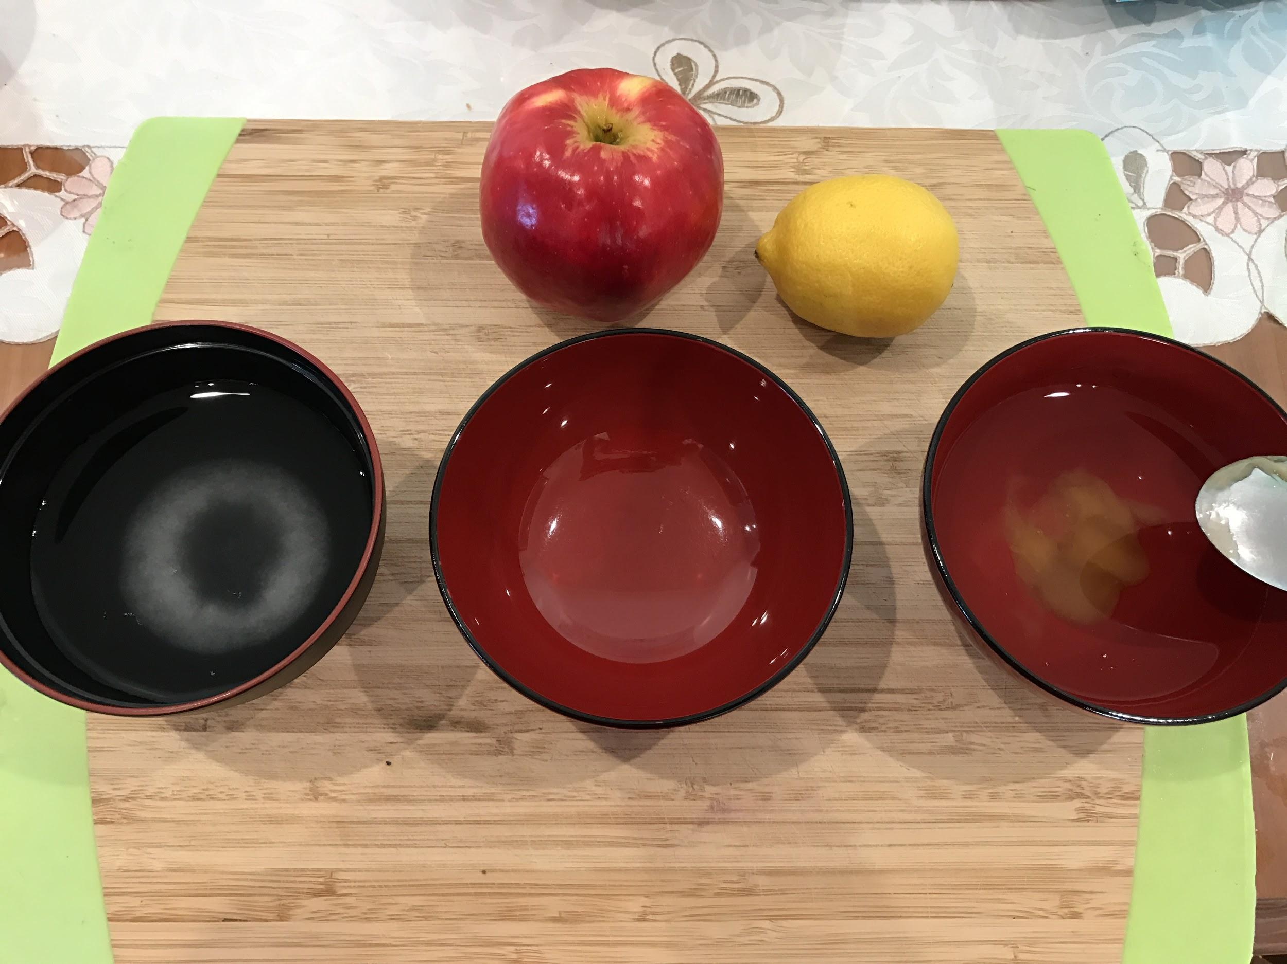
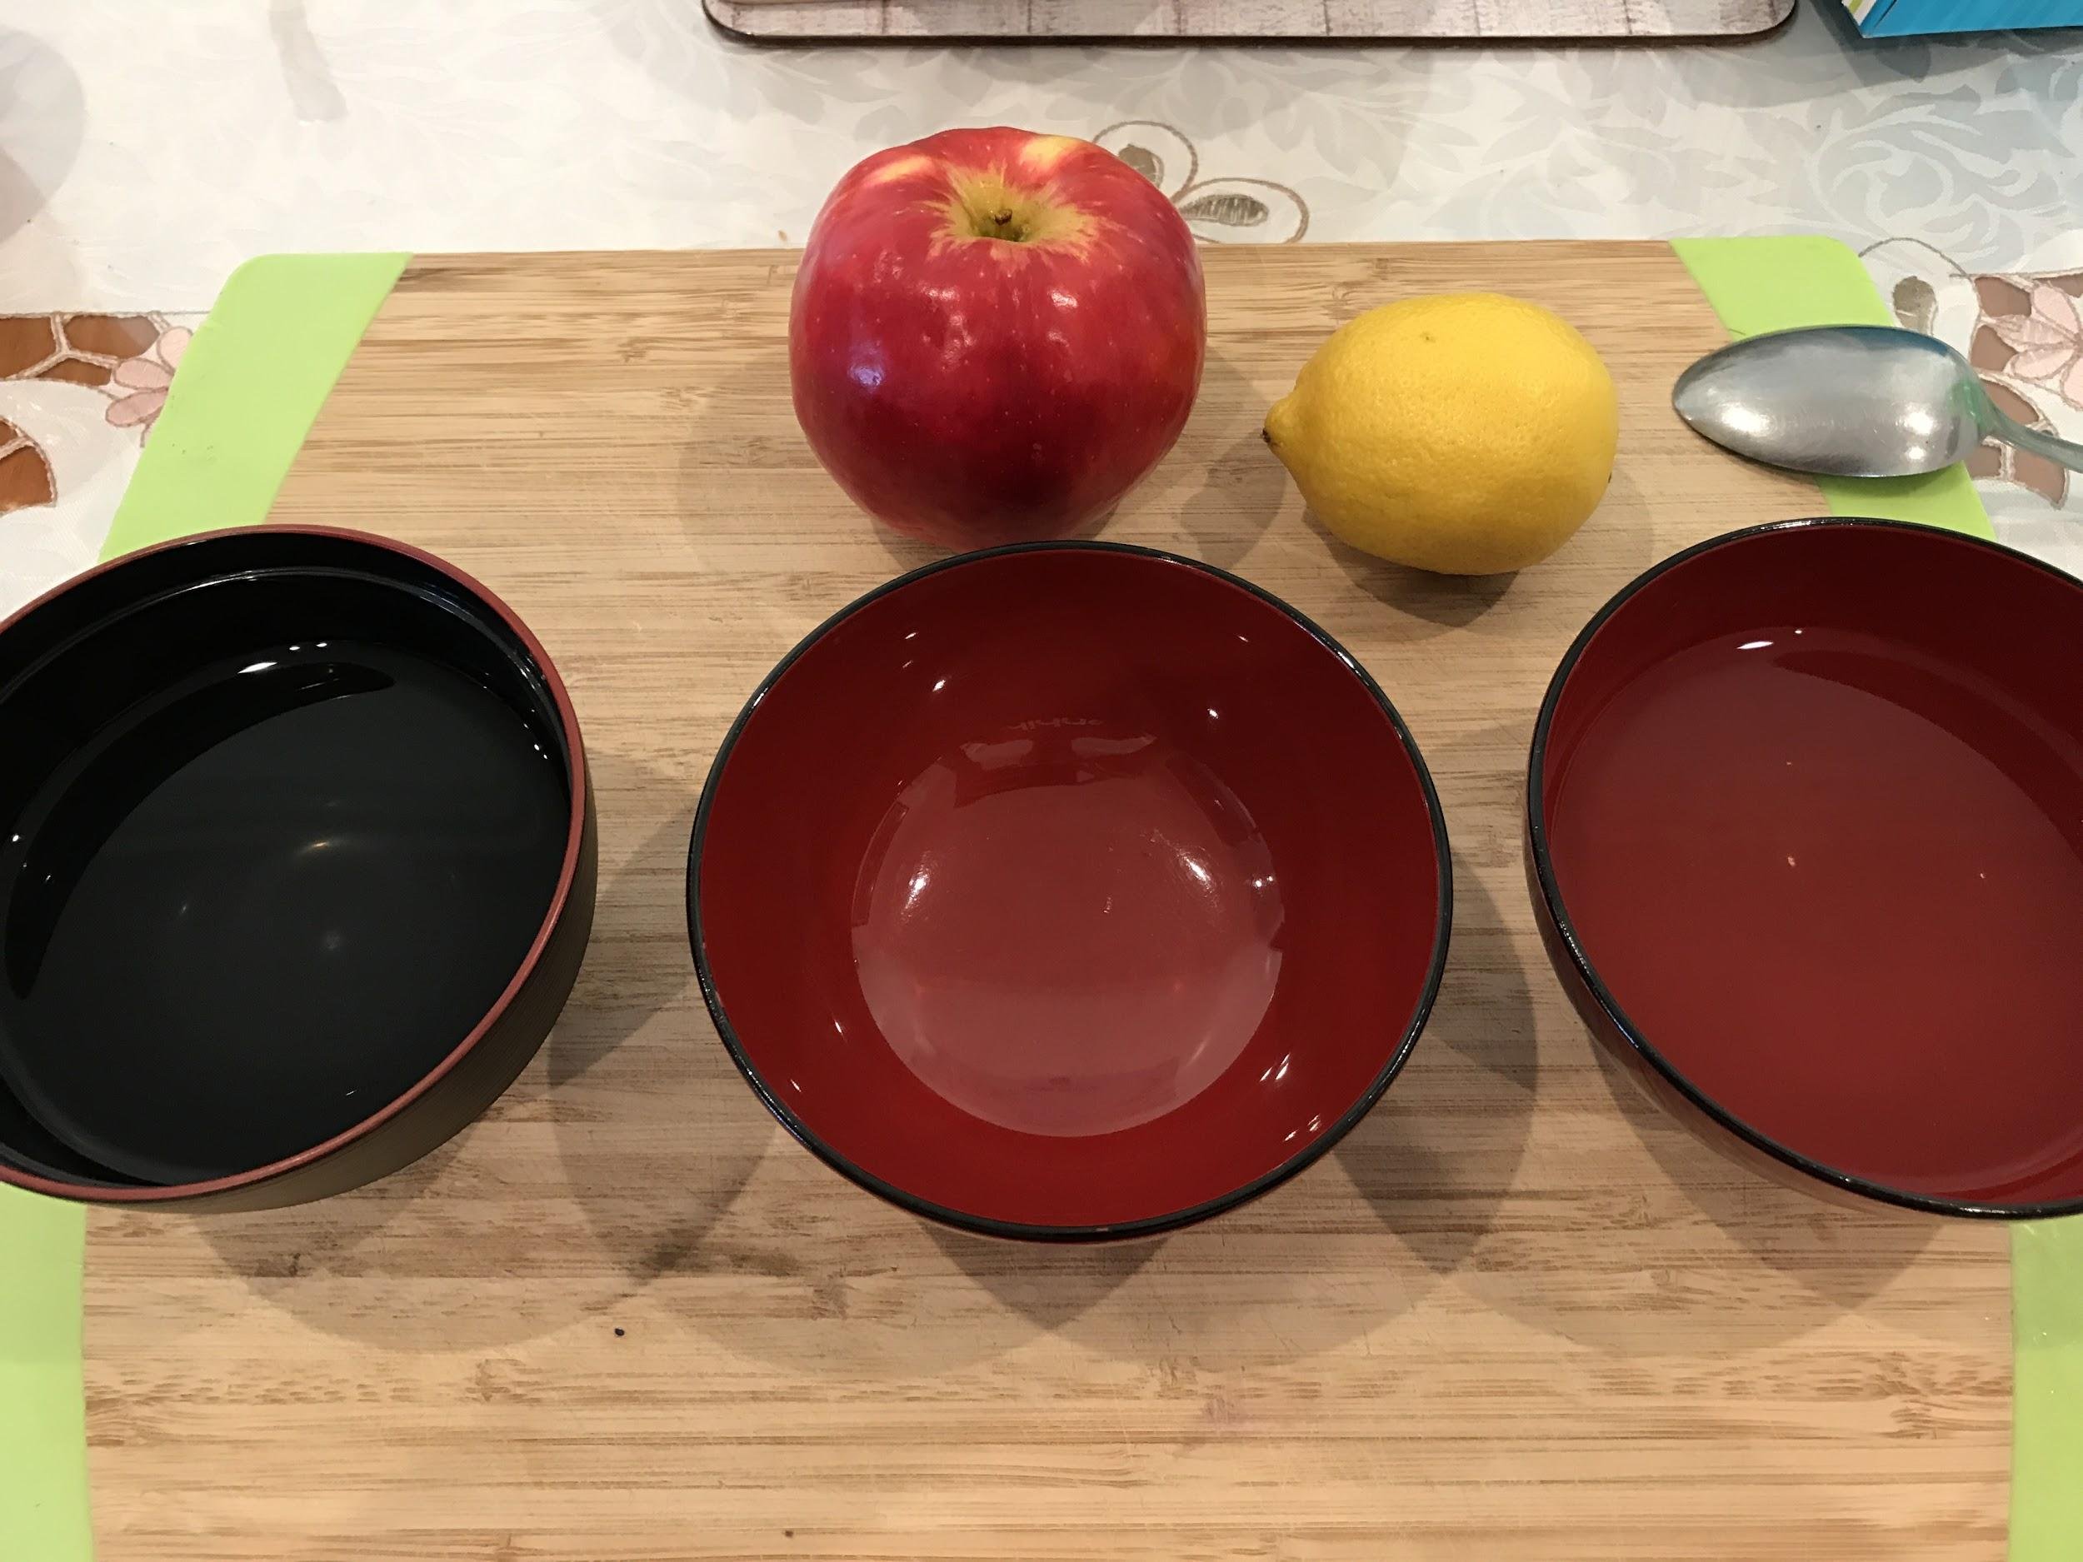
Step 1
Salt
Lemon
Honey
15

Slide 16
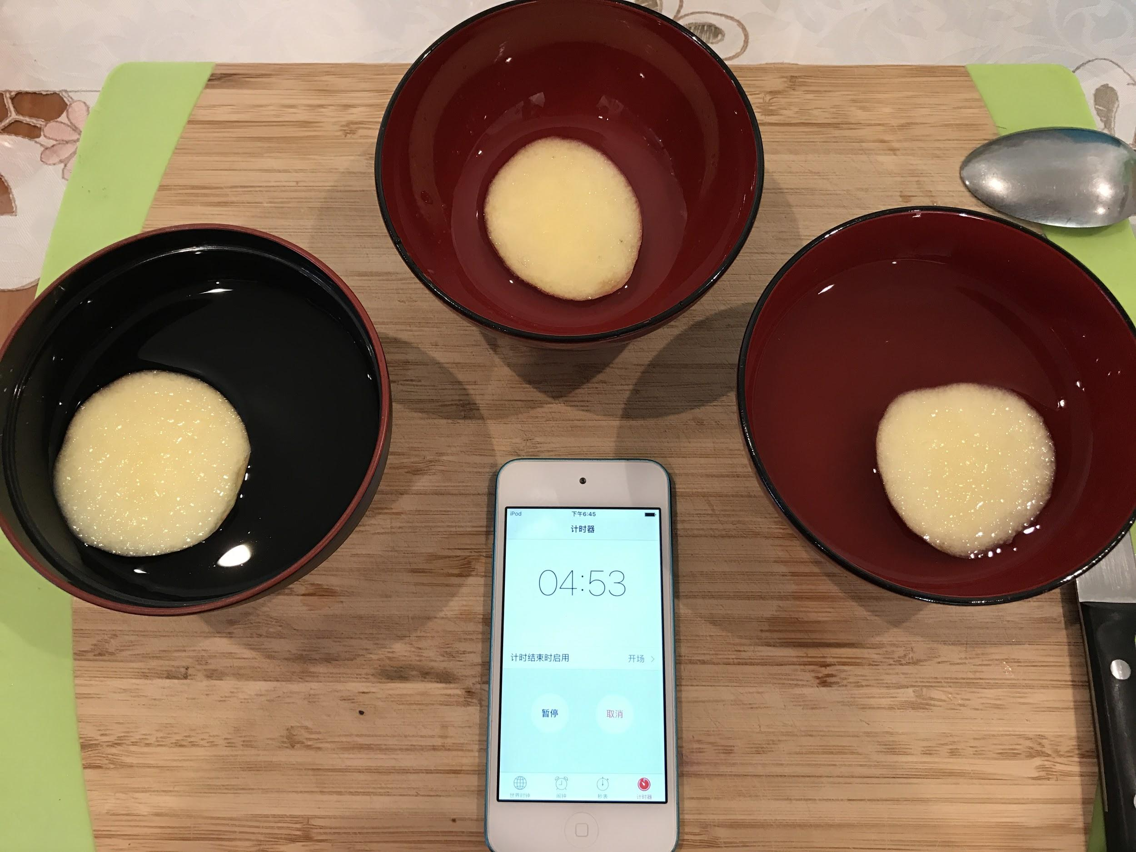
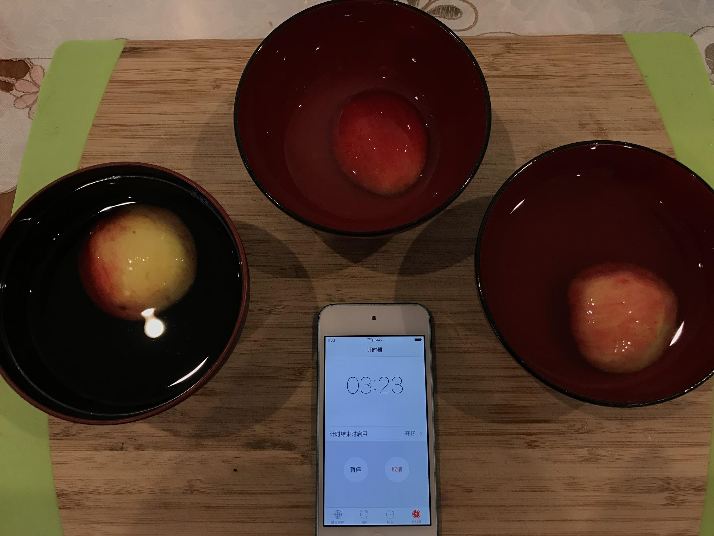
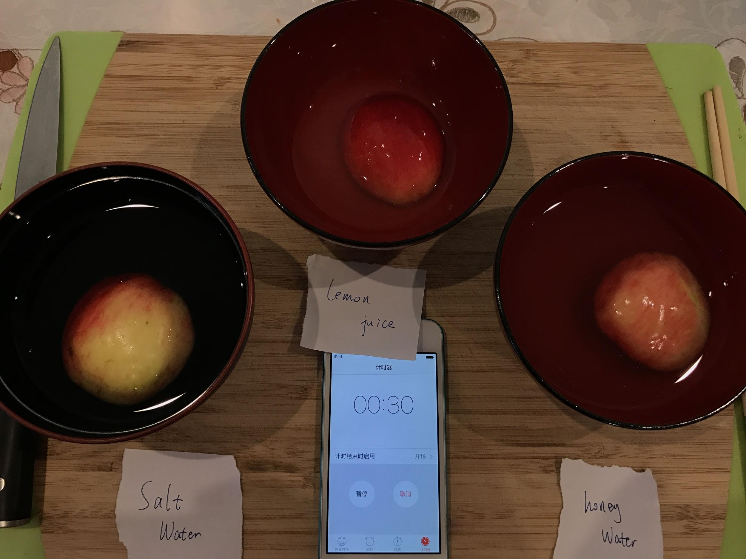
Step 2
-----------------------------------------------
5th IYNT 2017
Wellington High School
16
Notes:
Soaked for 5 minutues

Slide 17
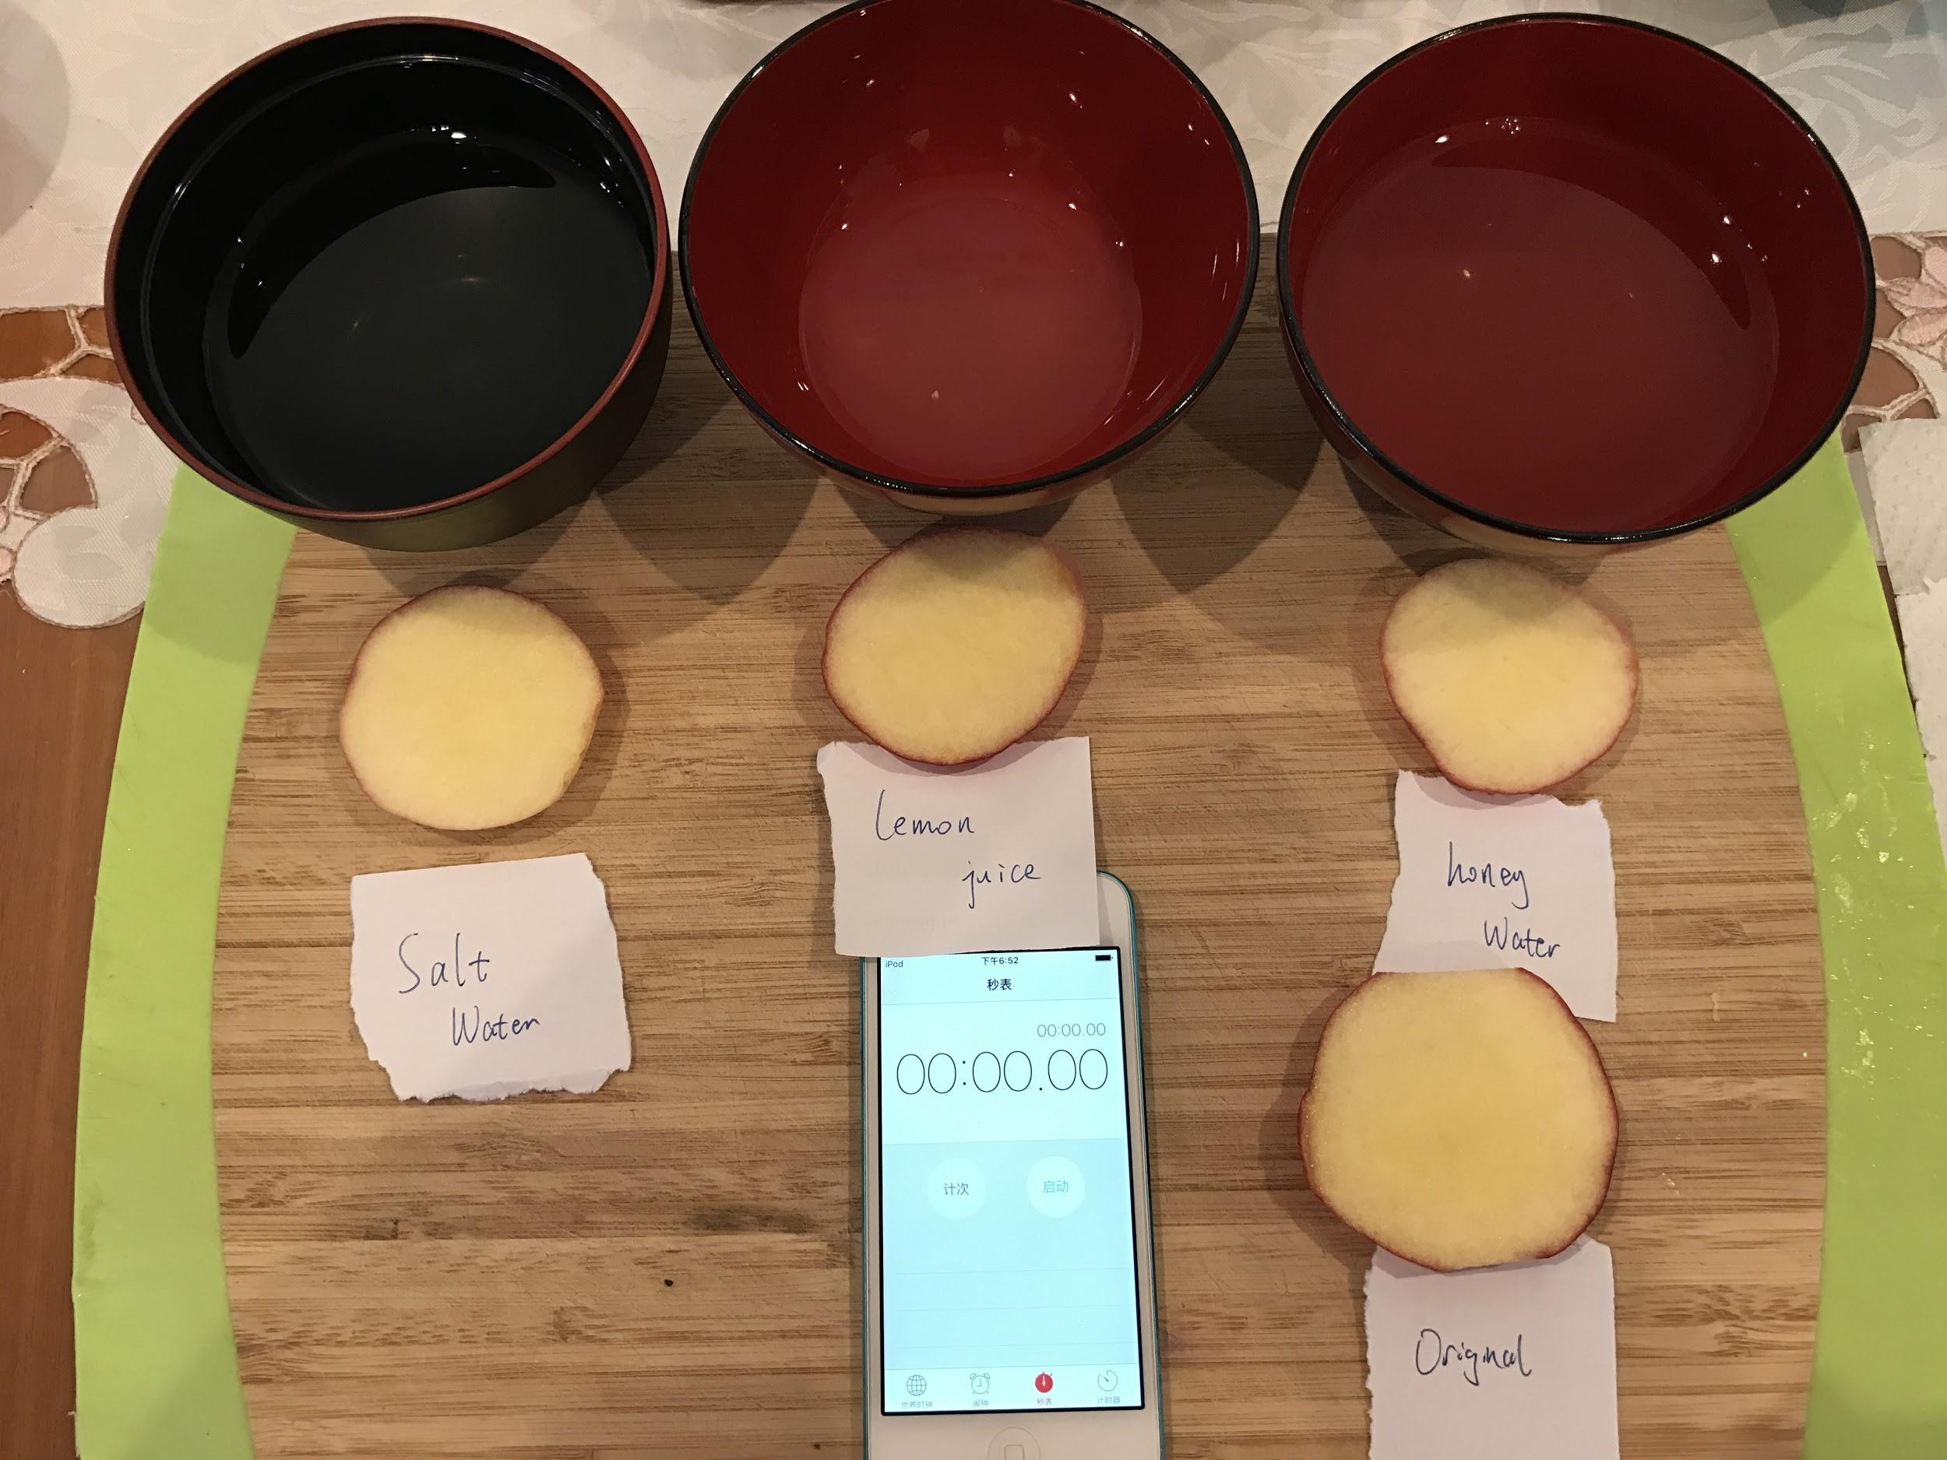
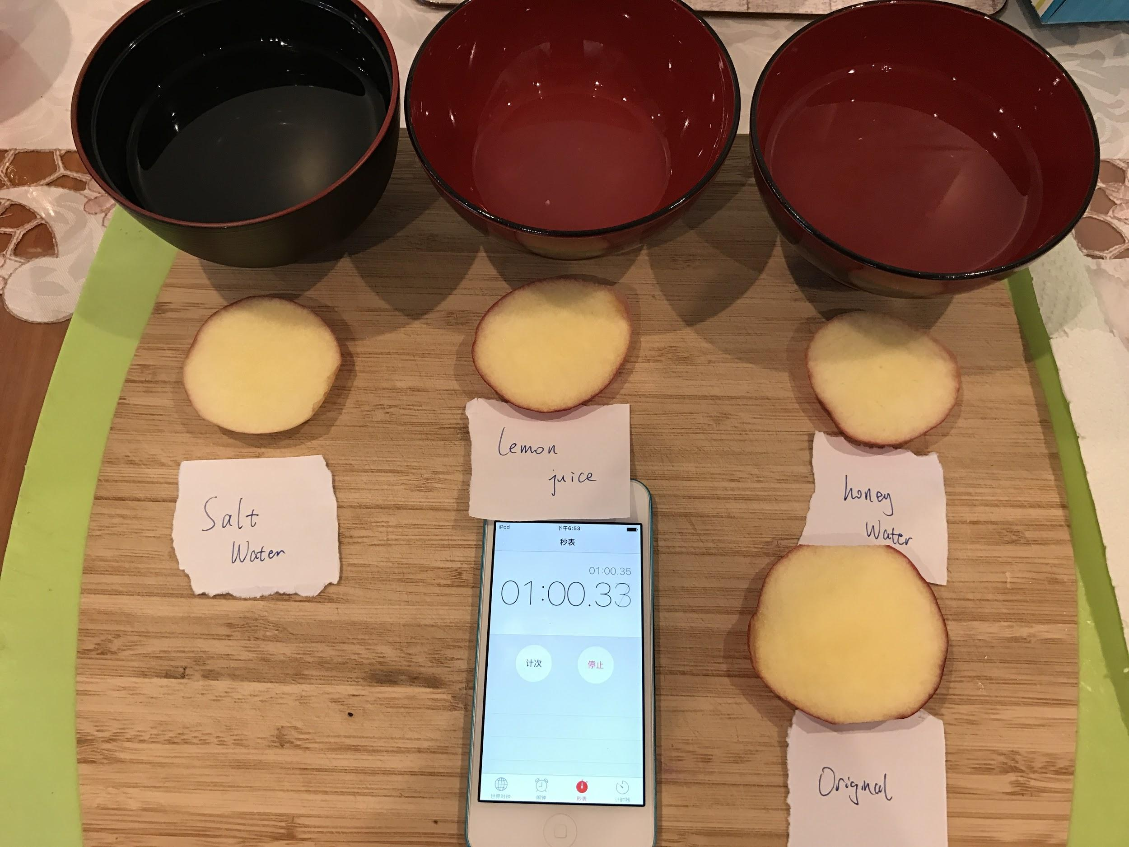
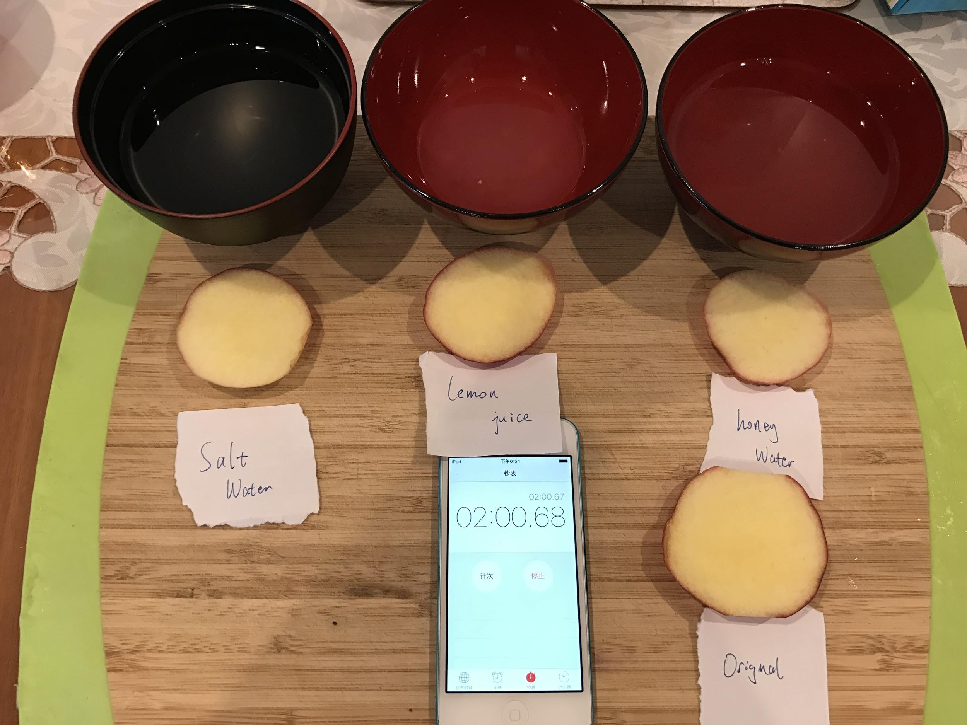
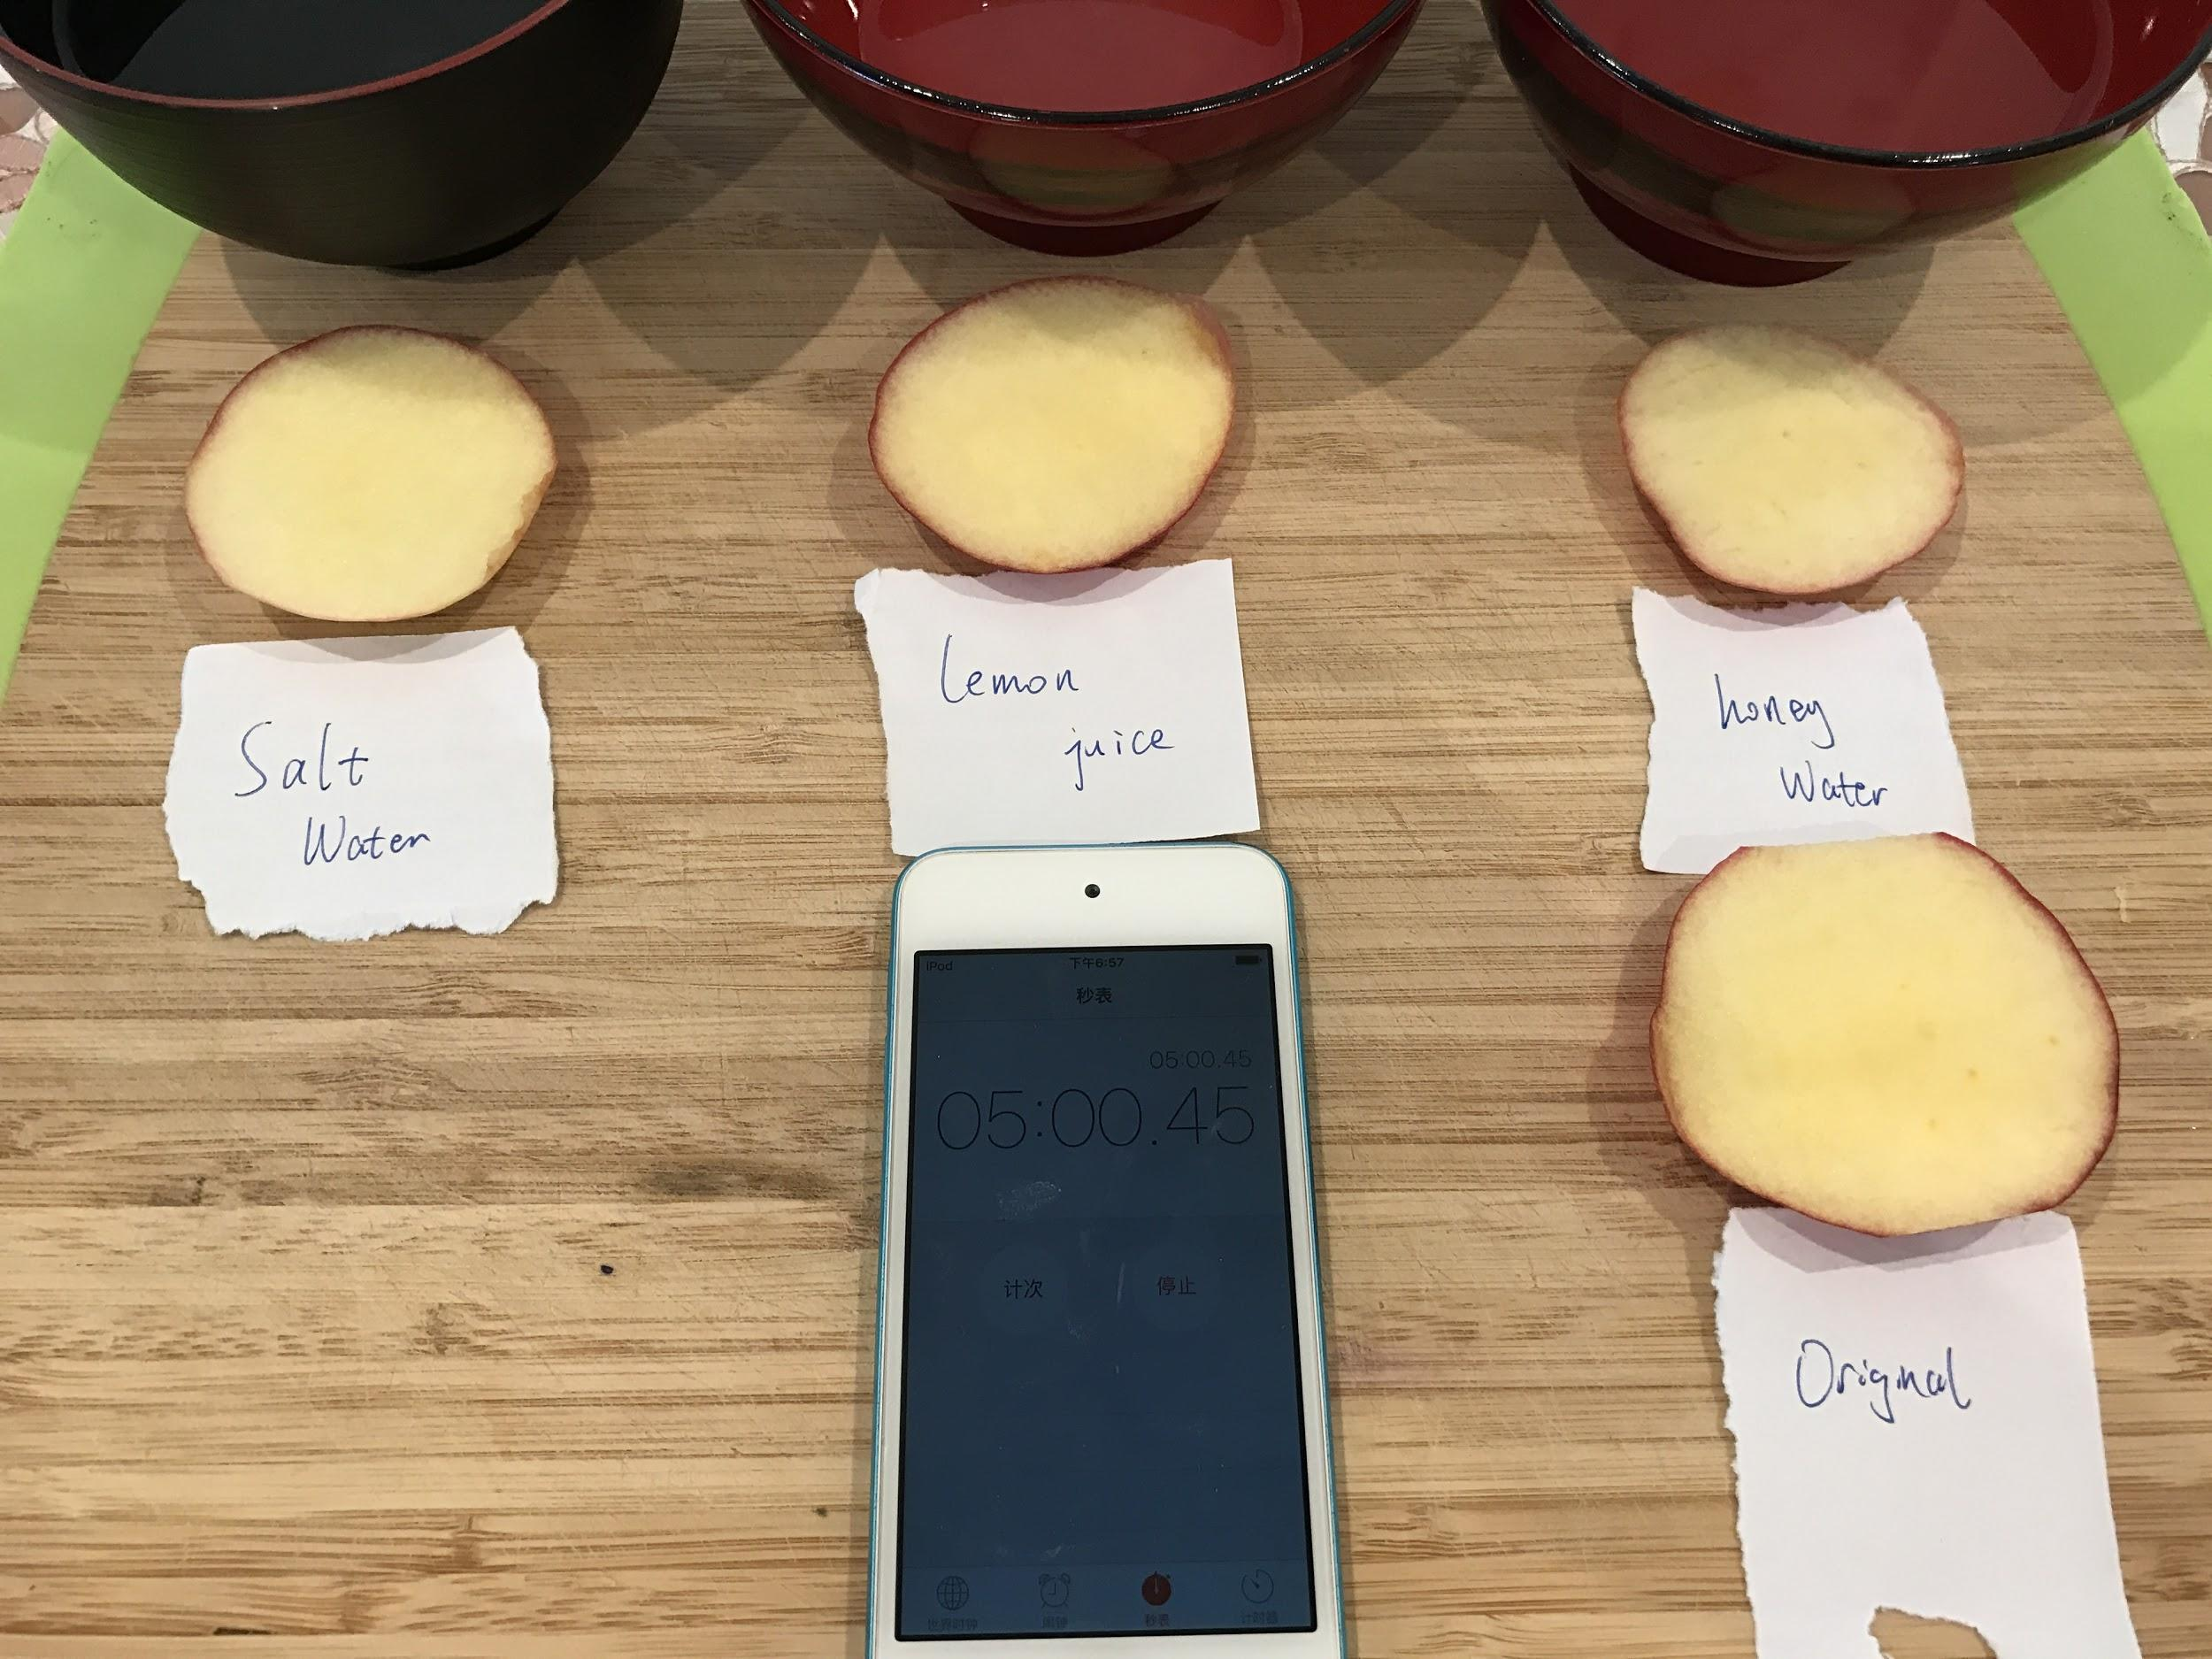
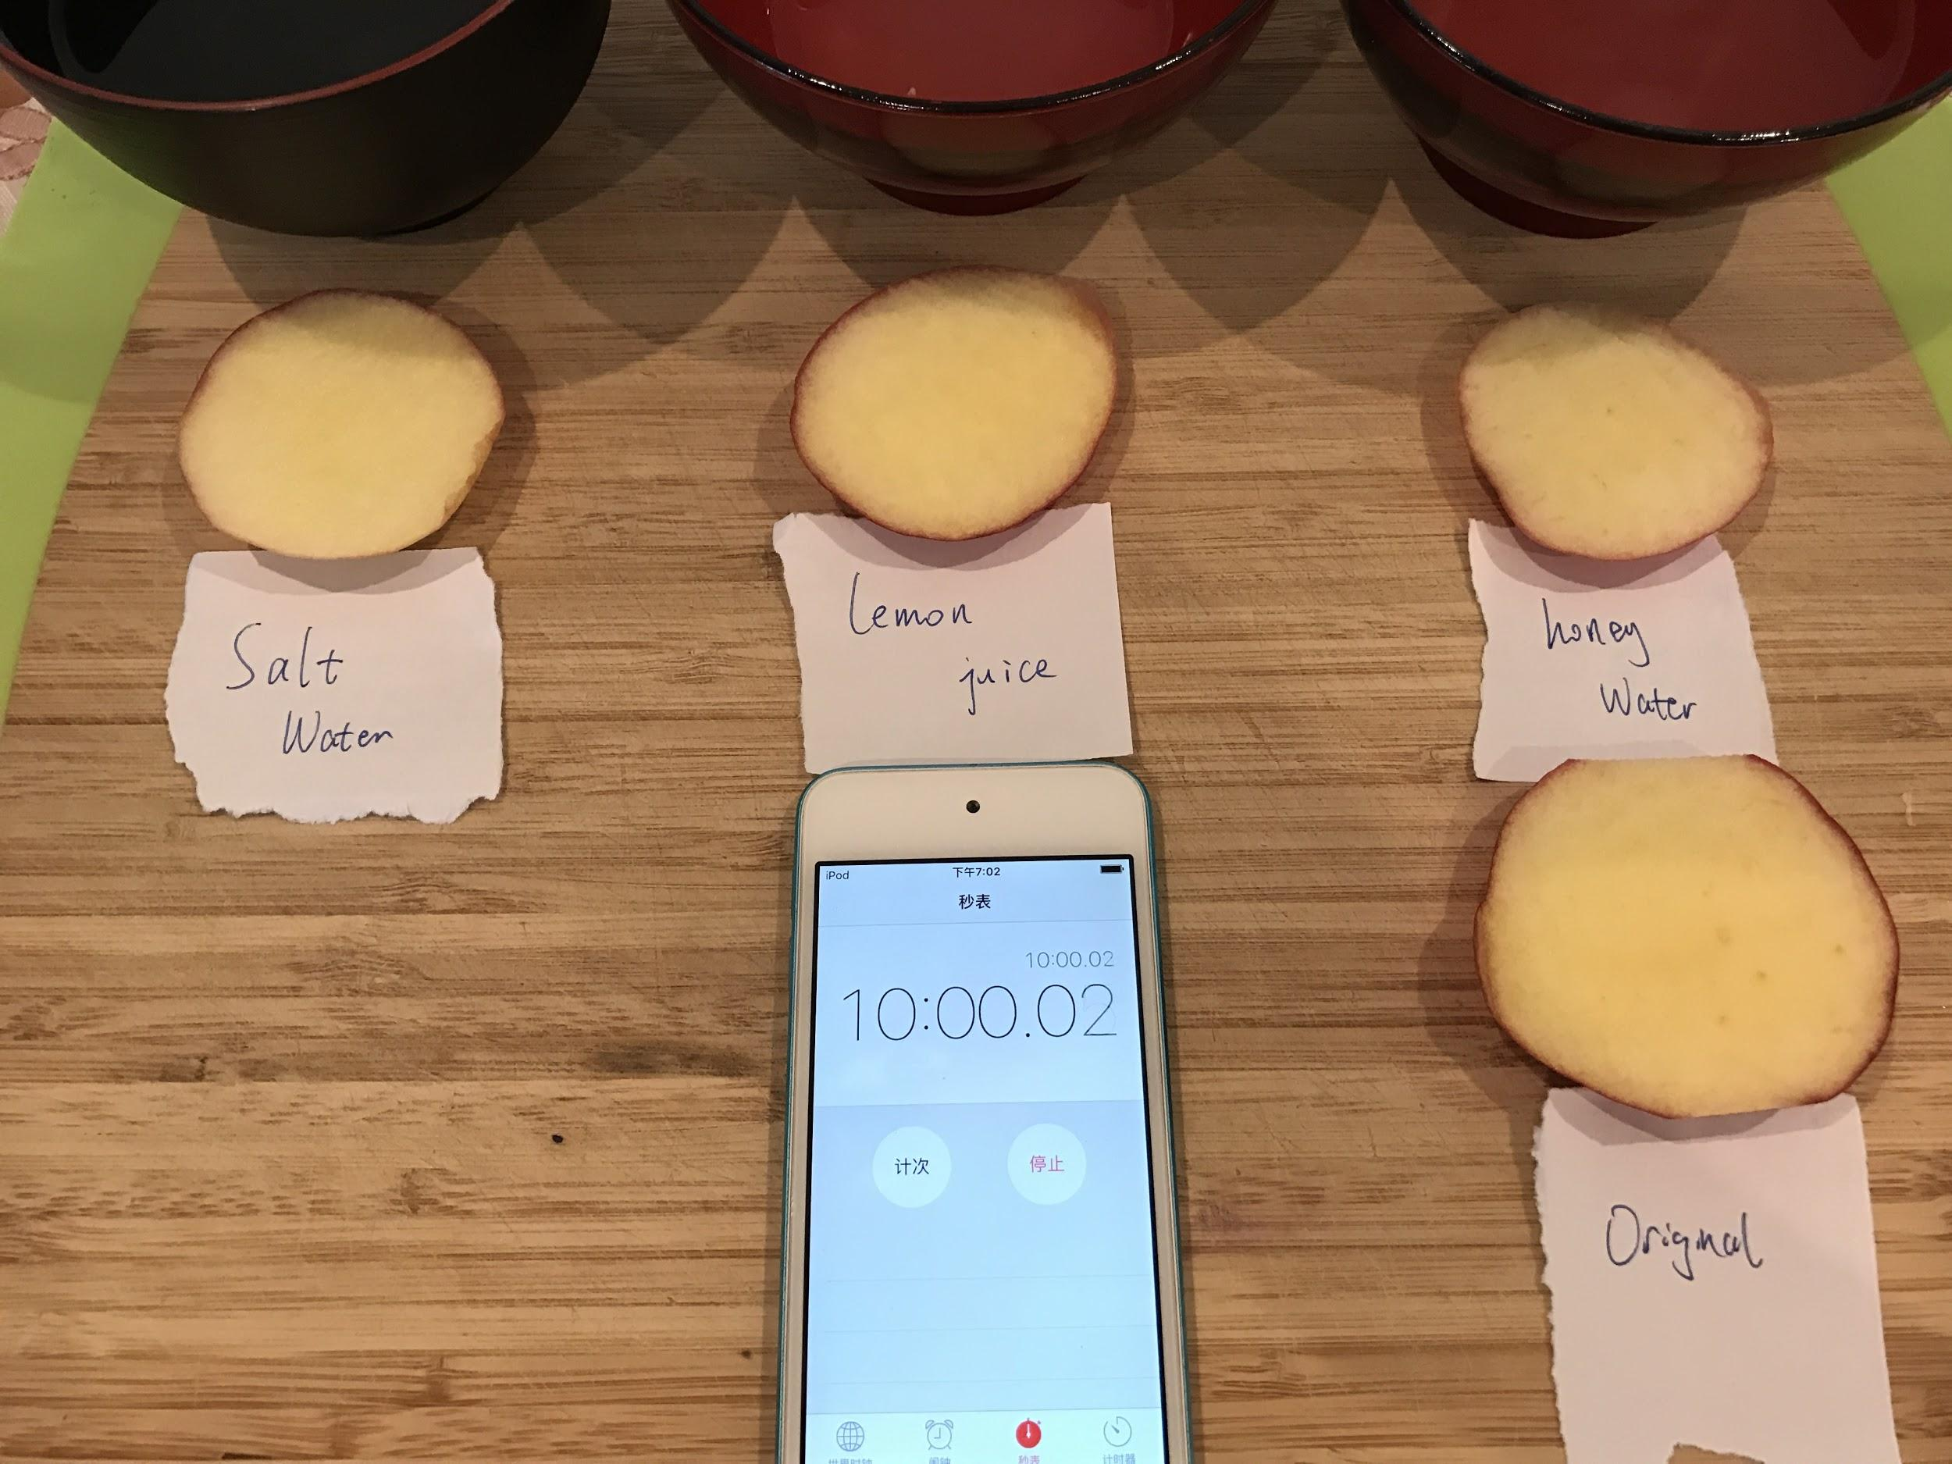
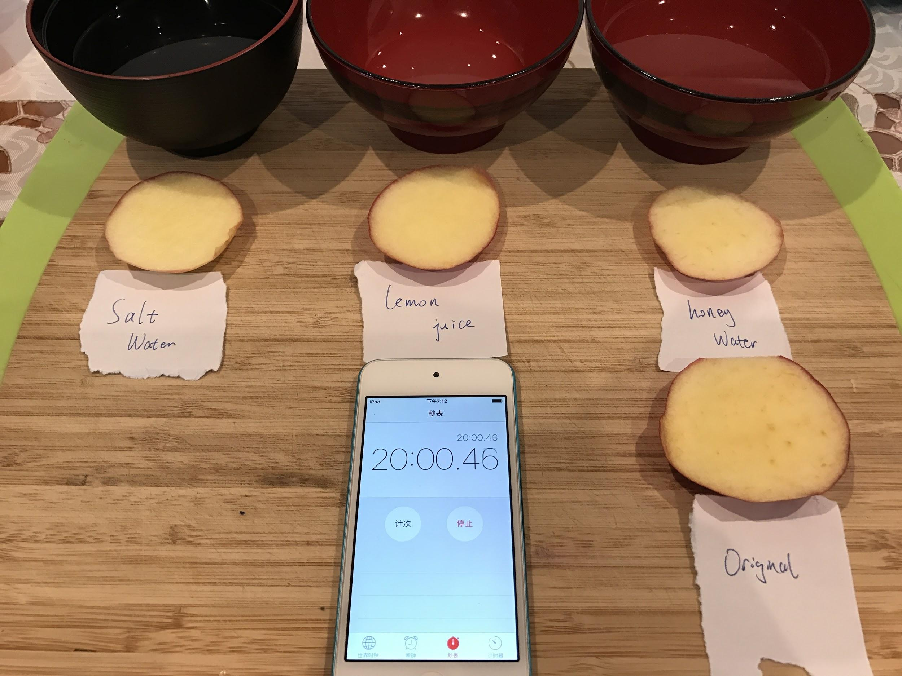
Step 3
17

Slide 18
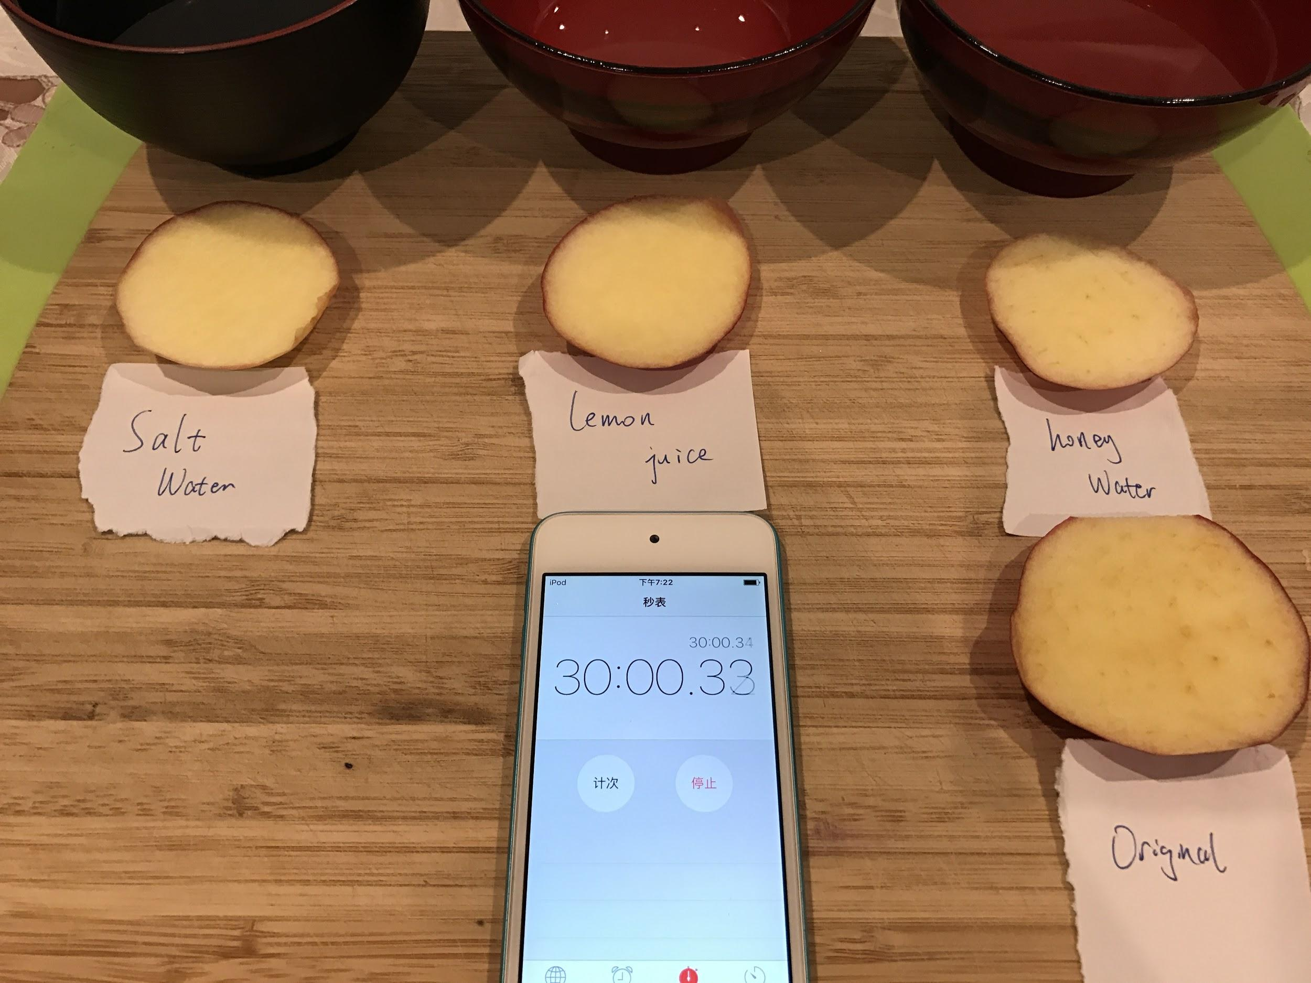
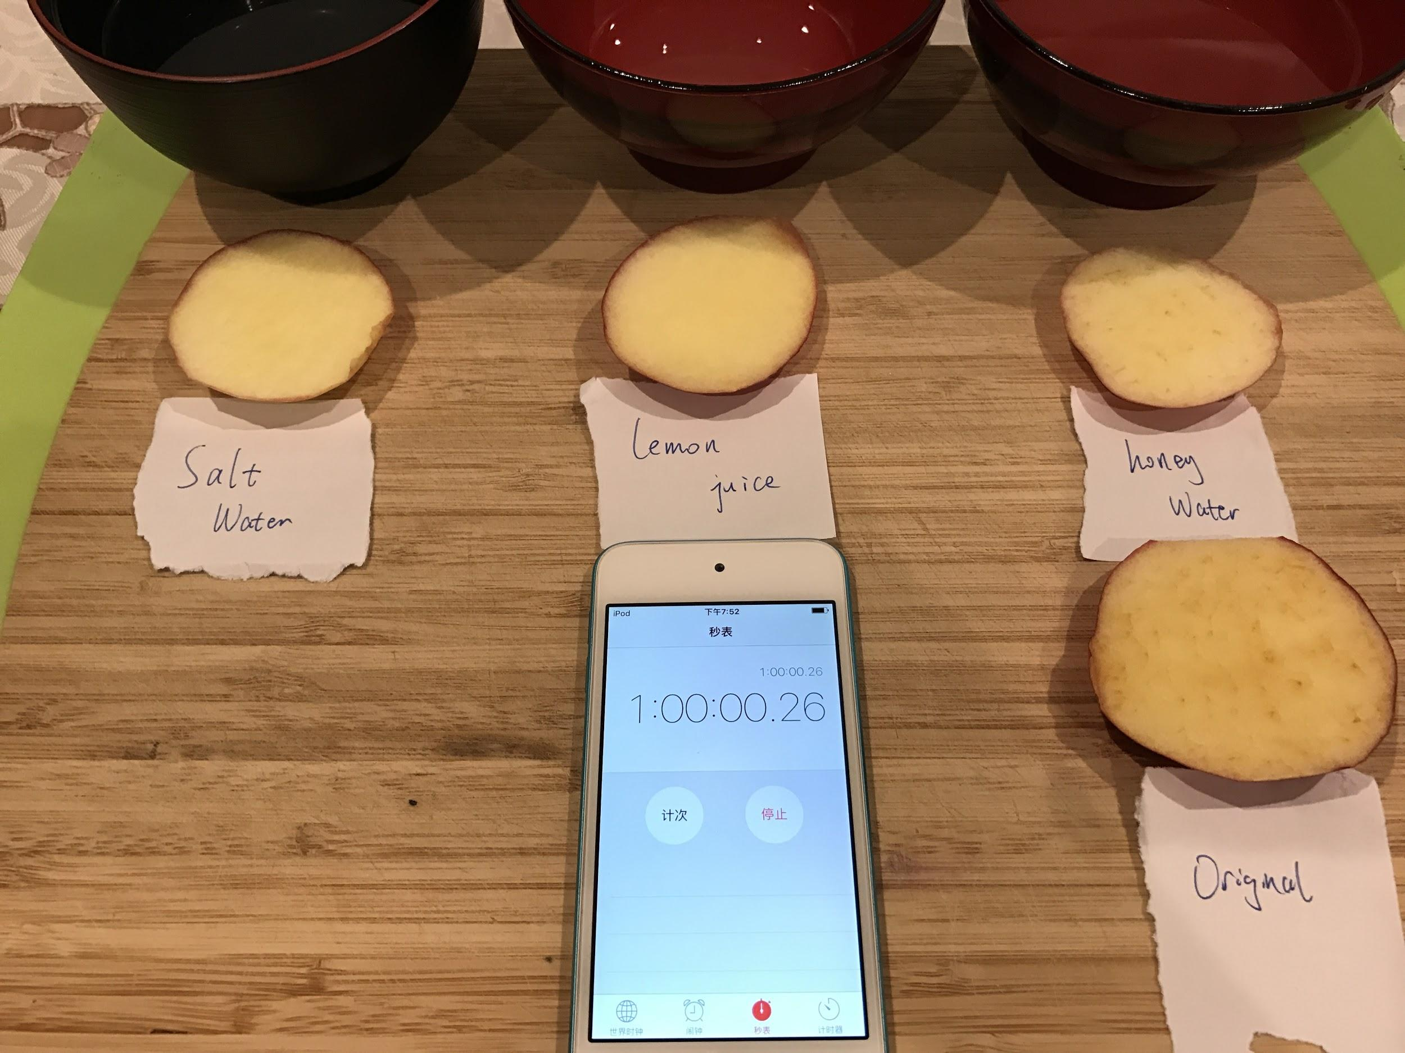
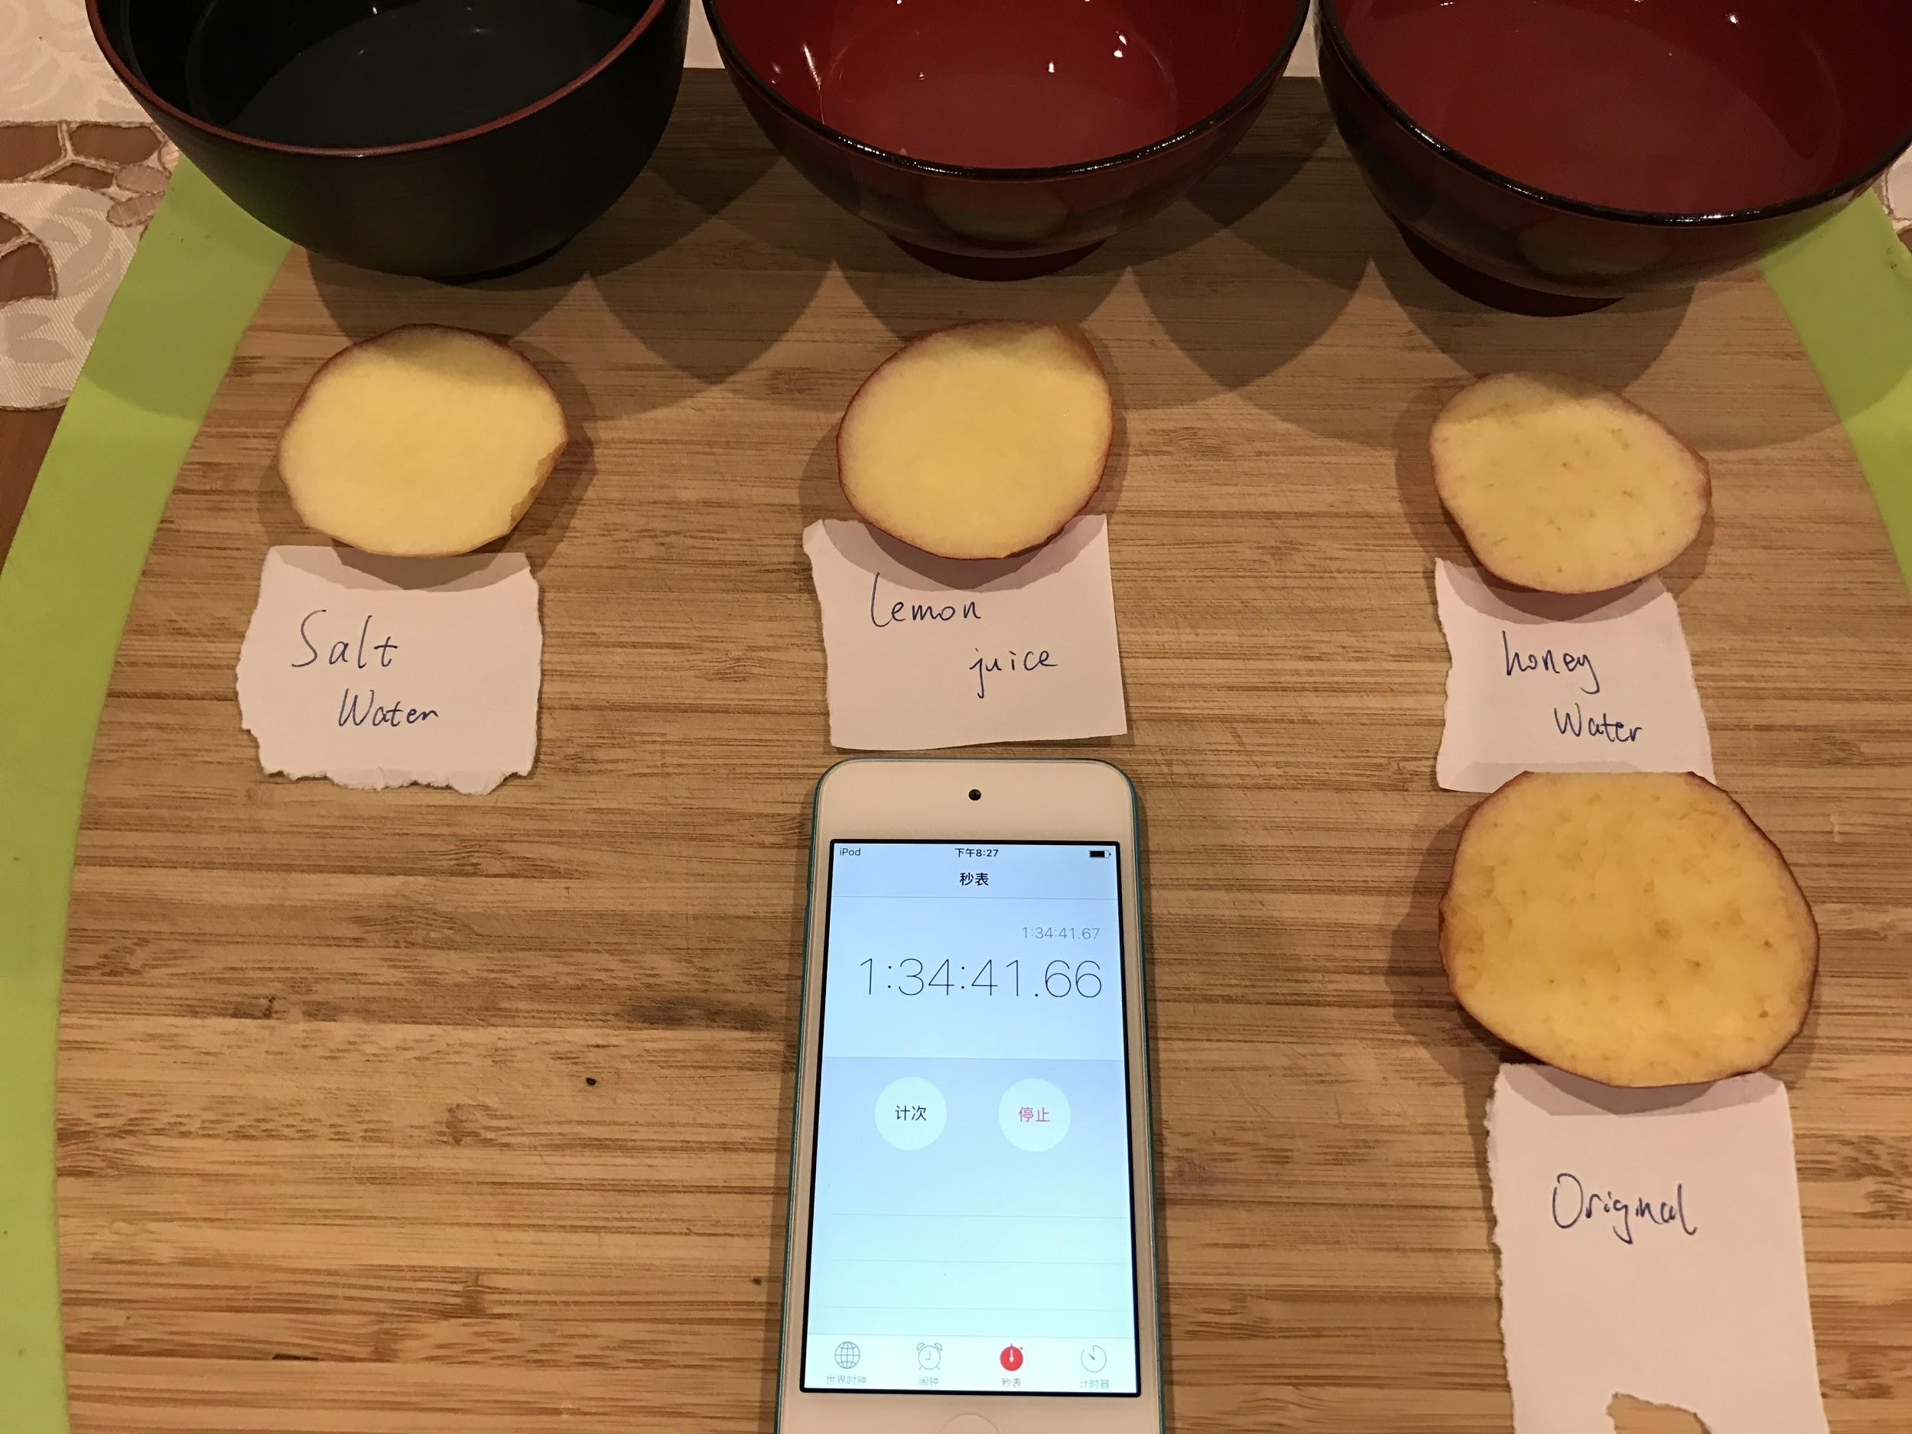
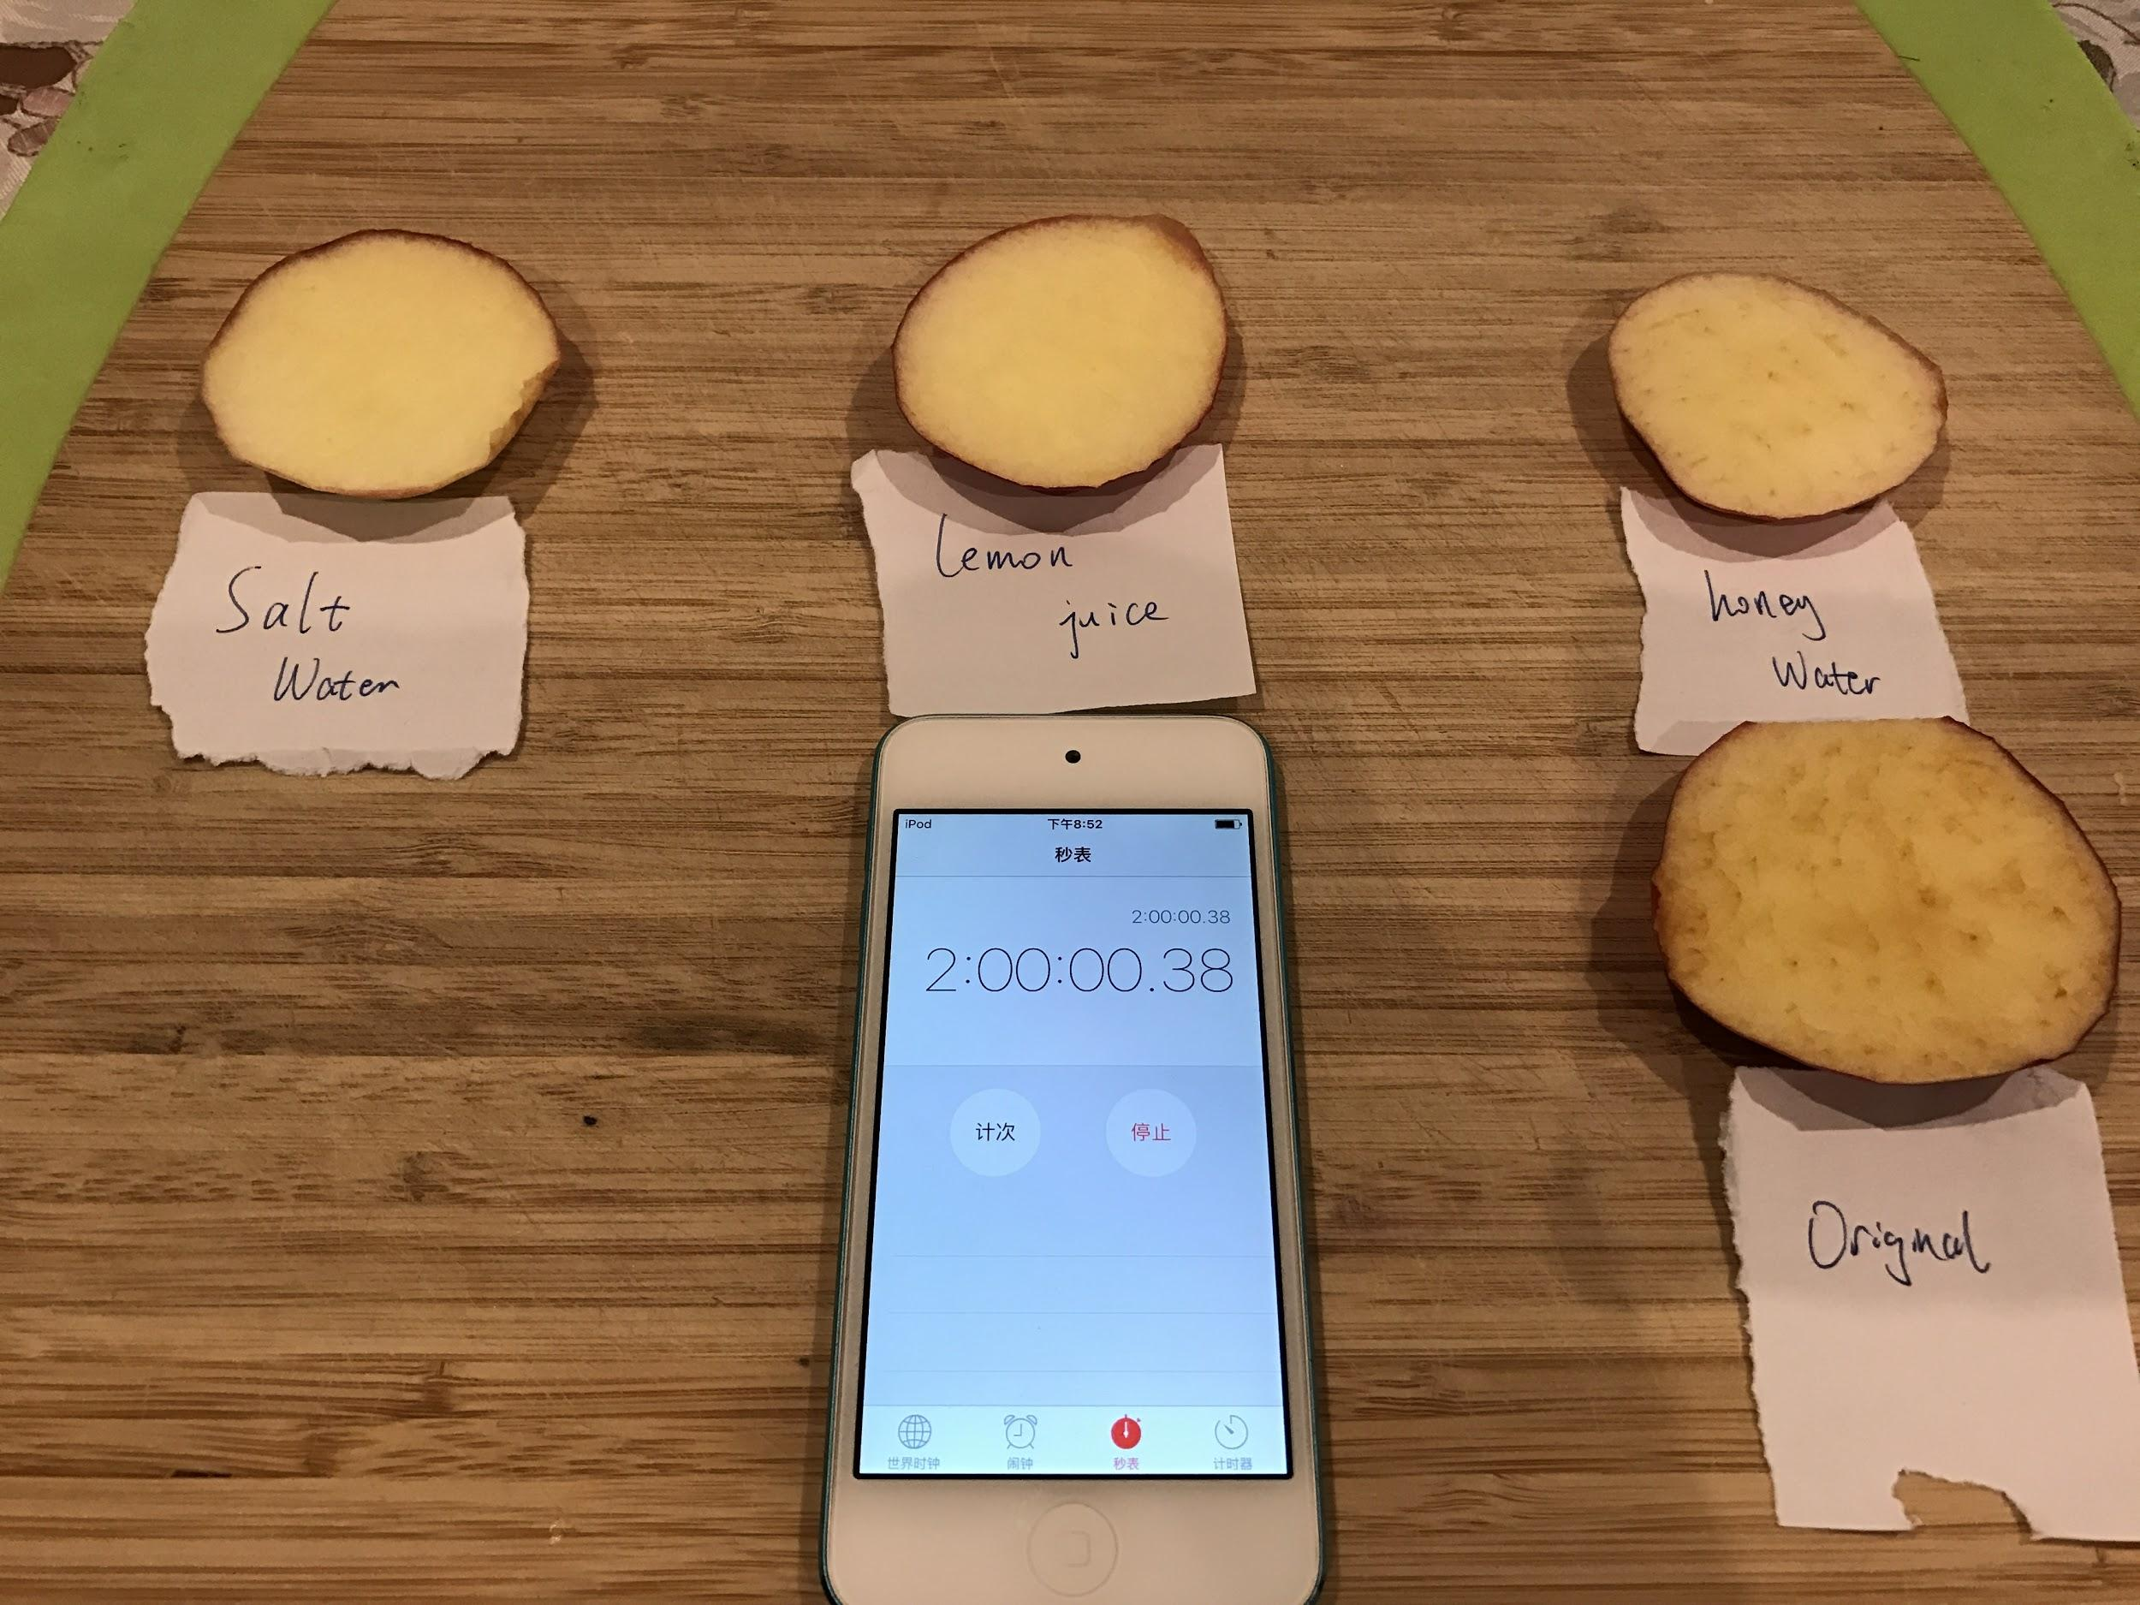
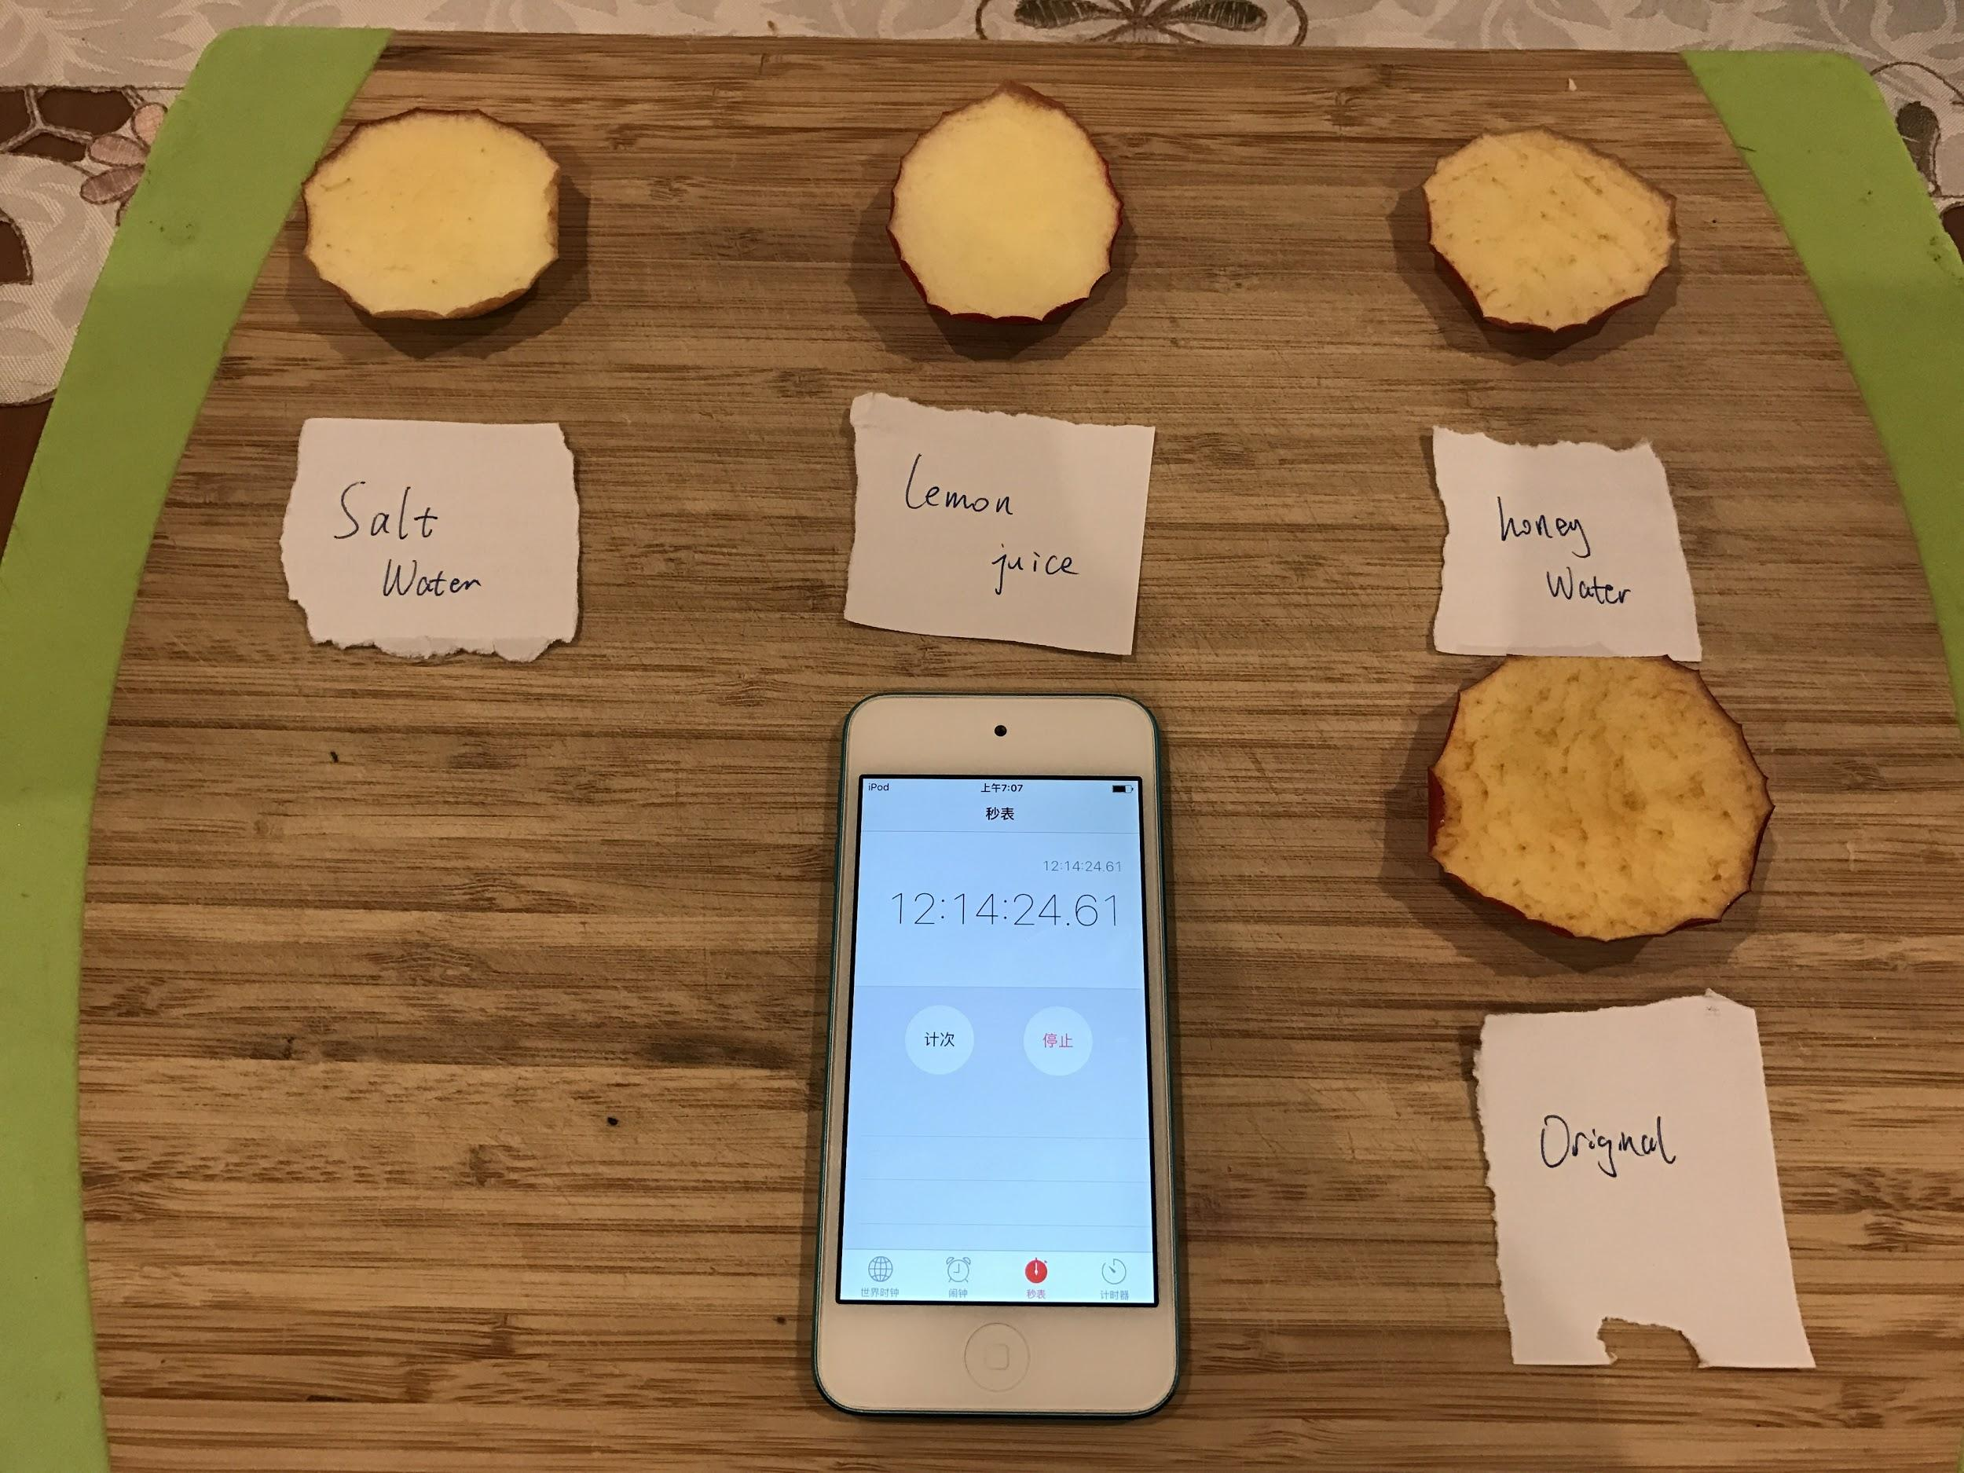
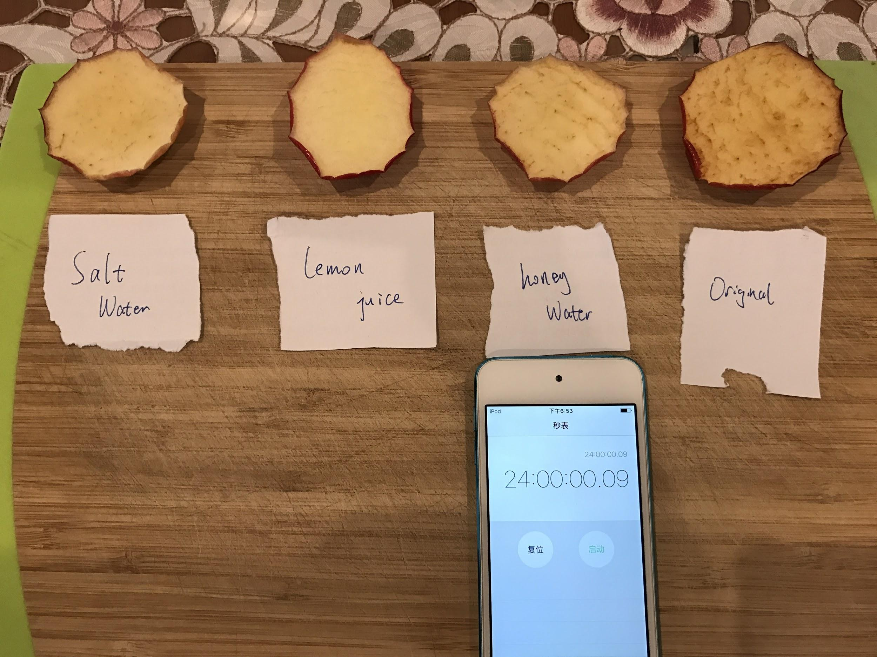
18

Slide 19
19
Notes:
This is the results of the test two. We can get an idea that the lemon juice has the best performance as an antioxidant.

Slide 20
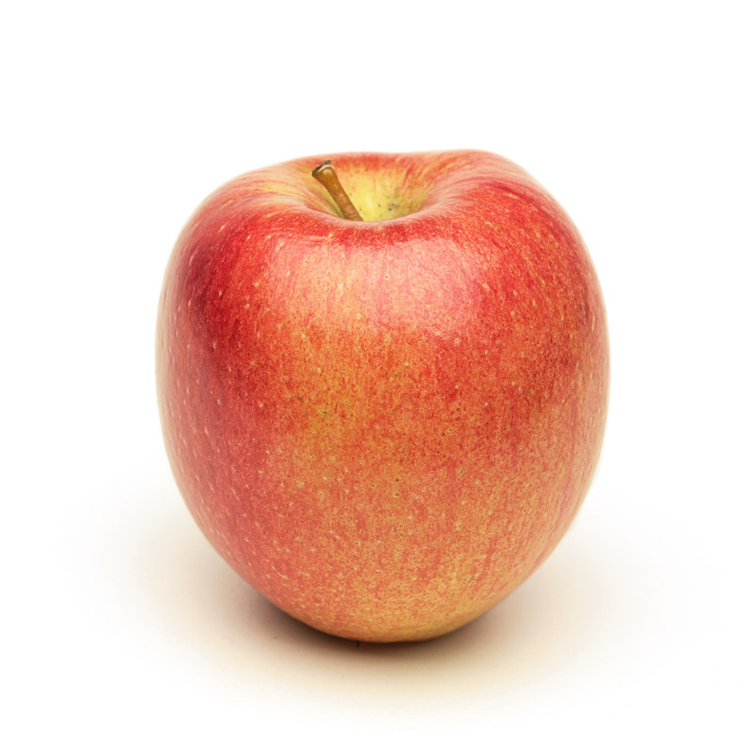
Professional Method
Braeburn Apples
20
Notes:
The previous experiments I was talking about the household methods to investigate the browning. Now I’m going to show you the Industry Standard Treatment which came up by Dr. Allan Woolf. I contacted with Dr. Allan who works for The New Zealand Institute. He showed me his research on the apples. In his experiment, he used Braeburn Apples which have a high level of ascorbic acid (Vitamin C). I used the same type of apple and investigate his experiment.

Slide 21
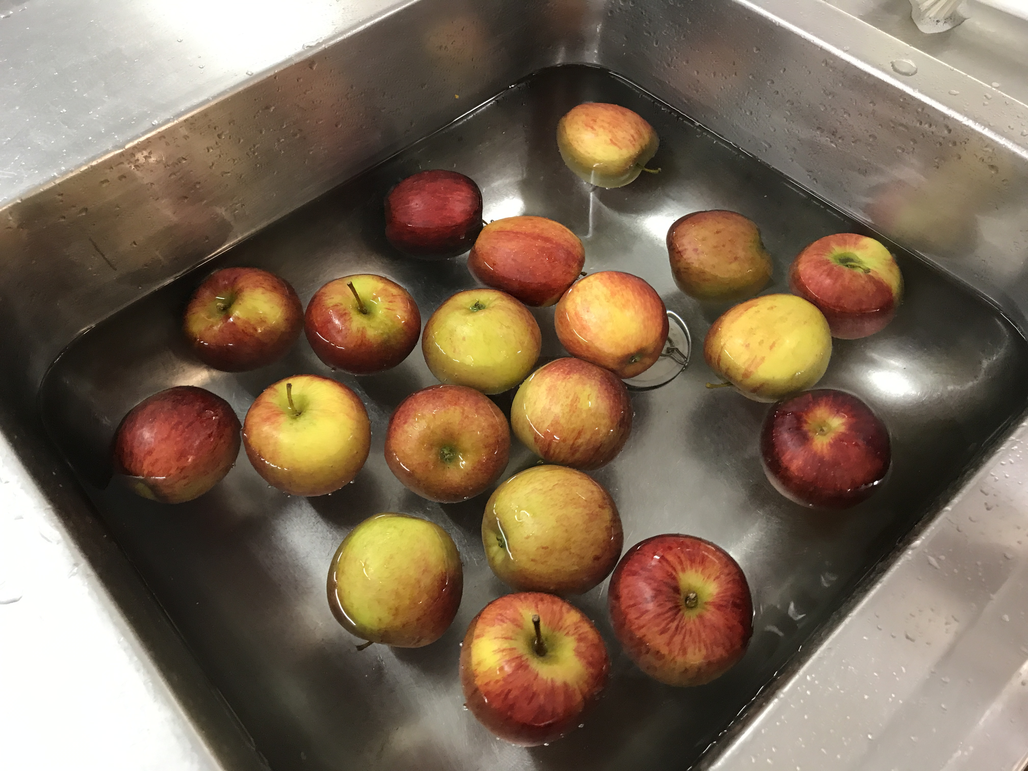
Step 1
21
Notes:
First I put the apples into the cold water.

Slide 22
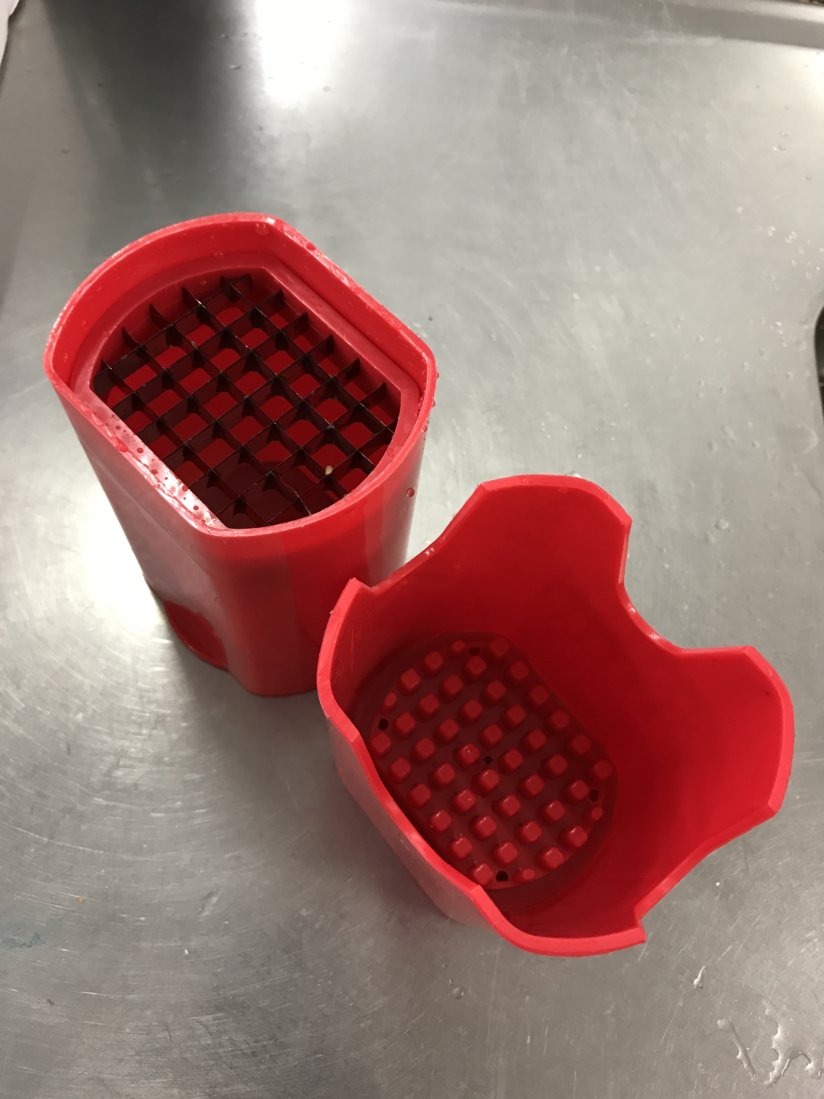
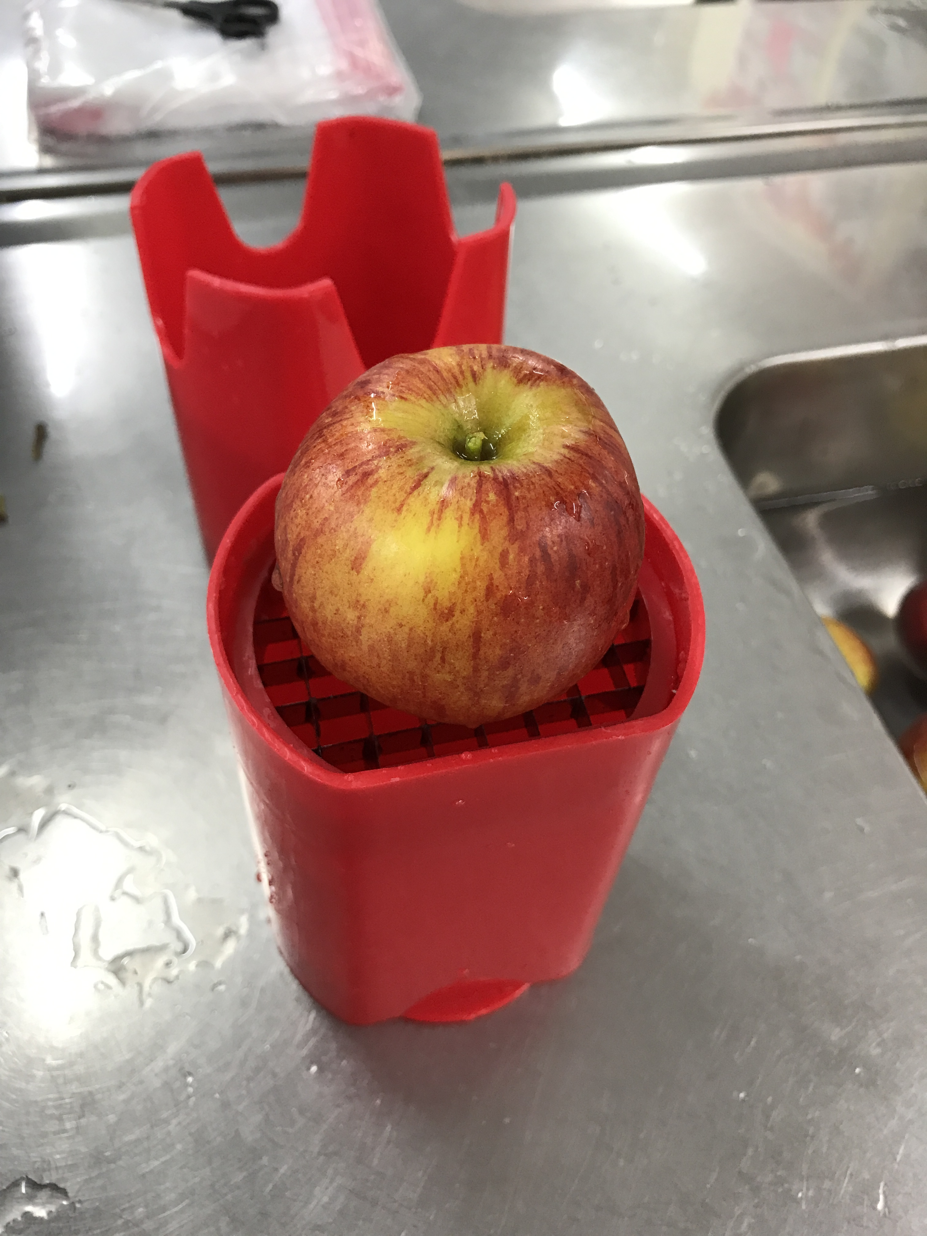
Step 2
22
Notes:
And then I used the Apple Cutter to cut the whole apples into the apple slices.

Slide 23
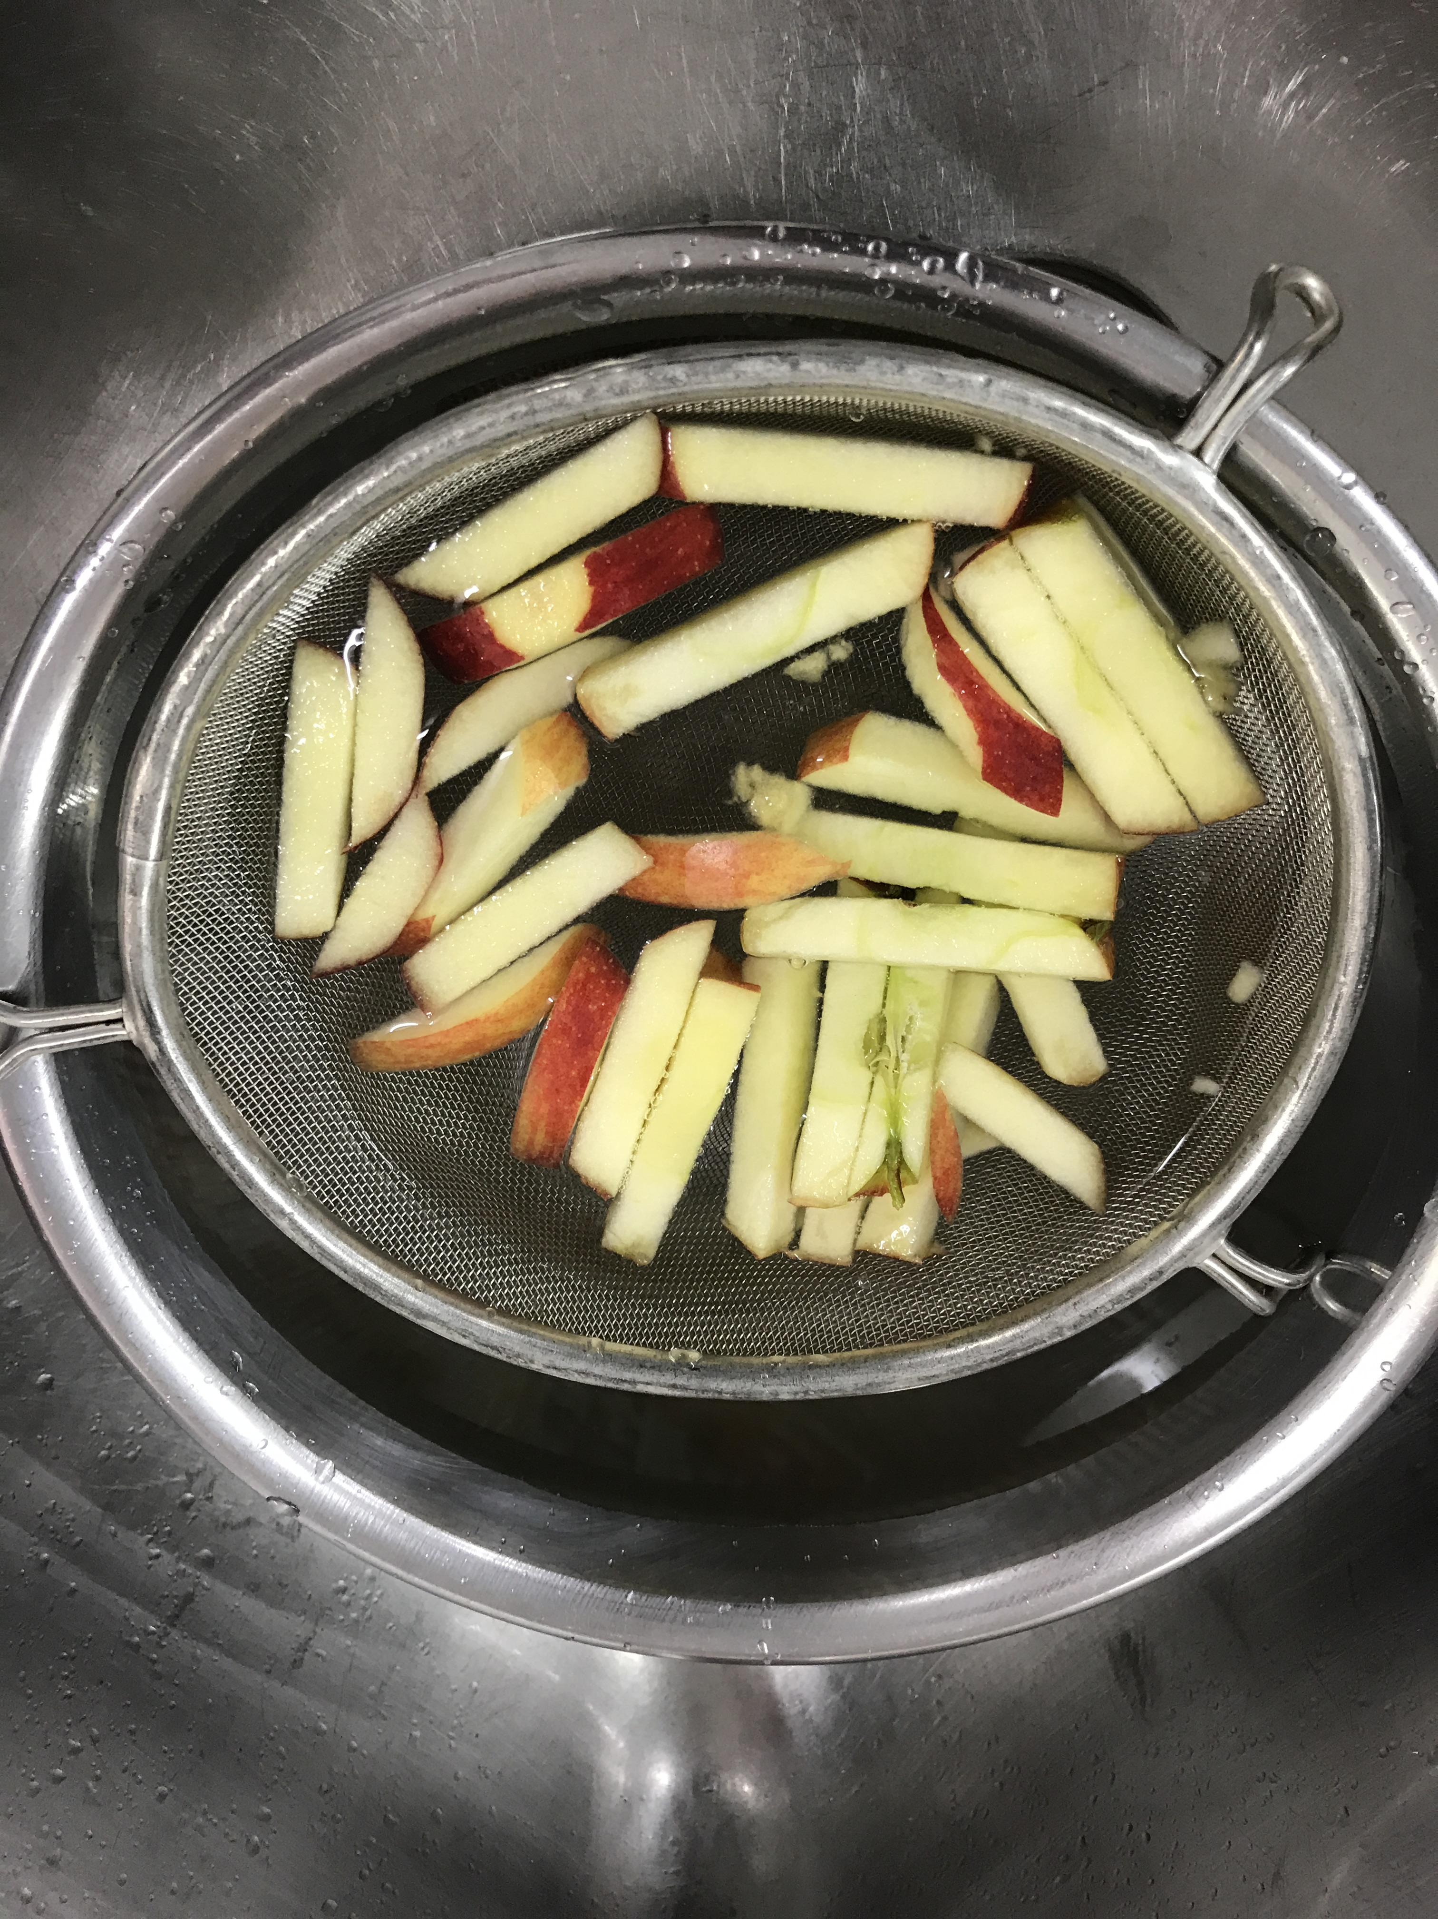
Step 3
23
Notes:
After that, I soaked the apple slices into the 1 part per million (ppm) Chlorine Solution for 4 minutes to kill microbes.

Slide 24
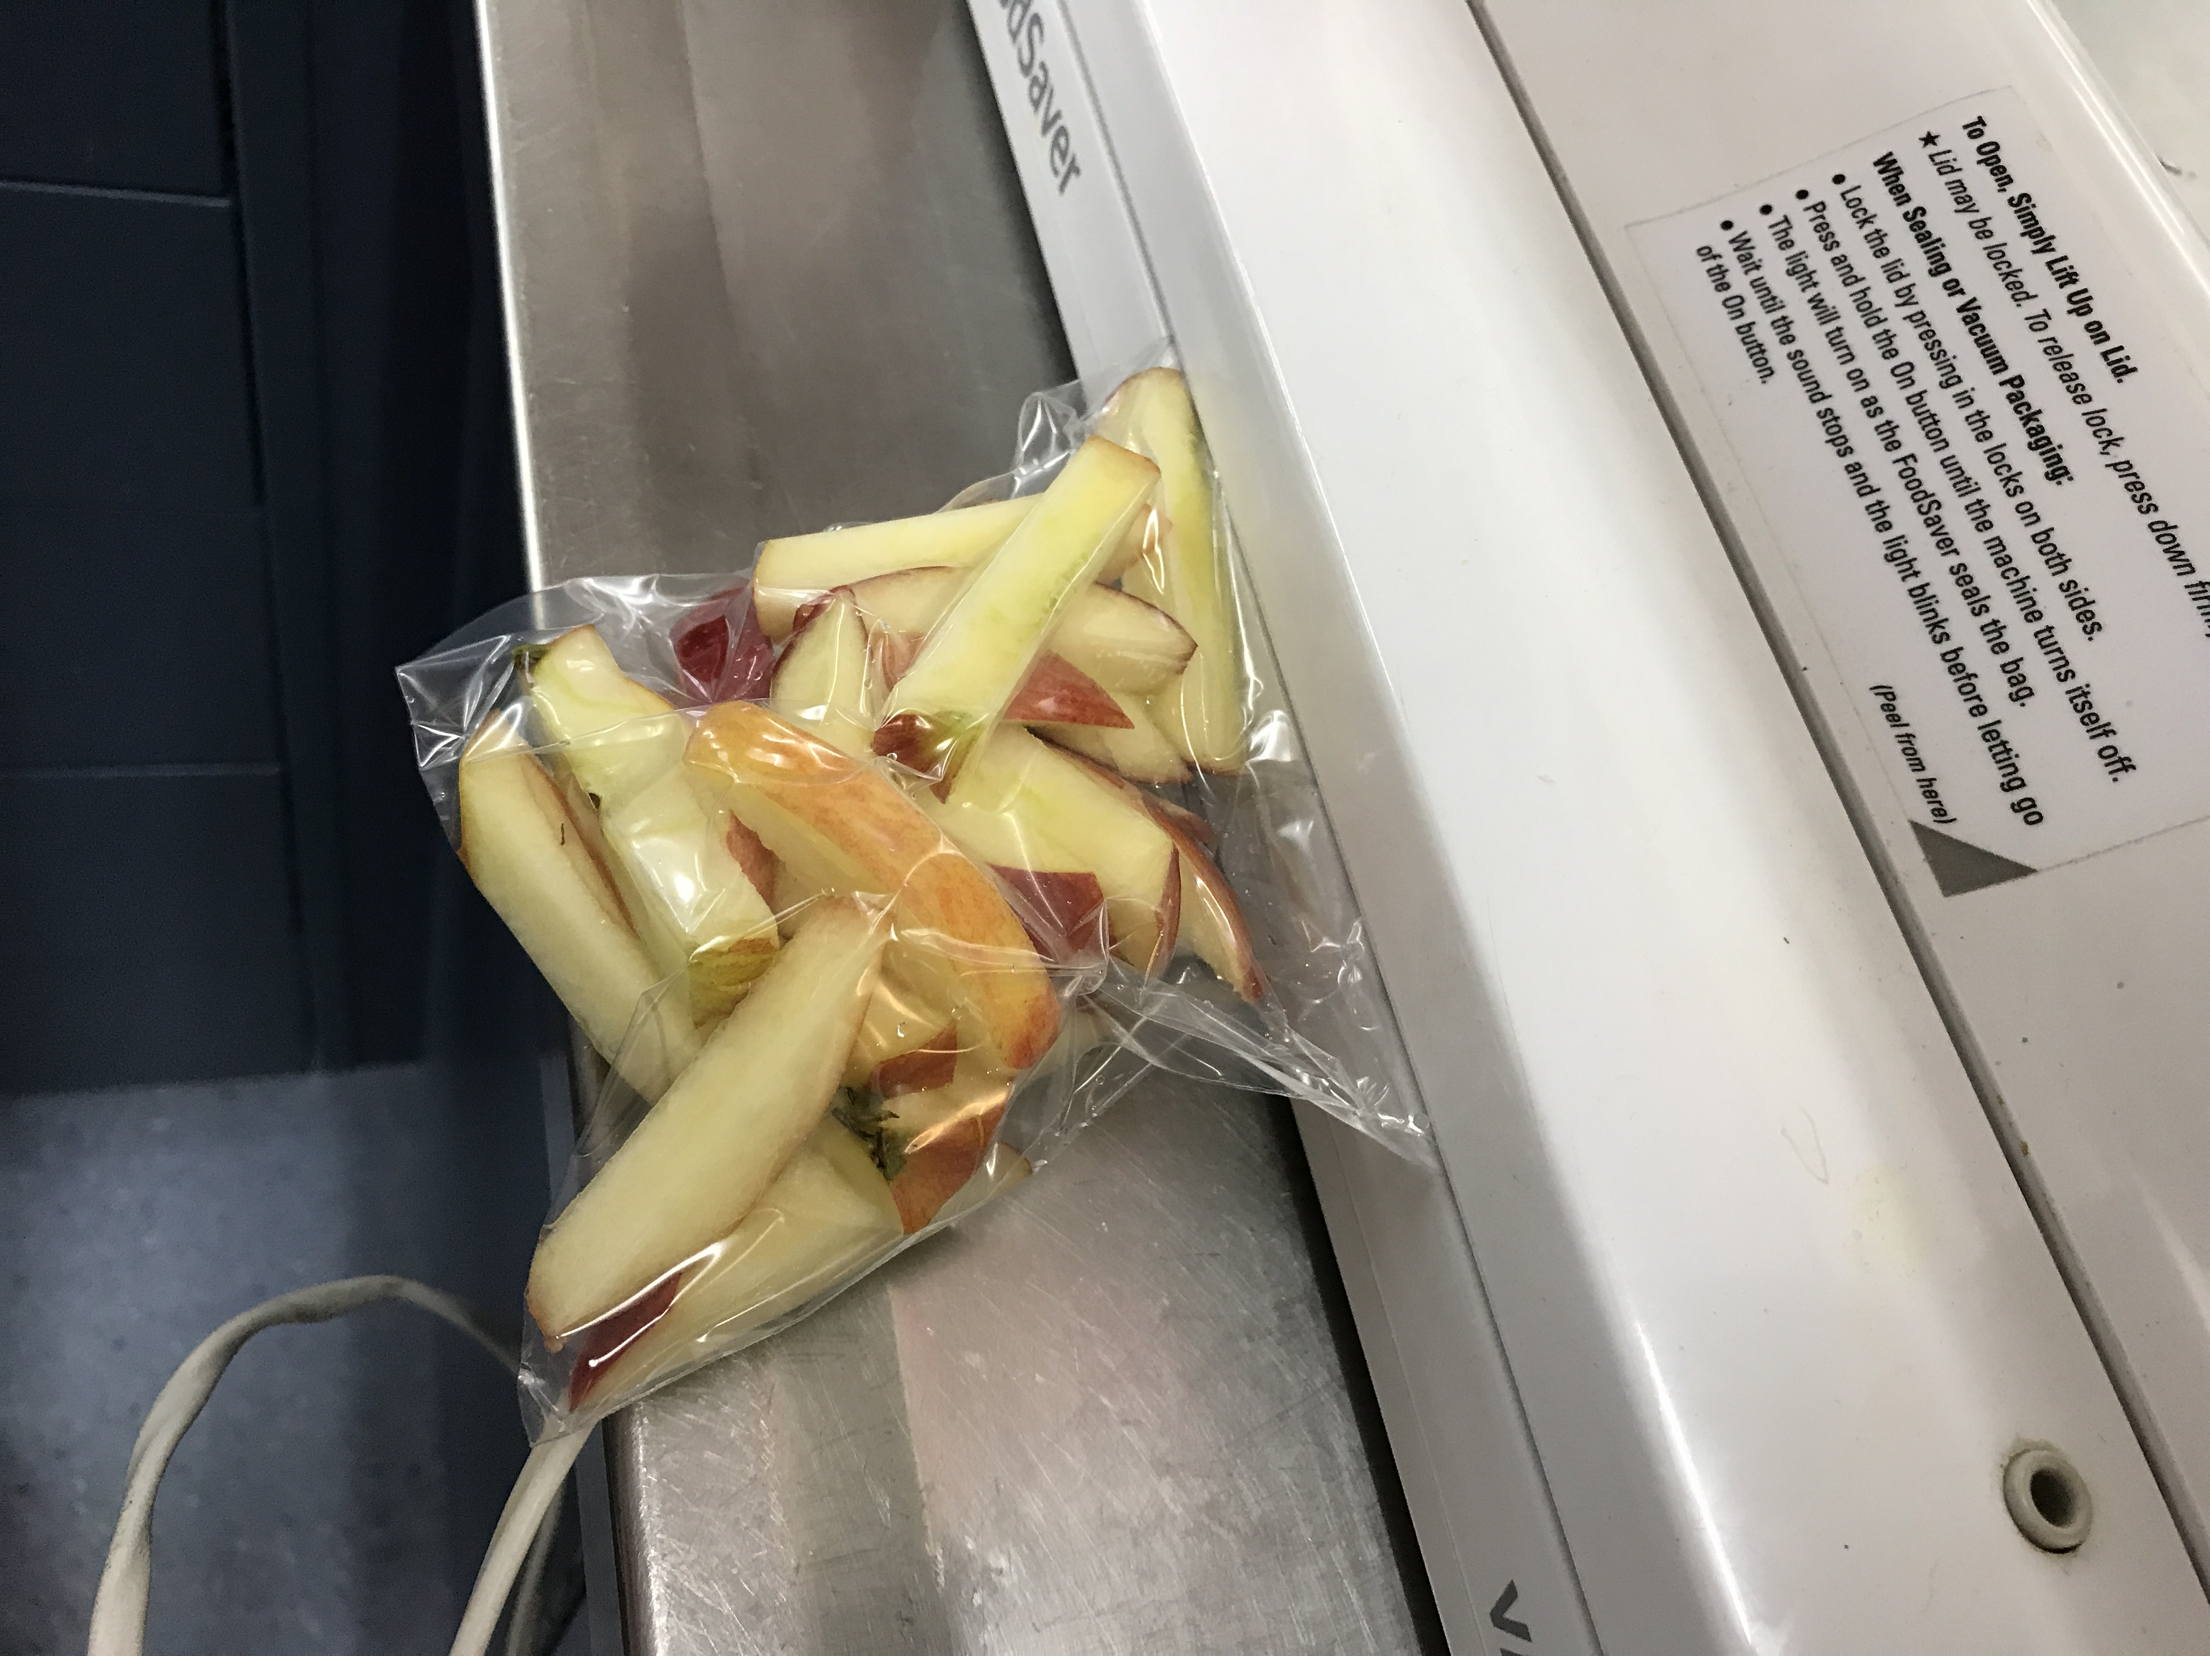
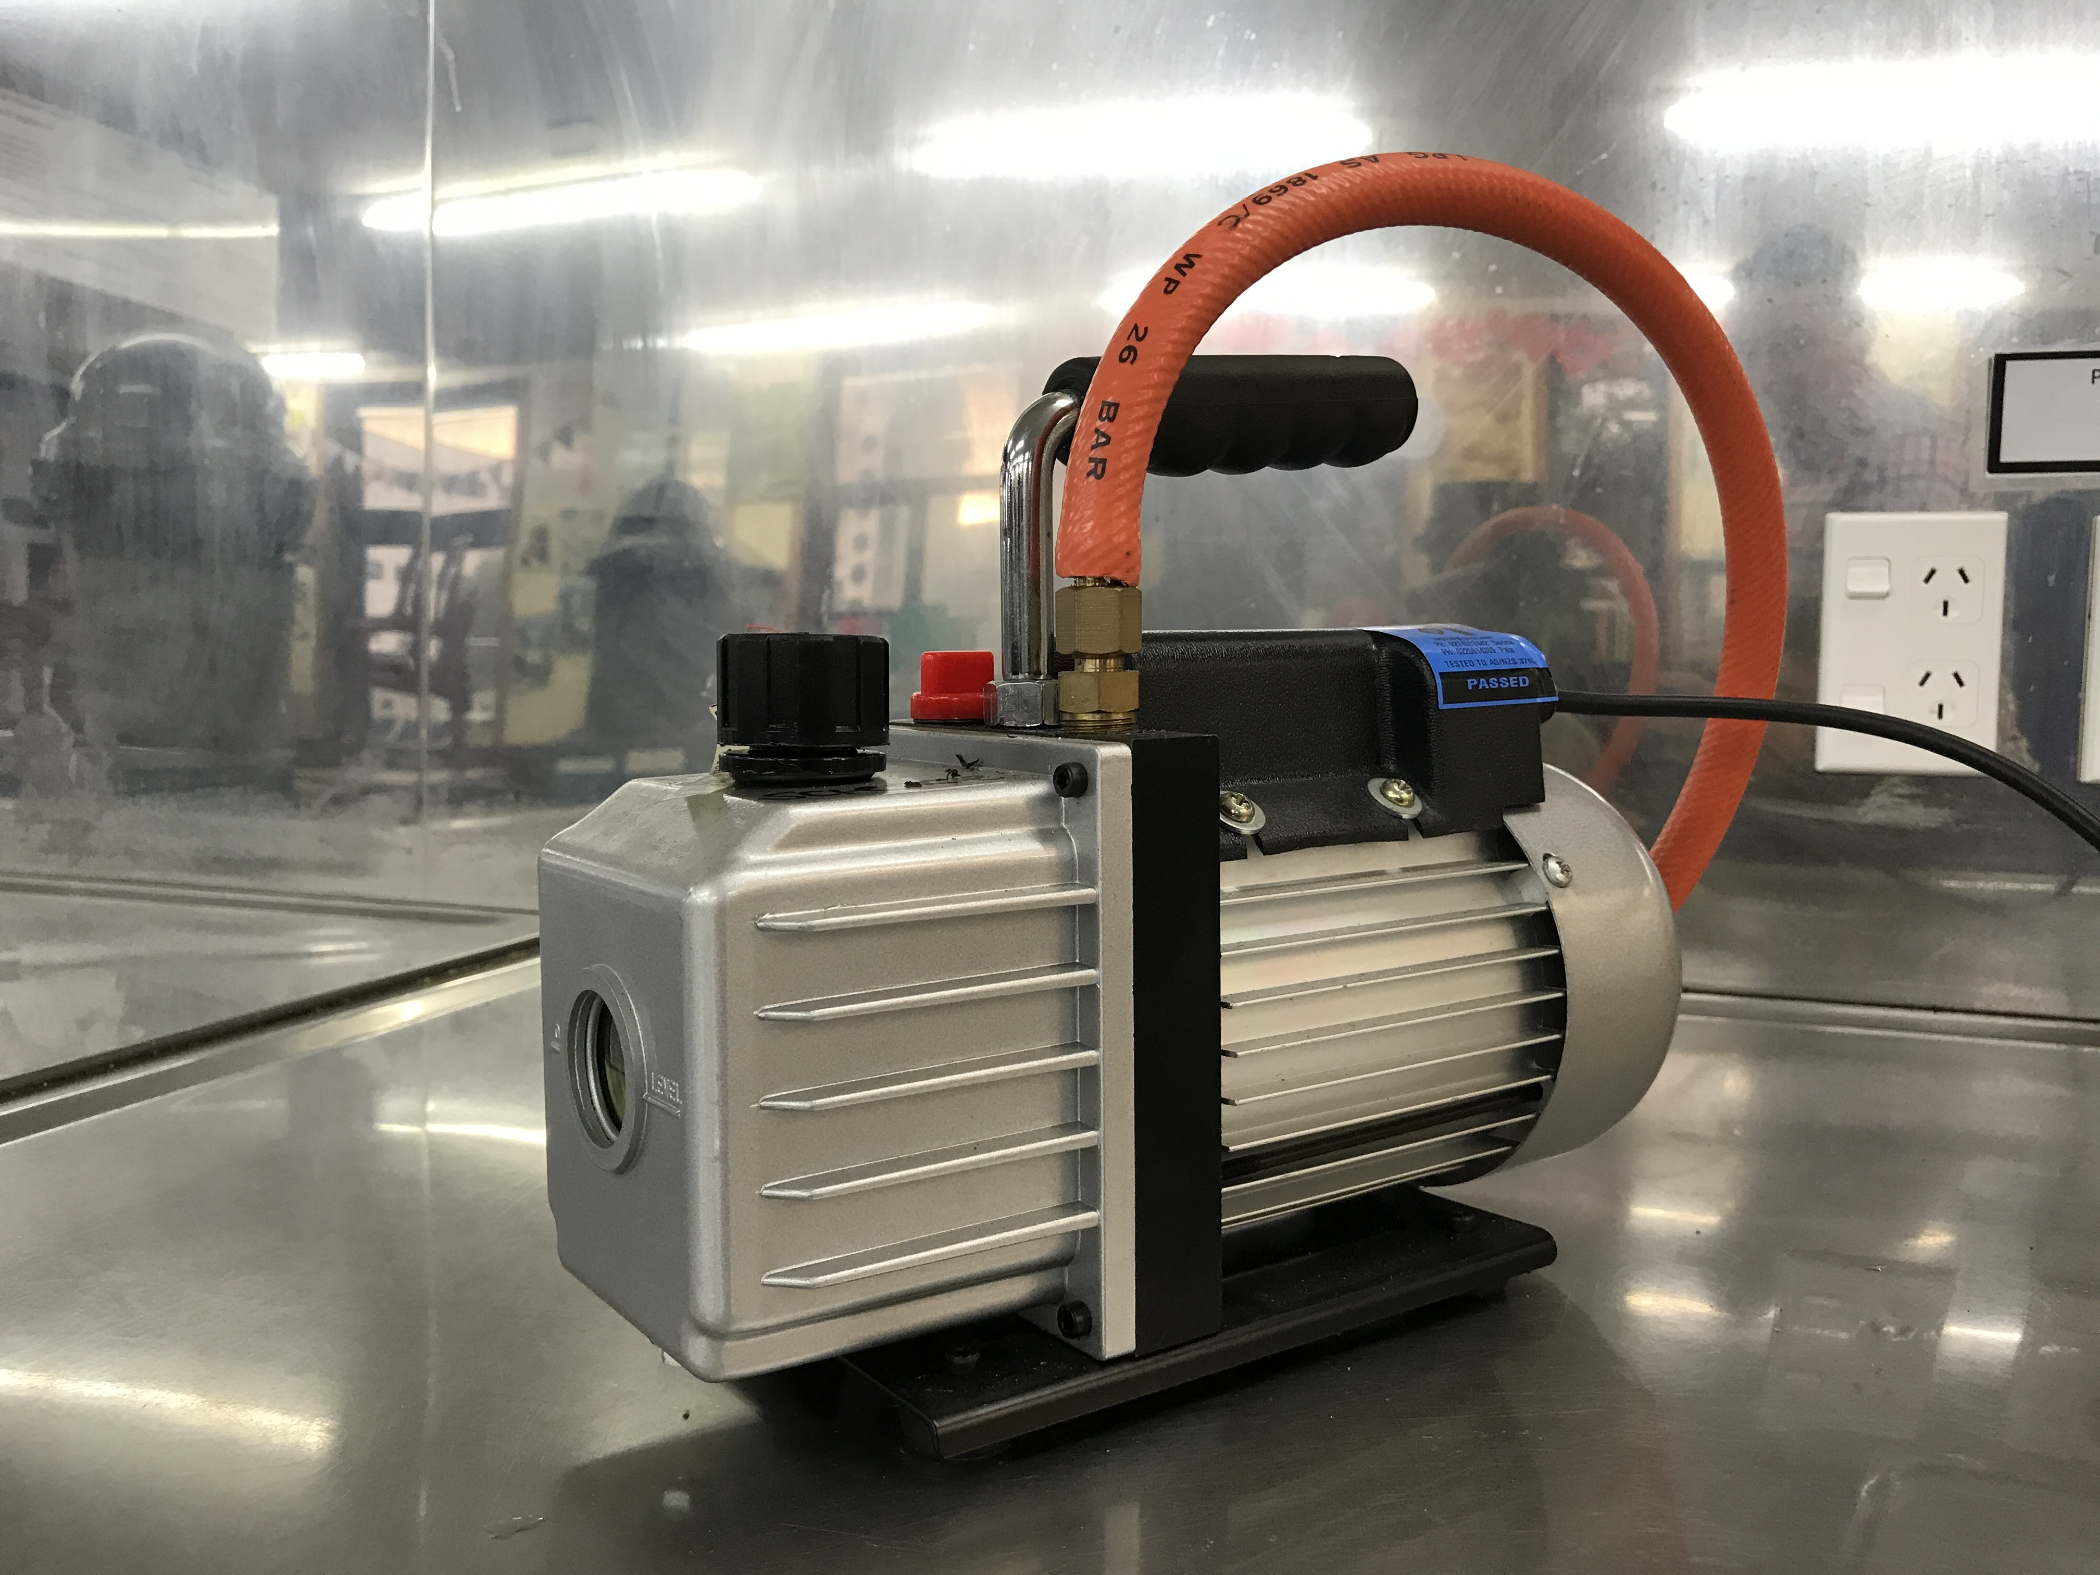
Step 4
24
Notes:
Vacuumed the plastic bag with the pumping machine.

Slide 25
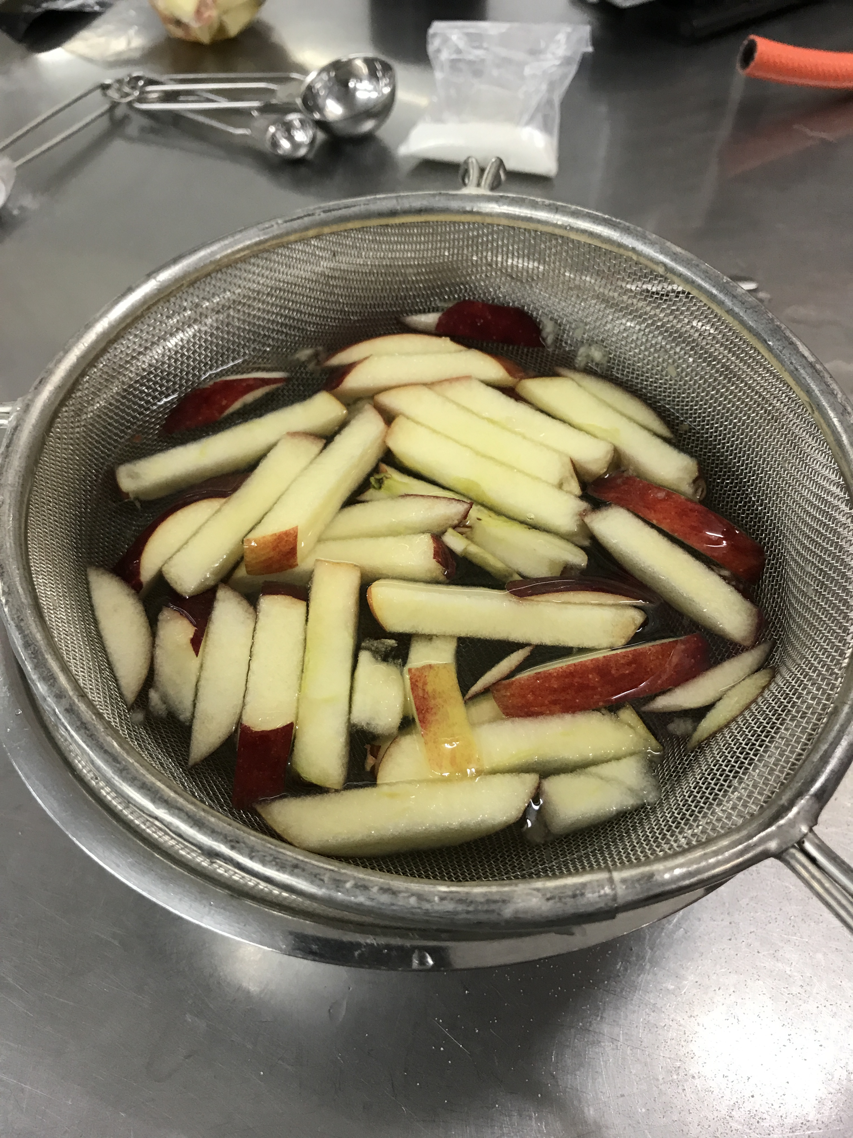
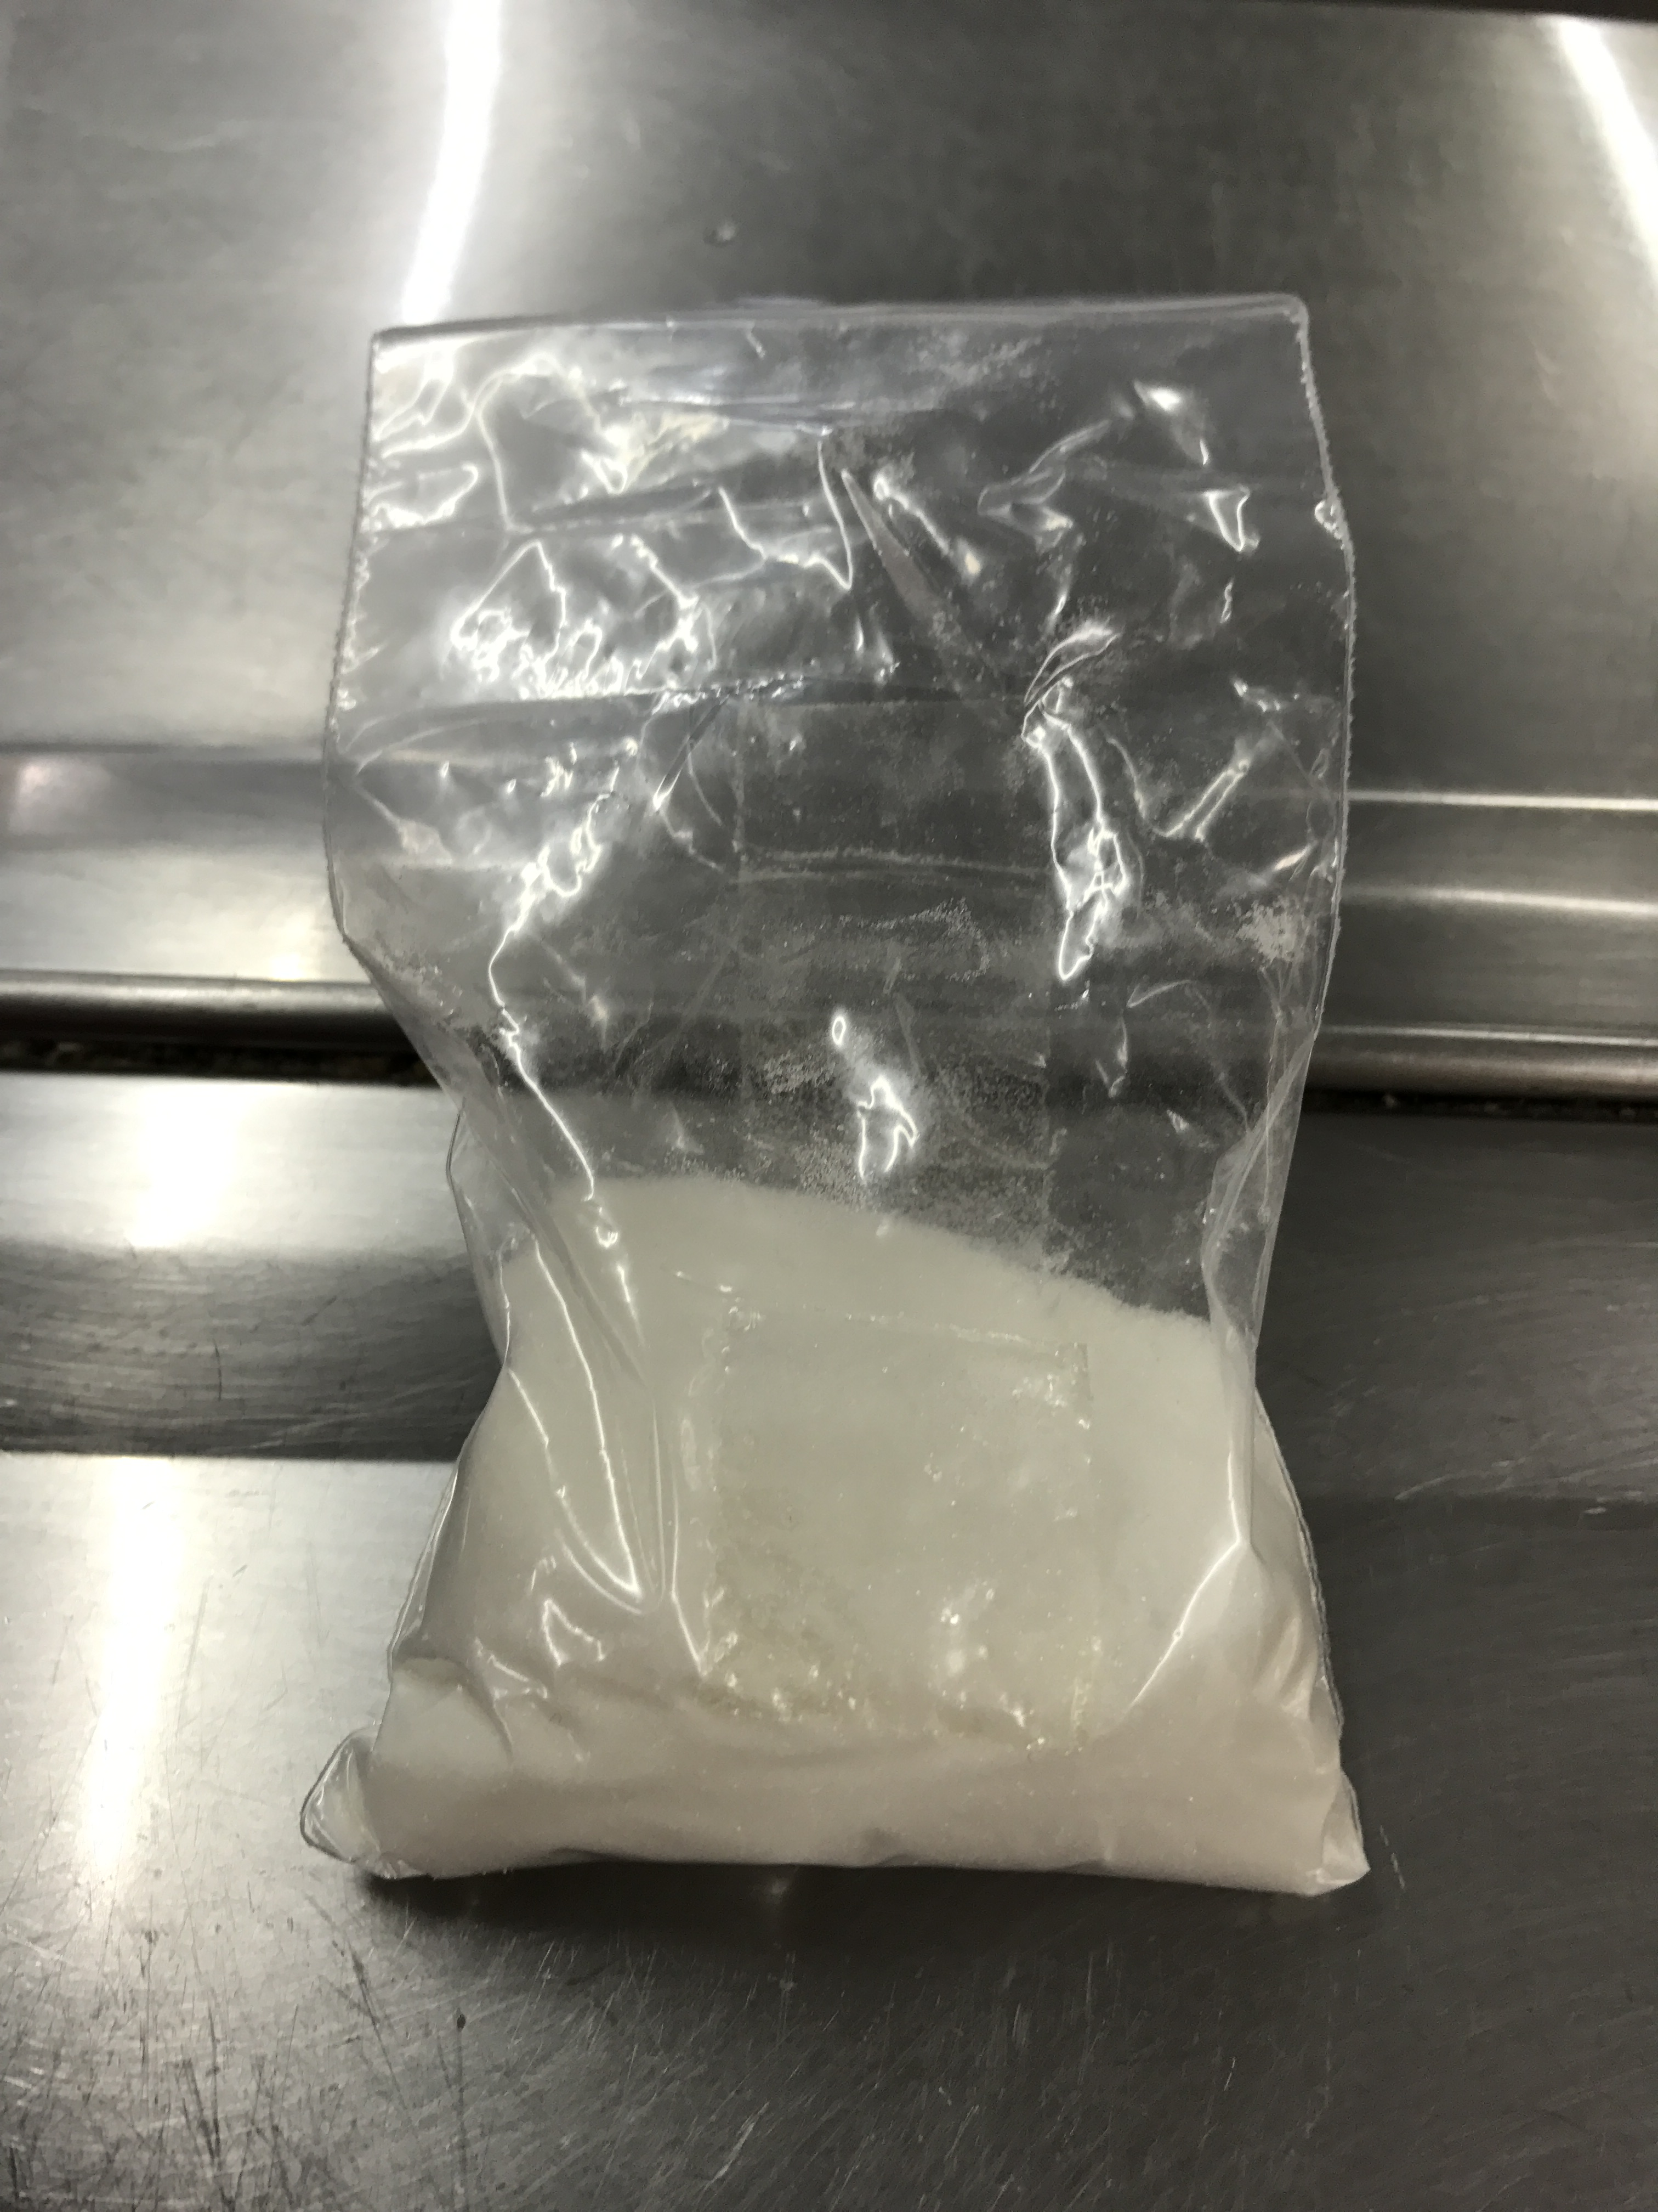
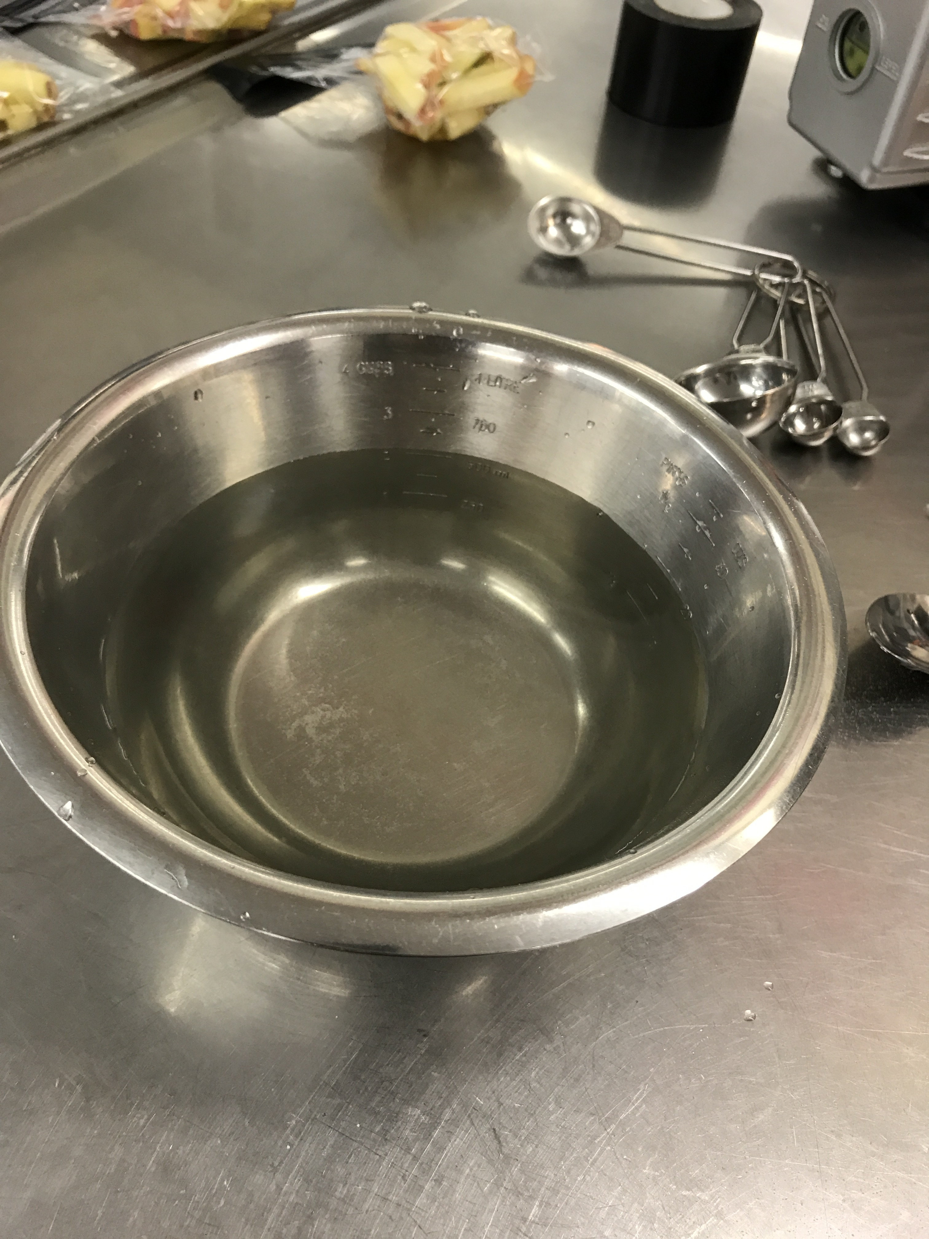
Step 5
25
Notes:
Then I cut some other apple slices and then soaked them into the Calcium Ascorbate solution. Due to Dr Allan’s statements, increases the Salt of Ascorbic acid and the Calcium slows down the softness. He tried 0%, 4%, 6%, 12% and 20% and found that 0% and 4% didn’t effect much on the apple slices. The 6, 12 and 20 didn’t have many differences. So I chose to use 6% of Calcium Ascorbate for the concentration.

Slide 26
Step 6
B
E
F
A
C
D
G
H
26
Notes:
I made 8 bags of sample. A and B were added nothing. C and D were added nothing but vacuumed. E and F were treated by the Calcium Ascorbate solution. G and F were treated by the Calcium Ascorbate and vacuumed.

Slide 27
Day 0
June 8th
27
Notes:
I put the sample A, C, E, G and B, D F, H in different trays. Then I put the first tray into the fridge (4 degrees) and leave the second tray in the room temperature (25 degrees).

Slide 28
Day 1
June 9th
28

Slide 29
Day 5
June 13th
29

Slide 30
Day 6
June 14th
30

Slide 31
Day 7
June 15th
31

Slide 32
Final Results – June 23rd
Room
Fridge
32
Notes:
These were my final results that after 17 days. I couldn’t stand the smelling so after that I just cleaned them.

Slide 33
Fridge
Vacuumed
Room
Vacuumed
33

Slide 34
Fridge
Calcium Ascorbate
Room
Calcium Ascorbate
34

Slide 35
Fridge
Calcium Ascorbate
Vacuumed
Room
Calcium Ascorbate
Vacuumed
35

Slide 36
Conclusion -- Browning
The apple slices turn brown after been cut is because the enzyme that reacts with the oxygen and the cofactors. The ferrous (Fe²⁺) will change to ferric (Fe³⁺). Because the color of the ferric is brown, the apple will turn brown This reaction is called oxidization.
36

Slide 37
Conclusion -- Treatment
Calcium Ascorbate
Refrigerate at 4 ℃
37
Notes:
My second test shows me that the lemon juice is the best choice for antioxidants, but the lemon juice will be able to change the flavor of the apples. Then I got some incredible results from the last test. The sample E which was treated by the 6% of Calcium Ascorbate solution and put into the fridge gave me a big surprise. The sample E wasn’t brown at all. It was also eatable, smells good and taste very nice. I tried some of the slices, the flavor didn’t change at all. The best way to prevent the apple slices to browning is, soak the apple slices into 6% of Calcium Ascorbate for 4 minutes, put into a plastic bag and put them into the fridge at 4 degrees.

Slide 38
Bibliography
⧫ Teammates: Luke Roeven, Zuni Preece, Sai August, Tristan Harris, Anna Liu
⧫ Teachers: Murray Chisholm, Kerry Parker, Tony Cairns, Jack Tregidga
⧫ Special Thanks: Ryan Bright
-----------------------------------------------
5th IYNT 2017
Wellington High School

