Slide 1
3. Grow Light
New Zealand
IYNT 2017
Tristan Harris
Notes:
Damping off
Fungal infeection
Too much water
Plants to close
Not enough aeration
Incandescent light

Slide 2
Contents of presentation
Problem
Theory
Electromagnetic waves
Photosynthesis
Experimental
Setup
Data
Conclusions
Next time
Resources
Acknowledgments

Slide 3
The Problem
Investigate how different types of artificial lights affect plant growth. What is the role of light spectrum?

Slide 4
Theory
Suns emissions line up with plant absorption
400-700nm
Notes:
Plants mainly use wavelengths between 400 and 700nm to carry out most of their vital task of photosynthesis. This incidentally corresponds with the visible light spectrum because plants have evolved the same way as us to receive as much of the suns energy as possible.

Slide 5
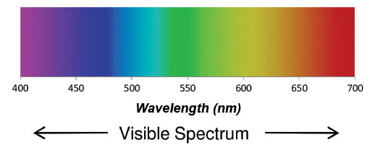
Theory
Photosynthesis uses wavelengths 400-700nm
650-665nm (red)
460-475nm (blue)
Notes:
Red light (650-665nm) fits perfectly with the absorption peak of chlorophyll, so therefore provides more energy for photosynthesis. A drawback with this is that it leads to unbalanced growth and elongation in most species of plants.
Blue boosts photosynthesis and helps achieve more balanced and compact growth.

Slide 6
Photosynthesis
How plants get energy
$6CO2+6H2O→Light energy→C6H12O6+6O2$
Chloroplasts make sucrose
Notes:
Photosyntheis is the process that plants use to convert light enrgy into chemical potential energy. They do this by use carbon dioxide and water to make sucrose and Oxygen.

Slide 7
Photosynthesis
Notes:
This is the diagram of what happens inside a chloroplast cell. Light, water and carbondioxide enter a chloroplast cell, and oxygen and sucrose are exported.
Chloroplast use the suns radiant energy to turn Adenosine Diphosphate (ADP) into Adenosine triphosphate (ATP). This ATP is then used in the Calvin cycle to make sucrose, which plants use for energy. As plants use the suns visible light to do this process, the different wavelengths effect the growth of the plants.

Slide 8
Photon Energy
$$E=\frac{hc}{λ}$$
$$∵h =constant$$
$$∵c=constant$$
$$∴Eαλ$$
Notes:
This is the equation for how much energy a photon has.
E is the energy of the photon
H is Planck Constant, and,
C is the speed of light in a vacuum,
And lamdba is the wavelength.
Since both h and c are constants the amount of enregy is negatively proportined to the wavelength
This theoritacally means that the smaller the wavelength, the more energy is being transferred into the plant. This is not true how ever, as plants are better at absorbing some wave lentghs, for example, they can not absorb much green, as they reflect most of it back.

Slide 9
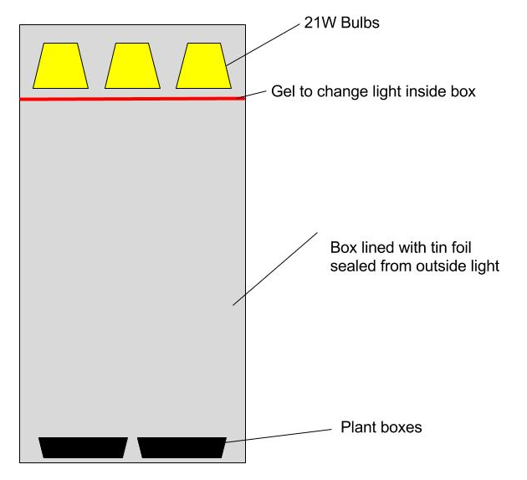
Test one ~ Different colour light
Red light (627-631nm)
Green light (487-573nm)
Blue light (427-563nm)
White light (full spectrum)
Notes:
In this test we tested Red, blue, green and white lights. We grew the plants in identiacl cardboard boxes lined with tinfoil wirth 3 21 watt bulbs in the top. We changed the colour of the lights inside the grow box by taping different coloured gels from stage lighting. We then adjusted the power connected to each box until they had the same light output. I Am aware that the machine we were using could be more sensitive to certain wavelengths, so there might be some in accuracies there.
We germinated 15 seeds in each box before putting them in the grow boxes, so they all started out the same.

Slide 10
Measuring Different coloured light
Gel over incandescent light
Spectroscope
Diffraction grating
400 lines/mm
Picture of spectroscope
Notes:
We measured the wavelentghs that the gels let through with a spectroscope. Spectrocopes let a small sliver of light through a diffraction grating, which is attached to a revolving stand. By looking through the eye piece at different angles relative to the diffraction grating, you can see what wavelengths are being let through. We measured the gels, by placing a portion of them over an incandescent light, and then looking at it through the spectroscope.

Slide 11
Test one ~ Results
 | Red | Green | Blue | White
Amount of plants | 7 | 4 | 5 | 14
Avg height (cm) | 11.5 | 12.5 | 11.4 | 8.45
Avg weight wet (g) | 0.32 | 0.275 | 0.3 | 0.32
Avg leaves | 1.71 | 2 | 1.4 | 1.42
Notes:
Out of those 15 seeds, none of them all grew, but the white light got the closest. This goes against our theory, as it suggests that red light is most efficient for photosynthesis.
We then repeated this test again, but didn’t water them as much, and the red and the green one died, where as the blue and white survived. I believe this is because the red gel let through higher concentrations of infra red, which dried out the plants and killed them. I think the green one died because as plants are is green, they reflect most green light and don’t absorb much for photosynthesis. I think the blue one survived because it lets through such a large portion of the visible wavelengths, it is practically a white light.

Slide 12
Test two ~ Different types of light
Compact Fluorescent
LED
Incandescent
Compact Fluorescent (437-605nm)
LED (cold, full spectrum)
Incandescent (hot, full spectrum)
Notes:
In this test, we tested an LED against a Compact Fluorescent against an incandescent.
We chose this because we have one light that is hot and has the whole spectrum, the incandescent, one which was cold and let through the whole spectrum, the LED, and one that was cold and let through a small portion of wavelengths. Because we were having difficulties germinating seedlings all the same by ourselves, we bought identical carrot seedlings and used them. We chose carrots because the had the most foliage, which was the easiest to see changes in.

Slide 13
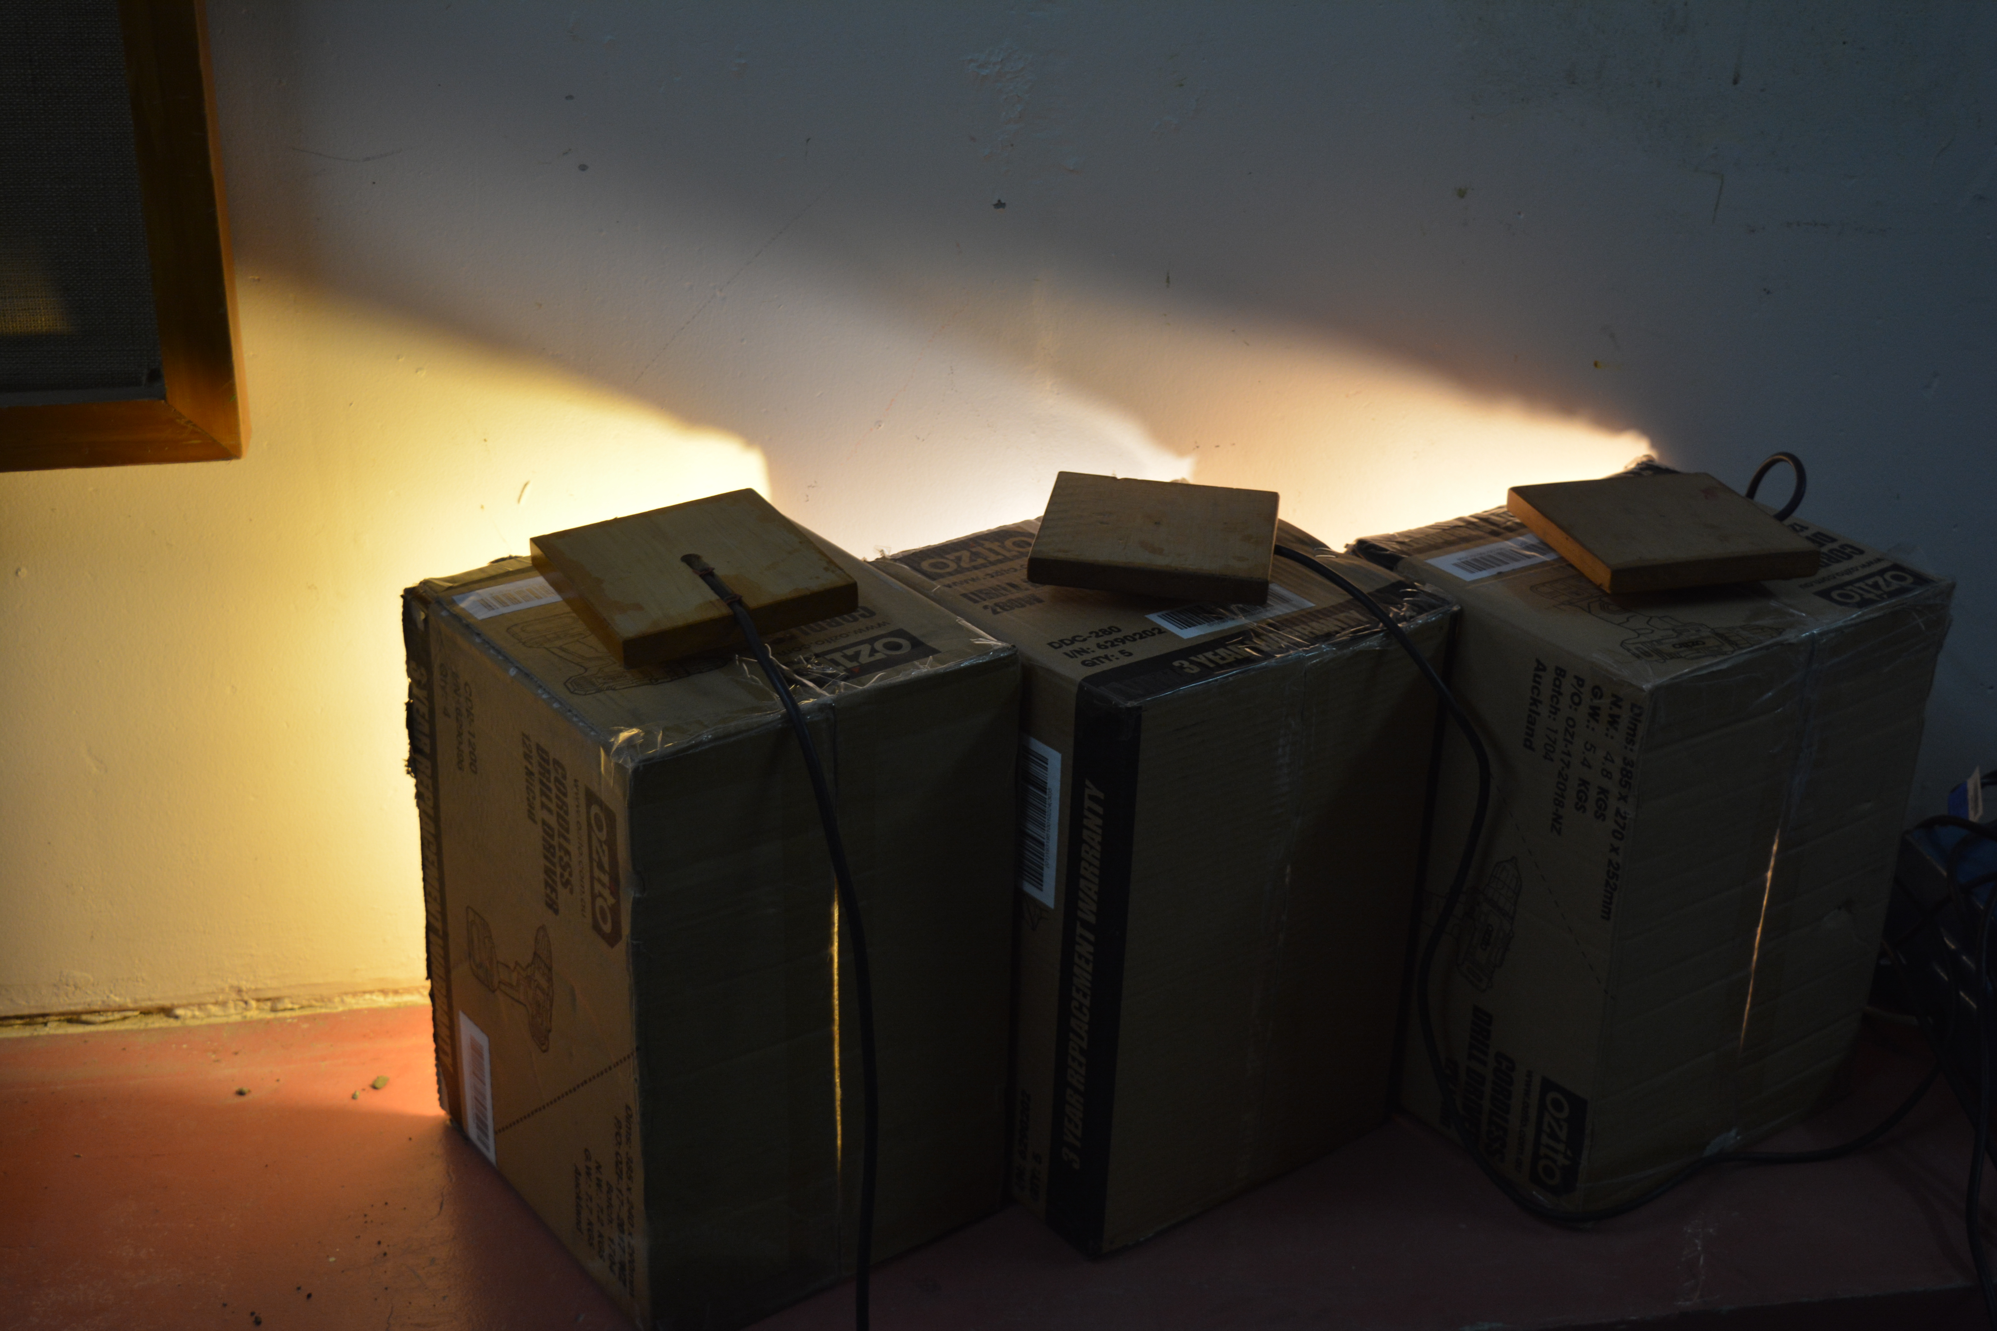
Test two ~ Setup
Notes:
Here is the setup for testing how different light types effect the growth of plants. We got three identical boxes, and removed the front of them, so the air surrounding the plants would be roughly the same temperature. We then cut a hole in the top, and stuck the lamps through them. Placing one edge against a wall meant that minimal light escaped to a different box, but still having decent air flow

Slide 14
Test two ~ Results ~ Fluorescent

Slide 15
Test two ~ Results ~ LED

Slide 16
Test two ~ Results ~ Incandescent

Slide 17
Test two ~ Results

Slide 18
Conclusions
Different coloured light
Red and Green died most times
Blue and White always survived
Different types of light
Compact fluorescent
LED
Incandescent
Notes:
From my first set of results, where we tested different wavelengths of light, the red and the green both died most times. I think the red one died because the gel was letting through to much infra red, which dried out the soil quicker. The green one died because as plants are green, they cannot absorb as much green light for photosynthesis. The blue light always survived because the blue gel wasn’t as strong, so it let through most of the spectrum, making it very similar to the white light, which also survived.
Il tell u about the different lights when I do them

Slide 19
Next Time
Hydroponic watering system
Bigger boxes and plants
Wider range of more specific wavelengths
Different light types but with same temperature
Notes:
If I was to repeat my testing I would design a hydroponic water system that watered the plants at a steady rate, so they can be watered more regularly.
I would build much bigger grow boxes to accommodate larger plants and watch them grow over months, if not years. I would then try and find more exact filters for the light, so we could adjust the wavelengths more finely and exactly.
With the different types of light, I had problems, as the LED and the fluorescent lamps both were cold, so they didn’t dry out the soil as quickly as the incansescent. This meant that when I watered them, the soil under the incandescent lamp quickly absorbed the water, whereas the cold lamps, were still moist so most of the water just went on the floor.
I would also try different light types, but at the same temperature.

Slide 20
Resources
https://www.ncbi.nlm.nih.gov/pmc/articles/PMC3949401/
http://hortsci.ashspublications.org/content/43/7/1951.full
https://www.maximumyield.com/on-the-dawn-of-a-grow-light-revolution-seeing-light-differently/2/1427
http://onlinelibrary.wiley.com/doi/10.1111/1365-2745.12551/full
http://www.pagepress.org/journals/index.php/pb/article/view/6281/6769
Wikipedia

Slide 21
Acknowledgments
My team
Luke Roeven, Sai August, Anna Liu, Ethan Wu and Zuni Prius
My Teachers
Murray Chisolm, Kerry Parker, Jack Trigonometry and Prudence McFarlane
Minions
Ryan, Ella Zoe

