Slide 1
7. Growing Through Asphalt
New Zealand IYNT 2017 Zuni Preece

Slide 2
Question
Can a little plant grow straight up through concrete or asphalt?

Slide 3
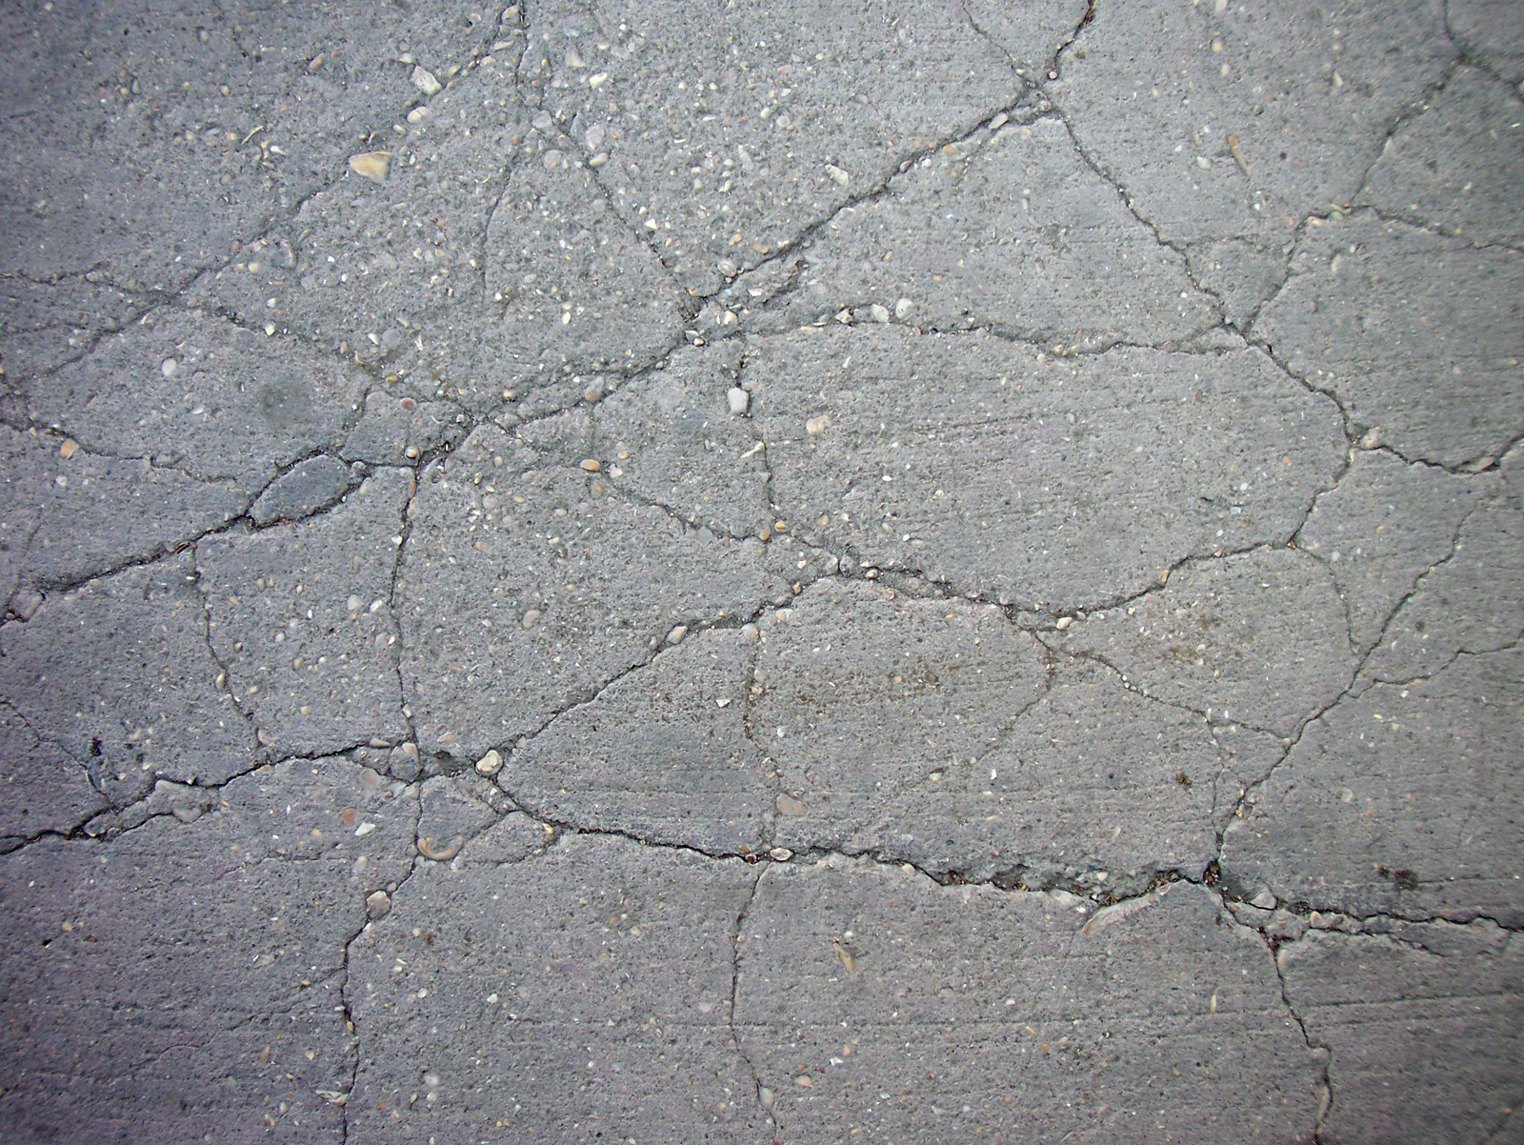
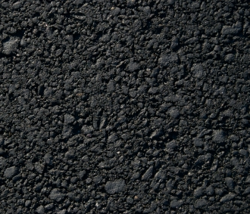
Concrete or Asphalt
Notes:
Both concrete and asphalt consist of coarse aggregate being bonded together by a different material. However, in the case of asphalt, this bonding material is asphalt, or bitumen, and in concrete it is cement. These two substrates give asphalt and concrete their unique characteristics. However as asphalt is a more difficult material to acquire and work with, for the purposes of answering this question I will be using concrete only.

Slide 4
Notes:
Right off the bat, we can determine that yes, a little plant can indeed grow through concrete. The way that this concrete is cracked clearly indicates that it has been pushed outwards by the force of these plants growing through it. The problem, then, is to determine how a little plant is able to grow through concrete.

Slide 5
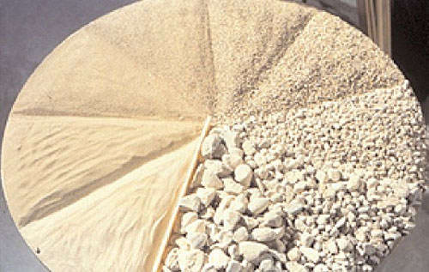
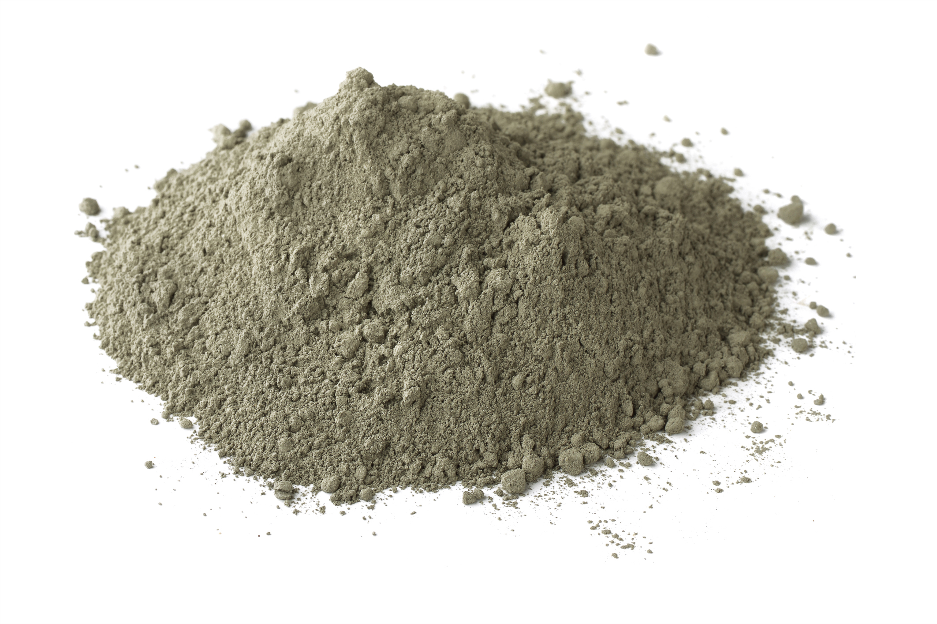
What is concrete?
Notes:
First, it’s important to understand the structure of concrete. Concrete is composed of two parts- aggregate and cement. The term “aggregate” can describe a broad category of coarse materials used in construction, including things such as gravel and crushed stone.

Slide 6
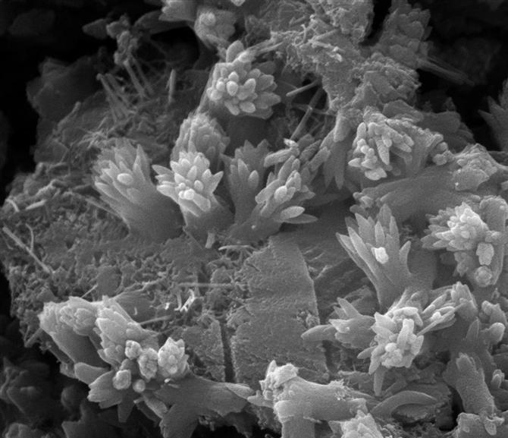
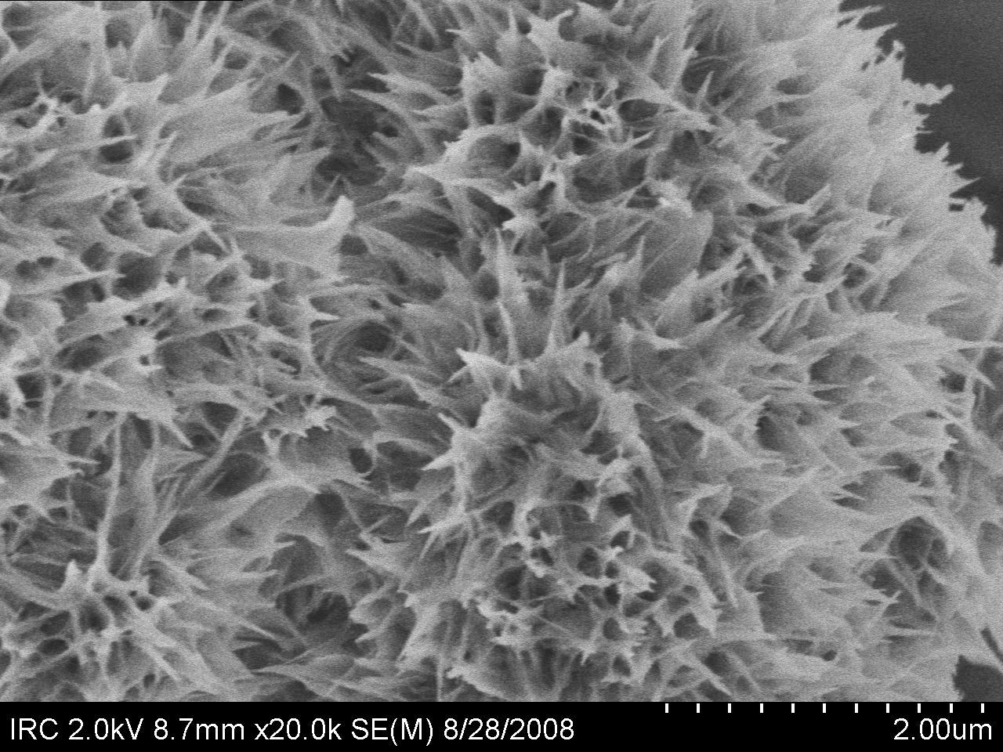
Hydration Reaction
CaO SiO₂
Al₂O₃
Fe₂O₂
...
----> 3CaO₂ . 2SiO₂ . 4H₂O
Notes:
It is a common misconception that concrete “dries out”. However, it does not. Instead of water evaporating from the concrete, CaO (calcium oxide), SiO2 (silicon dioxide), and other molecules, like Aluminium oxide and Iron (III) oxide, combine with water molecules to create new compounds. One of these is 3CaO2.2SiO2.4H2O (calcium silicate hydrate), that forms crystalline structures that bond together and literally cement the aggregate together. This type of reaction is called a hydration reaction. This makes the concrete a solid. \

Slide 7
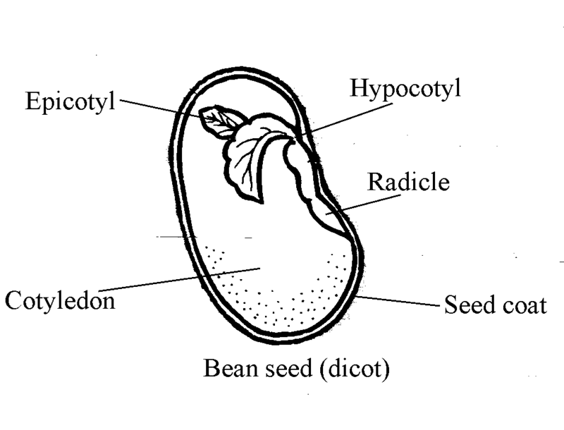
Conditions that must be fulfilled for growth
Seed
Plant
Water
Oxygen
Heat
Nutrients
Water
Oxygen
Heat
Soil pH
Nutrients
Support
Notes:
In order for a plant to be able to grow through concrete, it has to be able to grow at all.
The conditions for germination and growth are different. To germinate, seeds need to have water, for the seed to imbibe and swell, oxygen, and to be in a certain temperature range, which can vary based on the species. Nutrients are provided within the seed’s cotyledon for germination and the first stage of growth. Germinated plants, however, require water, air, correct temperature, a slightly acidic to neutral soil pH, nutrients, and support.
A plant can grow in a pre-existing crack in concrete just like in any other part of the ground, as long as the conditions are correct for the seed. If enough soil accumulates in a crack, it may retain enough moisture for a little plant to germinate. This soil could then provide enough nutrients for growth. The difficulty, then, is in making a plant grow through solid concrete without any prior cracks. The plant has to create its own cracks.

Slide 8
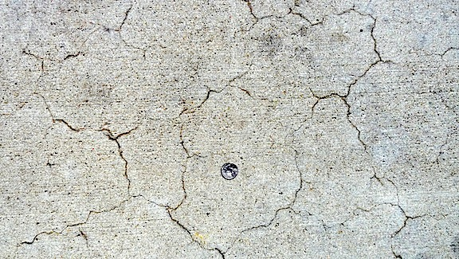
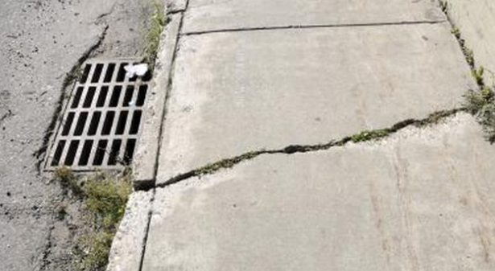
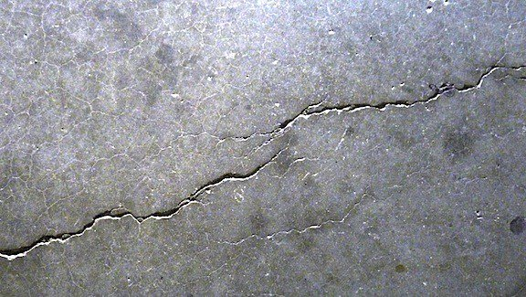
Ways that Concrete can crack
Notes:
Concrete always cracks, but the type of crack that is formed depends on the cause.
Offset or Settlement cracks may appear when the underlying ground has not been compacted or prepared properly. Due to uneven surfaces below the concrete, such as subgrade settlement or pressure from objects such as tree roots, previously-placed concrete, or rebar.
Plastic-shrinkage cracks run to the mid-depth of the concrete, are distributed across the surface unevenly, and are usually short in length. Most often occurs while concrete is curing, due to the surface of the concrete drying too rapidly relative to the concrete below.
Crazing, or Map cracking appears as web of fine, shallow cracks across the surface of the concrete. Map cracks are similar to shrinkage cracks in that they also occur during curing due to the surface of concrete drying faster than the interior concrete, but the surface drying occurs at a lesser depth.

Slide 9
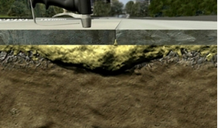
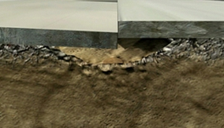
Plants causing settlement cracks
Notes:
Before laid, the area where concrete is being placed is prepared by being compacted. If any material underneath is soft, like uncompacted soil or plant matter, it may collapse or rot and then, if a downwards force is applied to it, the concrete may collapse into this empty area. The seeds of plants could grow through these cracks, and that is one way for plants to cause the initial cracking of concrete, although indirectly.

Slide 10
Notes:
Concrete is like polystyrene in that its compressive strength is much higher than tensile. If you try to crush a polystyrene sheet, you will have difficulty compressing the particles. But if you snap it, you need very little effort to break it in half. In the case of concrete, at some point you would be able to crush its constituents, but it is not capable of pulling itself together and so its bonds break at a low tension. It is weak in tension
There is a tendency to assume that the properties of the cement and the aggregate is unaffected by the presence of the other. But the cement particles in fresh concrete, which are suspended in the mix water, cannot pack together as efficiently when they are in the close vicinity of a much larger solid object, such an aggregate particle. The result is a narrow region around the aggregate particles with fewer cement particles and more weak ettringite crystals. This region has important effects on the properties of concrete, because it tends to act as the "weak link in the chain" when compared to the bulk cement paste and the aggregate particles. Thus the lower strength and stiffness of this area translates directly into lower tensile strength of concrete where the cement cannot hold the aggregate particles together.
- Interfacial Transition Zone

Slide 11
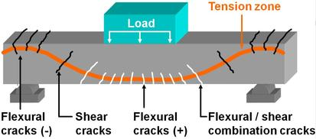
Notes:
If a plant is trying to grow upwards through concrete as the question specifies, it will be applying an upwards force to the concrete, bending it. This will cause tensile cracking in the concrete, similar to what you see when you apply a load on a concrete beam.

Slide 12
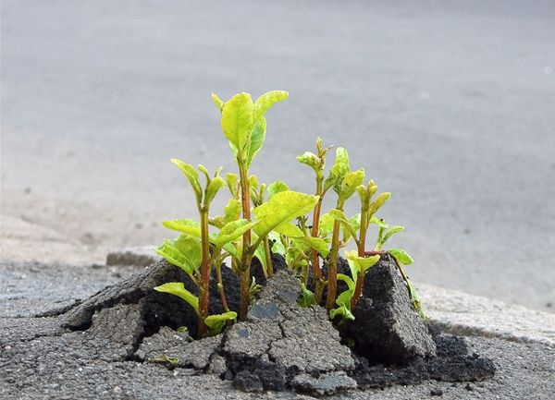
Notes:
If you look again at this photo of a plant that has broken through concrete, you can see very clearly that it has bent the concrete upwards.

Slide 13
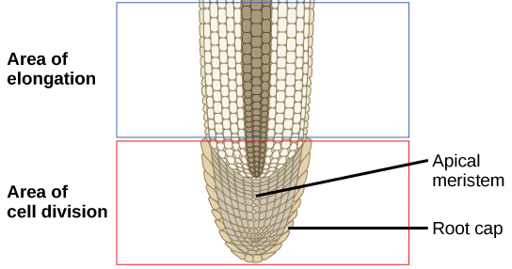
Notes:
So, what kind of force can a plant exert on concrete?
Plants can’t crack concrete via direct kinetic energy (they don’t karate chop the concrete), but by applying pressure to existing cracks.
New cell growth takes place at the tips of plant shoots. As the plant grows, these tips act as feelers, seeking out the path of least resistance for expansion. These shoot tips can find microscopic fissures in concrete and push into the tiny crack.
Behind the growing root tip is an area of cells that are no longer dividing but instead expanding. The driving force behind this expansion is osmosis, and the turgor pressure that it creates.

Slide 14
Notes:
This video shows the movement of bean roots growing.

Slide 15
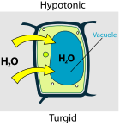
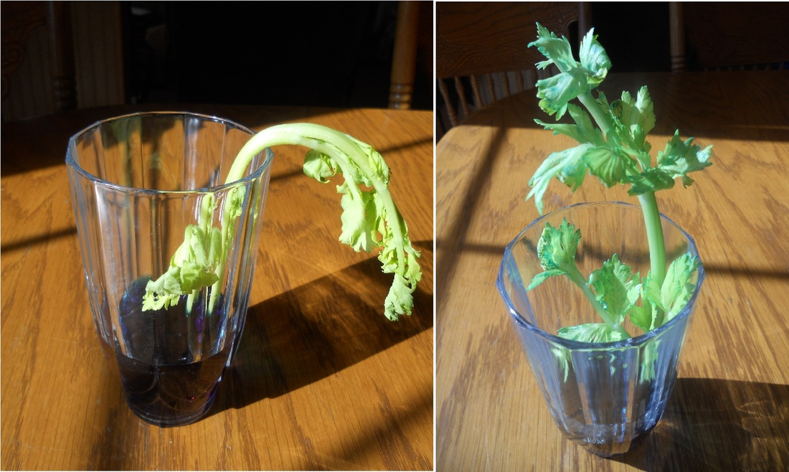
Turgor Pressure
Notes:
Turgor pressure is the driving force of growth within a cell. An increase in turgor pressure causes expansion of cells. Osmosis of water into the cell increases turgor pressure by increasing the amount of vacuolar sap. A growing root cell’s turgor pressure can be up to 0.6mPa- over 3 times that of a car tire, at 0.2mPa. Epidermal cells in a leaf can have pressures ranging from 1.5-2.0 mPa. Seeing as plants operate at such high pressures, it can explain how it could expand a crack inside concrete.

Slide 16
Imbibition
Notes:
Even a seed itself, before germination, may be able to crack concrete if it has enough water.
The adsorption of water by colloidal solids is known as imbibition. When a dry imbibant comes into contact with water, a steep gradient of water potential is created and water diffuses into the imbibitant. The volume of an imbibitant increases during imbibition. Imbibition is the first step of seed germination.
When an imbibing substance is kept in a confined space, pressure is developed due to the matric potential of the imbibitant.
When water is in contact with solid particles like clay or sand particles within soil, there are adhesive intermolecular forces between the water and the solid. The forces between the water molecules and the solid particles in combination with attraction among water molecules forms menisci within the colloid. Force is then required to break these menisci.
Although water movement due to water potential may be slow, it is still extremely important to the process of imbibition. The pressure created by imbibition can be called matrix potential. This potential is always negative because the water attracted by the soil matrix has an energy state lower than that of pure water (with a potential of 0mPa). It only occurs in unsaturated material. If the potential approaches a value of zero, nearly all pores are completely filled with water, i.e. fully saturated and at maximum retentive capacity.
Leaf tissue has a matric potential of about -1 mPa. Dry seeds usually have a matric potential between -350 and -50 MPa.
This huge difference between the dry seed tissue water potential and the ambient water potential (at least in the case of pure water) results in rapid water influx during imbibition.

Slide 17
Notes:
To demonstrate the process of imbibition, I tested the imbibition of various seeds. I did this by placing 10 seeds at a time into measuring cylinders and added a known volume of distilled water to measure the volume of the seeds. Here, the X axis is the length of time that the seeds have been soaked, and the Y axis the percentage of their original volume. As demonstrated by this graph, a seed’s volume will increase by around 150% to 350% when soaked in pure water.

Slide 18
Notes:
We did a non-quantitative test of imbibition by setting cement around a seed. You can see that the imbibition of the seed has cracked the concrete as it dries.

Slide 19
Conclusion
Question: Can a little plant grow upwards through concrete or asphalt?
Yes!
Low tensile strength of concrete allows force exerted by turgor pressure and imbibition to crack concrete

Slide 20
Sources
http://www.seedbiology.de/water.asp
http://www.biologydiscussion.com/plants/imbibition/imbibition-conditions-characteristics-factors-role-and-significance-botany/14845
http://www.aces.uiuc.edu/vista/html_pubs/hydro/require.html
https://civil-engg-world.blogspot.co.nz/2009/04/relation-between-compressive-and.html
https://www.nrmca.org/aboutconcrete/cips/35p.pdf
https://qph.ec.quoracdn.net/main-qimg-8cfa5a658577697b0f826725816b28dd
https://failures.wikispaces.com/+Overview+of+Types+and+Causes
http://iti.northwestern.edu/cement/monograph/Monograph5_5_2.html

Slide 21
Acknowledgements
Team Leaders: Jack Trigonometry & Murray Chisholm
Teachers: Kerry Parker & Murray Chisholm
Team Members: Sai August, Tristan Harris, Anna Liu, Luke Roeven, Ethan Wu
Our Minions: Zoe, Ryan, Riley, Ella, Liam
Others: DJ Nomeme

Slide 22
7. Growing Through Asphalt
New Zealand IYNT 2017 Zuni Preece

Slide 23
Notes:
This is the data, by volume rather than percentage of the original.

Slide 24
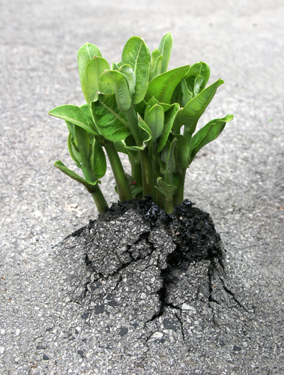
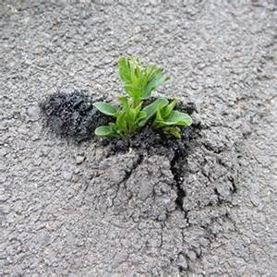
Notes:
LITTLE PLANTS

