Slide 1
An investigation into the milk
Question No. 12
Yucen (Ethan) Wu
-----------------------------------------------
5th IYNT 2017
Wellington High School
Notes:
Hi, my name is Ethan Wu and I’m going to present the question 12. My topic is an investigation into the milk

Slide 2
Question No. 12
Develop simple methods allowing determination of some of the important properties of milk. Suggest an investigation requiring comparison of various milk samples.
-----------------------------------------------
5th IYNT 2017
Wellington High School
2

Slide 3
What’s in Milk?
Fat
Lecithin
Water
Fat
Phospholipids
Cephalin
Lipids
Complex Lipids
Glycolipid
Nerve Phospholipids
Neutral Complex Lipid
Lipids Soluble Vitamins :
Vitamin A, Vitamin D, Vitamin E, Vitamin K, Carotene.
ᵅ - Casein
Casein
ᵦ - Casein
ᵧ - Casein
ᵅ-Lactoglobulin
Protein
Whey Protein
ᵦ - Lactalbumin
Serum Albumin
Fat Globulin Protein
Immunoglobulin
Solids Non Fat
Milk Solids
Nonprotein Compound :
Milk
Urea, Amino Acids, Creatine, Creatinine etc.
Carbohydrates :
Lactose, Glucose, Oligosaccharides etc.
Main Elements :
Calcium, Phosphorus, Potassium, Chlorine, Sodium, Magnesium, Sulfur, Iron.
Mineral :
Zinc, Aluminium, Copper, Silicon, Manganese, Molybdenum, Selenium, Lithium, Strontium, Boron, Fluorine.
Trace Elements :
Pigment :
Carotene, Lutein, Phosphatase, esterase etc.
Water Soluble Vitamins :
Vitamin B, Vitamin B2, Vitamin B6, Vitamin B12, Vitamin C, Niacin, Pantothenic Acid, Biotin, Folic Acid etc.
-------------------------------
5th IYNT 2017
Wellington High School
Cells : Breast Internal Epidermal Cells, Leukocyte.
Gas : Carbon dioxide, Nitrogen, Oxygen.
3
Notes:
People may know the answer to the question “What’s in milk?”. Like Fat, Calcium or protein. But what exact properties there are in one bottle of milk? First of all, there are Water, Milk Solids and Gas in milk. Milk solids are small, dairy-derived food particles that contain Lipids, Casein, Lactose and Trace Minerals of the products from which they were derived. But let’s just make it easier so that you can understand clearer. We can generalize the solids as Fat and Solids Non Fat. The customers are usually interested in the Fat content. The farmers are paid by the amount of Solids Non Fat. So that’s why these two are the important properties.

Slide 4
Established Methods
Dehydration
Gerber Method
Spectroscopy
-----------------------------------------------
5th IYNT 2017
Wellington High School
4
Notes:
To find the content of Fat and Solids Non Fat, I did three experiments by using these three methods: Dehydration, Gerber Method and Spectroscopy.

Slide 5
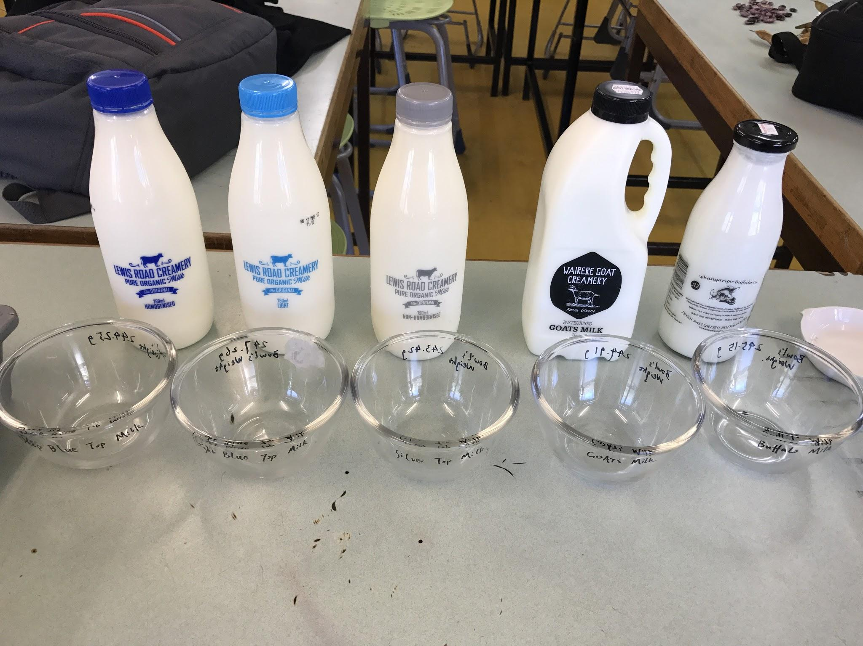
Milk Samples
Standard Fat
Light Fat
Full Fat
Samples:
Dark Blue Top Milk
Light Blue Top Milk
Silver Top Milk
Goats Milk
Buffalo Milk
--------------------------------
5th IYNT 2017
Wellington High School
5
Notes:
The milk in New Zealand usually have different top to distinguish different types of milk. The Dark Blue top stands for Standard Fat Milk. The Light blue top stands for Light Fat milk and the Silver top stands for Full Fat milk. The rest of two are Goats Milk and Buffalo Milk.

Slide 6
Dehydration
FIND THE PERCENTAGE OF SOLIDS IN THE MILK SAMPLES
Dark Blue Top Organic Milk
Light Blue Top Organic Milk
Silver Top Organic Milk
Goats Milk
Buffalo Milk
--------------------------------
5th IYNT 2017
Wellington High School
6
Notes:
The first test I did was mean to find the percentage of solids in the milk samples.

Slide 7
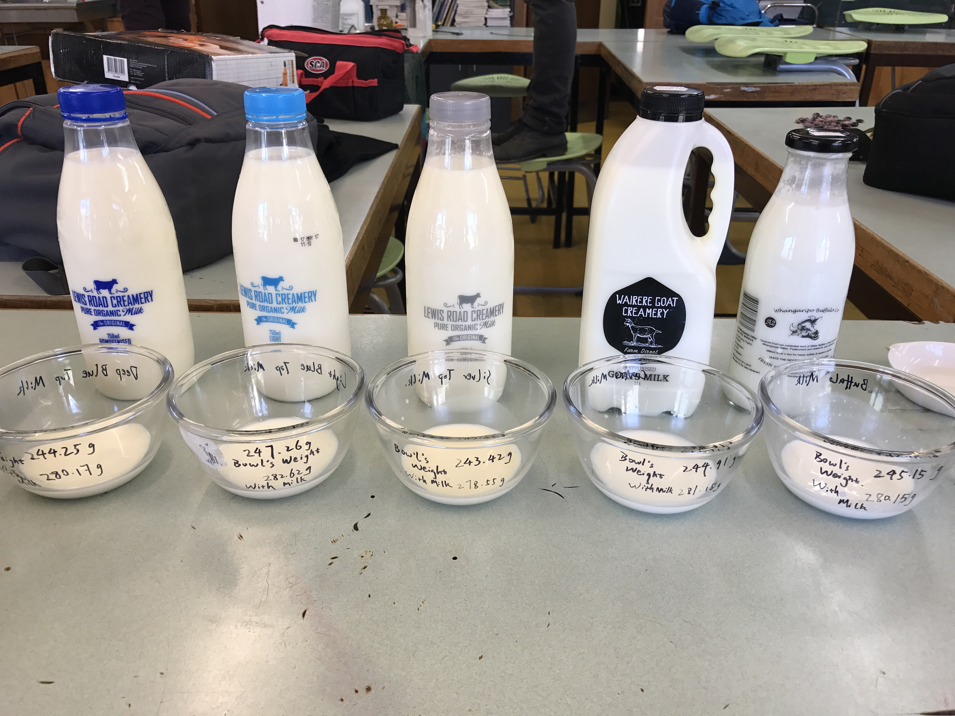
Step 1
Glass Bowl
Electronic Scales
(2 decimal places)
-------------------------------
5th IYNT 2017
Wellington High School
7
Notes:
Before I pour the milk into the glass bowls, I weighted the glass bowls. I weighted again after I pour the milk into the bowls so that I could get a result of the weight of the milk.

Slide 8
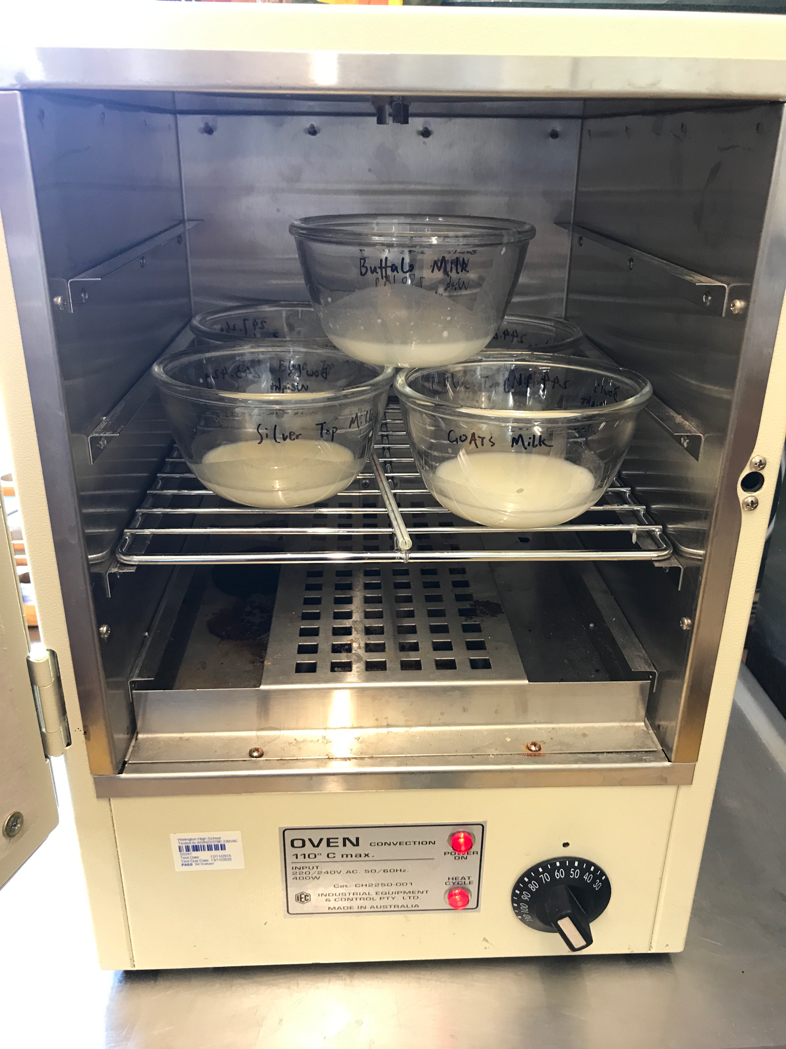
Step 2
Setting Temperature:
56℃
Dehydrator
Thermometer
Actual Temperature:
52℃~62℃
-----------------------------------------------
5th IYNT 2017
Wellington High School
8

Slide 9
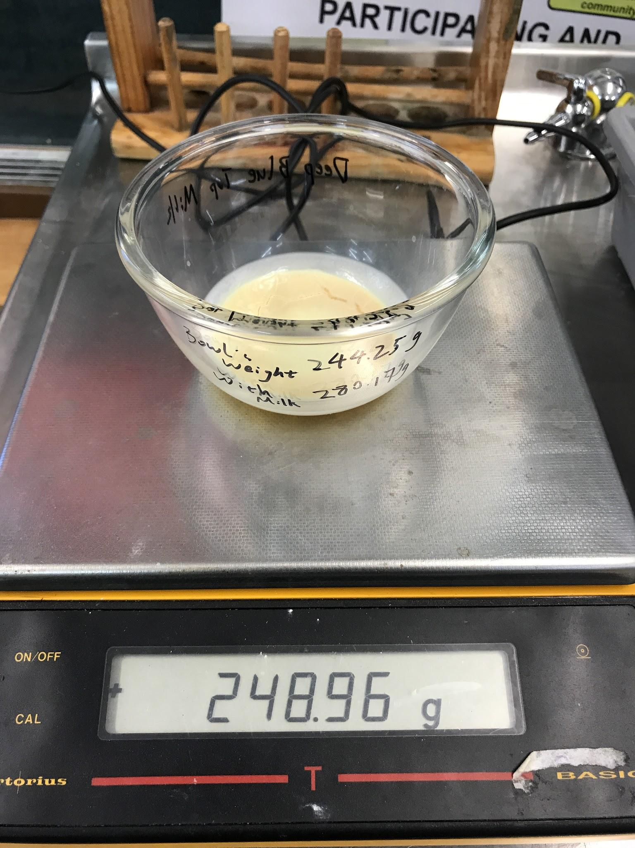
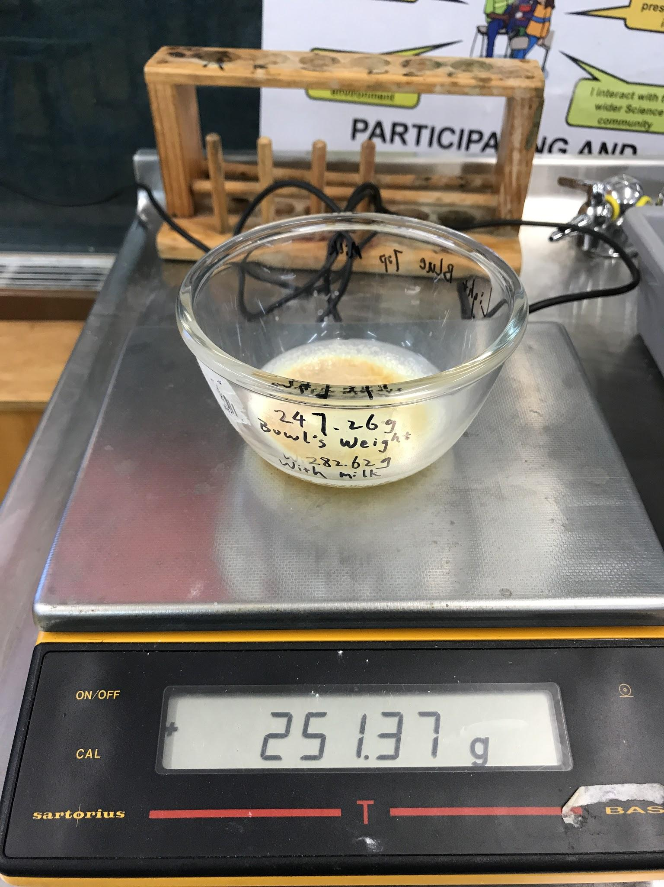
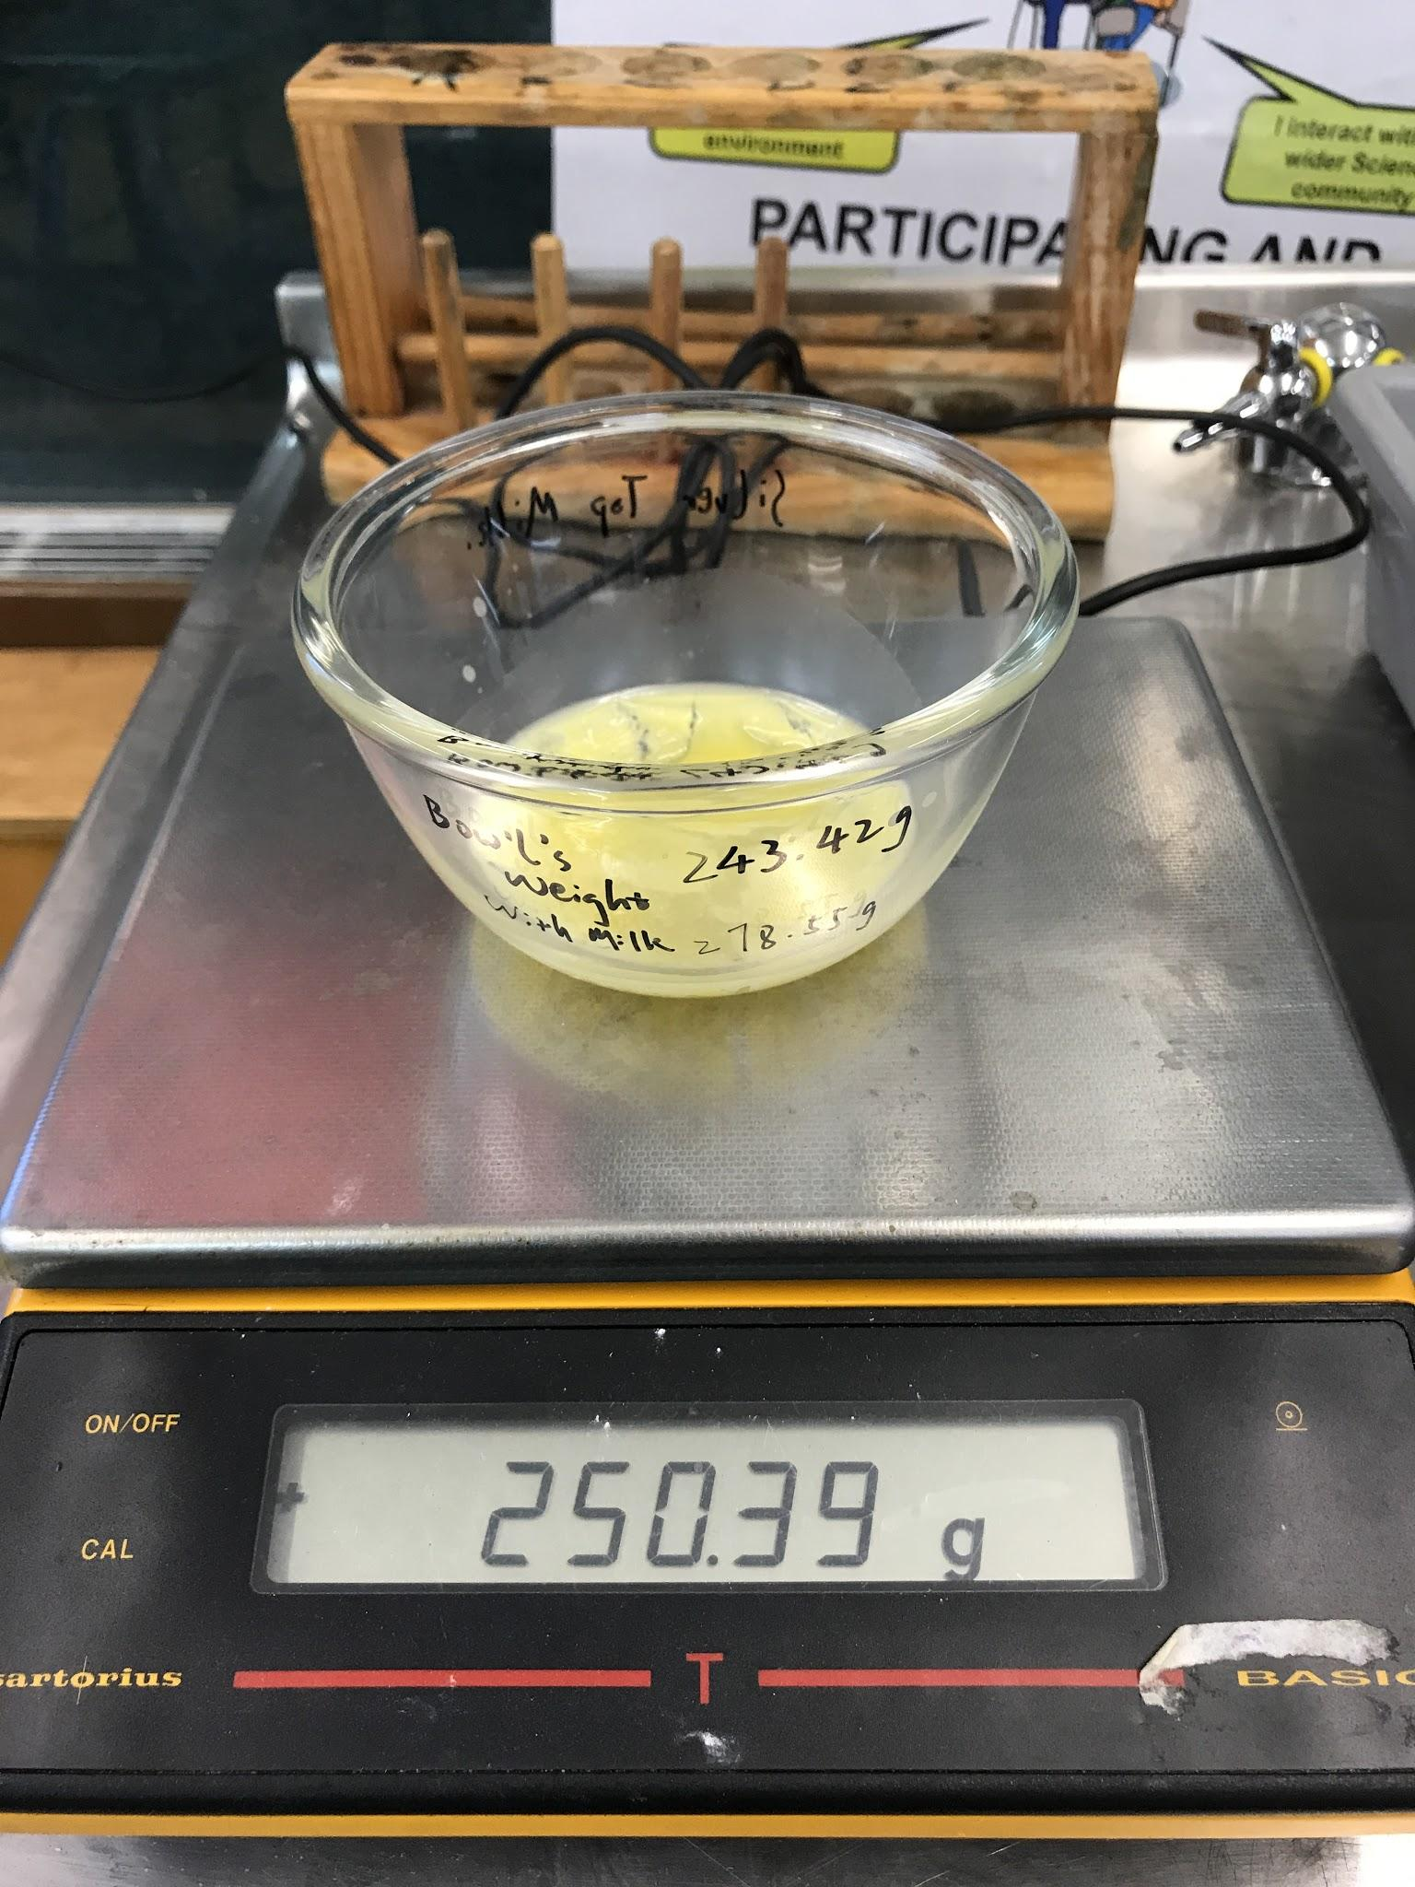
Result - 1
Total Time: 21.5 hours
Dark Blue Top Milk
Light Blue Top Milk
Silver Top Milk
4.71g
4.11g
6.97g
9
Notes:
After 21.5 hours, I got a result about the weight of the solids from different milk samples.

Slide 10
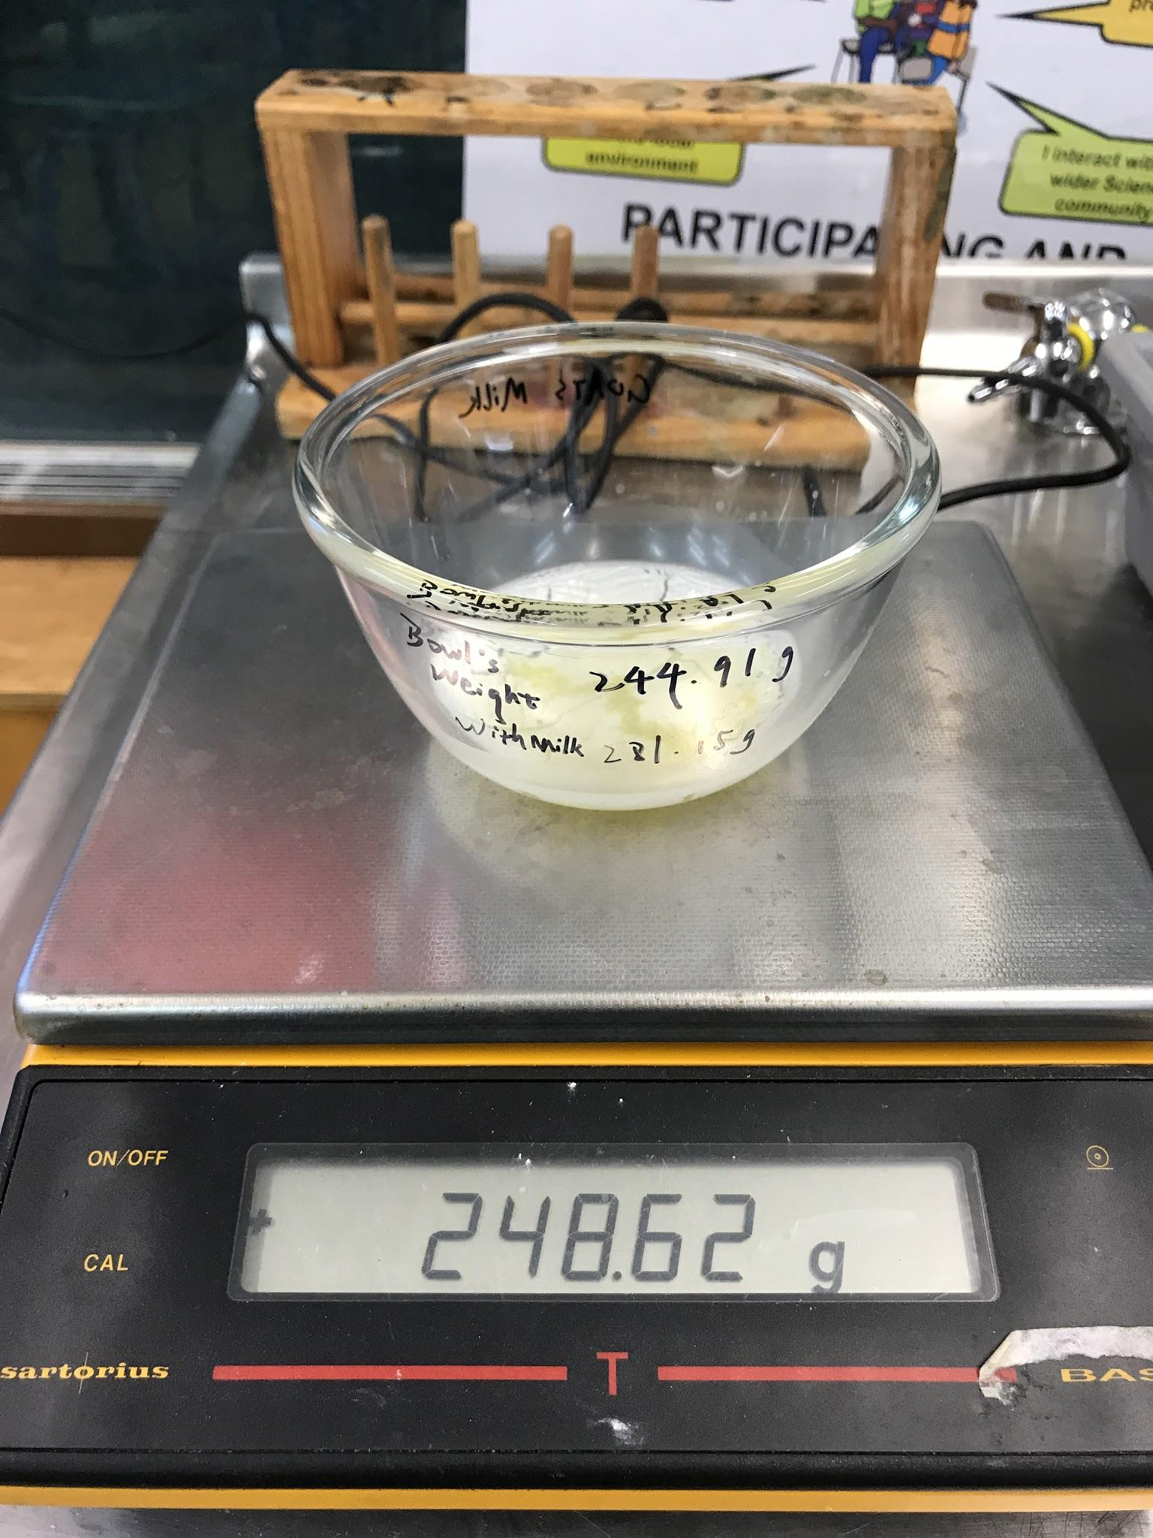
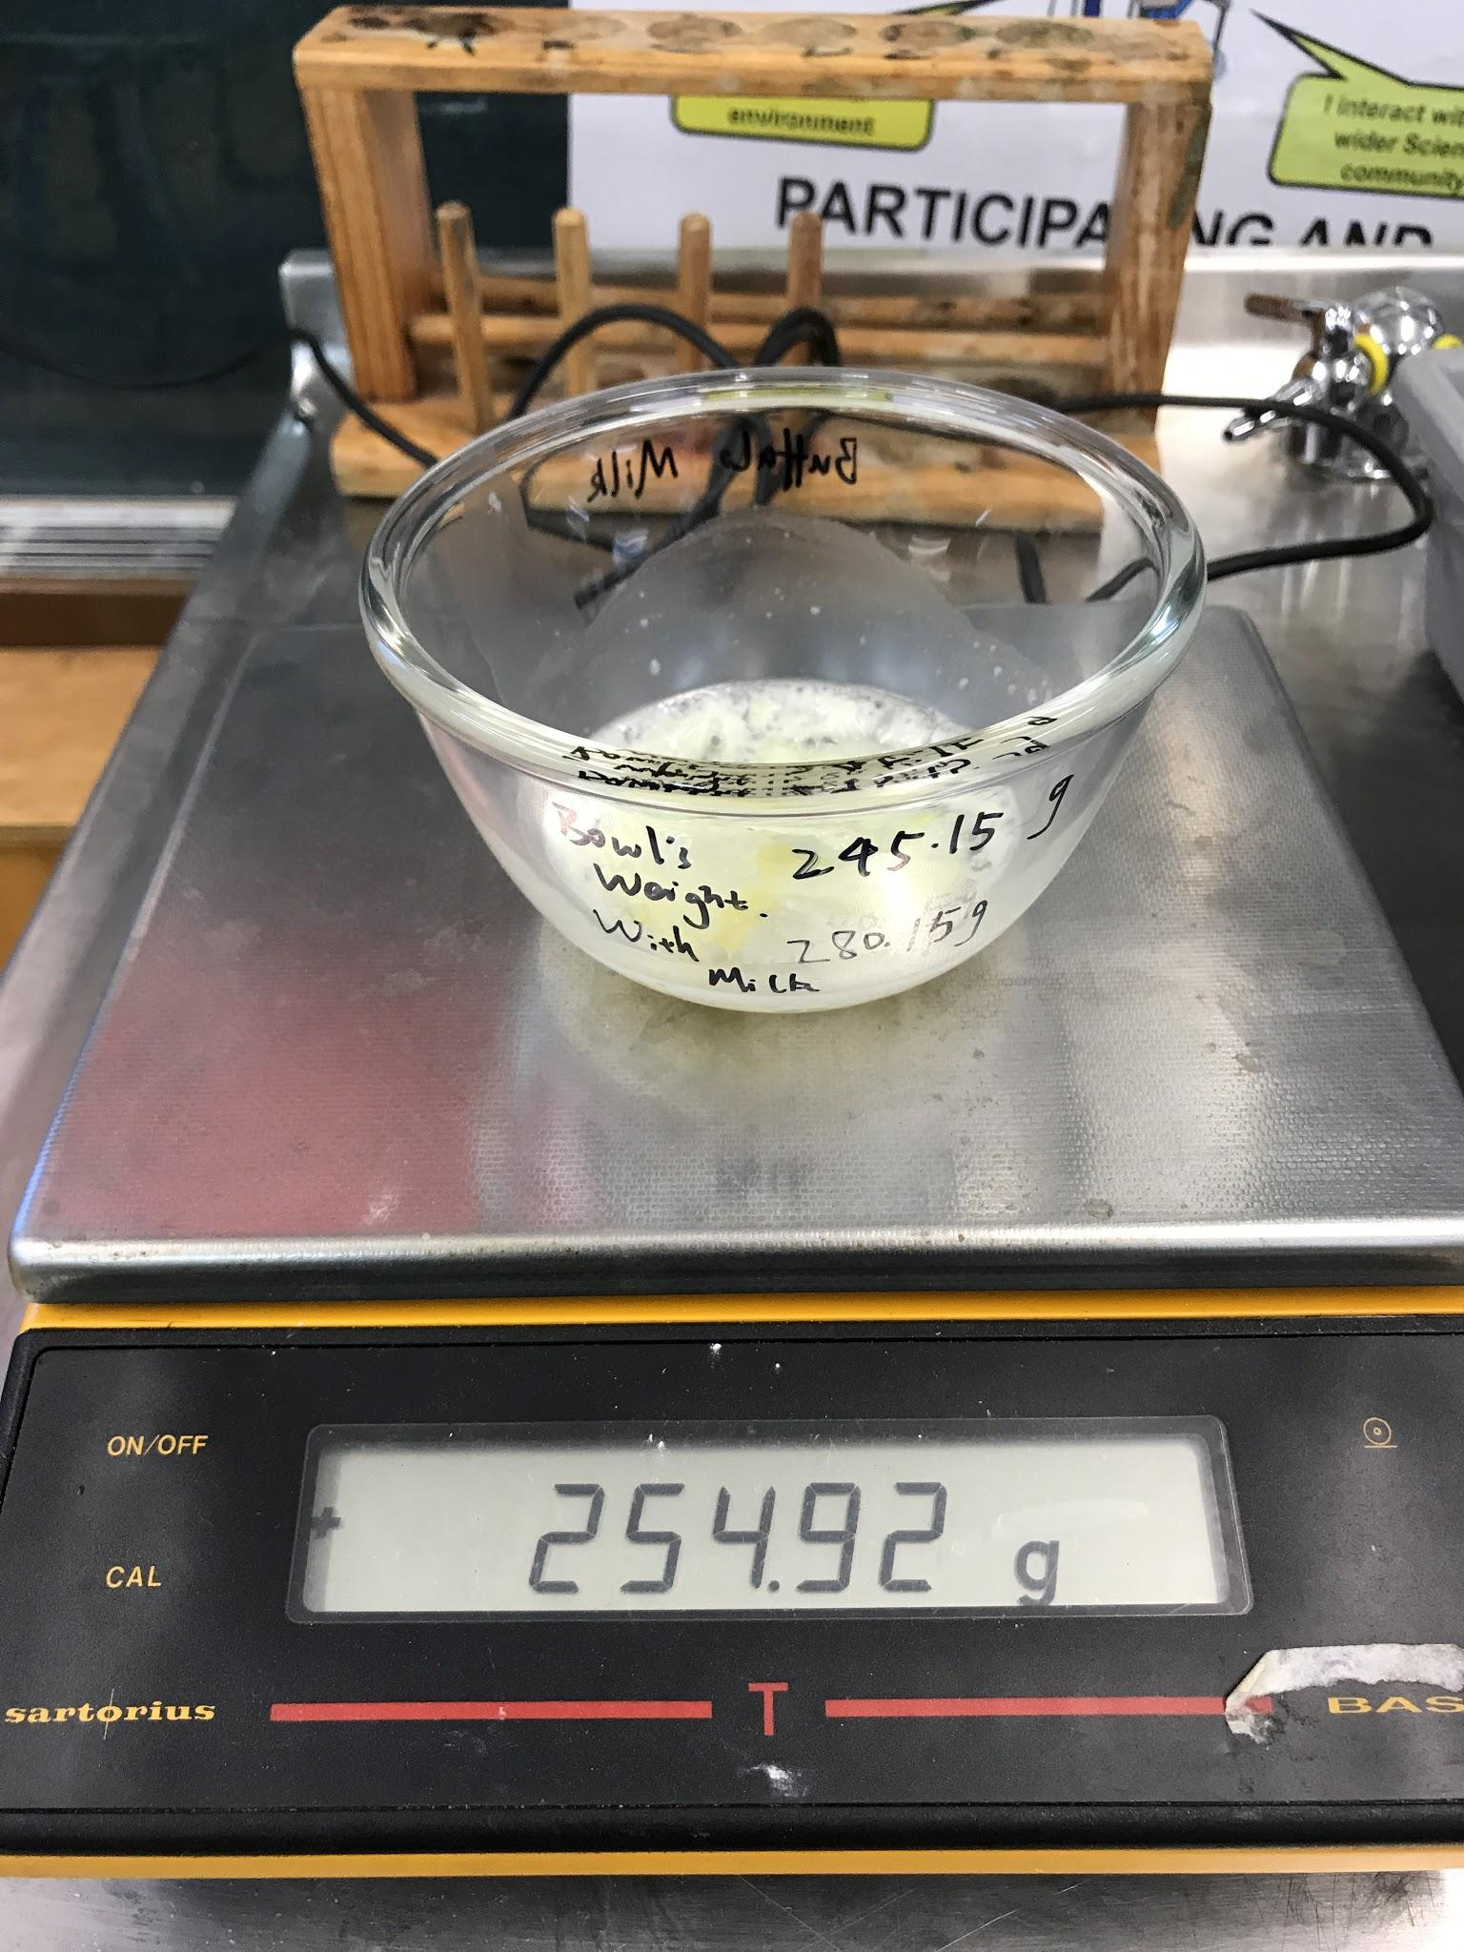
Result - 2
Goats Milk
Buffalo Milk
3.71g
9.77g
10

Slide 11
Integrations of Resources
 | Dark Blue Top Milk | Light Blue Top Milk | Silver Top Milk | Goats Milk | Buffalo Milk
The Mass of The Milk Samples | 35.92g | 35.36g | 35.13g | 36.24g | 35.00g
Volume of Milk | 34.87 ml | 34.33 ml | 34.10 ml | 35.18 ml | 33.98 ml
The Mass of The Left Solids | 4.71g | 4.11g | 6.97g | 3.71g | 9.77g
Mass per 100 ml | 13.5 g | 12.0 g | 20.4 g | 10.5 g | 28.8 g
-----------------------------------------------
5th IYNT 2017
Wellington High School
11
Notes:
After I got the weight of the solids from different samples,

Slide 12
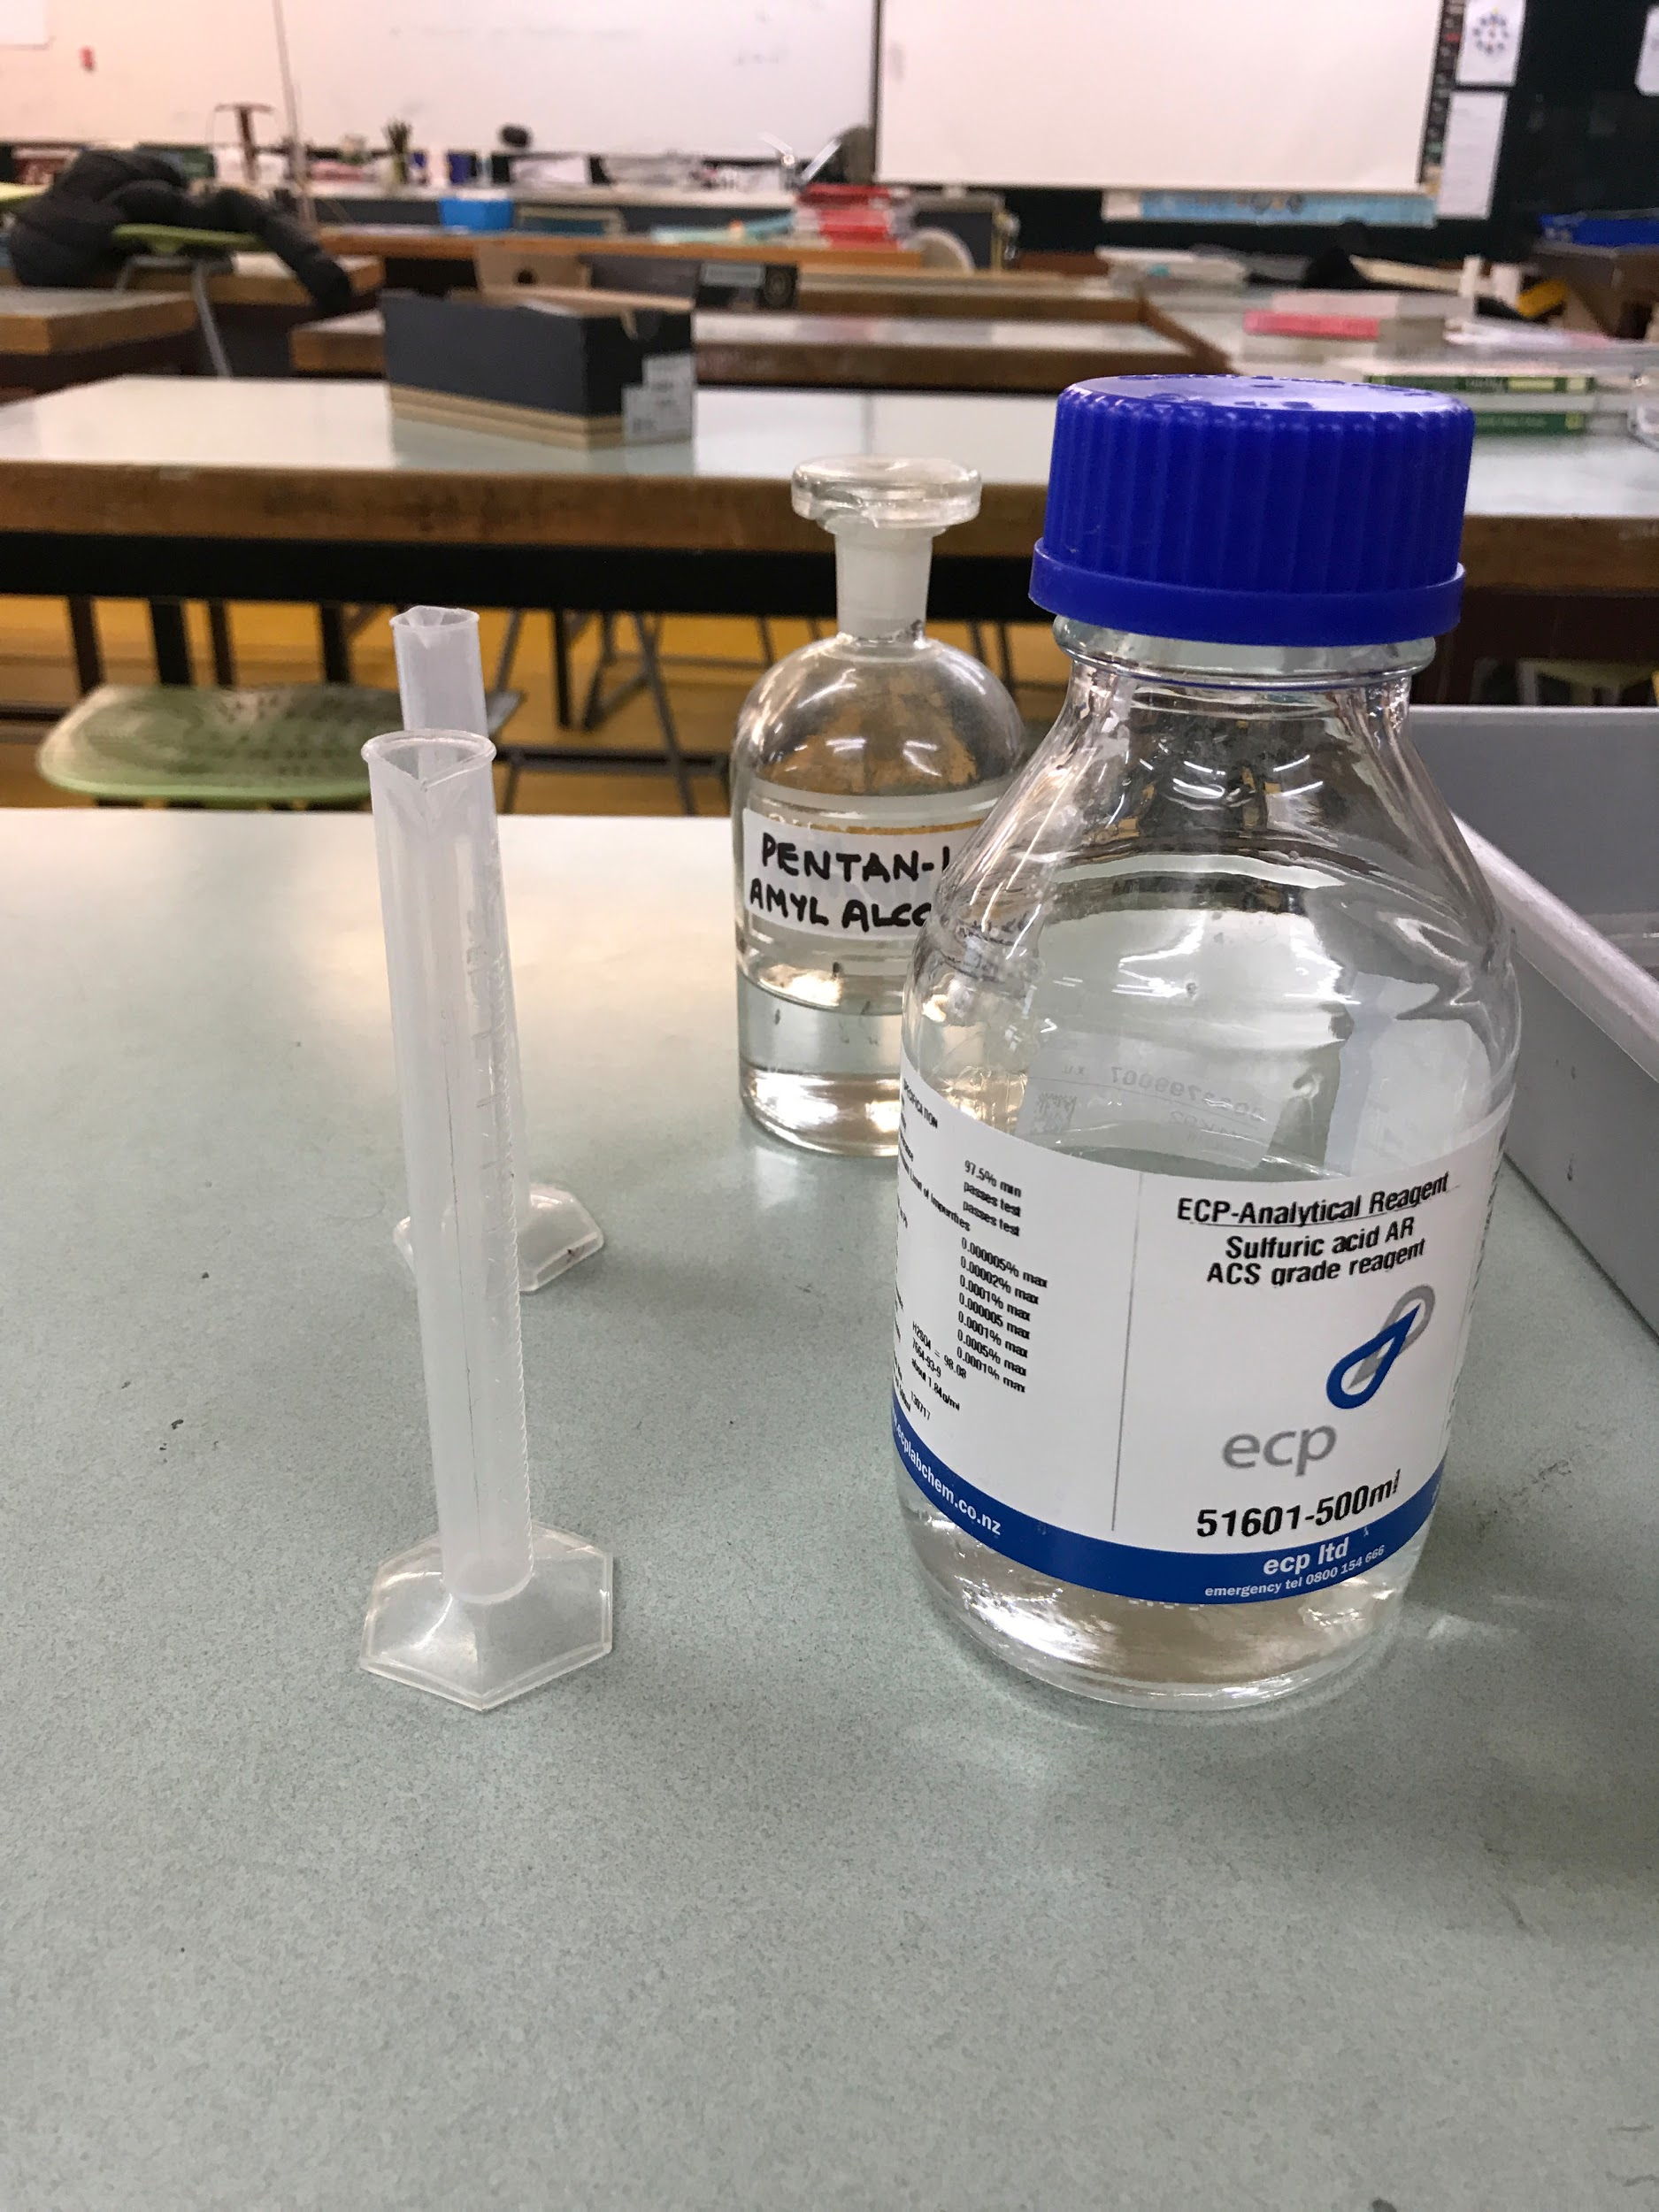
Gerber Method
FIND THE PERCENTAGE OF FAT
IN THE MILK SAMPLES
Sulphuric acid
Amyl alcohol
-----------------------------------------------
5th IYNT 2017
Wellington High School
12
Notes:
The second method I used was Gerber Method. The fat testing using Gerber method is one of the many quality assurance test procedures carried out in milk. Due to application of centrifugal force lighter substances (fat) are thrown towards center and rest of serum portion that is heavier is thrown towards the periphery. The Gerber Method is mean to find the percentage of fat in the milk.

Slide 13
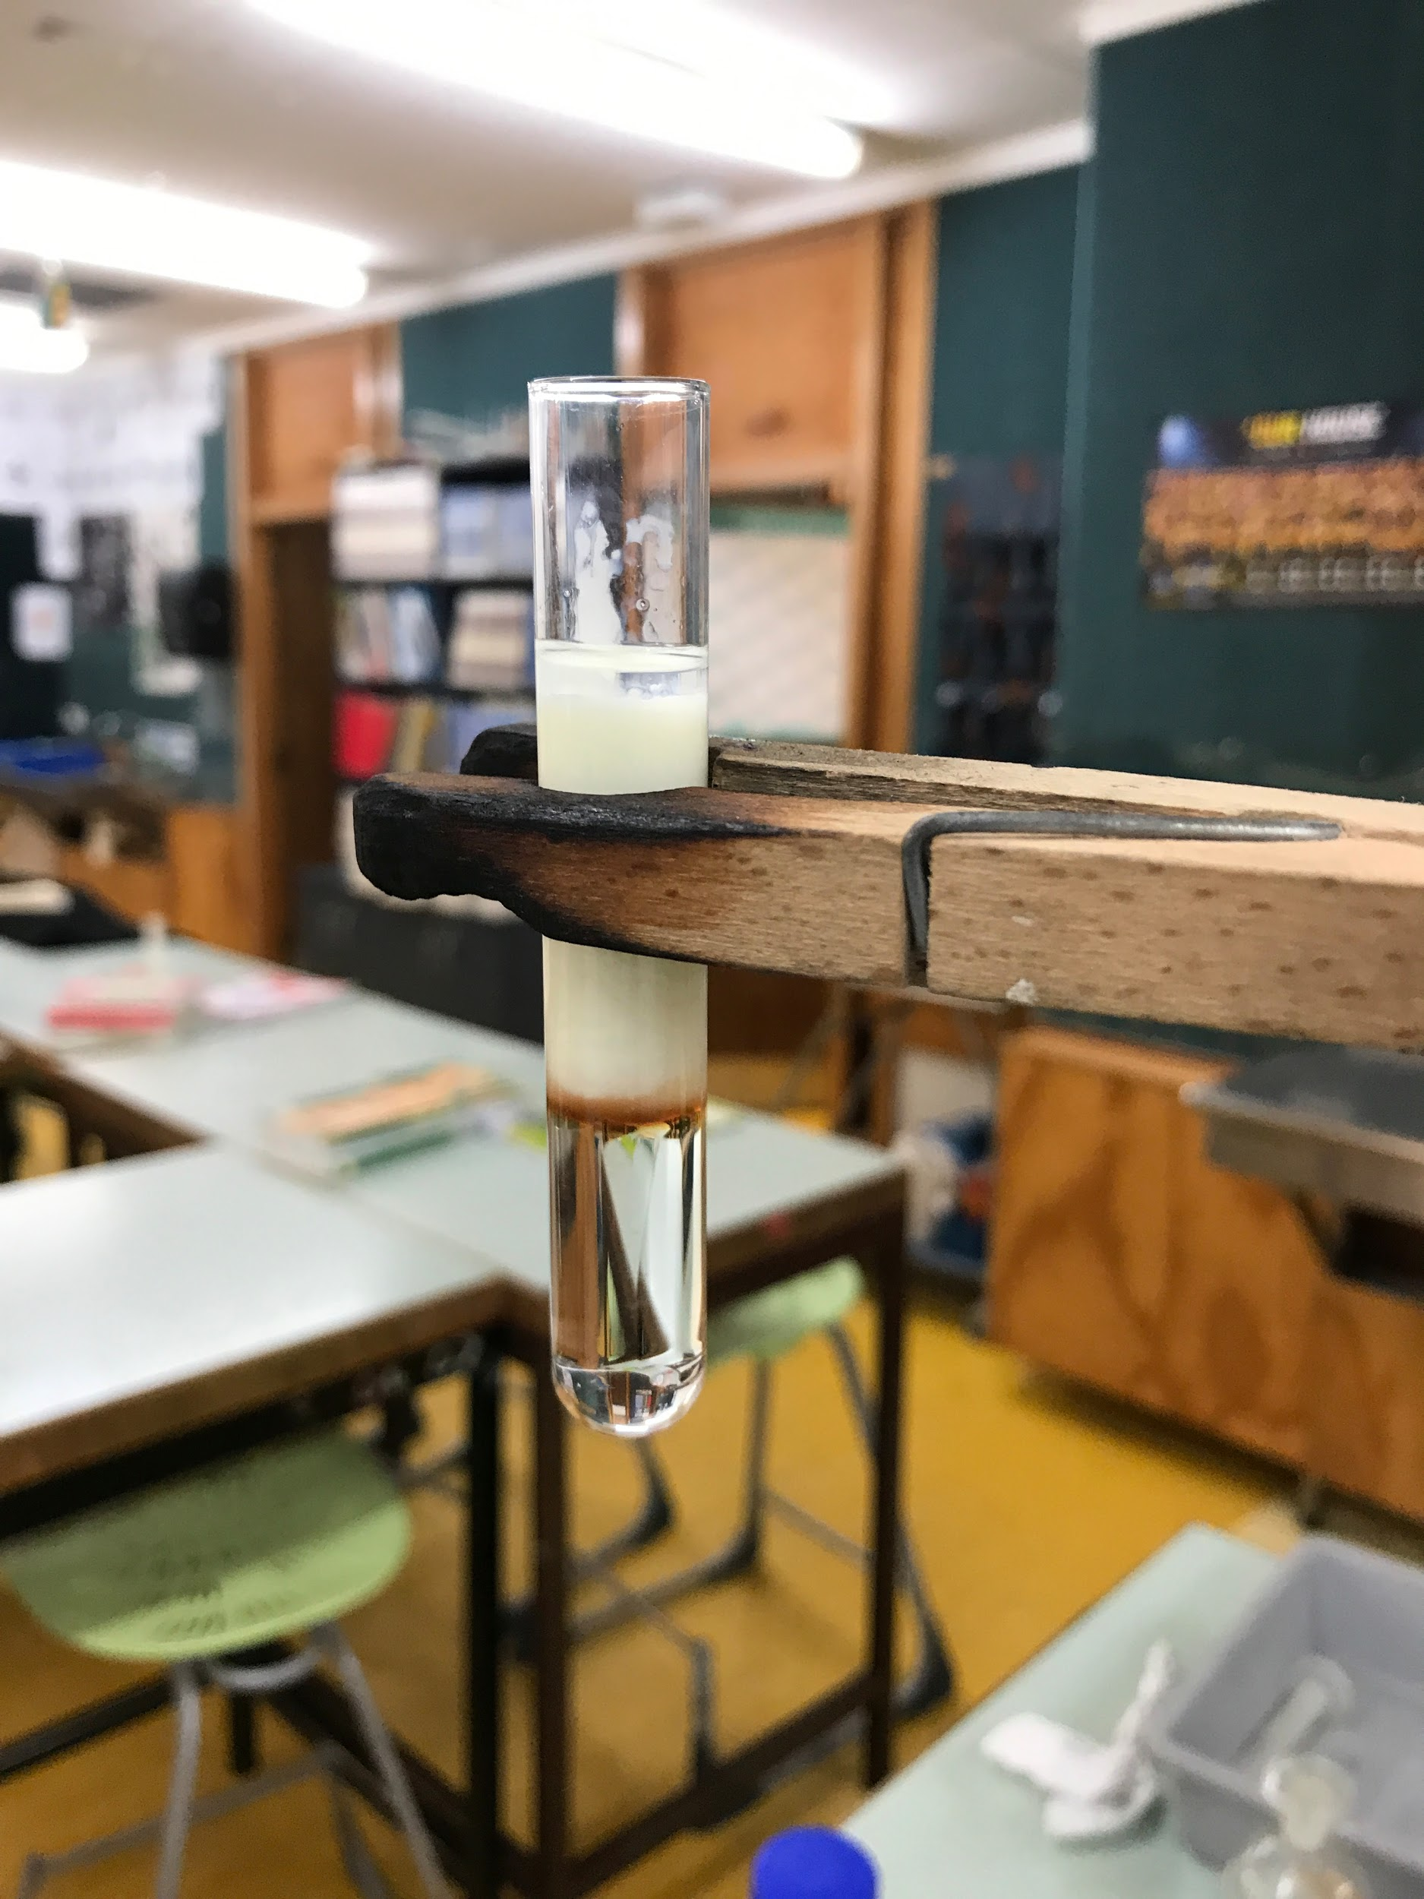
Step 1
Amyl alcohol -- 0.5 ml
Milk -- 5.375 ml
Sulphuric acid -- 5 ml
-----------------------------------------------
5th IYNT 2017
Wellington High School
13
Notes:
I put these reagents in the order of Sulphuric Acid, Milk and covered with Amyl Alcohol. Adding milk into the acid produces an exothermic reaction. The heat produced melts the fat and reduces its viscosity. I suppose to use 10.75 milliliters of milk, but unfortunately the big test tube couldn’t fit the centrifuge, So I decided to half all the reagents. Addition of amyl alcohol helps for separation of fat from the milk acid mixture and also prevents the charging of fat and sugar by the Sulfuric Acid.
The reason to use 10.75 milliliters of milk is that The principle relies on the weight of fat in the sample. For each 1% calibration of the butyrometer, there will be 0.125ml of fat.
This means that the weight of the fat content is equivalent to the volume X density; 0.125 x 0.93 = 0.1125. Now, if 1 % graduation represents 0.1125g then 100 % will give us 11.25g of the fat content. Milk has an average specific gravity of 1.032, you should use 11.25 / 1.032 = 10.9 ml of milk. Since there will always be some residual volume of milk left in the pipette, hence the pipette calibration to 10.75 ml.

Slide 14
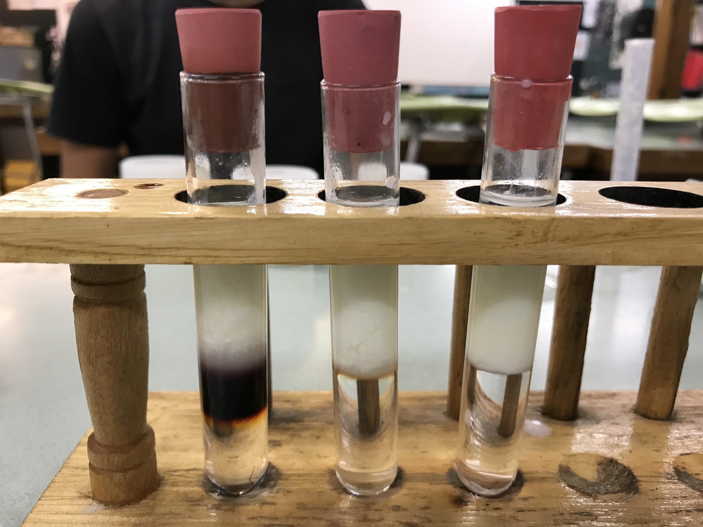
Step 2
Rubber stoppers
-----------------------------------------------
5th IYNT 2017
Wellington High School
14
Notes:
The reason I used the Sulphuric Acid is, Digests casein and organic matter in milk to facilitate fat separation. The differences in density between the acid and fat will make the distinction clearer during and after centrifuging

Slide 15
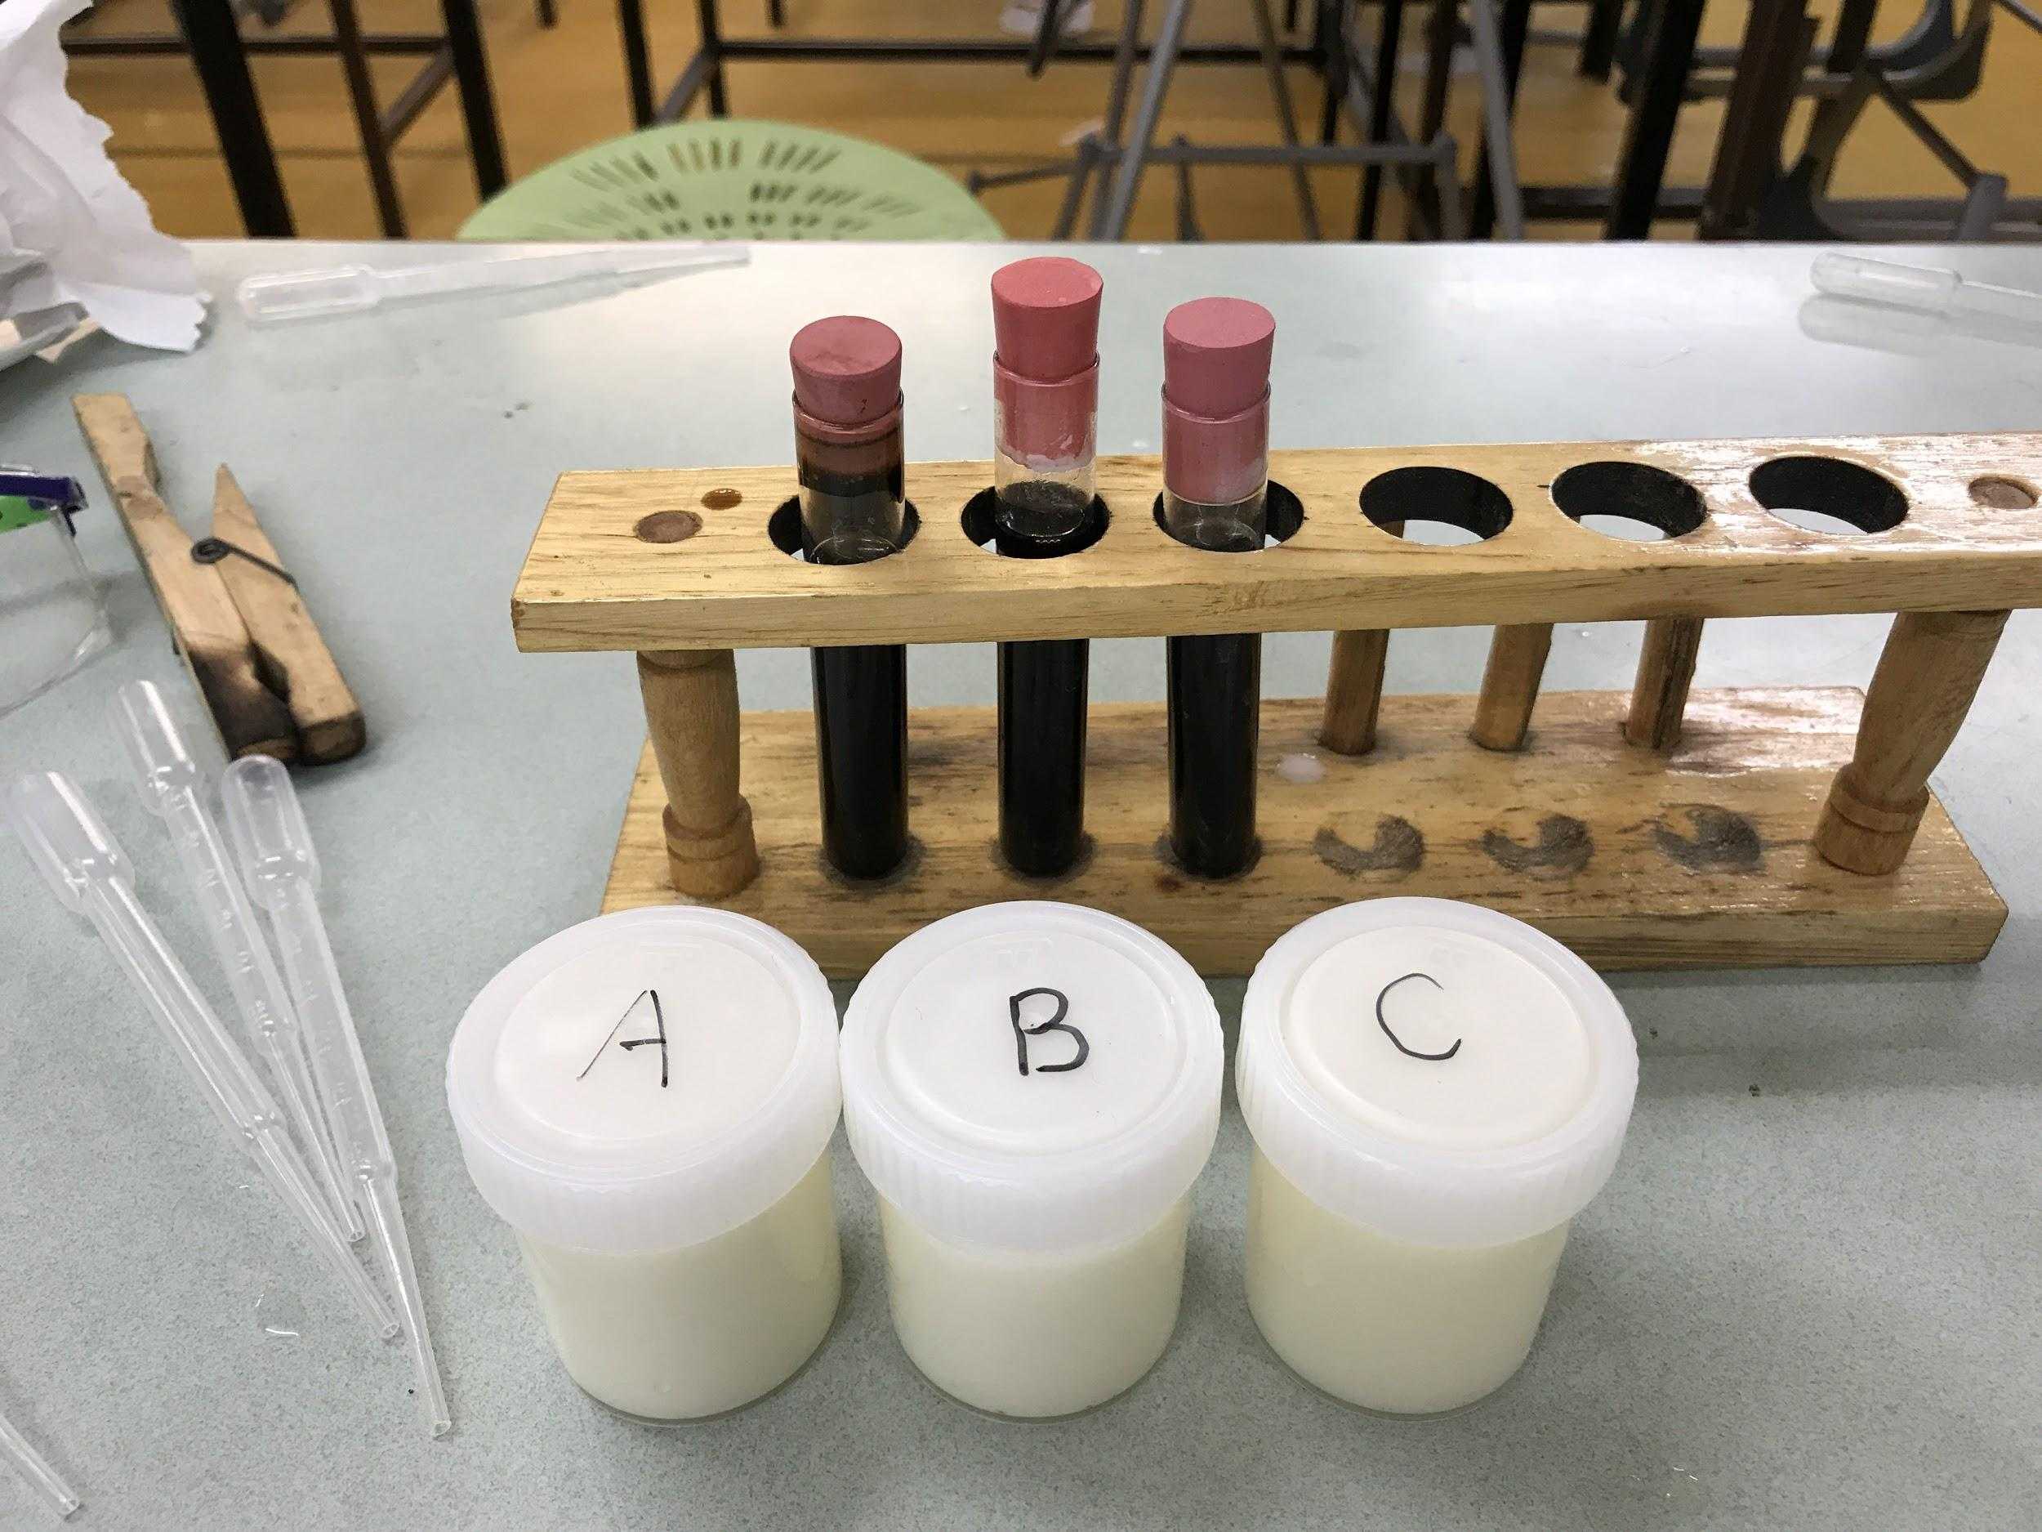
Step 3
Shake and Mix them
-----------------------------------------------
5th IYNT 2017
Wellington High School
15

Slide 16
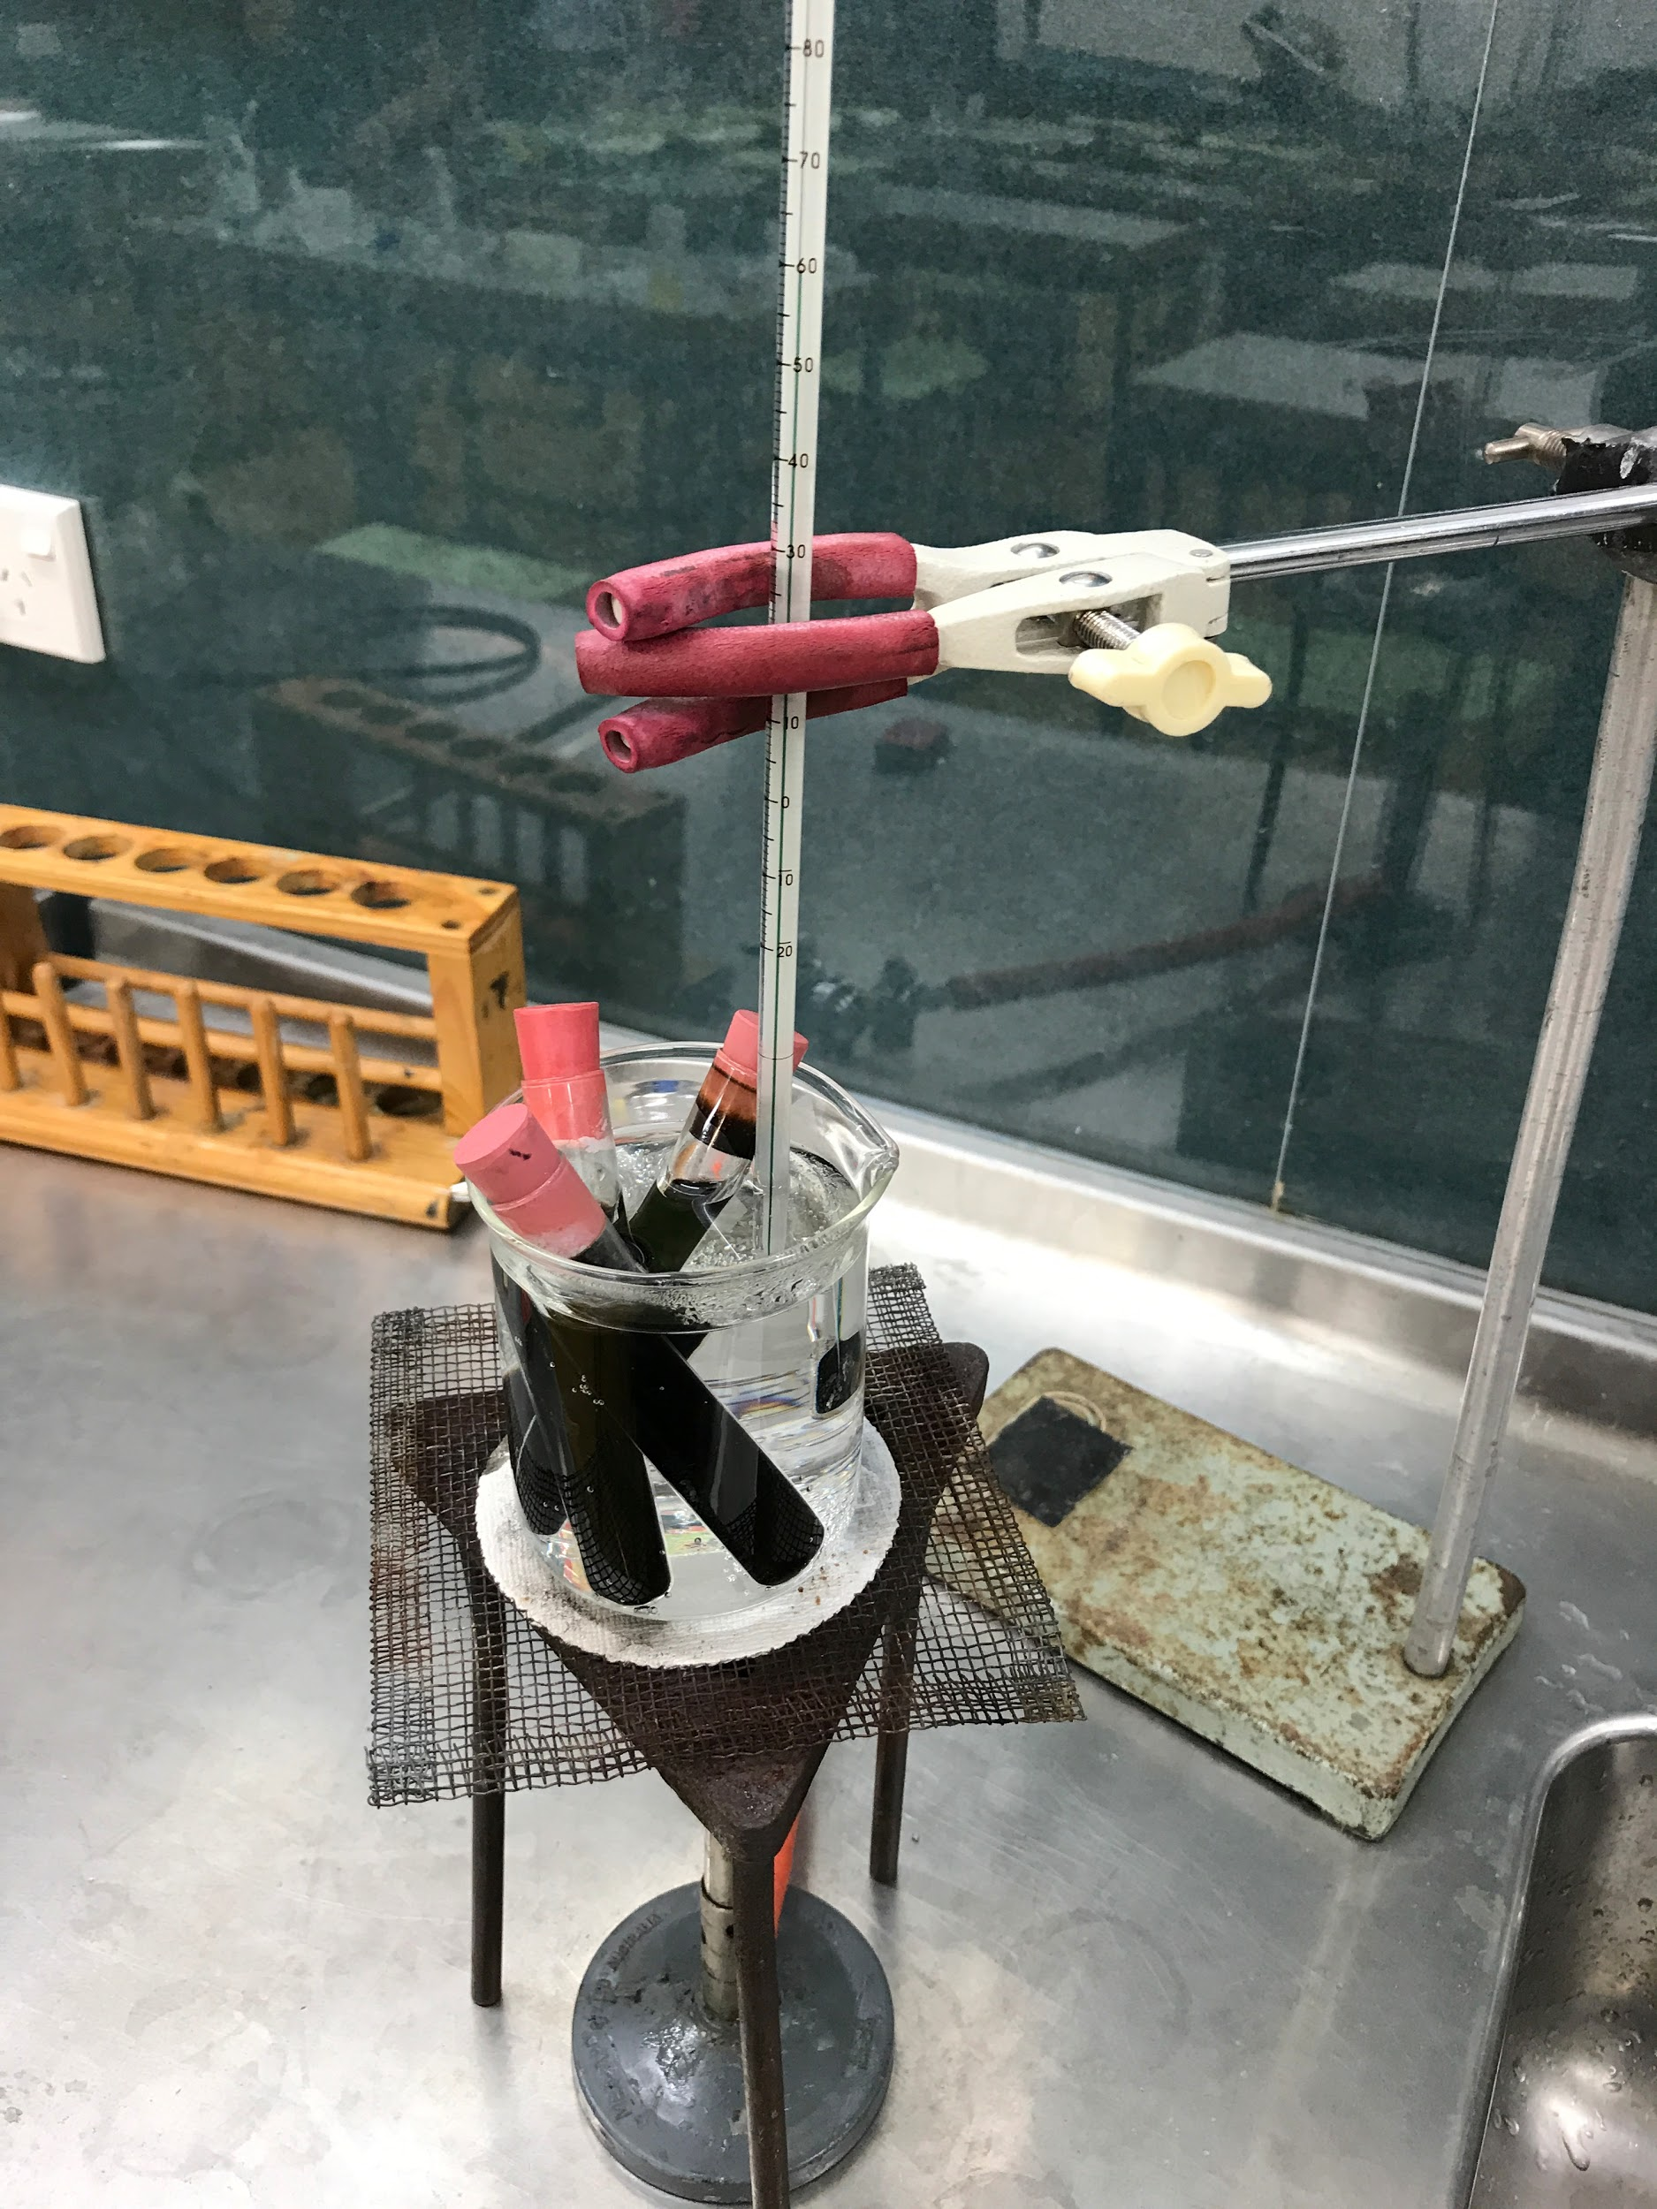
Step 4
Thermostatic water bath for 3
minutes at 60℃
-----------------------------------------------
5th IYNT 2017
Wellington High School
16

Slide 17
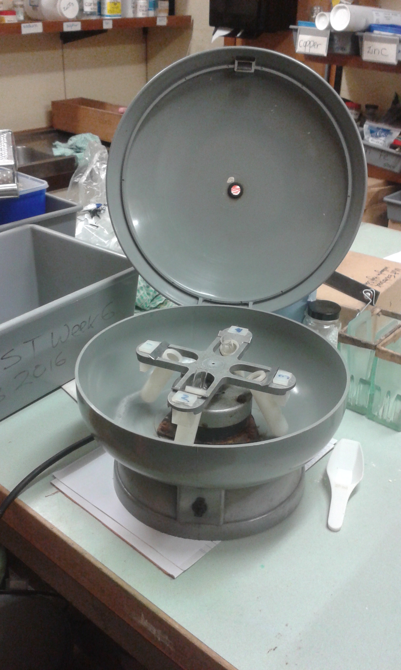
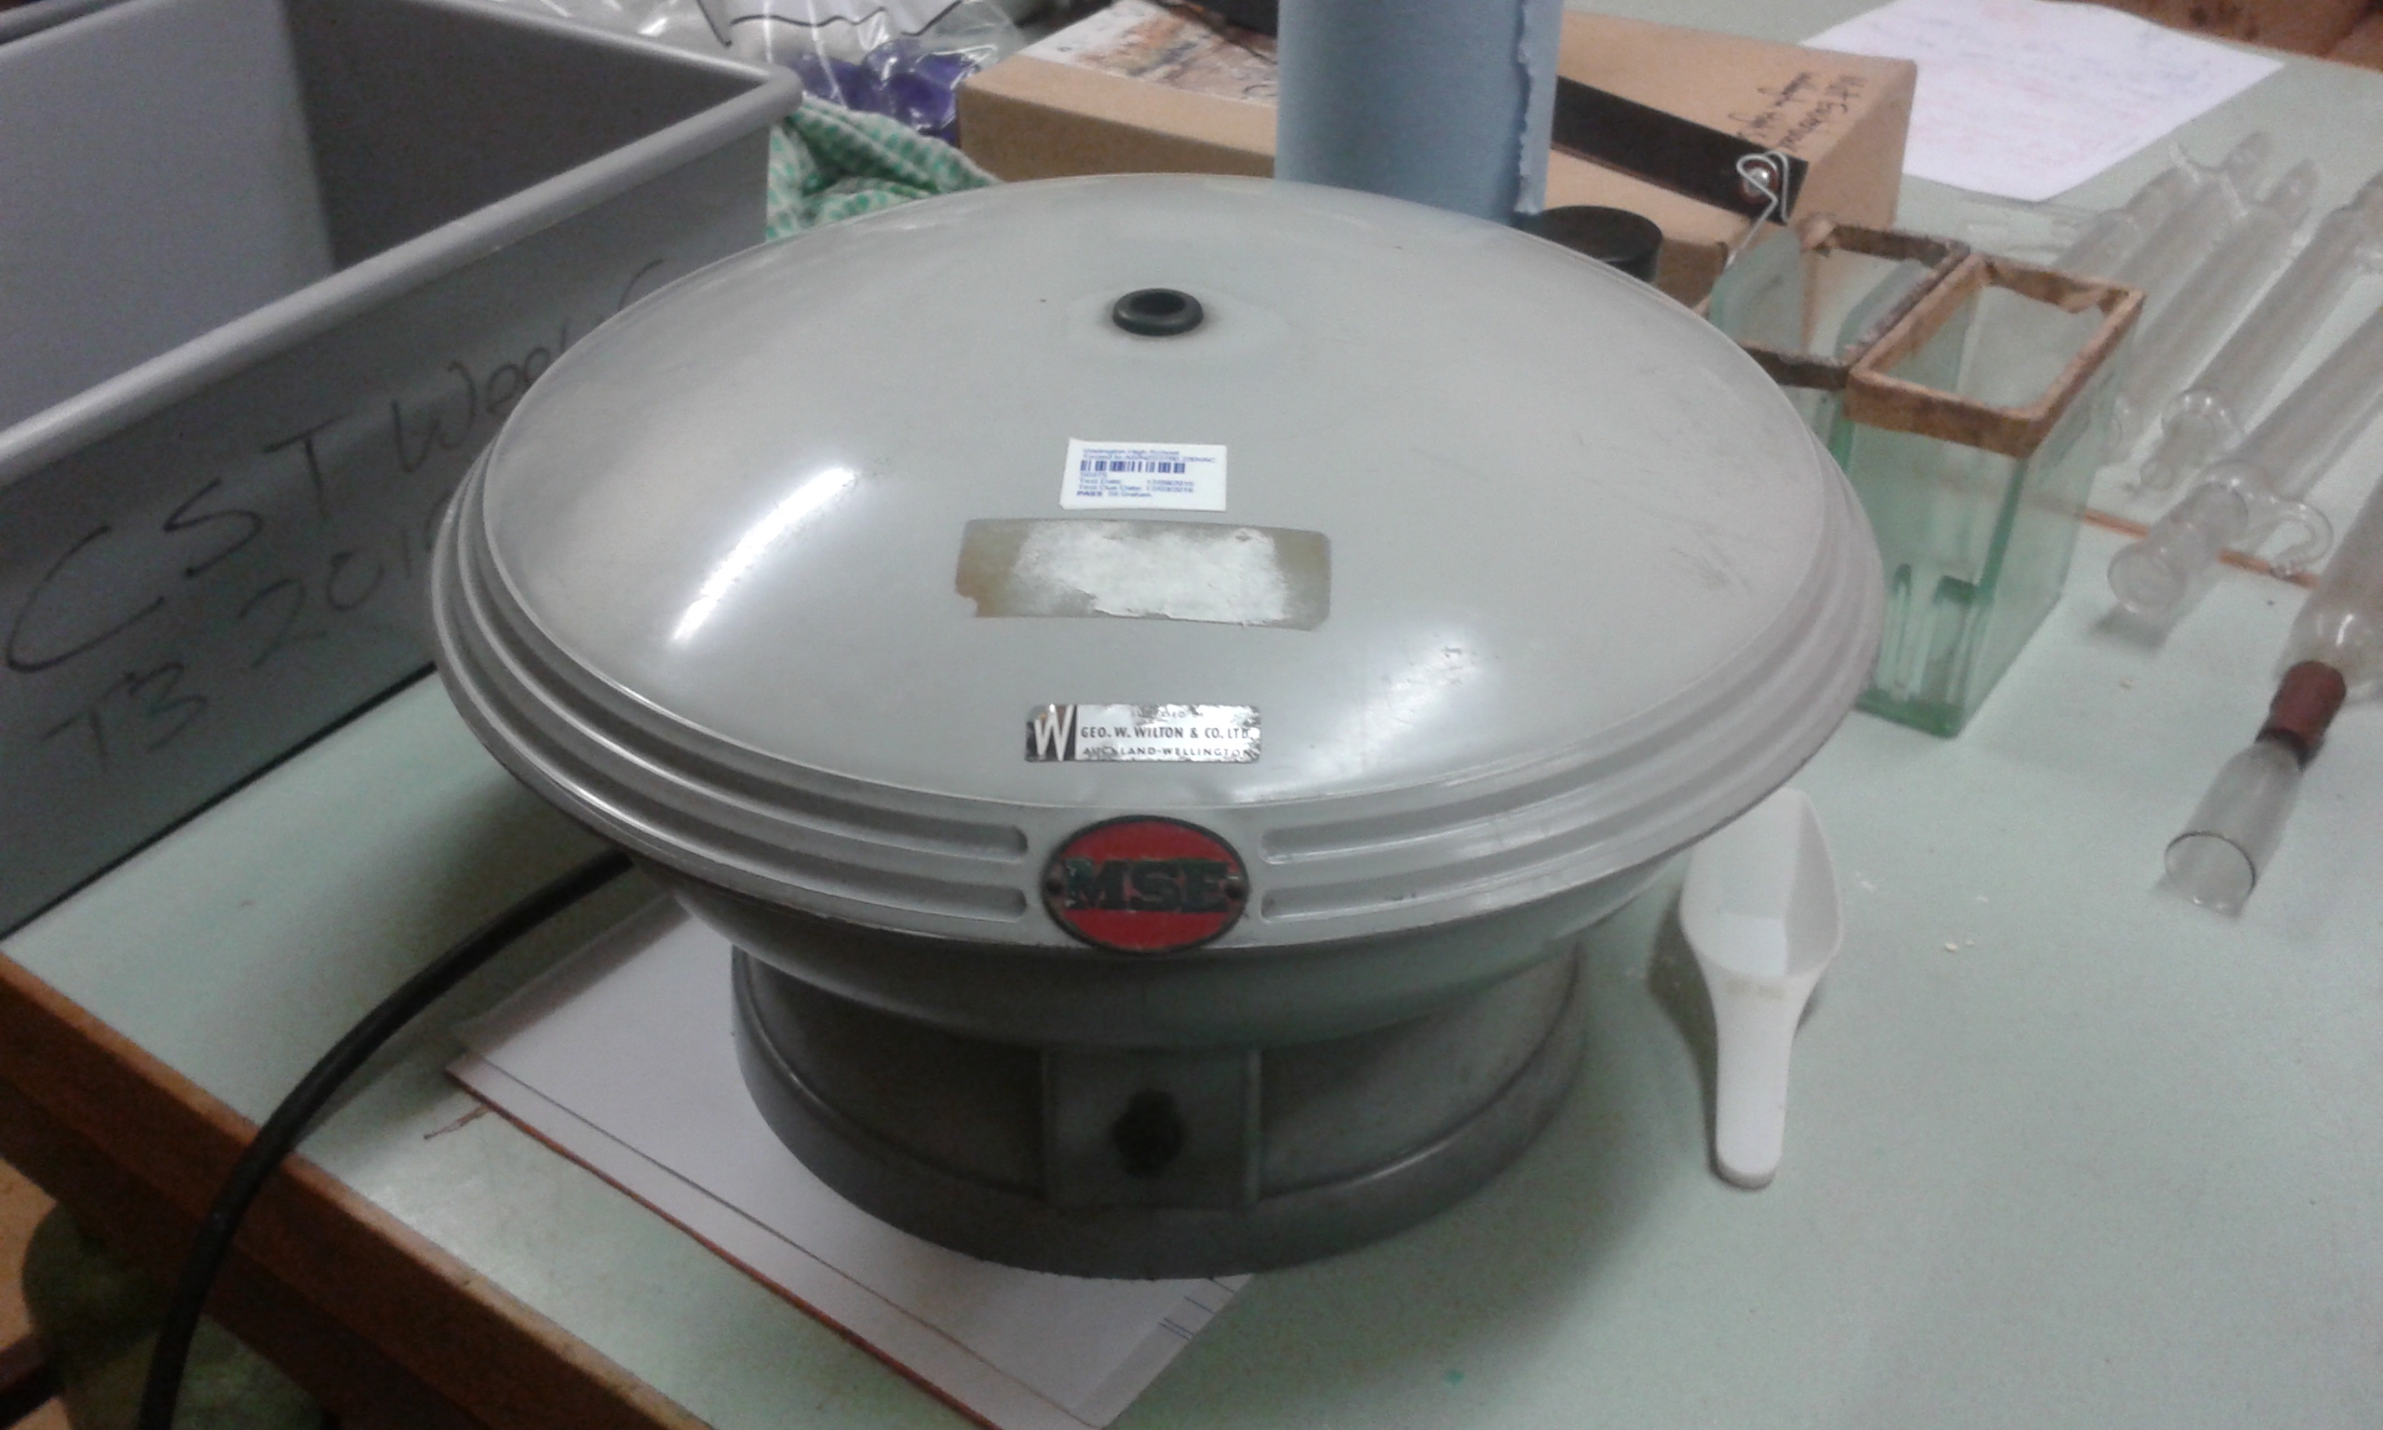
Step 5
Put into the centrifuge for 4 minutes (1100 rpm)
-----------------------------------------------
5th IYNT 2017
Wellington High School
17

Slide 18
Result - 1
A
B
C
C
D
E
18

Slide 19
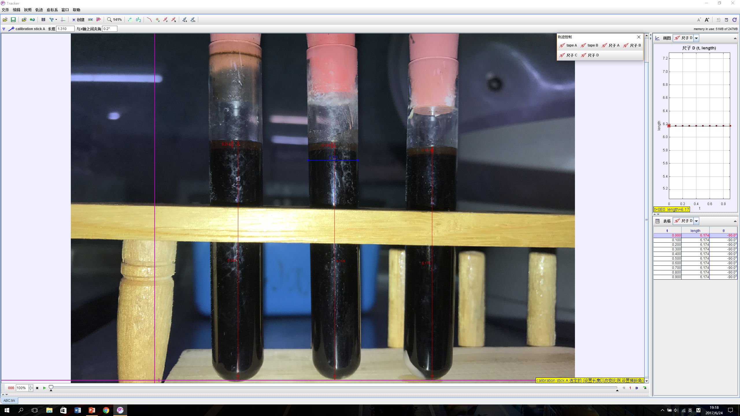
0.214
0.168
0.193
1.310
6.342
6.286
6.174
19
Notes:
First I measured the interior diameter of the test tube and made a proportion on the photo. I can then get the height of the fat. Then I can solve the volume of the fat content.

Slide 20
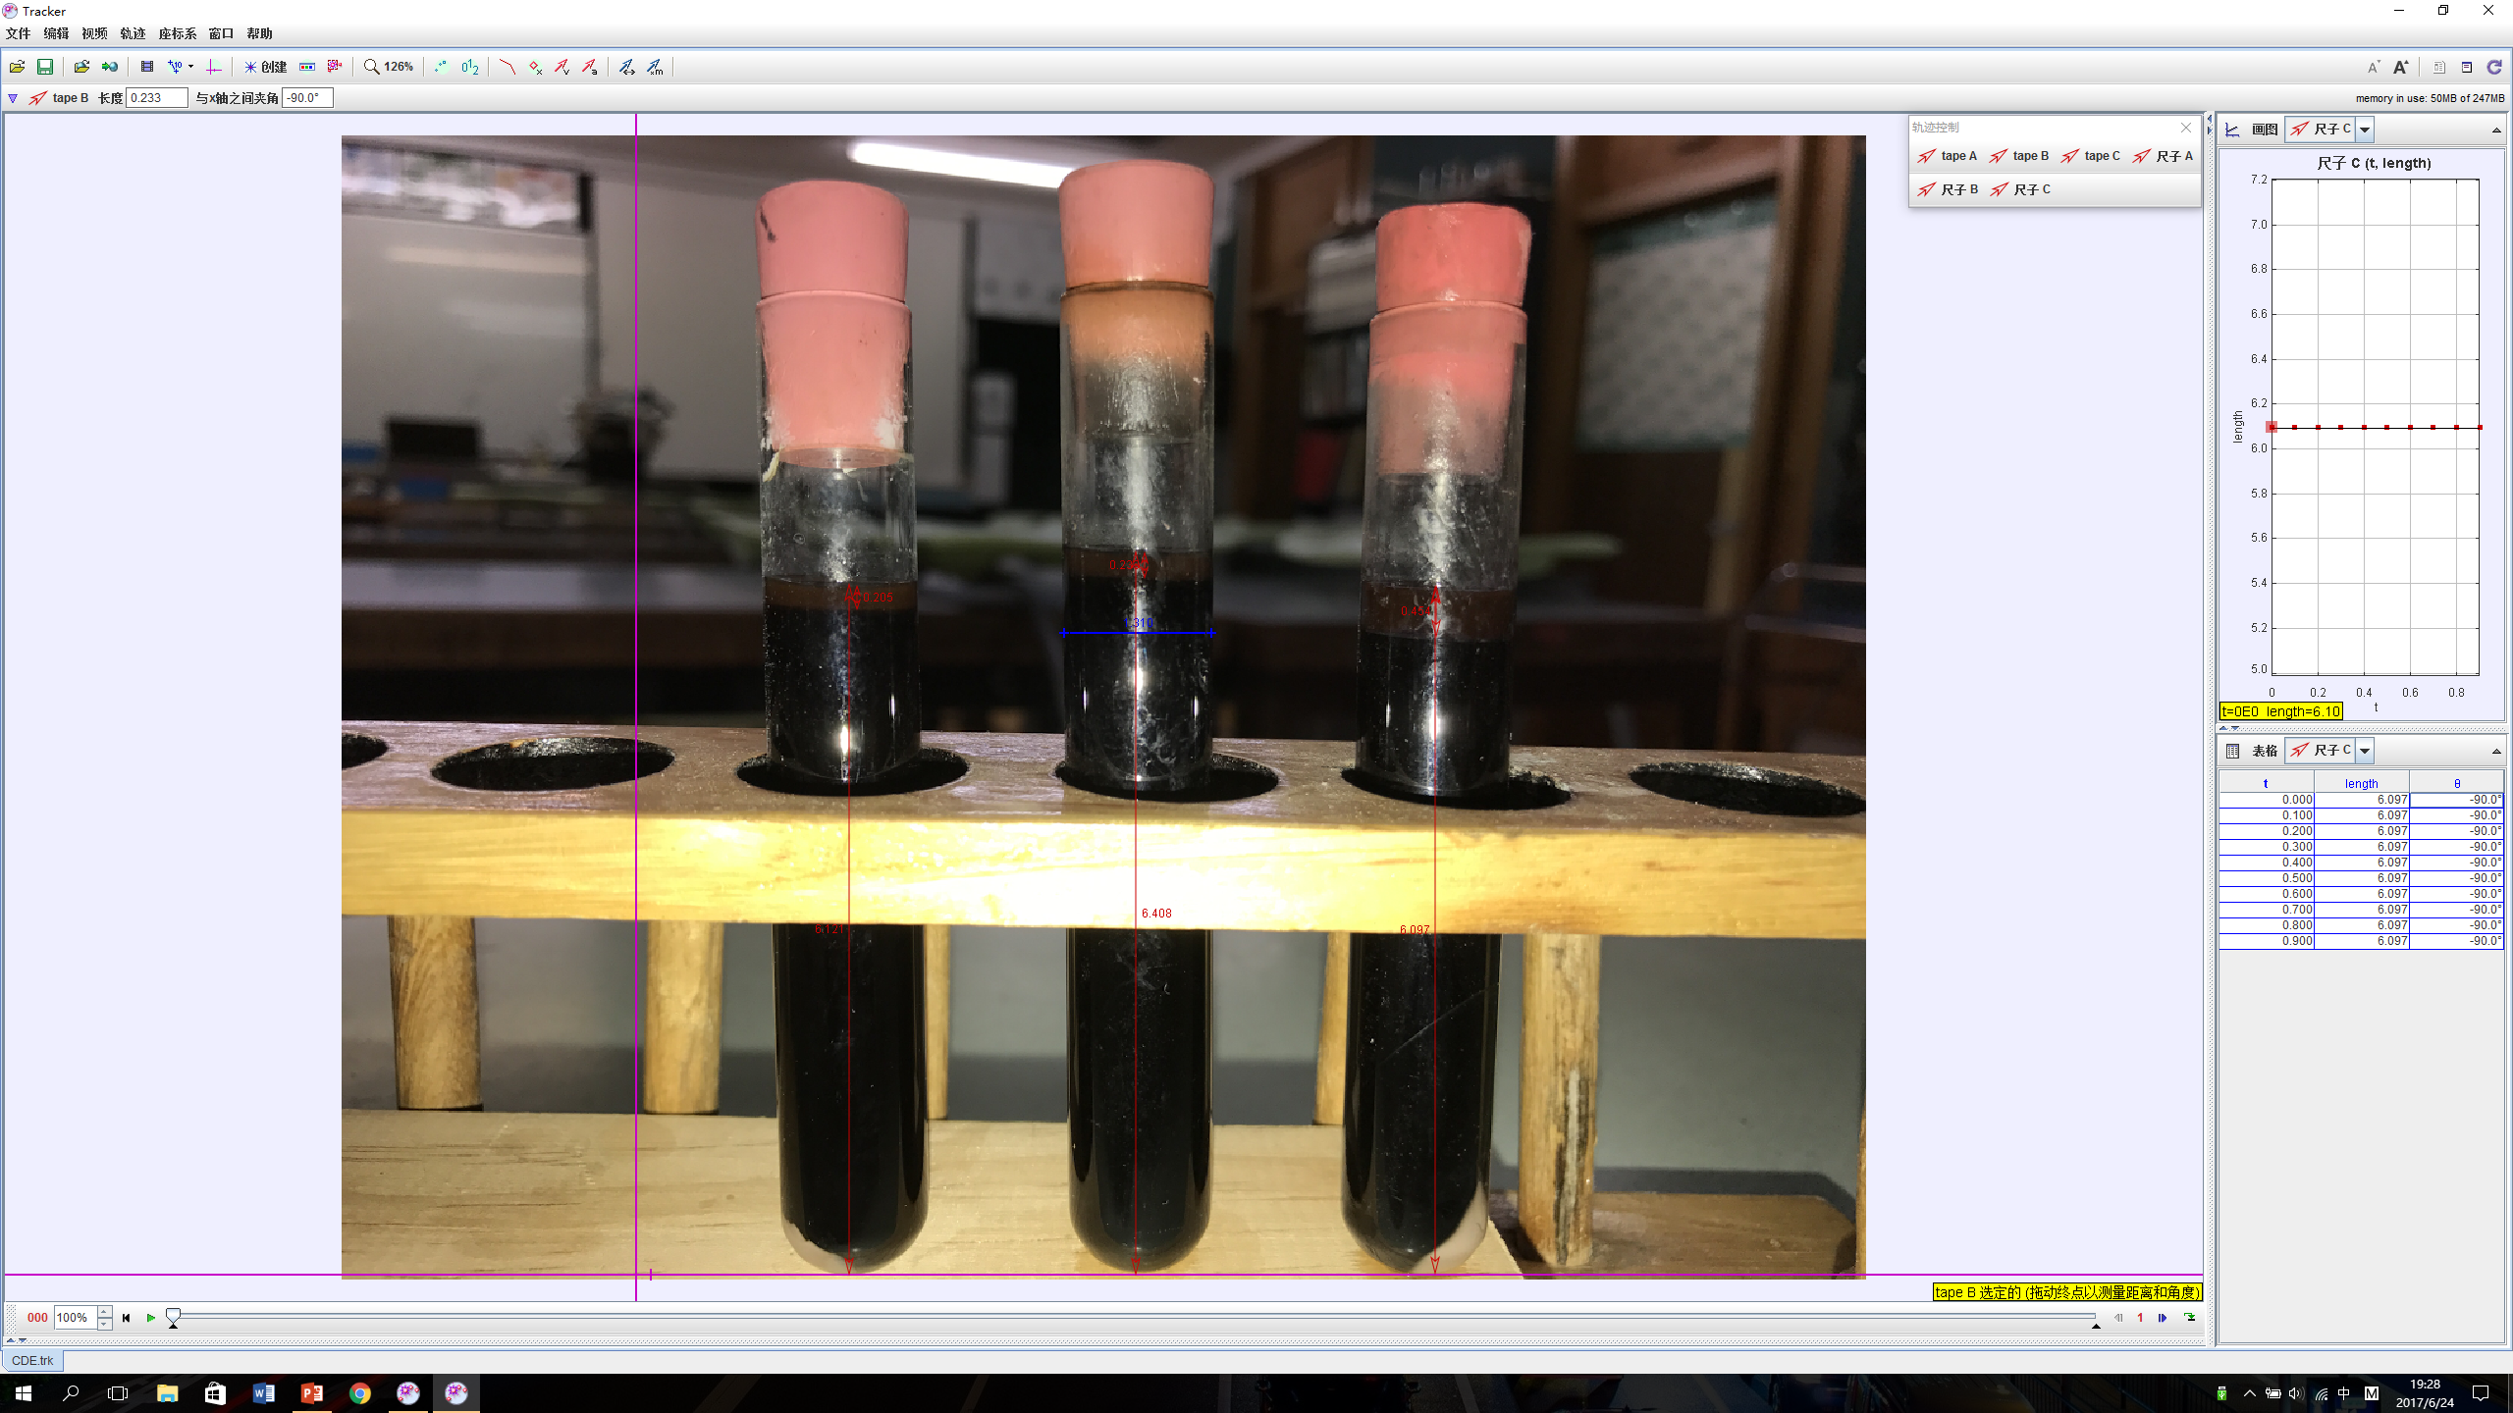
0.233
0.205
0.454
1.310
6.121
6.408
6.097
20

Slide 21
Result - 2
 | Dark Blue Top Milk | Light Blue Top Milk | Silver Top Milk | Goats Milk | Buffalo Milk
Volume of Fat | 0.29cm³ | 0.23cm³ | 0.28cm³ | 0.31cm³ | 0.61cm³
Mass per 100 ml | 5.0 g | 4.0 g | 4.8 g | 5.4 g | 10.6 g
Details shows on the bottles | 3.4 g / 100ml | 1.5 g / 100ml | 4.4 g / 100ml | 2.6 g / 100ml | 10.3 g / 100ml
-----------------------------------------------
5th IYNT 2017
Wellington High School
21
Notes:
I got the following results. Comparing the details that were show on the bottles, only the silver top and buffalo milk were close to the results that I suppose to get.

Slide 22
Result - 3
 | Dark Blue Top Milk | Light Blue Top Milk | Silver Top Milk | Goats Milk | Buffalo Milk
Solids per 100ml | 13.5 g | 12.0 g | 20.4 g | 10.5 g | 28.8 g
Fat per 100ml | 5.0 g | 4.0 g | 4.8 g | 5.4 g | 10.6 g
Solids Non Fat per 100ml | 8.5 g | 8.0 g | 15.6 g | 5.1 g | 18.2 g
12.4 g
- 3.9g
13.2 g
12.4 g
10.3 g
15.4 g
22

Slide 23
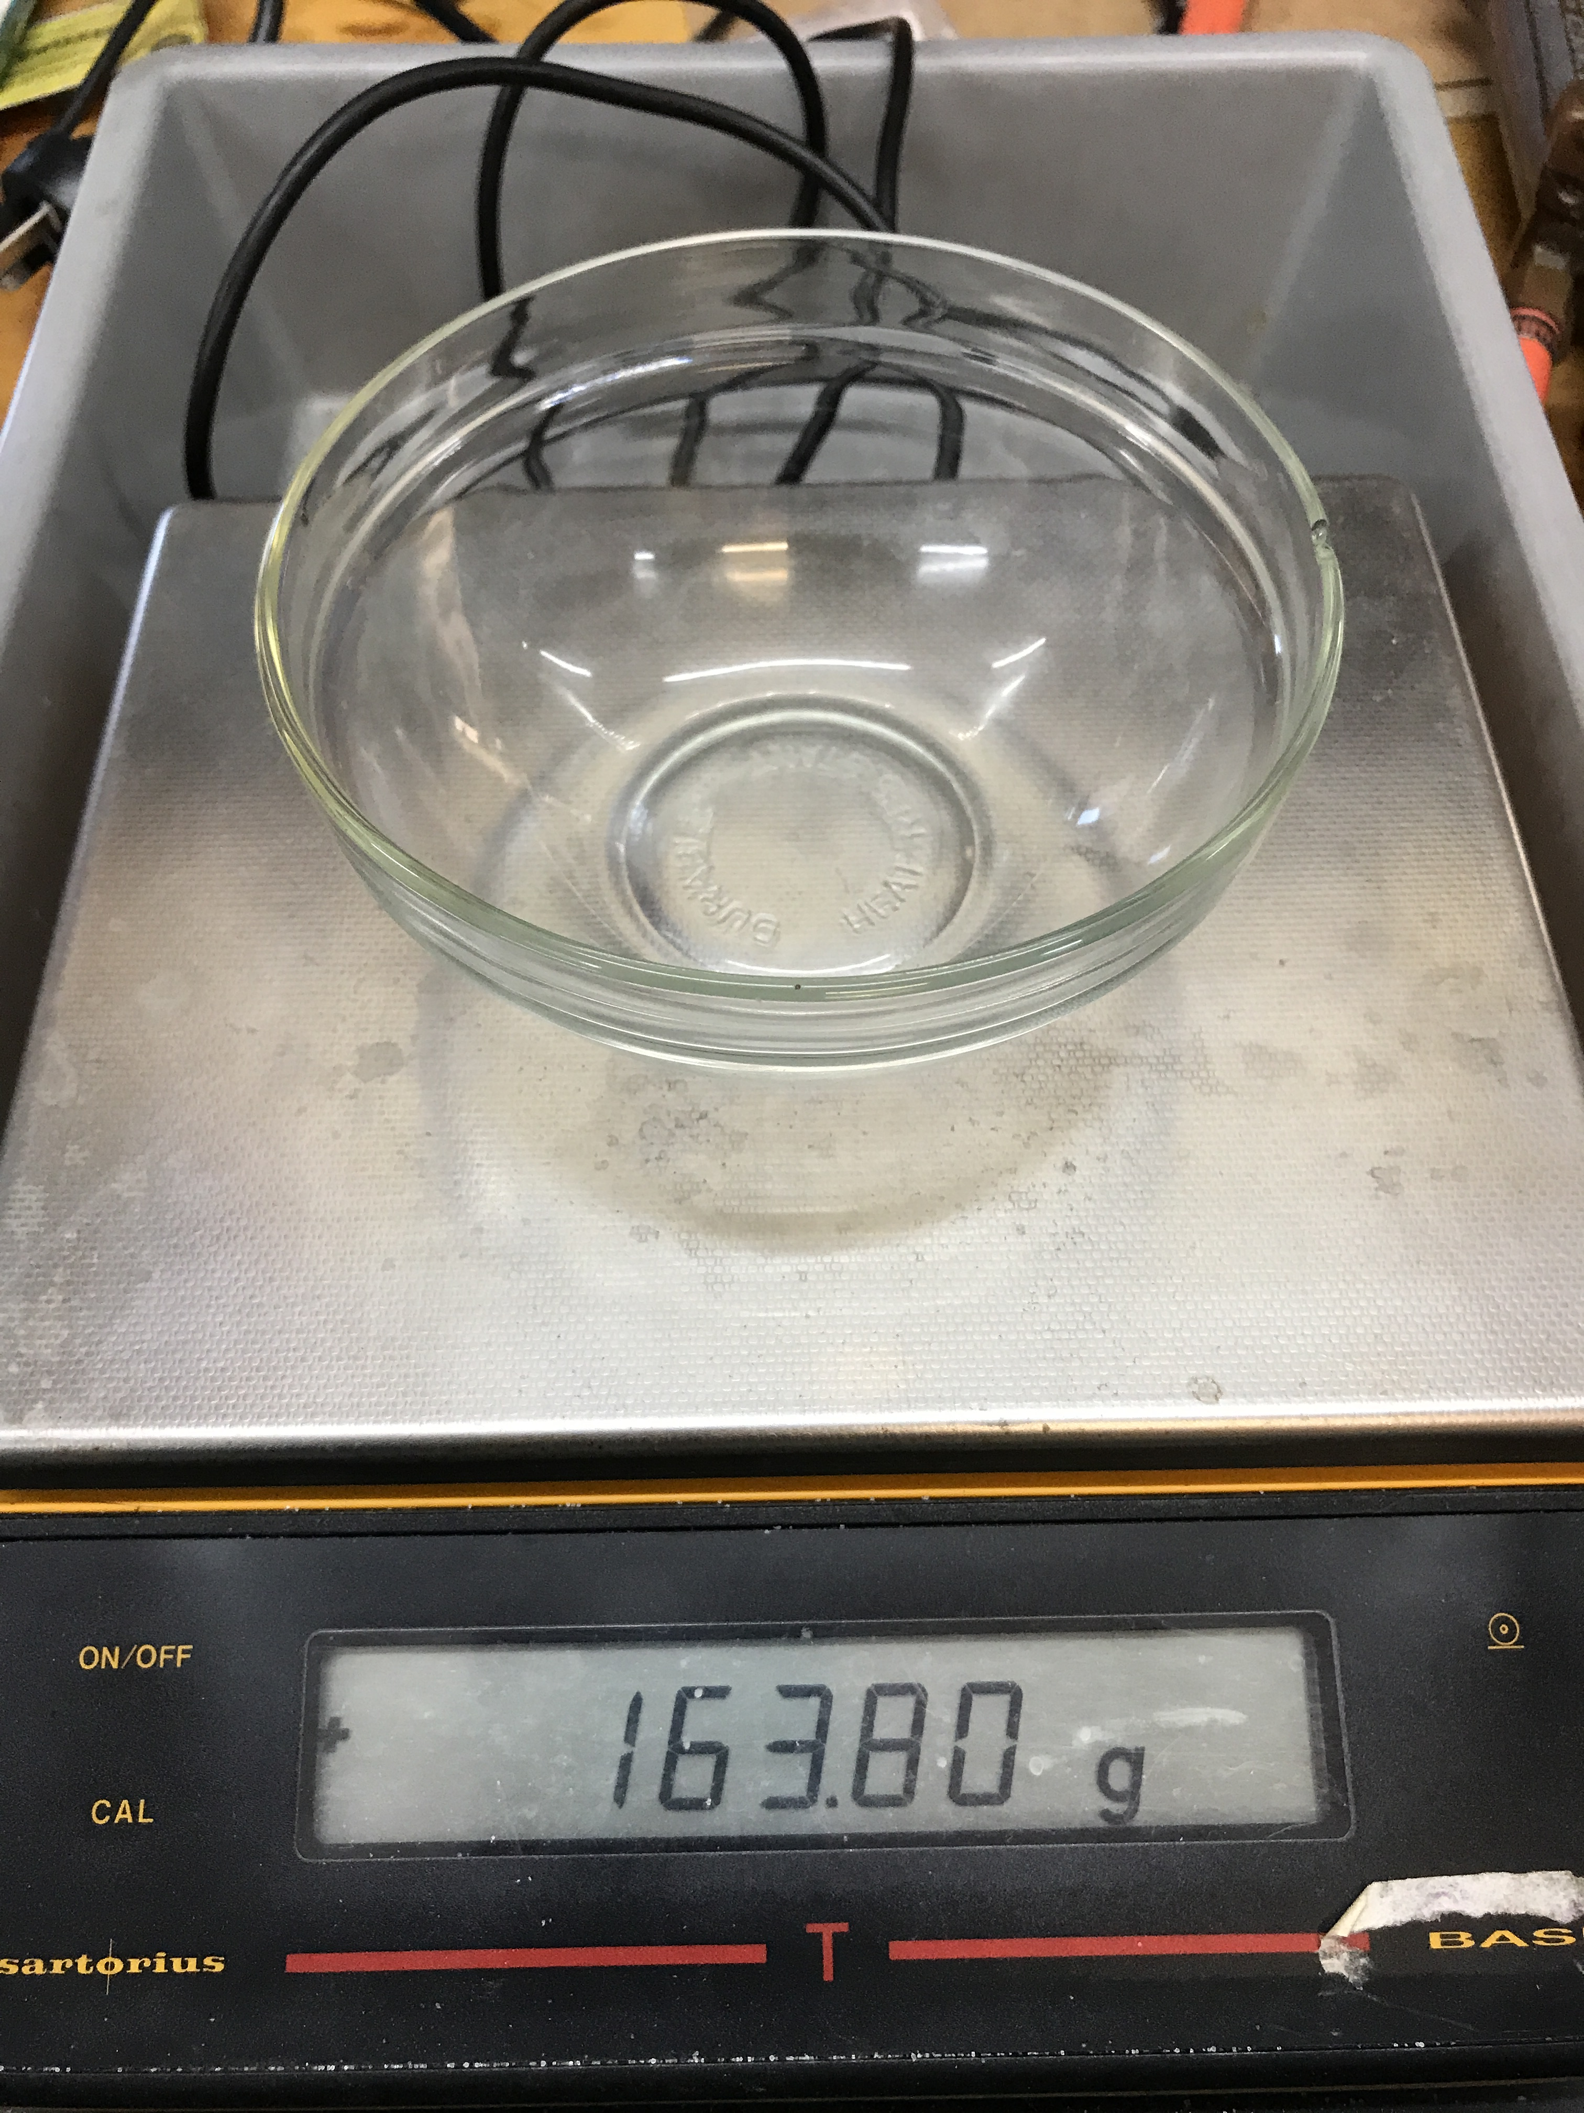
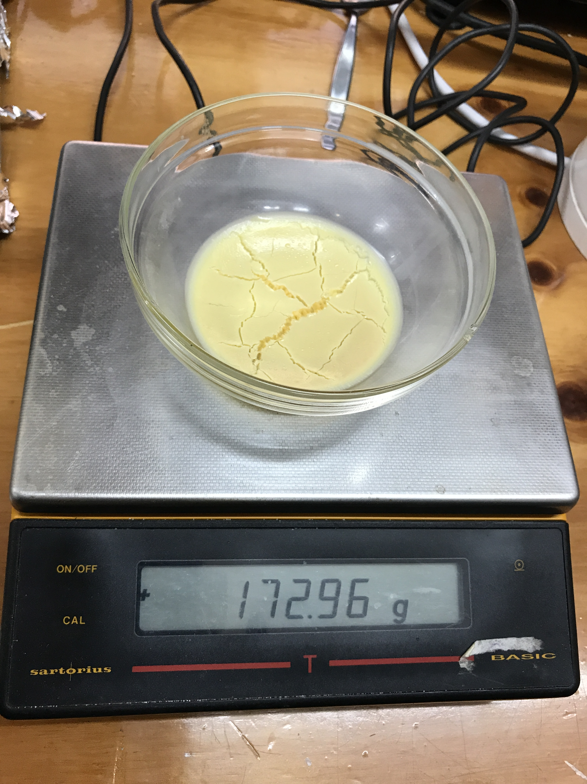
Validate test methods with unknown sample
Firstly, I used “Dehydration” to solve the percentage of solids in the unknown milk sample.
I put the milk sample into the dehydrator for 45 hours at 60 ℃.
Milk: 35.00g
Left solids: 9.16g
Percentages: 26.2%
23
Notes:
Then I received an unknown milk sample from my teacher. I used the same methods as I did which are Dehydration Method and the Gerber Method. I got some result from my experiment.

Slide 24
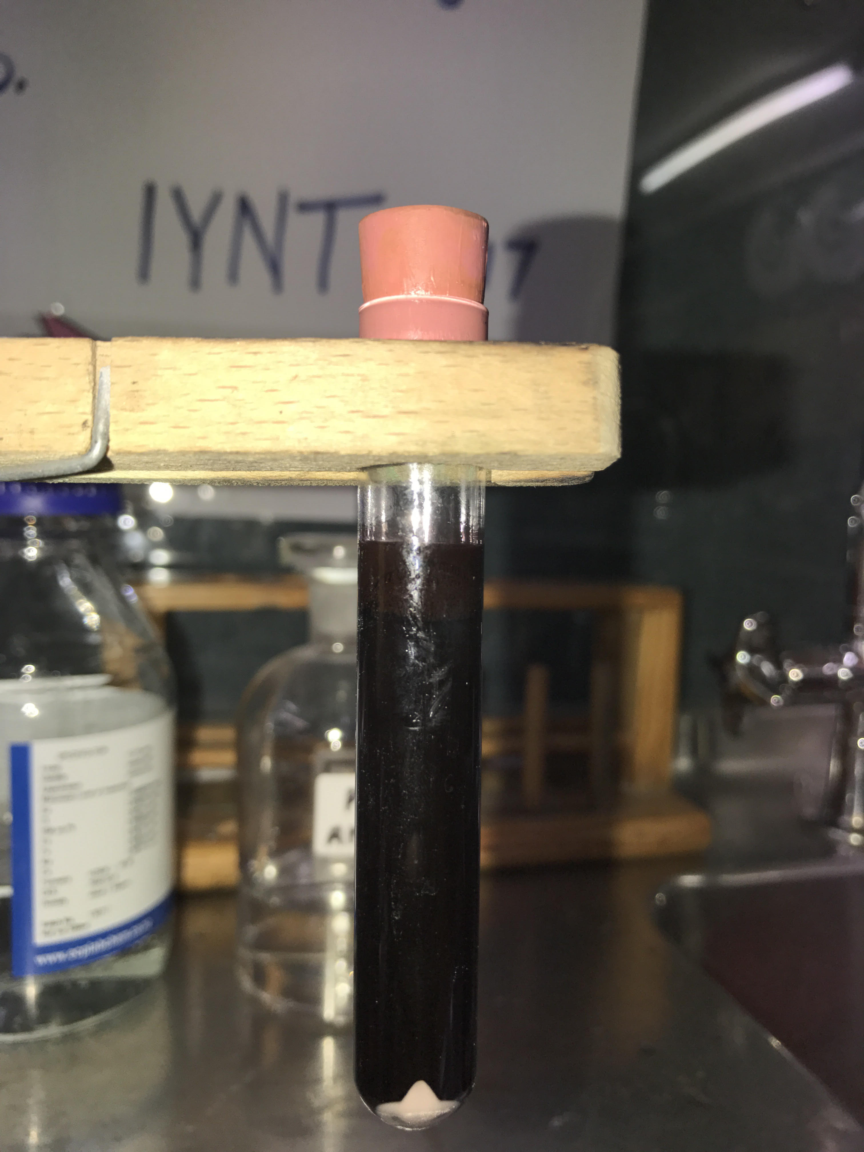
Then I used Gerber method to find the percentage of fat.
According to the diameter of the test tube, I used ICY to measure the height of the fat, so I could solve the volume of the Fat. Thereby, I could solve the percentage of the fat.
Fat
Volume: 1.08g
Percentage: 14.1%
24

Slide 25
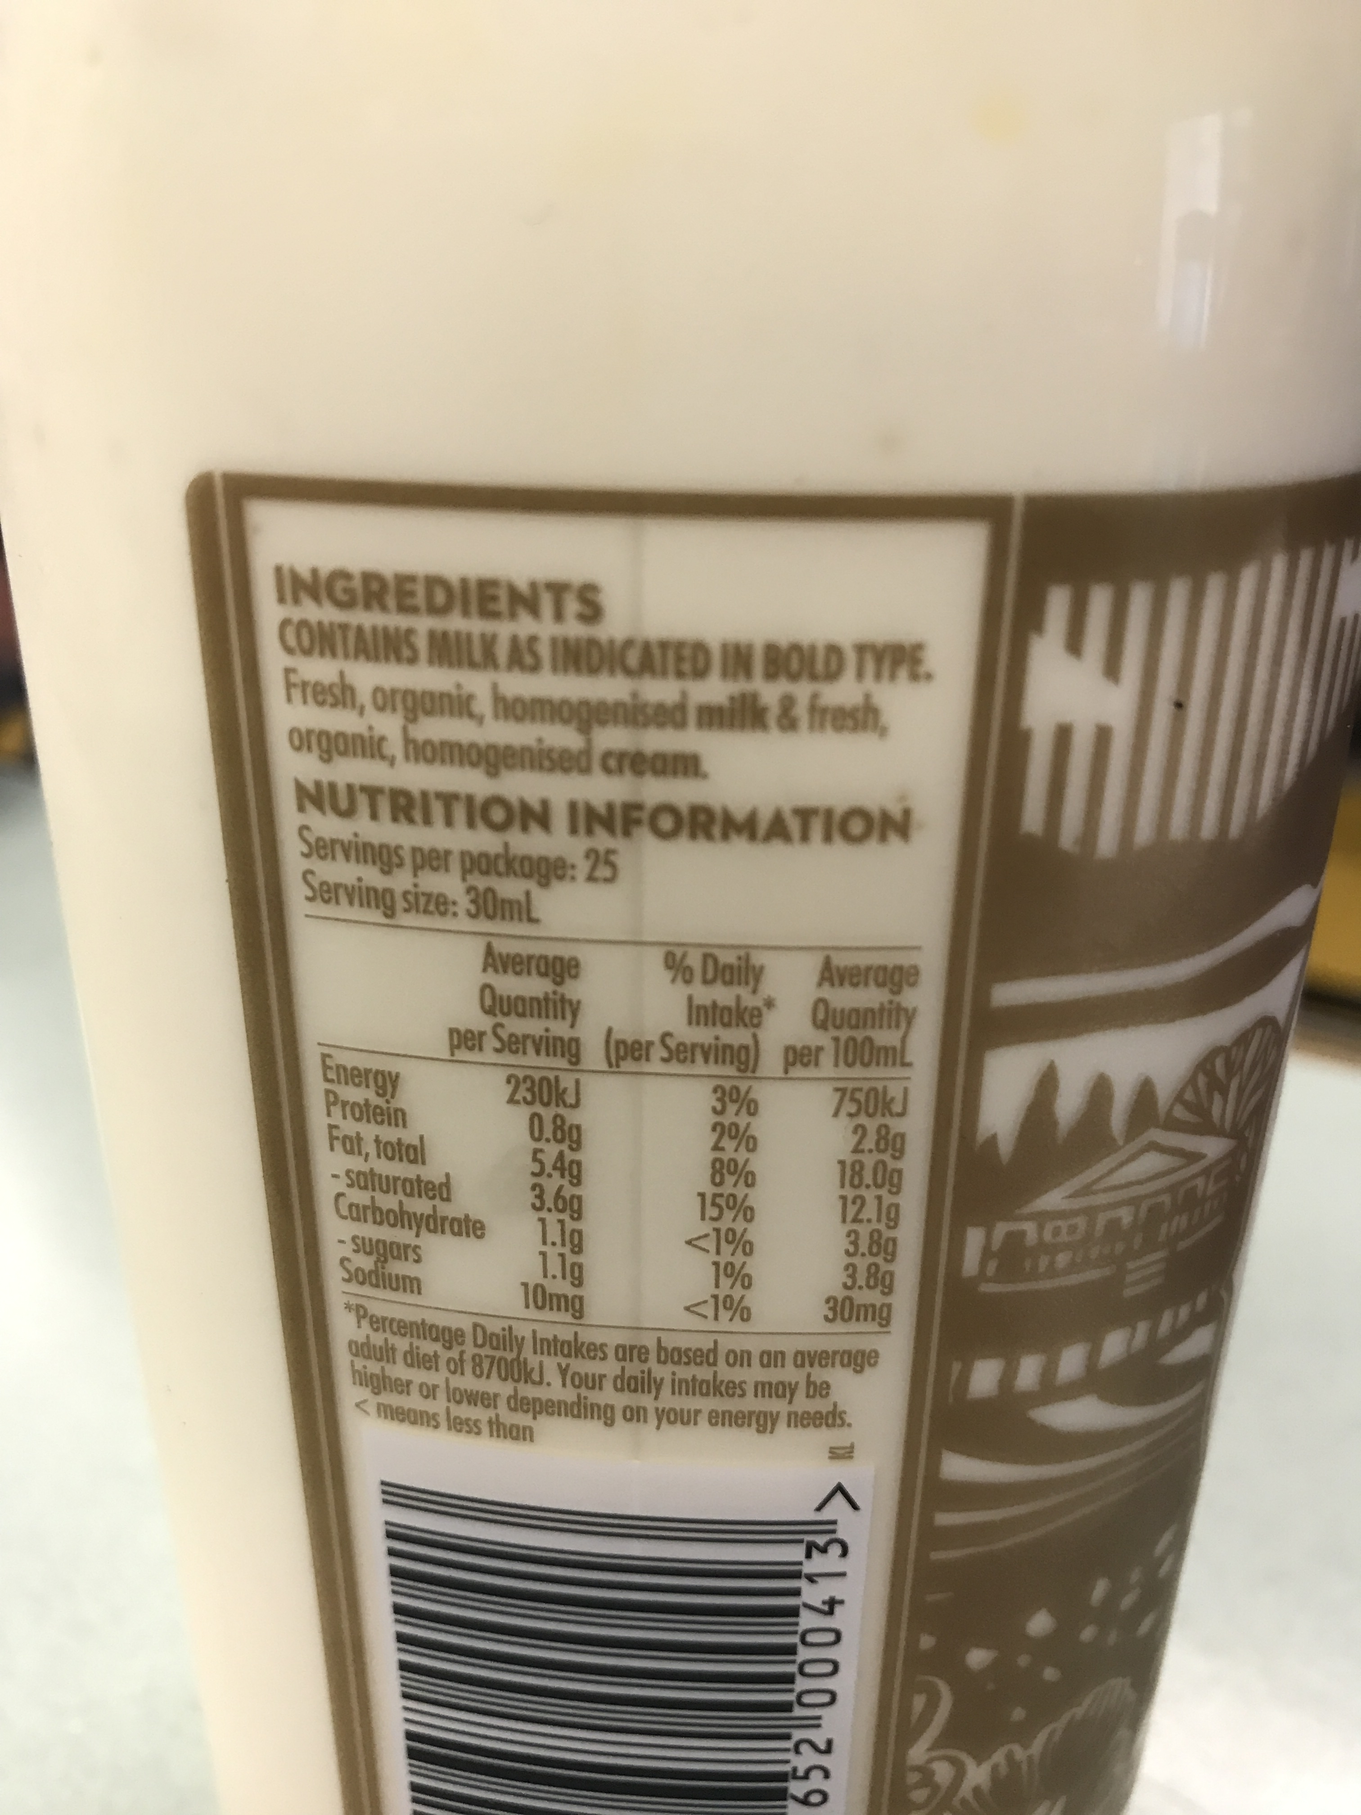
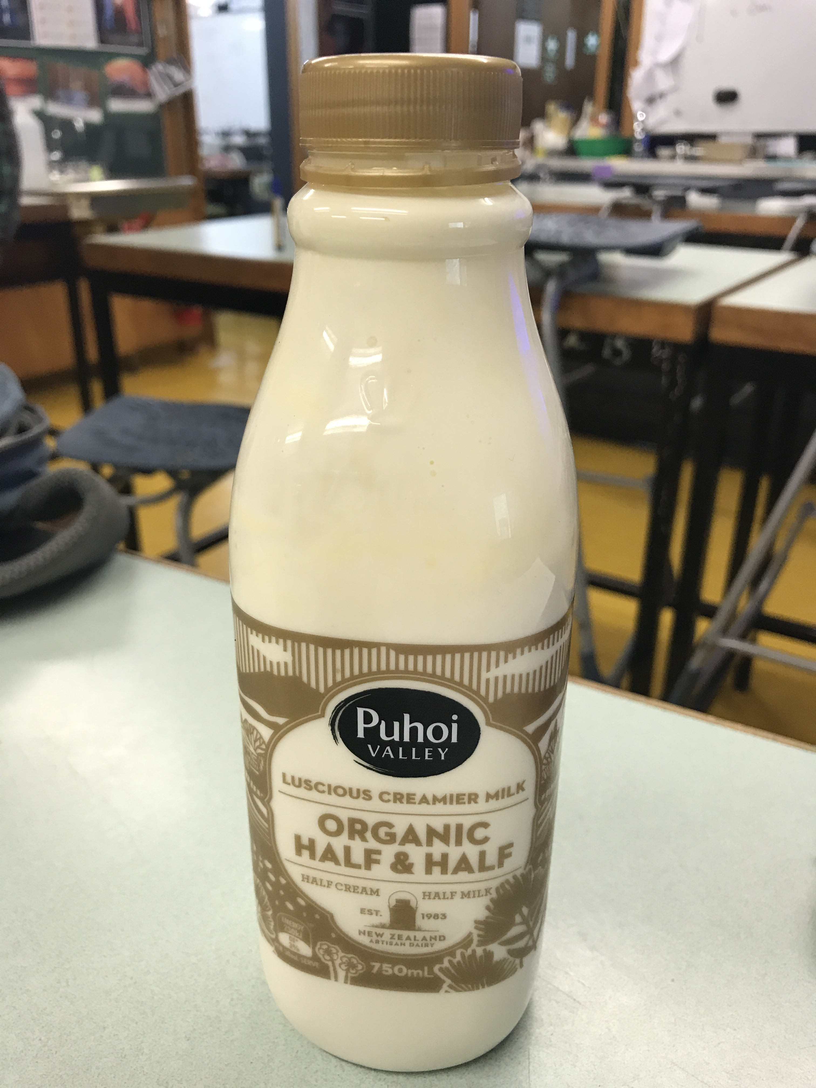
Result
25
Notes:
According to the data showed on the bottle, I know that the sample was the “Half Cream” milk.

Slide 26
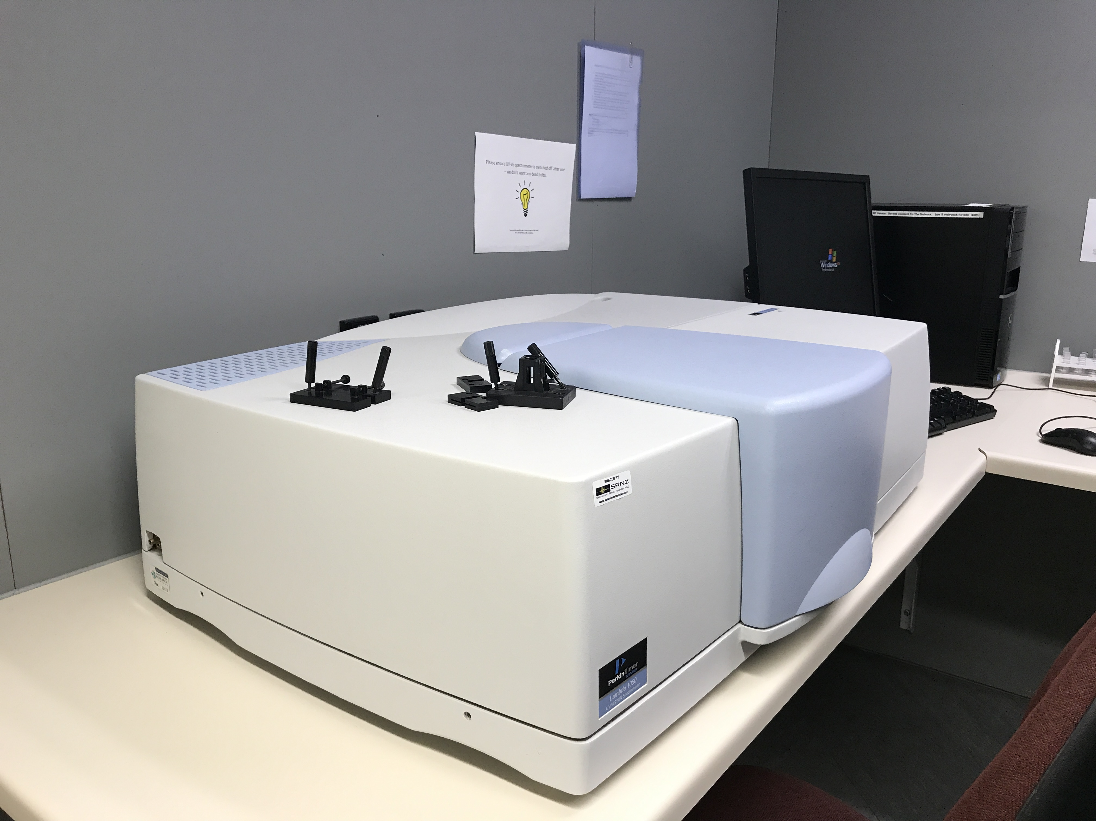
Spectroscopy
26
Notes:
Spectroscopy is terms used to refer to the measurement of radiation intensity as a function of wavelength and are often used to describe experimental spectroscopic methods. The method of extracting the reflectance by ejecting the sample with different bands of lights, Ultraviolet light, visible light and infrared light.

Slide 27
%
UV
Visible
Infrared
E
C
X
D
A
B
nm
27
Notes:
This diagram here shows the absorbance of different milk. The data on the Y-axis is the percentage of the lights that were absorbed. The data on the X-axis is the range of the spectrum. Among them, between 200 to 400 nanometers is Ultraviolet which is UV light, between 400 to 700 nanometers is visible light, above 700 nanometers is infrared light. The less percentages are, the bigger molecules they have which means the more milk solids content in the milk. The data I compared was mainly in the infrared light.

Slide 28
Conclusion
The important properties in the milk are Solids and Solids non fat. The farmers are paid by the content of the solids non fat.
My task was to find simple methods to analyze the important properties of milk. I have shown that I have used traditional methods and produced realistic results. I investigated using spectroscopy. It’s very easy, quick and accurate to get the results. It’s also easy to record the data so we can have comparisons of different milk samples.
28

Slide 29
Bibliography
⧫ Teammates: Luke Roeven, Zuni Preece, Sai August, Tristan Harris, Anna Liu.
⧫ Teachers: Murray Chisholm, Kerry Parker, Tony Cairns, Jack Tregidga
⧫ Special Thanks: CallaghamInnovation, Ryan Bright.
-----------------------------------------------
5th IYNT 2017
Wellington High School

