Slide 1
10. Rijke’s Tube
New Zealand IYNT 2017 Zuni Preece

Slide 2
Question
“If air inside a vertical cylindrical tube open at both ends is heated, the tube produces sound. Study this effect.”

Slide 3
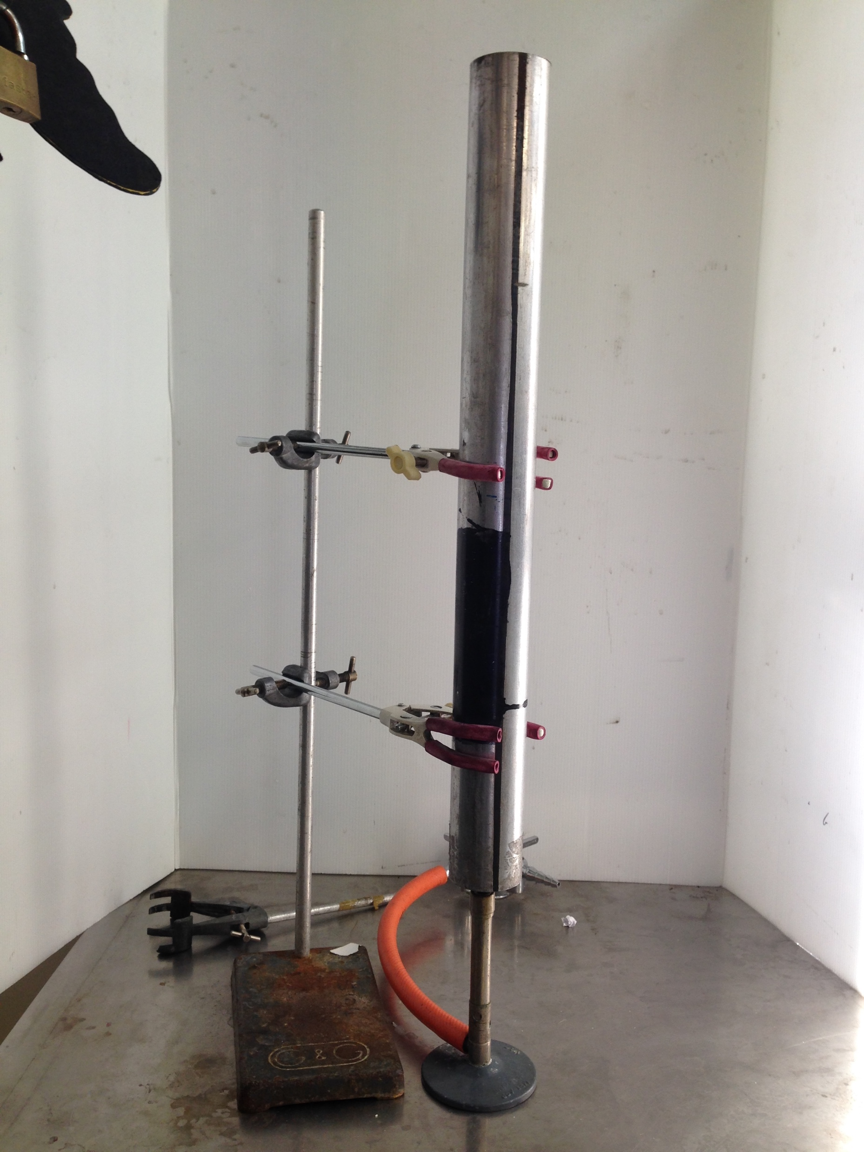
0.538m
Notes:
The question is asking us to study the Rijke tube, which is a device which generates sound from the cooling of gauze placed inside the tube. This is the setup that I used for my experiments, with the tube held by two clamps on a clamp stand 1 centimetre from the Bunsen burner top.

Slide 4
RIJKE TUBE FUNCTION

Slide 5
Notes:
Here we have a Rijke tube that we have just

Slide 6
Notes:
Once all of the air has risen, the air in the tube and also the gauze have been heated to a high temperature.

Slide 7
Notes:
Once you turn off the Bunsen burner, the hot air inside the tube continues to rise due to convection. Cold air from underneath is drawn into the tube to fill the pressure differential.

Slide 8
Notes:
At this point, some cool air that has been drawn from the bottom hits the hot gauze. This causes the hot air to rapidly heat up and expand, beginning the cycle that causes the generation of sound. The expansion of the air causes the pressure inside the tube to rise.

Slide 9
Notes:
Due to the high pressure, air rushes out of both ends of the tube and the pressure becomes low again. This also completes the first cycle. The same cycle continues- along with the push and pull of the pressure/sound wave, the continuous convection current is moving everything upwards so there is always fresh cool air to expand, until the gauze cools down. The highest pressure change is occurring in the middle of the tube. The cycle of air being drawn in and out is creating a standing wave in the tube.

Slide 10
Notes:
When the gauze is in the top half of the tube, the tube produces no sound, as cool air hits the gauze during a pressure minimum and the sudden increase of pressure serves more to mute the sound than generate it.

Slide 11
SOUND AND STANDING WAVES

Slide 12
Notes:
Sound is a pressure wave that propagates outwards from its source. This kind of wave, that has a forwards and backwards movement, is known as a longitudinal wave. As you can see here, the wave fronts of compressions and rarefactions are moving to the right. However, if you watch an individual particle like any of the red ones highlighted here, you’ll see that they are oscillating along the wave propagation and there is no actual net particle movement. The phenomenon of sound is a shockwave, a way of moving energy from one point to another.
However, what’s not pictured here is the interaction between the particles in this tube and the ones outside it that causes wave reflection. Consider a low pressure region, a rarefaction, travelling along the tube towards the open end. The air outside is at atmospheric pressure, so when the low pressure region hits the end of the tube, air from the atmosphere rushes in and creates a compression wave heading back down the tube.

Slide 13
Notes:
When two waves interact, you can superimpose them to find the overall amplitude. When the sound is the right frequency to reflect at the perfect time, you will find that the backwards-travelling wave can amplify itself and appear to create a wave with no moving fronts, but points of constructive interference which create maximum displacement, and points of destructive interference, with no displacement. This is the type of wave being generated inside the Rijke tube.

Slide 14
Notes:
This is what a longitudinal standing wave looks like, in a closed ended tube. In this case, reflection happens not because of the outside air molecules, but the fact that the wave bounces off the closed end of the tube. In the open end of a tube, a displacement antinode will always be formed, as you cannot change the atmospheric pressure.
You can see here the same patterns as we saw in the last slide. The points which have no movement are called displacement nodes, and the points with maximum movement are displacement antinodes. A displacement wave is the opposite of a pressure wave, so the displacement nodes will be pressure antinodes, and displacement antinodes will be pressure nodes.

Slide 15
VERIFICATION OF STANDING WAVE PRODUCTION

Slide 16
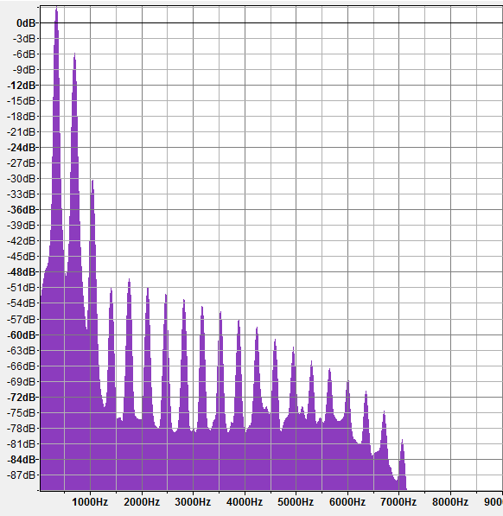
Notes:
The X axis covers the frequency of the sound and the Y axis is the amplitude, which is arbitrary. Here you can see that certain frequencies have been amplified a large amount, creating a saw-toothed pattern with regular intervals. These are the resonant frequencies.
We can determine that the Rijke Tube is producing a standing wave by analysing its resonant frequencies and comparing them with the frequencies that should theoretically be produced.

Slide 17
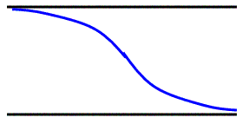
$$λ=2L$$
$$f=\frac{v}{λ}$$
Notes:
As the fundamental (first harmonic) for an open end pipe needs to have a displacement antinode at both ends, and a node in the middle, the smallest wave we can fit in is shown here. This is half of a full wavelength. This means that 1 wavelength is the same as twice the length of the tube. As the speed of the wave is the frequency times the wavelength, we can use this to find the speed of sound which has been changed due to the air heating up. Since heat is a form of kinetic energy, the particles in the air can vibrate faster and travel more quickly. In order to find the theoretical resonance, we need to know the speed of sound, which we can derive from air temperature (as it effects the gas density).

Slide 18
Notes:
I measured the temperature after 20 seconds of heating, against the distance from the bottom of the tube. I repeated each test 4 times. I needed the average temperature of air in the tube, so I had to take measurements from multiple points. The error bars on this graph are from the half range, so you can see there was a very wide scatter in my results.

Slide 19
v from temperature 425ms-1
v from fundemental frequency 429ms-1
Notes:
However, when you compare the speed of sound derived from the temperature and compare it against the velocity from the equation v=fλ, the values are very similar.

Slide 20
Notes:
However, even when adjusted for the air temperature, the data is close does not quite match the theory.

Slide 21
End correction to find acoustic length
Tube length: 538mm
Tube diameter (internal): 48mm
For an open ended pipe:
ΔL = 1.2r
ΔL = 28.8mm
Corrected length
=566.8mm
Notes:
This is because we need to apply an end correction to find the acoustic length of our tube. The pressure nodes, and displacement antinodes are actually forming somewhat outside the ends of the pipe, so the theoretical resonant frequencies are higher than in practice. The end correction, written as ΔL is a short distance which is added to the physical length of a resonance tube, in order to calculate the precise resonant frequencies of the pipe.

Slide 22
Notes:
Once end correction is applied, the experimental data is very similar to our theory. This supports the hypothesis that the tube is producing a self-amplifying standing wave. As you can see, the corrected values (in blue) are more similar to the experimental results than the uncorrected (in green).

Slide 23
EXPERIMENTAL

Slide 24
Experimental Setup
538mm long tube
48mm internal diameter
566.8mm acoustic length
Steel
20 seconds of heating
Notes:
I used the same tube for all of my experiments, so the parameters kept constant across my experiments were: a 0.538m long tube, made of aluminium with an internal diameter of 0.048m, and as demonstrated before an acoustic length of 0.567m.

Slide 25
Notes:
I thought the position of the gauze would be a good variable because there are conflicting sources on the optimum position. The figures often given are 1/5 or ¼ up the tube. The transfer of heat from the gauze to the gas is greatest where the gas is moving most, that is at a displacement antinode. But the effect of the hot gauze on sustaining the oscillations would be greatest at a pressure node, so the best position for the gauze is a compromise between these two conflicting locations, that is some way between a displacement antinode and a pressure antinode. The software I used to record, Audacity, uses an arbitrary unit of measurement for volume so that cannot be compared between tests and I will mostly be ignoring it. Sound below -26 is counted as silence, as it is indistinguishable from background noise. As you can see here, the optimum position is around 0.09m, which in the case of my tube is approximately 1/5 of the way up.

Slide 26
Notes:
I also wanted to test the effects of different amounts of gauze inside the Rijke tube. It seemed logical that more gauze would mean a longer sound, since it would take longer to cool down.
When there is not enough gauze, it would cool down quickly and cross the threshold for producing sound earlier, explaining the rising trend in the beginning of the graph. However, here you can see that this graph quickly levels out and begins to decline, before producing very little to no sound at approximately 30 grams. However, the loudness of the sound is consistently decreasing as we add more gauze. I believe that the decrease in duration is because the adding of extra mesh to the tube has meant that some of the mesh has risen above the halfway mark and begun to work against the production of sound, as explained earlier.

Slide 27
Conclusion
“If air inside a vertical cylindrical tube open at both ends is heated, the tube produces sound. Study this effect.”
Generates a standing wave
Operates via convection and rapid heating of cool gases
Ran experiments on the effect of amount and position of gauze on loudness and duration of sound
Notes:
To restate the question: “If air inside a vertical cylindrical tube open at both ends is heated, the tube produces sound. Study this effect.”
I investigated the phenomenon of a Rijke tube, which generates a standing wave via convection and rapid heating of cool gases. I experimented on the effect of the amount and position of gauze inside the tube on the loudness and duration of the sound produced.

Slide 28
Sources
http://www.fonema.se/mouthcorr/mouthcorr.htm
http://www.studyphysics.ca/newnotes/20/unit03_mechanicalwaves/chp141516_waves/lesson51.htm
http://media.uws.ac.uk/~davison/labpage/tube/tube.html
http://physics.tutorvista.com/waves/longitudinal-waves.html
http://www.acs.psu.edu/drussell/Demos/StandingWaves/StandingWaves.html
http://hyperphysics.phy-astr.gsu.edu/hbase/class/phscilab/restube2.html
http://hyperphysics.phy-astr.gsu.edu/Hbase/waves/opecol.html

Slide 29
Acknowledgements
Team Leaders: Jack Trigonometry & Murray Chisholm
Physics Teachers: Kerry Parker & Murray Chisholm
Team Members: Sai August, Tristan Harris, Anna Liu, Luke Roeven, Ethan Wu
Our Minions: Zoe, Ryan, Riley, Ella, Liam
Others: DJ Nomeme

