Slide 1
routers and garden cress
Ensai August
Wellington High School, New Zealand
IYNT 2017

Slide 2
The Problem
In 2013, five young students claimed a sensational discovery that garden cress (Lepidium sativum) won't germinate when placed near two Wi-Fi routers. Reproduce their experiments under controlled conditions to support or dismiss their conclusions.

Slide 3
The “Phenomenon”
Not exposed to Wifi
Exposed to Wifi
Notes:
These are photos from the original experiment.

Slide 4
What is Wifi?
Notes:
Wifi is a kind of wireless signal, and wireless signals are just electromagnetic waves. All electromagnetic waves occupy a spectrum of frequencies which are shown on the electromagnetic spectrum. Wifi can be said to be kind of microwave, which are the waves that occupy the 0.3 GHz-300 GHz frequency band on the spectrum. Wifi routers broadcast most commonly on the 2.4 GHz band, while some broadcast at a frequency band of 5 GHz.

Slide 5
What is germination?
Notes:
For my experiments, I defined germination as the observable emergence of the radicle from the testa.

Slide 6
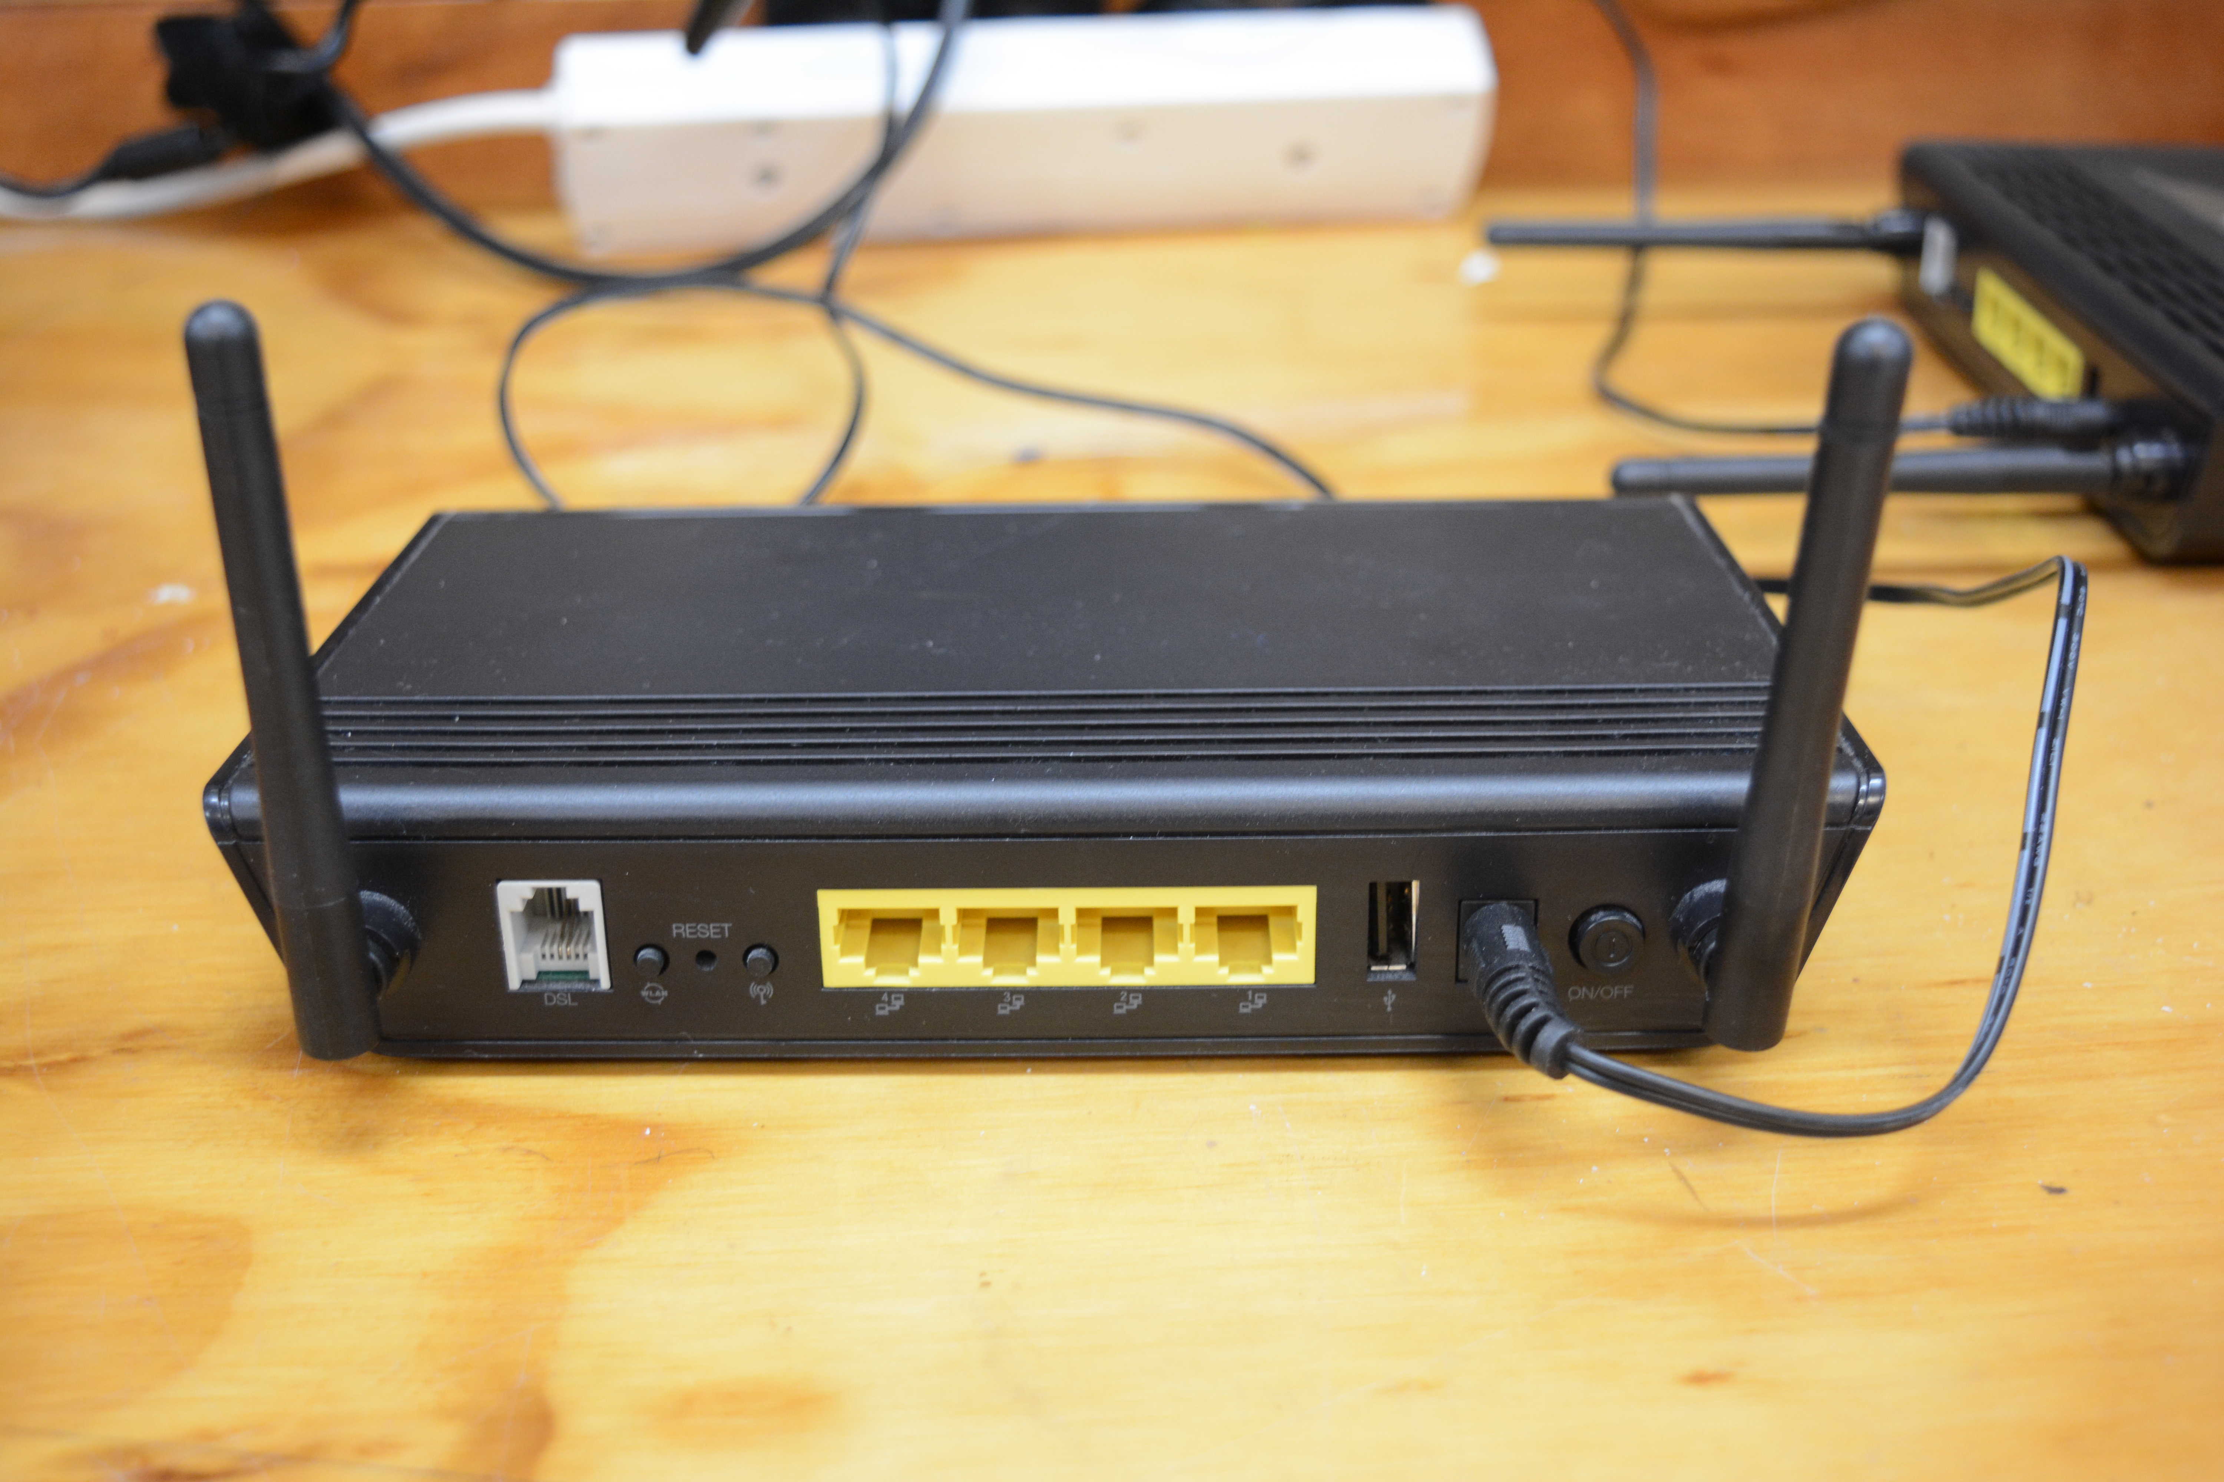
My Setup
Notes:
Two identical wireless routers

Slide 7
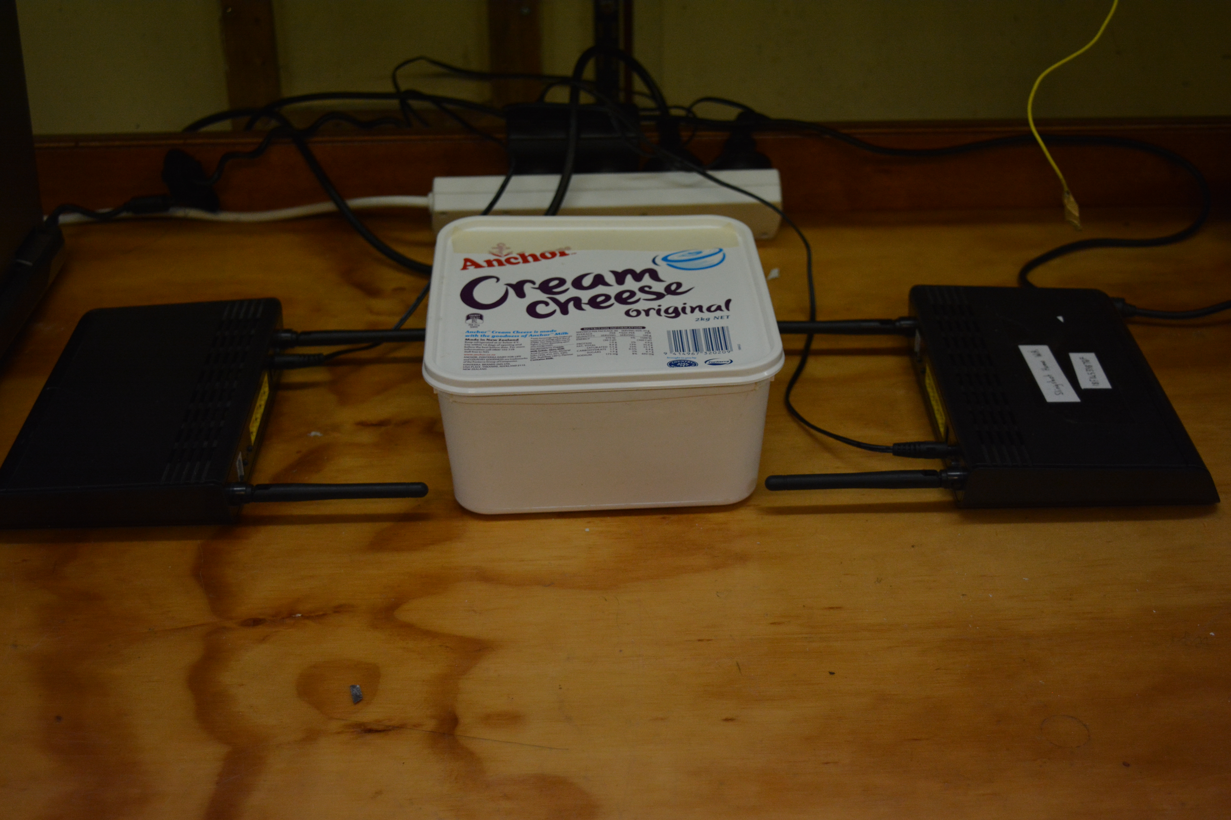
My Setup
Notes:
Placed 100 cress seeds from the same packet in a petri dish lined with paper towel and 5ml of water. Put one petri dishes into an ice cream container and one into my “faraday” ice cream container for 24 hours

Slide 8
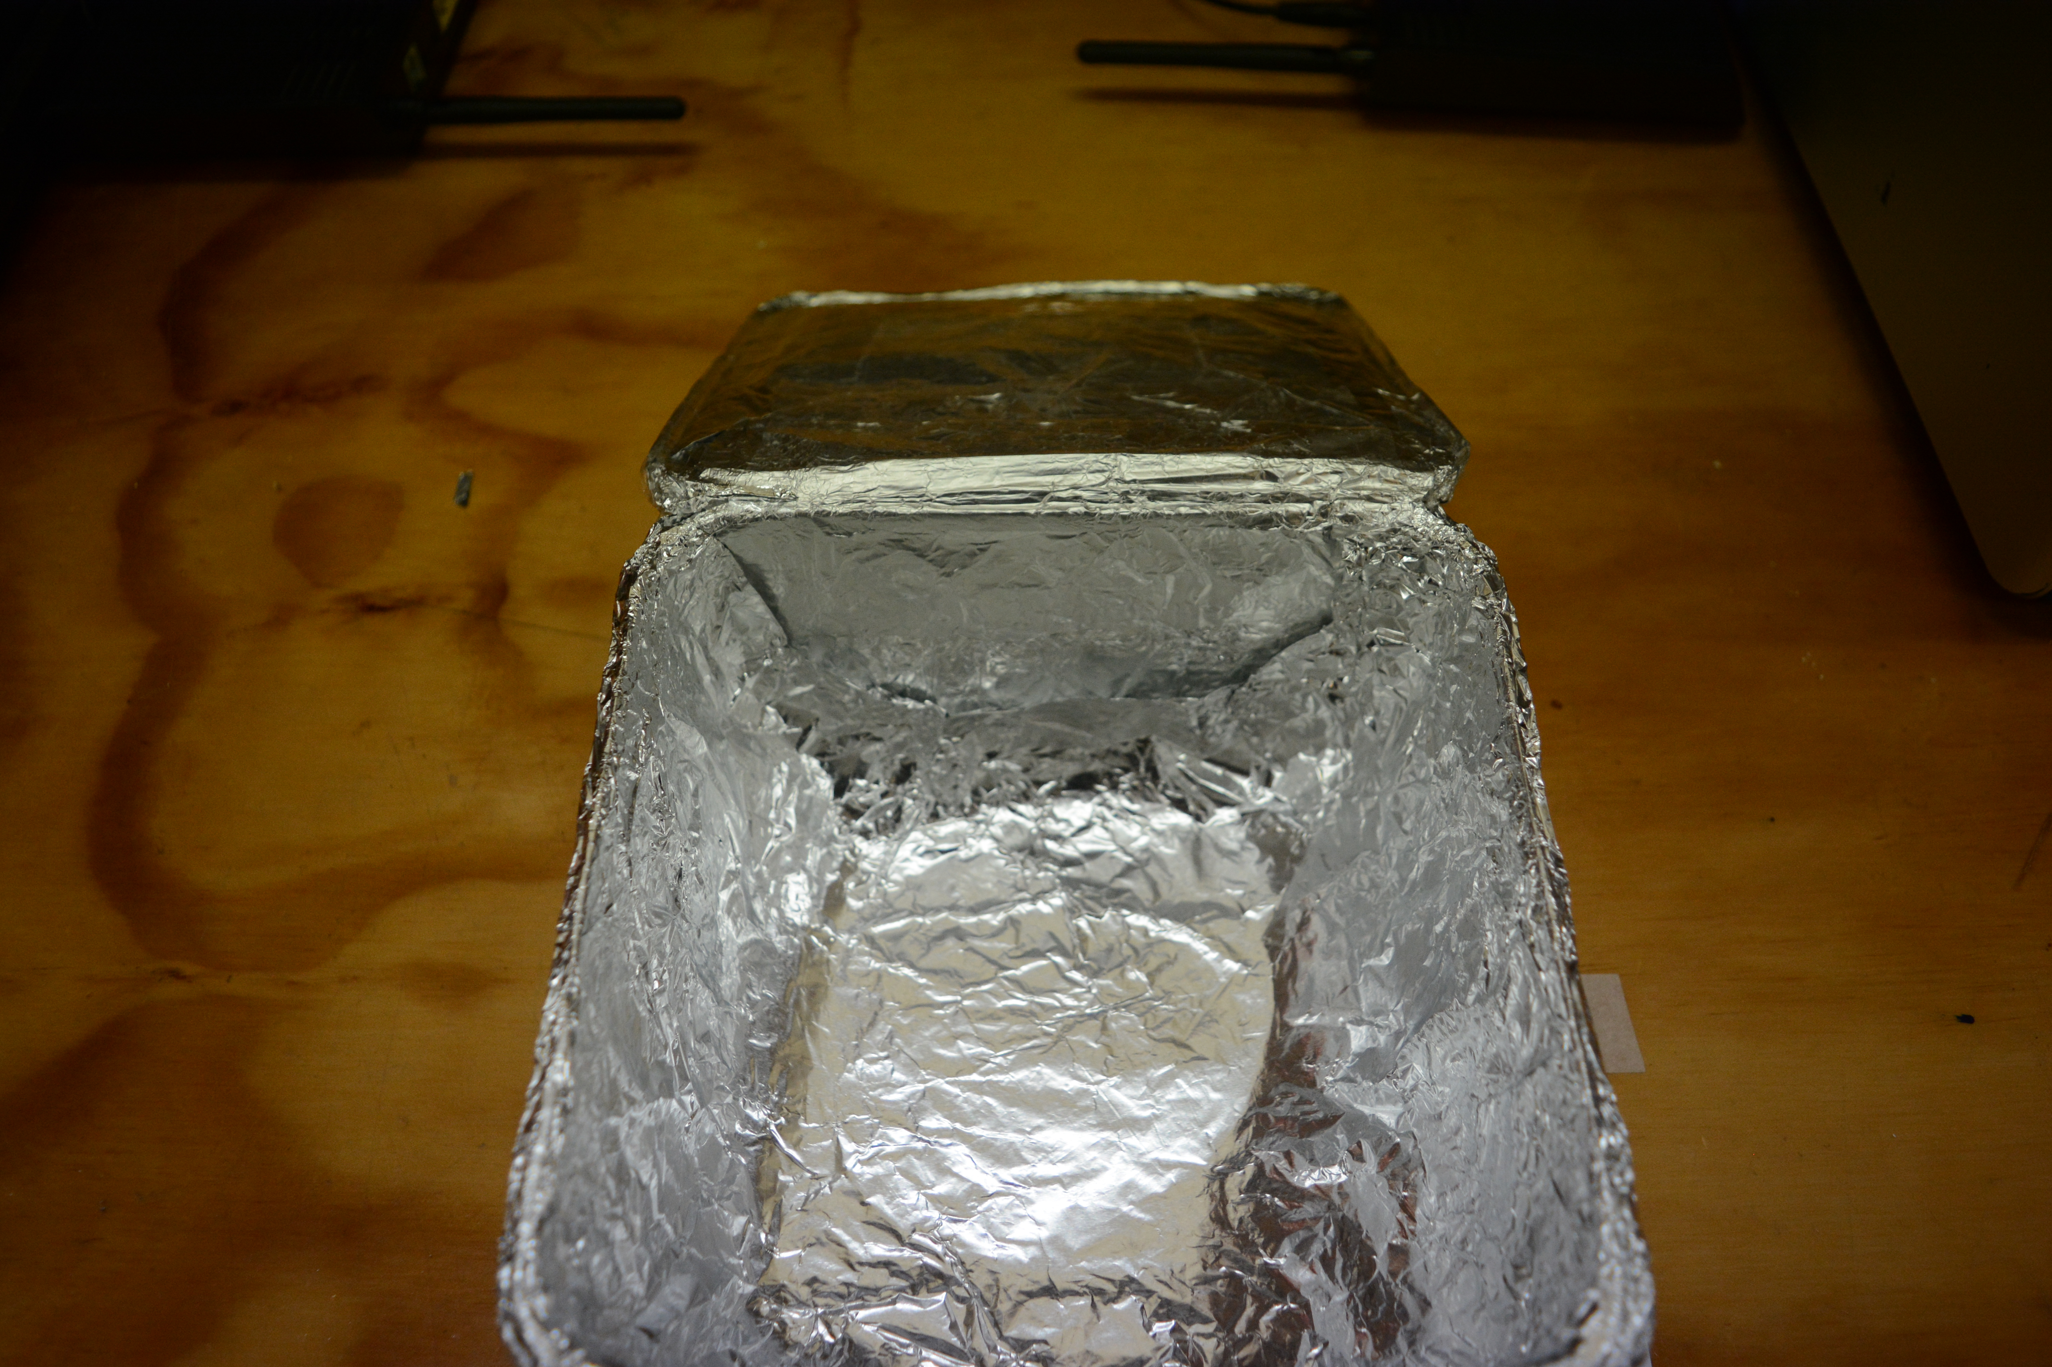
My Setup
Notes:
Lined an ice cream container with aluminium foil, tested with a cellphone, microwave detector

Slide 9
Germination after 24 Hours

Slide 10
Conclusion
An average of 97% of the cress seeds exposed to wifi germinated.
An average of 97% of the cress seeds shielded from wifi germinated.
Therefore wifi does not have any observable effect on the germination of cress seeds.

Slide 12
“Microwaving” Cress

