Slide 1
Problem No. 17: Tornado Machine
Luke Roeven
Wellington high school
IYNT 2017
Notes:
Hello, my name is Luke Roeven and today I will be presenting my solution to problem number 17 tornado machine.

Slide 2
The problem
Build a machine to produce an indoor air tornado. Investigate the properties and stability of the tornado. Is the machine portative enough to be demonstrated at a Science Fight room of the 5th IYNT?
Notes:
This is the problem statement (Build a machine to produce an indoor air tornado. Investigate the properties and stability of the tornado. Is the machine portative enough to be demonstrated at a Science Fight room of the 5th IYNT?).

Slide 3
Table of contents
Tornado formation
Supercells
Tornadoes
Definitions of stability and explanation of important properties
Machine design
Researched designs and there problems
Our design
Results
Conclusion
Notes:
Here is my table of contents.
First I will go over what a tornado is and why they form.
Second I will explain how we came up with our machine’s design, and why we did particular things.
Thirdly I will go over my results on the parameter of the tornado we changed.
To then finish with the conclusion.

Slide 4
Defining terms
Properties?
Stability?
Notes:
To measure the properties and stability of the tornado, we must first explain and quantify what these terms mean. But firstly, what is a tornado.

Slide 5
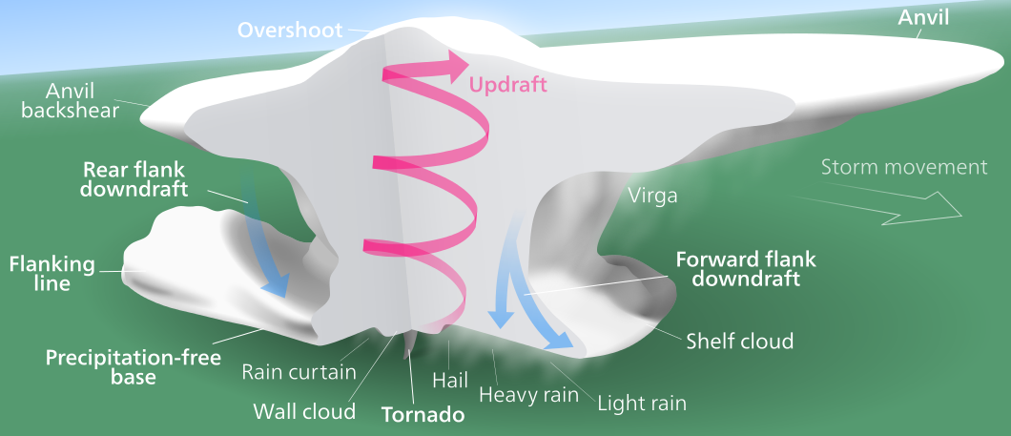
What a tornado is
Notes:
A tornado is a rotating column of air which is connected to the ground. There are two main types of tornados, those that form within a supercell, and those the form individually. Those that form due to a supercell thunderstorm are much stronger but far harder to build a machine to replicate, so for this presentation I will only talk about those that form individually.

Slide 6
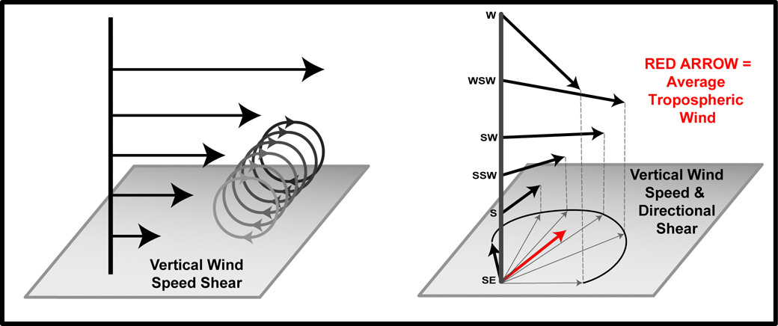
Tornado formation
Average wind direction
Notes:
The process of tornado formation is not fully understood, but the presence of warm and moist air underneath cool air, moving perpendicular to each other has been identified as a key factor. The collision of the warm and cold air creates wind shear (both directional and speed), as well as a strong updraft from the buoyant warm air.

Slide 7
Tornado formation
Notes:
The speed shear makes a horizontally rotating mass of air, which the updraft pushes upwards, bending it into two rotating columns of air, of which the directional shear negates one of the columns leaving only one. What we are left with after this is a tornado. These aren’t as stable as the supercell formed tornados as the column of air has no mechanisms to add vorticity after it has lifted of the ground besides simple updraft and directional shear which dissipates as the temperature difference decreases.

Slide 8
Defining terms
Measure
Vary
Temperature
Radius
Height/ volume
Vorticity
Velocity
Properties
Returns to equilibrium
instability
Vorticity
Velocity
Notes:
Now that we understand how tornados form we can identify the important properties of the tornado.
The most measurable property of a tornado is it’s vorticity. And the variables that will show the greatest change in vorticity are temperature, Radius, and Height above the ground.
I could not find any information on a specific definition for stability in a tornado. So, I used the general definition of “stable equilibrium” it says that a system is in stable equilibrium if it returns to equilibrium after being displaced
of a tornado to measure or vary are: vorticity, tangential velocity, temperature, radius, and height.

Slide 9
Our setup
Polycarbonate sheet
Slit for air to enter
Wooden block to reduce unwanted air flow
Ht plate
Notes:
This is the machine we came up with: there is a hot plate at the bottom providing heat, and at enclosed cylinder made of a polycarbonate sheet with a slit at one end for the air to enter. The curvature and single entering point was the best approximation of the directional wind shear we could manufacture, and the hot plate is imitating the updraft produced by the interaction of the hot and cold air in a real tornado.

Slide 10
How it works
Air flows through and curves with the polycarbonate sheet
Heats air making it less dense
Notes:
The hot plate heats up the cool air around it. This makes it less dense and thus making it more buoyant causing it to rise. To keep the mass flowrate constant new cold air needs to come in through the slit we made. Since the walls are curved, the air coming must rotate, producing vorticity and a tornado.

Slide 11
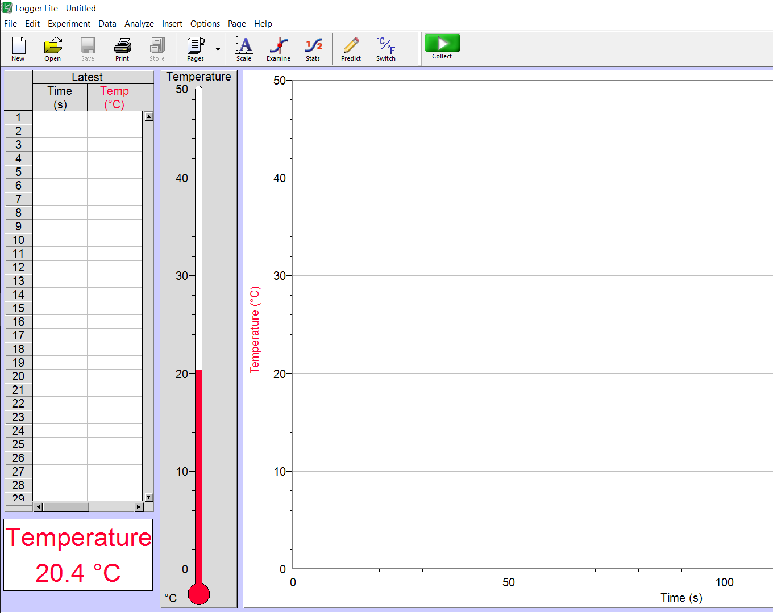
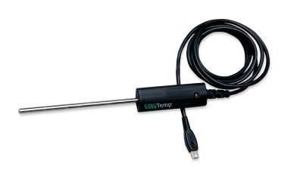
How we measured temperature
Notes:
For our tests which involved varying temperature, we used a temperature probe to measure the temperature of the air just above the hot plate. This was removed when the data was collected as to not interfere with the results.

Slide 12
How we measured velocity
Stick to hold pendulum
Pendulum with light mass on end
$$θ$$
Angle measured
Vertical line
Notes:
To calculate the tangential velocity of the air we attached a small wind sock to a stick and measured the angle from the vertical with some simple mathematics to find an arbitrary (unitless) measurement for velocity.

Slide 13
How we measured velocity
Notes:
I used a program called tracker to analyse the photos I took to get the angle.

Slide 14
Tangential velocity tests
Temperature
Distance from centre
Height above hot plate
Notes:
For testing the properties of the tornado we varied these parameters: temperature, radius from centre, and height above ground.

Slide 15
Temperature
Notes:
First, we tested how the temperature of the air affected the tangential velocity and vorticity of the system. The values are arbitrary, but can still be used to compare tests. Here you can see that as the temperature increases the velocity and vorticity both increase. This is logical as by increasing the temperature, you are effectively increasing the directional shear and updraft.

Slide 16
Why does this happen
Increasing buoyant force
Increasing updraft
Air more air must enter per second
Notes:
By increasing the temperature you are increasing the buoyant force, creating a stronger updraft. For the mass flow rate of the system to be conserved, more air must enter per second, increasing wind shear.

Slide 17
Radius
distance
Stick with wind sock
Notes:
After this we changed the distance our wind sock was from the centre. We got the expected results, which is that as you get closer the velocity increases.

Slide 18
Why does this happen?
Fluid flow across curved sheet
Fluid flow through pipe
Notes:
Why is it like this, I stated this is intuitive but why? This is due to the viscose forces that the air will experience when in contact with the wall, much like the flow in a pipe. The air touching the walls will barely move but as you get further away from the wall the air can move faster.

Slide 19
Why does this happen?
Fluid flow across curved sheet
Fluid flow through pipe
$$L=mvr$$
Notes:
Also, since air has an angular velocity given by the equation L = mvr, as the radius decreases, to keep the angular momentum constant the tangential velocity must increase.

Slide 20
Height
Height
Notes:
To test the effect of height, I repeated the radius tests at 2 different heights producing this graph. This is because most of the air is drawn from the bottom as that is where most of the air is heated. So further up the top, the temperature difference is less so less air moves into the machine at this point.

Slide 21
Stability tests
1.
3.
5.
7.
Notes:
We first tested temperature and found that it there was no obvious difference in stability. We then tested how opening the gap between the two end of the polycarbonate sheet. And measured the stability by hanging a pendulum from the top of the machine and opened the gap until the pendulum no longer returned back after we stopped its movement by holding it. We found that after the 6th point with a distance of 13cm the pendulum would only occasionally rotate and at 7 (at a distance of ) it didn’t move at all. This is due to the inconsistent flow of air into the curved surface as lots of the air can just move through the gap.

Slide 22
Conclusion
Build a machine to produce an indoor air tornado. Investigate the properties and stability of the tornado. Is the machine portative enough to be demonstrated at a Science Fight room of the 5th IYNT?
Notes:
In conclusion, the problem asks us to investigate the properties and stability of the tornado, as well as asking if the device is portative enough.

Slide 23
Properties that were investigated
Temperature
Notes:
We investigated temperatures effect on the tangential velocity.

Slide 24
Properties that were investigated
Temperature
Distance away from radius
Notes:
The distance the wind sock was from the centre.

Slide 25
Properties that were investigated
Temperature
Distance away from radius
Height above hot plate
Notes:
The height of the above the tornado.

Slide 26
Stability investigation
1.
3.
5.
7.
Notes:
And found the point at which the tornado was no longer stable.

Slide 27
Portative
YES!
Notes:
The question asks, is to portative enough. Clearly since it is here the answer is yes.

Slide 28
Acknowledgements
Team leaders: Jack Trigonometry and Murray Chisholm
Teachers: Kerry Parker, Murray Chisholm
Team members: Sai August, Tristan Harris, Anna Liu, Zuni Preece, Ethan Wu
Our Minions: Zoe, Ryan, Riley, Ella, Liam
Other: DJ nomeme

Slide 29
Bibliography
http://www.physics.indiana.edu/~dermisek/CM_13/Tornado_Physics_Justin_Vasel.pdf
http://www.sjsu.edu/faculty/watkins/thermal.htm
http://writing.rochester.edu/celebrating/2015/TorrisiContestSubmission.pdf
http://sites.apam.columbia.edu/courses/apph4200x/Lecture-9.pdf
http://writing.rochester.edu/celebrating/2015/TorrisiContestSubmission.pdf
http://www.weatherscapes.com/Techniques/Tornado/tornado.pdf
https://web.archive.org/web/20130627013639/http://mathscience.kiau.ac.ir/Content/Vol5No2/1.pdf

Slide 30
Problem No. 17: Tornado Machine
Luke Roeven
Wellington high school
IYNT 2017
Notes:
Thank you.

Slide 31
Mesocyclone tornado formation
Notes:
A tornado can form if the mesocyclone’s downdraft of cool air (formed due to condensed cooled air sinking) form what is called a rear flank down draft. This rear flank down draft…..

Slide 32
How we measured velocity (maths)
$$F_{w}$$
$$F_{d}$$
$$θ$$
$$F_{d}$$
$$F_{w}$$
Notes:
To calculate the tangential velocity of the air we attached a small wind sock to a stick and measured the angle from the vertical with some simple mathematics to find an arbitrary (unitless) measurement for velocity.

Slide 33
Tornado formation
Average wind direction
Notes:
Most tornadoes form from thunderstorms with mesocyclones, called supercells. It is not fully understood how supercells form. The current theory states the presence of strong vertical wind shear, containing both directional and speed shear is important for the development, as well as updraft produced by a temperature difference between the top and bottom of the thunderstorm.

Slide 34
Tornado formation
https://en.wikipedia.org/wiki/Supercell
Notes:
Most tornadoes form from thunderstorms with mesocyclones, called supercells. It is not fully understood how supercells form. The current theory states the presence of strong vertical wind shear, containing both directional and speed shear is important for the development, as well as updraft produced by a temperature difference between the top and bottom of the thunderstorm.
Speed shear produces a horizontal rotation and the updraft lifts and bends into rotating columns of air, creating two oppositely spinning columns (cyclonic (anti-clockwise) and anti-cyclonic (clockwise)). In the northern hemisphere, directional wind shear then reduces and diminishes the anti-cyclonic rotation and amplifies the cyclonic. Producing a vertically rotating thunderstorm or mesocyclone.

Slide 35
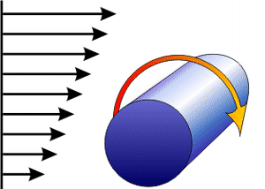
Tornado formation
$$Vertical height$$
Notes:
Most tornadoes form from thunderstorms with mesocyclones, called supercells. It is not fully understood how supercells form. The current theory states the presence of strong vertical wind shear, containing both directional and speed shear is important for the development, as well as updraft produced by a temperature difference between the top and bottom of the thunderstorm.
Speed shear produces a horizontal rotation and the updraft lifts and bends into rotating columns of air, creating two oppositely spinning columns (cyclonic (anti-clockwise) and anti-cyclonic (clockwise)). In the northern hemisphere, directional wind shear then reduces and diminishes the anti-cyclonic rotation and amplifies the cyclonic. Producing a vertically rotating thunderstorm or mesocyclone.

