Slide 1
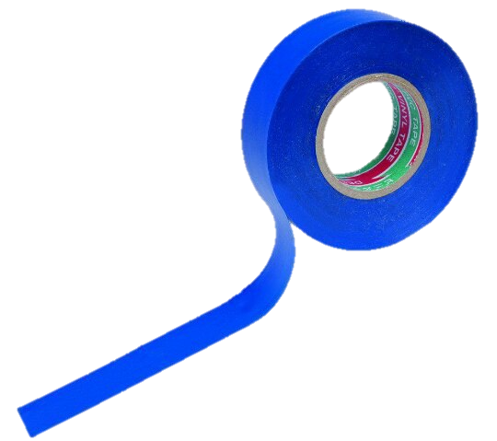
Allometria «Task №13 »
Zhuravleva Angelina

Slide 2
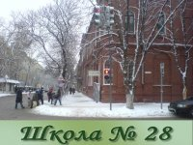
Our team:
- Polina Parinova(captain)
-Angelina Zhuravleva
- Ilia Vasiliev
-Sergey Glebov
-Maksim Shilihin
-Elisaveta Zarezina

Slide 3
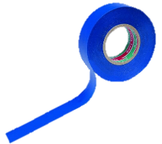
The task:
How length and thickness of bones influence on animal’s weight and growth.

Slide 4
The aim:
Find mathematical dependence between bones and weight and growth.
Our objectives
make limitations
investigate an essence of growth
take account an impact of other factors
make a conclusion

Slide 5
Epiphysis
Metaphysis
Diaphysis

Slide 6
Proliferative Growth
Multiplicative
Accretionary
N_{n}= 2^{n}
Both daughter cells again come into division. The number of cells grows exponentially.
N_{n}= 2n
After each division, only one of the cells is divided
Recurrent
N_{n} =N_{n-1} +N_{n-2}
All daughter cells are divided again, _{but} with a break in one generation. It grows according to the Fibonacci series (1,2,3,5,8,13,21 ...).

Slide 7
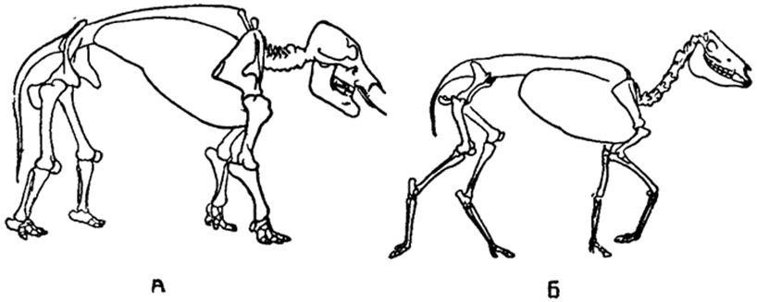
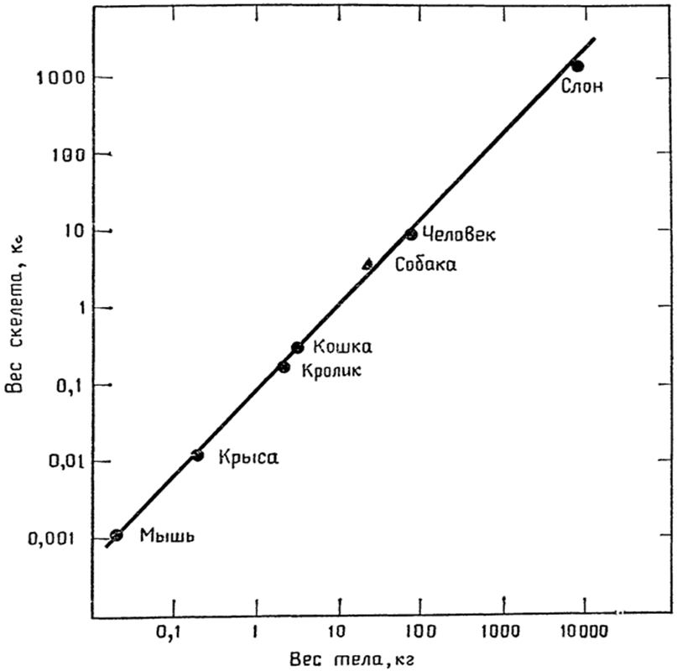
mastodont
Wild hours
Weight changed isometric
a=1

Slide 8
y=bxª
x–weight or growth;
y–separate parameter;
b –const of opening growth;
a – const of balance

Slide 9
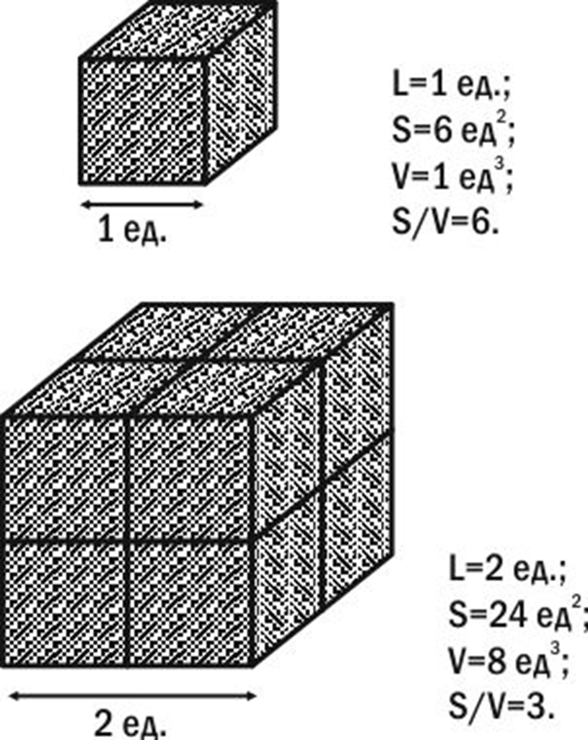

Slide 11
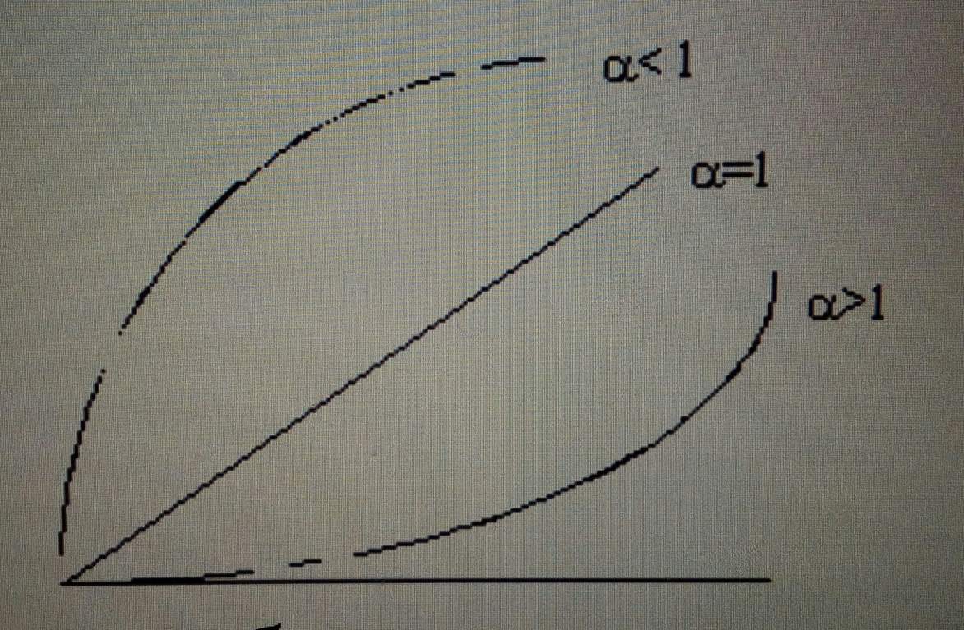

Slide 12
The rules of Allen and Bergman
The protruding parts of the bodies of warm-blooded animals (ears, legs, tails) are less in a cold climate than in warm weather.
The body size of warm-blooded animals in a colder climate is greater than in warm.

Slide 13
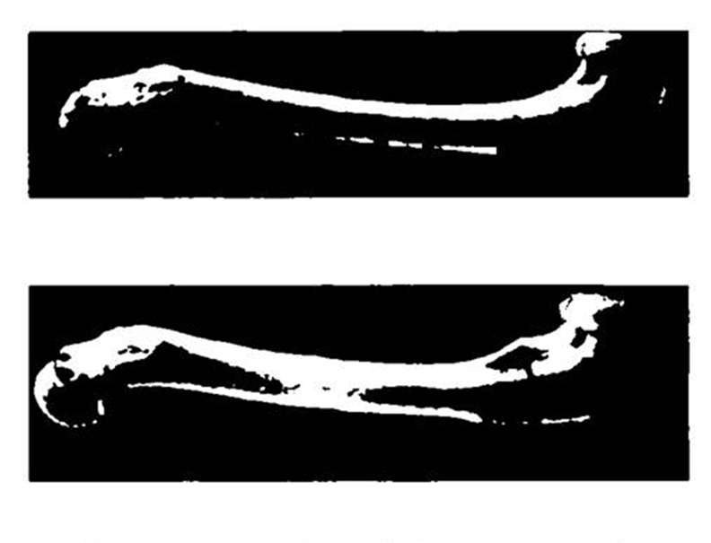
Thigh of American minks

Slide 14
Conclusion
I found out that only proliferation multiplicative growth should be considered
Dependence of bone length and thickness on mass or height is expressed by function y=bxª.
The growth and weight of animals is also affected by climate and lifestyle.

