Slide 1
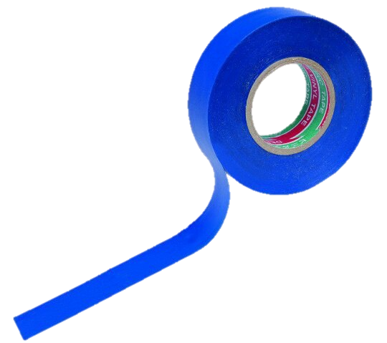
The task №6 Apples
Angelina Zhuravleva
Team «Izolenta»

Slide 2
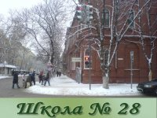
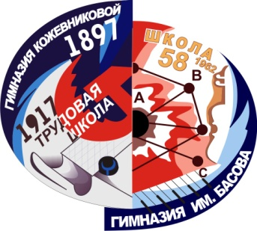
Our team:
- Polina Parinova(captain)
-Angelina Zhuravleva
- Ilia Vasiliev
-Sergey Glebov
-Maksim Shilihin
-Elisaveta Zarezina

Slide 3
Task
Why do apple slices turn brown after being cut? Investigate the speed of this process and test
methods to prevent browning of apple slices.

Slide 4
The structure of research:
Aim:
Investigate the process of browning after apple is being cut.
Our objectives:
Provide methods to prevent browning.
Investigate the speed of this process.
Сonduct experiments.
Make the full conclusion.

Slide 5
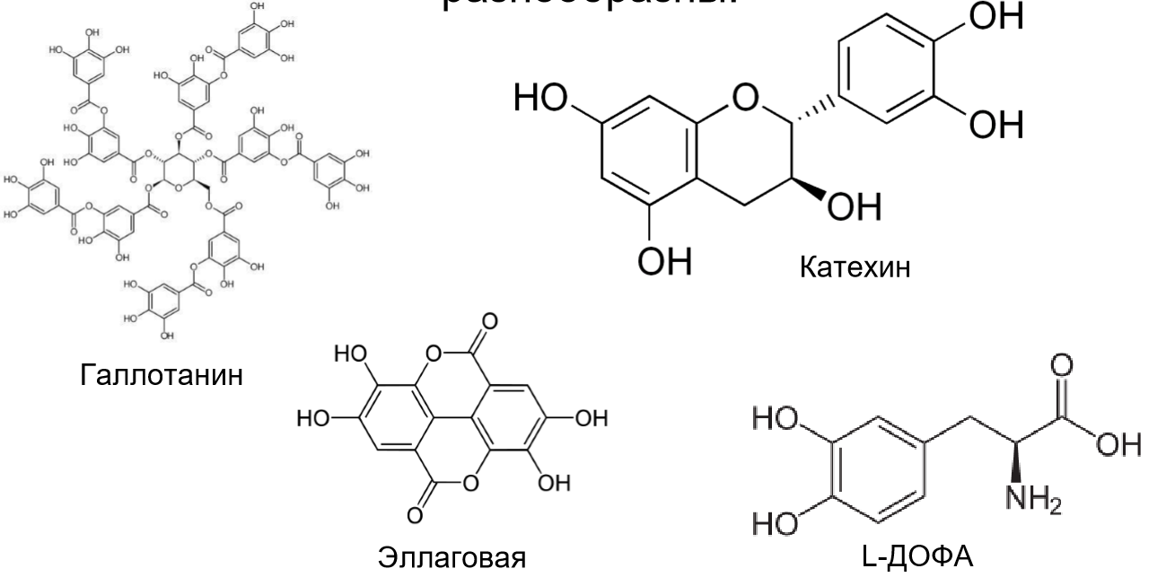
The polyphenols contained in the Apple

Slide 6
The reason of turn brown
PPO catalyzes reactions where molecular oxygen is the acceptor of hydrogen , and phenols act as a donor of hydrogen. The result is ortho-benzoquinone. It contains an unique system of paired connections called Qinode group. Qinode group is chromophore. ortho-benzoquinone is painted in bright red color due to the longer conjugated system, causing bathochromic shift.
PPO

Slide 7
Factors that determine the rate of darkening
1.PPO activity
pH
Temperature
Presence of inhibitor
2. Oxygen

Slide 8
PPO
Belongs to the class of oxidoreductases.
The main characteristic is ability to catalyze two reactions:
hydroxylation of o-phenols To O-difenol
oxidation by molecular oxygen in difenol quinones
Active:
5-7 pH
Temperature: 10-60°C

Slide 9
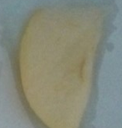
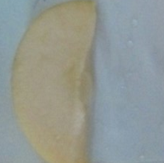
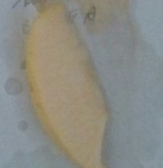
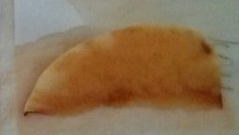
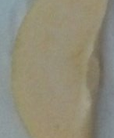
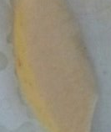
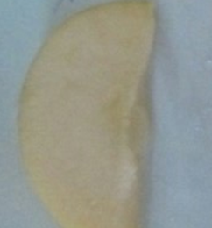
KOH
HCl
NaCl
C₆H₈O₇
CH₃COOH
10 minute
170 minute
330 minute

Slide 10
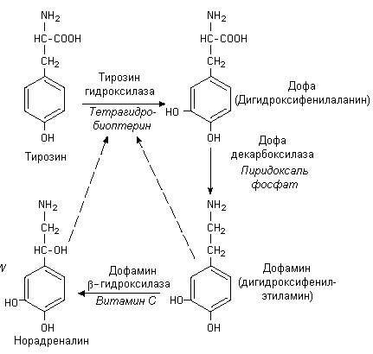
Tirosinasa
DOPA
Decarboksilasa
Dopamin

Slide 11
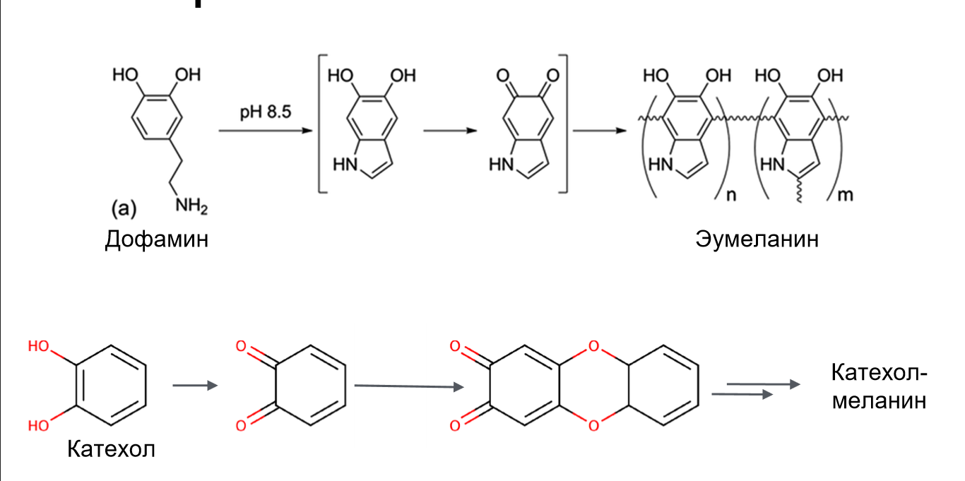
KOH
The formation of melanin
Dopamine
Eymelanin
Katehol-melanin
Katehol

Slide 12
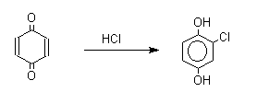
HCl
Protein denaturation
Formation of chlorohydroquinone

Slide 13
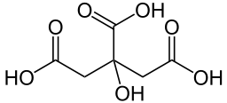
The antioxidant molecules interact with the active radicals with the formation of inactive radicals.
C₆H₈O₇
[O]
$$→$$
+
+

Slide 14
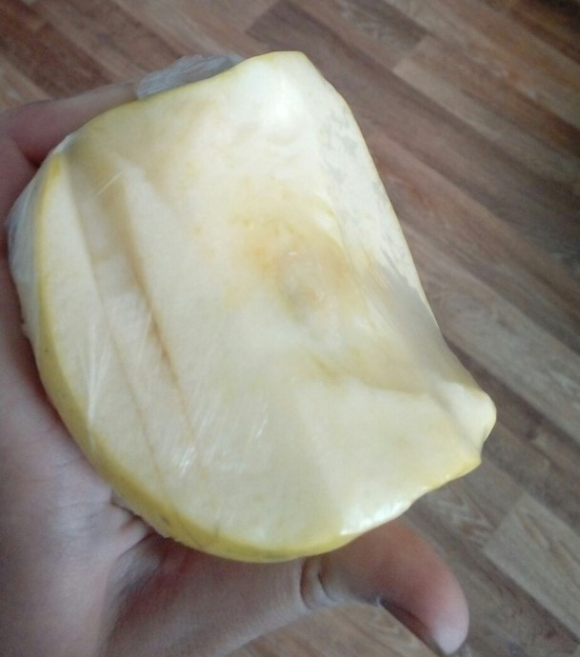
Stop air penetration

Slide 15
Blanching

Slide 16
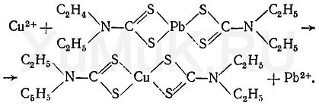
Inhibitor
Diethylcarbamoyl

Slide 17
β-cyclodextrin (heptamer of glucose)

Slide 19
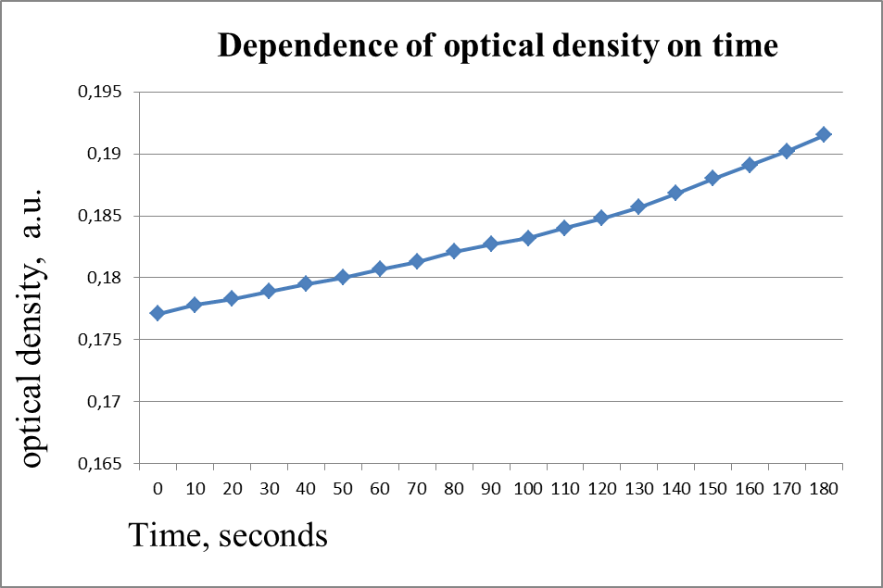
D’ =D^{n+1} – D^{n} / t² – t¹ => D’=0,00005 unit of optical density/ second

Slide 20
Calculations
I/I’=T
I - transmitted ray
I҆ - incident ray
T – coefficient of transmittance
D=lgT
D’ =D^{n+1} – D^{n} / t² – t¹
D’- the speed of change of optical density.
From D^{n} to D^{n+1} - line section

Slide 21
Conclusion
The result of oxidation is ortho-benzoquinone. It is painted in red color because of the longer conjugated system.
Melanin is formed (when pH>7)
The ways to stop browning: decrease of pH; stopping air penetration; inhibitor; blanching; penetration of antioxidants.
We investigated the speed of this process.
D’=0,00005 unit of optical density/ second.

Slide 22
Thank you for watching!

Slide 23
Used saucers
http://flavorchemist.livejournal.com/165771.html
https://elhow.ru/eda-i-napitki/frukty/pochemu-jabloko-temneet
http://www.kakprosto.ru/kak-91600-pochemu-yabloko-temneet
http://allforchildren.ru/why/why123.php
http://tehtab.ru/Guide/GuideChemistry/pH/phFoodTable/
http://
http://studwiki.info/3_18100_lektsiya--.html
http://biokhimija.ru/narushenie-aminokislot/sintez-melaninov.html
https://ru.scribd.com/document/343956393/ACCION-Y-EFECTOS-DE-LA-POLIFENOLOXIDASA-EN-pdf
https://vk.com/doc171658362_447210999?hash=842c7cbf159a8e8221&dl=96372b34c9ccd24928
http://www.ngpedia.ru/id577808p1.html

Slide 24
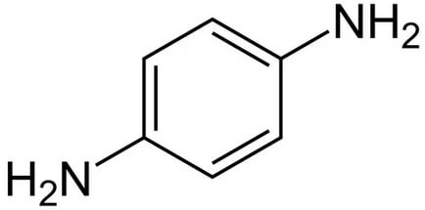
A diamine is an organic compound with two amino groups.

