Slide 1
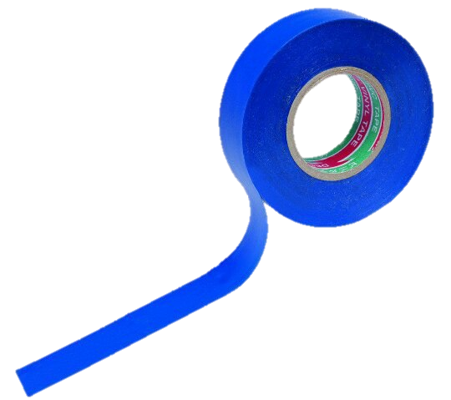
«Task №11 »
Team “Izolenta"
Prepared Polina Parinova
Voronezh, Russia.

Slide 2
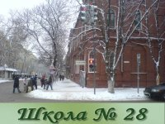
Izolenta team:
-Polina Parinova (Capitan)
-Zhuravleva Angelina
-Vasiliev Ilia
-Glebov Sergey
-Shilikhin Maxim
-Zarezina Elizaveta

Slide 3
Task condition.
11. Grow light
Investigate how different types of artificial lights affect plant growth. What is the role of light spectrum?

Slide 4
Plan of report:
We will consider various types of possible artificial lighting and the spectrum emitted by them.
Look at the experiment that we conducted.
Find out the results of our study.
During for decision of this problem we set the tasks for ourselves:
To create controlled conditions for growth of plants.
Make photos of experiment.

Slide 5
Aim:
Study the role of different light spectra on plants.

Slide 6
Incandescent lamp spectrum:
(red-orange spectrum + thermal infrared radiation)
ultraviolet
Infrared
Incandescent lamp spectrum

Slide 8
Spectrum of sodium lamps
(Orange-yellow spectrum)
ultraviolet
Spectrum of sodium lamps
Infrared

Slide 10
Spectrum of fluorescent lamp
(Green-yellow and partly оrange spectrum)
ultraviolet
Infrared
Spectrum of fluorescent lamp

Slide 12
Spectrum of LEDs
(Almost complete absence of ultraviolet and infrared radiation)
ultraviolet
Infrared
Spectrum of LEDs
Spectrum of LEDs

Slide 14
Spectrum of special fitolamp.
(Used blue and red LEDs, red and blue spectrum simultaneously)
ultraviolet
Infrared

Slide 15
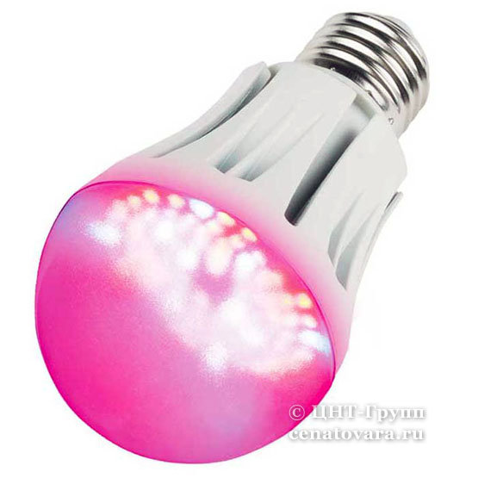

Slide 16
Influence of different types of spectrum on the growth of plant parts:

Slide 17
Characteristics of spectra in our experiment:
Type of spectrum | Wavelength range, nm | Range of frequencies, TНz
Purple | ≤450 | ≥667
Blue | 450—480 | 625—667
Red | ≥630 | ≤476
Natural lighting | 400-700 | 430—750

Slide 18
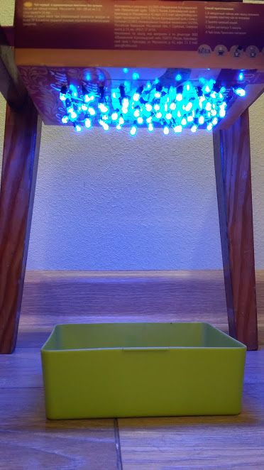
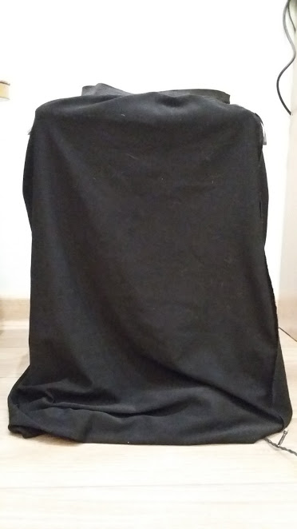
Our experimental setup:
For experiment setup with blue and red spectrum we used:
150 blue/red LEDs with a power of 0.06 Watts;
Seeds of wheat, barley, oats, peas, rye, sorghum and millet;
Plastic container;
Water for watering;
Black dense not translucent tissue;
Ruler.

Slide 19
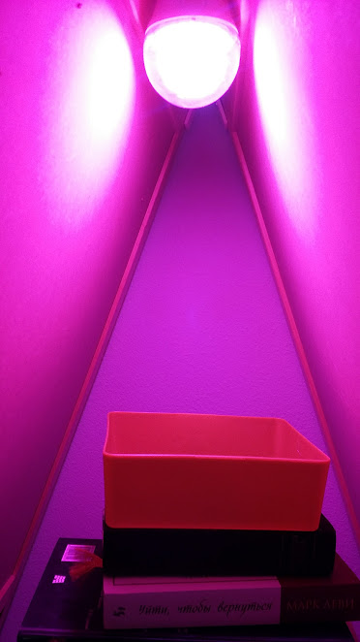
Our experimental setup:
For experiment setup with fitolamp spectrum we used:
Fitolamp with a power of 9 Watts;
Seeds of wheat, barley, oats, peas, rye, sorghum and millet;
Plastic container;
Water for watering;
Black dense not translucent tissue;
Ruler.

Slide 20
Our experimental setup:
For control group under natural lighting we used:
Window;
Seeds of wheat, barley, oats, peas, rye, sorghum and millet;
Plastic container;
Water for watering;
Black dense not translucent tissue;
Ruler.

Slide 21
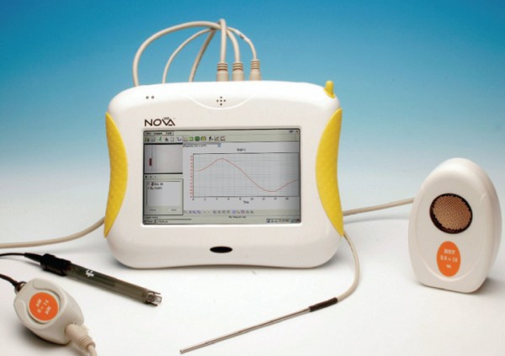
The degree of illumination in our experimental setup.
In all experimental setups the sensors digital lab Nova 5000 showed a light level of 400 lx.
Digital lab Nova 5000

Slide 22
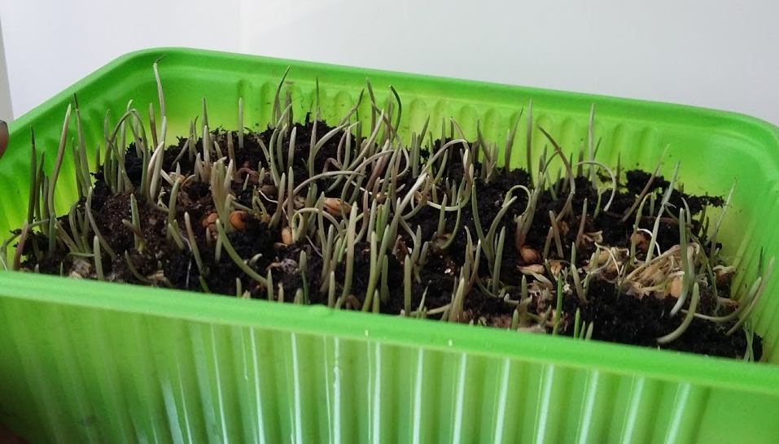
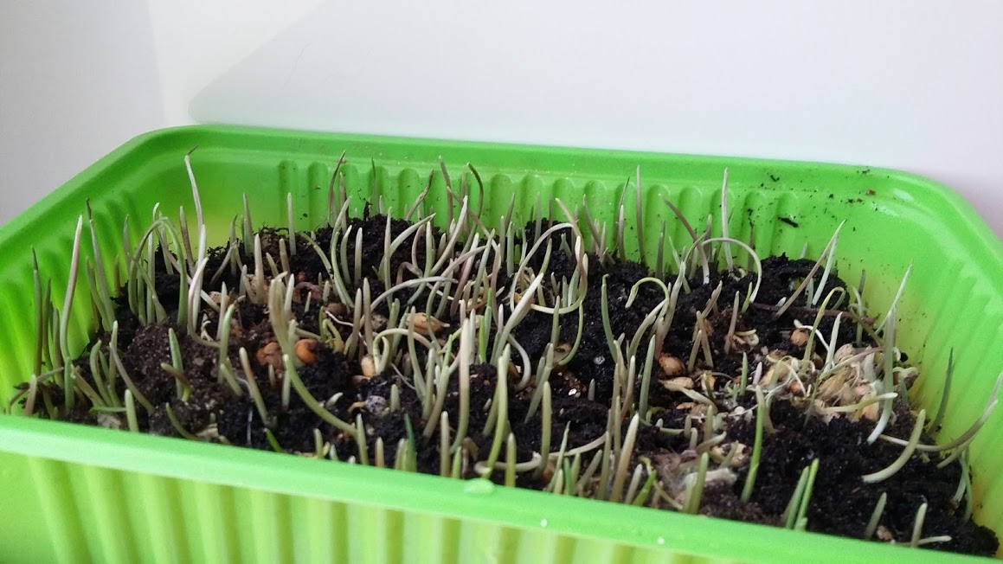
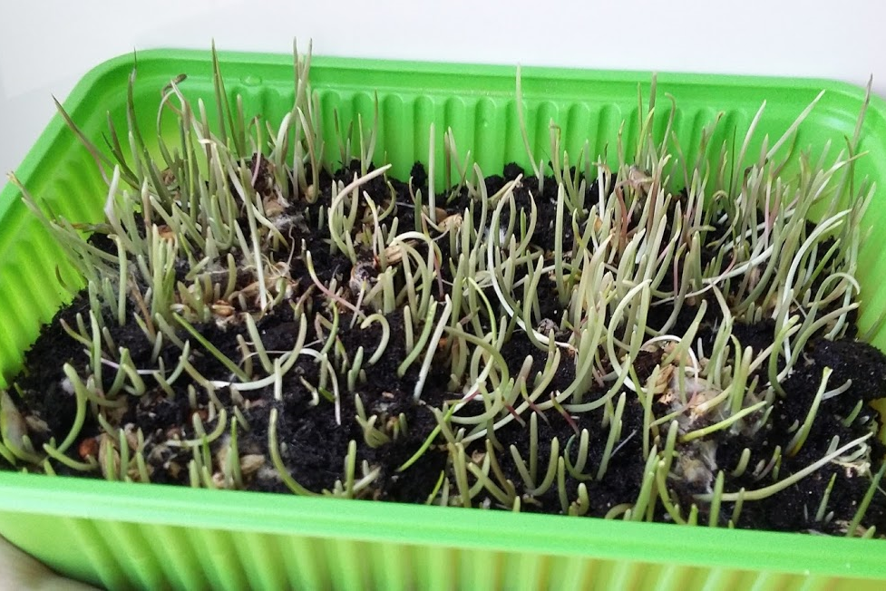
Experiment: 1st day.
Blue Spectrum
Red Spectrum
Fitolamp
Natural lighting

Slide 23
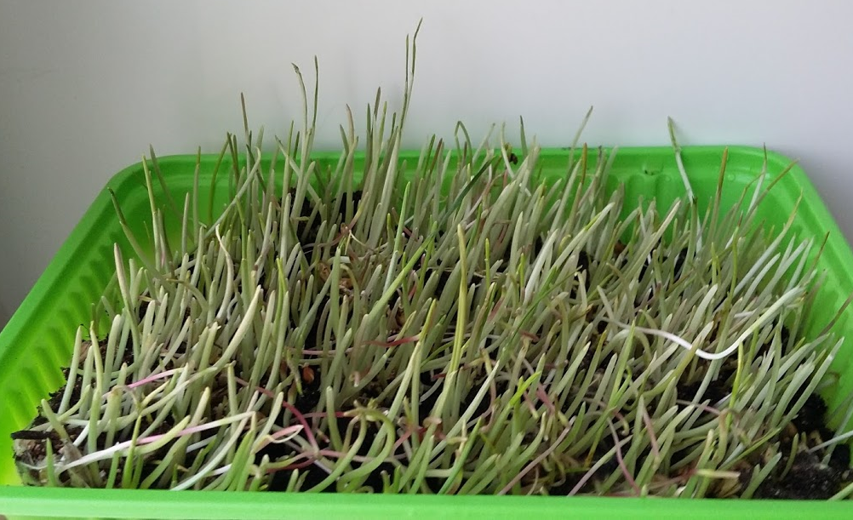
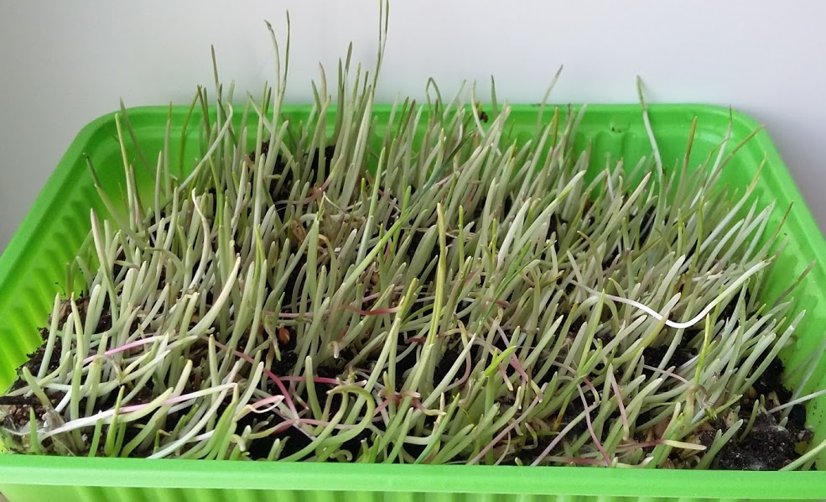
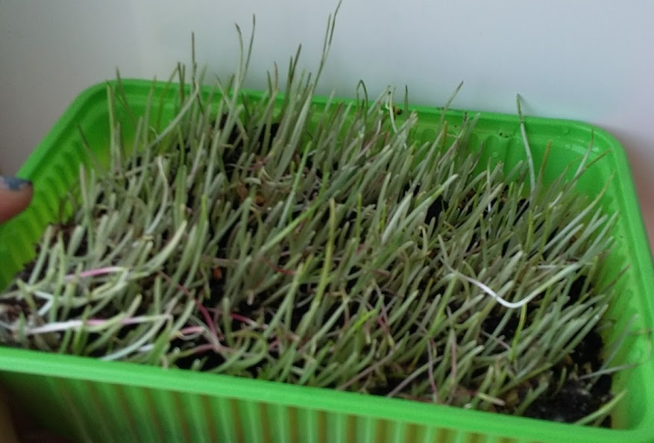
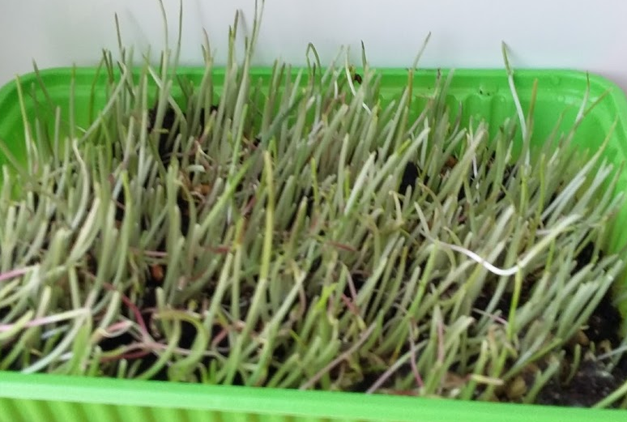
Experiment: 5th day.
Blue spectrum
Red spectrum
Fitolamp
Natural lighting

Slide 24
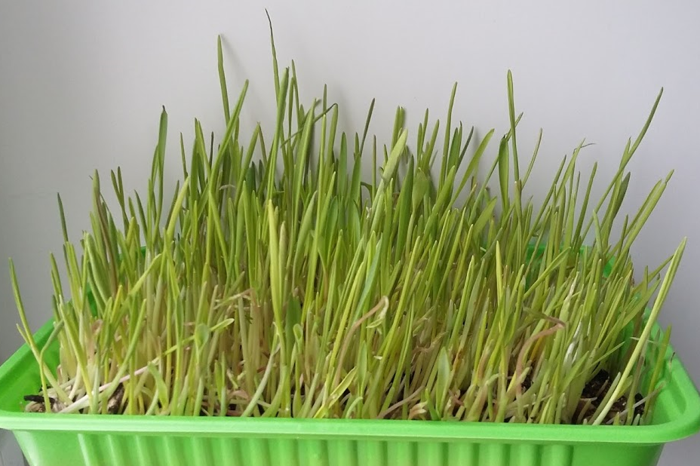
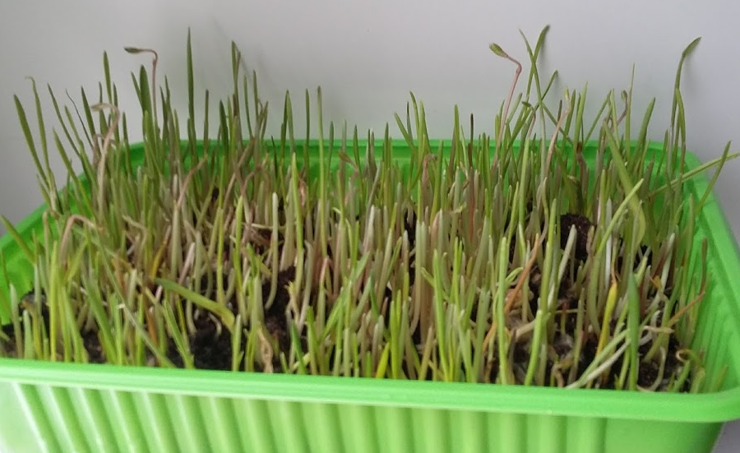
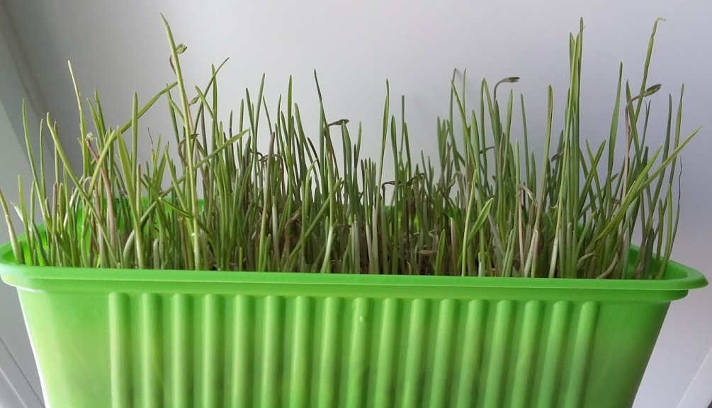
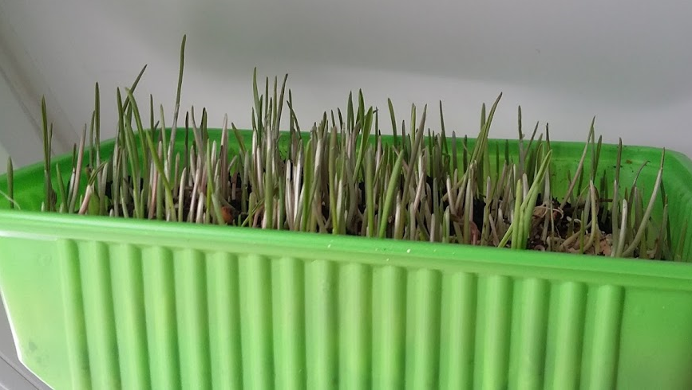
Experiment: 10th day.
Blue spectrum
Red spectrum
Fitolamp
Natural lighting

Slide 25
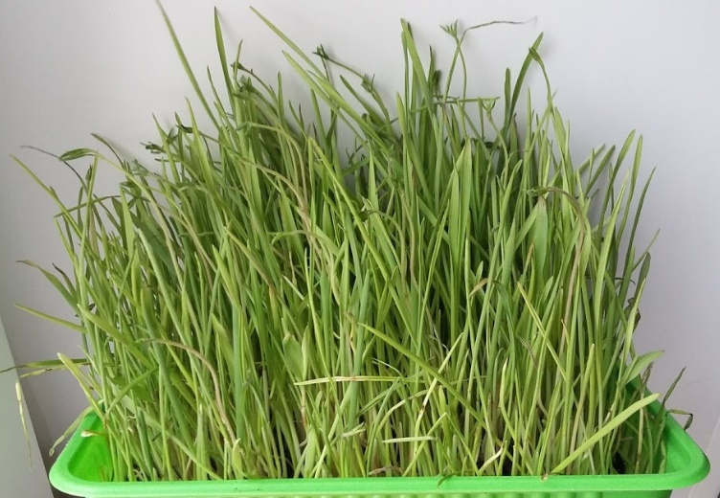
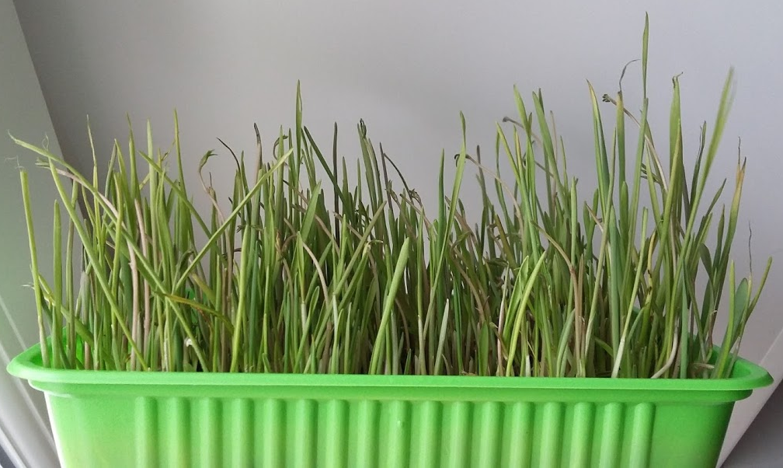
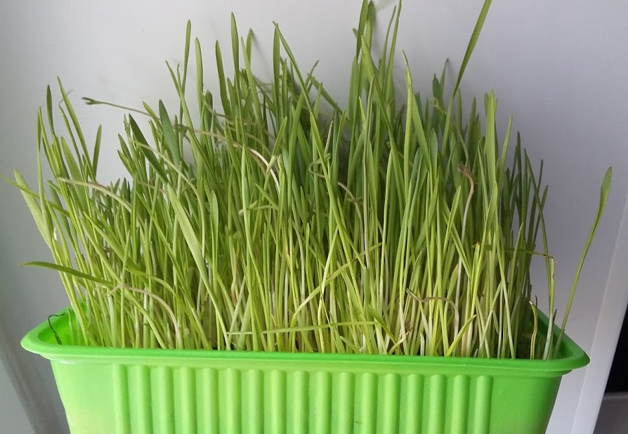
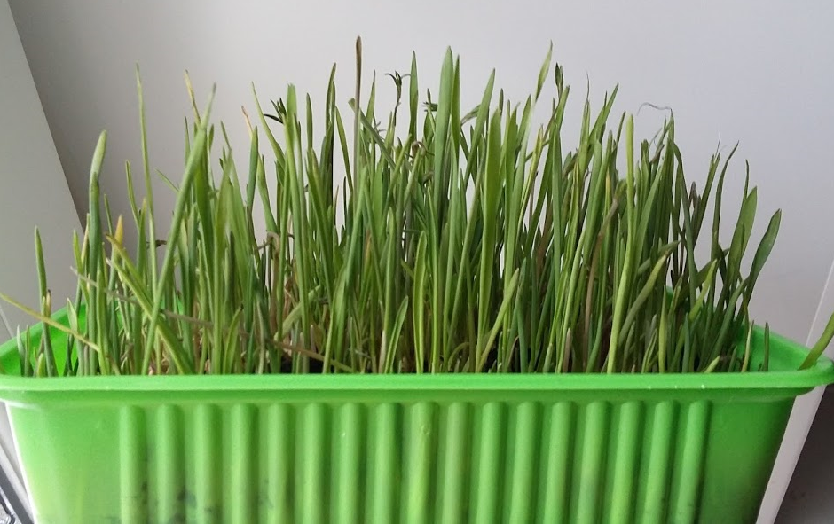
Experiment: 20th day.
Blue spectrum
Red spectrum
Fitolamp
Natural lighting

Slide 26
The influence of blue spectrum for plant growth:

Slide 27
The influence of red spectrum for plant growth:

Slide 28
Influence of fitolamp on the growth of plants:

Slide 29
Influence of natural lighting on growth of plants:

Slide 30
Comparison of effects of different types of lighting on plants:

Slide 31
Conclusion:
On the growth of plants most favorably affects the lighting of the blue spectrum.

Slide 32
Sources of information:
Newton i. Optics or a treatise on reflexes, angles and colours of Light/translation S.I. Vavilov — Ed-e 2-e.-m.: State. IZD-vo techno-theoretical literature, 1954. -S. 131. — 367 pp. — (series "Classics of natural science)
Gagarin a. p. Light. Physical encyclopedia: [t 5]/Hl. Ed. A. M. Prokhorov. — М.: great Russian encyclopedia, 1994. — T. 4: Poynting-Robertson-Streamers.
https://ru.wikipedia.org/wiki/%D0%92%D0%B8%D0%B4%D0%B8%D0%BC%D0%BE%D0%B5_%D0%B8%D0%B7%D0%BB%D1%83%D1%87%D0%B5%D0%BD%D0%B8%D0%B5
http://le-diod.ru/rabota/kak-opredelit-moshhnost-svetodioda/
https://ru.wikipedia.org/wiki/%D0%92%D0%B8%D0%B4%D0%B8%D0%BC%D0%BE%D0%B5_%D0%B8%D0%B7%D0%BB%D1%83%D1%87%D0%B5%D0%BD%D0%B8%D0%B5
http://www.floralworld.ru/care/light.html

Slide 33
Thanks for your attention!

