Slide 1
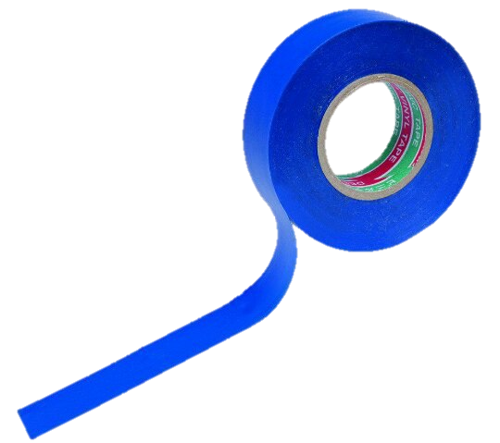
Task № 7.
Prepared by Elizaveta Zarezina, team «Izolenta»

Slide 2
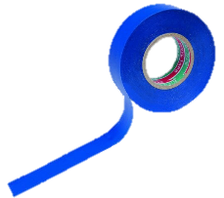
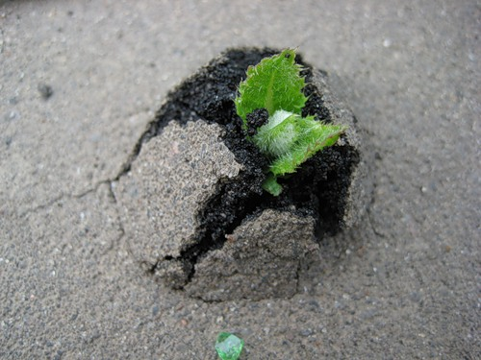
Growing through asphalt
Can a little plant grow straight up through concrete or asphalt?

Slide 3
Structure of research
Aim: to investigate the phenomenon of growing plants through asphalt or concrete.
Tasks:
1. To explain why plants can or can`t grow through asphalt or concrete and how they do it;
2. To make appropriate experiments;
3. To compare theory and experiment.

Slide 4
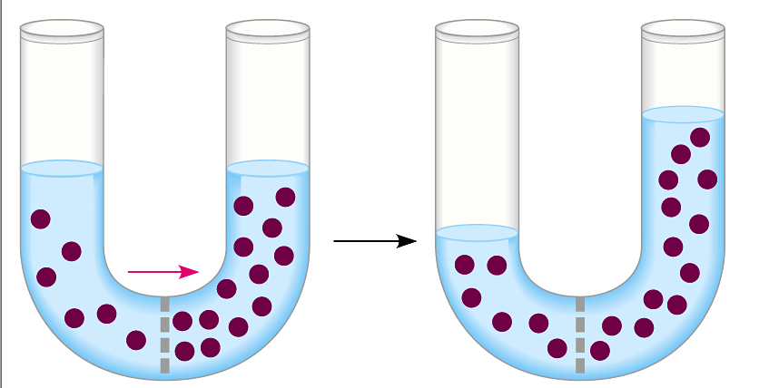
Process of plant`s growing
When seed begins growing, it draws water from the soil with big force and it begins to swell. There are several processes in plants` cells that determine it.
Osmosis is the spontaneous net movement of solvent molecules through a semi-permeable membrane into a region of higher solute concentration, in the direction that tends to equalize the solute concentrations on the two sides.

Slide 5
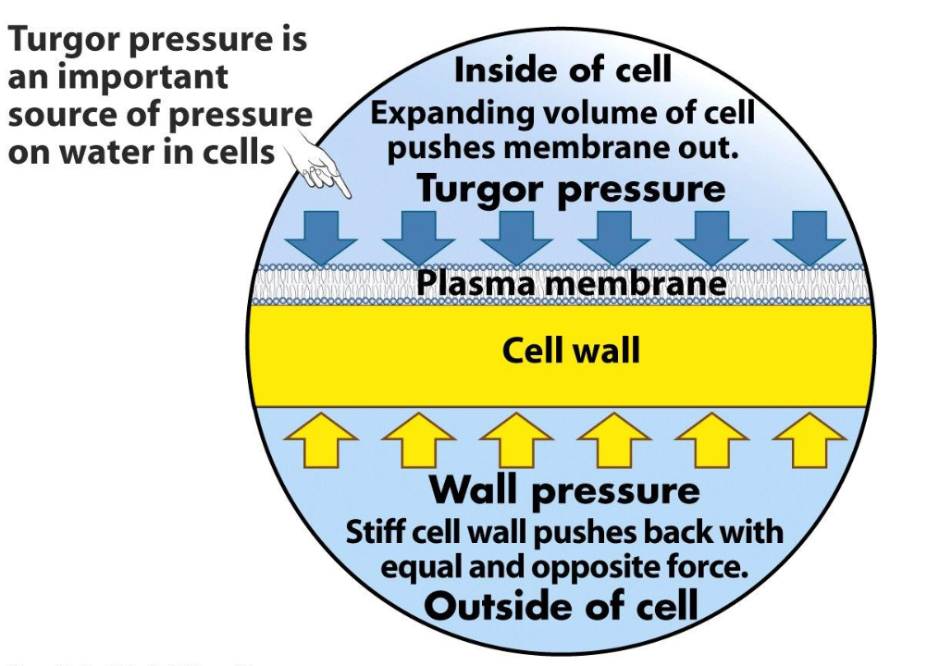
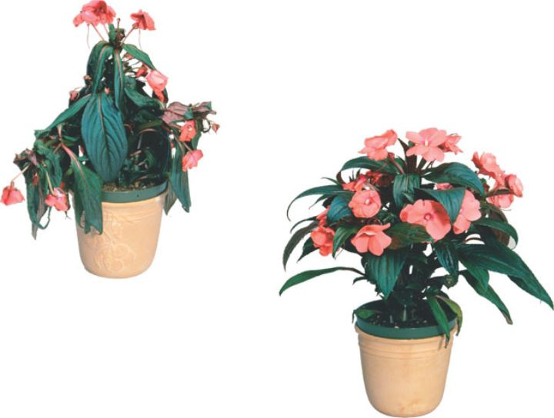
Turgor pressure is the internal hydrostatic pressure in a living cell that causes the voltage of the cell wall. In plant cells turgor pressure is usually about one megapascal. This huge pressure lets small plants grow through the asphalt or concrete.

Slide 6
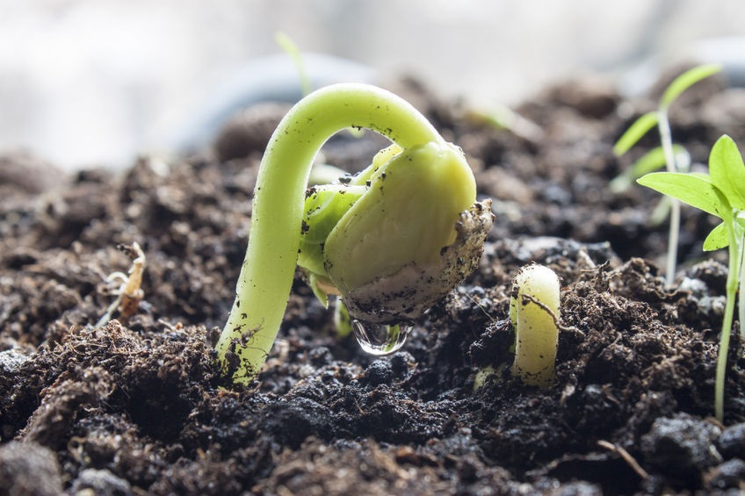
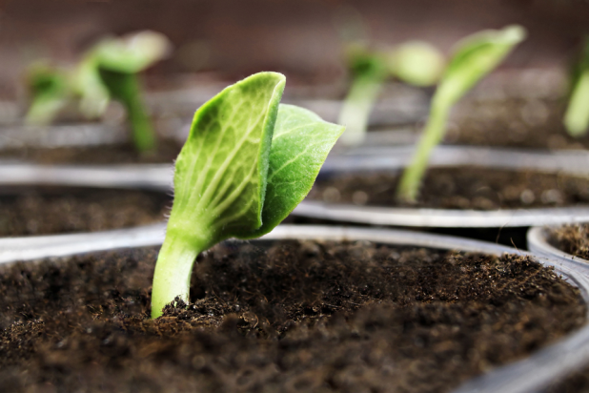
Also many plants have special tools which help them overcome the obstacles.
According to the negative gravitropism plants overcome asphalt or concrete, literally breaking it.

Slide 7
An asphalt and concrete pavement always have cracks and bumps. They can be very very little, but it matters.

Slide 8
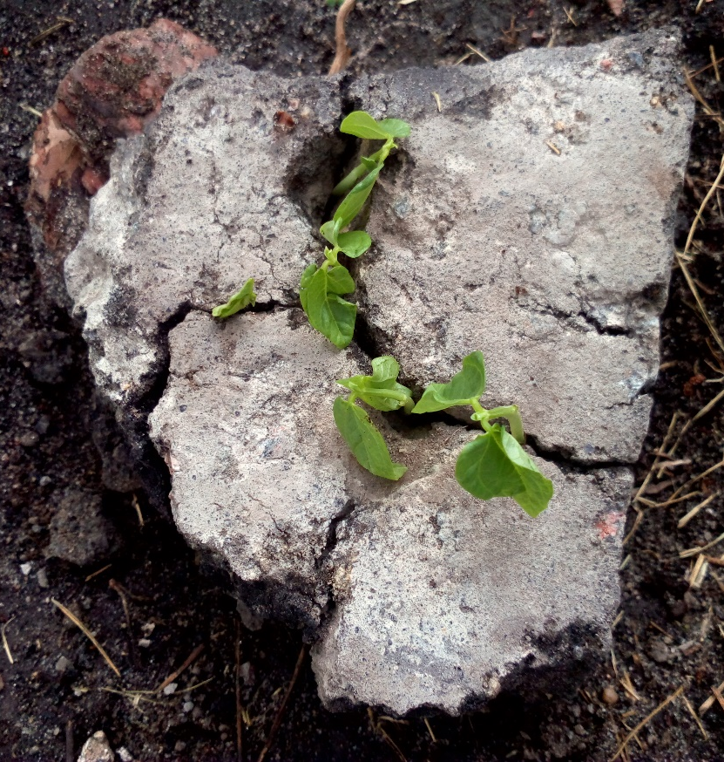
We made an experiment to confirm our theory in practice. We have grown beans covered a peace of asphalt. It has broke its pavement, so our theory was right.

Slide 9
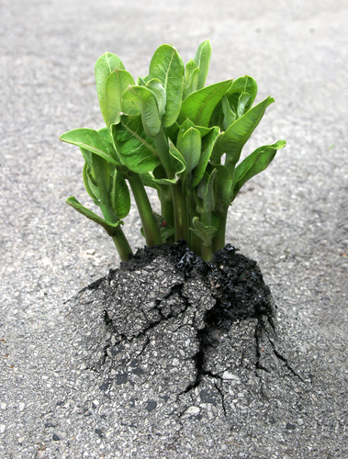
Conclusion
Little plant really can grow straight up through concrete or asphalt. It is possible because there is a huge hydrostatic pressure in plants` cells, and plants have special tools to overcome obstacles, and asphalt and concrete pavements always have little imperfections.

Slide 10
Sources of information
Pritchard, Jeremy (2001). "Turgor Pressure". Encyclopedia of Life Sciences.
Fricke, Wieland (January 2017). "Turgor Pressure". Encyclopedia of Life Sciences.
Steudle, Ernst (February 1977). "Effect of Turgor Pressure and Cell Size on the Wall Elasticity of Plant Cells". Plant Physiology. PMC 542383 Freely accessible.
"Khan Academy". Khan Academy. Retrieved 2017-04-27.
"Osmosis (Cellular) - Osmosis In Plant Cells". science.jrank.org. Retrieved 2017-04-27.

Slide 11
Thank you for whatching

