Slide 1
12. Milk

Slide 2
Problem
Develop simple methods allowing determination of some of the important properties of milk. Suggest an investigation requiring comparison of various milk samples.

Slide 3
Aim
With the help of simple methods investigate the most important properties of milk.

Slide 4
Task
Define the most important properties of milk which can be tested without using special equipment.

Slide 5
Processing materials and substances
Iodine
Litmus test paper
cotton filter
Ethanol
Glasses
2 various milk samples

Slide 6
Types of tests
Presence of added water
Presence of starch
Mechanical impurities
Presence of antibiotics
Presence of soda

Slide 7
Tests conditions
All tests were conducted under the room temperature.

Slide 8
Test 1
In this test, the purity of milk samples is tested.
Cotton filters are used to pass the milk samples through.
If there are particles left on the cotton filter, the milk does not comply with the standards of purity. But in the photo there are no visible particles.

Slide 9
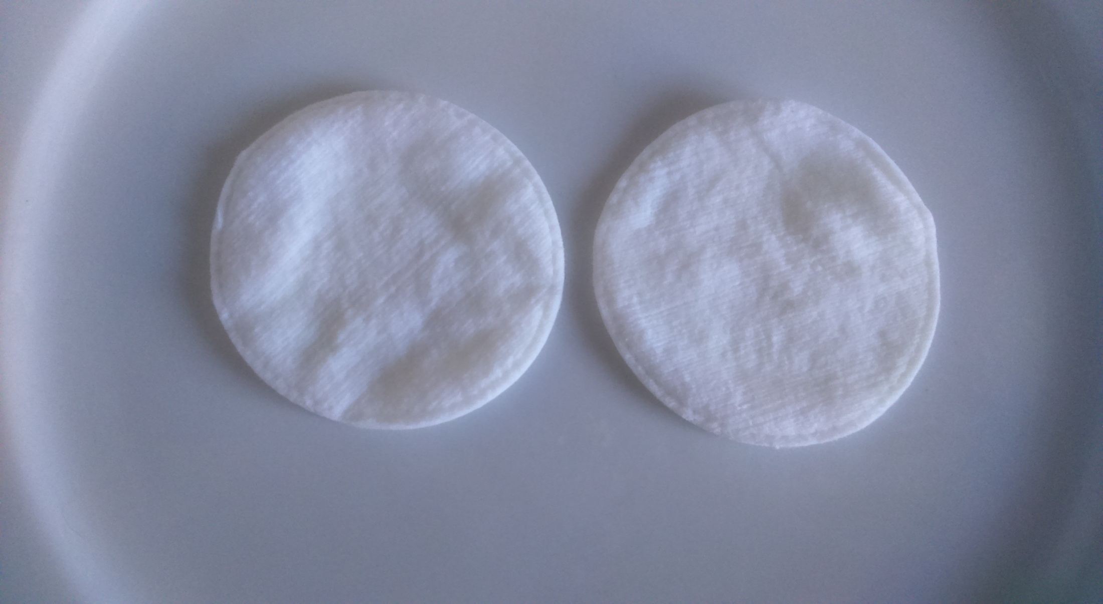
Detecting mechanical impurities

Slide 10
Test 2
In this experiment we will analyze milk for soda in it.
To complete this test we will use litmus paper, because it can define the titratable acidity.
Since the color of litmus paper has not changed, there is no soda in our milk samples.

Slide 11
Detection for soda

Slide 12
Test 3
To detect starch in milk we will use iodine for identification test.
After we have added drops of iodine into milk, the color of milk became yellowish, but not blue.
Therefore, we can say that there are no starch in both samples of milk

Slide 13
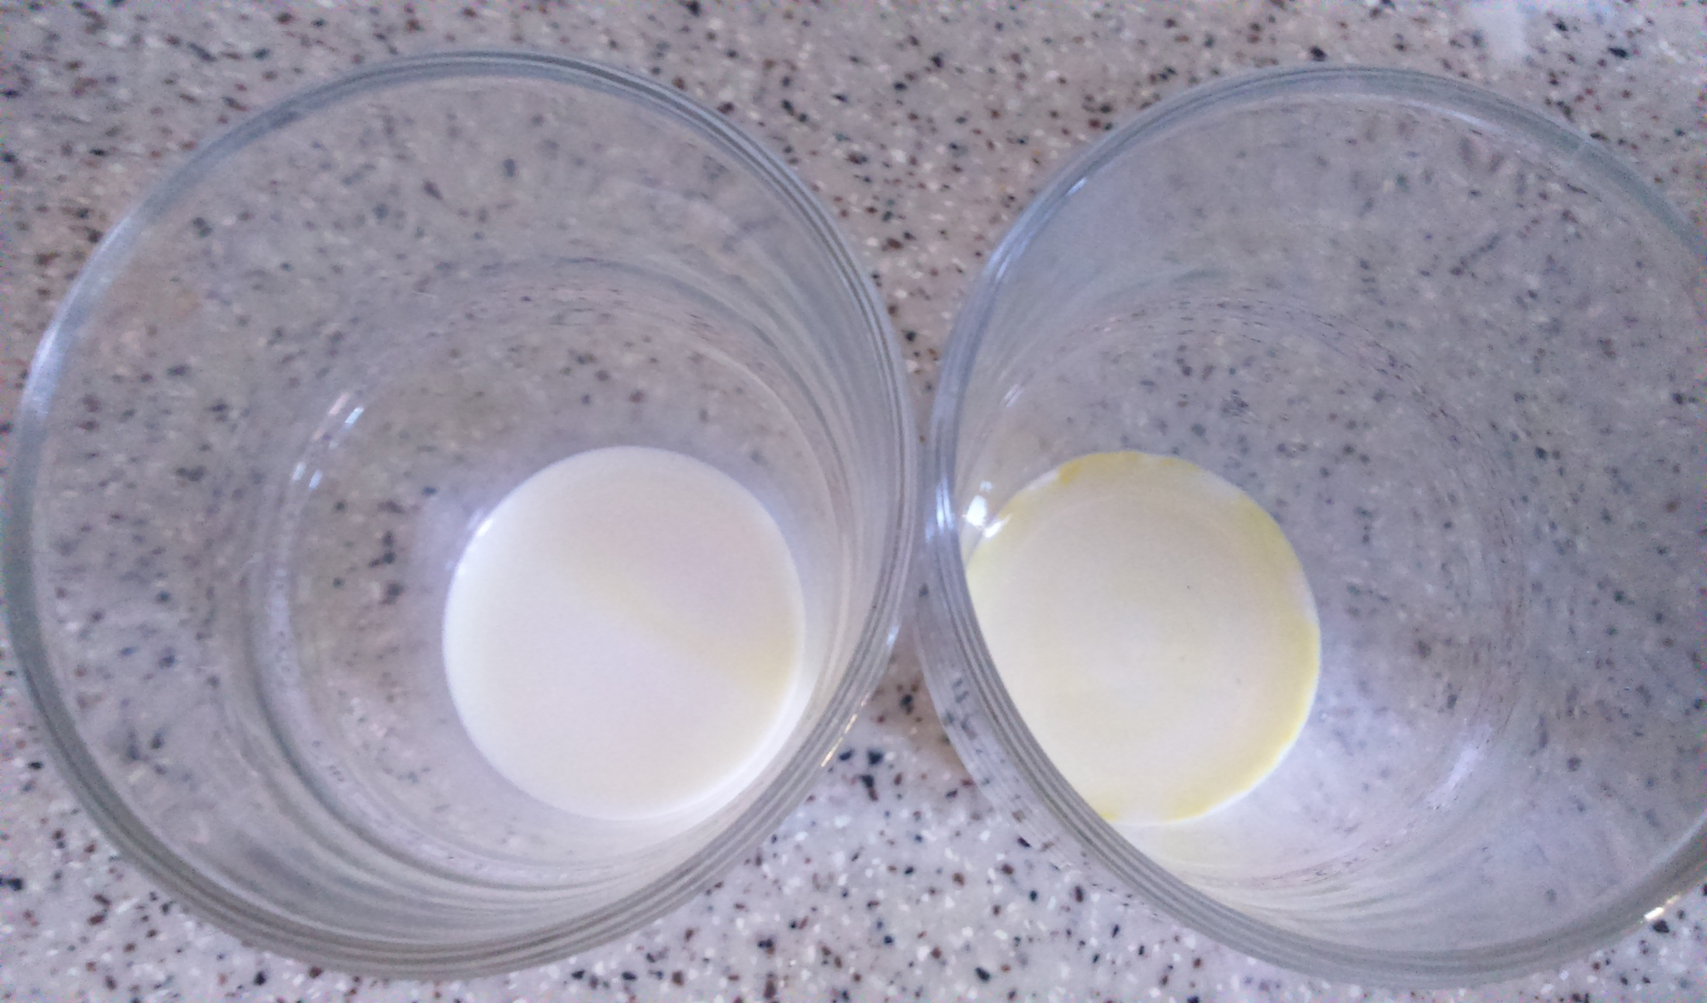
Detection for starch

Slide 14
Test 4
In this test, presence of added water is examined.
Step 1: 1 part of milk is mixed with 2 parts of ethanol.
Step 2: each sample is shaked for 1 minute.
Step 3: the mixture is poured into a plate.
Step 4: protein is denaturated and turns into “flakes”.
If “flakes” appear within a minute after pouring the mixture into the plate, no water was added to the milk.
If no “flakes” appear, water was added to the milk.

Slide 15
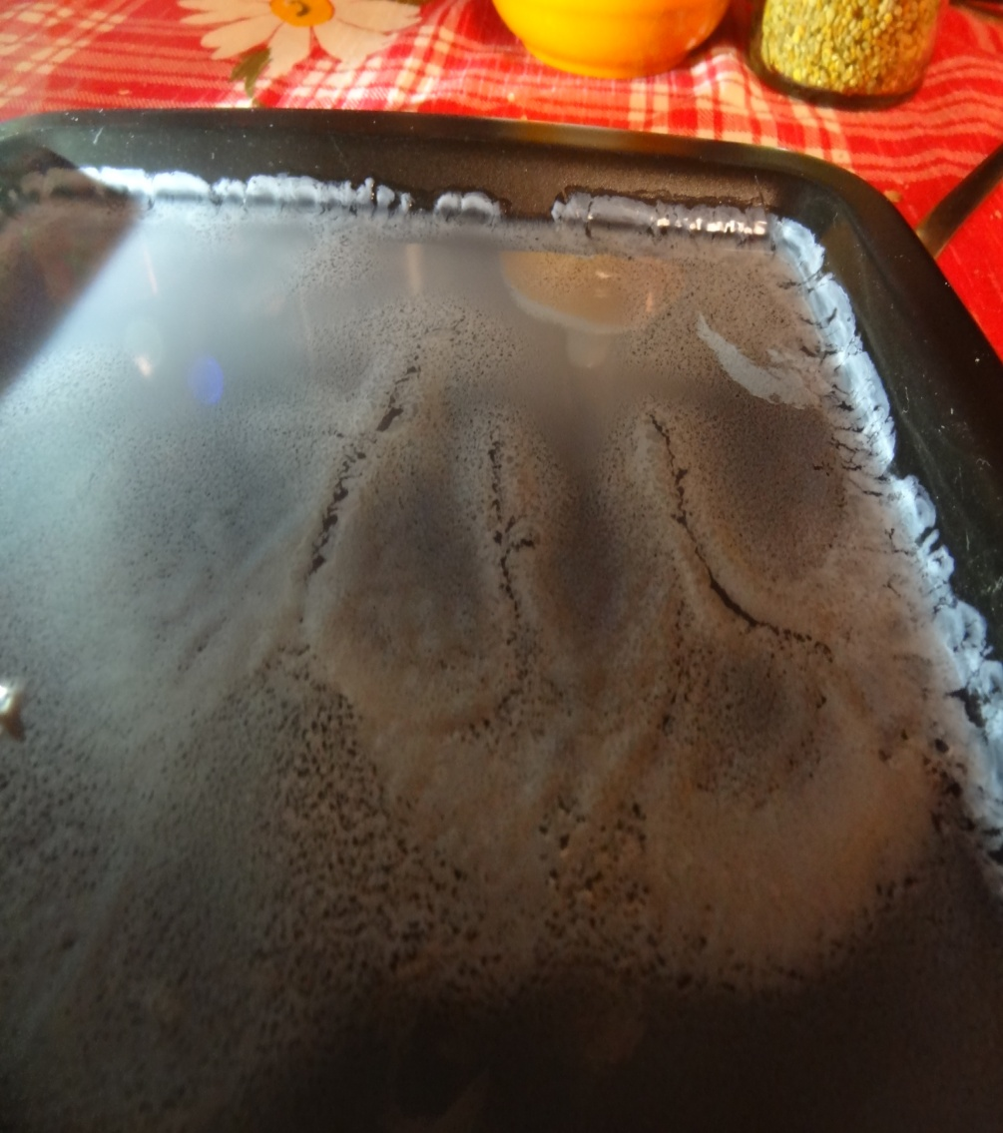
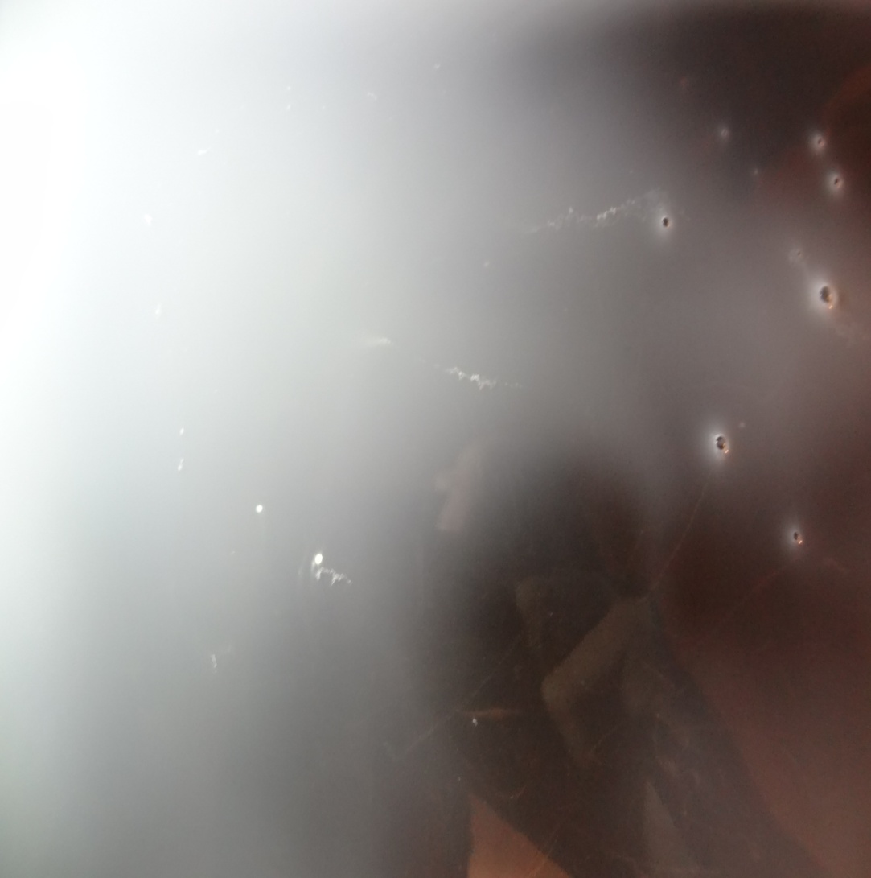
Detection for water presence

Slide 16
Detection of antibiotics
Sample 1 was soured for 15 hours
Sample 2 was not soured and became bitter in 4 days
So we can certainly say that un Sample 1 there are antibiotics and there are no antibiotics in Sample 2

Slide 17
Conclusion
By comparing 2 samples of milk we have defined some properties of milk
Fat content
Presence of water
Сontaining of starch
Mechanical impurities
Presence of antibiotics
Presence of soda

Slide 18
References
https://xn--j1ahfl.xn--p1ai/library/issledovanie_kachestva_moloka_v_domashnih_usloviyah_052058.html
http://nsportal.ru/ap/library/drugoe/2012/03/02/opredelenie-kachestva-moloka-v-domashnikh-usloviyakh

Slide 19
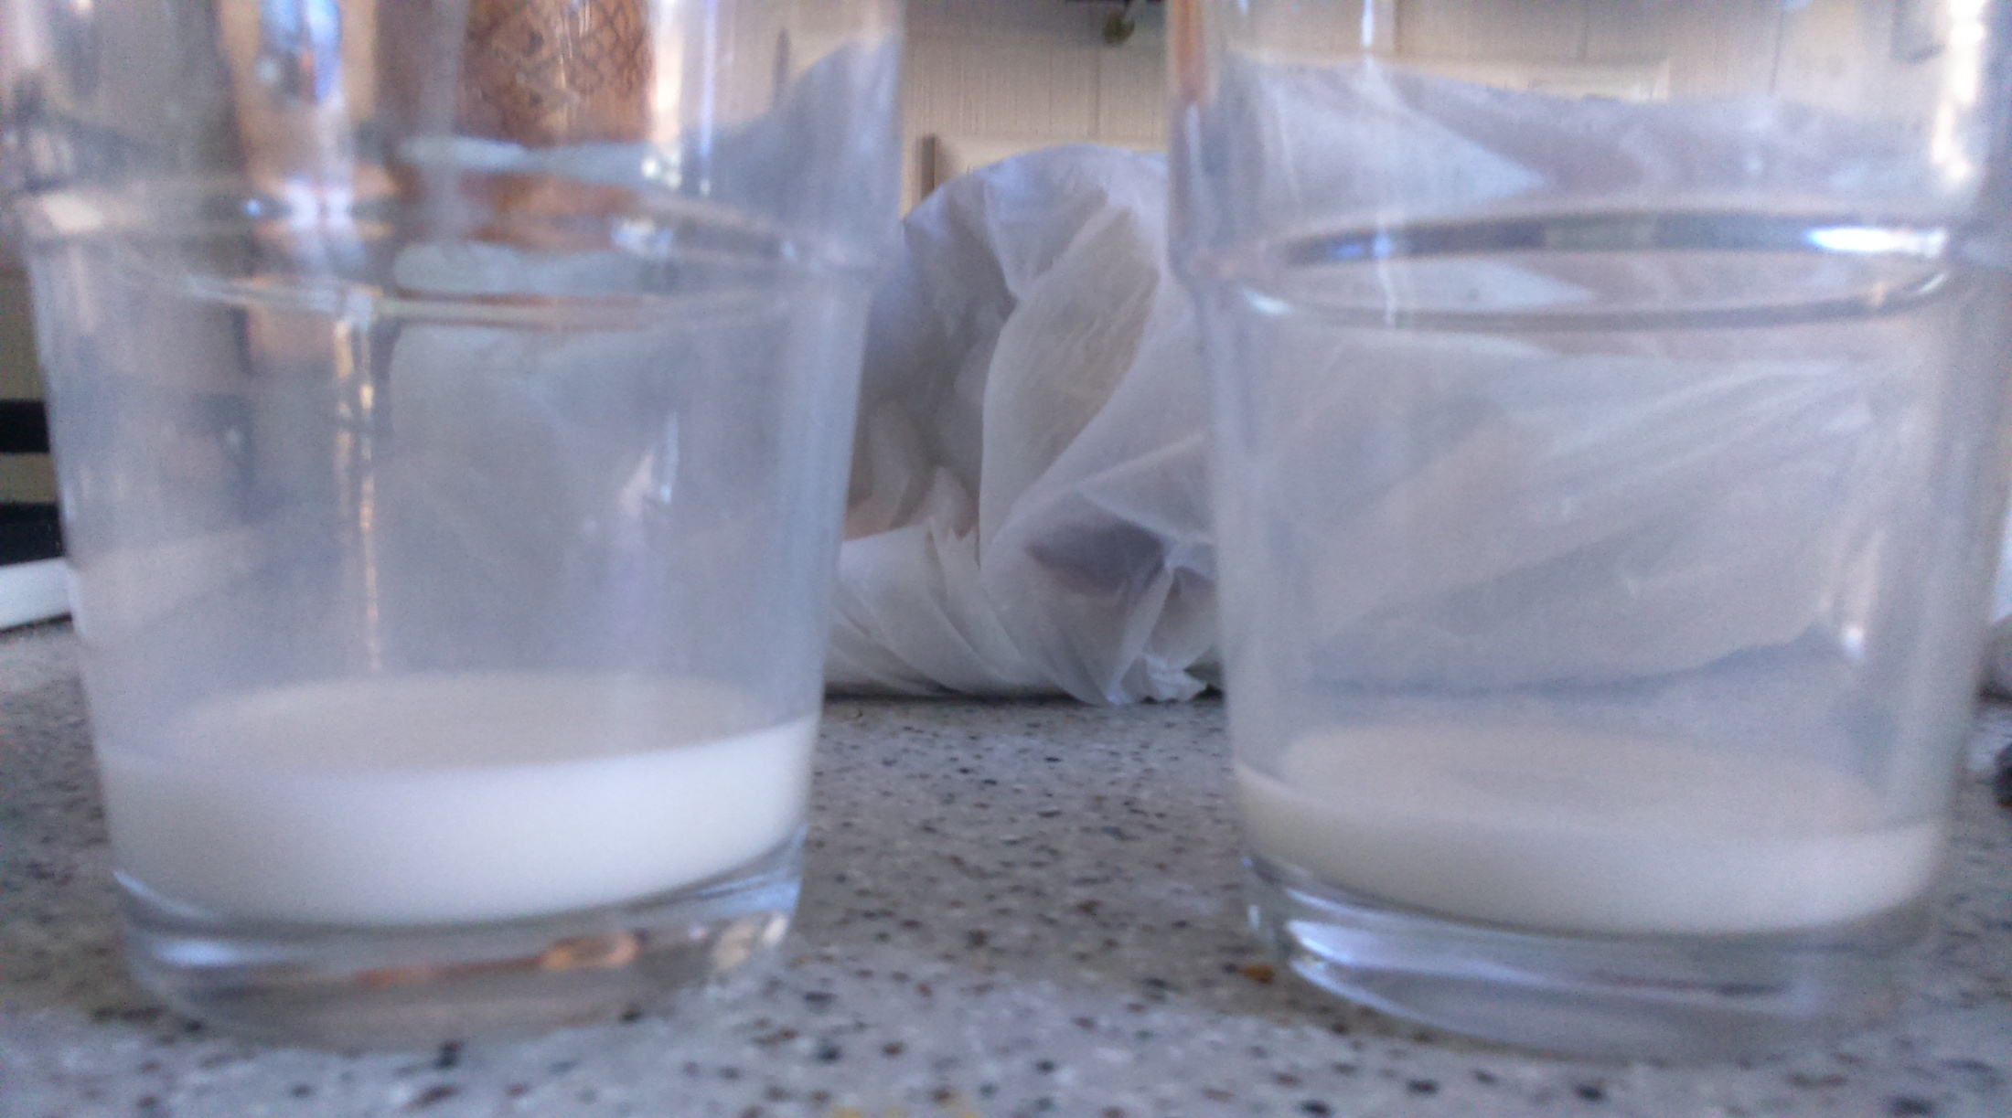
Detection for fat and quality analyze

