Slide 1
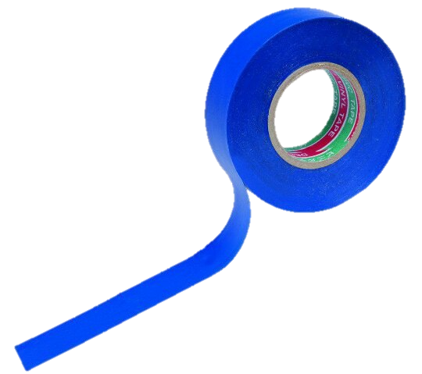
«Task № 10 »
Prepared by Elizaveta Zarezina
Team «Izolenta»
Voronezh, Russia

Slide 2
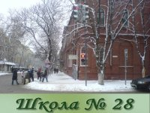
Izolenta team:
-Polina Parinova (Capitan)
-Zhuravleva Angelina
-Vasiliev Ilia
-Glebov Sergey
-Shilikhin Maxim
-Zarezina Elizaveta

Slide 3
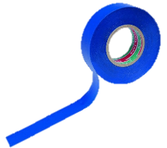
The problem:
If air inside a vertical cylindrical tube open at both ends is heated, the tube produces sound. Study this effect.

Slide 4
Structure of solution
Aim: to review this effect and to study it.
Tasks:
1. To explain sound producing;
2. To make several Rijke's tube setups;
3. To characterize and analyze this effect.

Slide 5
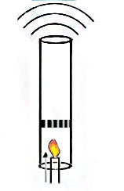
A self-excitation of sound oscillations occurs in Rijke`s tubes. A convective current of air expands near the heated element and compresses in unheated upper part of tube, and it causes sound producing.
Also Rijke`s tube is a self-oscillation system

Slide 6
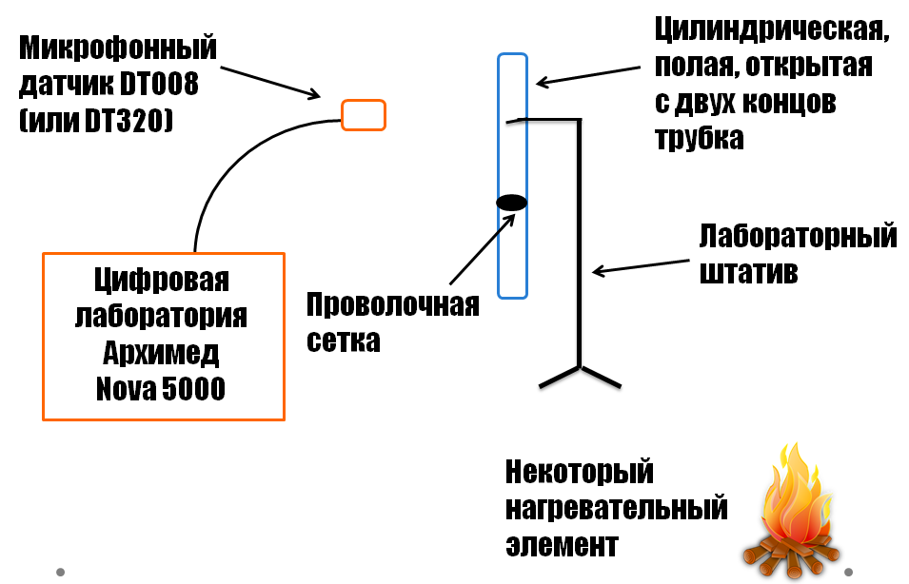
Scheme of experiment
frequency and loudness sensors
vertical cylindrical tube open at both ends
portable computerized science lab
metal wire mesh
heater – gas burner

Slide 7
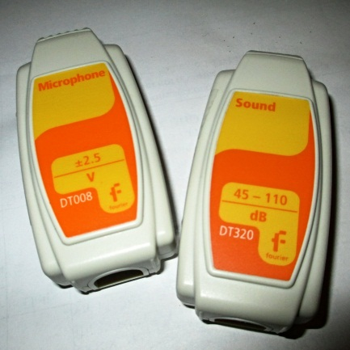
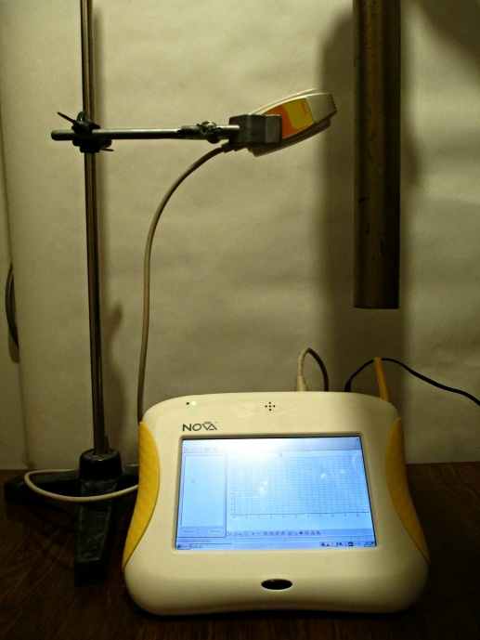
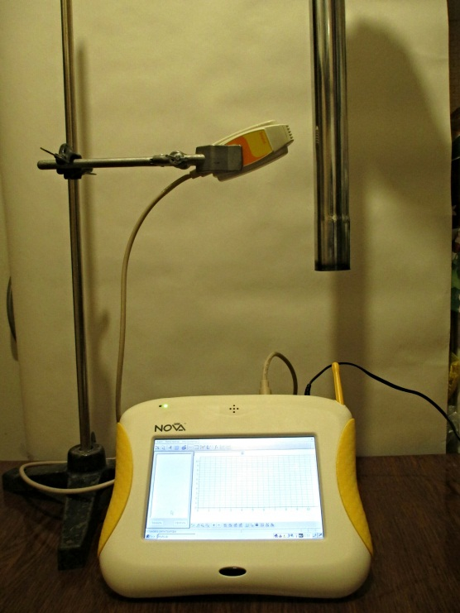
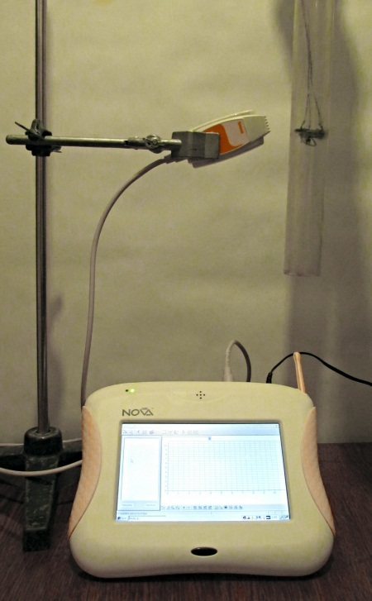
Photos of experiments
frequency and loudness sensors
process of mesh heating
experimental setups

Slide 8
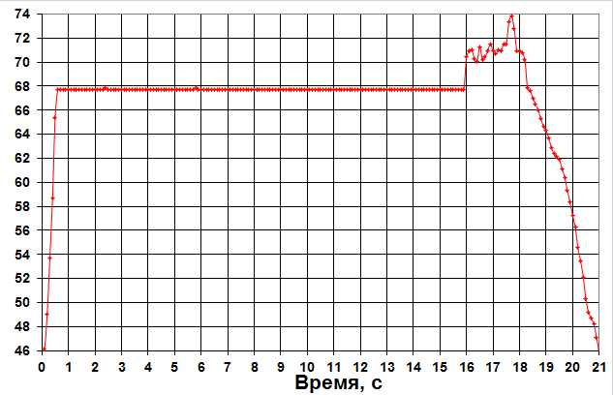
Loudness graph
Loudness, dB
Time, seconds

Slide 9
Demonstration
of Rijke`s tube effect

Slide 10
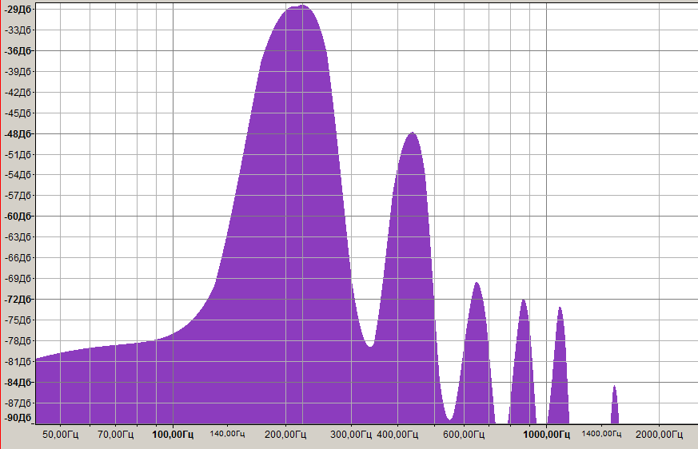
Spectrum of one of tube`s sounds
(frequency analysis)
fundamental frequency of sound (222 Hz, -29,5 dB)
overtones

Slide 11
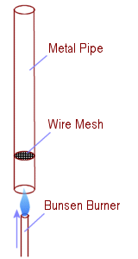
We can identify several dependences:
The longer the tube, the less the frequency.
The bigger the diameter of tube, the bigger the amplitude.
The sound is the loudest if a distance between lower end of tube and heating element is about a quarter of tube`s length.

Slide 12
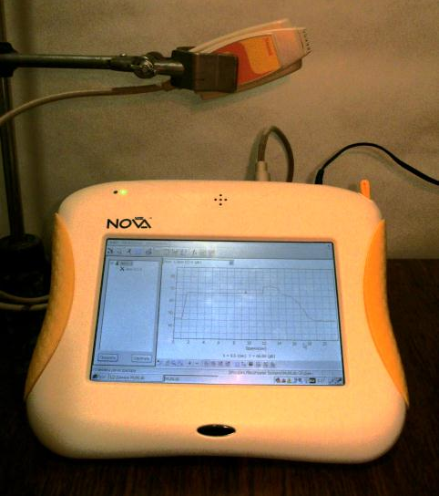
Conclusion
Therefore, Rijke`s tube is a self-oscillation system, and an oscillating air inside that tube produces a sound, and its physical properties depends on a volume of air, a tube`s characteristics and a heating element properties.

Slide 13
Sources of information
1. V. Meier. Drops. Streams. Sound. Moscow, Science, 1985.
John William Strutt, 3rd Baron Rayleigh. Theory of sound. М., ГТТИ, 1940
I. Y. Maroone, А. А. Tarakanovckyi. Investigation of sound excitations in Rijke`s tube. S-Pb., ЦКТИ, 1966
N. P. Belik, N. M. Belyaev, А. V. Polschin. Review of literature about Rijke`s thermoacoustic oscillations. ВИНИТИ, 1973

