Slide 1
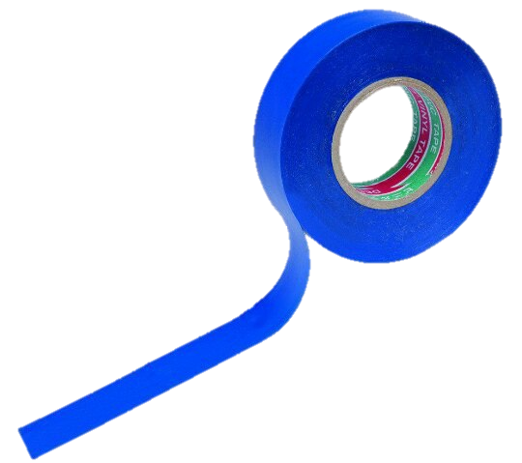
«Task №14»
Team “Izolenta"
Prepared Polina Parinova
Voronezh, Russia.

Slide 2
Izolenta team:
-Polina Parinova (Capitan)
-Zhuravleva Angelina
-Vasiliev Ilia
-Glebov Sergey
-Shilikhin Maxim
-Zarezina Elizaveta

Slide 3
Task condition.
14. Routers and garden cress
In 2013, five young students claimed a sensational discovery that garden cress (Lepidium
sativum) won't germinate when placed near two Wi-Fi routers. Reproduce their experiments
under controlled conditions to support or dismiss their conclusions.

Slide 4
Plan of report:
We will consider our hypothesis;
Consider what routers and garden cress are;
Consider the experiment that we conducted;
Find out the results of our study.

Slide 5
Aim:
During for decision of problem we set the tasks for ourselves:
Create a controlled conditions for growing garden cress;
Reproduce the experiment of young students and refute or confirm the result of the experiment;
Justify the experimental results theoretically, having ascertained the effect mechanism of electromagnetic waves on plants.
To study the effect of the Wi-Fi on plant growth by the example of garden cress.

Slide 6
Hypothesis:
Garden cress will not give sprouts because of the influence of the effect electromagnetic wave of Wi-Fi, which in some way hinders the growth of plants.

Slide 7
Wi-Fi routers.
The absence of a wired connection means the transmission of information through electromagnetic radiation. Routers use decimeter and centimeter waves of ultrahigh and superhigh frequency in the frequency range of 2.4 GHz and 5 GHz.

Slide 8
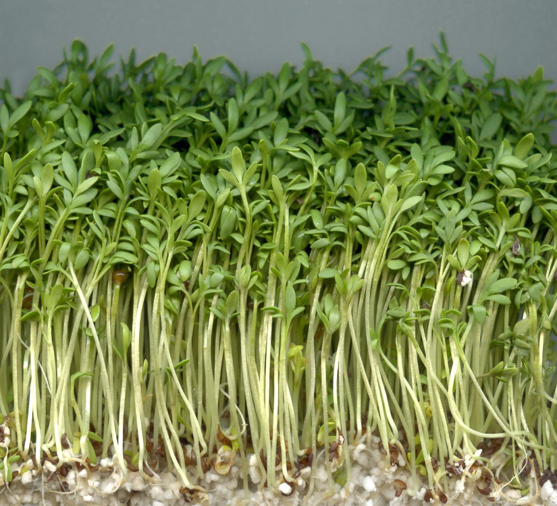
Garden cress.
Cress-salad (Latin Lepidium sativum) is a representative of the clover genus, an annual vegetable plant.
The birthplace of this plant is Iran, thanks to its unpretentious care of growing almost all over the world.
The most famous variety is "Dukat" (it refers to early maturing, since no more than 3 weeks pass from seedling to ripeness).
The optimal temperature for germination is +7 ° C ... + 15 ° C

Slide 9
Equipment for our experiment:
4 Wi-Fi router (two configured on 5 GHz, two on 2.4 GHz).
Garden cress seeds varieties "Ducat".
Soil, drainage, plastic cups.
Ruler with 1 mm divisions.
Hygrometer, thermometer for monitoring the conditions of the experiment.

Slide 10
The appearance of planting seeds:

Slide 11
Experiment №1
We created favorable conditions.
Place group A between two routers tuned to 2.4 GHz frequency, group B to a place where there is no Wi-Fi signal.
During the experiment, favorable conditions for germination of seeds in both groups were maintained, and plants were irrigated.
Seedlings appeared on the third day of the experiment in both groups.
At the end of ten day shoots reached an average height in group A 12.8 cm and 12.5 cm in group B (measurement error ± 0.05 cm).

Slide 12
Experiment №1. 10-th day. The appearance of sprouts.
Group A:
Group B:

Slide 13
The conclusions of the experiment №1:
Wi-Fi wave frequency 2.4 GHz does not affect the germination of seeds of plants, and the first 10 days of growth, because the difference between the regulated groups less than 3%.

Slide 14
Experiment №2
We created favorable conditions.
Place group A between two routers tuned to a frequency of 5 GHz, group B in a place where there is no Wi-Fi signal.
During the experiment, favorable conditions for germination of seeds in both groups were maintained, and plants were irrigated.
Seedlings appeared on the third day of the experiment in both groups.
At the end of ten days shoots reached an average height in group A 12.7 cm and 12.5 cm in group B (measurement error ± 0.05 cm).

Slide 15
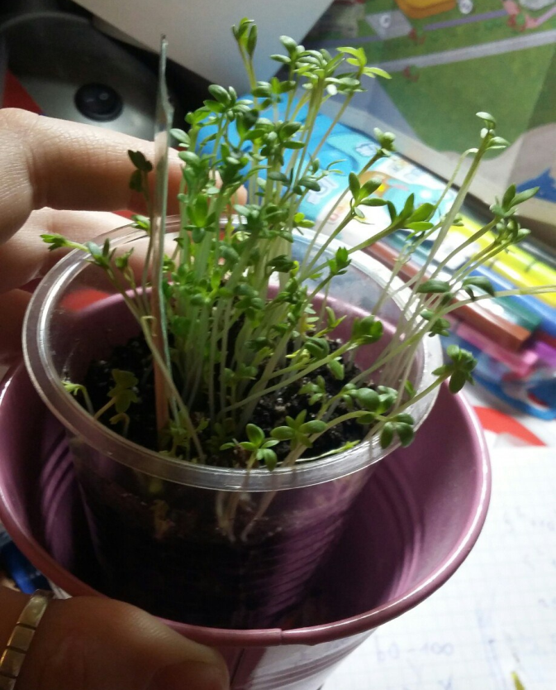
Experiment №2. 10-th day. The appearance of sprouts.
Group A:
Group B:

Slide 16
The conclusions of the experiment №2:
Wi-Fi - 5 GHz waves do not affect the germination of plant seeds and the first 10 days of growth, since the difference between the controlled groups is less than 2%.

Slide 17
Experiment № 3.
We created favorable conditions.
They placed group A between four routers, two of which are tuned to 2.4 GHz and two are set to 5 GHz, group B to a place where there is no Wi-Fi signal.
During the experiment, favorable conditions for germination of seeds in both groups were maintained, and plants were irrigated.
Seedlings appeared on the third day in both groups.
At the end of ten days, the average height of shoots in group A was 12.7 cm, and in group B - 12.5 cm (measurement error ± 0.05 cm).

Slide 18
Experiment №3. 10-th day. The appearance of sprouts.
Group A:
Group B:

Slide 19
The conclusions of the experiment №3:
Wi-Fi - wave frequency of 2.4 GHz and 5 GHz does not affect the germination of seeds, do not adversely affect the shoots of watercress cultivar Dukat.

Slide 20
Table of observations.
Frequency of radiation | Number of shoots of the plant (percent of germination) | The average height of shoots | General view of shoots
2.4 GHz | 99% | 12.8 sm ±0.05 sm | Green, succulent leaves large, fibrous root system is very well developed.
5 GHz | 98% | 12.7 sm±0.05 sm | Meet yellow-green shoots, juicy leaves large, fibrous root system is good.
2.4 и 5 GHz | 98% | 12.6 sm±0.05 sm | Green, fibrous root system is good.
Сontrol group | 98% | 12.5 sm±0.05 sm | Green, succulent, fibrous root system is good.

Slide 21
Theoretical justification:
Wi-fi is an electromagnetic wave that has both transmitting energy. The plant has its own limit for obtaining energy through electromagnetic radiation. Wi-fi has enough power to make the plant grow faster and more actively. But when the all energy obtained by the plant reaches its maximum, the plant will also start to wither quickly.
Wi-fi can inject into the resonance the water molecules in the plant cells, these water molecules are heated by friction and can cause irreversible changes inside the plant.

Slide 22
Conclusions:
There is a stimulating, favorable effect of short (centimeter or decimeter) waves on plants and on garden cress;
The impact of two (four) Wi-Fi routers does not affect the germination of seeds of watercress, but the process of growth of sprouts will be affected by waves;
We can refute the conclusion of young students about the damaging effect of Wi-Fi routers on watercress. Microwaves have a beneficial effect on the growth of garden cress.

Slide 23
Thanks for your attention!

Slide 24
Sources of information:
Scientific journal EUROPEAN JOURNAL OF NATURAL HISTORY
(http://elibrary.ru/title_about.asp?id=33625)ru.wikipedia.org/wiki/Wi-Fi
ru.wikipedia.org/wiki/IEEE_802.11 en.wikipedia.org/wiki/IEEE_802.11n-2009
d-link.ua/study

Slide 25
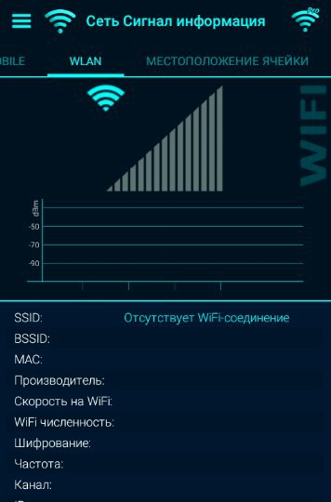
Network Signal Information

