Slide 1
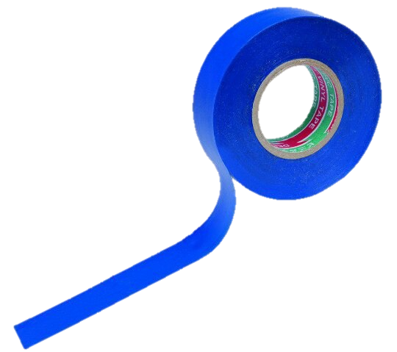
Task №8
Prepared by Sergei Glebov, Team «Isolenta»

Slide 2
Our team:
- Polina Parinova(капитан)
-Angelina Zhuravleva
- Ilia Vasiliev
-Sergey Glebov
-Maksim Shilihin
-Elizaveta Zarezina

Slide 3
Task №8: Tonic water in UV light
Tonic water glows brightly when exposed to an ultraviolet black light bulb. It is however easy to quench the glow of tonic water by adding salt. Investigate this effect. What other common substances glow under UV light and how can one influence their glow?

Slide 4
Structure of Research:
Our aim: to study the phenomenon of glow of some substances in the ultraviolet;
Our objectives:
1) To find out why there is a glow;
2) To find out how these substances differ from others;
3)To determine the mechanism of cessation of glow;

Slide 5
Glow effect
Fluorescence - the property of substances become especially self-luminous during the time that they are exposed to an extraneous light source. The phenomenon occurs in fluorescent objects almost exclusively under the influence of light, which contains rays of short wavelength - violet and ultraviolet. The rays that cause the fluorescence of the body are always absorbed by this body. The rays sent by a fluorescent substance have always a longer wavelength than the rays absorbed by this substance and causing fluorescence.

Slide 6
Glow effect
According to the concepts of quantum chemistry, electrons in atoms are located at energy levels. The distance between the energy levels in a molecule depends on its structure. When some kind of substances are irradiated with light, it is possible to transfer electrons between different energy levels - the so-called "excitation" of electrons. The typical lifetime of such an excited state is 10⁻¹¹-10⁻⁶ s.

Slide 7
Glow effect
The energy difference between the energy levels and the frequency of the oscillations of the absorbed light are correlated by the equation (II postulate of Bohr):
E 2 − E 1 = h*ν, where h – The Planck constant; h ≈6,626 J*s, ν- frequency;
After absorption of light, part of the energy received by the system is consumed as a result of relaxation, the process of establishing balance in a physical system consisting of a large number of particles. Part of it can be emitted in the form of a photon of a certain energy - emitting in our case.

Slide 8
Glow effect
The fluorescence emission spectrum is shifted relative to the absorption spectrum toward the long wavelengths. This phenomenon was called the "Stokes shift". Its cause are nonradiative relaxation processes. As a result, some of the absorbed energy is lost, and the emitted photon -elementary particle, the quantum of electromagnetic emission has a lower energy, and, correspondingly, a longer wavelength.

Slide 9
Experimental part
The composition of tonic and examining the information from other sources, it was concluded that the quinine in tonic glows(C₂₀H₂₄N₂O₂).
To solve the problem, three experiments were carried out : with the usual tonic, with the addition of salt (NaCl), as well as with the addition of other salt : potassium permanganate (KMnO₄). Salts were added in 100 ml tonic in portions: 5 grams of potassium permanganate and common salt.

Slide 10
Quinine structural formula

Slide 11
Photos of the first experiment

Slide 12
Photos of the second experiment

Slide 13
Photos of the third experiment

Slide 14
Experiment results
When adding the usual salt and potassium permanganate, the emitting greatly reduced. Examining the information from other sources, it was concluded that there was a phenomenon, called quenching.

Slide 15
Quenching
The phenomenon of quenching-the attenuation of fluorescence under the influence of certain factors-has been observed. Such factors in our case are the special structure of quinine molecules, its concentration and the presence of ions after the addition of salt in the tonic. In our second experiment the light emitted by quinine is absorbed by chlorine ions, transforming them into an excited state, and then they quickly go back to a stable state because of collision with natrium ions and other extraneous molecules. Similarly in the third experiment with potassium permanganate.

Slide 16
Quenching
As we can see, peak of quinine emission is on the boundary between the violet and blue parts of the spectrum. But according to the Wine law this are the waves of these wavelengths that the chlorine ions will absorb and then lose the energy received as a result of collision with sodium ions

Slide 17
Experimental part
The optimal concentration for quenching substances is 0.1 mol / l. With an increase of this concentration, quenching remains the same, and with a decrease - quenching also decreases. From calculations : our concentration is 0,862 mol / l. Our Concentration is higher, than optimal, but this does not affect quenching.

Slide 18
Other substances glowing in the ultraviolet
Many organic substances, usually containing a system of conjugated π-bonds, are capable of fluorescence. It is because of this that such substances are glowing. The most famous are quinine, organic dyes, fluorescin, and many others. For each such substance, one or more of the following extinguishing mechanisms operates: by chemical reaction, breaking π-bonds, adding substances that extinguish fluorescence, increasing the temperature of the solution of the fluorescent substance or significantly increasing its concentration.

Slide 19
Conclusion
The phenomenon of glowing in the ultraviolet of certain substances was investigated. Confirmed that not only ordinary salt can extinguish the glow. Found out what such substances differ from others by the presence of conjugated π-bonds. There was explained how to extinguish the glow of such substances.

Slide 20
Used sources
https://ru.wikipedia.org/wiki/%D0%A4%D0%BB%D1%83%D0%BE%D1%80%D0%B5%D1%81%D1%86%D0%B5%D0%BD%D1%86%D0%B8%D1%8F
http://chem21.info/page/240102076242034156157155183113048021254214137
http://studopedia.su/18_20209_gashenie-fluorestsentsii.html
О.Ф. Кабардин, В.А.Орлов, А.А. Пинский, А.Т. Глазунов, А.Н. Малинин, Физика 11 класс. – М.: Просвещение, 2014 – 416с.

Slide 21
Thanks for watching!

