Slide 1
Task №17
Prepared by Shilikhin Maksim, Team «Izolenta»

Slide 2
Our team:
- Polina Parinova(капитан)
-Angelina Zhuravleva
- Ilia Vasiliev
-Sergey Glebov
-Maksim Shilihin
-Elisaveta Zarezina

Slide 3
Task №17: Tornado machine
Build a machine to produce an indoor air tornado. Investigate the properties and stability of the tornado. Is the machine portative enough to be demonstrated at a Science Fight room of the 5th IYNT?

Slide 4
Structure of Research:
Our aim: to build a portative tornado machine;
Our objectives
To investigate mechanism of generation of natural tornado;
To build a tornado machine;
To investigate some parameters of tornado.

Slide 5
What is tornado?
The tornado is an atmospheric vortex that arises in a thundercloud and spreads downward, often to the surface of the earth, in the form of a cloudy sleeve in the diameter of tens and hundreds of meters. Tornadoes pass in their development in three main stages.

Slide 6
Tornado life cycle
At the initial stage of the storm cloud appears the initial funnel, hanging over the ground. The cold layers of air that are directly underneath the cloud rush down to replace the warm ones, which go up(such an unstable system is usually formed by combining two atmospheric fronts - warm and cold).

Slide 7
Tornado life cycle
The rotational speed increases with time, while in the center of the tornado the air begins to rise intensively. This is the second stage of the tornado's existence - the stage of the formed vortex of maximum power. The tornado is fully formed and moves in different directions.

Slide 8
Tornado life cycle
The final stage is the destruction of the vortex. The power of the tornado weakens, the funnel narrows and breaks away from the surface of the earth, gradually rising back into the mother cloud.
The lifetime of each stage varies and ranges from a few minutes, to several hours (in exceptional cases). The rate of advance of tornadoes is also different, on average - 40-60 km / h (in very rare cases it can reach 200 km / h).

Slide 9
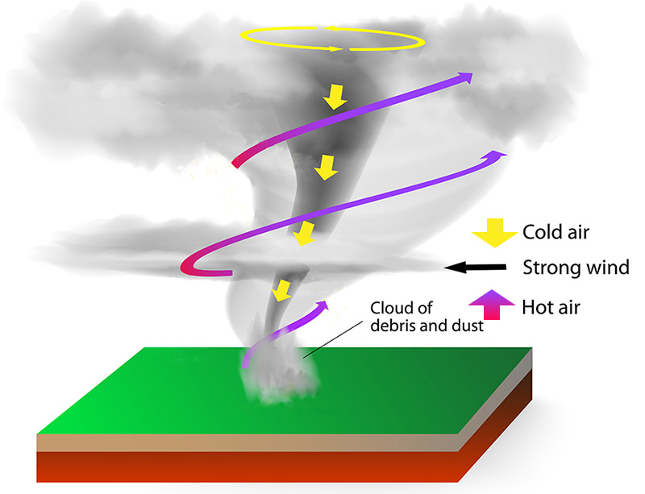
Tornado structure

Slide 10
Tornado structure
Along the central vertical axis there is always a swirling upward flow, there is a rarefaction of air. The rarefaction is so significant that closed objects filled with gas, including buildings, can explode from within because of the pressure difference. The flow in the center of the tornado is the most important basis for its stability.

Slide 11
Difference between natural and our tornados
Natural tornado usually comes down from sky but our tornado starts from the ground. For detecting our tornado we used sieved sand. To make it we pushed layers of air: chilled by ice and heated by a hair dryer.

Slide 12
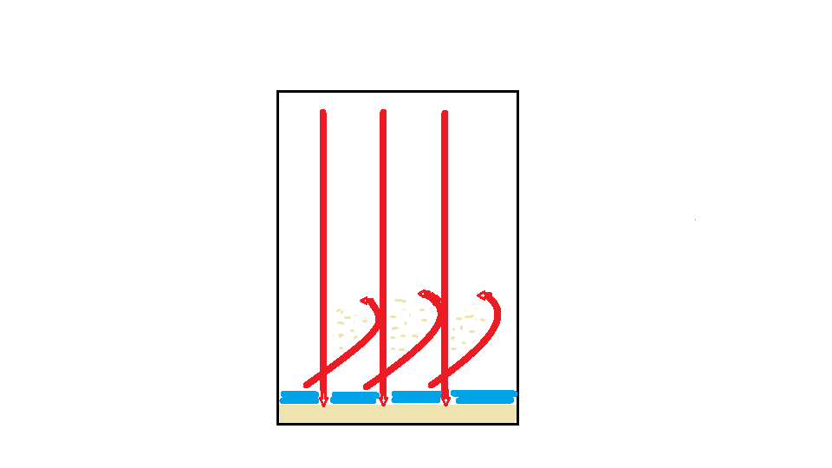
First experiment setup plan
Flows of warm air
Cold air layer

Slide 13
Video of the experiment

Slide 14
Results of experiment
By freeze-frames we have defined properties of tornado in the experiment:
Speed of tornado ( rotation velocity) is 12m/s;
Height of tornado is 45cm;
Average radius of tornado is 2cm;
Average ability of carrying is 20 gramms.

Slide 15
Second experiment
Due to the differences between the natural tornado and ours, it was decided to carry out the second experiment, changing the places of warm and cold layers of air. For this, an electric heater tile was used.

Slide 16
Video of the experiment

Slide 17
Conclusions
We investigated mechanism of generation of tornado;
We built a portative tornado machine which could be demonstrated at a Science Fight room of the 5th IYNT.

Slide 18
Used sources
http://sitekid.ru/planeta_zemlya/smerch.html
https://ru.wikipedia.org/wiki/%D0%A1%D0%BC%D0%B5%D1%80%D1%87
http://www.evgars.com/true.htm

Slide 19
Thanks for watching!

