Slide 1
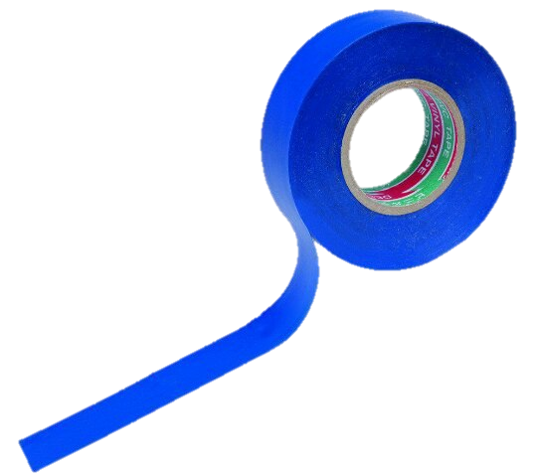
«Task №15 »
Team «Izolenta»
Prepared by Ilya Vasilev

Slide 2
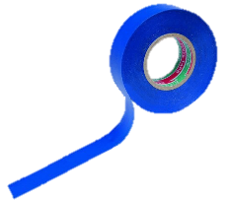
The condition of problem:
Design and construct a device allowing collection of water by condensing moisture from air. Determine if the water obtained with your device is suitable for drinking. What amount of water is possible to collect during one Science Fight?

Slide 3
Objectives
Theoretically suggest ways for getting water from air.
Create the device.
Confirm the theory in practice.
Investigate the characteristics of getting water.

Slide 4
The principle of operation of a capacitor
Condensation is the change of the physical state of matter from gas phase into liquid phase.
With decrease of temperature less molecules of water can be in the air and vapor condenses, because molecules needs less energy to be in liquid state than gas state.

Slide 5
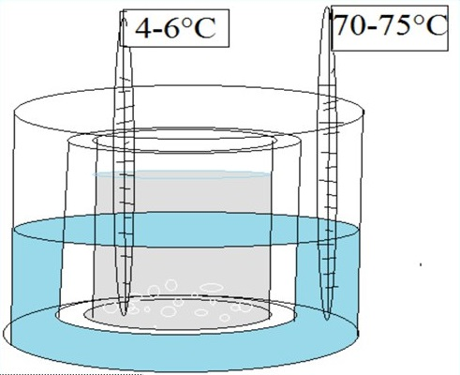
Scheme of setup

Slide 6
Dependence of water quantity on the temperature difference
With decrease of temperature less molecules of water can be in the air and vapor condenses and vapor condenses.
So, with larger temperature difference we will get more water.

Slide 7
We used a chemical reaction to create a temperature difference
There was a release of heat as a result of these reactions:
Hydrolysis:
Cu²⁺+H₂O ⇄ CuOH⁺+H⁺ pH<7
Destruction of oxide film:
Al₂O₃+6H ⁺→2Al³⁺+3HOH
Hydrogen evolvation:
2Al+6H₂O = 2Al(OH)₃↓+3H
Destruction of sediment:
Al(OH)₃+H⁺→ Al³⁺+H₂O
Formation of other salts:
3СuSO₄+2Al=Al₂(SO₄)₃+3Cu͎↓

Slide 8
We used a chemical reaction to create a temperature difference
Endothermic reaction:
Hydrolysis:
NH₄NO₃+H₂O ⇄ NH₄OH+HNO₃
NH₄⁺ + H₂O ⇄ NH₄OH + H⁺
The temperature difference was changed with the concentration of copper sulphate and aluminum oxide.

Slide 9
The dependence of the quantity of water on the temperature difference

Slide 10
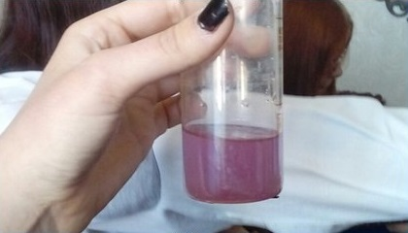
Characteristics of produced water
pH of getting water is 7
Water is distilled
Water can be drunk for a short time.

Slide 11
Conclusion
We construct a device, allowing collection of water by condensing moisture from air.
Obtained water is impossible to drink.
It is possible to collect 900 ml of water during one Science Fight (3 h)

