Slide 1
Problem №13 “Allometry”

Slide 2
Text of the problem:
How do length and thickness of bones scale with overall size and weight of animal?

Slide 3
Aims of the problem:
Find a dependence animals’ bone length from their mass
Find a dependence animals’ bone length from their body length
Find a dependence animals’ bone thickness from their mass
Find a dependence animals’ bone thickness from their body length

Slide 4
Symbols:
l - bone length
d - bone thickness
L – animal’s body length
m – animal’s mass
V – animal’s volume

Slide 5
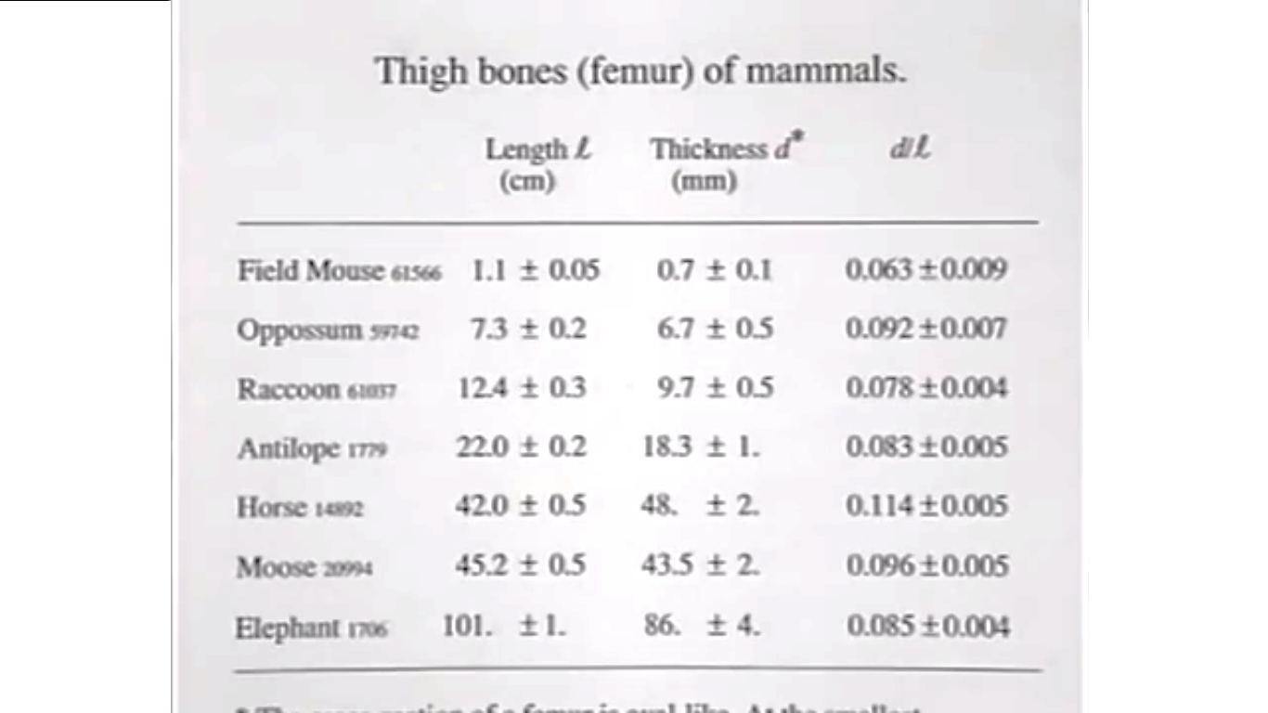
Screenshot from professor’s lecture with data

Slide 6
Our data
 | min mass, kg | max mass, kg | min Length, cm | max Length, cm | mean mass, kg | mean Length, cm | Thick-ness, cm | length, cm
Field mouse | 0,007 | 0,013 | 5,5 | 7 | 0,01 | 6,25 | 0,07 | 1,1
Opossum | 2,1 | 2,8 | 33 | 55 | 2,45 | 44 | 0,67 | 7,3
Raccon | 5 | 9 | 45 | 60 | 7 | 52,5 | 0,97 | 12,4
Antilope | 20 | 30 | 115 | 125 | 25 | 120 | 1,83 | 22
Horse | 400 | 1000 | 245 | 274 | 700 | 259,5 | 4,8 | 42
Moose | 380 | 700 | 240 | 320 | 540 | 280 | 4,35 | 45,2
Elephant | 5400 | 6000 | 5500 | 7500 | 5700 | 6500 | 8,6 | 101

Slide 7
A dependence between bone length and mass

Slide 8
A dependence between bone length and body length

Slide 9
A dependence between bone thickness and mass

Slide 10
A dependence between bone thickness and body length

Slide 11

Hypothesis of Walter Lewin:
$Pressure\sim m and pressure\sim \frac{πd^{2}}{4}$, so $m\sim d^{2}$
$m\sim V and V\sim l^{3}$, so $m\sim l^{3}$
$m\sim l^{3} and m\sim d^{2}→l^{3}\sim d^{2}$
$\ln\left(l\right)\sim 0,66∗ln⁡(d)$

Slide 12
A dependence between bone length and bone thickness in logarithmic scale

Slide 13

Equations
$$y^{α}\sim x^{β}↔y\sim x^{\frac{α}{β}}$$
$$\ln\left(y\right)\sim \frac{α}{β}∗ln⁡(x)$$
$$\ln\left(l\right)\sim 0,915∗ln⁡(d)$$

Slide 14
Conclusions:
$d\sim m^{0.36}↔d^{2,8}\sim m$
$l \sim m^{0,33}↔l^{3}\sim m$
There are no dependences which we can find between bone thickness and body length, bone length and body length

Slide 15

Checking
$d^{2,8}\sim m and l^{3}\sim m→\ln\left(l\right)\sim 0,933∗ln⁡(d)$

Slide 16
Resources:
https://www.youtube.com/watch?v=X9c0MRooBzQ&list=PLUdYlQf0_sSsb2tNcA3gtgOt8LGH6tJbr&index=2
http://razmery.info
https://en.wikipedia.org

