Slide 1
Task №6
Why do apple slices turn brown after being cut? Investigate the speed of this process and test methods to prevent browning of apple slices

Slide 2
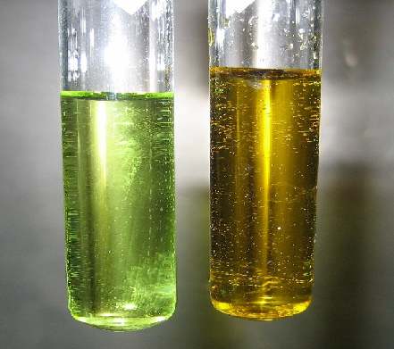
Why do apples turn brown?
1st version
Some Fe(2+) is included in apples
After the oxidation we have Fe(3+), that is brown
On the foto there are ferrum solutions in different oxidation states
*there is 2,6mg of Fe in 100g of apples

Slide 3
Why do apples turn brown??
2nd theory
Polyphenols are oxidated. Polyphenols are natural antioxidants. Their oxidation is speeded up by the enzyme (polyphenoloxidase).
Produced quinone is yellow-brown colored

Slide 4
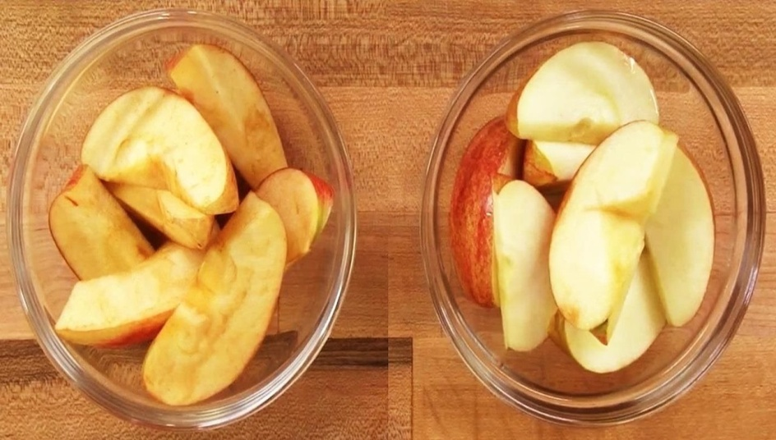
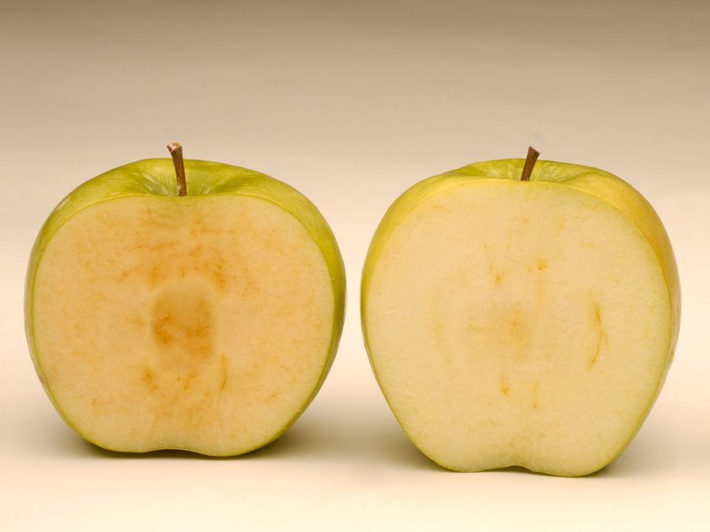
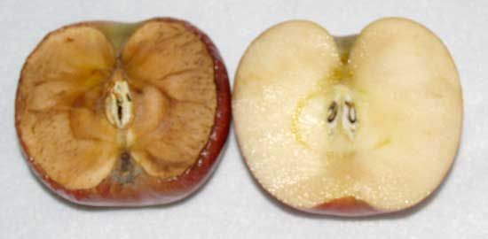
Ра
Brown apples after being for different time on the air

Slide 5
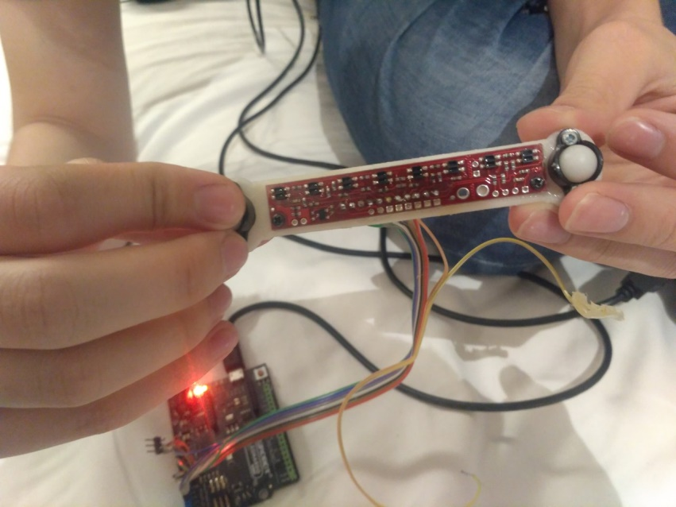
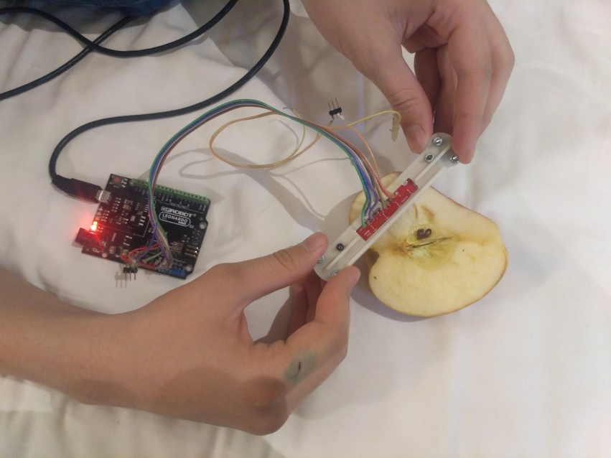
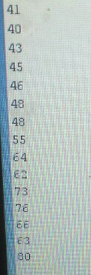
Speed of browning
For detecting the grade of browning we’ve used the color sensor

Slide 6
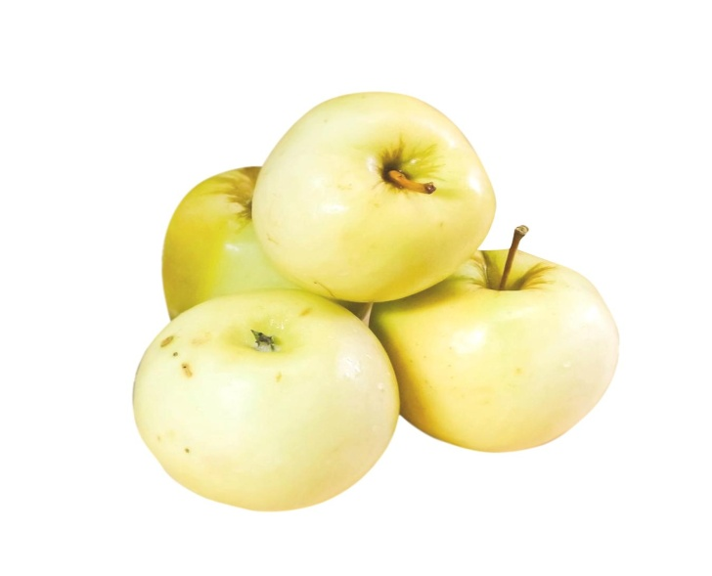
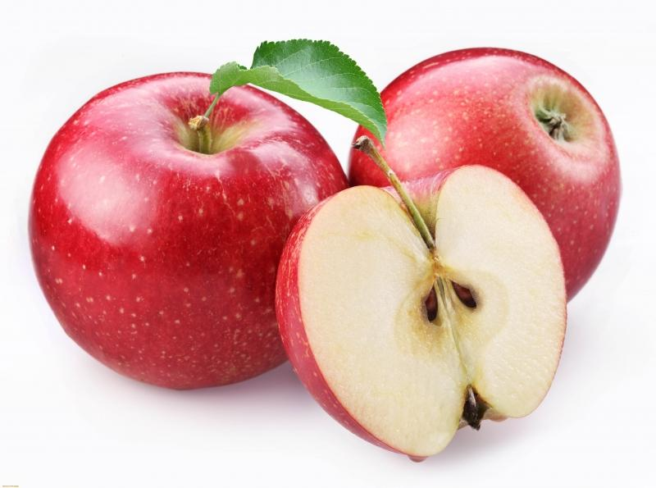
Speed of ‘browning’
Speed depends on the type of apples, because of microelements and acids in apples
‘Antonovka’ apples.
2:07
‘Rozoviy naliv’ apples
7:24

Slide 7
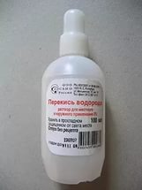
Methods of changing the speed of browning
Increase or decrease the amount of oxygen in the air
2H2O2→2H2O+O2 (MnO2 - catalyst)
Na2CO3+H2SO4(sol)→
→Na2SO4+H2O+CO2
H2O2 – the source of oxygen

Slide 8
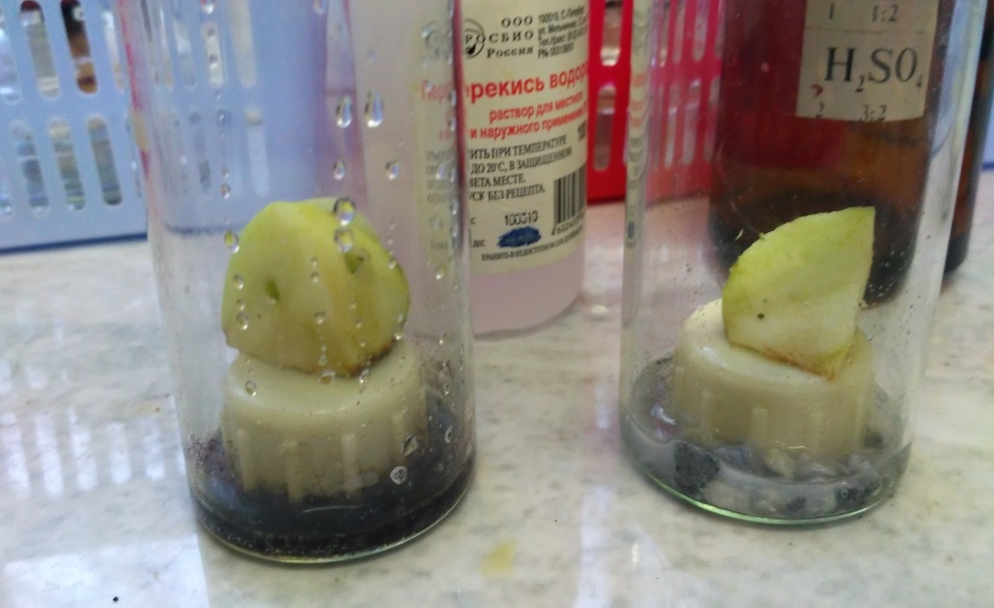
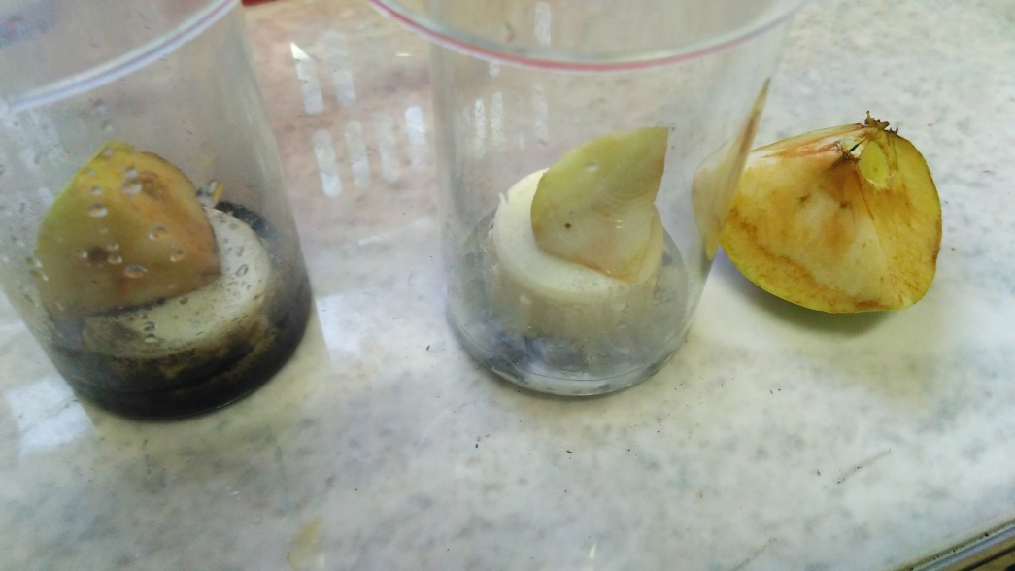
The experiment
Pieces of apple are put in different air
7 minutes is normal time
On the left there is
Increased oxygen air
On the right - decreased
After 2.20 min (apple on the right is for comparison)
We couldn’t notice the browning on the right apple after 30 minutes

Slide 9
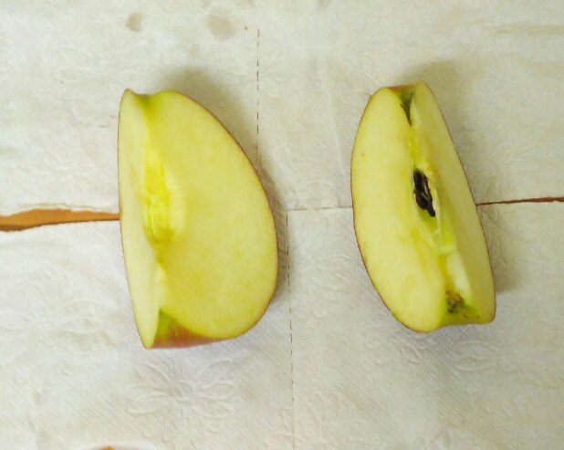
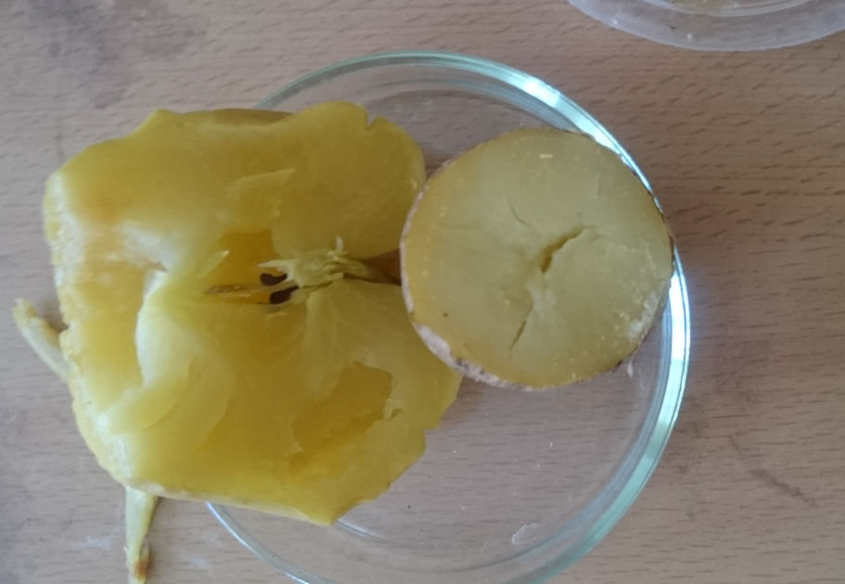
Methods of changing the speed of browning
Changing the conditions of polyphenoloxidase influence
Changing pH
Changing temperature

Slide 10
Conclusion
Browning of apples is caused by catalysed oxidation of polyphenols
We can speed up the process by increasing the amount of oxygen in the air
We can slow down this process by:
a) Decreasing the amount of oxygen
b) Decreasing pH on the surface of the apple
c) Decreasing the temperature of the apple
d) Destroying the polyphenoloxidase by heating

Slide 11
Sources
Science american
“Энциклопедия для детей том 17”

