Slide 1
Problem №7 “Growing through asphalt”

Slide 2
Text of the problem:
Can a little plant grow straight up through concrete or asphalt?

Slide 3
Aims of the problem:
Can plants grow through asphalt
Find out conditions of growing plants through asphalt

Slide 4
Asphalt

Slide 5
Concrete

Slide 6
Turgor
Еxternal environment
Cell membrane is tough, inextensible, semi-permeable membrane
Cell’s protoplasm. Water with solutes
Turgor is occurred because of inextensible cell membrane.
Water is come into cell because of osmosis
P_{осм} – osmosis pressure

Slide 7
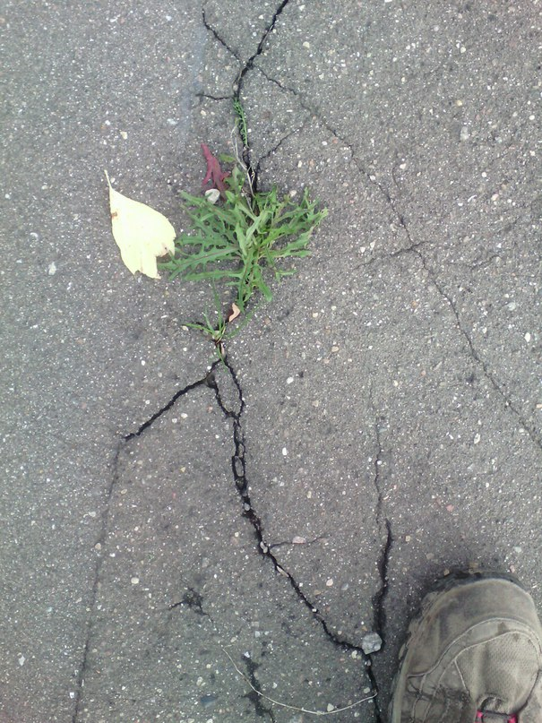
Observed frequents

Slide 8
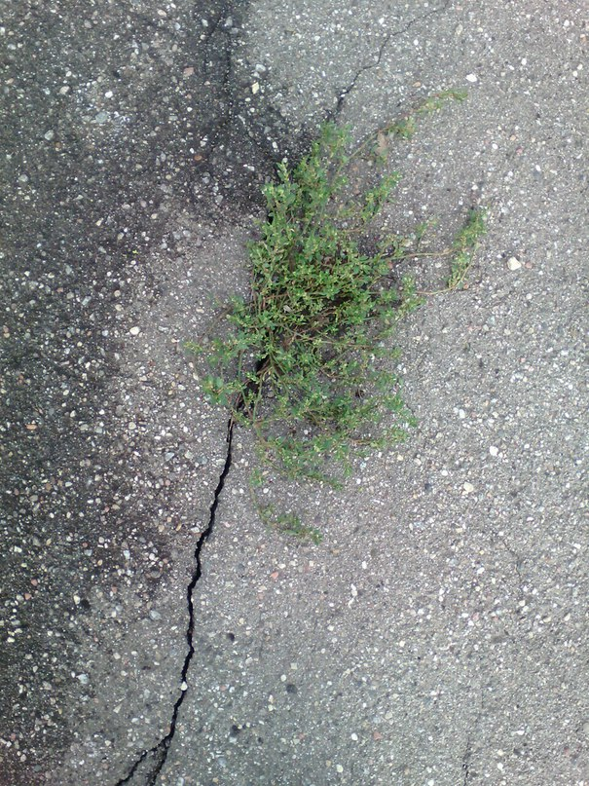
Observed frequents

Slide 9
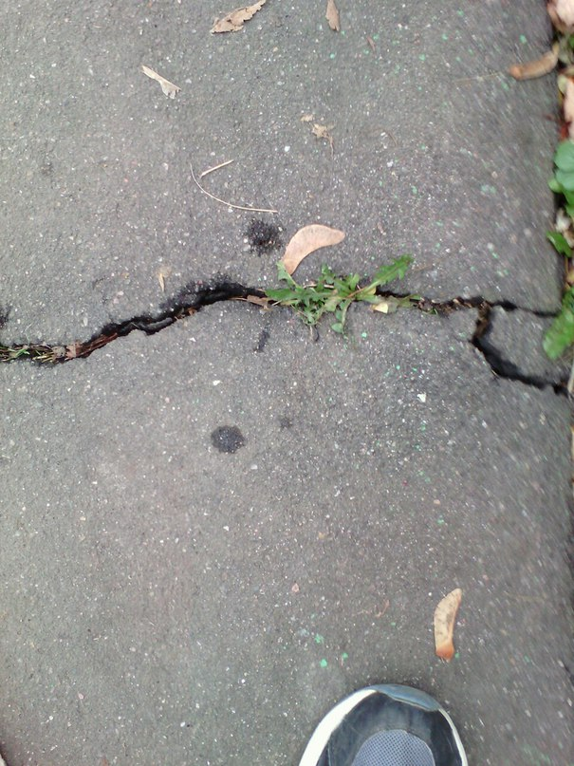
Observed frequents

Slide 10
Experiment

Slide 11
Experiment
We have used peanut sprouts to know which mass plants can lift

Slide 12
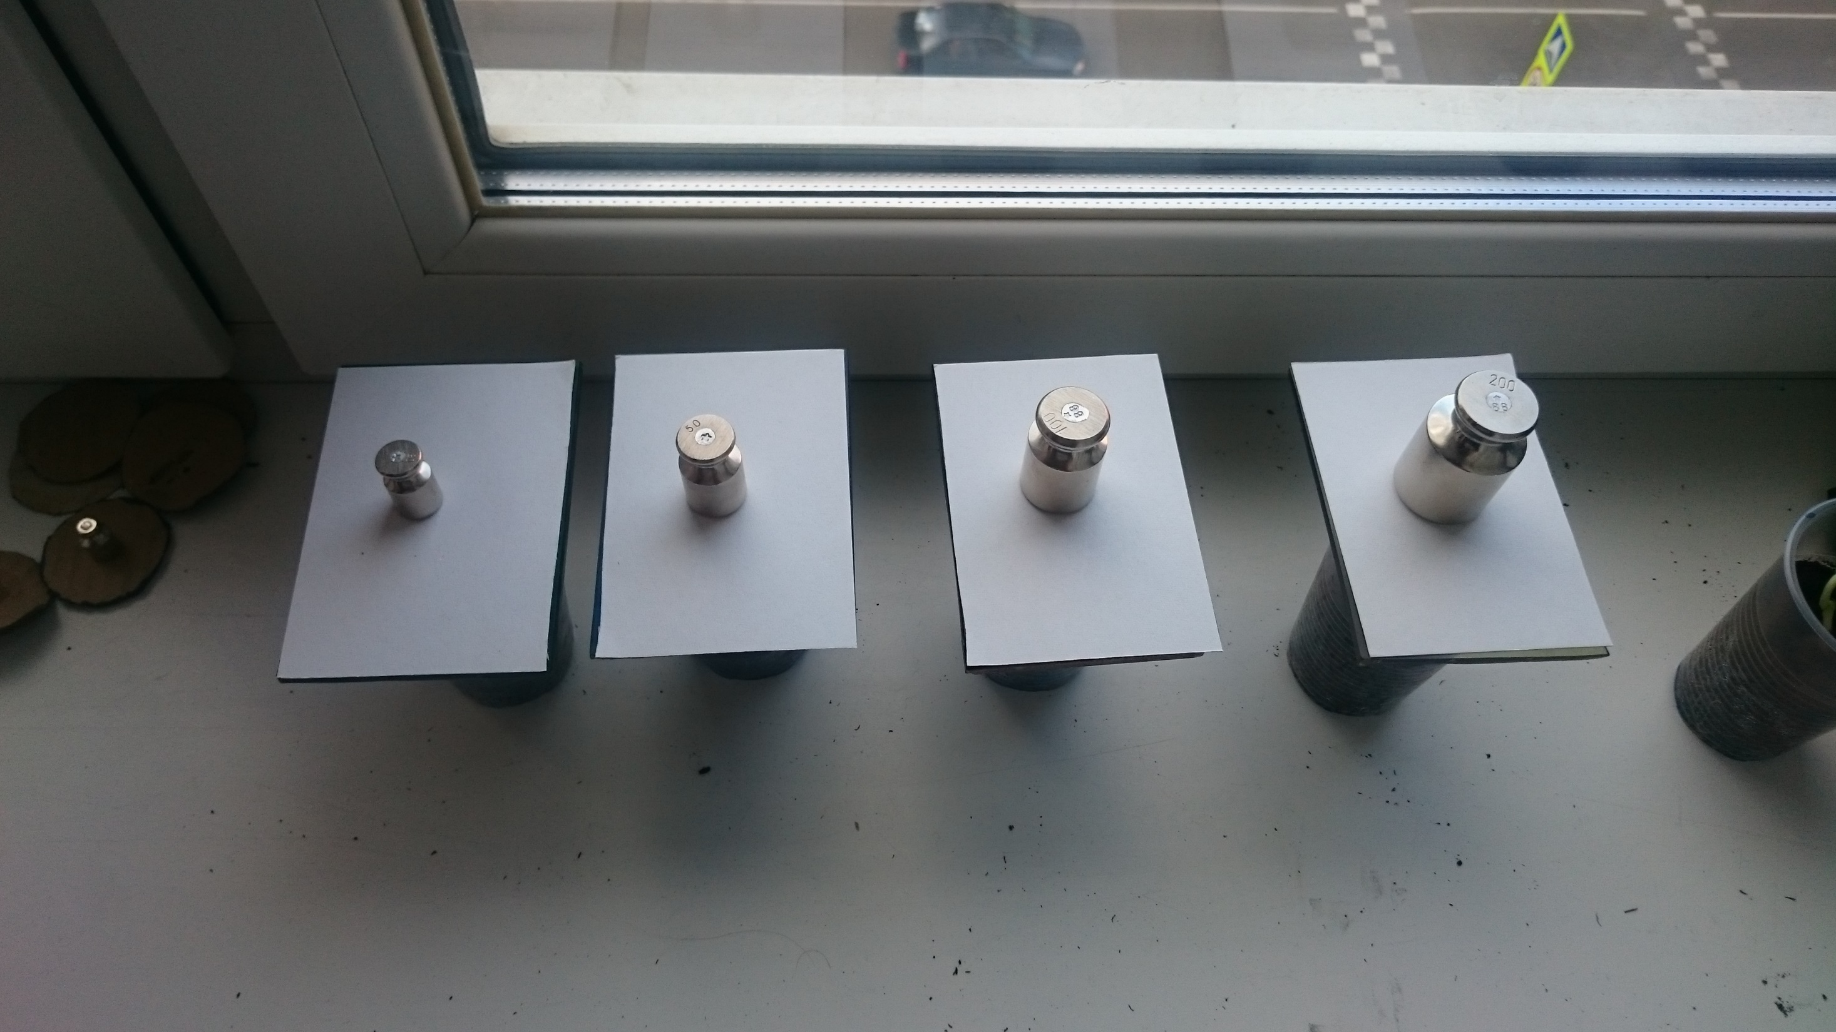
Growing of seeds
First day

Slide 13
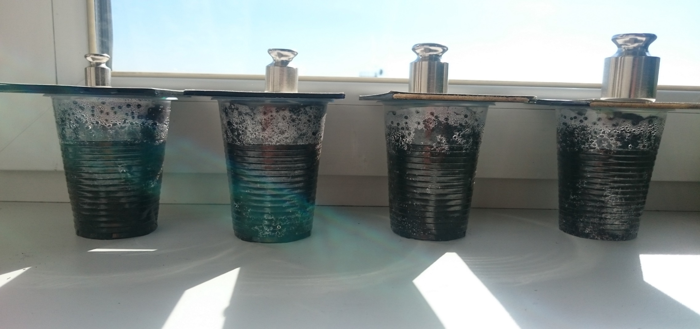
Growing of seeds

Slide 14
Conclusion:
Plants can’t grow through asphalt and concrete if there are no cracks in these materials

Slide 15
Resources:
www.Wikipedia.com
www.gost.ru

