Slide 1
Milk
Develop simple methods allowing determination of some of the important properties of milk. Suggest an investigation requiring comparison of various milk samples. .

Slide 2
Aims of work
Identify the main properties of milk
Find or develop methods of determination of these properties
Examine some samples of milk

Slide 3
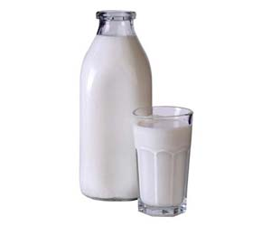
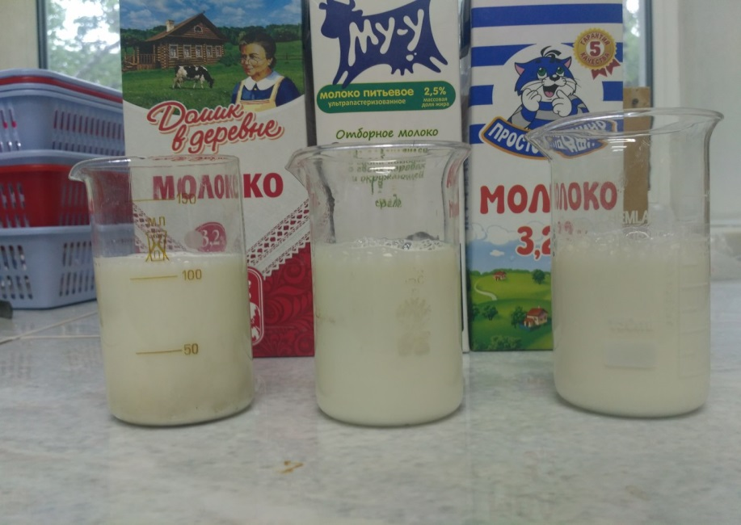
Milk
Milk is a pale liquid produced by the mammary glands of mammals. It is the primary source of nutrition for infant mammals (including humans who breastfeed) before they are able to digest other types of food. Nowadays it’s included into lots of products, and its producing became a large industry
Milk includes 87-88% of water
We took 3 samples, one of them is ultra-pasteurized

Slide 4
Properties
Purity
Density
Dilution with water
Dilution with starch
Freshness

Slide 5
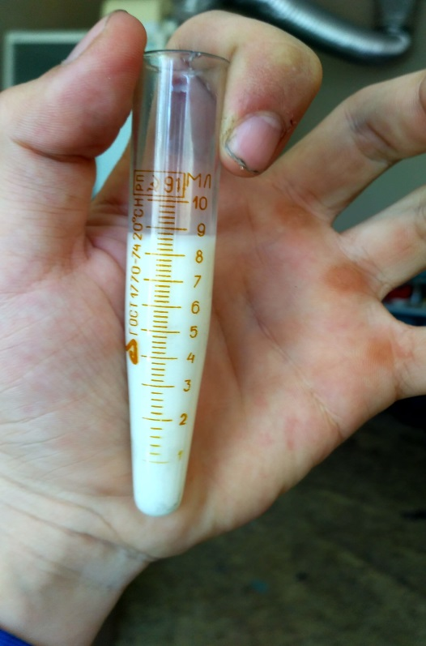
Purity
We compared colours of samples
Milk was settled for 1 hour

Slide 6
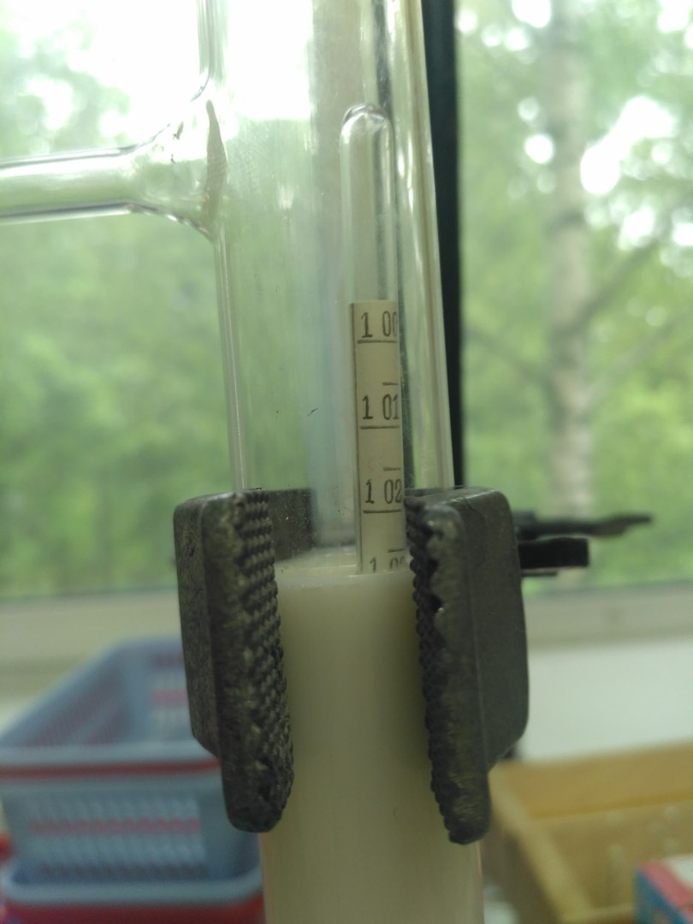
Density
1) 1,032
2) 1,034 (gramms/cm3)
3) 1,030

Slide 7
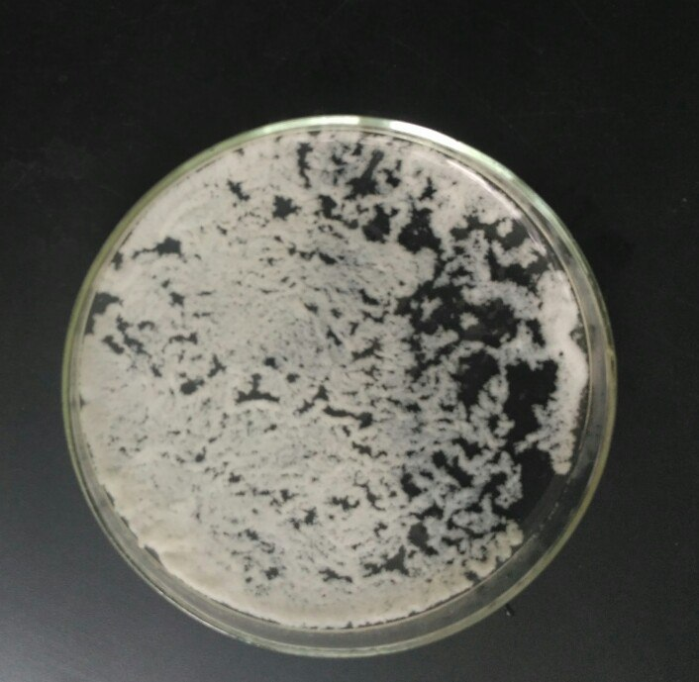
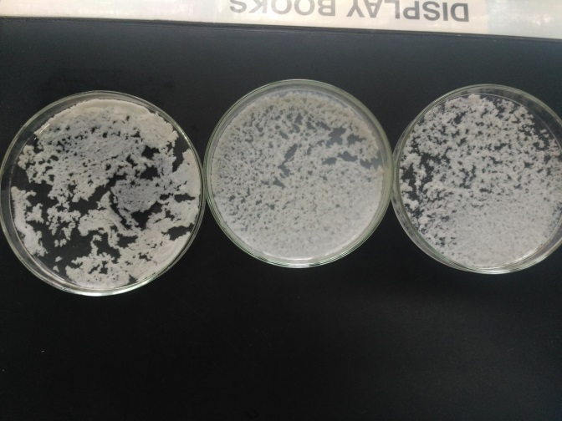
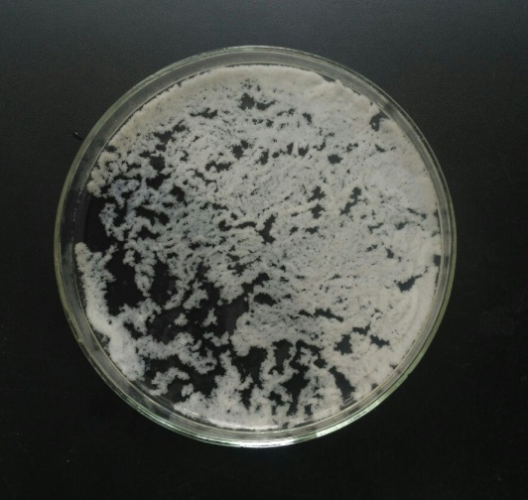
Dilution with water
We added ethyl alcohol into the sample(2p to 1p)
The mixture is quickly stirred and then we wait for the precipitate. For good milk you’ll wait for 5-7 seconds

Slide 8
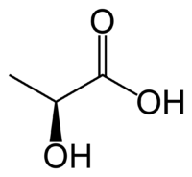
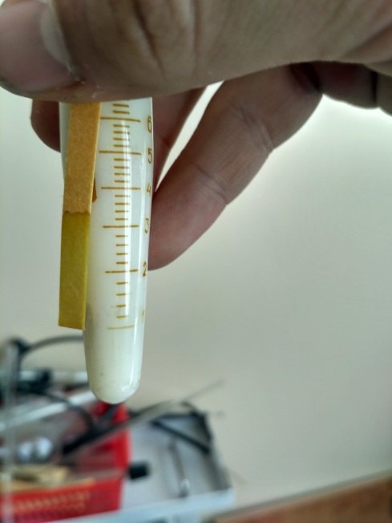
Freshness
During the souring of milk the lactic acid is produced
We can detect it using
pH indicators
The value is from 6 to 6,9 pH
(experimentally, from the literature)
If we add sodium carbonate in the sample with acid, we’ll see the gas exhalation
In the examined samples of milk the gas hasn’t been exhalated

Slide 9
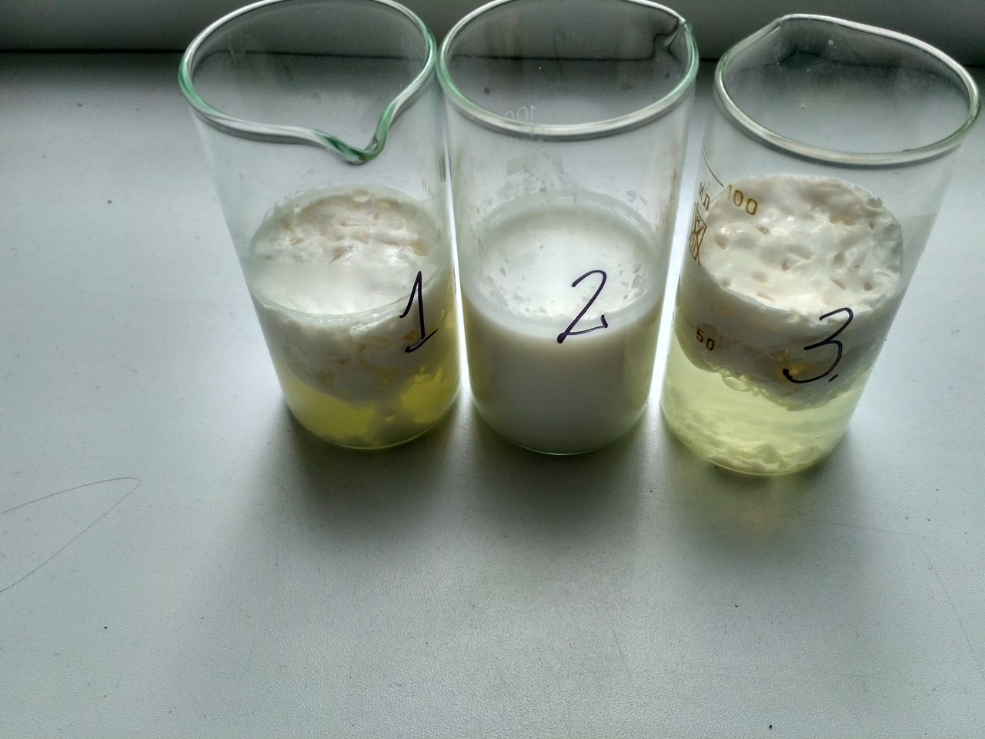
Time of souring
1) 22 hours, 2) more than 3 days, 3) 45-46 hours

Slide 10
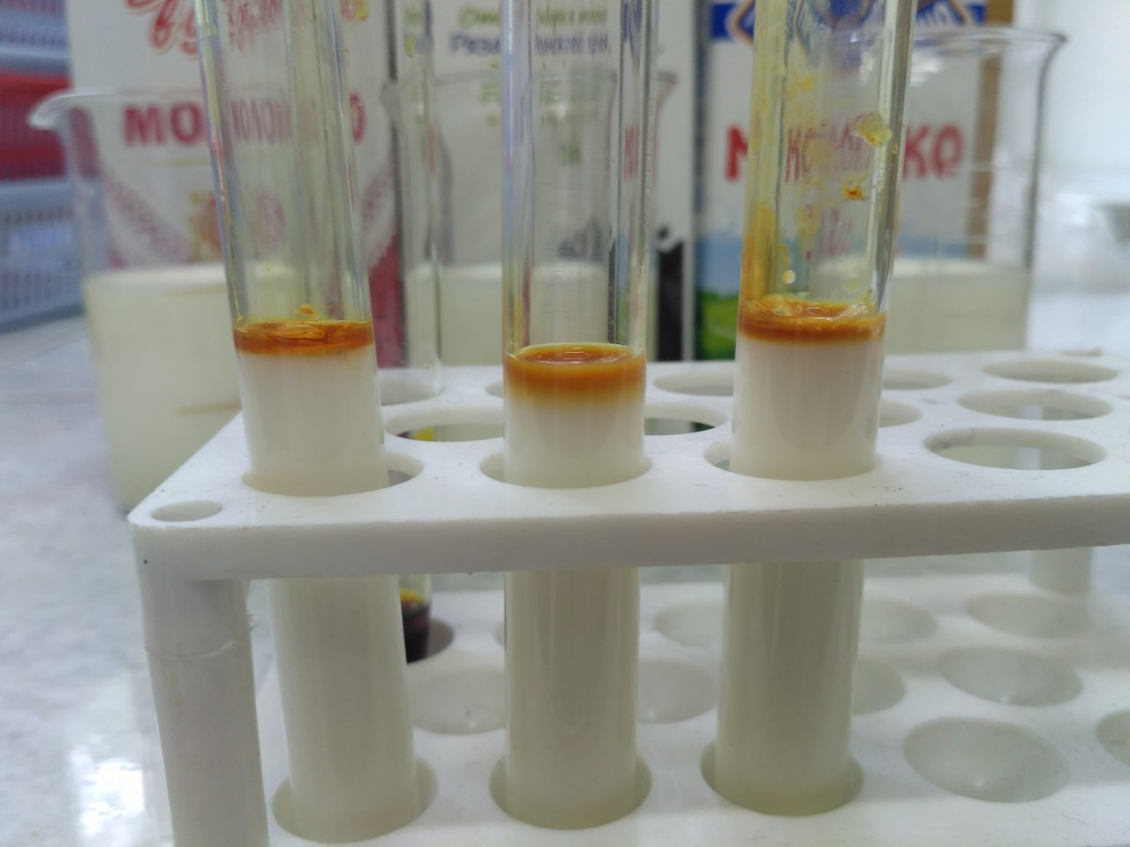
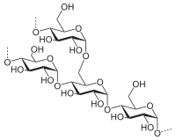
Starch
We added some iodine solution into the small amounts of milk

Slide 11
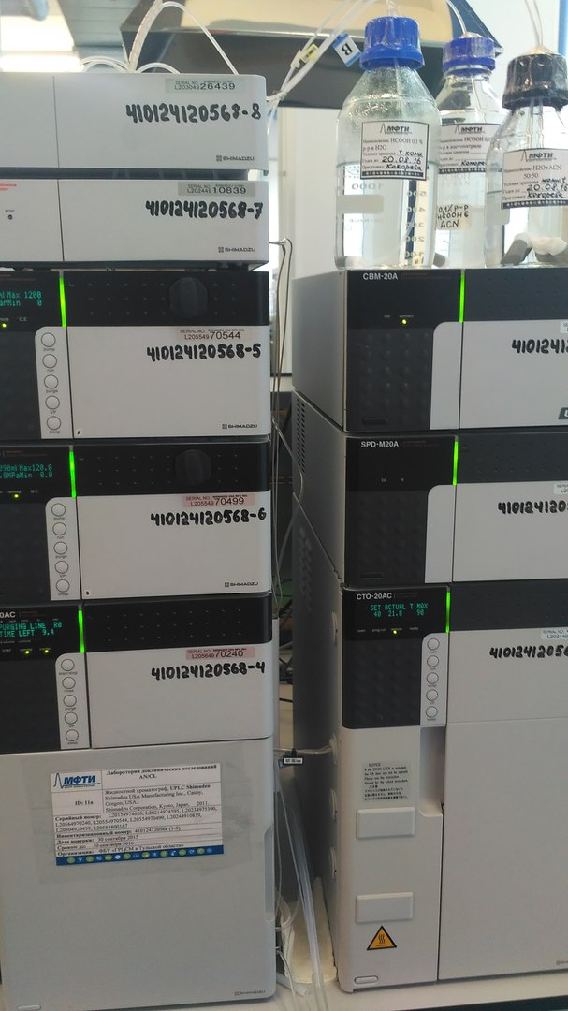
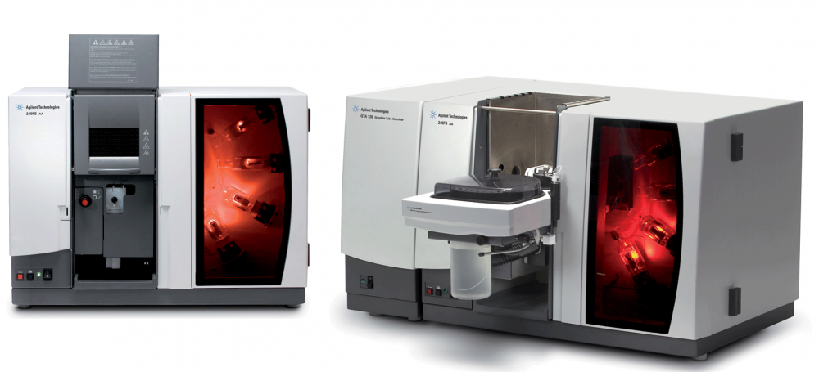
Industrial methods
Atomic absorption spectroscopy
Mass spectroscopy

Slide 12
Conclusion
We have determined main properties of milk, that we can examine easily
We have offered some methods of determination of density, dilution and freshness
We have examined 3 most popular types of milk, and didn’t find any deviations

Slide 13
Sources
Молоко. Полезные свойства. [Электронный ресурс]. –URL: http://chudesalegko.ru/moloko-poleznye-svojstva-i-protivopokazaniya/
Википедия. Молоко. [Электронный ресурс]. – URL:http://ru.wikipedia.org/wiki/
Как определить качество молока в домашних условиях [Электронный ресурс]. – URL: http://nsportal.ru/ap/nauchno-tekhnicheskoe-tvorchestvo/issledovatelskaya-rabota-na-npk-kak-opredelit-kachestvo

