Slide 1
16.Paper wrinkles
5th Lyceum
Zinets Anastasiia
1

Slide 2
When a piece of paper dries after being wet, it can get wrinkled. Investigate and explain this phenomenon
3

Slide 3
Aim of work
To study and to explain the phenomenon of paper wrinkles
2

Slide 4
Tasks of work
1) to study the process of producing the paper and to indentify factors, which can cause wrinkling of paper after getting wet and dry
2) to study the features of polymer state of the main component of paper- celuloze
3) to propose a hypothesis
4) to confirm the hypothesis experiment
3

Slide 5
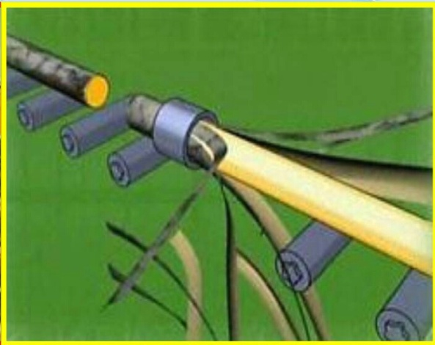
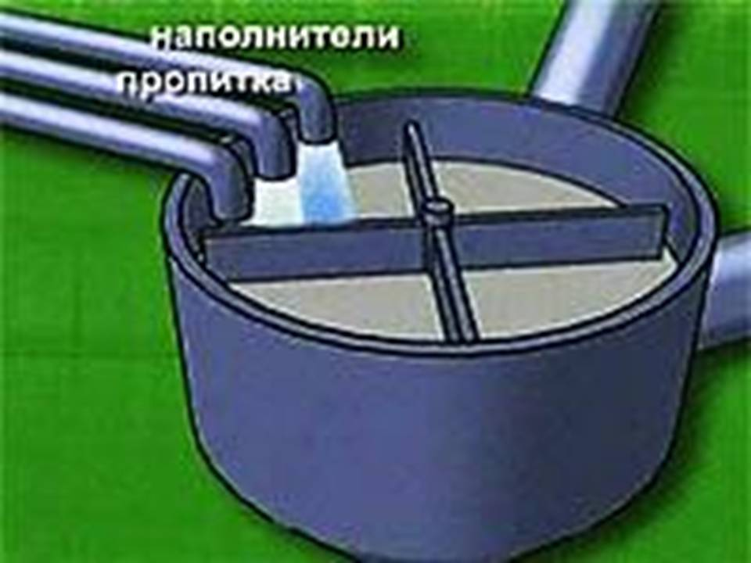
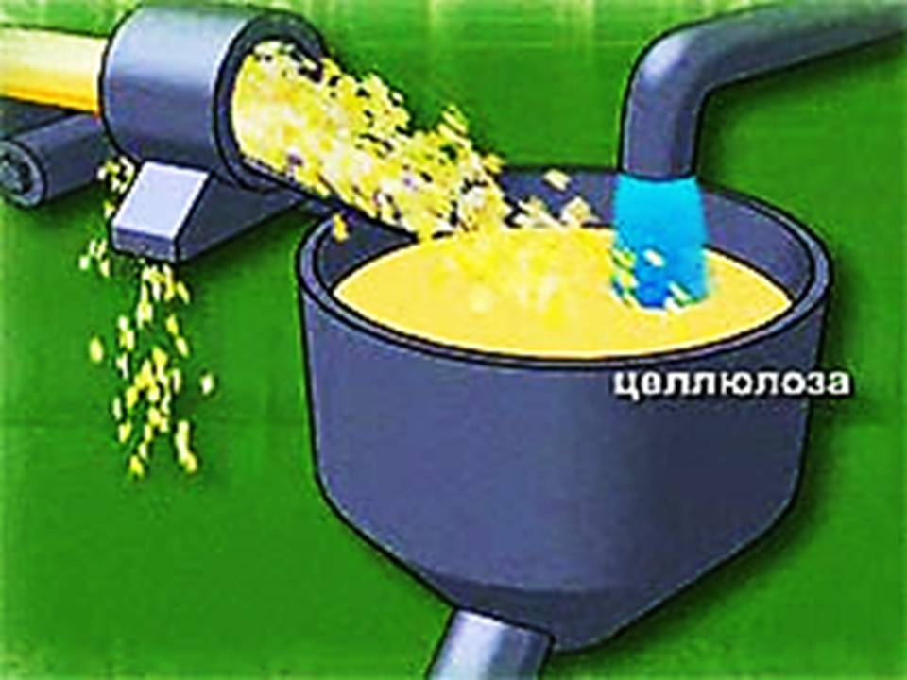
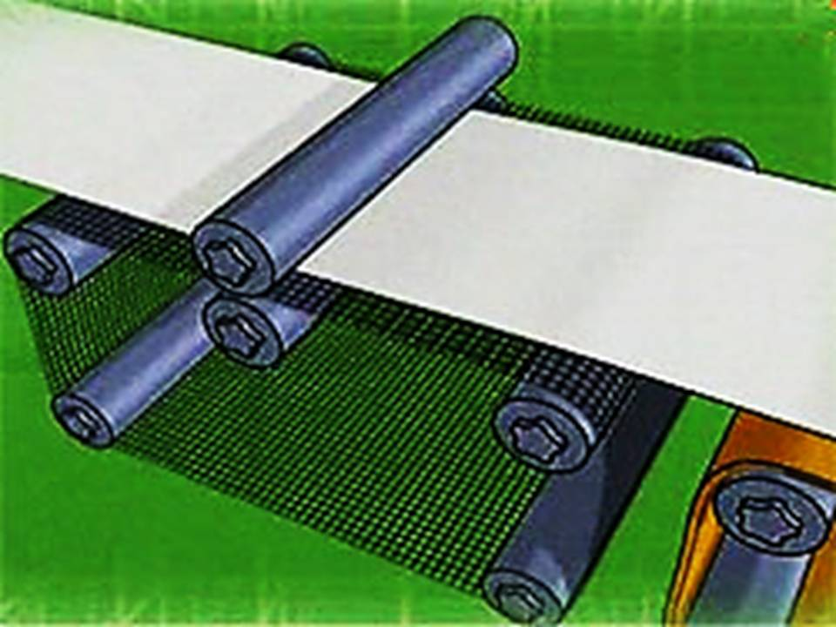
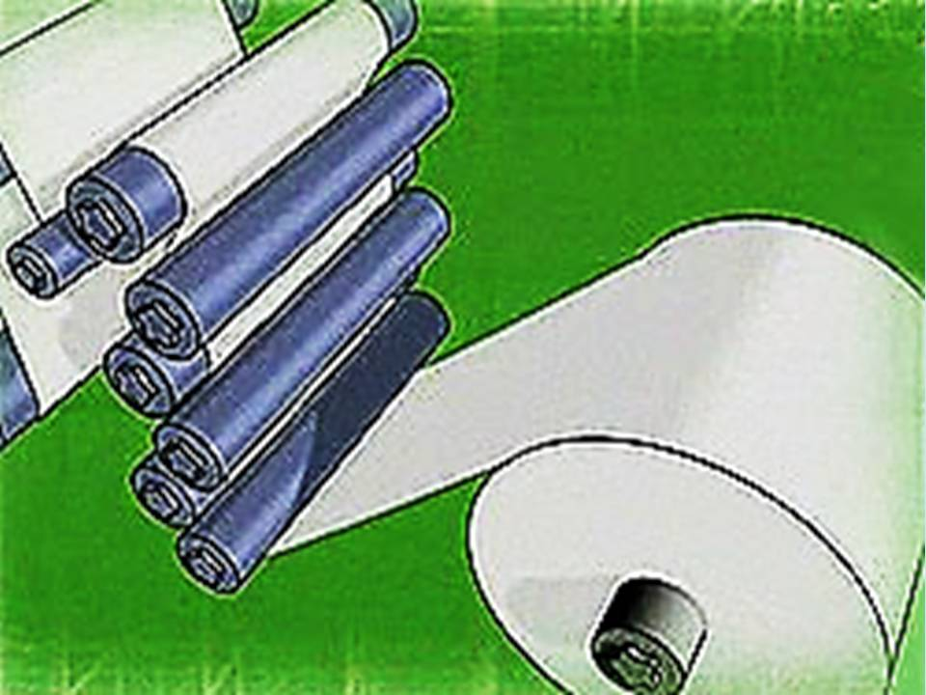
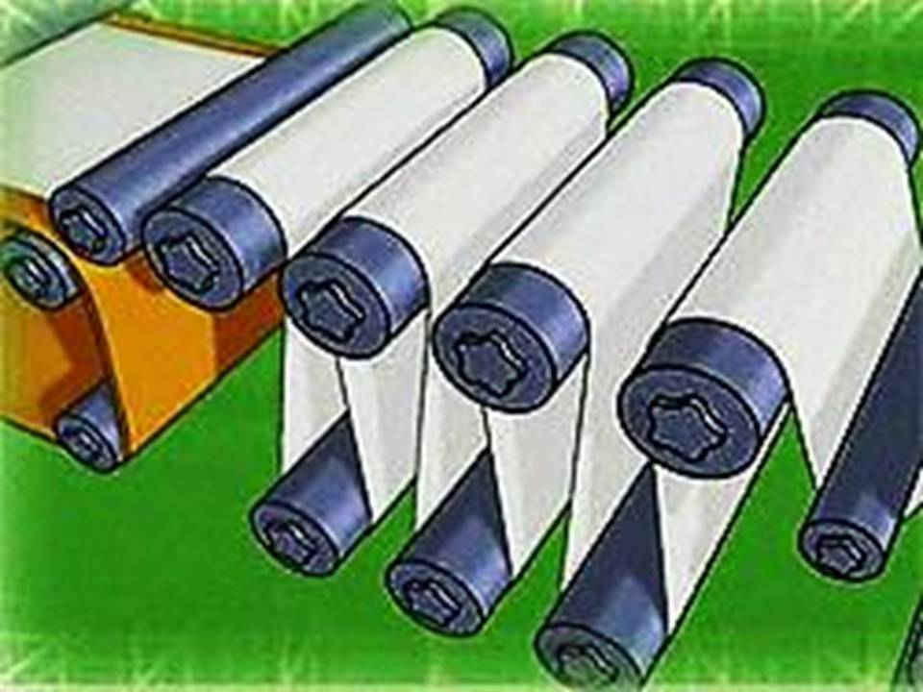
The process of producing the paper
3

Slide 6
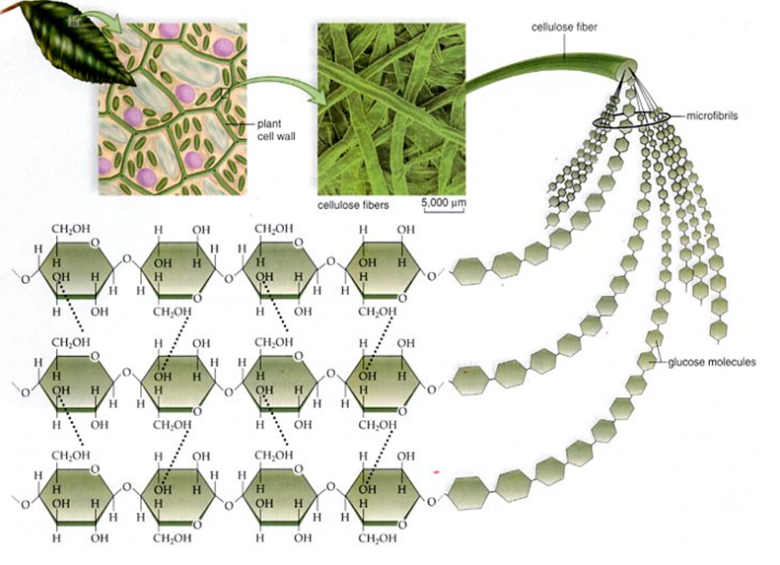
Cellulose structure

Slide 8
The process of producing the paper
3

Slide 9
Структуру бумаги на выходе из бумагоделательной машины

Slide 10
Processers, ongoing when paper is wetted anddried
1) filling the space between fibers with water
2) absorbing water with amorphic places of microfibrils

Slide 11
3

Slide 12
Hypotheses
Paper with bigger free space between fibers will deform less after getting wet and dry

Slide 13
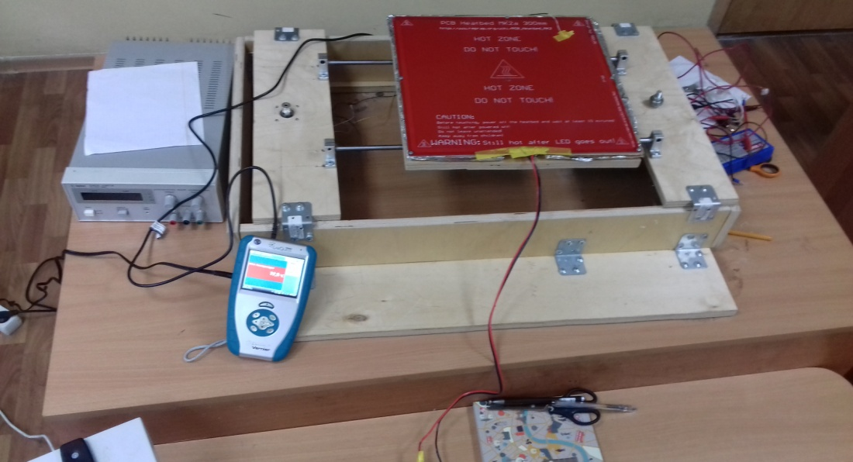
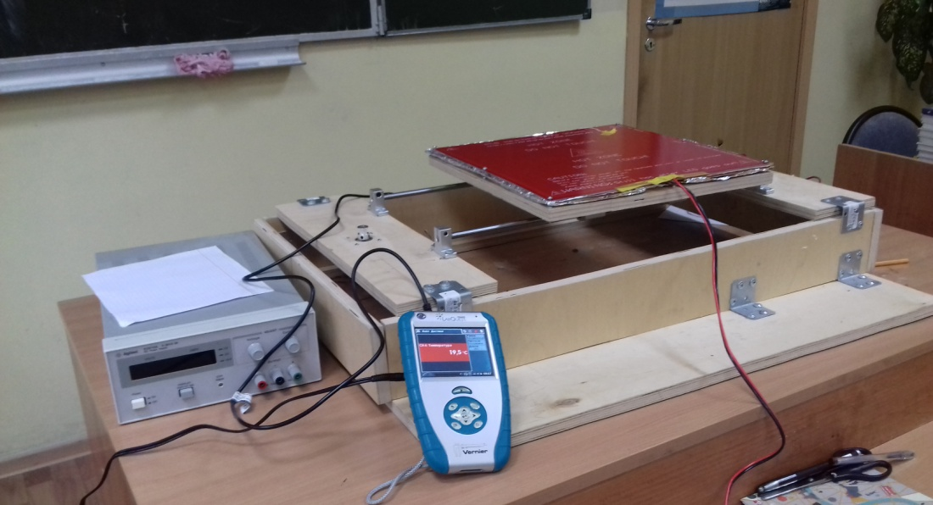

Slide 14
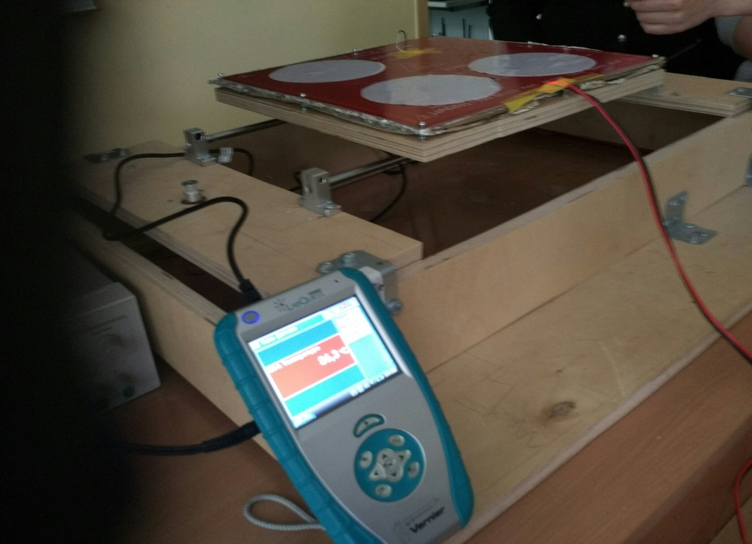
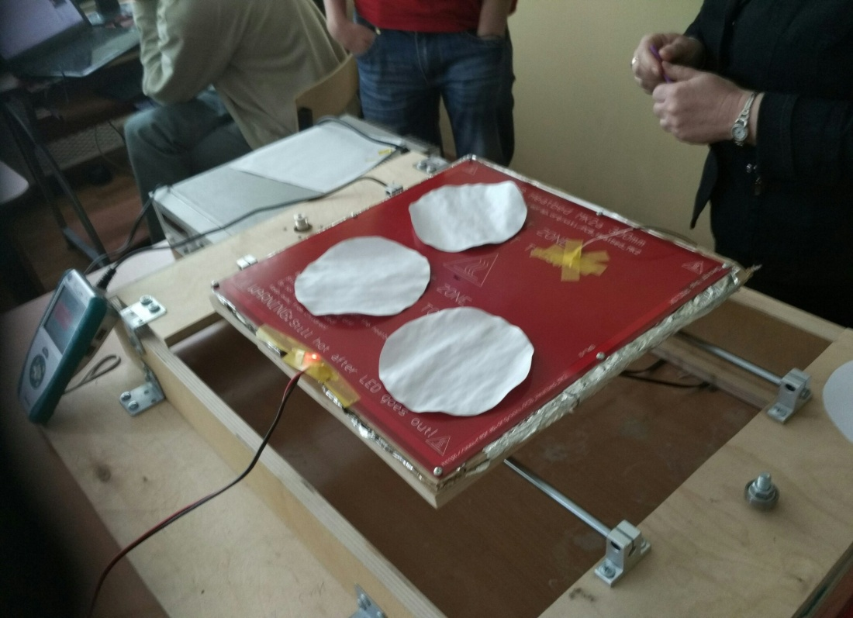

Slide 15
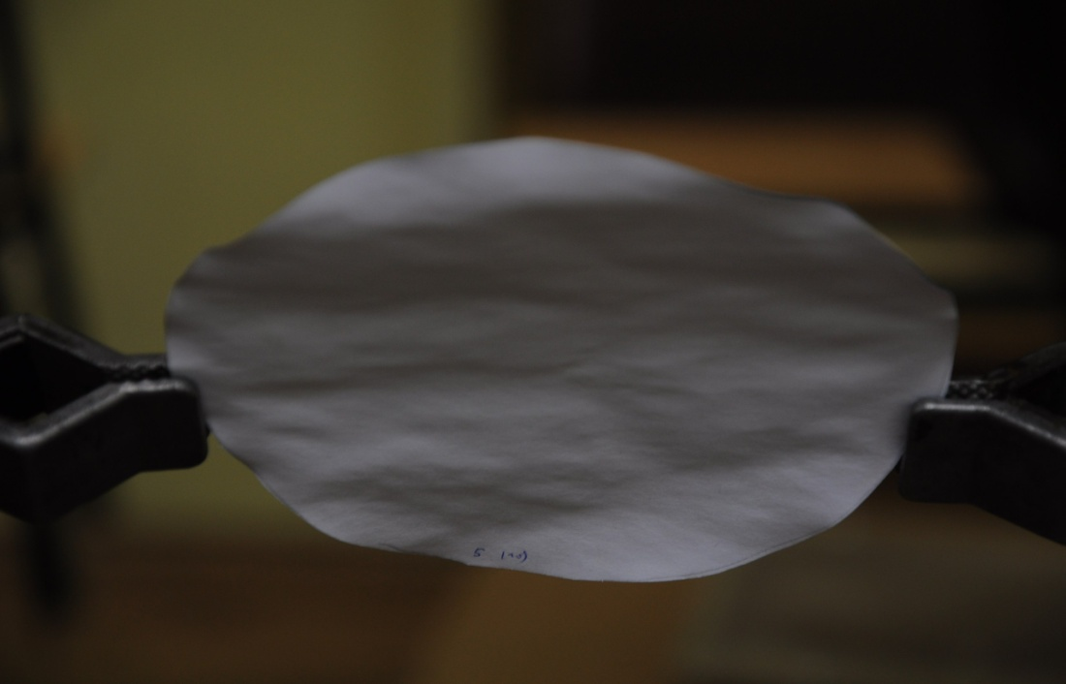
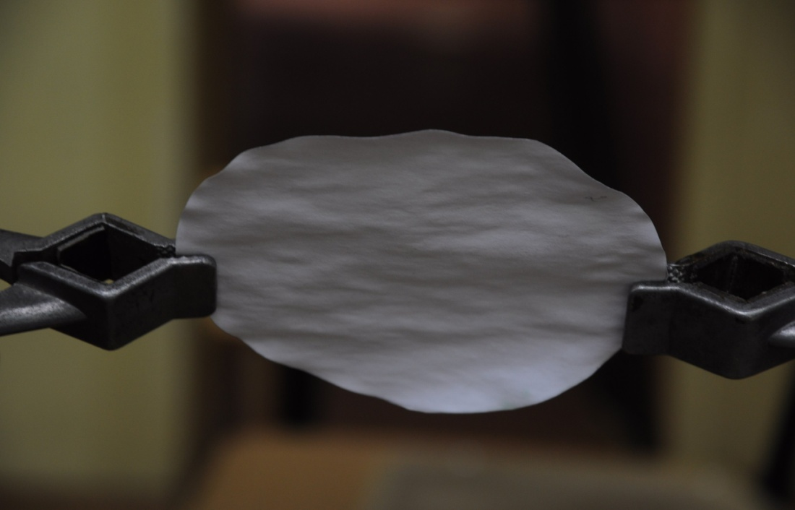
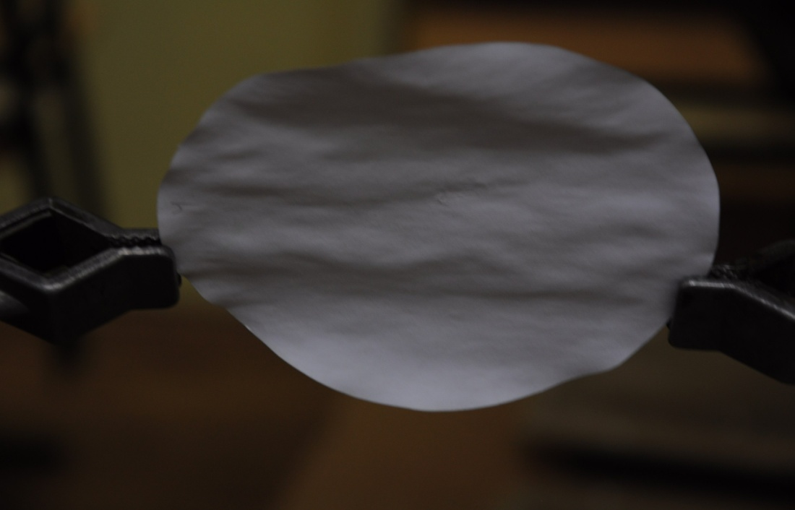
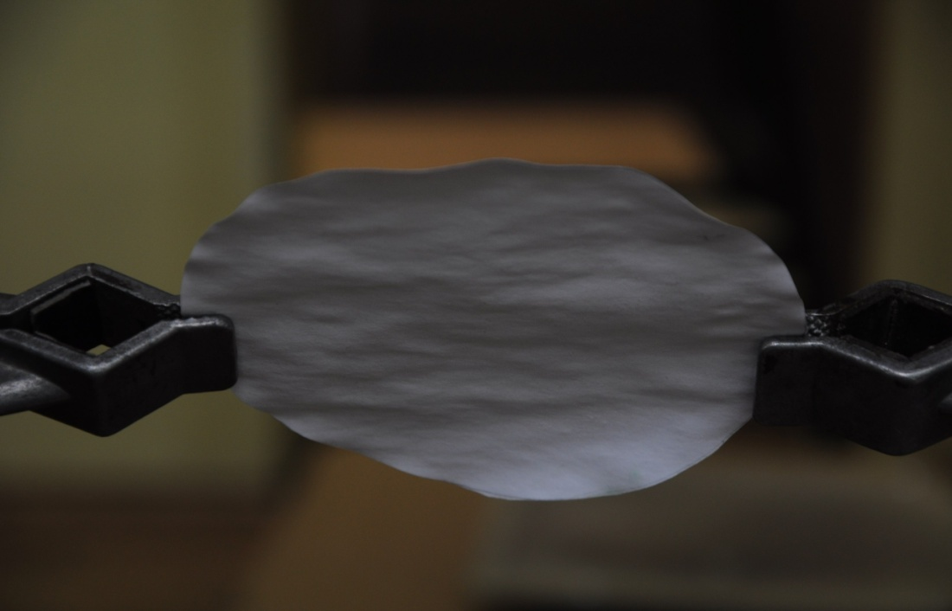
Offset paper
20 degree of Celsius 85 degree of Celsius

Slide 16
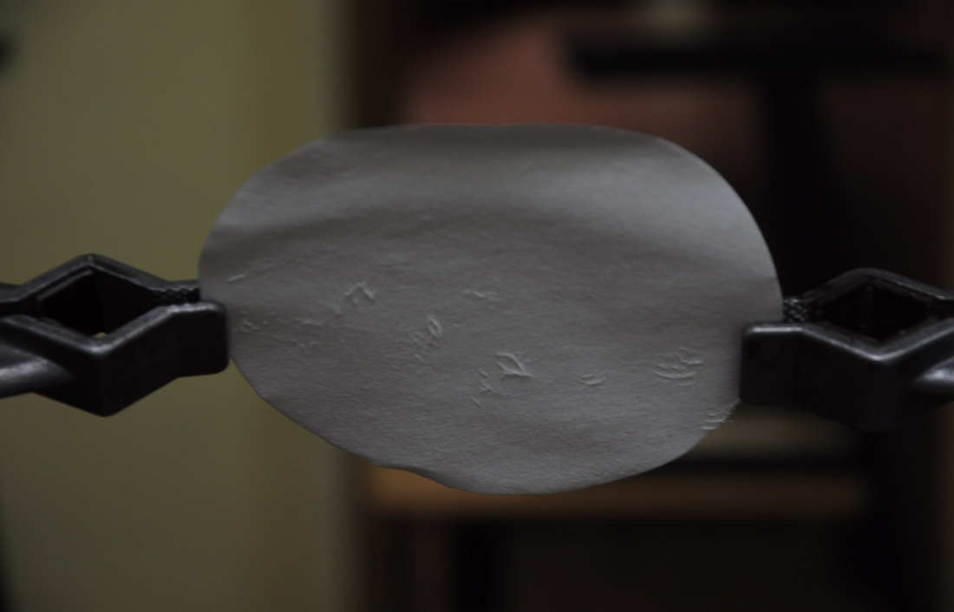
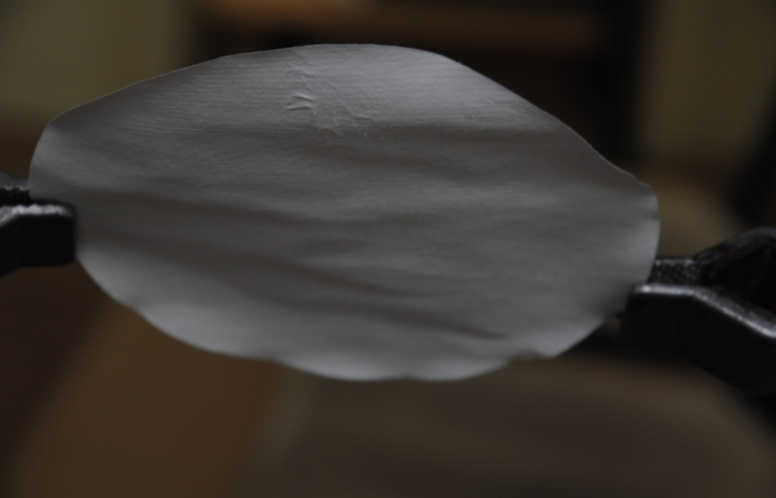
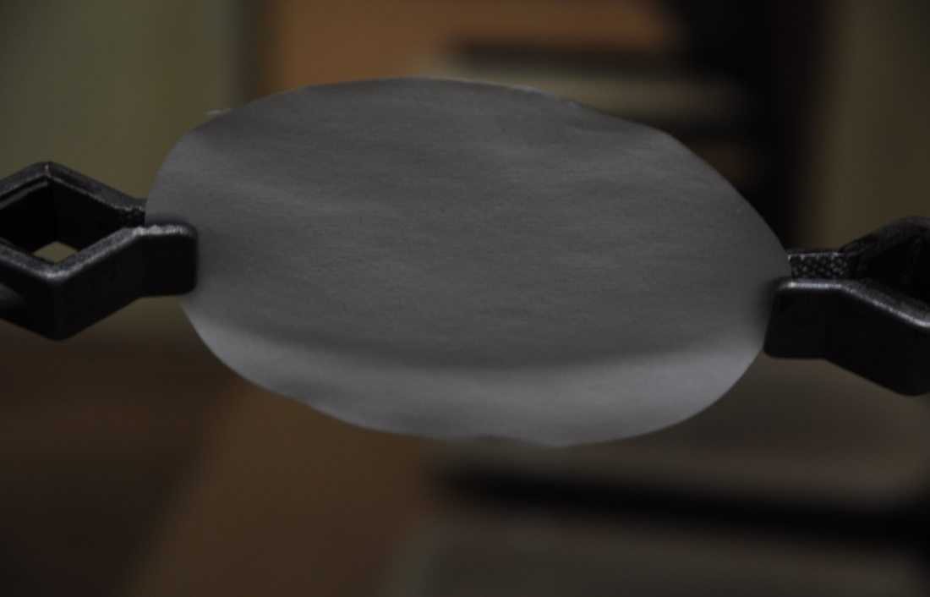
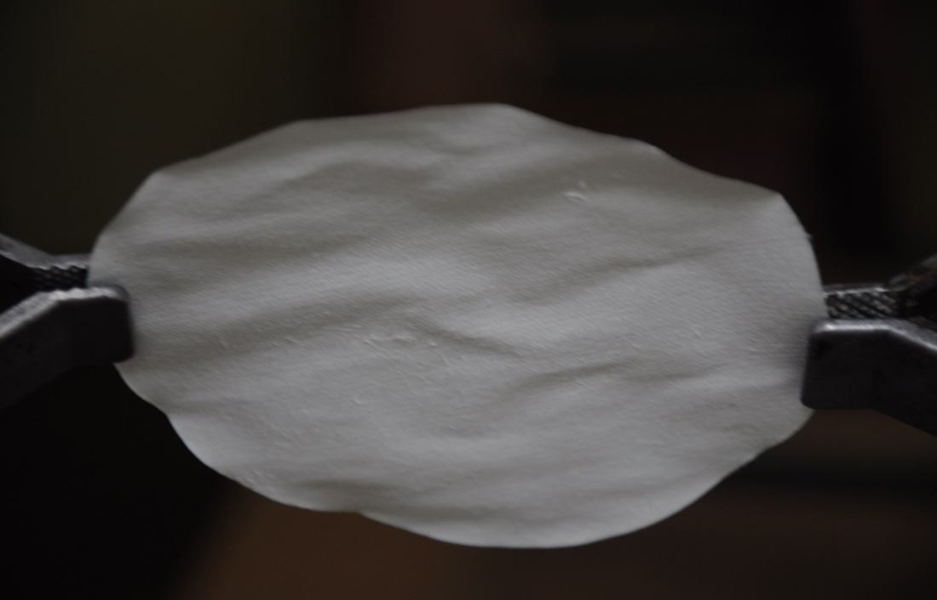
Filter paper
20 degree of Celsius 85 degree of Celsius

Slide 17
Conclusion
1) we have studied the process of prodacing the paper and made an inference, that the reason of wrinkling of the paper are internal stresses in paper
2) we have studied the structure of cellulose fibers.
3) we have made the hypothesis about power of deformation of paper with different density
4) we have showed experimentally, that more porosity paper deforms less, than less porosity in the process of getting wet and dry the paper and explained this phenomenon

