Slide 1
Task №9. Salt production
Group: 5 luceum.

Slide 2
9. Salt production
Solar evaporation of seawater or salt mining are common methods to produce common salt (NaCl). Propose a method to extract salt from a natural source and determine both productive capacity of your method and purity of the product. Demonstrate an amount of salt produced by your method.
Aim
Produce salt using natural materials.
1

Slide 3
Facts about salt
1)
A long time ago people detected the salty taste of some plants. They dried those plants and burned them in the campfire. Ash was used as spices for food
2)
Later people started pouring burning pieces of wood with salty water from the seas. They used that ash the same way
3)
People with increased acidity of stomach can use sodium hydrocarbonate. It reacts with acid and produces some salt:
HCl + NaHCO3 = NaCl + CO2 + H2O
One of the products of the reaction is NaCl
3

Slide 4
4)
People noticed, that ice, produced of salty water was not salty, and water became more salty. If you melt the ice you can produce pure water, and boiling the cold, but not crystalized water you’ll produce salt.
We simulated the water of the White Sea, where we have 26gramms of salt in 1 litre of water
We used: freezer, 2 pans, heater and scales
4

Slide 5
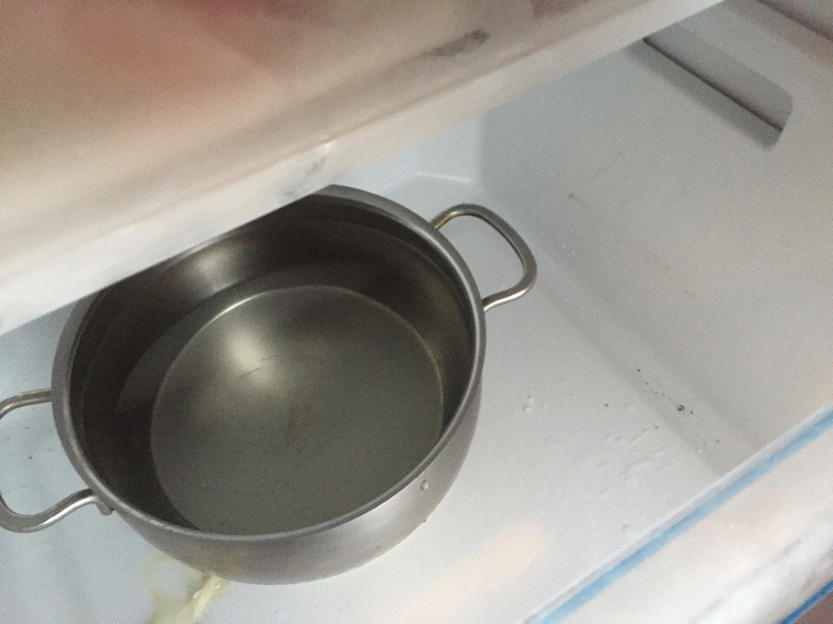
1. We put a pan with ‘sea water’ in the freezer
7

Slide 6
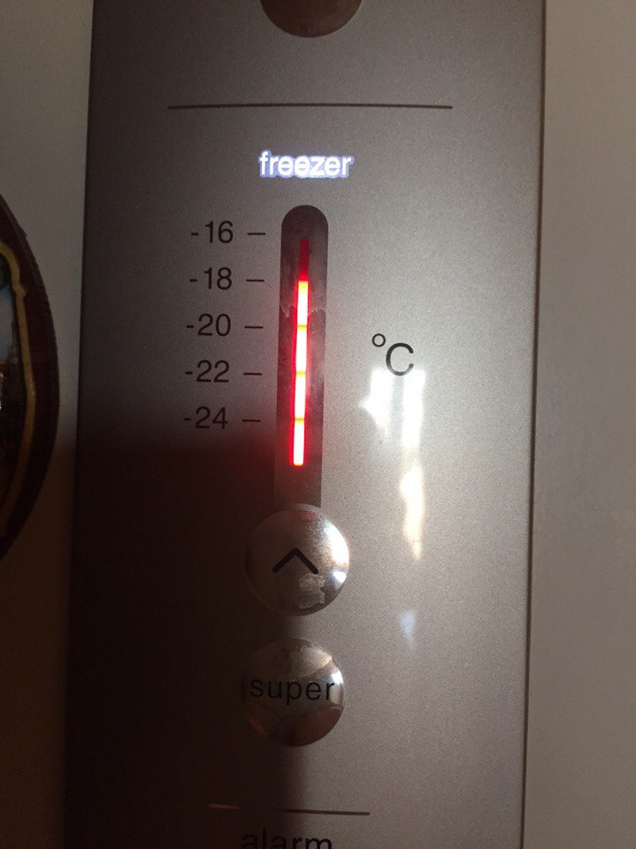
2. Temperature in the freezer- 18° С
8

Slide 7
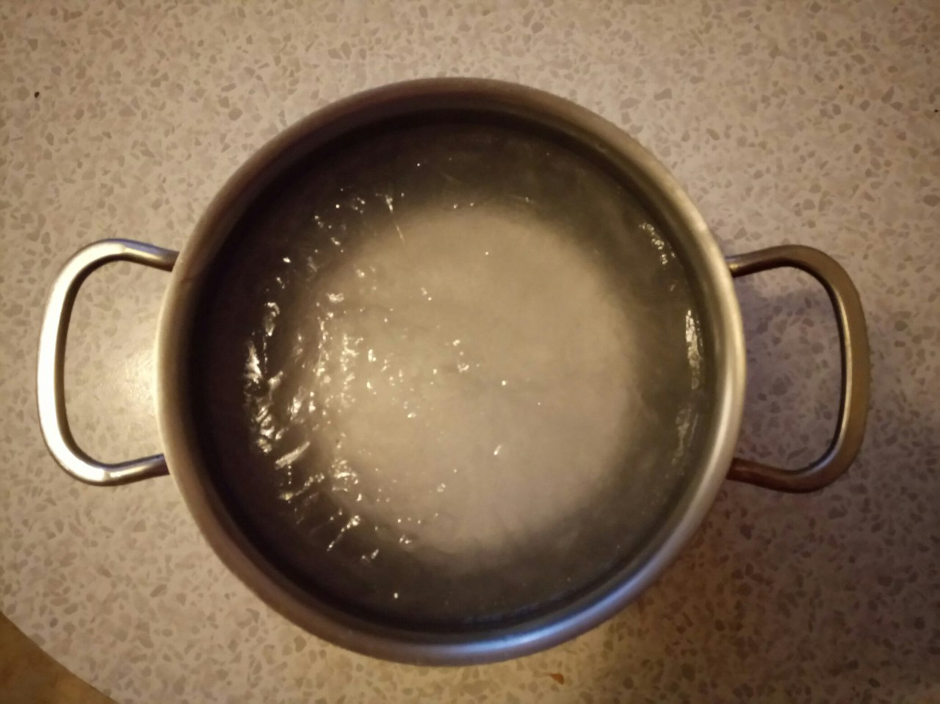
3After 4 hours of freezing
9

Slide 8
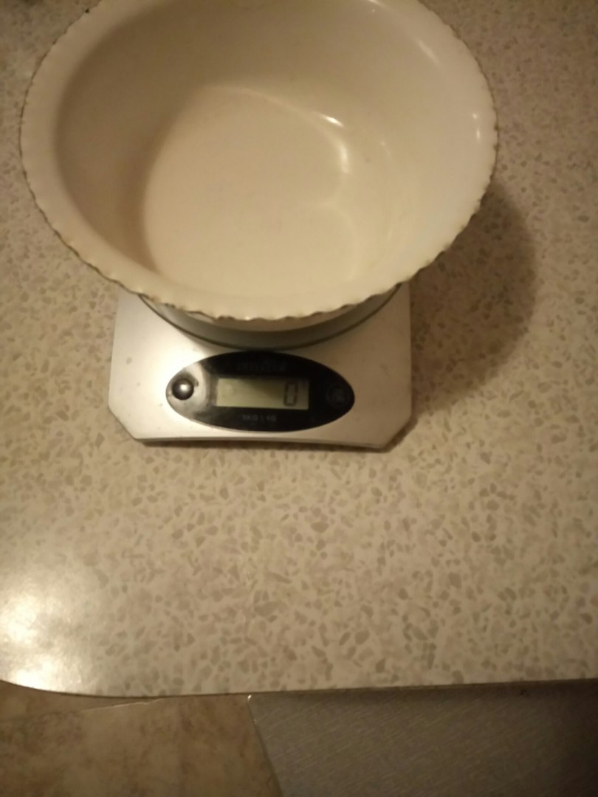
4. Our scales
10

Slide 9
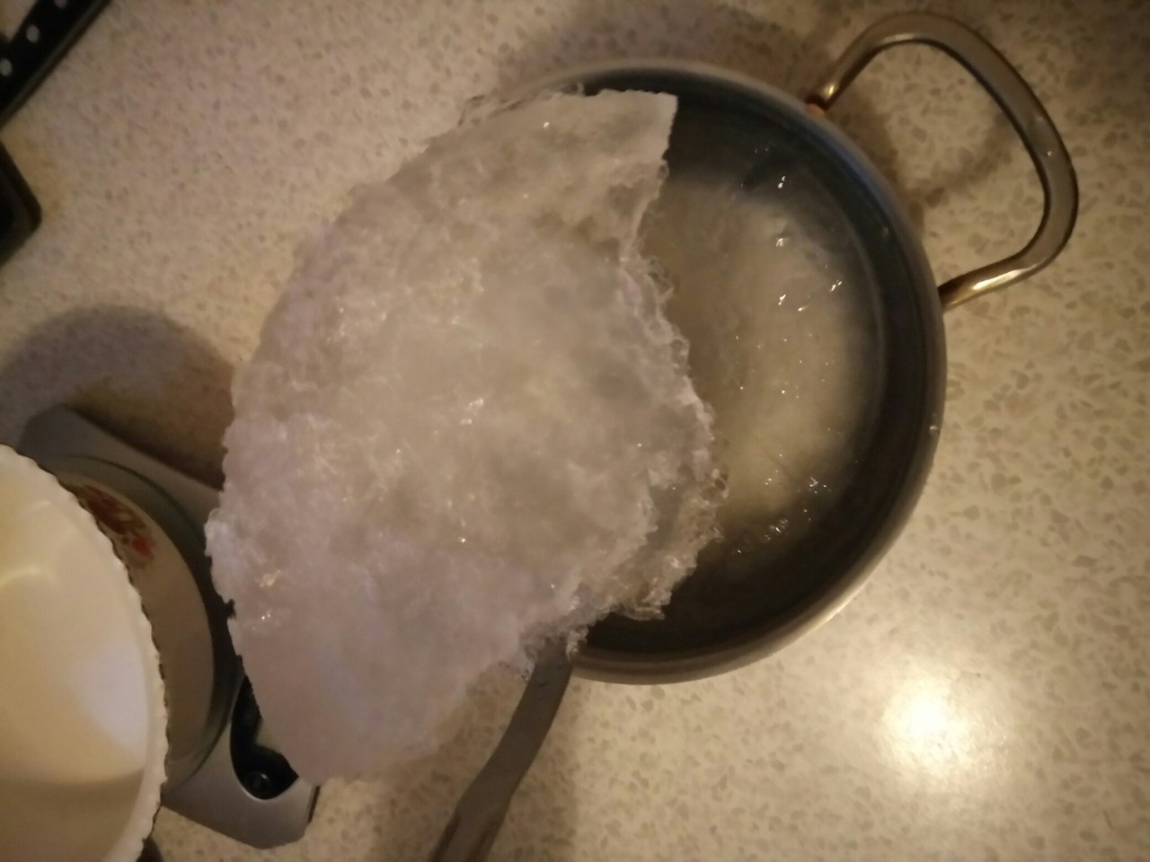
5. The ice (pure)
After 4 hours of freezing we have 403 grams of ice. We put the remaining solution into the freezer for 1 more hour.
11

Slide 10
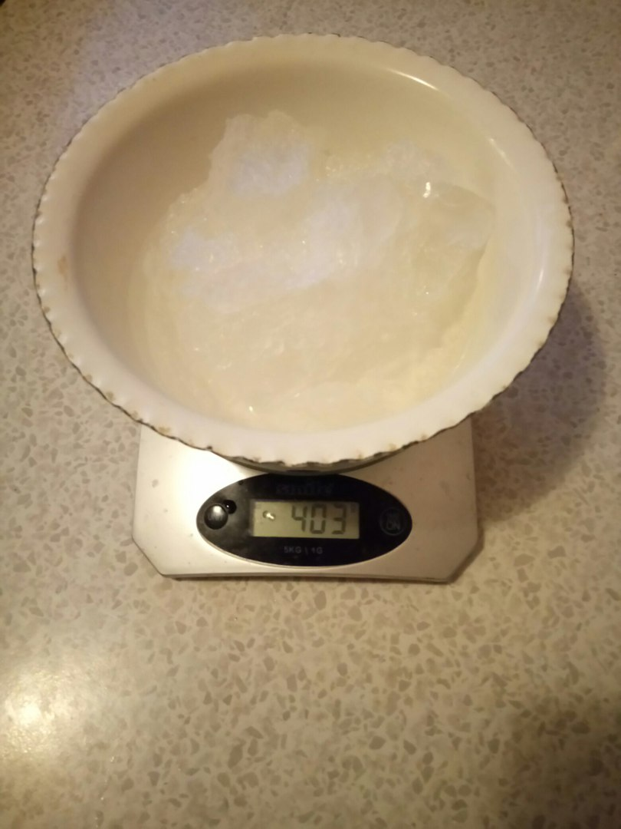
6. First ice
12

Slide 11
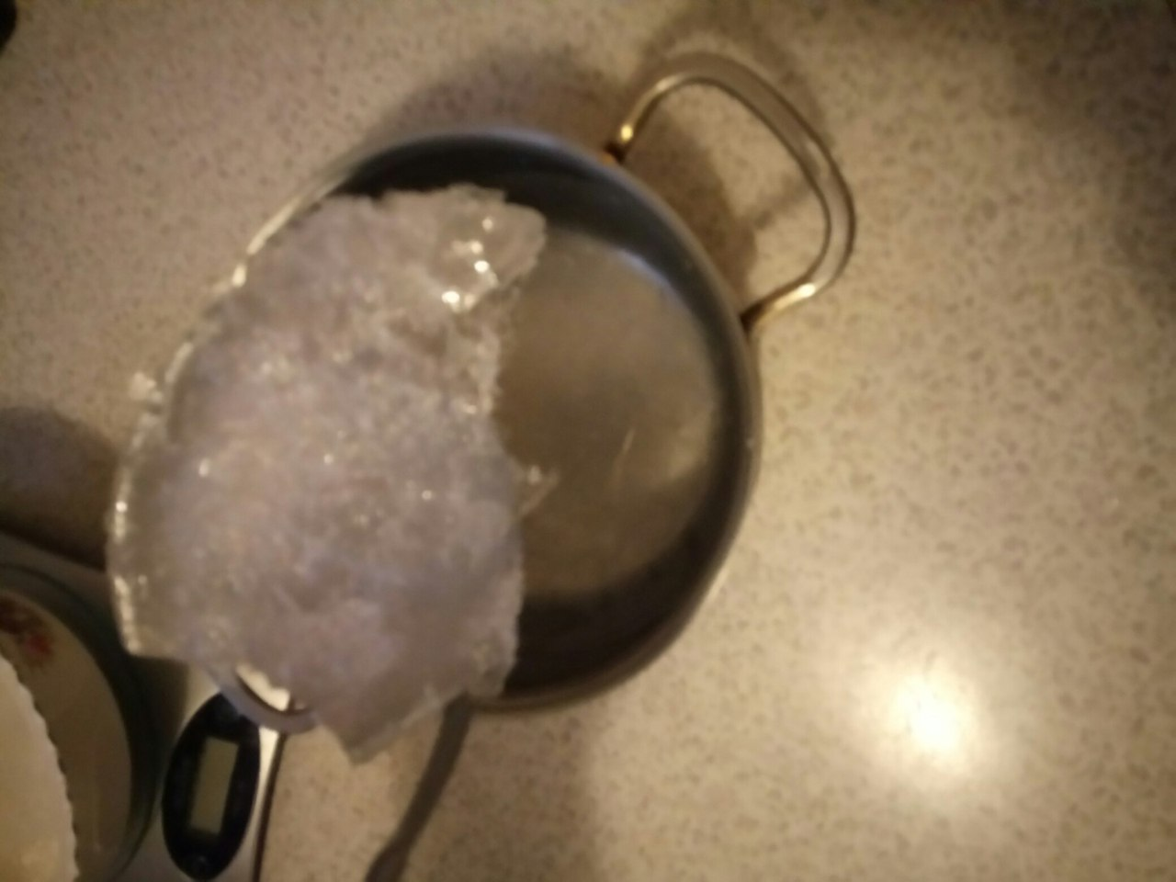
7. More ice
13

Slide 12
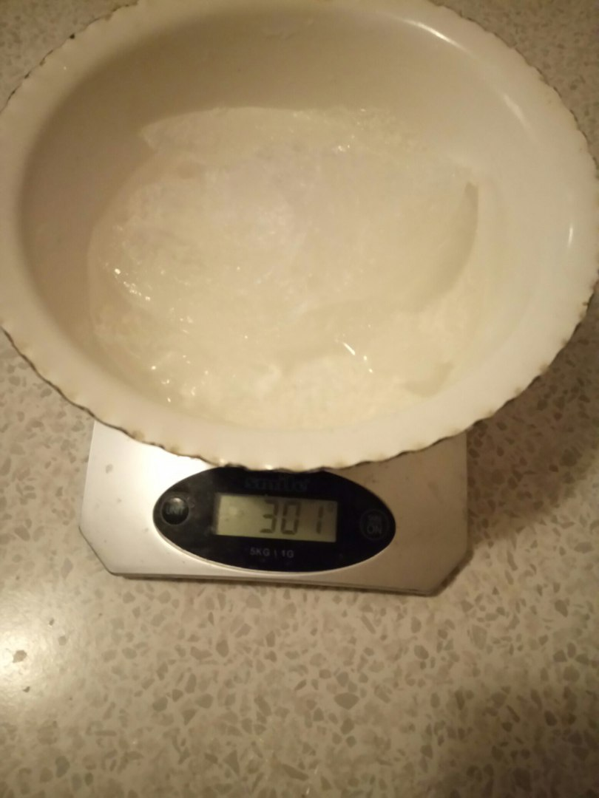
8. More 301 grams of ice
After an hour we remove ice from the pan.
14

Slide 13
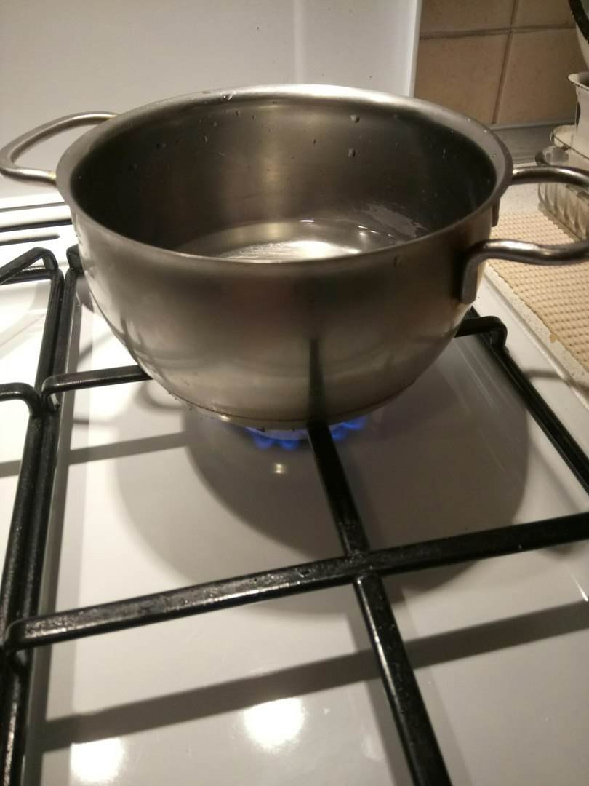
9. Start boiling of solution
15

Slide 14
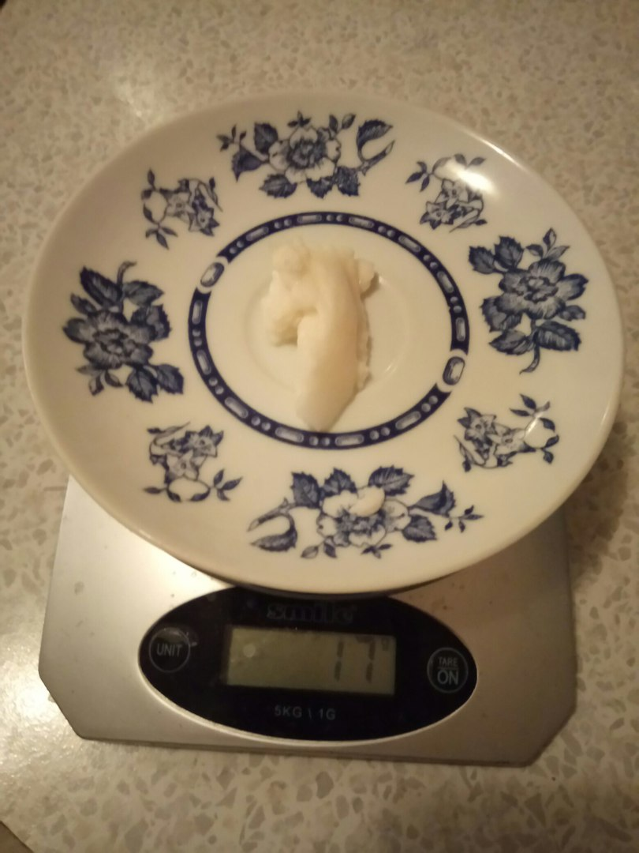
11. We have 17 grams of NaCl
16

Slide 15
Is the salt pure?
If we take sea water, we’ll detect other salts, sulphates of sodium, magnesium, chlorides of magnesium and potassium
The result:
17 grams of salt from 1 litre of sea water.
We spent 5 hours, so one day later we have got 74 grams.
17

Slide 16
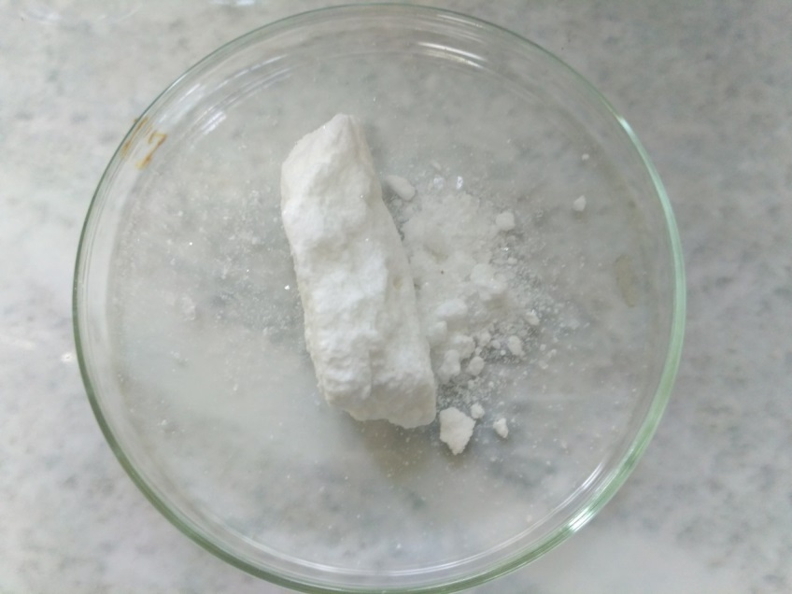
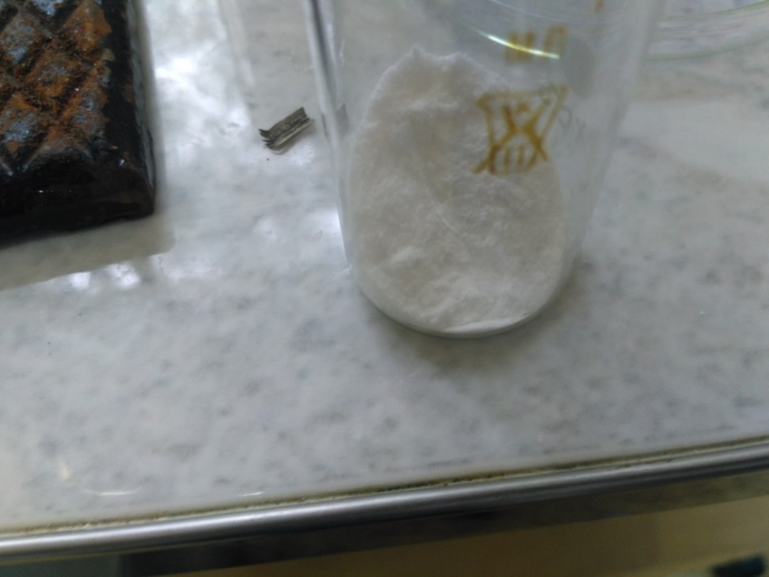
The second method, using minerals
Barium chloride (we can take it from barium minerals, or prepare using BaCO3 from witterite)
Sodium carbonate from
natrite

Slide 17
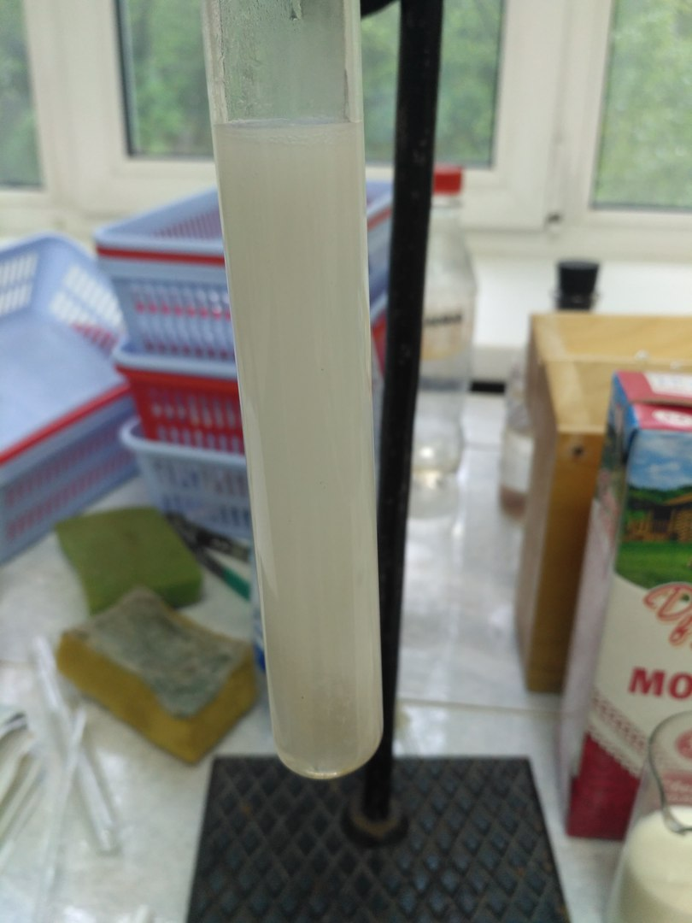
Here we can see the precipitate
Of BaCO3 and NaCl in the solution
We use filter and then boil the
Solution.
We produced 110grams of salt
Using 100 grams of carbonate
And 195 grams of barium chloride

Slide 18
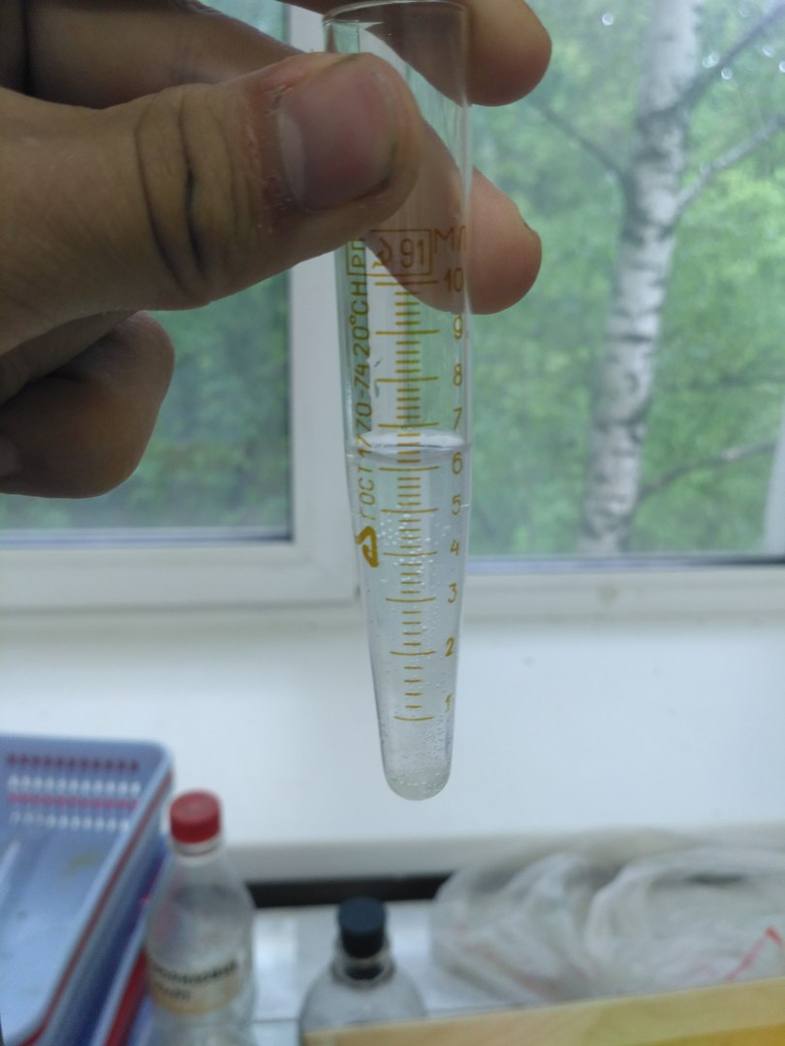
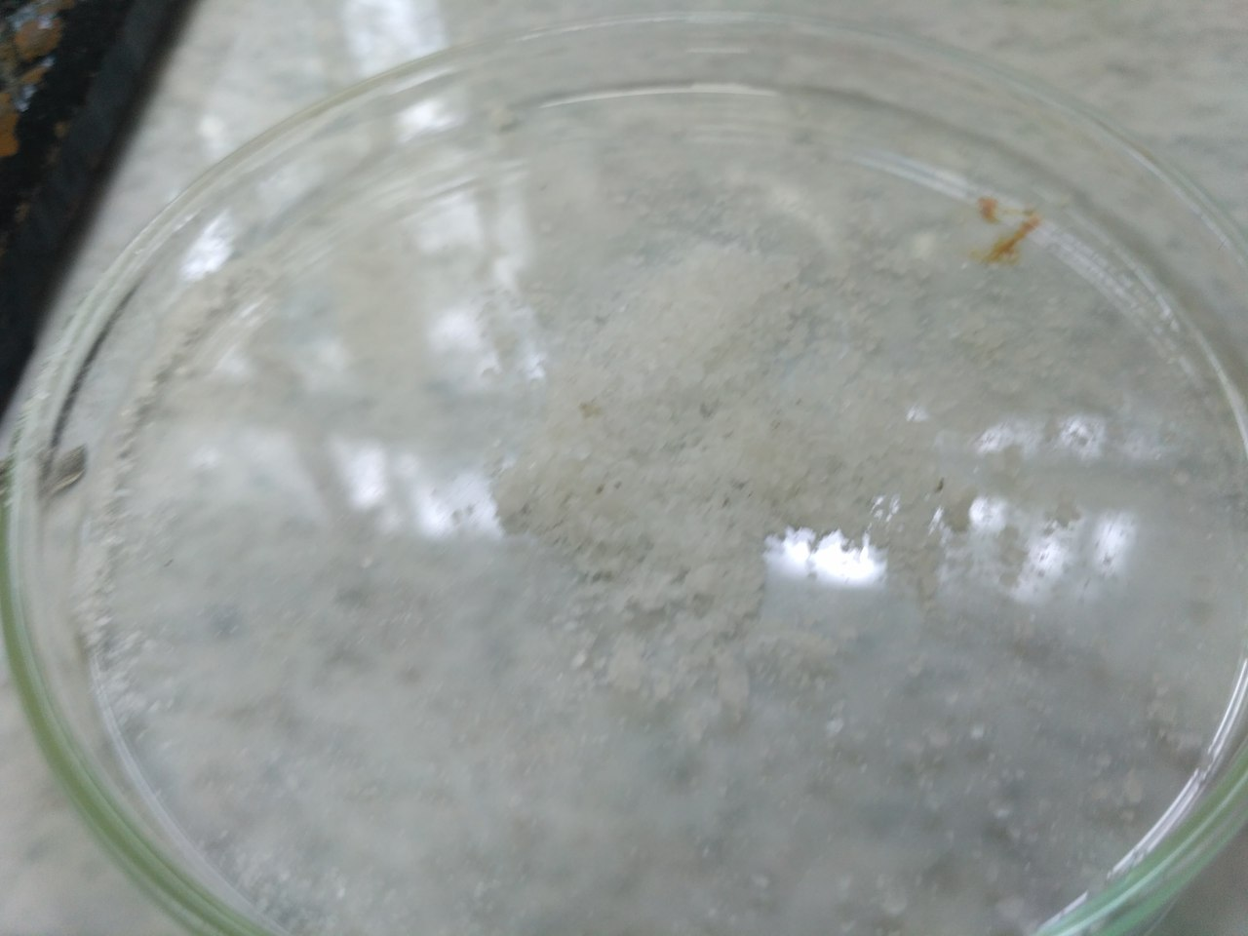
The solution after paper filter
Produced salt (the sample)

Slide 19
Sources:
Из книги Кукушкина Юрия Николаевича "Химия вокруг нас", 1992.
18

