Slide 1
Tornado machine

Slide 2
Problem
Build a machine to produce an indoor air tornado. Investigate the properties and stability of the tornado. Is the machine portative enough to be demonstrated at a Science Fight room of the 5th IYNT?

Slide 3
Aims
To understand what tornado is and to investigate how it appears naturally
To project tornado machine as close as it works in nature
To make tornado machine work
To investigate the properties and stability of the tornado

Slide 4
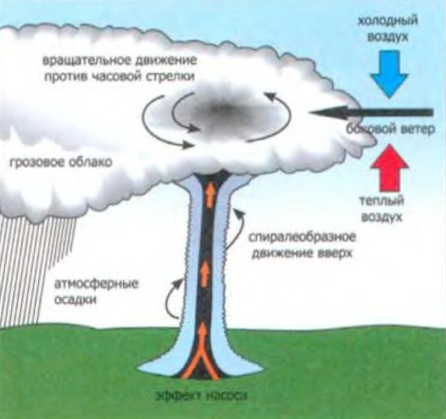
Tornado in nature
A tornado is a rapidly rotating column of air that is in contact with both the surface of the Earth and a cumulonimbus cloud or, in rare cases, the base of a cumulus cloud.

Slide 5
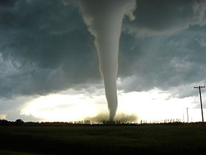
Tornado in nature
They are often referred to as twisters, whirlwinds or cyclones, although the word cyclone is used in meteorology to name a weather system with a low-pressure area in the center around which winds blow counterclockwise in the Northern Hemisphere and clockwise in the Southern

Slide 6
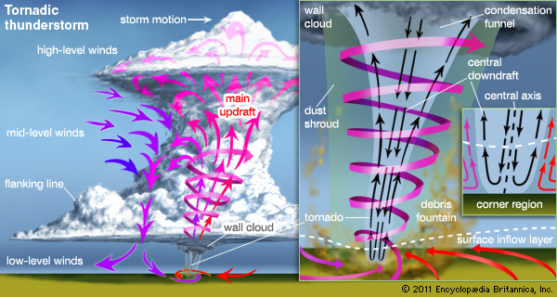
Tornado machine project
We need to create the main updraft by means of warm air moving and to make vortex - to impart rotate moment to the main updraft.

Slide 7
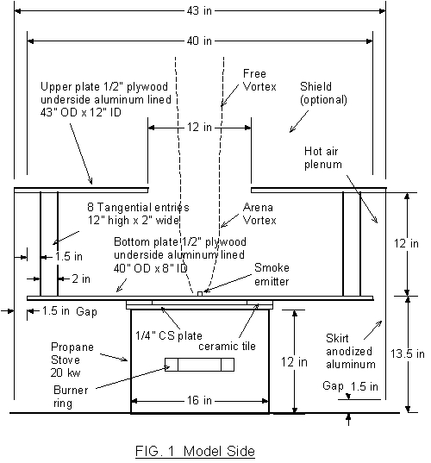
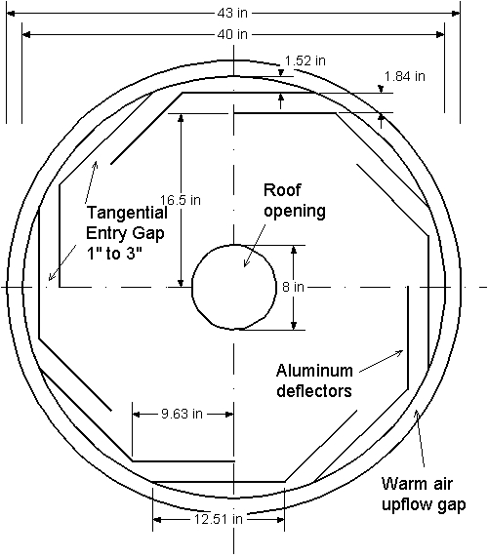
Project of the tornado machine
cm
cm
cm
cm
cm
cm
cm
cm
cm
cm
cm
cm
cm
Hot air
cm
Burner
Cold air

Slide 8
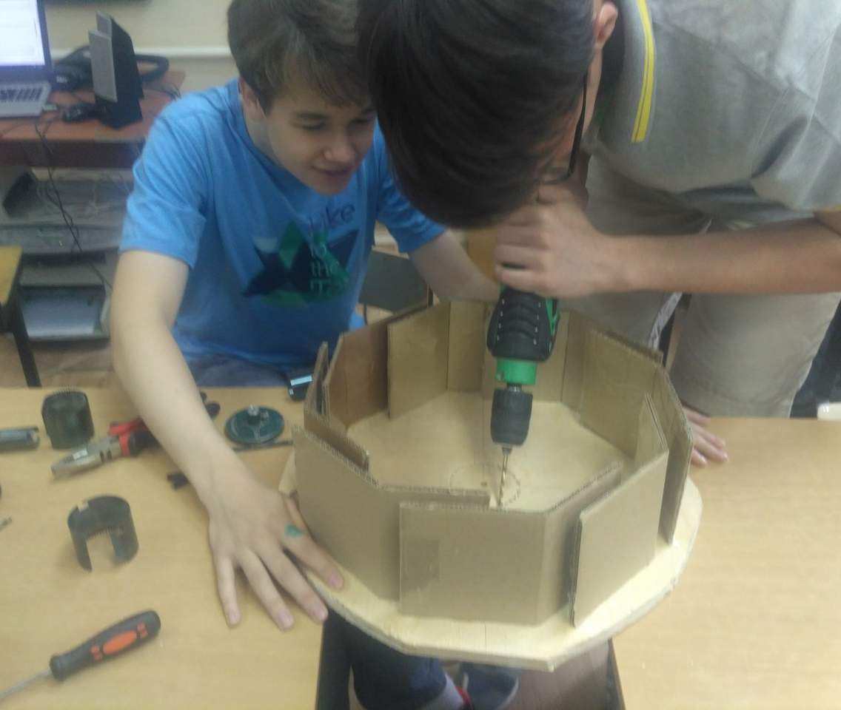
Crafting
We changed the project a bit. We replaced aluminum deflectors for carton ones for safety and easiness. Also we had problems with smoke emitter.

Slide 9
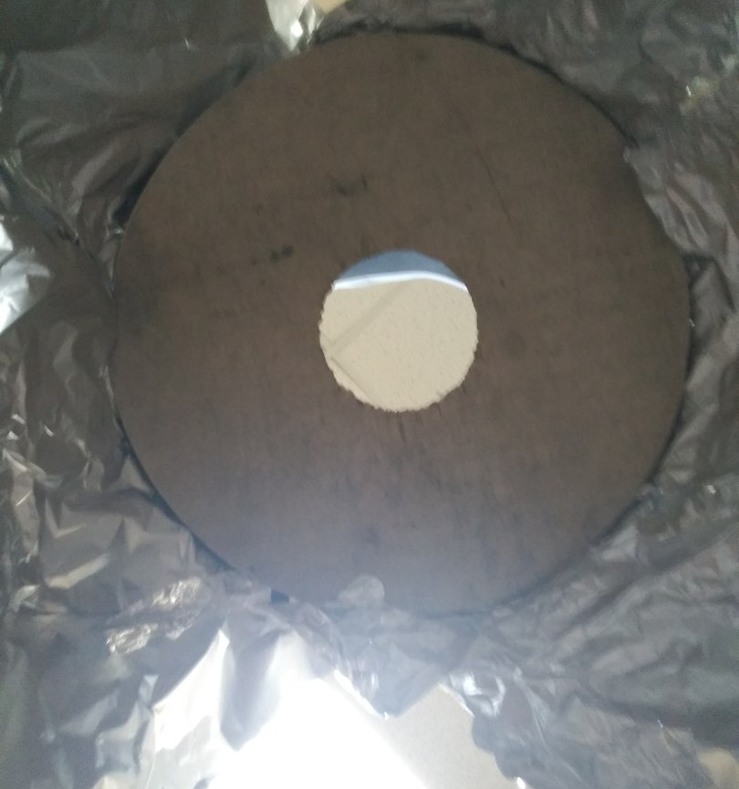
Crafting

Slide 10
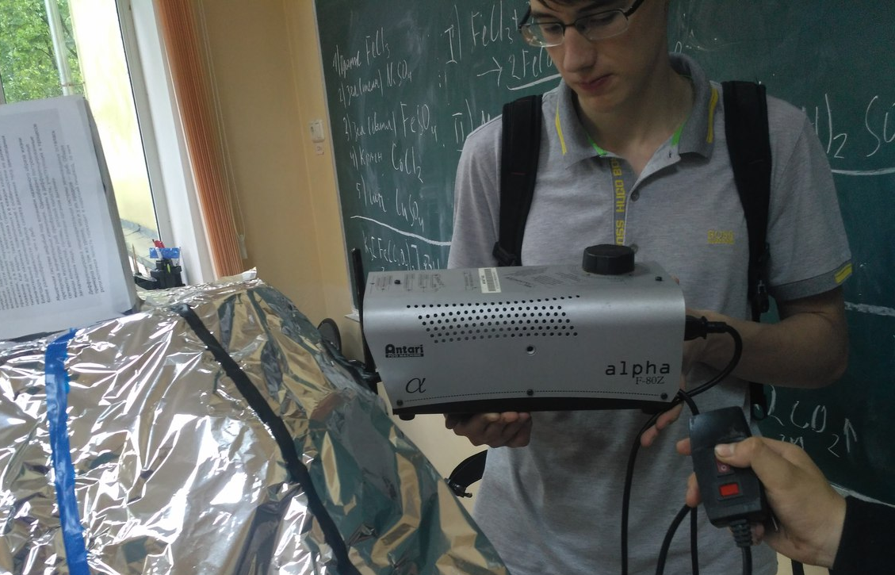
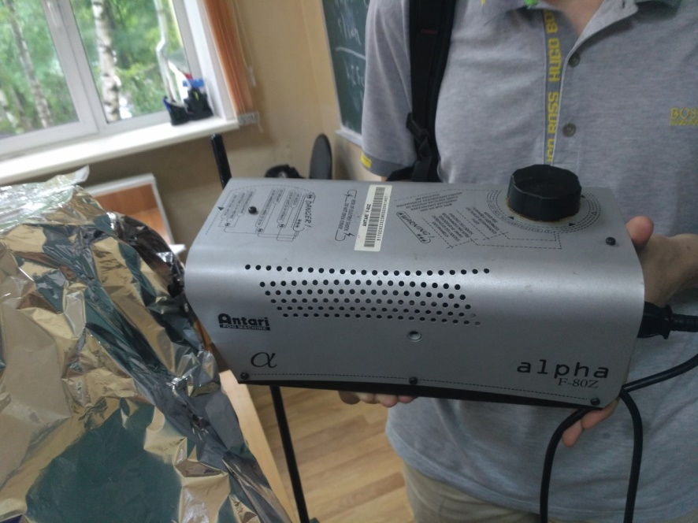
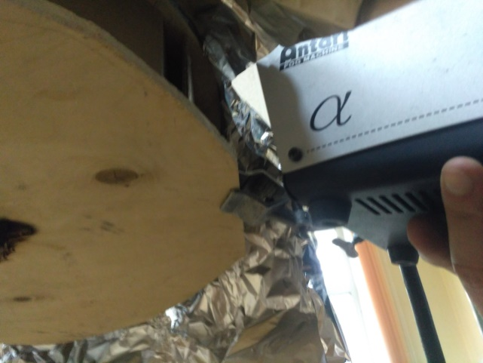
Crafting
We had to change the construction, because previous version of smoke emitter had low capacity. Then smoke got in one of the entry gaps faster. Also extra rotational moment was added to the swirl.

Slide 11
Tornadoes
видос

Slide 12
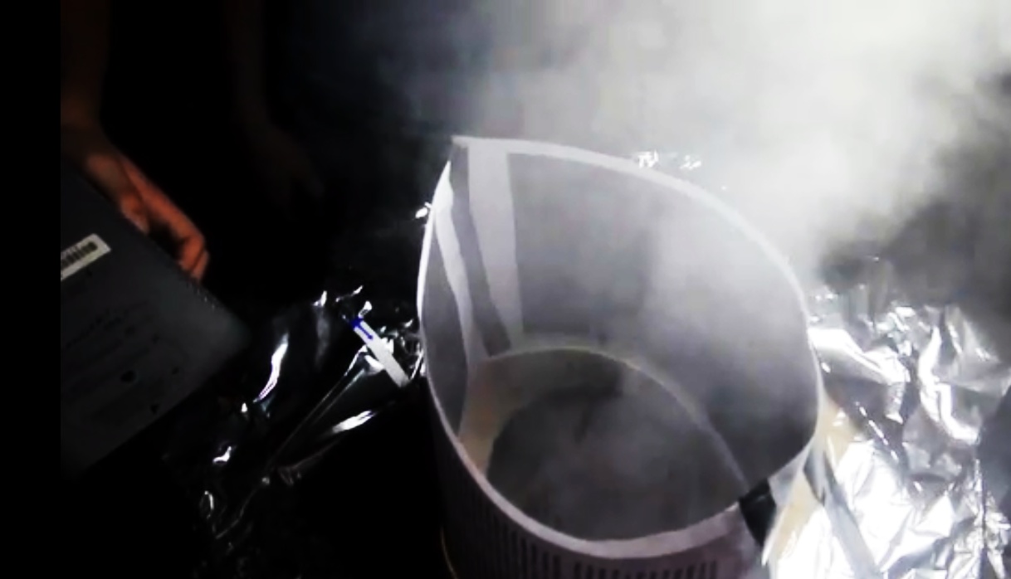
Tornadoes

Slide 13
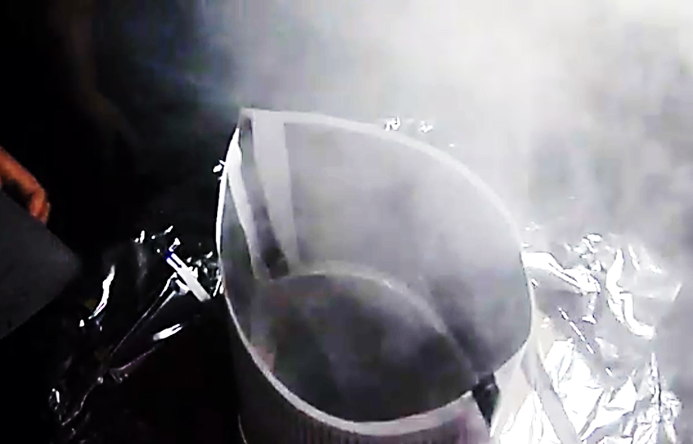
Tornadoes

Slide 14
Parameters
Portability of machine
Tornado life time
Tornado’s height
Approximate velocity of updraft
Temperature
Pressure in the different parts of tornado

Slide 15
Portability of machine
Machine is portable because the biggest part we can easily into the luggage. (the biggest part is the circle which diameter is 43 cm)

Slide 16
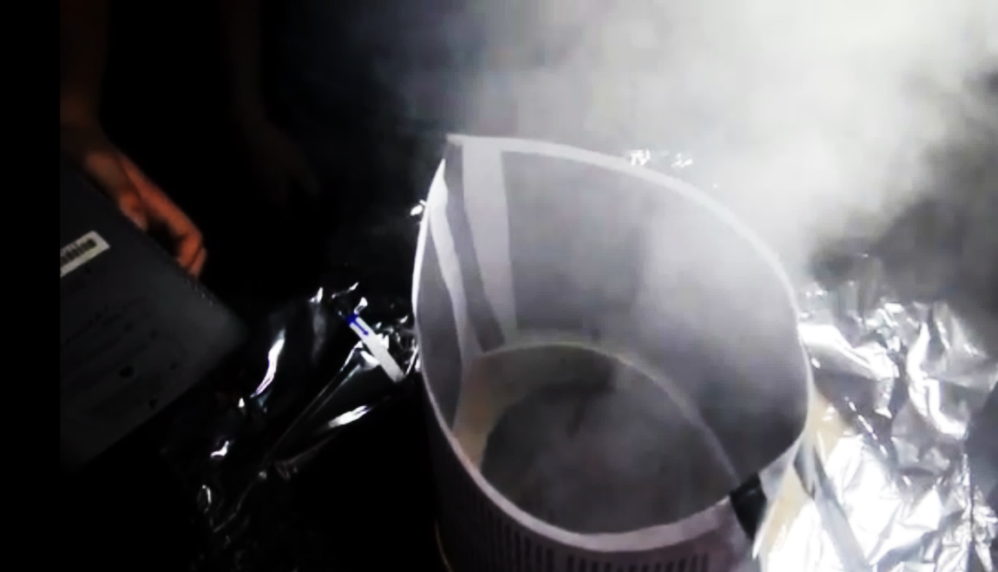
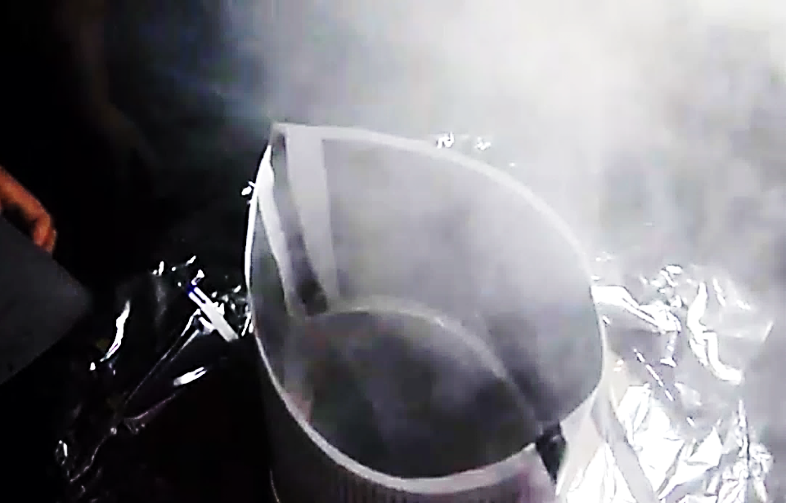
Tornado life time
The swirl was no constant because it was too much smoke. We measured tornado life time via video. It life time was 14 shots(~0,58 second)

Slide 17
Tornado’s height
We measured tornado’s height of the biggest and most observable tornado(via video). It was approximately 29 cm

Slide 18
Velocity of tornado updraft
Speed can be easily measured: it was 20 cm for 5 video shots. We know that it’s 1 m/s.

Slide 19
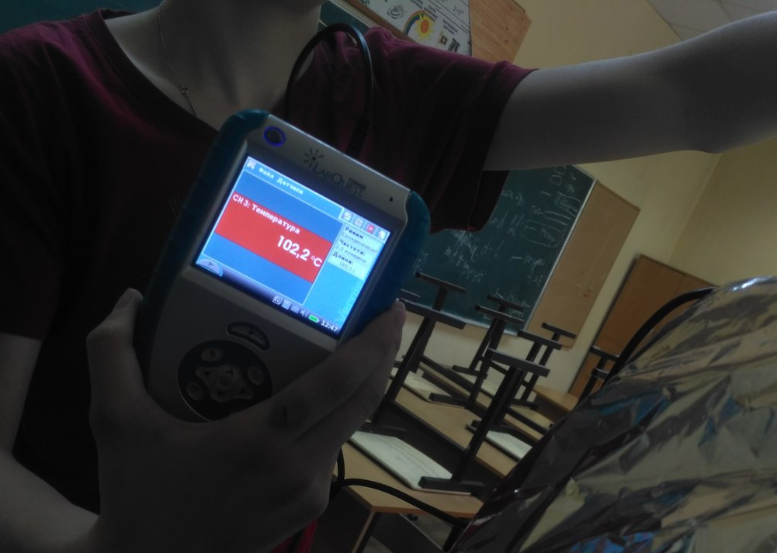
Temperature
We put thermometer into the center of tornado. It showed that temperature in the center of the tornado was 102.2 $℃$

Slide 20
Pressure
We have measured pressure in different parts of tornado. In bottom part pressure has been 99.003 kPa, in the middle part- 98.850 kPa and in the upper part- 98.725 kPa.

Slide 21
Conclusions
We’ve built machine which can make tornadoes
Tornado life time was short (0, 58 second), but they formed constantly
This machine is very similar to natural tornado formation

