Slide 1
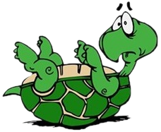
Reviewer presentation – team Awkward Turtles Bulgaria
Reporter
Opponent
Strong points | Weak points
Good theoretical model | Pipe not bottle
 | Didn’t tell about the numbers In the diagram
 | Not very well explained the Experiment
Strong points | Weak points
Founded mistakes in the presentation. | You didn’t help the reporter when you saw he had difficulties.
Three questions

