Slide 1



Team Awkward Turtles
Bulgaria
6. Eye color

Slide 2
Summary
1. Problem statement
2. Introduction
3. Materials, methods and experiment
4. Results and discussion
5. Conclusions

Slide 3
1. Problem statement
In certain human populations, genetics allows predicting inheritance of eye color among family members. In other populations of the present day World, nearly everyone has the same eye color. What information is it possible to determine about the eye colors in both distant and close ancestors, descendants, and relatives of one living person?

Slide 4
2. Introduction
Did you know that no two people have the ‘exact’ same eye color?
Or that every person with blue eyes can be traced back to the same ancestor that lived in the black sea region about 10,000 years ago? It’s true. Everyone alive today with blue eyes has a very specific DNA sequence.
The iris color is determined by the amount of melanin pigmentation. The more pigment there is, the darker the iris will be. Blue, gray, and green eyes are lighter because there is less melanin inside the iris.
Depending on where a person is born, eye color demographics can vary wildly. For instance, nearly all persons of African and Asian ancestry have brown eyes.
Among the genes that affect eye color, OCA2 and HERC2 stand out. Both of these genes are found in the human chromosome 15.

Slide 5
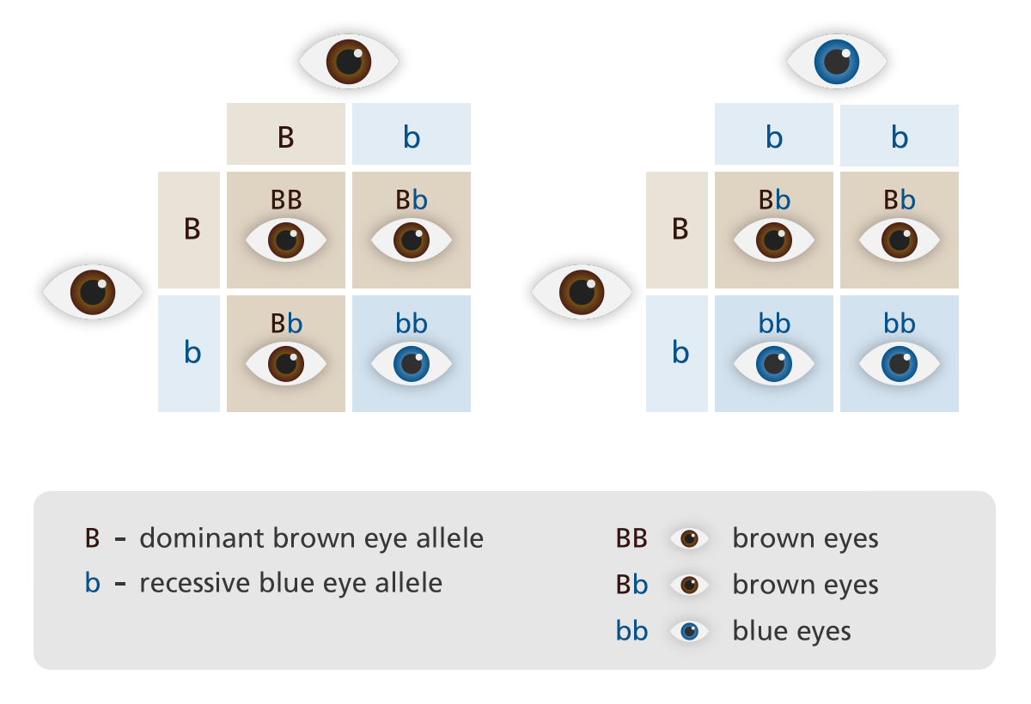
2. Introduction
Human cells carry two copies of each chromosome. These different versions of a gene are called alleles.
Alleles can be dominant or recessive.
Dominant - show their effect even if the
individual only has one copy of the allele
Recessive - show their effect if the individual
has two copies of the allele
The alleles for brown eyes are dominant over
blue and green.
Green is dominant over blue but recessive
to brown.

Slide 6
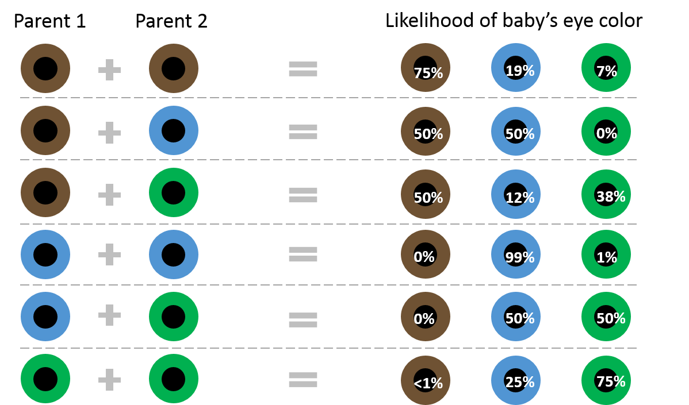
2. Introduction

Slide 7
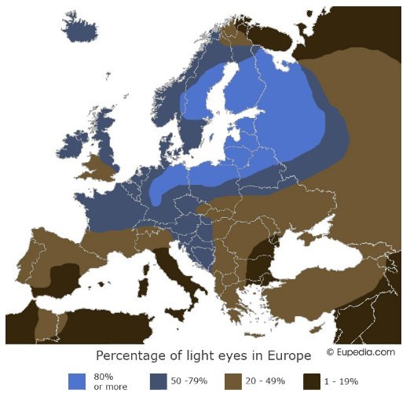
2. Introduction
Eyes color distribution in Europe
The map shows the percentage of people with blue eyes in Europe. The blues eyes are most common in northern Europe, while less common in the southern part.
The western part of Bulgaria has a higher percentage of blue eyed people (20-49%) and in the eastern part of the country blue eyes are less common (1-19%).

Slide 8
3. Materials, methods and experiment
Everyone of our team tried to collect information about the color of eyes of their ancestors
Statistical approach was decided

Slide 9
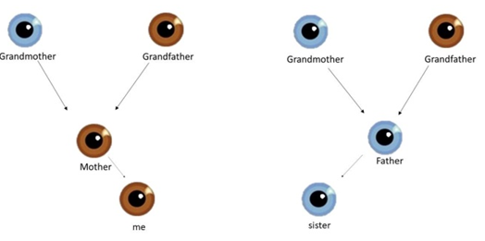
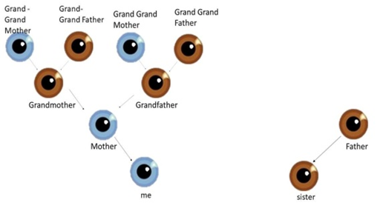
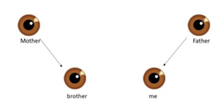
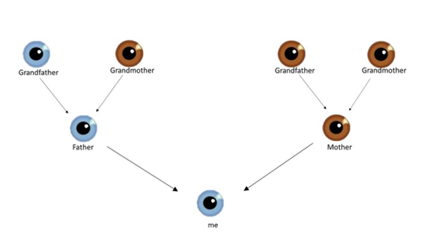
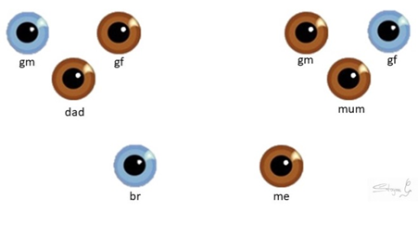
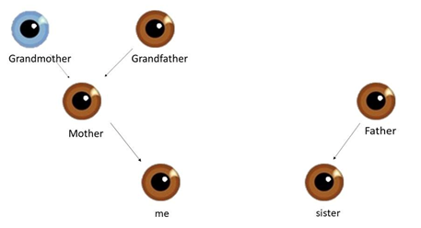
4. Results and discussion
The result of our research is a genealogical tree of eyes.

Slide 10
4. Results and discussion
Eye color distribution of our generation (team members and their siblings)
Eye color distribution of all population (ancestors and team members and siblings)

Slide 11
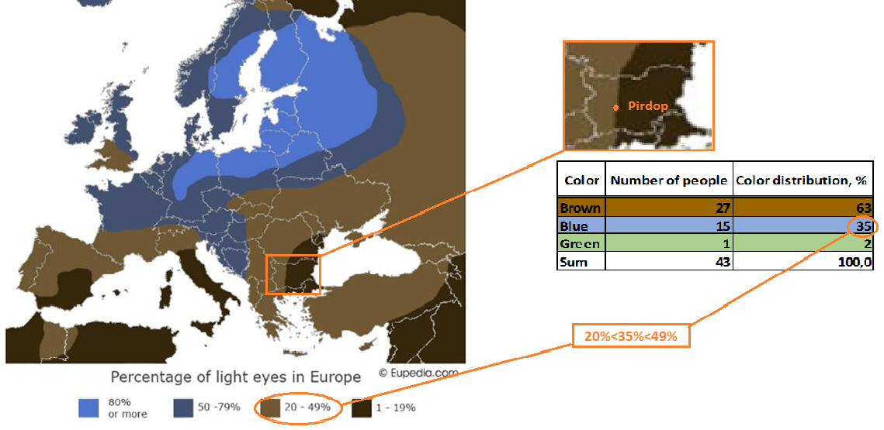
4. Results and discussion

Slide 12
4. Results and discussion
Eye color distribution of our generation (team members and their siblings)
Distribution for eyes color of ancestors is similar to distribution of colors for their successors. That proves genetic theory. Also if we compare the distributions we can see slightly decreasing of blue color eyes, respectively increasing of brown color eyes. This tendency is expected because of the genetically dominance of brown color gens.
Eye color distribution of all population (ancestors) €

Slide 13
5. Conclusions
1. Eyes color of successors can reveal information about eyes color of their ancestors.
2. Expected decreasing of number of recessive blue color eyes is proven in our small population.
3. The map of color distribution is correct for Pirdop area.

Slide 14


THANK YOU FOR YOUR ATTENTION!

Slide 15
Used literature
[1] https://genetics.thetech.org/ask/ask316
[2] https://www.diffen.com/difference/Dominant_vs_Recessive
[3] https://www.eupedia.com/europe/maps_of_europe.shtml?
[4] https://ghr.nlm.nih.gov/primer/traits/eyecolor

Slide 16
5. Conclusions
1. Eyes color of successors can reveal information about eyes color of their ancestors.
2. Expected decreasing of number of recessive blue color eyes is proven in our small population.
3. The map of color distribution is correct for Pirdop area.

