Slide 1
22. Montolfiere
Team Awkward Turtles Bulgaria

Slide 2
Summary
1. Problem statement
2. Introduction
3. Materials and methods
4. Experiment
5. Result

Slide 3
Problem statement
To heat air for a simple hot air balloon, one can even use a heater. Build such a buoyant. Explain the results for you experiments and determine important parameters.

Slide 4
Introduction
Balloon heats up
Balloon rises
Lift greater than weight

Slide 5
Materials and methods
Materials we used:
Electric heater
Threads
Garbage bags
Toster

Slide 6
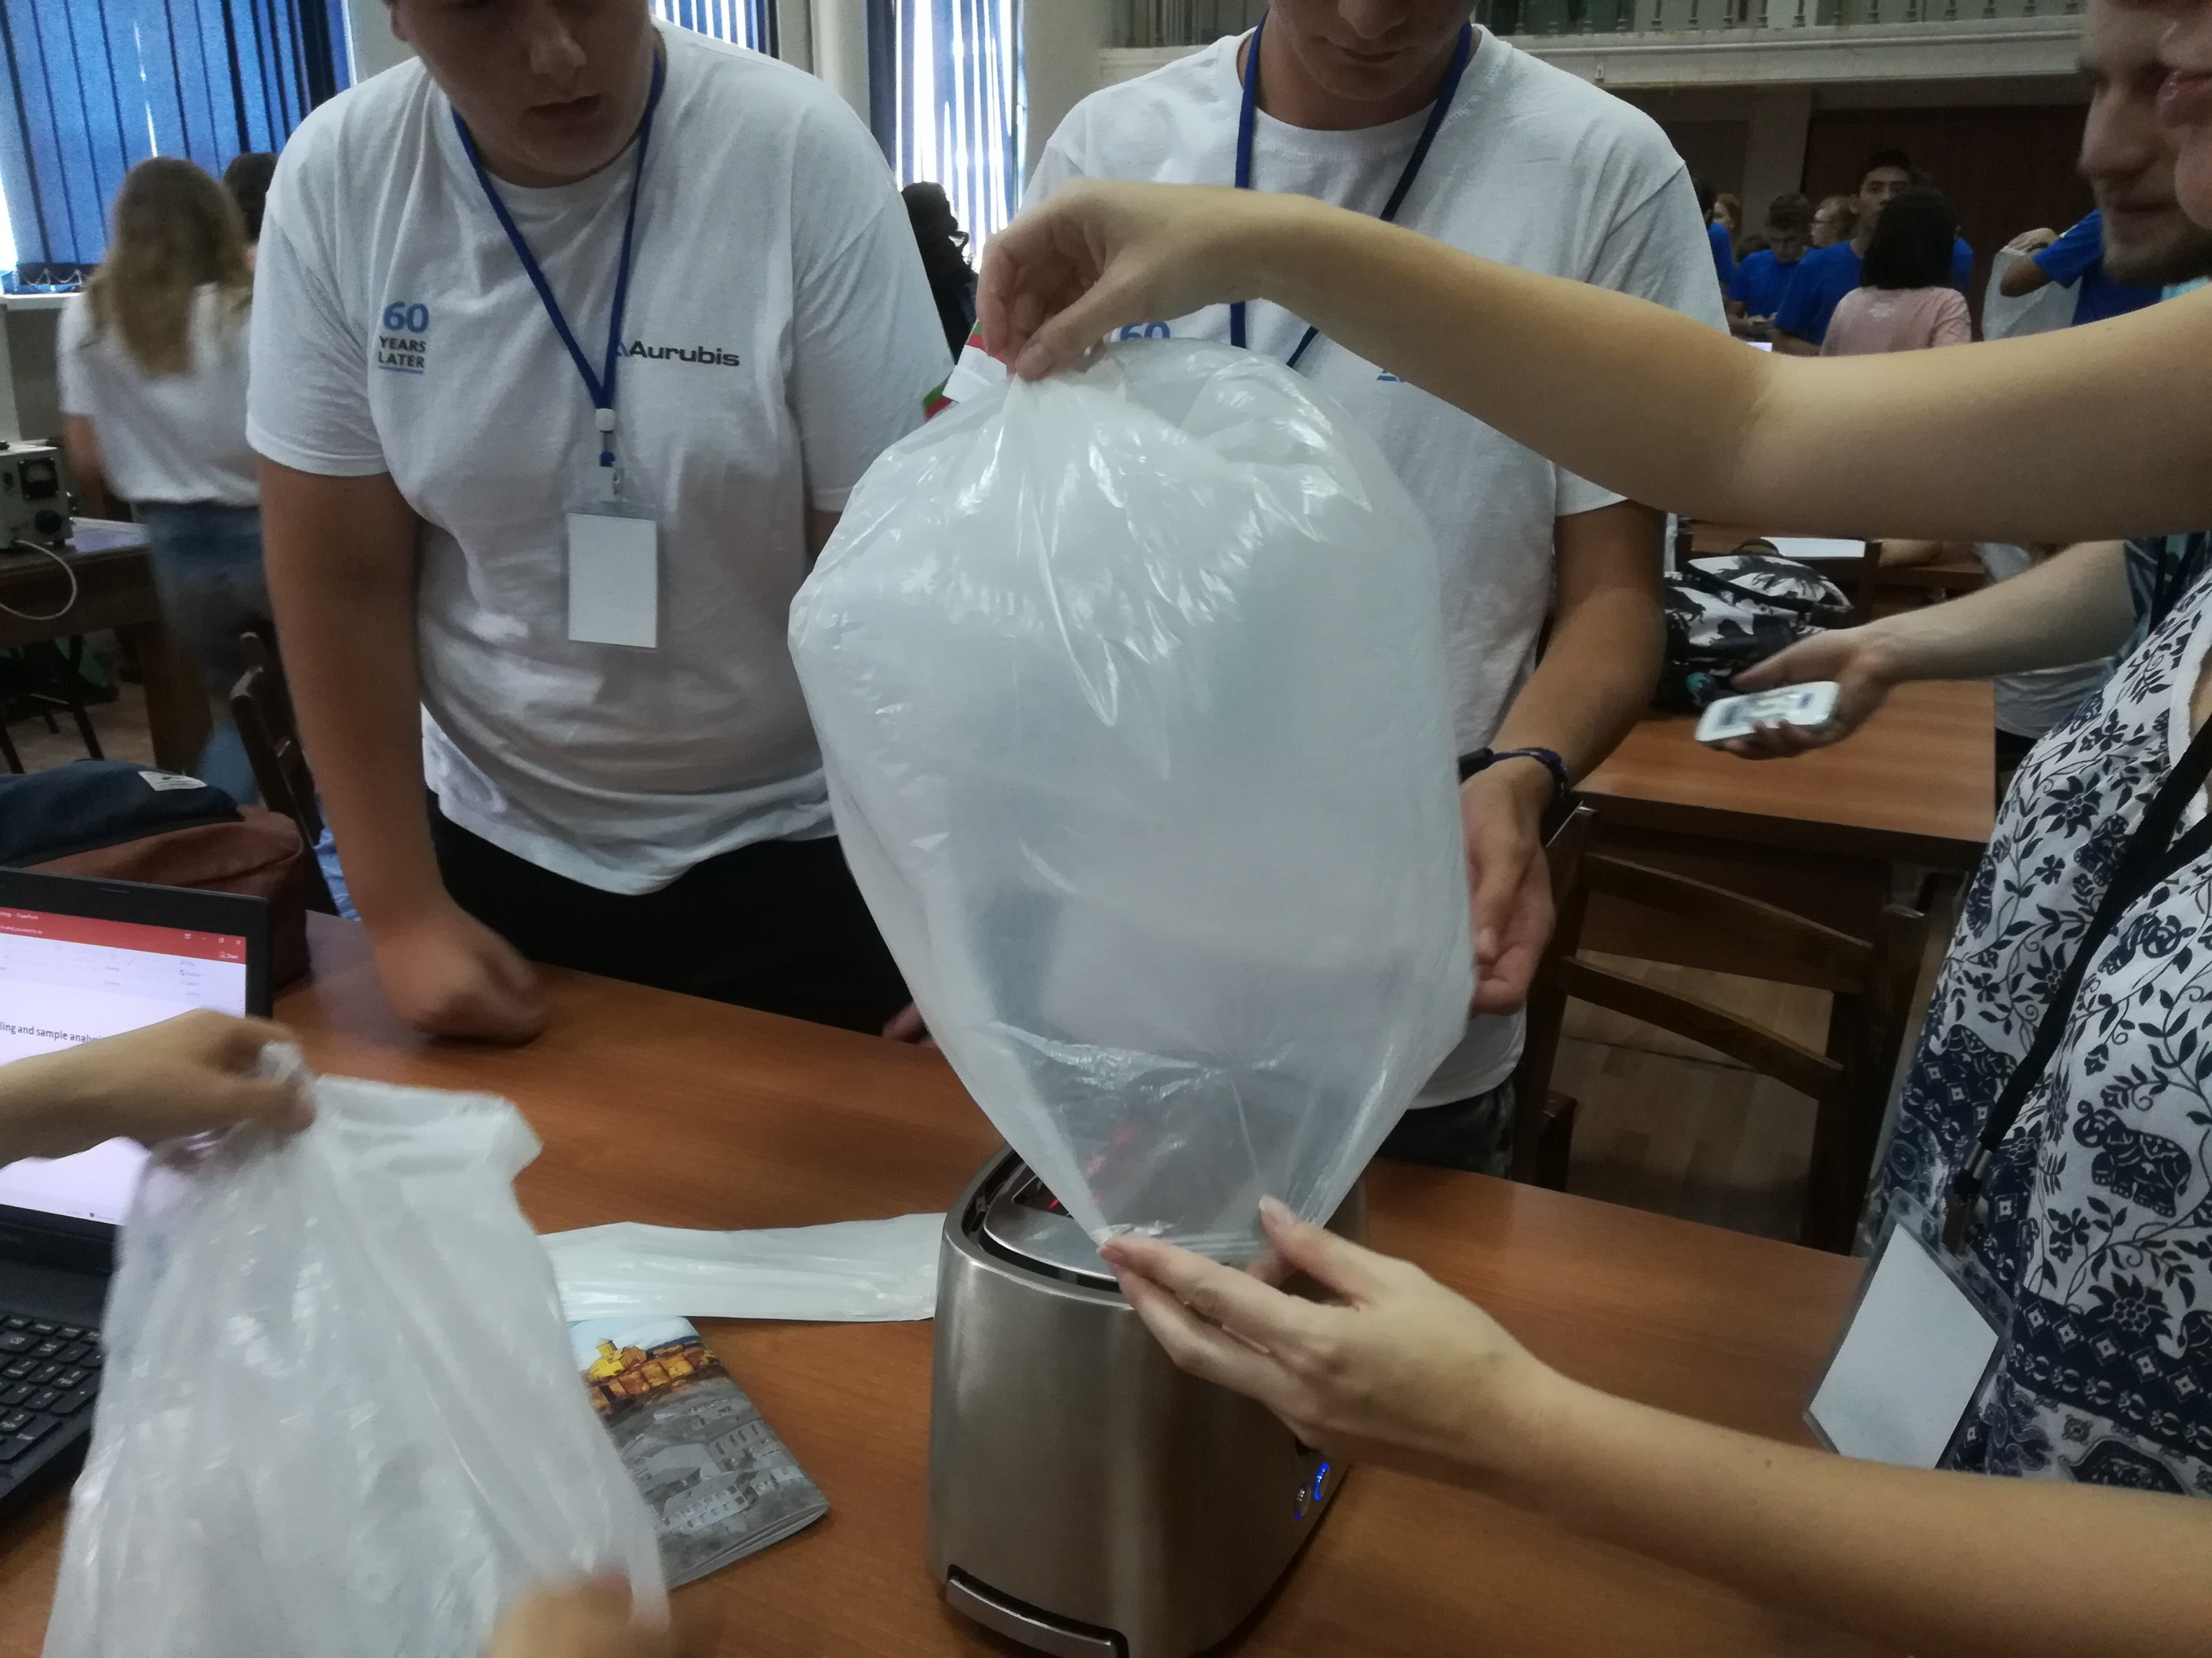
Materials and methods
Method:
We put the trash bag
on the toster.
The type of the
experiment is
convection

Slide 7
Results
The time that the ballon rised up was 18.026 secs

Slide 8
Thank you for you attention!

