Slide 1
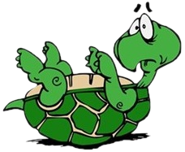
Opponent presentation – team Awkward Turtles Bulgaria
Strong points | Weak points
Well explained theory | Did not said why there is no bubbles on yeast.
Visoalisation on the experiment

