Slide 1
IYNT 2018
Problem №9
BOTTLE TONE
Team
Belarus
Reporter
Kseniya Shymborskaya
Notes:
Good afternoon, dear ladies and gentlemen. My name is Kseniya Shymborskaya, I’m the representative of the Belarusian team and I’m glad to present you our solution for the problem number 9 “Bottle tone”.

Slide 2
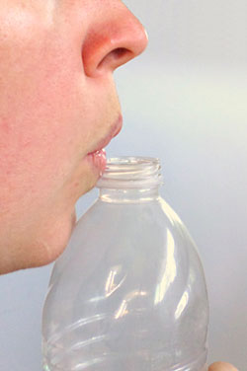
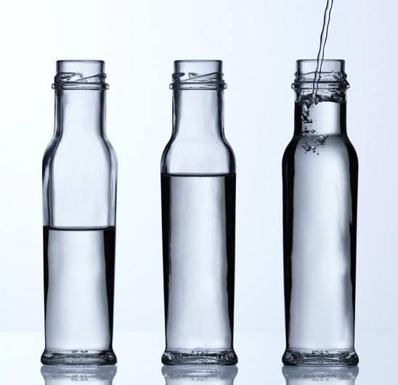
Problem statement
Take an empty bottle and blow air across its mouth to produce a sound. Now fill the bottle with some water and study how the sound changes.
Notes:
Let’s start with the problem statement.
Take an empty bottle and blow air across its mouth to produce a sound. Now fill the bottle with some water and study how the sound changes.

Slide 3
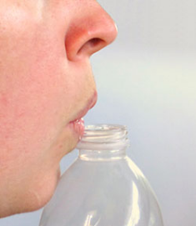
The analysis of the problem
Observations:
the pitch of the note gets higher as we add more water;
the large bottles give a lower note than the small ones.
Notes:
Видос со звуком
Before making any measurements and calculations I decided to make a provisional assessment by ear.
I took a half a liter empty plastic bottle and started to blow air across its mouth to produce a sound (the way I did it you can see on the screen) and remembered that sound. Then I added some water and blowed across the bottle again. The sound became higher. I repeated the actions five more times and found that the pitch of the note gets higher as I add more water. Then I tried different bottles (0.33 liter and 1 liter) and noticed that the large ones give a lower sound that the small ones.

Slide 4
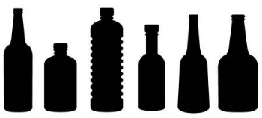
Explanation

Slide 5
OVERPRESSURE
SOUND
Notes:
Let’s try to understand what happens with the bottle when we blow the air. When we blow on the mouth of the bottle we are making a jet of air, if we hold our fingers nearby we can feel it. If we are making a noise this jet of air could either be deflected into the bottle or over the top of it, and it only takes a small force to change between these two paths.
CLICK! If the air starts off going into the bottle, there is nowhere for it to escape so the pressure increases, CLICK! at some point the pressure increases so much that the jet is pushed out of the bottle. CLICK! Now the fast moving air of the jet moves air out of bottle, reducing the pressure inside until it’s low enough to let the jet to get into the bottle again. We have made a vibration.

Slide 6
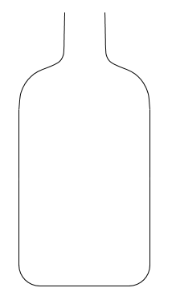
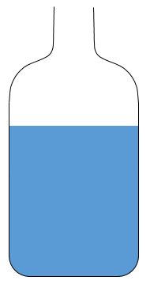
Notes:
CLICK! Pitch is just a measure of how fast the vibration is that reaches your ear, rapid vibrations mean high pitches. In a large bottle there is a lot of space so it takes more air flowing in to build up enough pressure to push the jet out again. Getting more air into the bottle takes a relatively long time so the air vibrates slowly.
CLICK! If we add water or use a smaller bottle there is less space available so it takes less time for the pressure to increase. This means the vibration happens more quickly and so produces a higher pitch.

Slide 7
open end: antinode
vibrating air molecules
closed end: node
Notes:
When we blow air and make vibrations, air oscillates in the bottle. It is known that acoustic wave reflects from the water surface almost entirely (the absorbed part of the wave if negligible).
Therefore acoustic waves are spreading to the water surface, reflect and go back, but as the air jet is continuing getting into ‘reflected’ wave go up and incident wave goes down and both waves almost equal in intensity. Their coherence can be explained by the fact that both of them are earlier and later parts of the same wave.
This interference pattern is called a standing wave.
It should be noted that in this phenomenon not only standing wave is formed; but other waves, except standing, decay very fast because of energy loss. In standing waves there is no energy transport and energy transforms from kinetic energy to potential energy, so wave doesn’t decay.

Slide 8
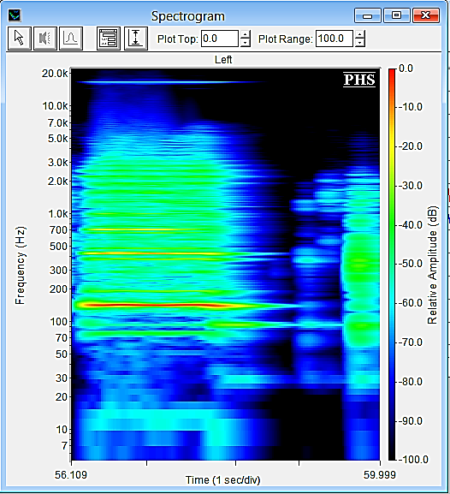
5th harmonic
3rd harmonic
1st harmonic
$$λ/4$$
$${5λ}/4$$
$${3λ}/4$$
Notes:
On this slide you can see spectrogram with pronounced odd harmonics as is the case for bottle, cause the mouth is open end and the bottom is the close end. So during fundamental oscillation CLICK!!! There is one quarter of the wave in the bottle CLICK!!!!! during the first overtone we have three quarters in the bottle CLICK!!!! during the second overtone we have five quarters in the bottle and So on

Slide 9
Parameters
effective volume;
height of the bottle’s mouth;
diameter of the bottle’s mouth;
angle;
shape of the bottle.
$$α$$
$$D$$
$$h$$
$$V_{e}$$
Notes:
Here you can see some parameters on which audio frequency depends on. It’s effective volume; height of the bottle’s mouth; diameter of the bottle’s mouth; angle; length of the air column; shape of the bottle.

Slide 10
Neglects
an absorption of the part of acoustic wave by water;
a change of the speed of the sound because of temperature changes;
length of oscillating air column is mush more than displacement of air column.
Notes:
On this slide you can see our neglects which we will use our theory. First of all we neglect an absorption of the part of acoustic wave by water; because it is less than 1 percent. Then we neglect a change of the speed of the sound because of temperature changes; because it raises only on 0,59 meters per second with increasing temperature on 1 Celsium degree and the last one neglection is length of oscillating air column is mush more than displacement of air column.

Slide 11
Theory
$$\frac{δρ}{ρ_{0}}=−\frac{ξ S}{V_{e}}$$
$${δp=\left(\frac{∂p}{∂ρ}\right)}_{ρ_{0}}δρ$$
$$S$$
$$ξ$$
$$p=p\left(ρ\right)$$
$$(1)$$
$$h$$
$$V_{e}$$
$$0$$
$ρ_{0}$ – density of the undisturbed air;
$δρ$ – air density change;
$ξ≪h$ – displacement of oscillating air column;
$p$ – pressure in the wave;
$δp$ – overpressure.
$$p$$
$$δp$$
$$p_{0}$$
$$\left|δρ\right|≪ρ_{0}$$
$$\left|δp\right|≪p_{0}$$
$$ρ_{0}$$
$$ρ$$
$$δρ$$
Notes:
On this slide you can see some theory. The air in the mouth of the bottle is oscillating mass. If appears displacement, for example, down, to effective volume, then air in this volume is compressed a little. But then appear overpressure forces and they act like restoring forces. Though air density changes on “delta ro”, it satisfies first equation. CLICK!!! Then we need to know constitutive equation of the medium CLICK!!! Qualitative dependence you can see on the graph CLICK!!!!!!! If perturbation of the density is small CLICK!!!!1 overpressure is CLICK!!!!!!!

Slide 12
Theory
$$δp=\frac{−ρ_{0}c^{2}S}{V_{e}}ξ$$
$$m\frac{∂^{2}ξ}{{∂t}^{2}}=δρS$$
$$ρ_{0}Sh\frac{∂^{2 }ξ}{∂t^{2}}=\frac{−ρ_{0}c^{2}S^{2}}{V_{e}}$$
$$\left(2\right)$$
$$ω_{0}=c\sqrt{\frac{S}{V_{e}h}}$$
$$f_{c}=\frac{c}{2π}\sqrt{\frac{S}{V_{e}h}}$$
$$S$$
$$ξ$$
$$h$$
$$ω=2πf$$
$$a_{max}={−ξω}^{2}$$
$$V_{e}$$
$c=\sqrt{{\left(\frac{∂p}{∂ρ}\right)}_{ρ_{0}}}$ – speed of the sound;
$$0$$
$m=ρ_{0}Sh$ – mass of the oscillating air column;
$ω_{0}$ – angular velocity of the air column’s oscillations in the bottle’s mouth;
$f_{c}$ – carrier frequency.
Notes:
we can introduce c CLICK!!!!!!!!!! And using equation number 1 we got it on previous slide We can find overpressure CLICK!!!!!! And according second newtons law we can find equation of motion of the oscillating air column CLICK!!!!!!!!! Using the first and the second formulas we can get this formula CLICK!!!!!!!! And with formula of maximal acceleration CLICK!!!!!!! We can easily calculate angular velocity CLICK!!!!!!!!!!!! And knowing dependency of angular velocity on frequency CLICK!!!!!!!!!!!!! Formula of carrier frequency is found CLICKKK

Slide 13
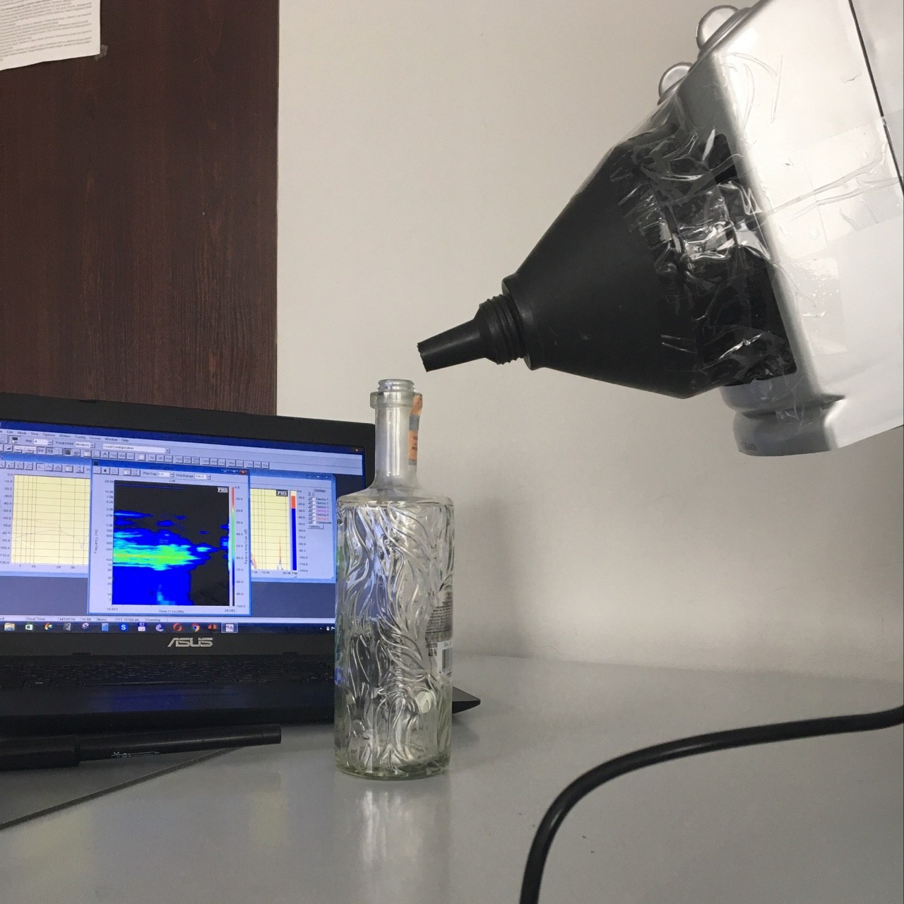
Set up
ventilator
funnel
computer
bottle
microphone with sensor
Notes:
Now let’s take a look on our experimental set up. We took a ventilator to ensure an even jet of the air and attached a funnel to focus this jet. Then we fixed this by tripod. Microphone and sensor we connected to computer.

Slide 14
DEPENDENCE OF AUDIO FREQUENCY ON THE ANGLE
$$α_{min}=7.53°$$
$$α_{max}=78.54°$$
$$α$$
Notes:
Here you can see of audio frequency on the angle. CLICK! As you can see bottle started to resonate only at a certain angles. CLICK! If an angle was larger or smaller than maximal or minimal angle resonance didn’t take place.

Slide 15
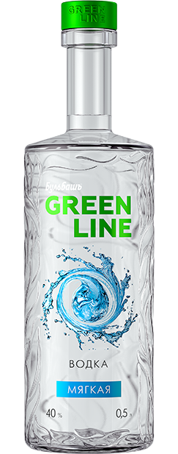
DEPENDENCE OF AUDIO FREQUENCY
ON EFFECTIVE VOLUME
Notes:
Here you can see the dependence of frequency on effective volume. As you can see theory and practice coincide almost completely.

Slide 16
DEPENDENCE OF AUDIO FREQUENCY ON
HEIGHT OF THE BOTTLE’S MOUTH
$D=\left(1.40±0.01\right)$ centimeters
$V_{e}=(615±2)$ millilitres
$$h$$
Notes:
Now let’s plot the dependence of frequency on height of the bottle’s mouth. We changed the height of the mouth by the bushings the same diameter but different height. Diameter of the bushings you can see on the screen.

Slide 17
DEPENDENCE OF AUDIO FREQUENCY ON
DIAMETER OF THE BOTTLE’S MOUTH
$h=\left(6.00±0.01\right)$ centimeters
$V_{e}=(615±2)$ millilitres
$$S=π\frac{D^{2}}{4}$$
$$D$$
$$f_{c}=\frac{c}{2π}\frac{D}{2}\sqrt{\frac{π}{V_{e}h}}$$
Notes:
Now let’s take a look on the dependence of frequency on diameter of the bottle’s mouth. Diameter of the mouth was changed by the bushings the same height but different diameter. The height of the bushings is on the screen. We modified a bit formula of carrier frequency using formula of the square.

Slide 18
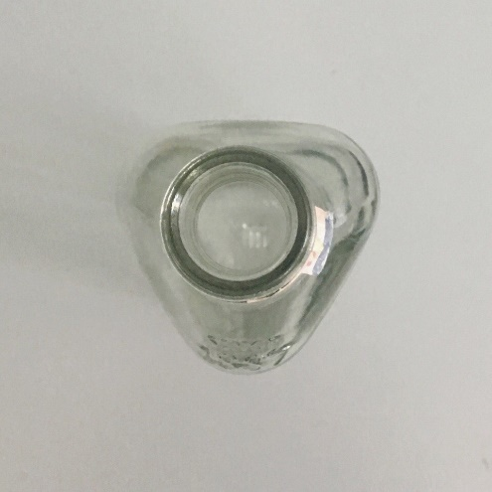
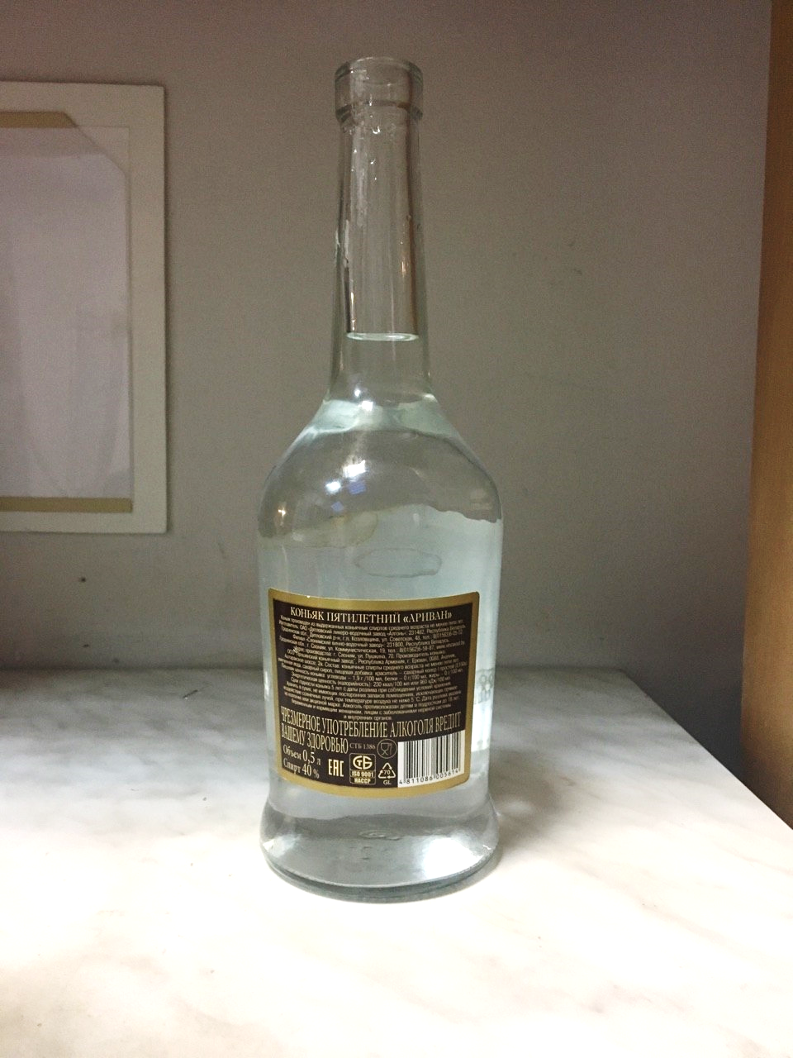
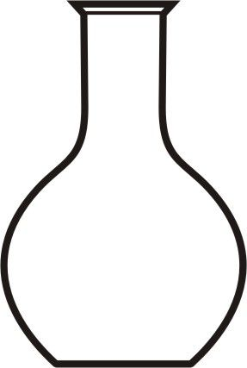
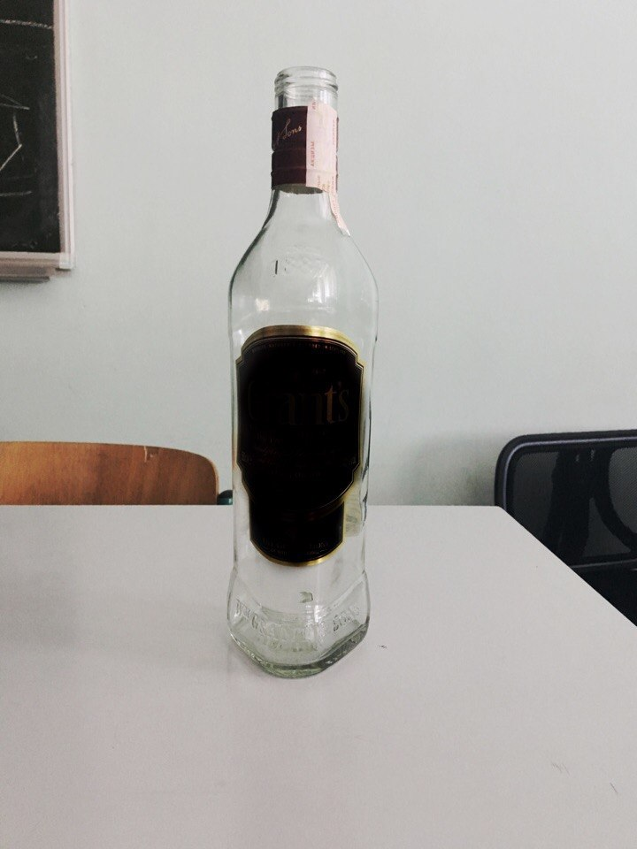
DEPENDENCE OF AUDIO FREQUENCY
ON SHAPE OF THE BOTTLE
Notes:
To investigate dependence of frequency on the shape of the bottle we took different bottles. CLICK!! It was round bottom flask CLICK another imperfect bottle CLICK! And prism bottle. As you can see there is significand divergence between theory and experiment

Slide 19
DEPENDENCE OF AUDIO FREQUENCY ON
VELOCITY OF THE AIR JET
$$θ_{min}=6.7m/s$$
Notes:
We measured speed of the air and noticed, that frequency does not depend on angle CLICK!! But resonance appears only with exact speed CLICK!! If the speed less than it, resonance does not take place CLICK!!

Slide 20
DEPENDENCE OF OSCILLATION AMPLITUDE
ON VELOCITY OF THE AIR JET

Slide 21
Conclusions
$$f_{c}=\frac{c}{2π}\sqrt{\frac{S}{V_{e}h}}$$
Critical values:
angle:
$$α_{min}=7.53°$$
$α_{max}=78.4°$
velocity:
Dependences:
Frequency:
effective volume;
height of the bottle’s mouth;
diameter of the bottle’s mouth;
length of the air column;
shape of the bottle;
angle;
velocity of the jet.
Oscillation amplitude:
velocity of the air jet.
$$θ_{min}=6.7m/s$$

Slide 22
Thank you for your attention

