Slide 1
IYNT 2018
Problem №23
MAGDEBURG HEMISPHERES
Team
Belarus
Reporter
Alexey Boris
Notes:
Good afternoon, dear ladies and gentlemen. My name is Kseniya Shymborskaya, I’m the representative of the Belarusian team and I’m glad to present you our solution for the problem number 9 “Bottle tone”.

Slide 2
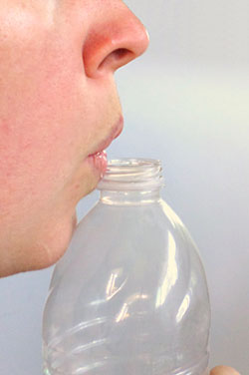
Problem statement
Prove the existence of atmospheric pressure using various beakers, a piece of paper, and other equipment of your choice. Is it possible to estimate the value of the atmospheric pressure?
Notes:
Let’s start with the problem statement.
Take an empty bottle and blow air across its mouth to produce a sound. Now fill the bottle with some water and study how the sound changes.

Slide 3
Theory
Pressure is the force applied perpendicular to the surface of an object per unit area over which that force is distributed. The atmospheric pressure is caused by the gas molecules colliding with the surface.
In our presentation we also used Boyle’s law to prove our calculations.
Notes:
Let’s start with the problem statement.
Take an empty bottle and blow air across its mouth to produce a sound. Now fill the bottle with some water and study how the sound changes.

Slide 4
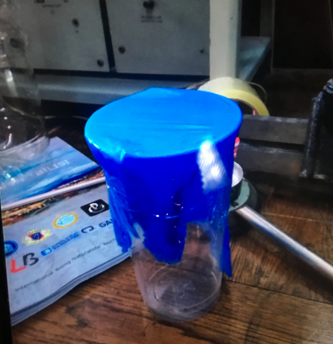
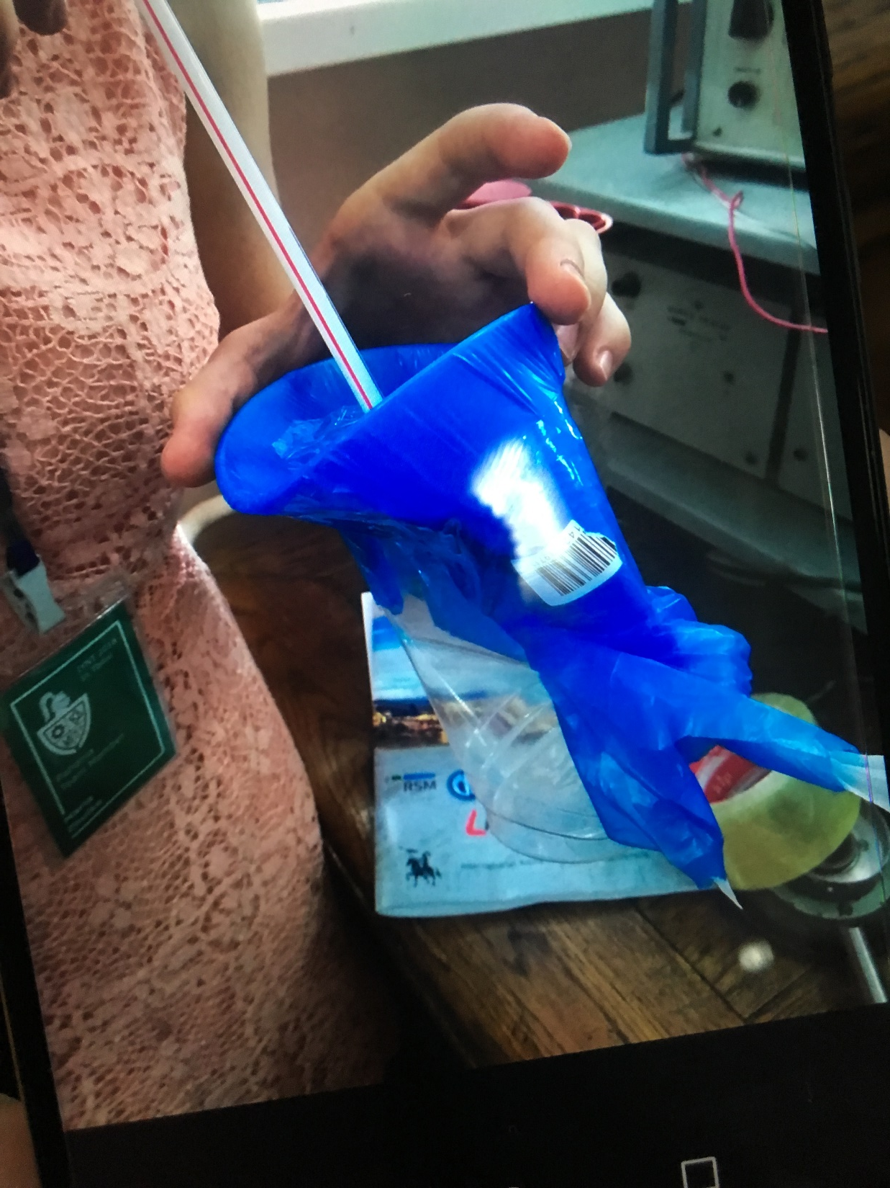
Set up №1

Slide 5
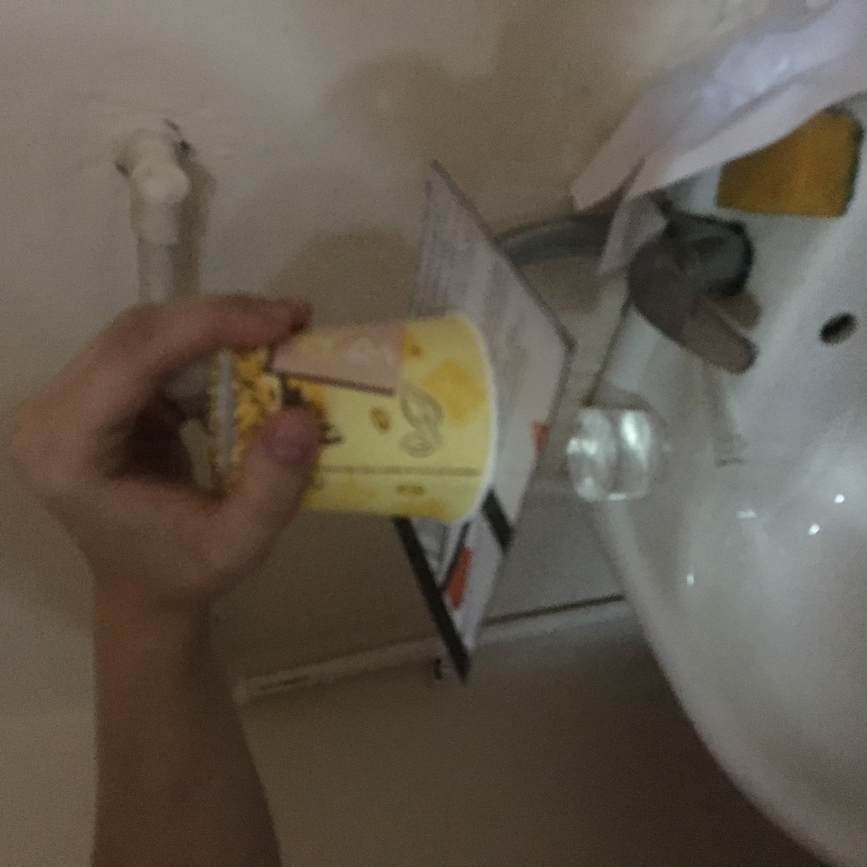
Set up №2
Water can’t drain if the glass is full.

Slide 6
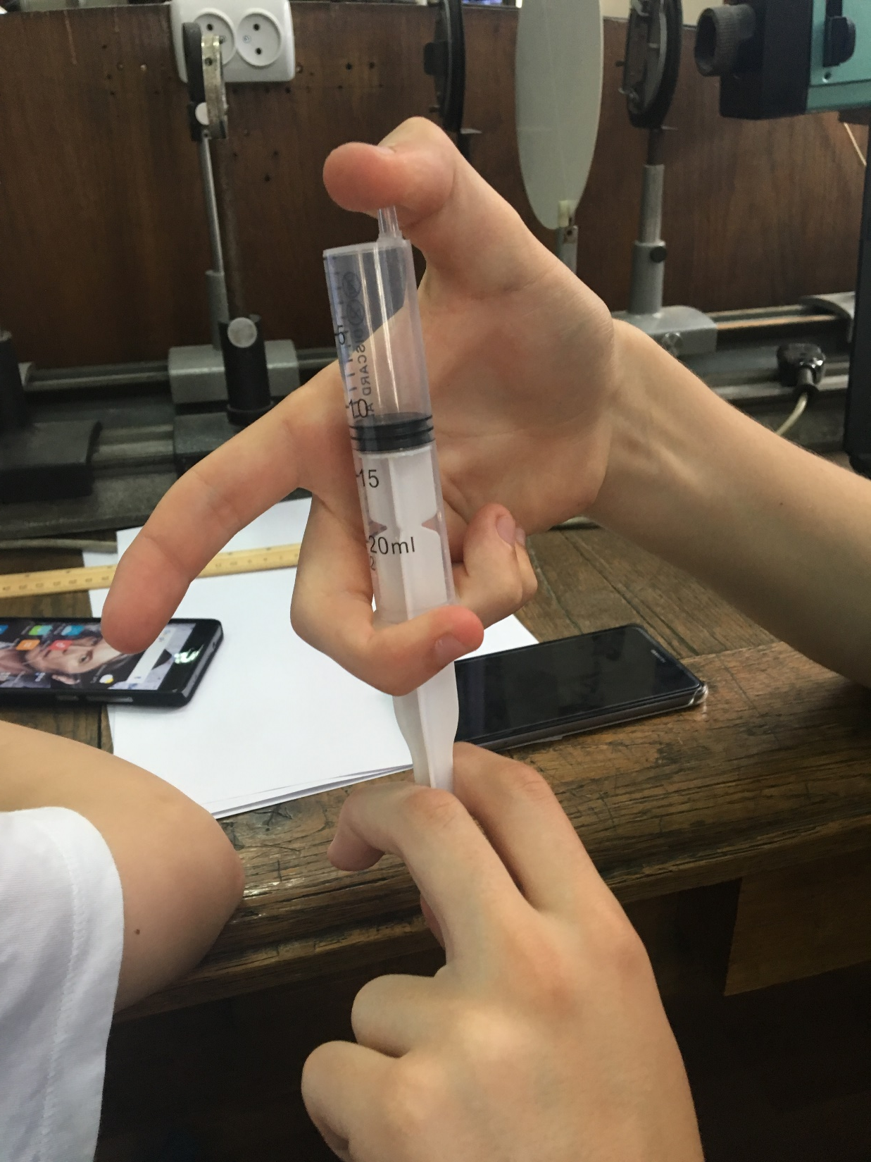
Set up №3
You can hear sound when releasing the finger.

Slide 7
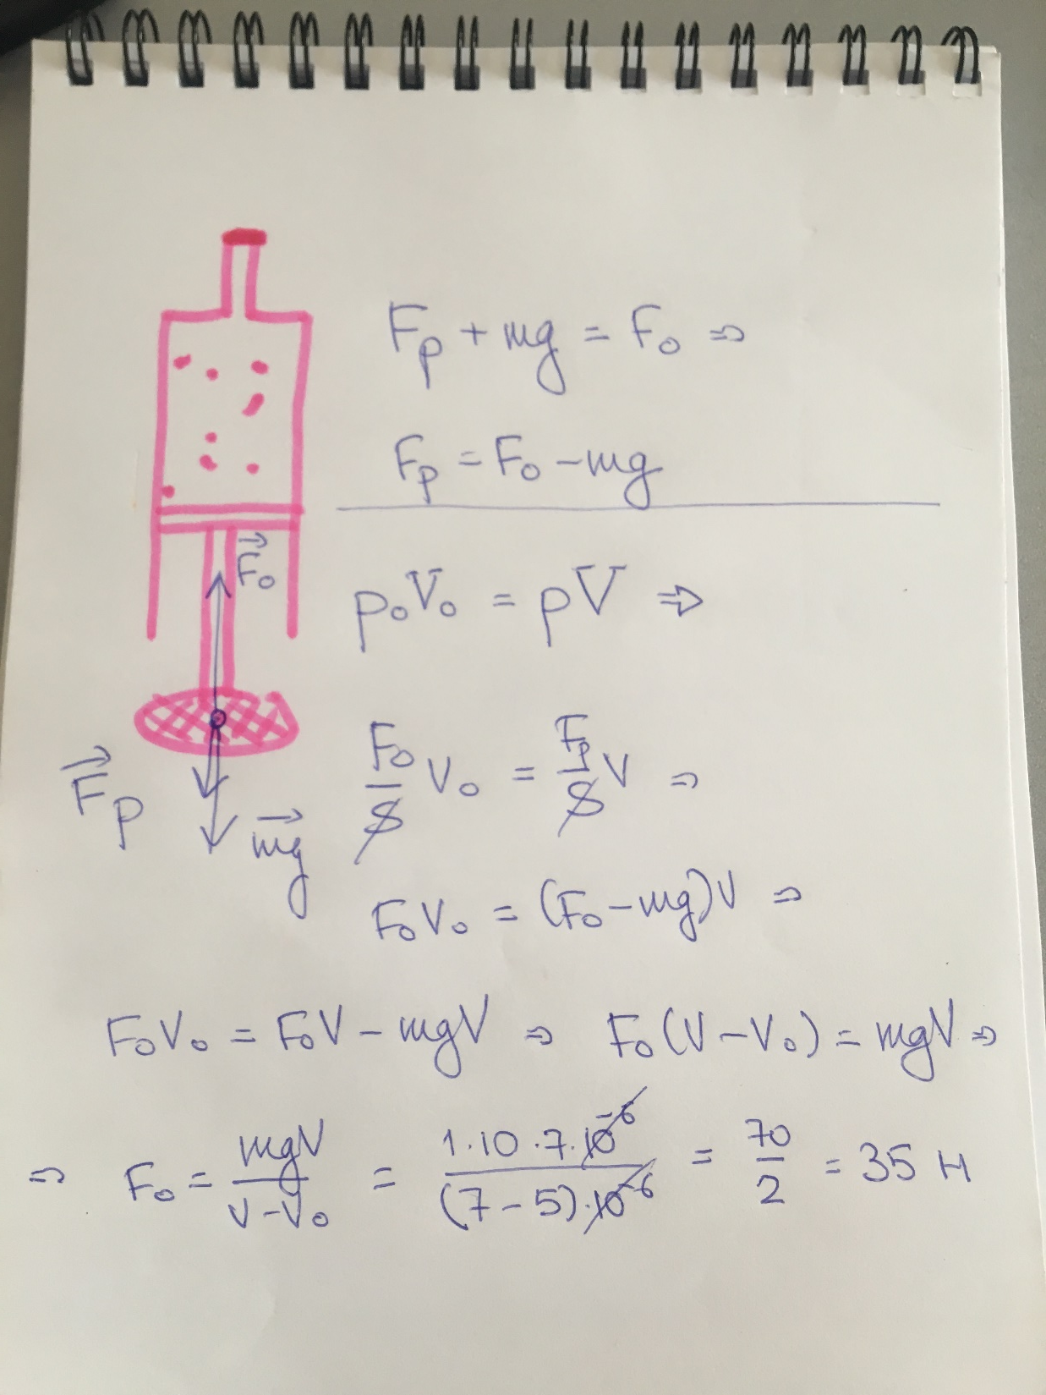
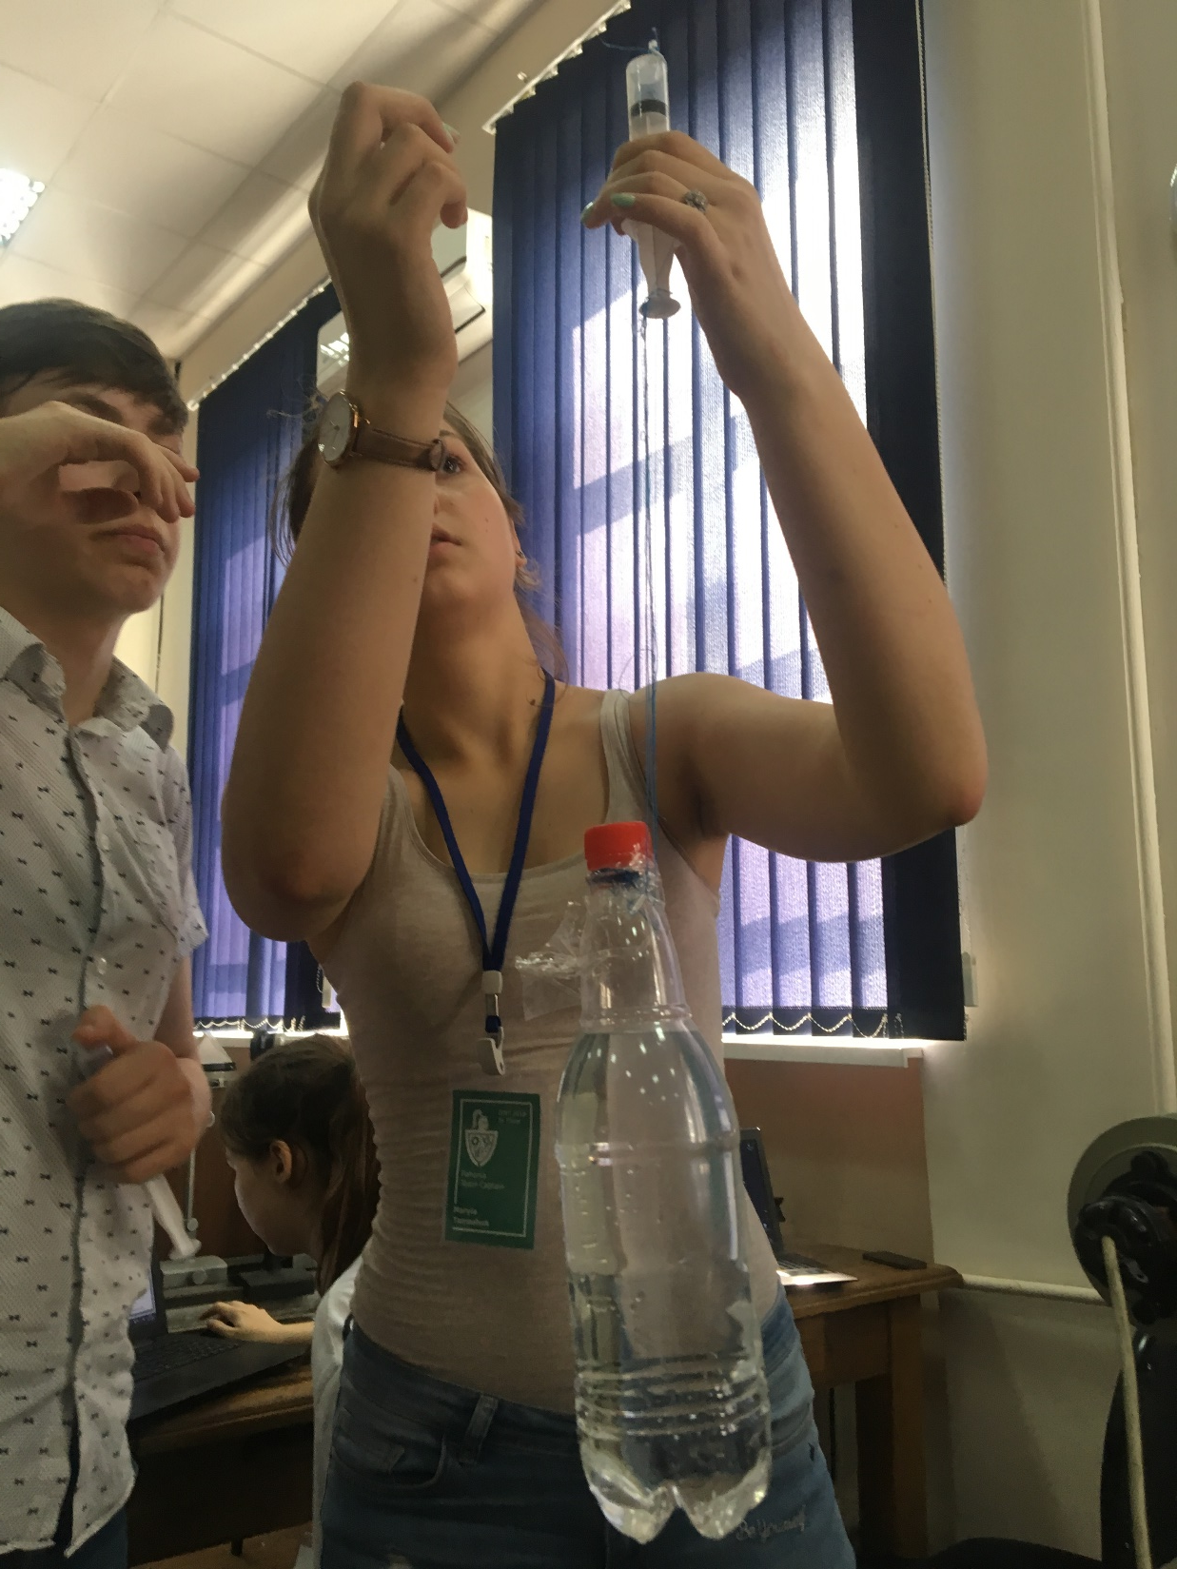
Set up №4

Slide 8
Set up №4
IYNT 2018
$$ε=10\%$$

Slide 9
Conclusions
We can prove existence of the atmosphere with several methods (we used four set ups)
We can measure the air pressure.

Slide 10
Thank you for your attention

