Slide 1
The problem № 4
Making quark
Reporter: Tomashuk Marya
Team of Belarus

Slide 2
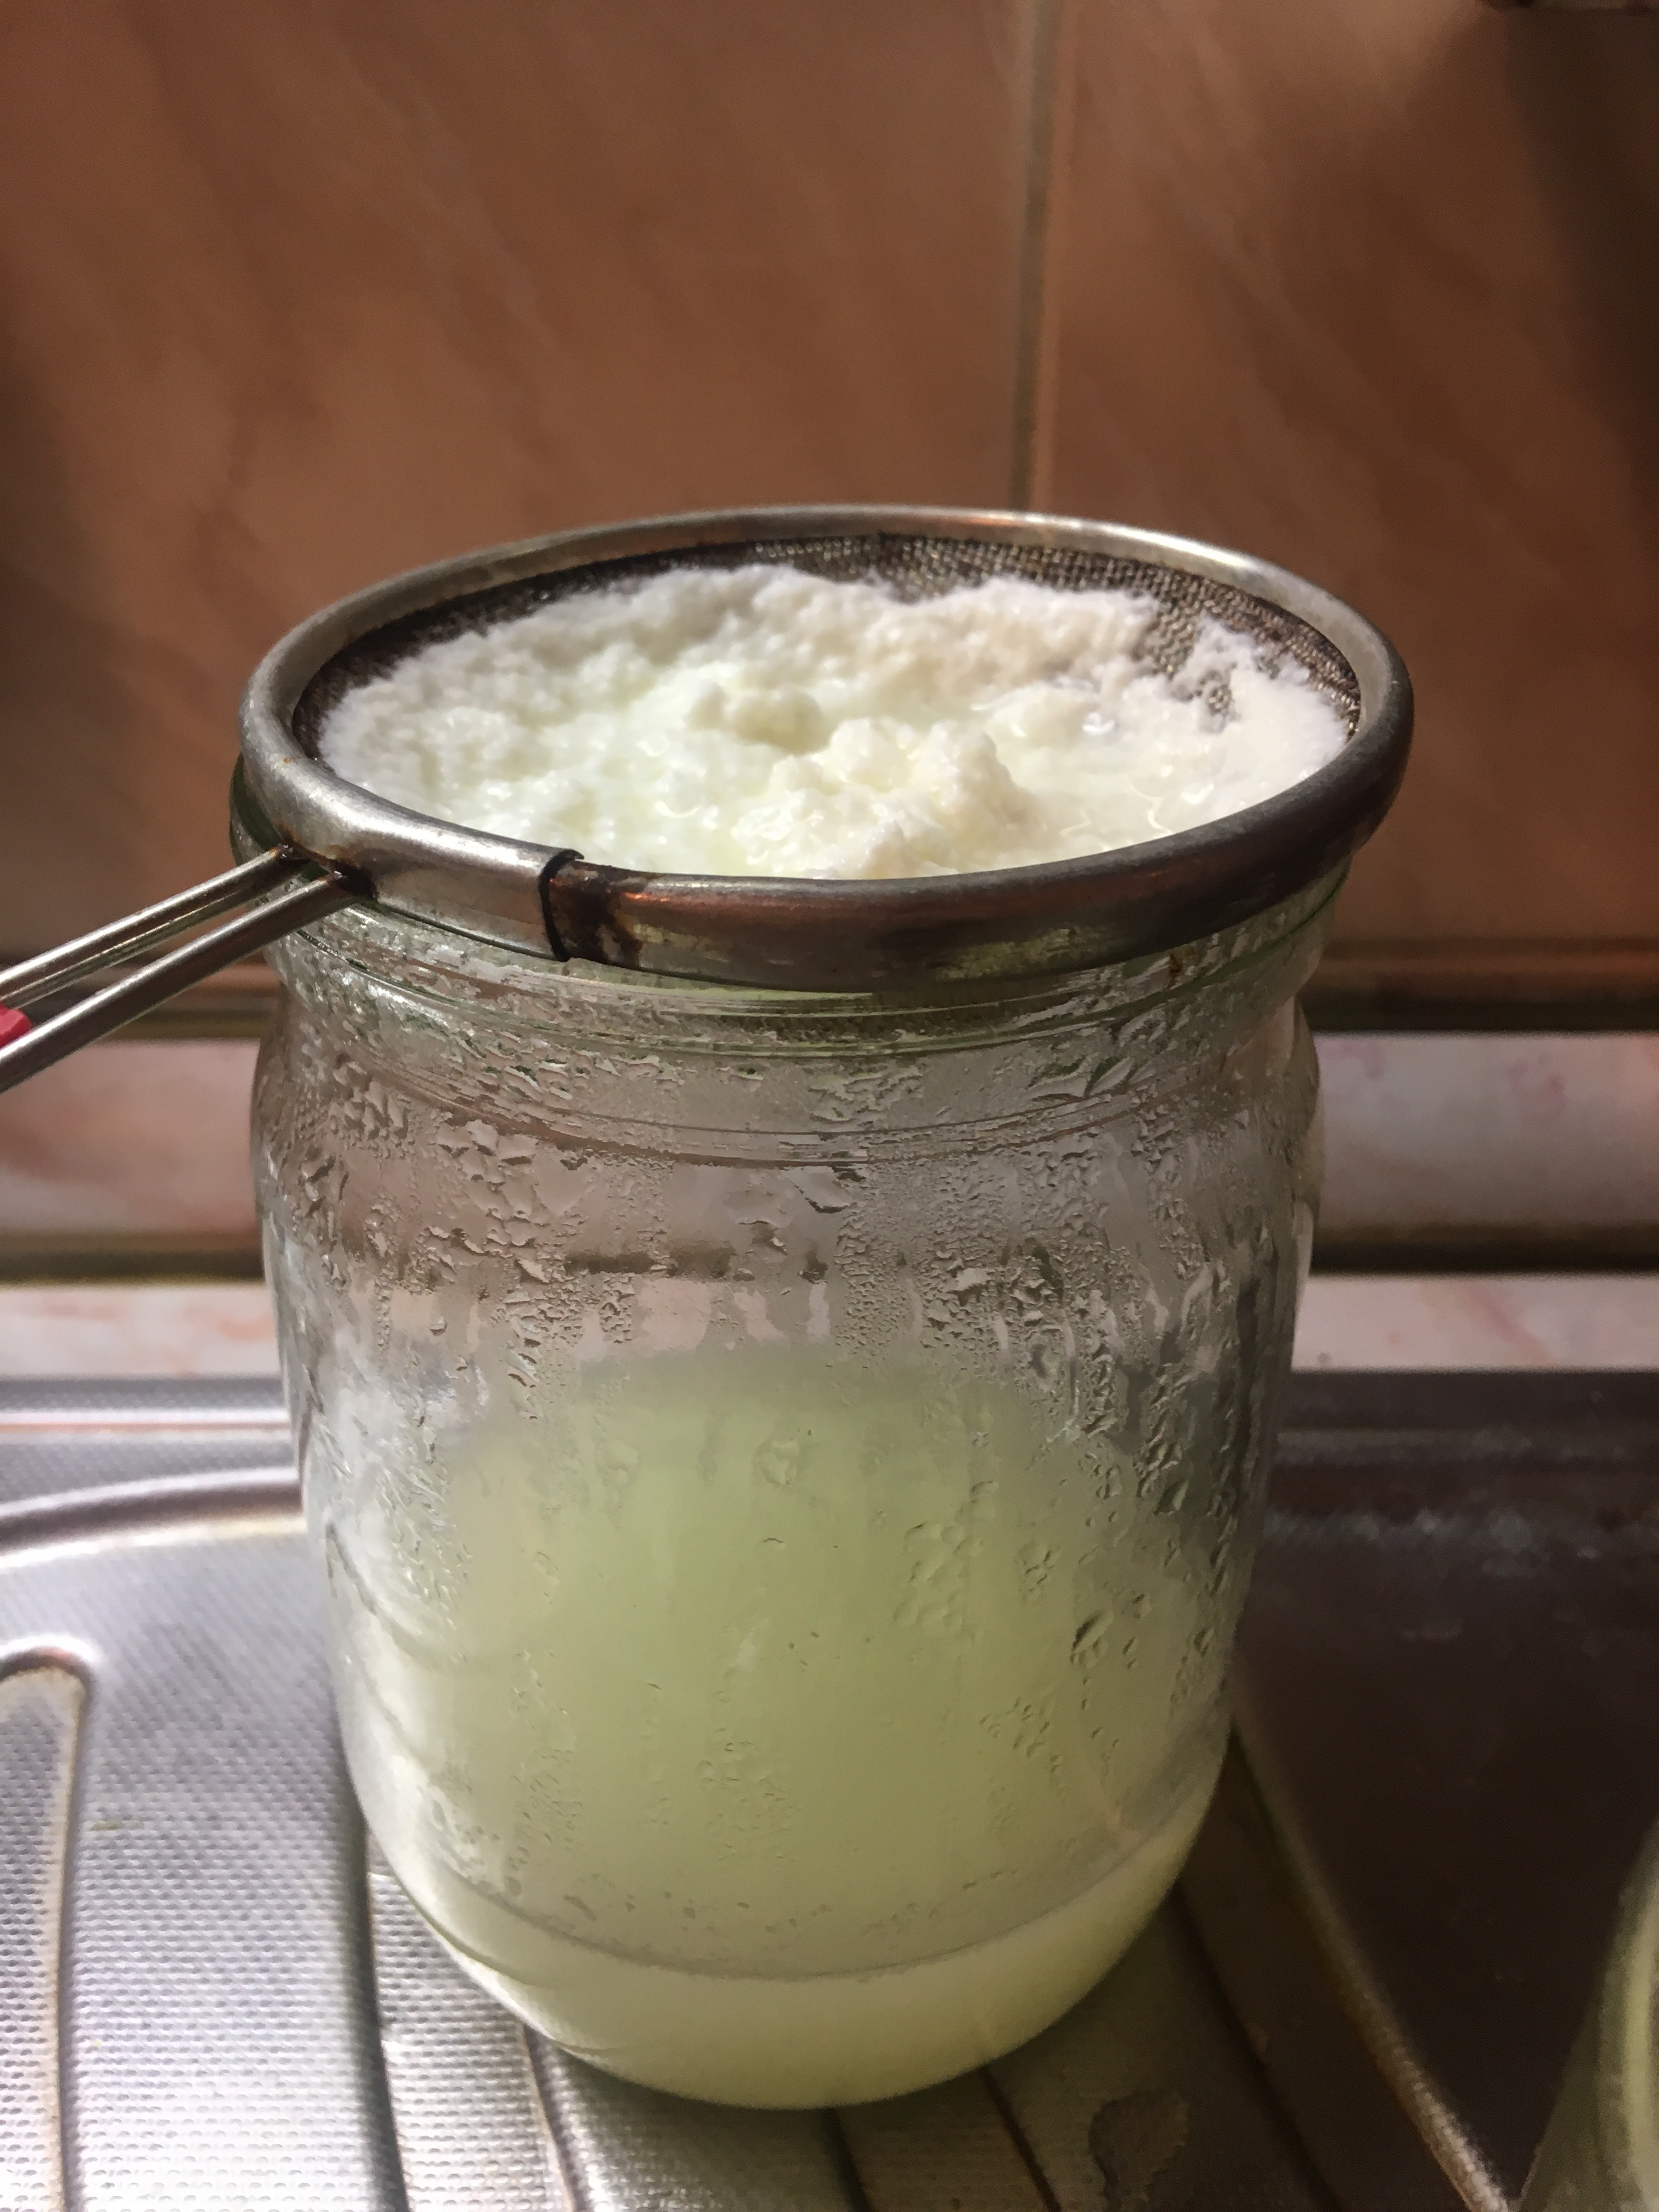
Statement:
Quark, cottage cheese, and similar varieties of white acid-set cheese can be produced from milk. Investigate this process experimentally and study the properties of the resulting product.

Slide 3
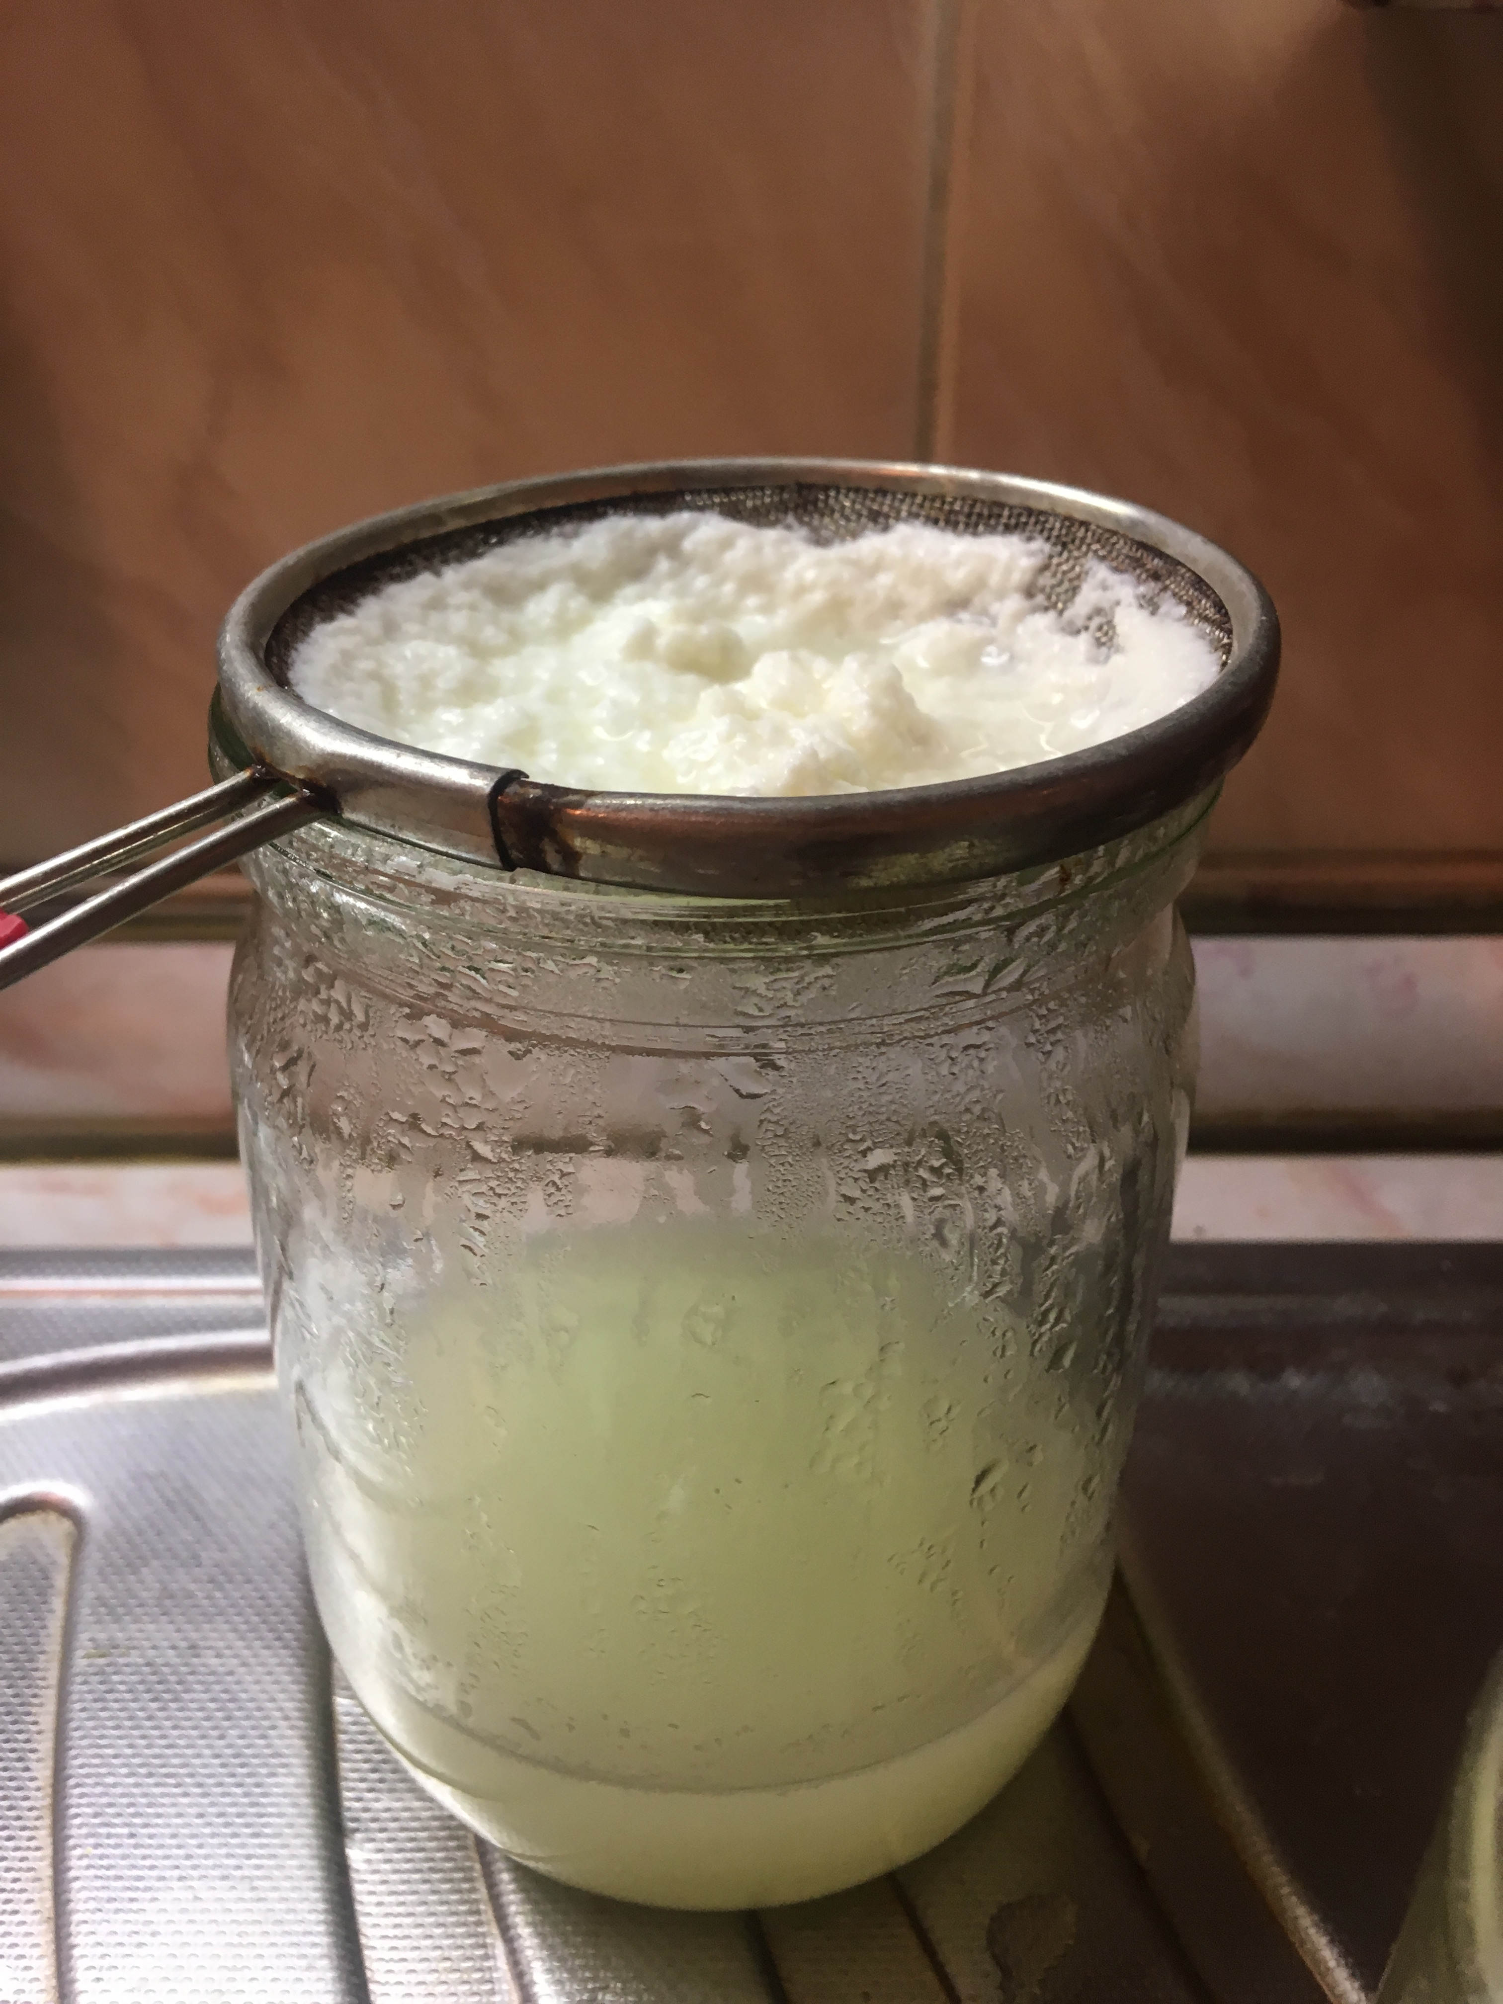
Experimental setup:
Acid
Milk
Notes:
On that slide you can see all types of cooking the cottage cheese: milk heating, adding of acids and filtrating of whey

Slide 4
Result
Quark
Milk
Whey
Notes:
Because of a weak body it is easier to study milk and whey instead of the cottage cheese separately.

Slide 5
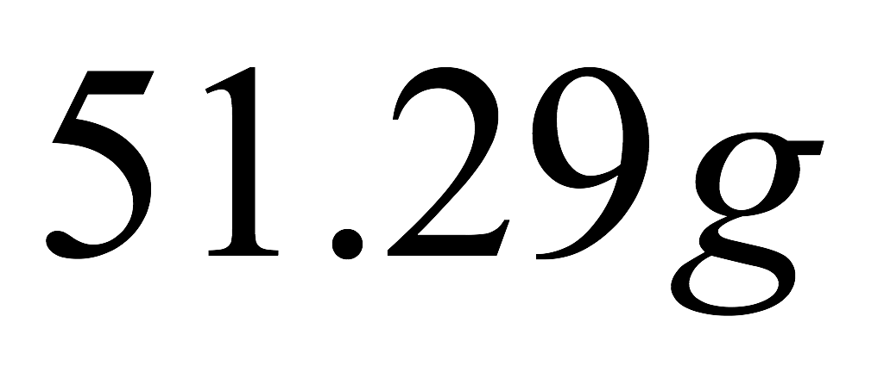
Cottage cheese from 200 ml of milk
From home milk
From shop milk
About 26% more

Slide 6
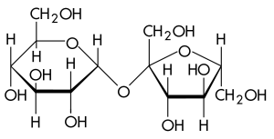
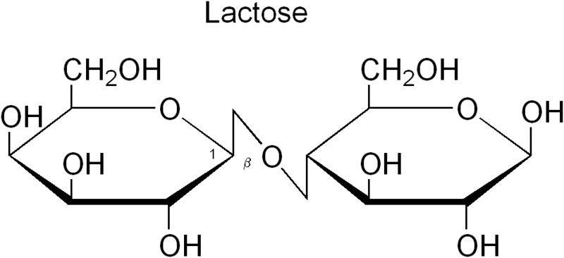
Milk consist of
Ca
Calcium
Protein
Carbohydrates
Other substance
Notes:
First of all I need to say what I’m going to study. Milk contains calcium, protein, carbohydrates and other substances. So hear you can see theirs formulas.

Slide 7
Reactions with HNO₃
Proteins
Carbohydrates
Denature
Will be oxidized to acids
Settling
Notes:
So first of all, if we speak about studding of milk, we need to denature acids to have a possibility of making reaction with protein and carbohydrates separately. I’m going to add HNO3 to milk- we will se a protein settling. Carbohydrates will be oxidized to acids.

Slide 8
Carbohydrates + HNO₃
+
+

Slide 9
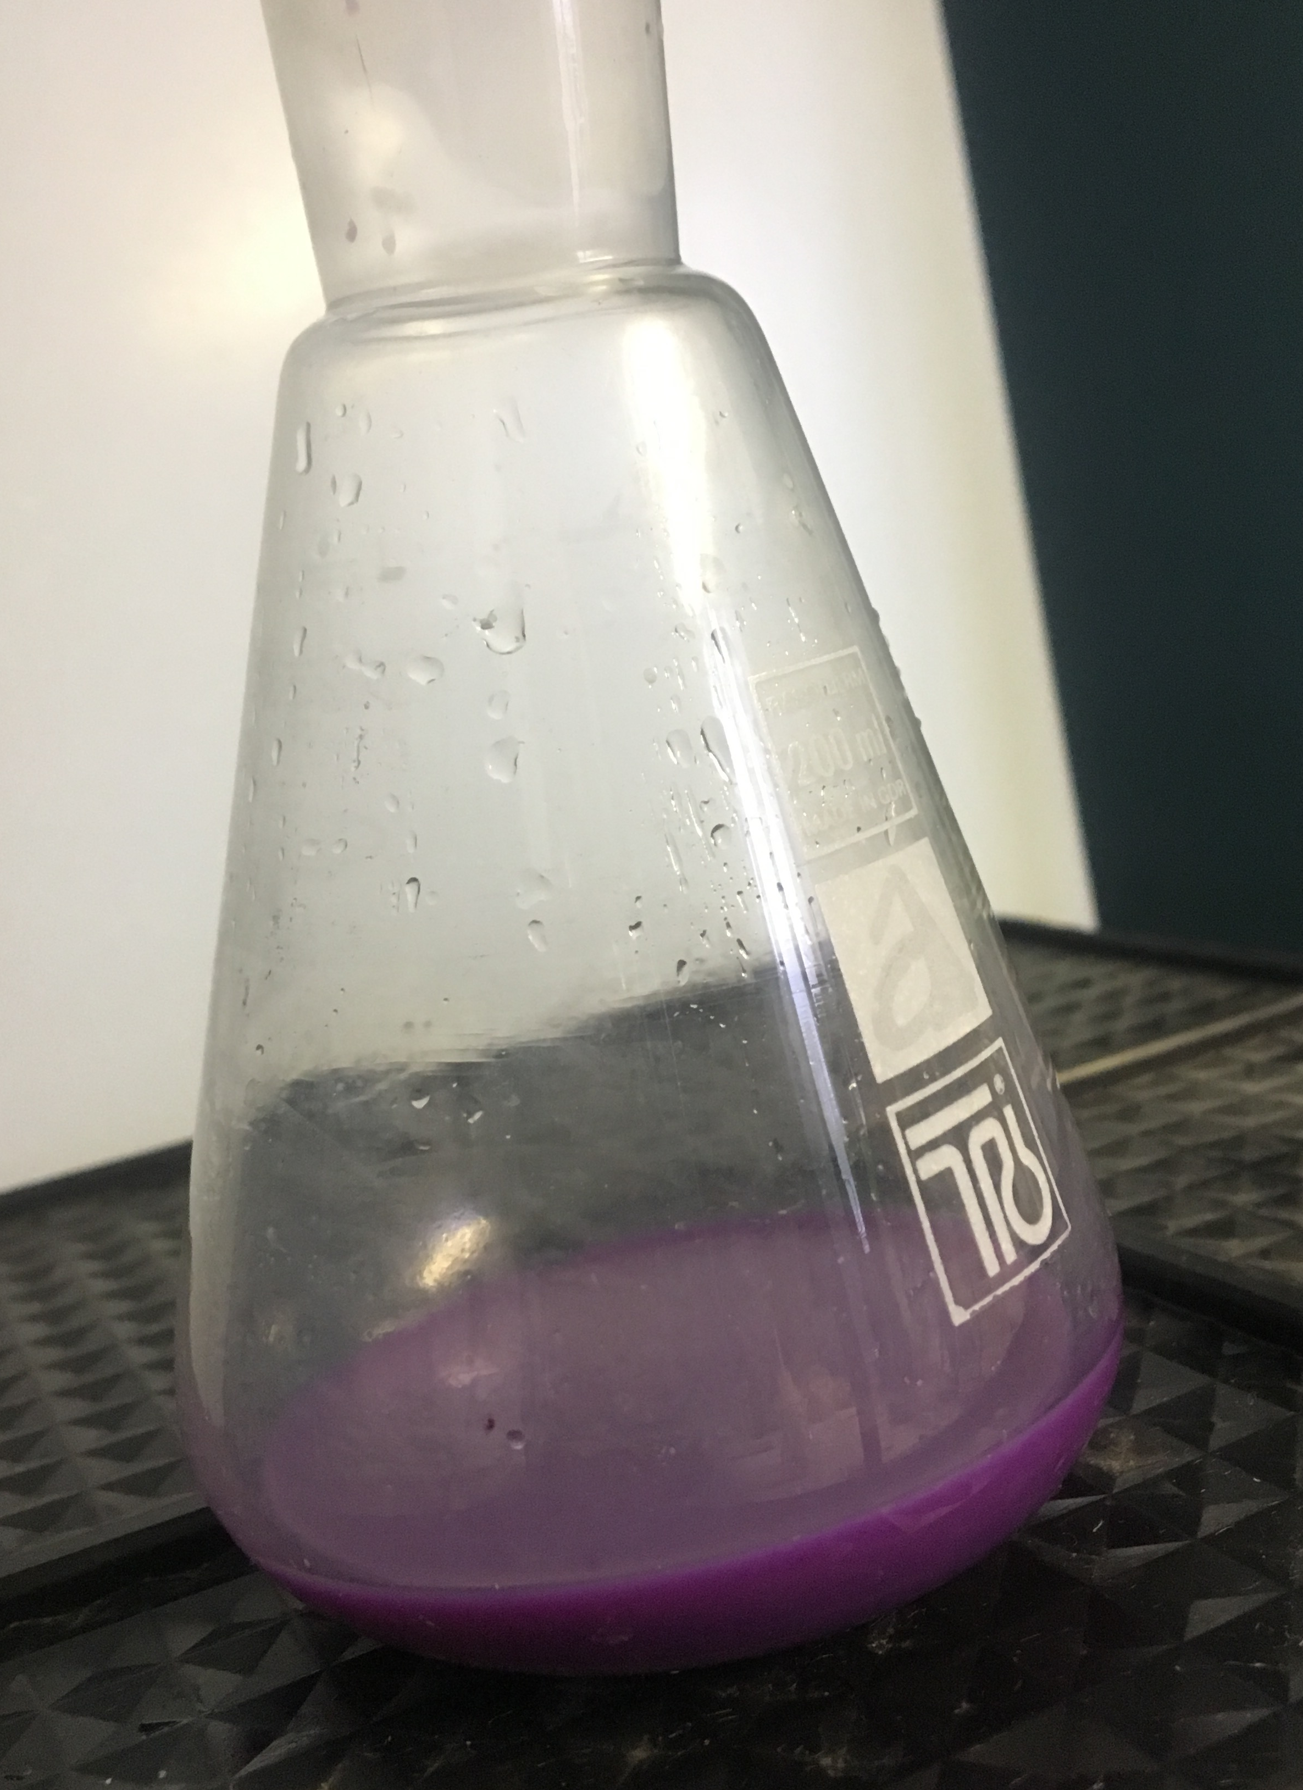
Titration
Whey
Milk
Notes:
If we talk about proteins first of all it is better to «open» the molecule by Formalinum to have a better yield of reaction. After that we can titrate the solution by sodium hydgrocside with bromine phenol red.
if we want to know how many carbohydrates is in a cottage cheese we need to subtract the amount of carbohydrates in milk and carbohydrates in whey.

Slide 10
Electrophorese
*
H-homemade
S-shop one
W-whey
M-milk
HM HW SM SW HW HM SM SW
Notes:
CAN SEE AN EXISTANCE OF PROTEIN it is based on different speeds of moleculas in depends of the size of that molecules. Heavy/light. We can see the separation of substances. Restitution(в-ние)

Slide 11
Shop milk VS Home milk
Milk
Whey
Proteins
Carbohydrates
protein
carbohydrates
carbohydrates
protein
Notes:
Much more fully with substances

Slide 12
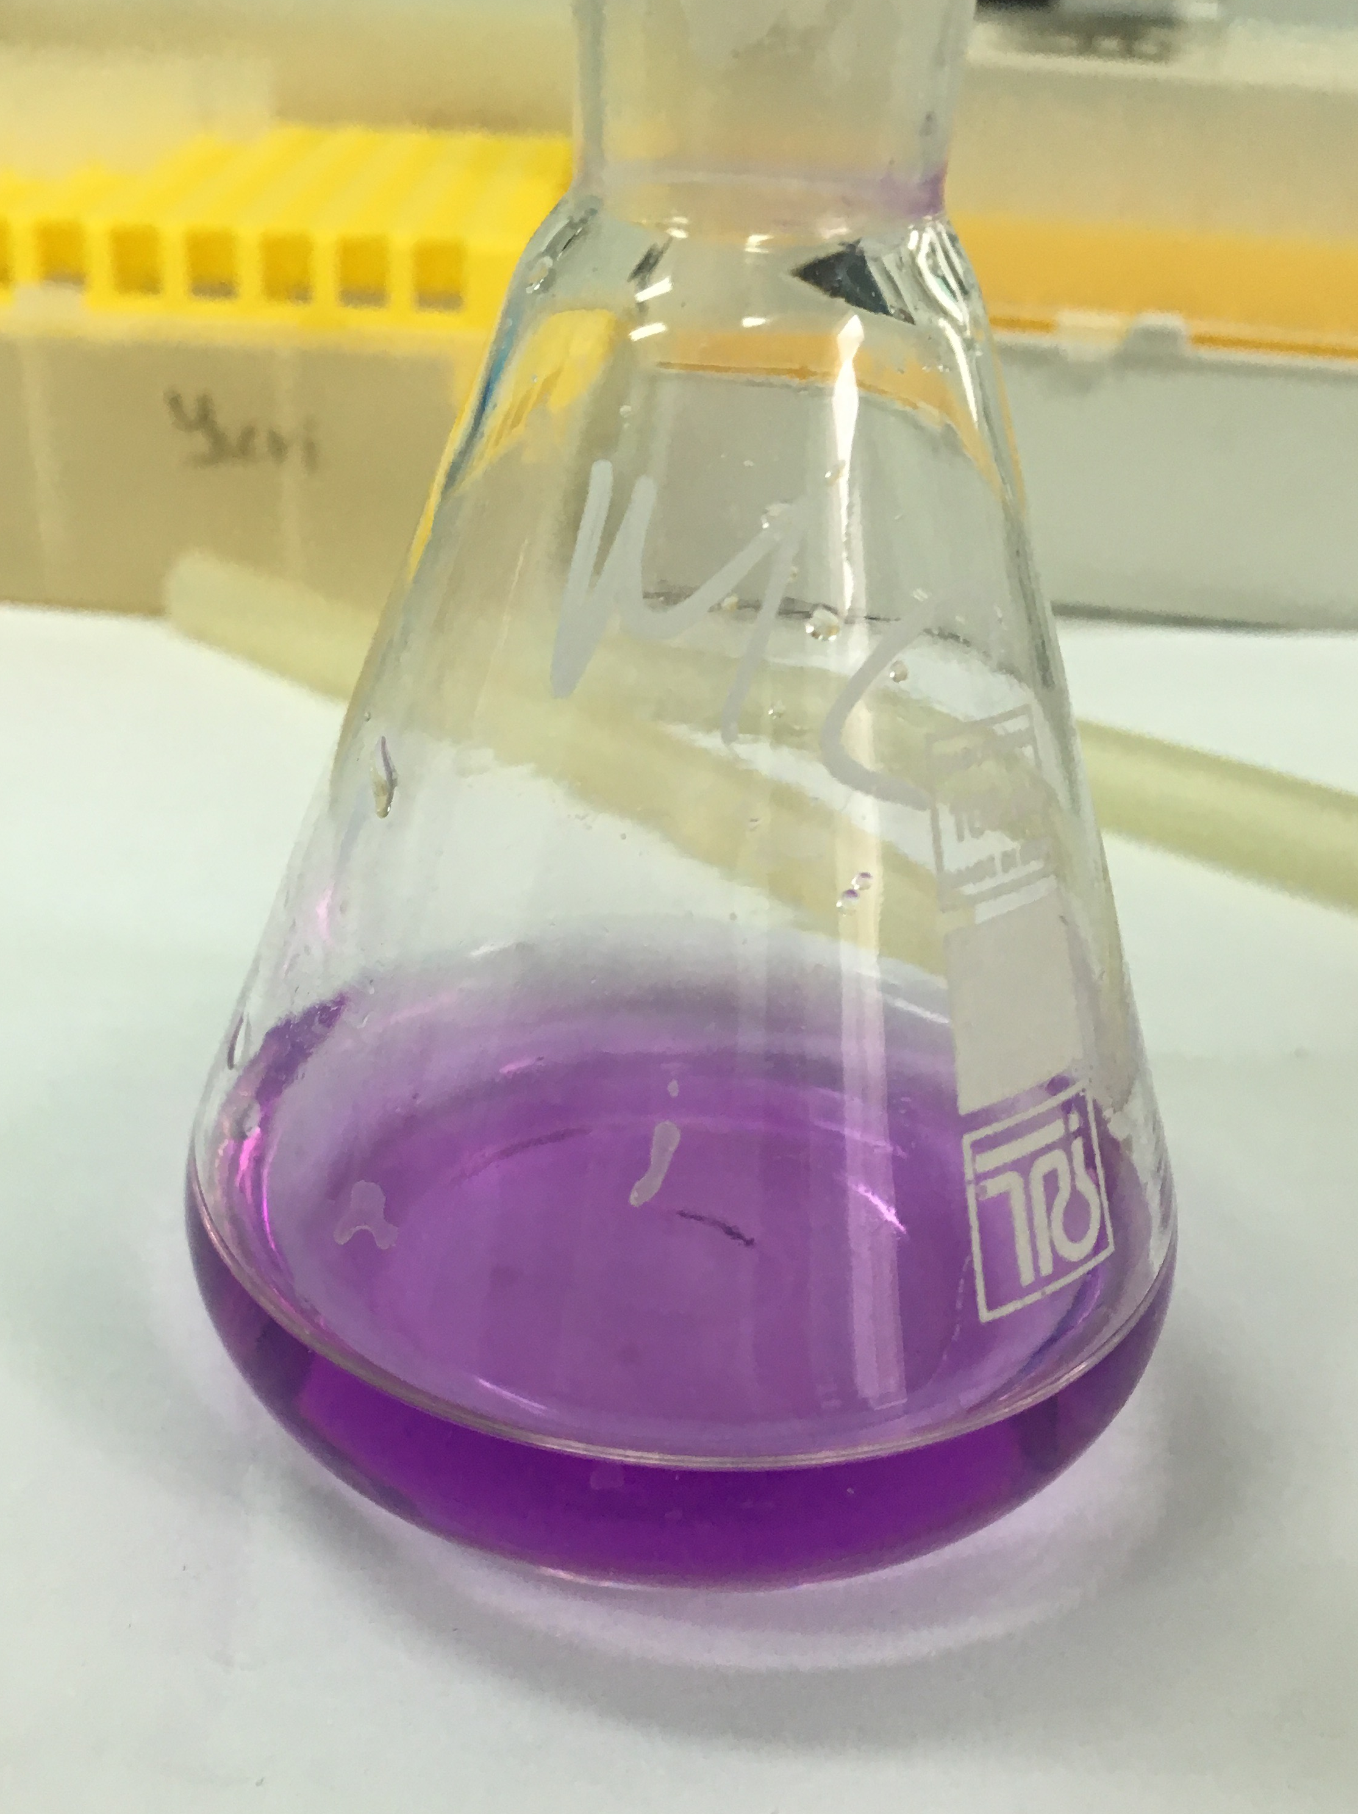
Calcium
Whey
Milk
Notes:
Not special method is a method of calculating of amount of calcium in milk. I made that with the help of special indicator Murecsid and calcium chloride. кальция (рН 10,8-13,2)
Murecside. Titrated by comlexon 3

Slide 13
Calcium(mg) in 100 ml

Slide 14
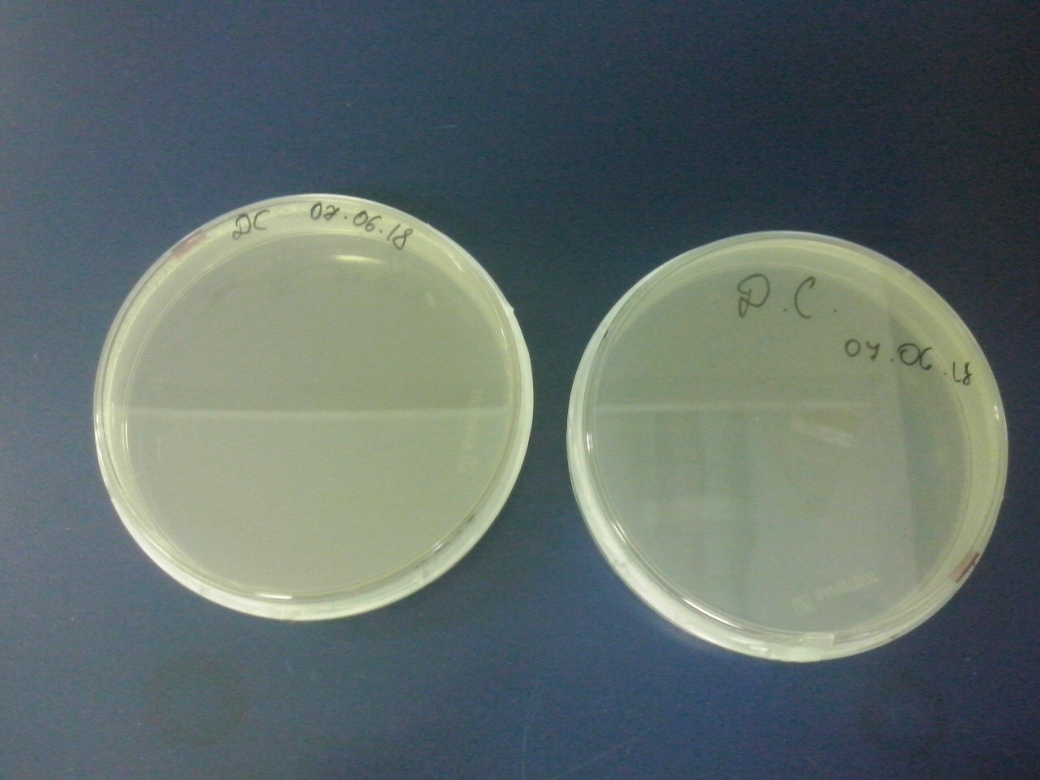
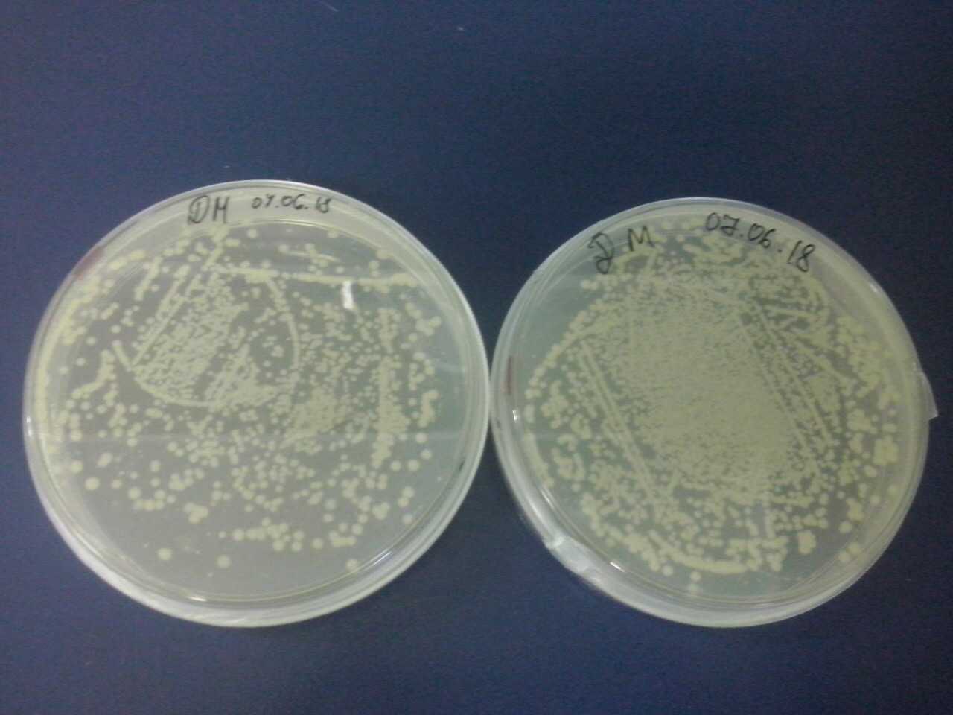
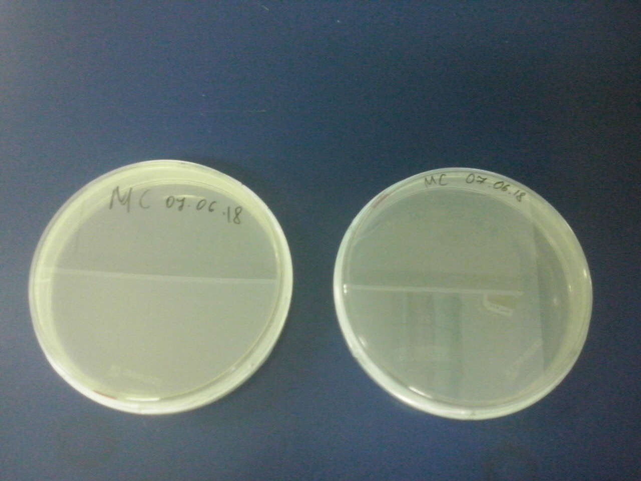
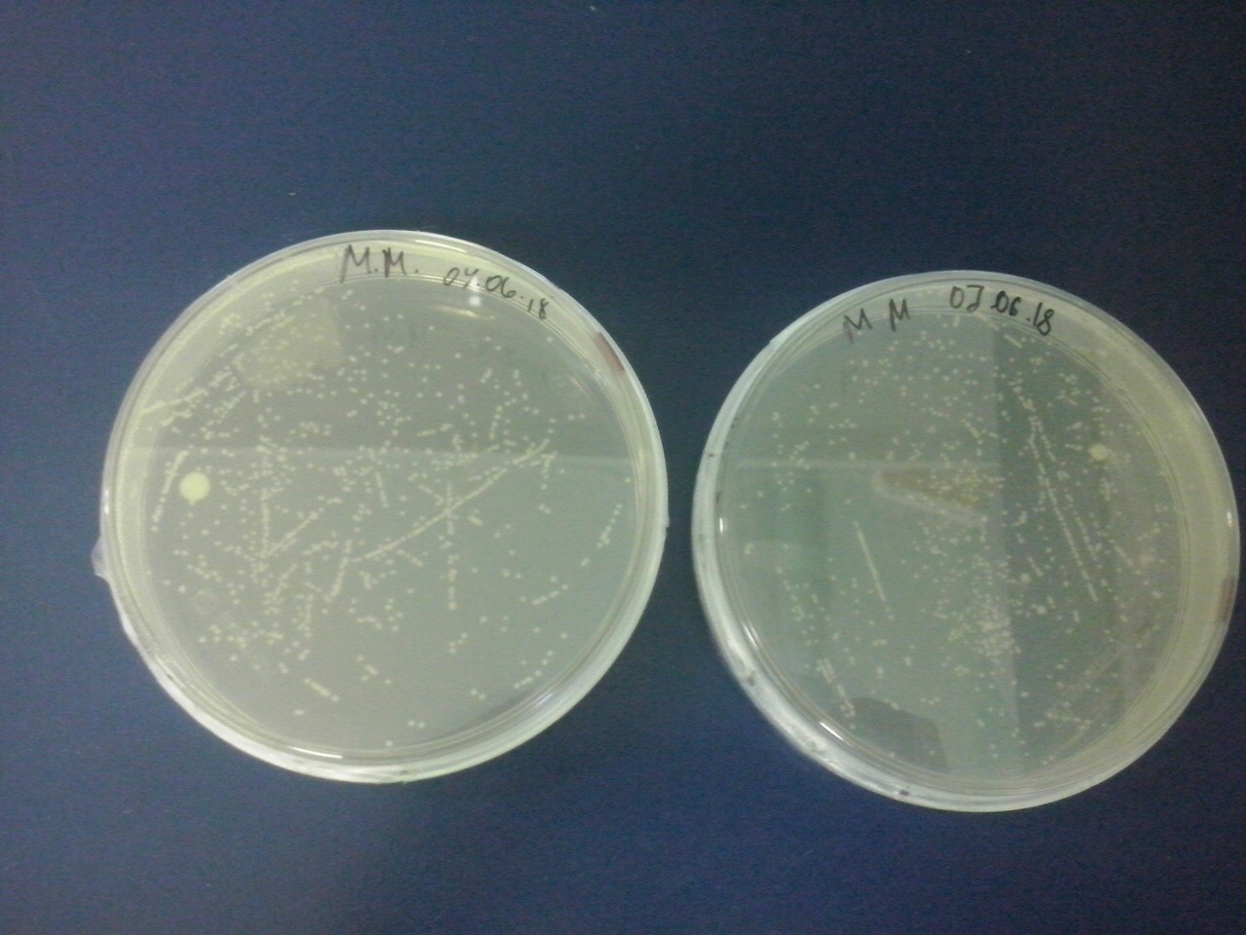
Lactobacteriase
*
H-homemade
S-shop one
W-whey
M-milk
HW
HM
SW
SM
Notes:
Into lurea-barteni medium. Dilute-разбавить

Slide 15
Lactobacteriase
H-homemade
S-shop one
W-whey
M-milk
Notes:
Because of the thermoprocessing

Slide 16
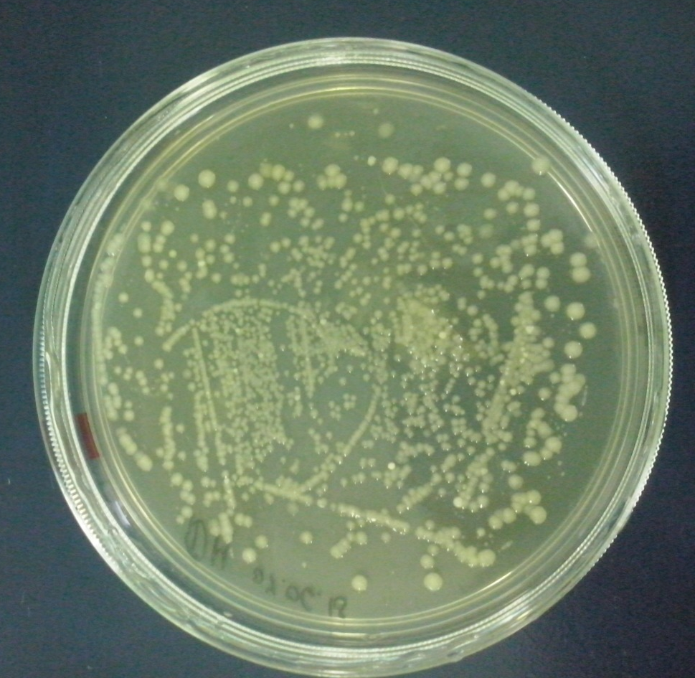
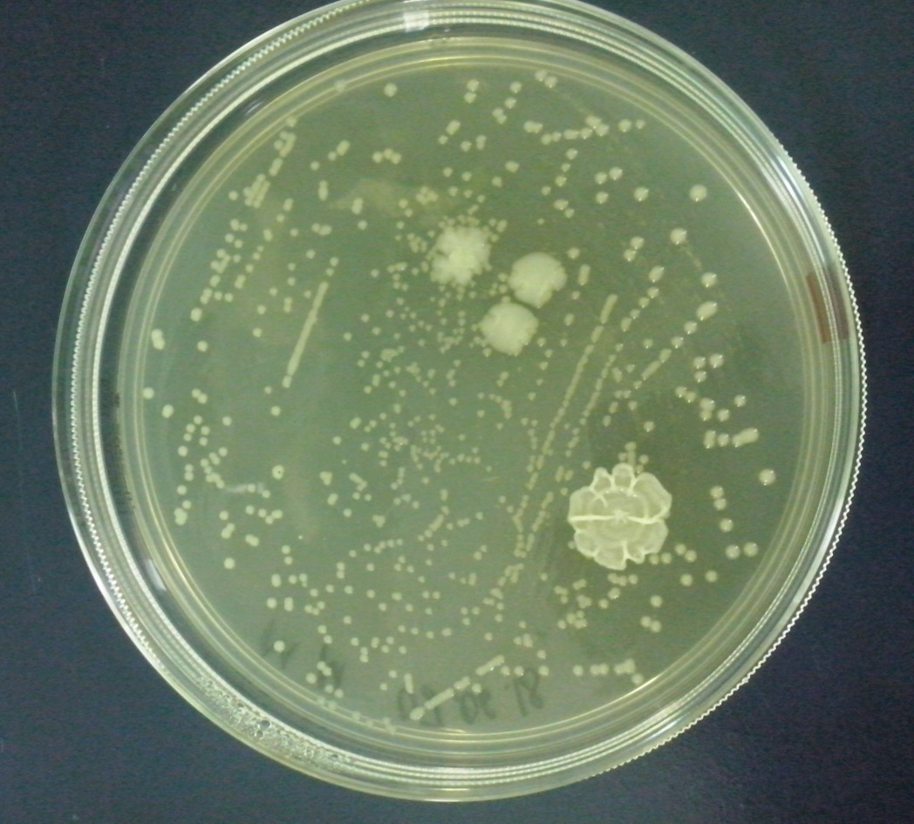
Homemade milk
Shop milk
Notes:
AFTER 3 weeks after removing milk into lurea-barteni medium we can see colonnias of bacillum in the sm. It means that people on a factore added to the milk difrent substanses.

Slide 17
Conclusion
Home milk is better to making cottage cheese:
Differences:
More protein
More calcium
Doesn’t have amylum
More lactobacterias
No antibiotics
Bacillus sp in shop milk
Different amount of bacterias

Slide 18
Thank you for your attention

Slide 19
Notes:
Divide- разделить
Sector
Colonies

