Slide 1
7.worms
Team of Belarus Reporter: Bondarik Elizaveta
1
Notes:
Good afternoon, dear participants and the jury of the tournament.

Slide 2
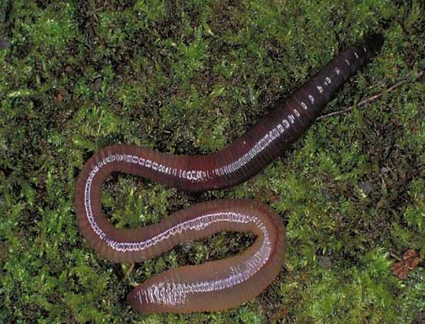
7.Worms
Earthworms change the mechanical properties of soil and make the soil more porous. Investigate this process and introduce quantitative parameters.
2

Slide 3
Soil
H₂O
Air
3
Notes:
Earthworms populations make the tunnels as they move. That encourages the passage of air and water to the plant roots and this increases the plant growth and affects the fertility of soil favorably

Slide 4
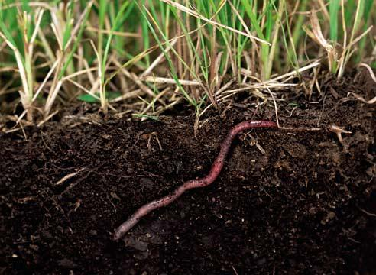
Earthworms populations improve properties of the soil
Physical:
Chemical:
Increase its
porosity
aeration
mineral substances penetration
the amount of humus increases
the acidity of the soil decreases
4

Slide 5
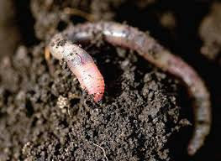
Our research is aimed at not only confirming the scientific fact that earthworms change the mechanical properties of the soil and make it more porous, but also investigate this process and measure the quantitative parameters
We decided to confirm the fact that the activity of earthworms affects favorably the fertility of the soil, and also to track changes in its properties: porosity and acidity.
5

Slide 6
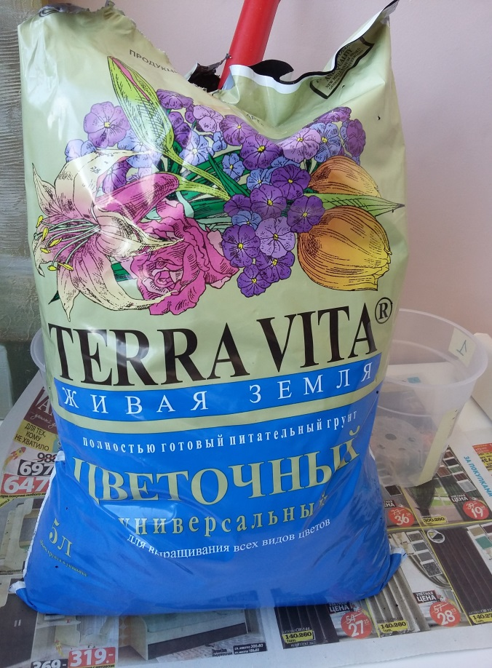
6
Notes:
For conducting a research, earthworms and forest soil were dug out, pea seeds and special soil for growing plants were bought in the store.

Slide 7
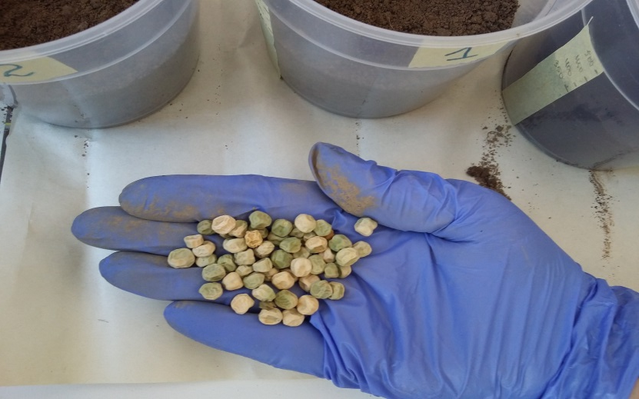
7
Notes:
Transparent measuring pots were prepared. Each pot was filled with 340 ml of soil and three pea seeds were planted into each pot.

Slide 8
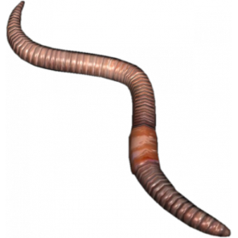
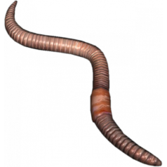
Object 3: Four earthworms in specially prepared soil for growing plants.
Object 1: Four earthworms in forest soil.
Object 4: Specially prepared soil without worms.
Object 2: Forest soil without worms.
8
Notes:
The objects of the study were divided into four groups. Pea seeds were planted into each pot. Watered.

Slide 9
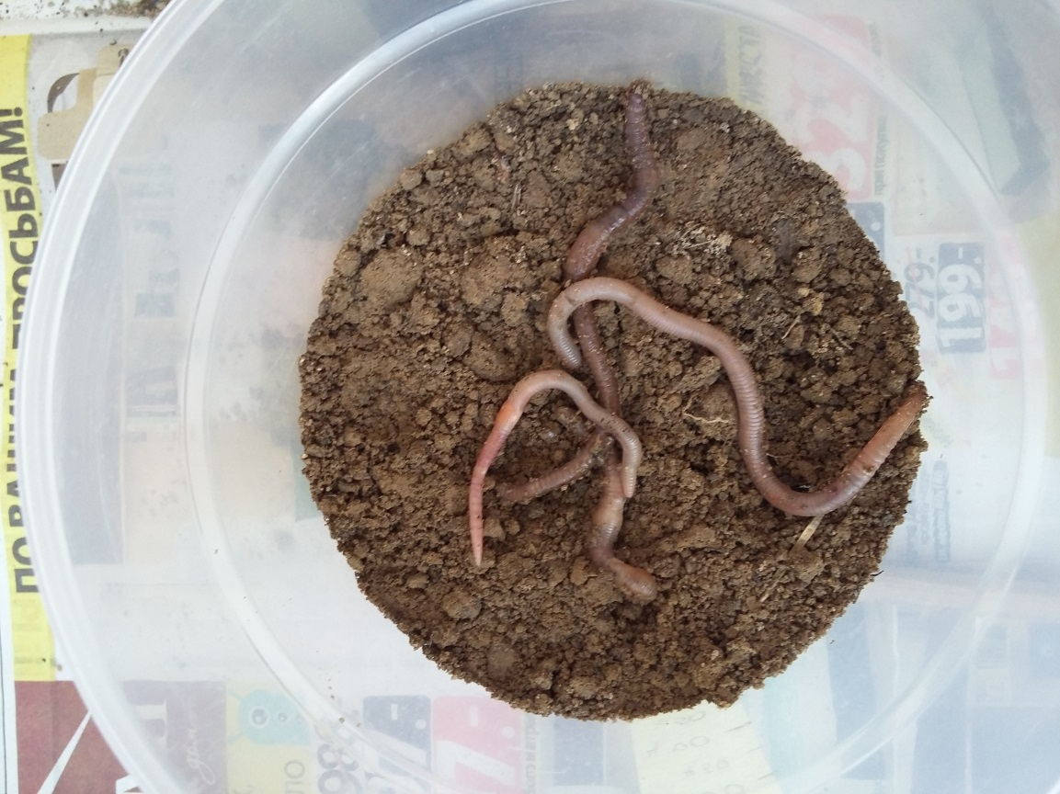
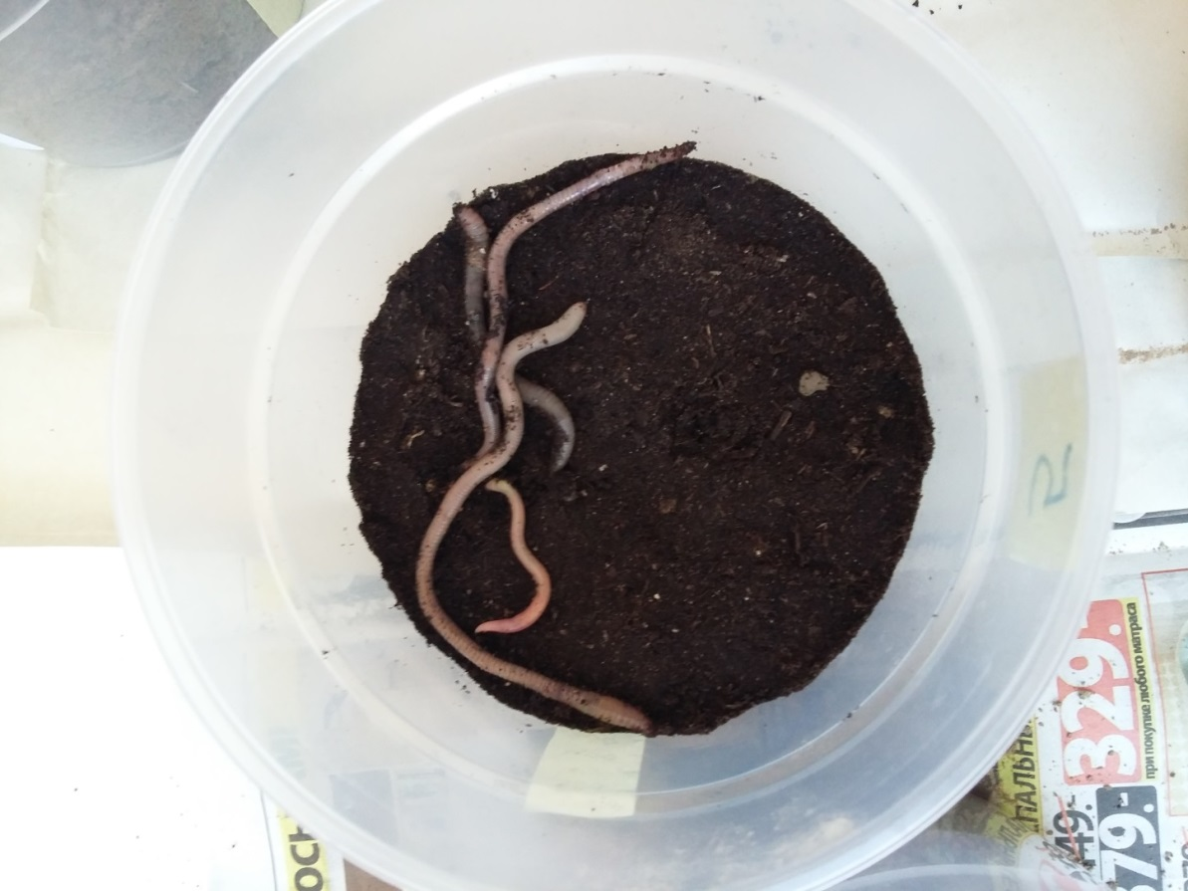
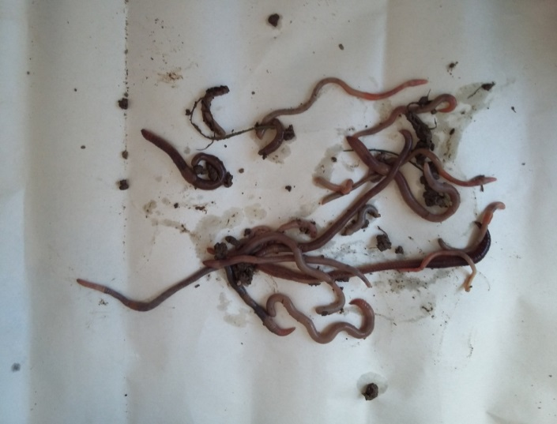
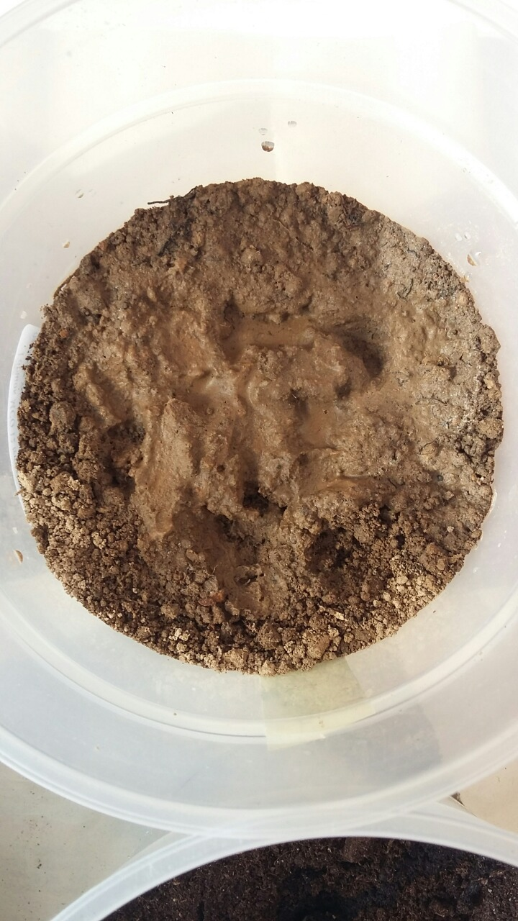
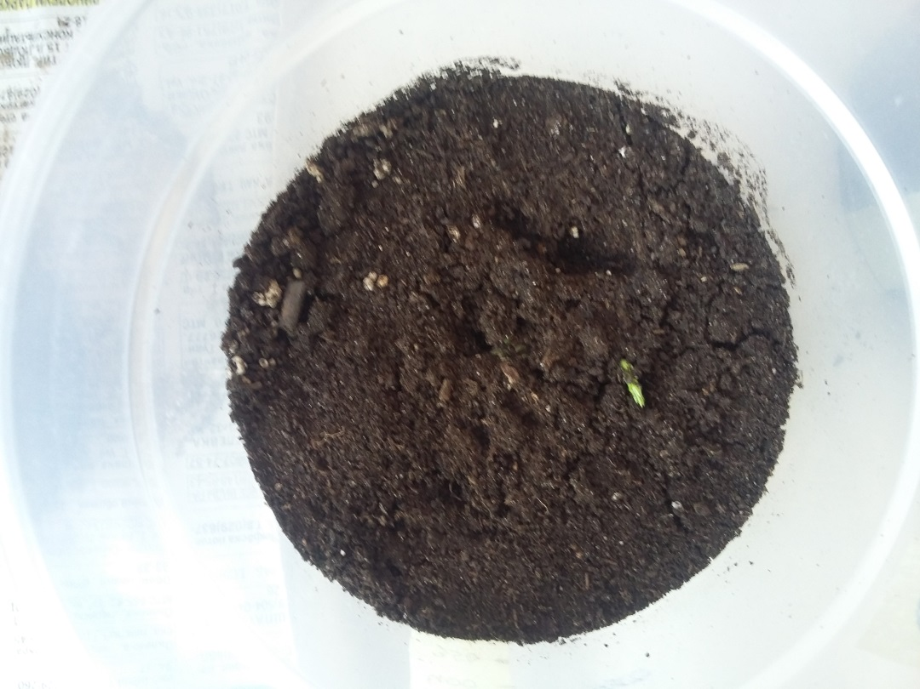
9
Notes:
It looked the following way

Slide 10
In bought soil the earthworms did not dig into the ground.
On the second day of the experiment, the worms in pot number 3 died.
3.Specially prepared soil
1.Forest soil.
10.
Notes:
In the pot with forest soil, the earthworms immediately began to cultivate the soil and make the burrows. In the pot with specially prepared soil, the worms began to eat the soil, which was noticeable by the changed color of their bodies, but they did not dig into the ground. On the second day of the experiment, they died.

Slide 11
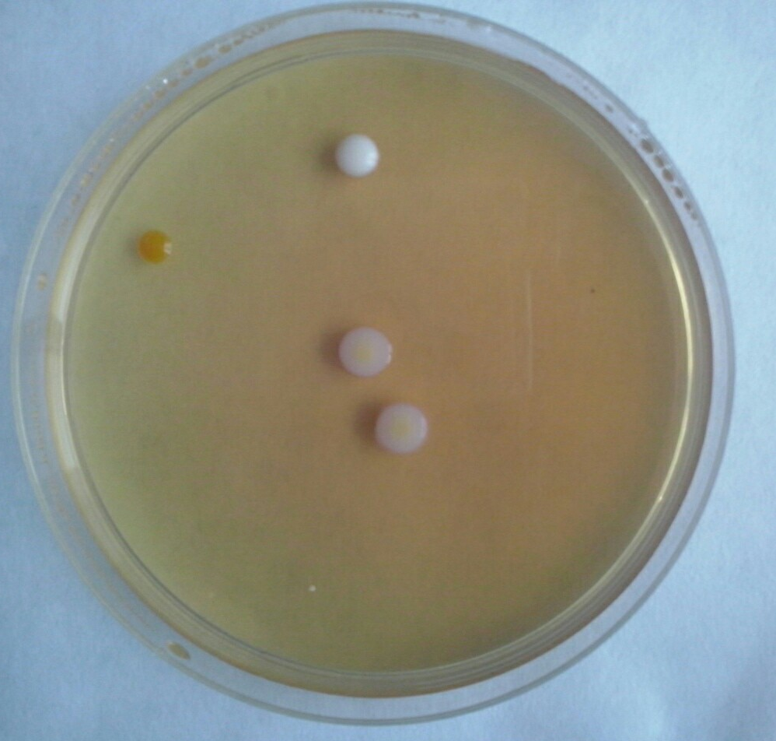
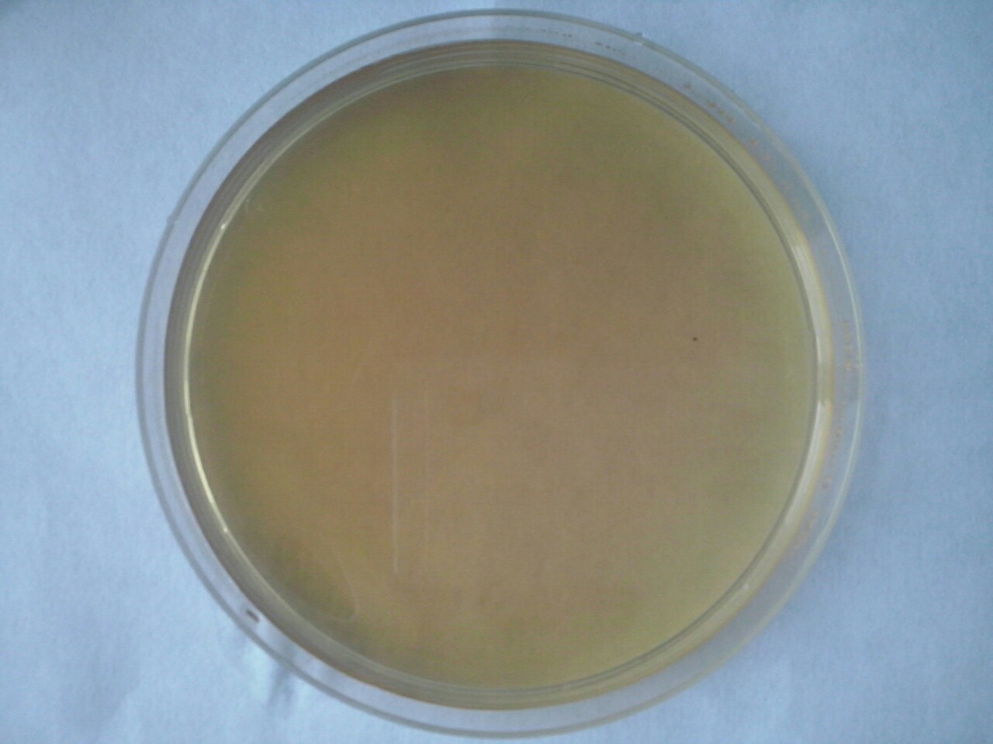
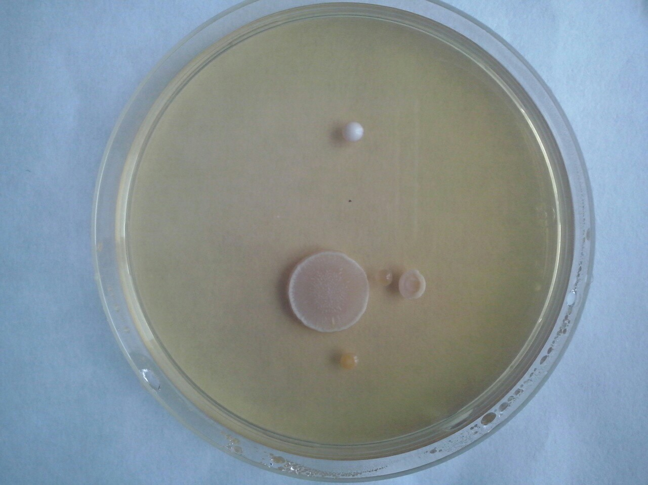
forest soil with worms
forest soil.
soil from the store
Notes:
To find out microorganisms contained in the soil, we mixed soil samples with water and made crops in Petri dishes. In 3 days we obtained the results: great number of bacteria grew in forest soil with worms and without them. No bacteria grew in the special soil from the shop. We assume that all microorganisms disappered in the result of active chemical or thermal treatment of soil. And earthworms died in this soil as well.

Slide 12
In the pot number 1, the soil became more friable and it absorbed water quickly. And the sample number 2 without worms had a visually smooth surface and absorbed water slower
Object 1: earthworms in forest soil
Object 2: Forest soil without worms
11
Notes:
On the third day of the experiment, there was a visible difference between object 1 and object 2 . In the pot number 1, the soil became more friable and it absorbed water quickly. And the sample number 2 without worms had a visually smooth surface and absorbed water slower

Slide 13
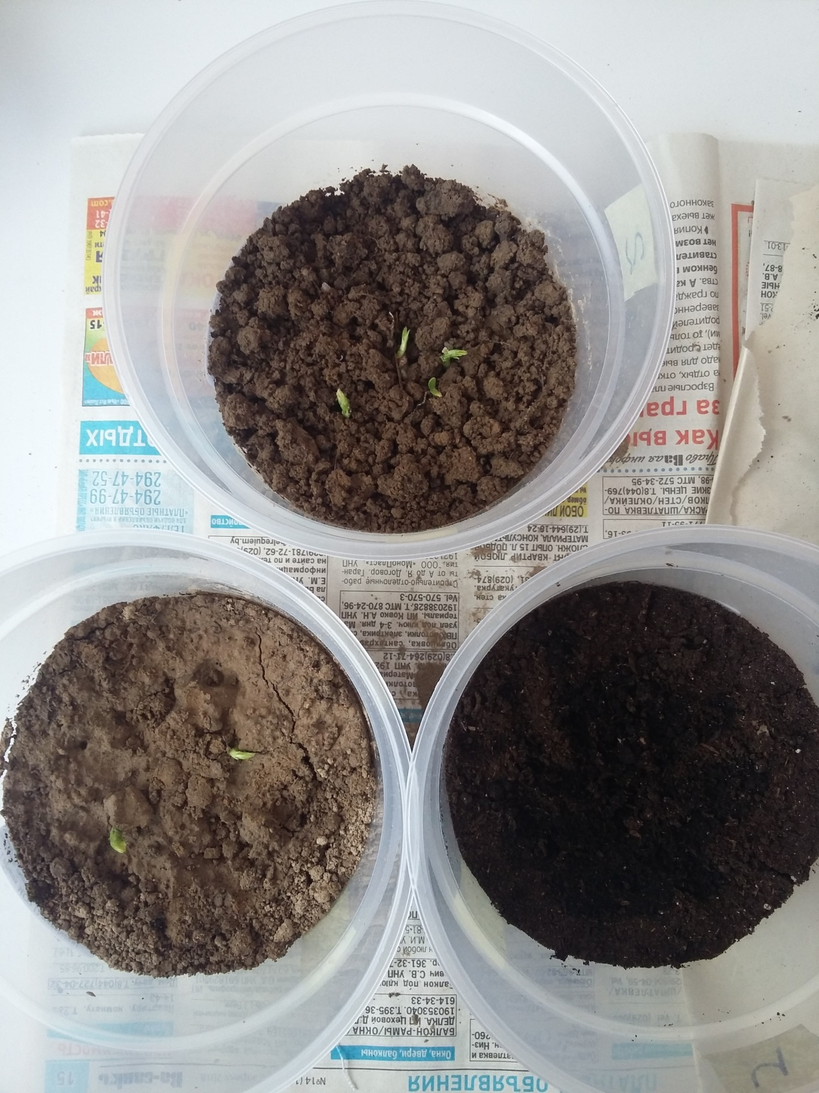
Germination
Object 1: earthworms in forest soil
3 seeds from 3
Object 2: Forest soil without worms
2 seeds from 3
Object 3: Specially prepared soil without worms. No seeds
12
Notes:
On the fifth day of the experiment, the peas began to germinate. The highest germination was observed in the pot (1) with worms and forest land. 3 seeds from 3 grew. In the second pot 2 seeds from 3 germinated. In the pot with the store soil seeds did not sprout.

Slide 14
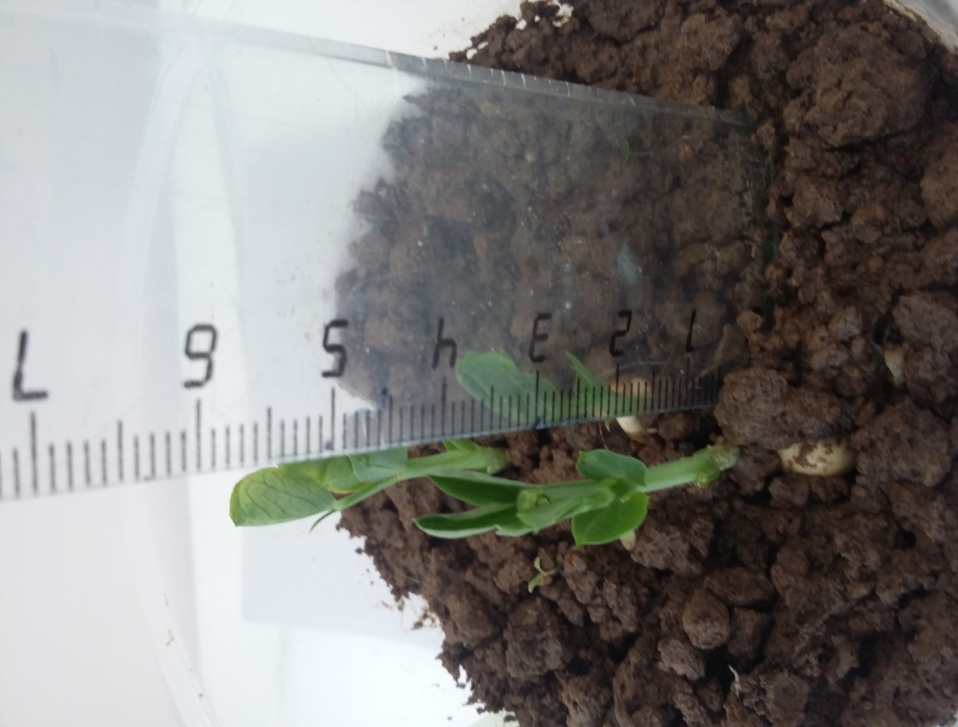
Object 1: Four earthworms in forest soil.
30.04.2018
03.05.2018:
13
36 ММ
4 days
78 ММ
Notes:
The growth of peas amounted to 78 mm.

Slide 15
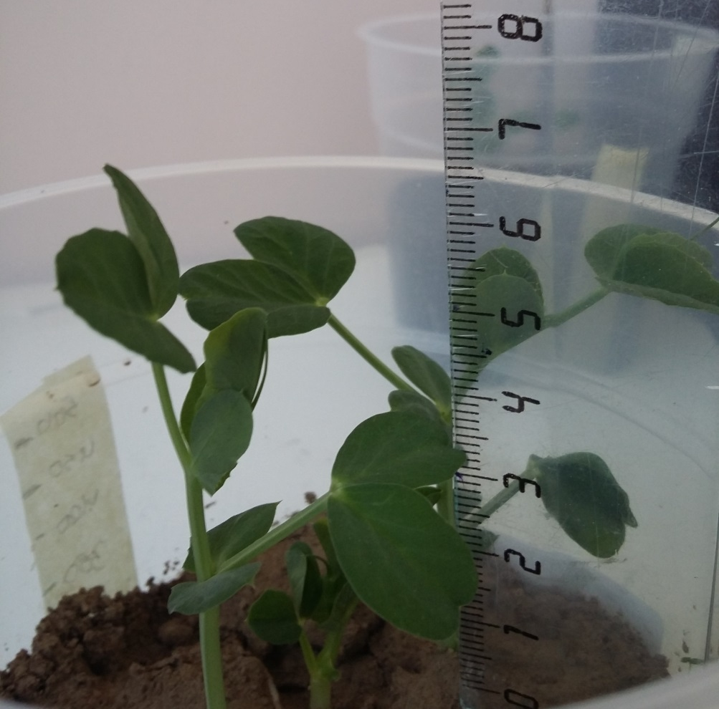
Object 2: Forest soil without worms
30.04.2018
03.05.2018
14
28 мм
4 days
54 мм
Notes:
The growth of peas amounted to 54 mm.

Slide 16
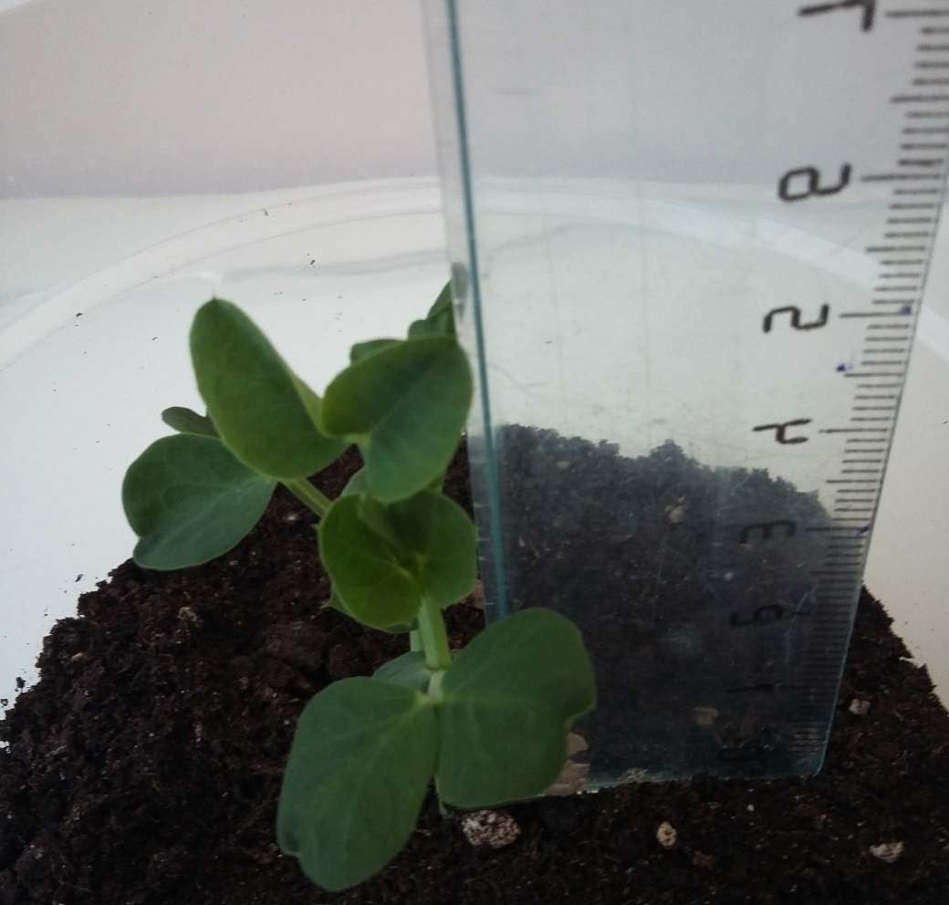
Object 3: Specially prepared soil
30.04.2018
03.05.2018:
15
21 мм
4 days
45 мм
Notes:
We can conclude that all samples maintained dynamics of growth.
The growth of peas amounted to 45 mm.

Slide 17
Leaves number (in 2 weeks)
12
Object 1: Four earthworms in forest soil:32
Object 2: Forest soil without worms: 22
Object 3: Specially prepared soil: 12
32
22
16
Notes:
You can see on slide that all objects have different leaves number

Slide 18
Total growth of all plants of the group:
17
Notes:
On the slide you can see the total growth of all plants of the group. The growth of all objects was steady relative to one another.

Slide 19
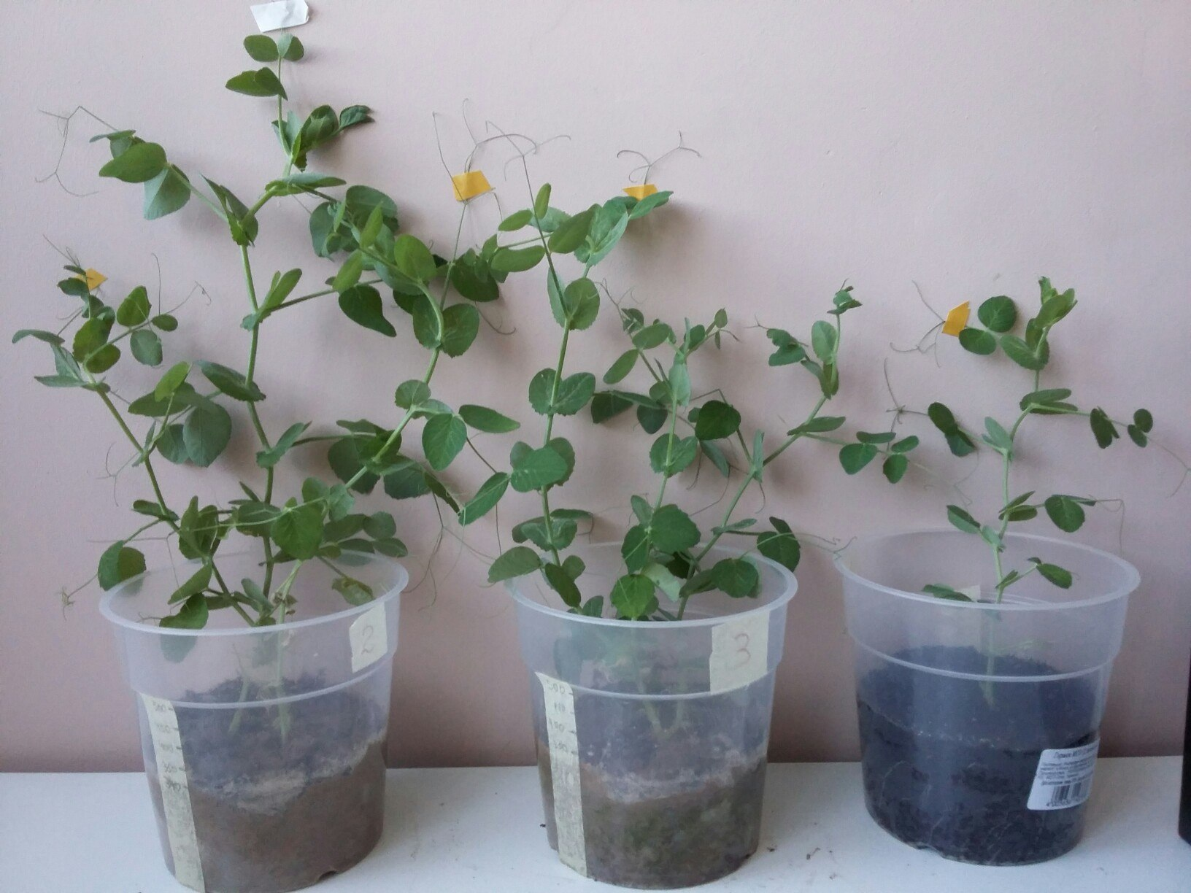
03.06.2018
260 mm
230 mm
195 mm
18
Notes:
This is the way three odjects looked in a month. We can conclude that all samples maintained dynamics of growth.

Slide 20
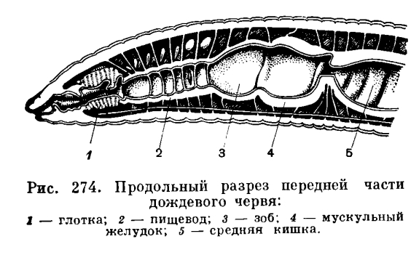
2.- esophagus with holes of calcareous glands
Coprolites (products of vital activity) enriched with amount of humus and decreased with amount of acidity
Notes:
One of the most important consequences of the passage of soil through the intestines of worms is its alkalinization. They reduce the acidity of soil (due to calcareous glands in their esophagus)
In soil enreached with the products of vital activity of earthwoms-coprolites the amount of humus increases, the acidity of the soil decreases.

Slide 21
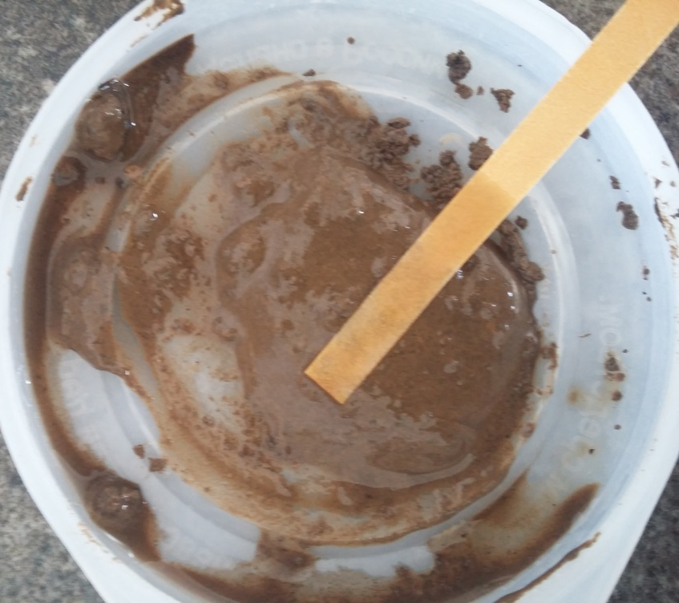
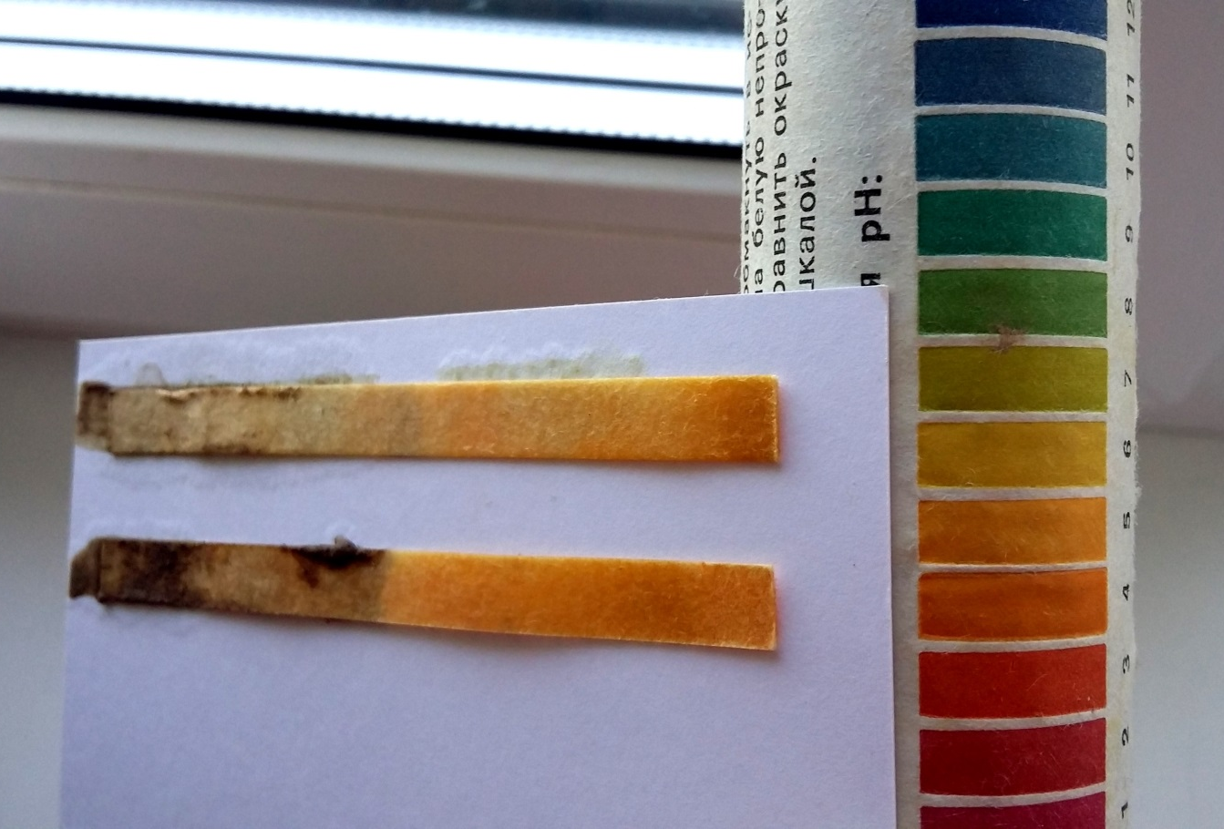
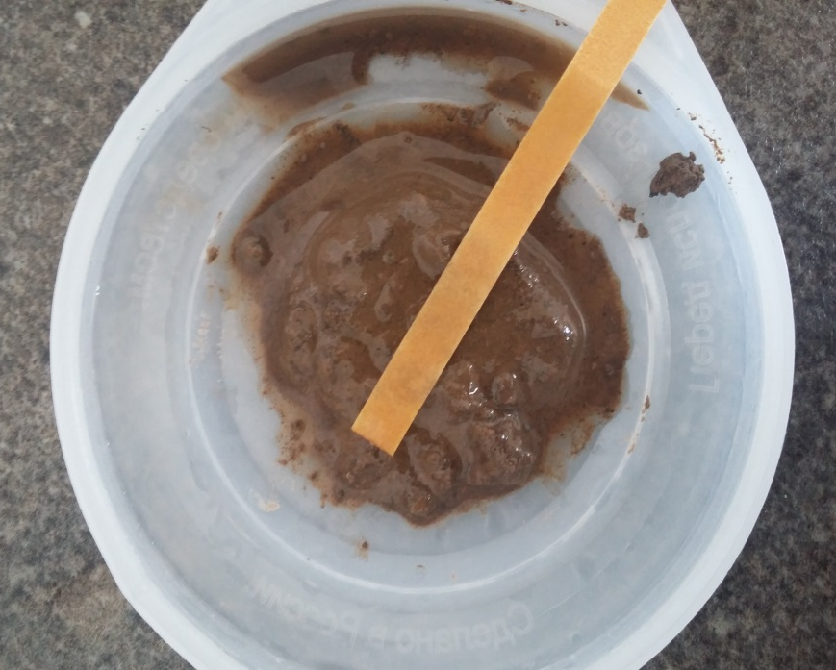
Acidity measurement
Object 1:
Object 1: pH=5
Object 2: pH=4
19
Object 2:
Notes:
To measure acidity of the soil, we took three soil samples, pour some water into them and applied litmus paper. Than we compared the color of litmus paper with pH scale. The acidity of the soil with worms was less than in soil without worms.

Slide 22
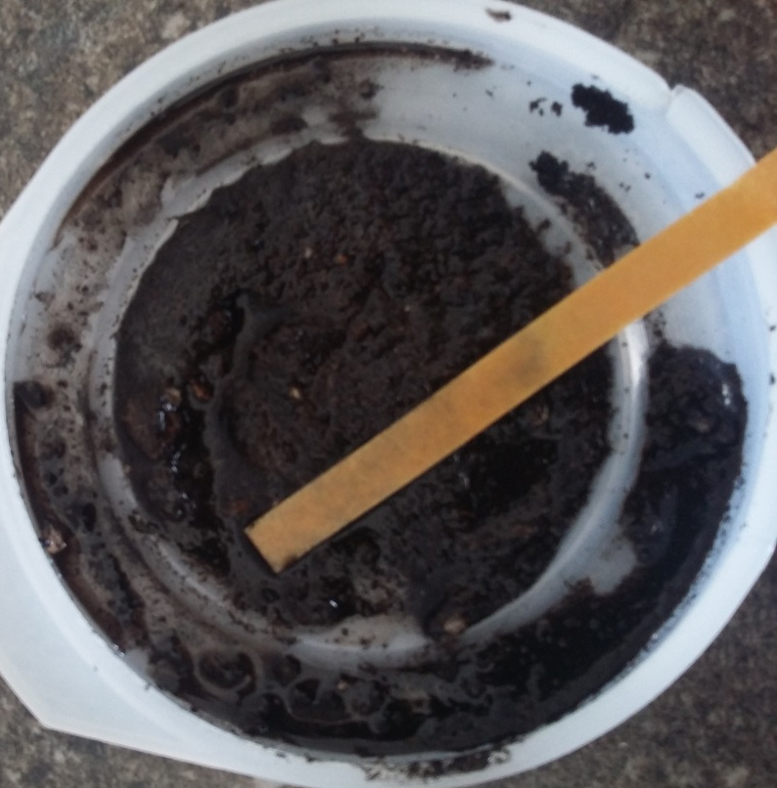
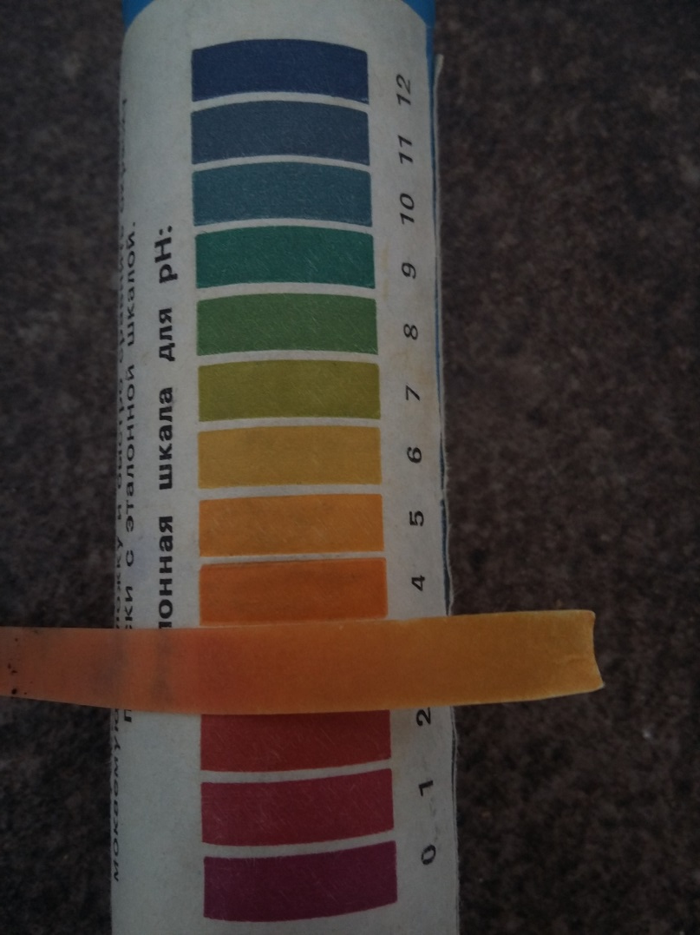
Object 3: pH=4
20
Notes:
The acidity in the third port was 4 pH

Slide 23
Porosity measurement
Pores are voids between particles of soil, filled with air.
Porosity is the ratio of the volume of the space to the total volume of the soil.
22
Notes:
At the end of our 2-weeks experiment, we calculated the porosity of the soil in all groups. Pores are voids between particles of soil, filled with air. Porosity is the ratio of the volume of the space to the total volume of the soil.
To calculate the porosity, we took 2 measuring glasses. One filled with water and the other with soil, trying not to change the structure. The soil sample was saturated with water. We poured the water to the top of the soil. The volume of added water is equal to the volume of the pores.

Slide 24
Porosity measurement
Object 1: 33%
Object 2: 14%
Object 3: 25%
Porosity $=\frac{V_{water}}{V_{water+V_{soil}}}∗100\%$
21
Notes:
Then we calculated porosity by the following formula. Porosity of the soil from the store was rather high initially. But the porosity of forest soil changed by 19% due to worms activity.

Slide 25
Results obtained
We monitored germination of seeds, plant growth and development, soil conditions for a time period of two weeks. We found:
The earthworms didn’t survive in special soil bought at the store.
No bacteria grew in the soil from the store as a result of active chemical and thermal soil treatment.
The seeds germinated faster and grew better in pot number 1
The acidity of soil with worms was slightly lower than in the same soil without worms.
Pot 1 – 5 pH
Pot 2 – 4 pH
Pot 3 – 4 pH
The porosity of forest soil with worms was higher than of two other samples
Pot 1 – 33 %
Pot 2 – 14 %
Pot 3 – 25 %
23

Slide 26
Conclusion:
The worms cultivate the soil, make burrows. Burrows loosen the soil, admitting air and water. Thus the porosity of soil with worms changed by 19% compared to the soil without worms. It helps roots grow and increases the fertility of soil.
Plants in the soil with worms grew by 31% better than in the same soil without worms.
But earthworms do not live in every soil. They died on the second day of our experiment in the soil for growing plants (bought at the store).
The activity of earthworms decreases acidity. Initially it was 4pH, but worms’ activity changed it into 5pH for 12 days.
24

Slide 27
THANK YOU FOR YOUR ATTENTION!

