Slide 1
2. All Roads Lead to Rome
Team Croatia
Reporter: Andrej Todic

Slide 2
2. All Roads Lead to Rome
Open a random Wikipedia article and click on the first link in the article. Keep clicking on the first link of each following article. It is argued that you will quickly end up on the page Philosophy. Investigate whether this is true. How can one describe such an observation?

Slide 3
Outline
Theoretical introduction
Experiment
Results
Facts about Wikipedia
Special: Random Feature
Use of Programming
Loop Occurences
Results (with and without modifications)
Description

Slide 4
Wikipedia
Multilingual web-based encyclopedia
Articles can be modified by volunteers
261 different languages
15 million pages → about 5 million in English

Slide 5
Example
Notes:
Rzdvojiti slike > maknuti dio sa contents
Naznaciti da slika2 slijedi iz slike 1 (strelica)

Slide 6
Special:Random
Generates random articles
Each page in the Wikipedia database has a unique index
An article is chosen by choosing a random index
Used to take random samples from the Wikipedia database
/wiki/Special:Random random Wikipedia article
Notes:
slika

Slide 7
Hypotheses
Hypothesis 1:
More than half of all articles will lead to Philosophy
Hypothesis 2:
If it’s possible to reach Philosophy, it can be done in under 50 clicks

Slide 8
Testing
Go to article
Is Philosophy?
Count steps
Find first link
Automated using Programming
Web client using the programming language Python
Automatically searches Wikipedia

Slide 9
Flow chart
Pick a random Wikipedia article
Link exists
NO
YES
End program
Link equals Philosophy
NO
YES
Go to link
Return number of clicks

Slide 10
Testing
Program checks if randomly picked web pages lead to Philosophy
Output consists of
Address of the starting web page
Number of clicks to reach Philosophy
Wikipedia article doesn’t lead to Philosophy
Number of clicks is set to -1

Slide 11
Infinite Loops
First links of randomly chosen articles:
lead to Philosophy
OR
lead to already visited articles
Second outcome means all the articles would have to be visited again
Test is stuck in a loop

Slide 12
When loops occur
First link is often about the etymology of a word
Ancient Greek
Greek language
Modern Greek
Colloquialism
...
Logical assertion
Logic

Slide 13
Modification
Ignoring the first links connected to infinite loops, such as:
“/wiki/Mathematics”
“/wiki/Truth”
“/wiki/Greek”
“/wiki/Latin”
Moving on to the next link
Possible to reach Philosophy more often
Notes:
Navedi dodatne linkove koje si zanemario

Slide 14
Results
28% which fail lead to:
Main Page
Page without links

Slide 15
Results
Notes:
Naziv grafa ispod

Slide 16
Results
Notes:
Povecati legendu

Slide 17
Results
Experiment repeated for 5000 randomly chosen articles
Average number of clicks ≈ 21

Slide 18
How can one describe such an observation?
Philosophy (from Greek φιλοσοφία, philosophia, literally „love of wisdom”) is the study of general and fundamental problems concerning matters such as existence, knowledge, values, reason,
mind, and language.
Wikipedia

Slide 19
Conclusion
If the task from the assignment is followed literally, it rarely leads to Philosophy
The number of links which lead to Philosophy is too small to make a conclusion
If first links which lead to loops are ignored
Both hypotheses are correct
Hypothesis 1:
More than half of all articles will lead to Philosophy
Hypothesis 2:
If it’s possible to reach Philosophy, it can be done in under 50 clicks
Philosophy – general and fundamental

Slide 20
Possibilities for future work
Downloading all Wikipedia articles for individual testing
Drawing a tree diagram which represents all the connections to Philosophy
Speeding up the program
Testing for articles other than Philosophy

Slide 21
Literature and Sources
https://en.wikipedia.org/wiki/Wikipedia:FAQ/Technical#random,
accessed on: 01.02.2018., 17:56
https://computer.howstuffworks.com/internet/basics/wiki1.htm,
accessed on: 01.02.2018, 16:34
http://www.findingdulcinea.com/guides/Technology/Wikipedia.xa_1.html, accessed on: 01.02.2018. 15:22
Notes:
Datum pristupa ---pravilno citiranje

Slide 22
THANK YOU!
Team Croatia
Reporter: Andrej Todic

Slide 23
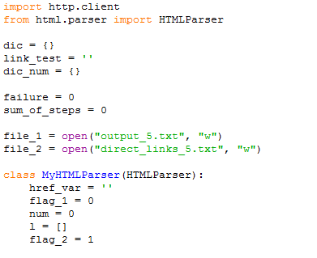
Additional slides

Slide 24
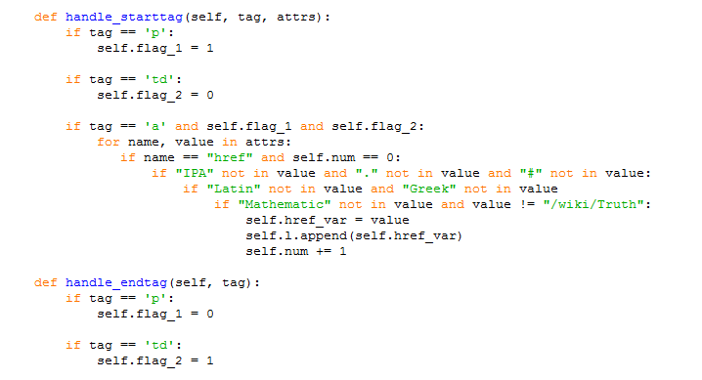
ADDitional slides

Slide 25
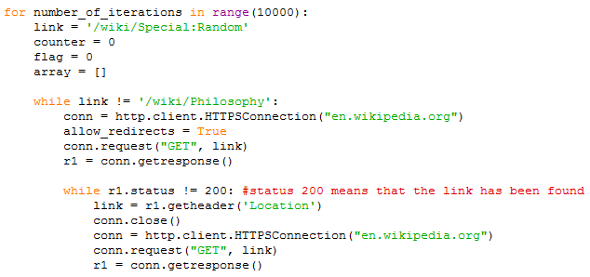
Additional slides

Slide 26
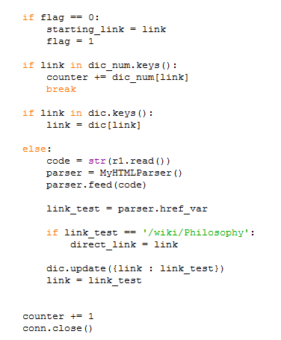
Additional slides

Slide 27
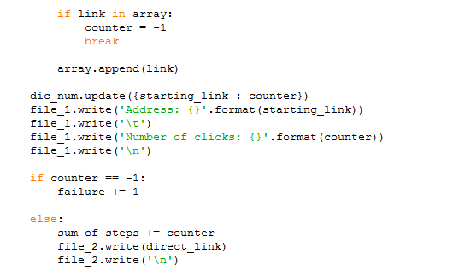
Additional slides

Slide 28
Additional slides

