Slide 1
Problem 3:Annoying foreground object
Team Croatia
Reporter: Luka Mikšić

Slide 2
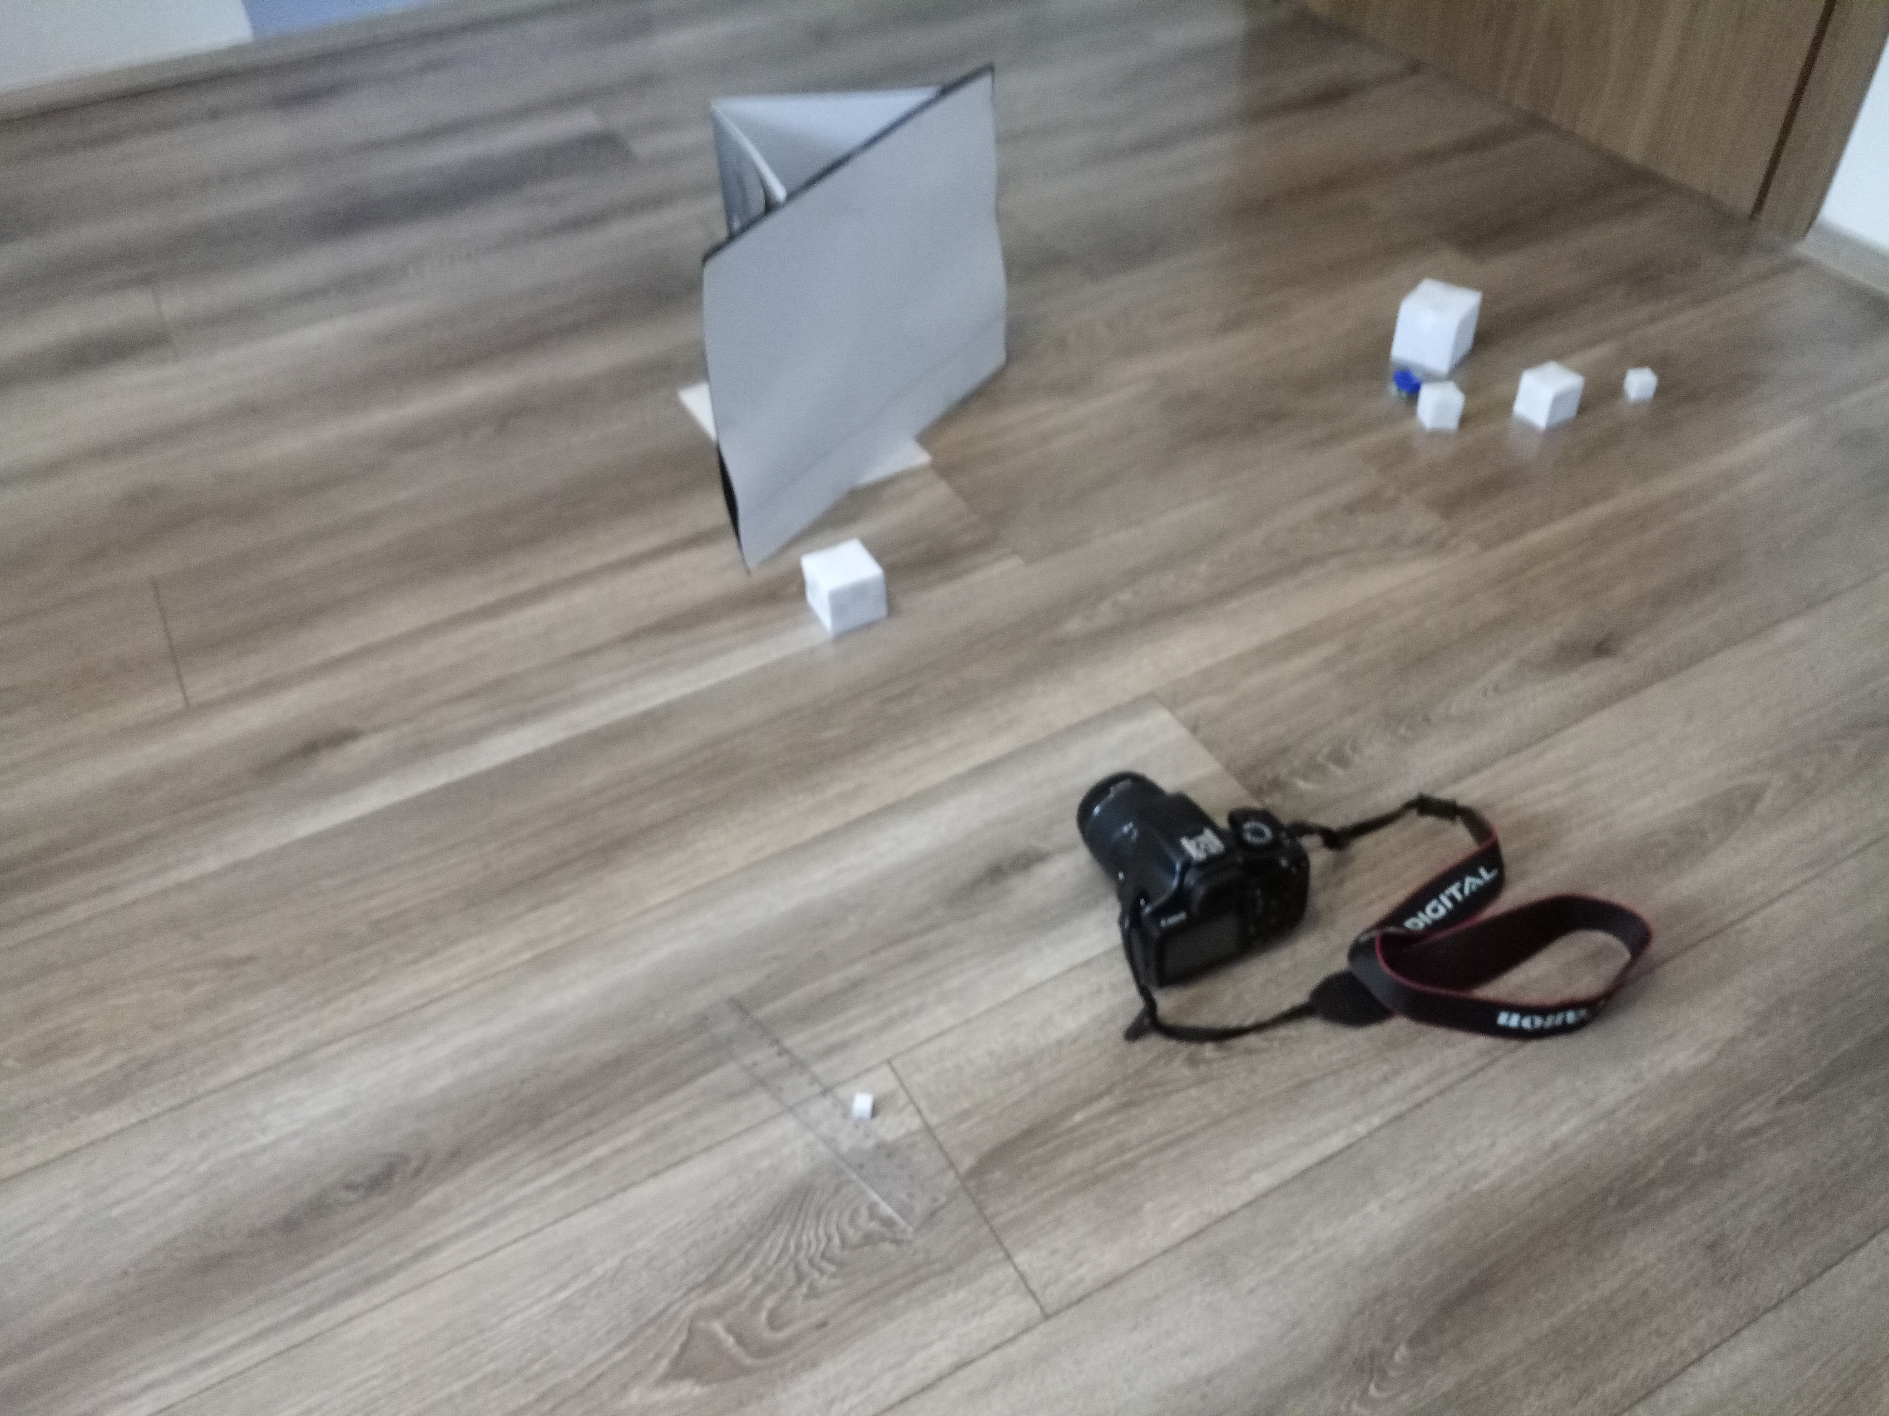
Problem 3:Annoying foreground object
Look at a flat photograph. What methods allow you to tell which objects were closer and which were farther from the camera when the shot was taken? Design and create a photograph that violates the intuitive judgment of relative distances. “

Slide 3
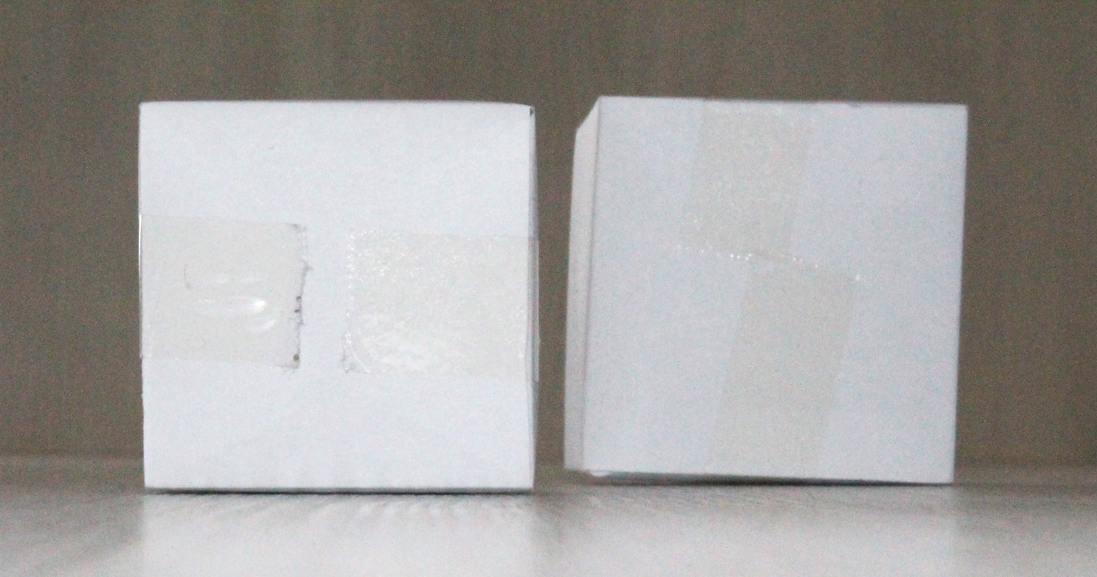
Demonstration of the phenomenon
Smaller object 4 cm
Bigger object 5 cm

Slide 4
Outline
Theoretical introduction
Experiment
Results
The perceived size of an object
Lenses
Experiment 1-Ratios
Experiment 2-Re-enactment of experiment
Conclusion
Experiment 3-Ratios 2
Discussion- designed experiment

Slide 5
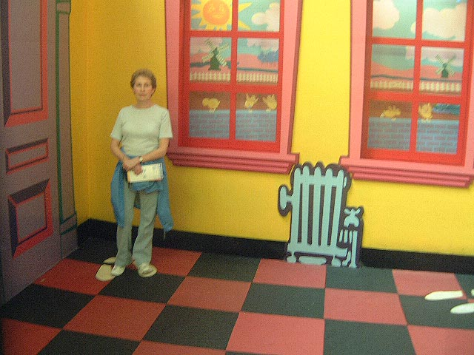
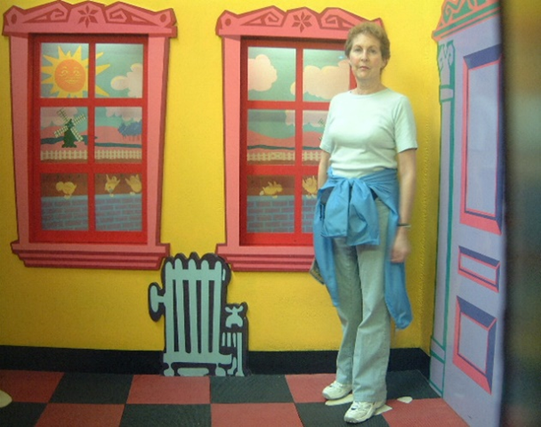
Theoretical slide
The perceived size of an object depends on:
the visual angle subtended by the object- the visual angle is decided by the size of an object and its distance from the observer
perspective (the Ames Distorted Room)

Slide 6
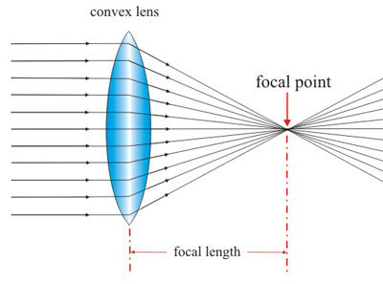
LENSES
there are 2 types of lenses: concave and convex
they are the ones used in cameras

Slide 7
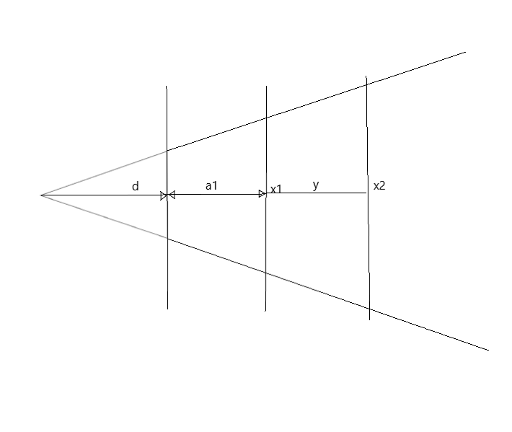
Perspective projection
$y=\left(d+a1\right)×\left(\frac{x2}{x1}−1\right)$
y-from smaller to bigger cube
d- imaginary value (distance behind)
a1-from camera to smaller cube
x1-size of smaller cube
x2-size of bigger cube

Slide 8
HYPOTHESIS
Manipulate the human perception of size by moving bigger objects further away from the camera and putting smaller objects closer
I could make a ratio in witch we can observe and predict at what distance we would need to move away the bigger objects so they seem smaller
I will try to re-enact the Ames Distorted Room

Slide 9
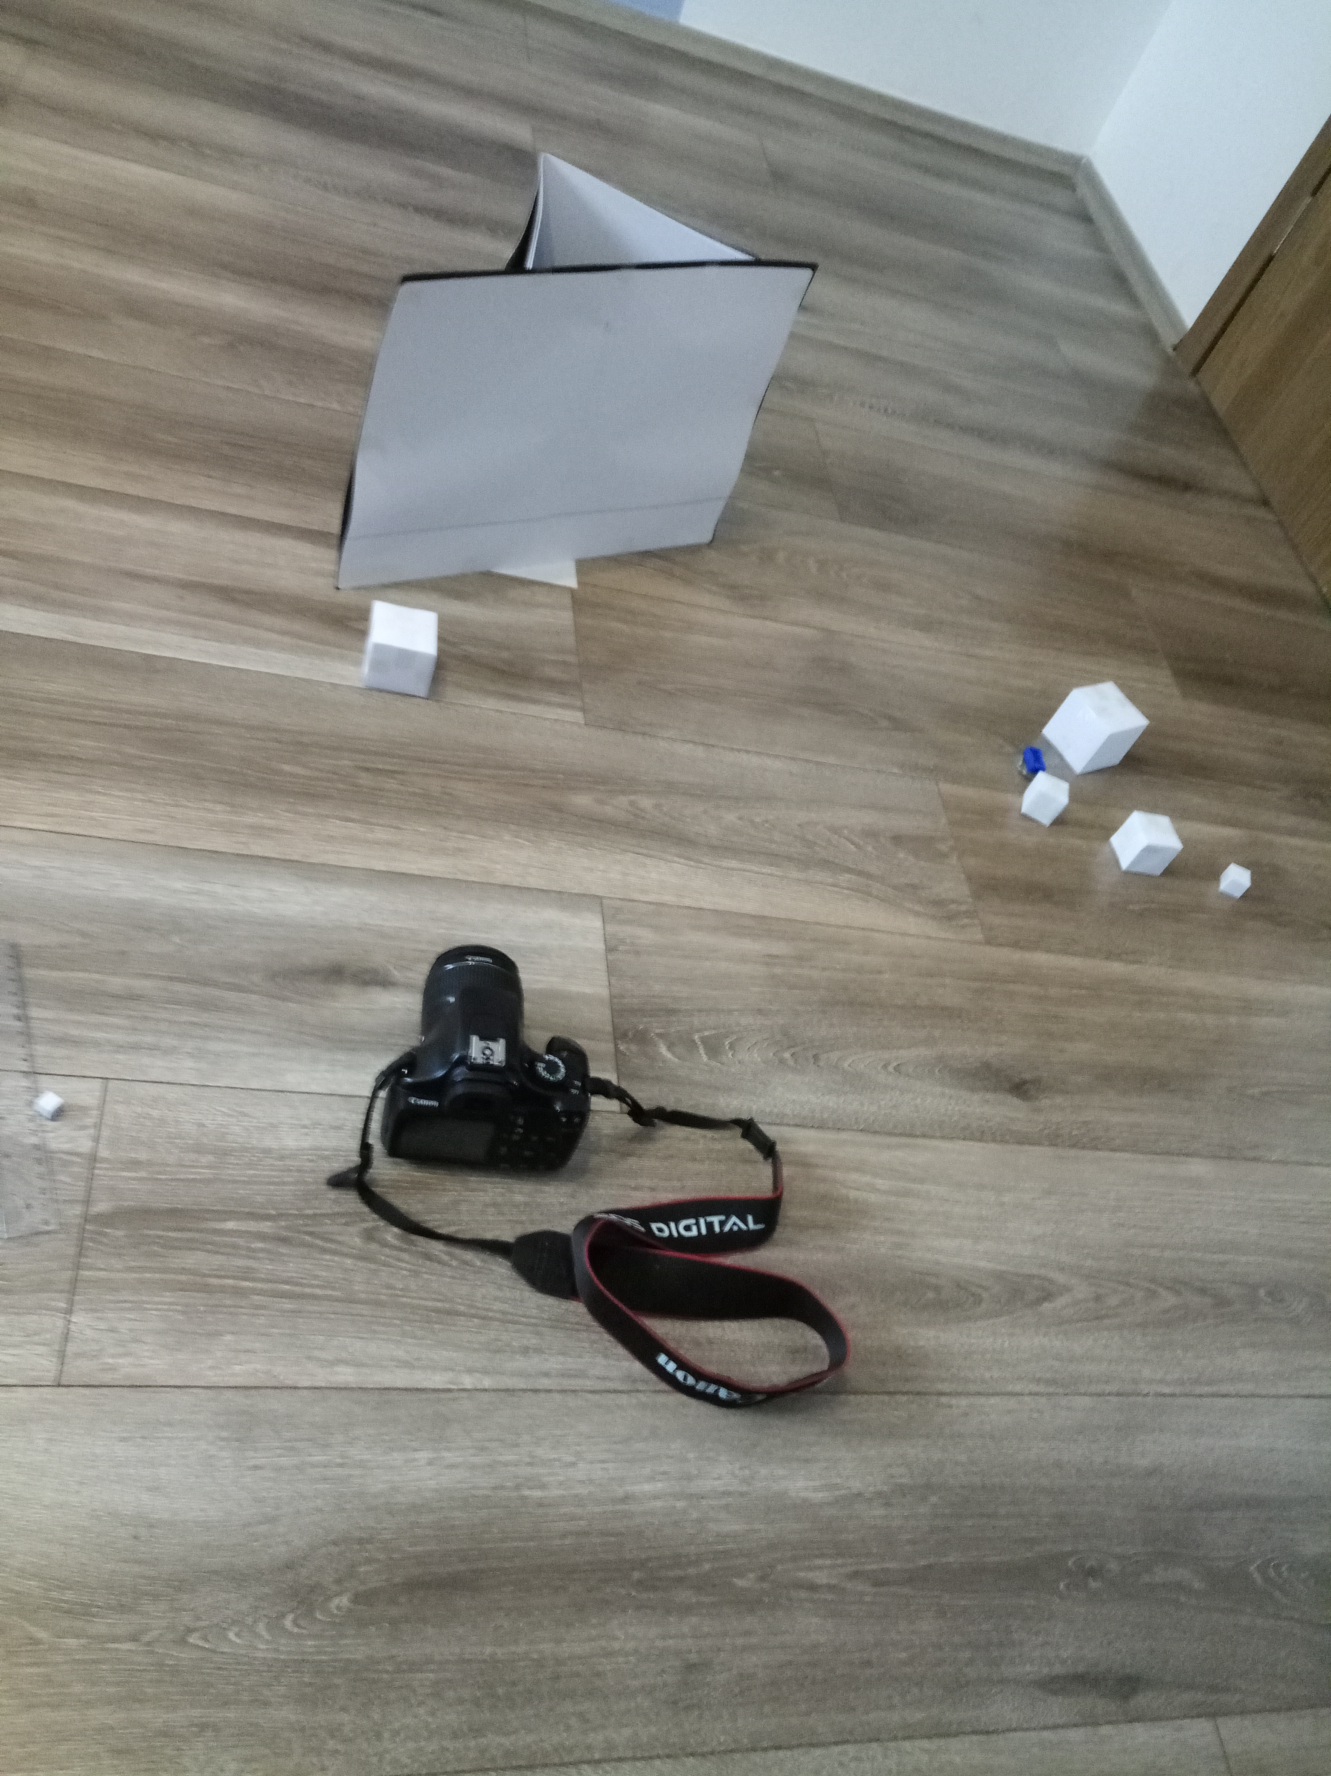
1st experimental setup
6 paper cubes➔1 to 6 cm tall
Different distances from the camera
Cubes- in ratios and kept moving away the bigger one by 5 cm until it seemed the same size as the smaller one
Setup for 1st experiment

Slide 10
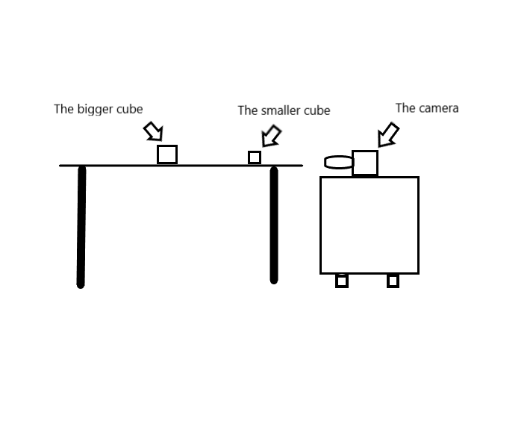
2nd experimental setup
Camera and cubes➔ same level
$y=\left(d+a1\right)×\left(\frac{x2}{x1}−1\right)$
The setup for 2nd experiment

Slide 11
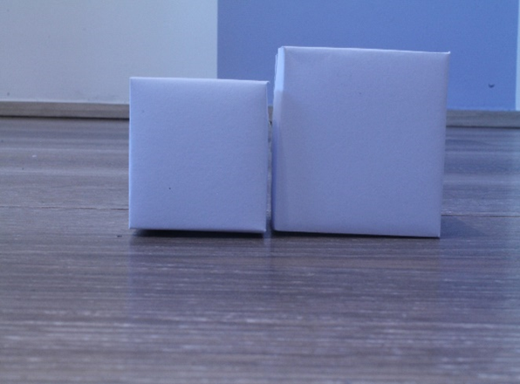
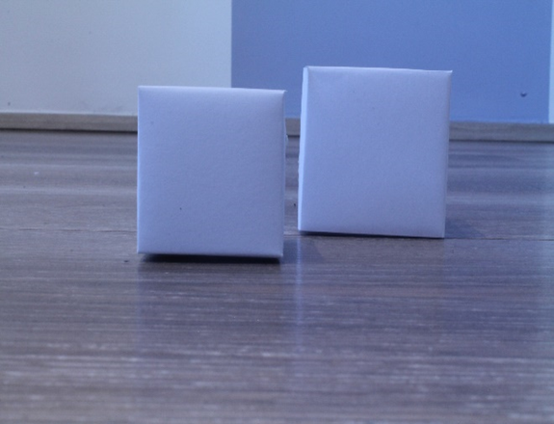
Measuring example➔ 1st method
Ratio-4:5
Basic distance of 20 cm from the camera
Comparison at the same distance 5 cm separated

Slide 12
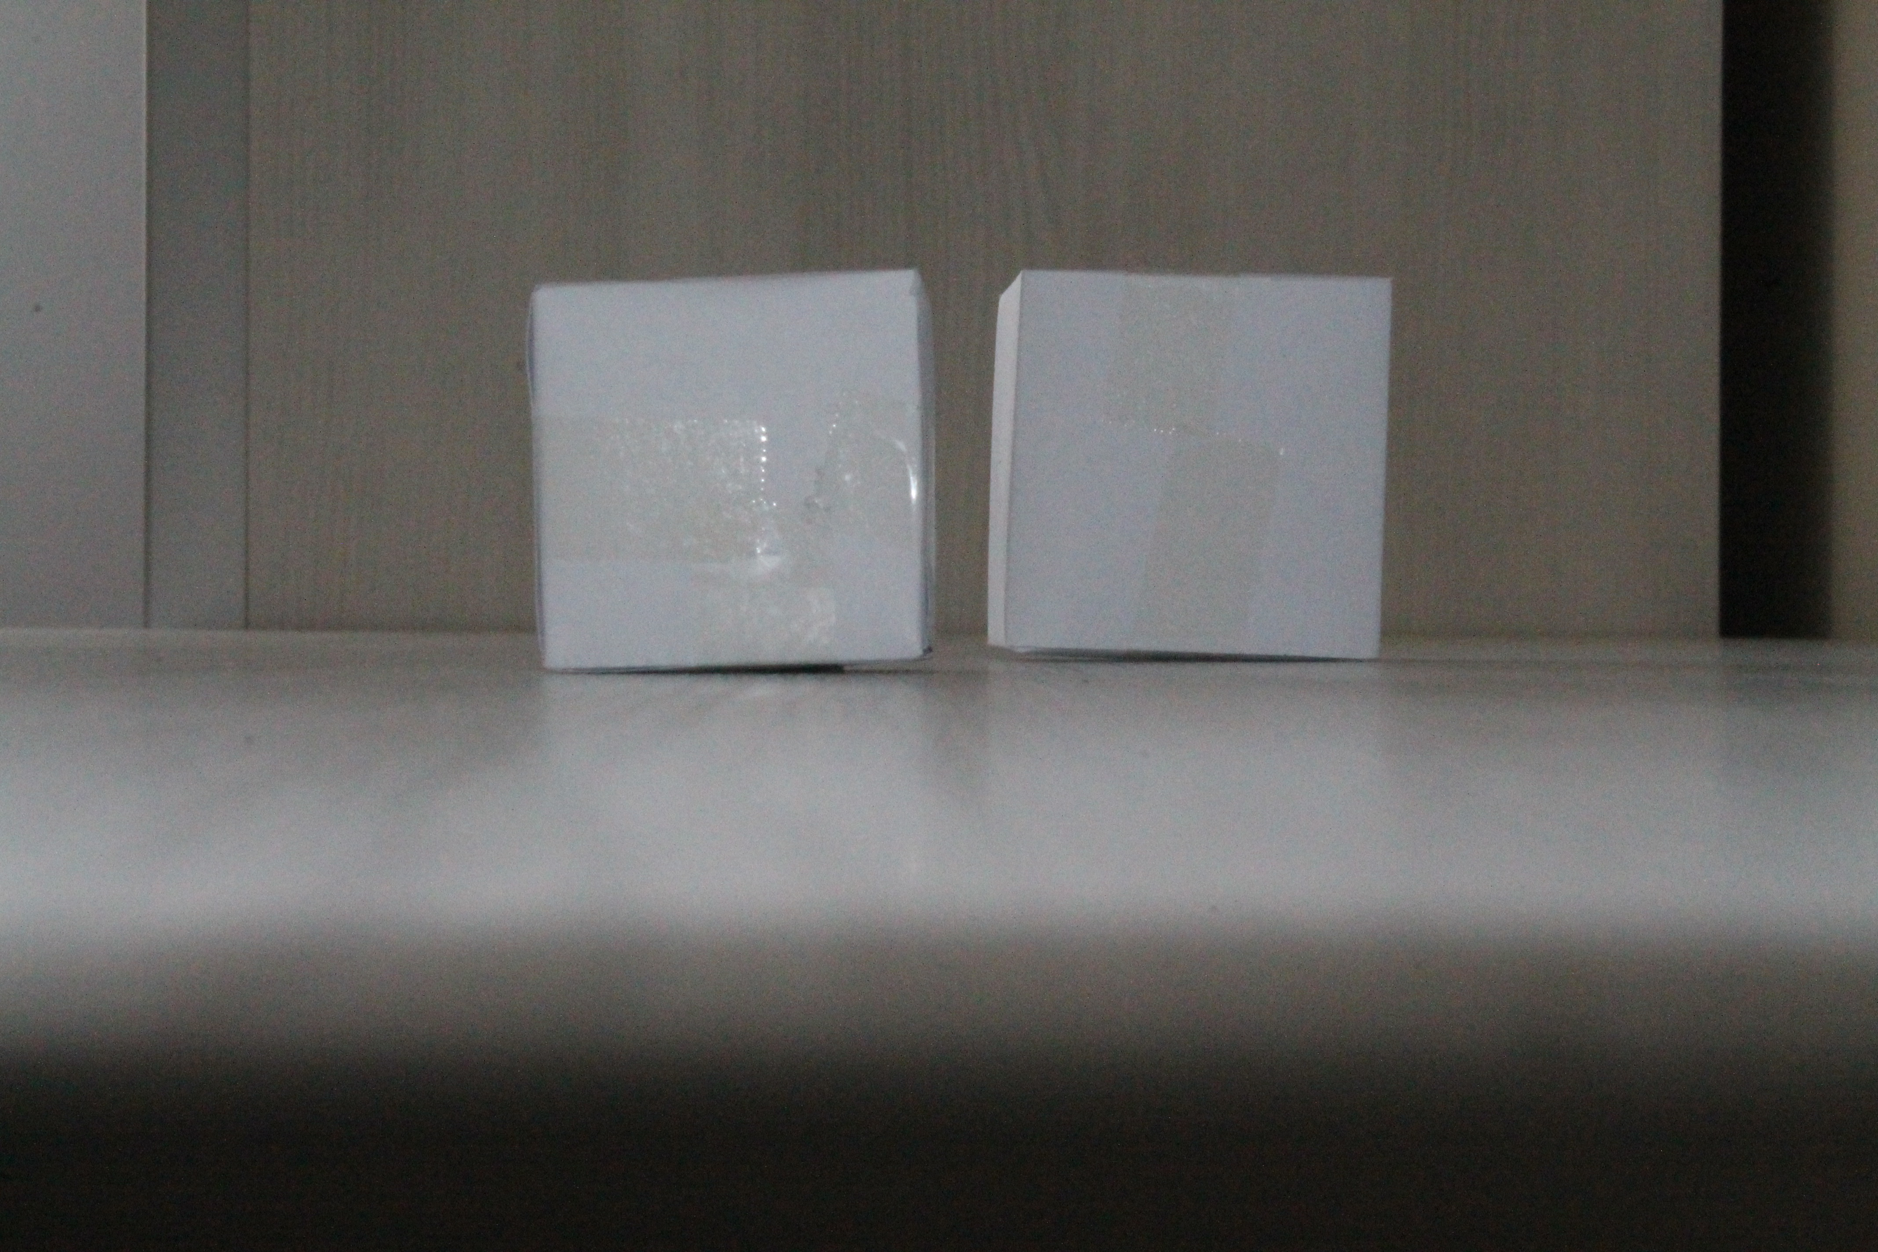
Measuring example➔ 2nd method
4:5- 40 cm from the camera
12,5 cm separated

Slide 13
Measuring example➔ 3rd method
I focused the camera on the further object
Blurriness made the closer object seem larger

Slide 14
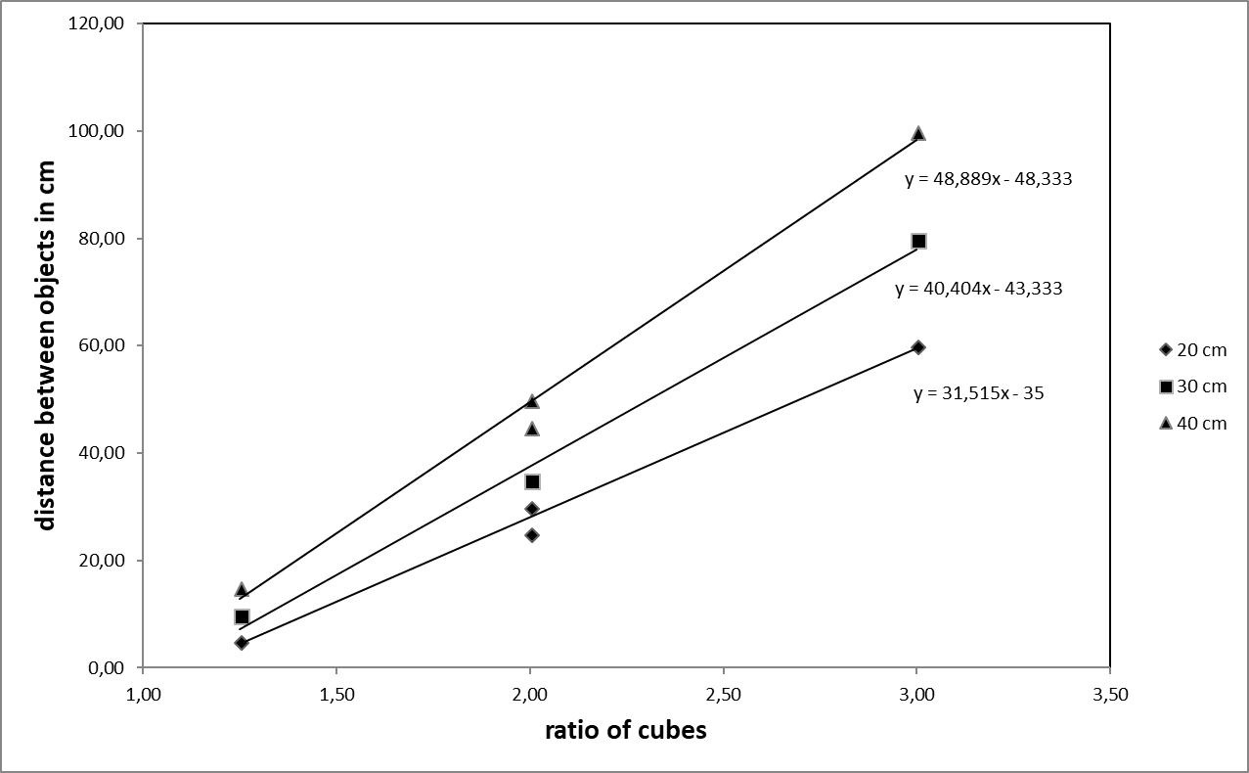
RESULTS
d- calculated from graph

Slide 15
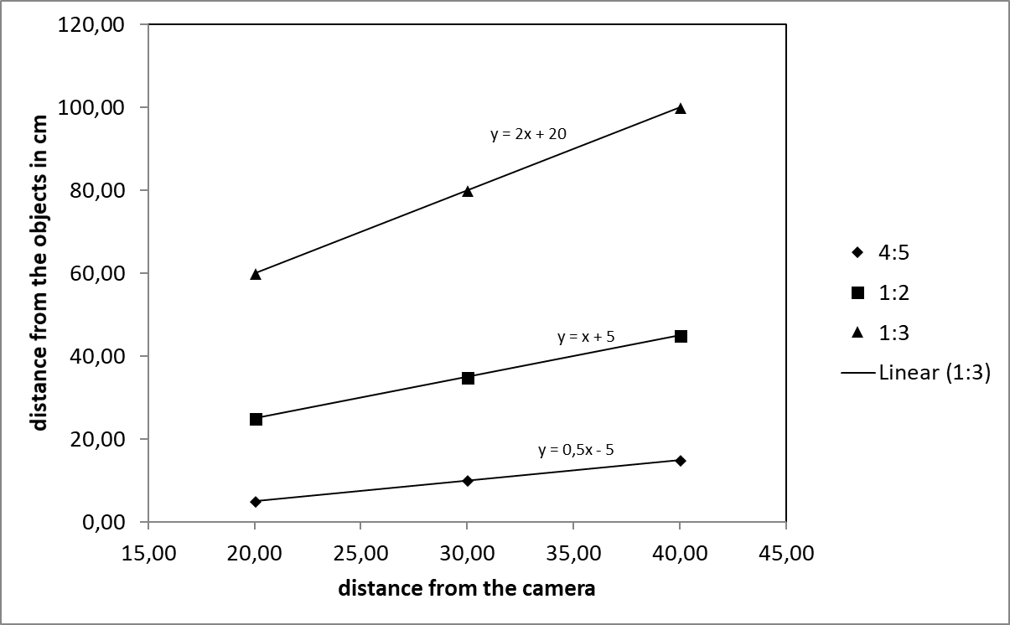
results
Linear growth of distance between the objects with the distance from the camera

Slide 16
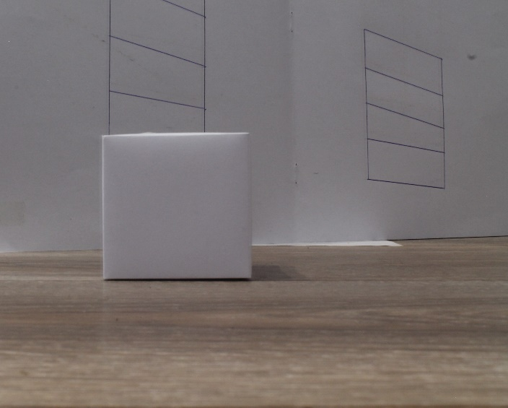
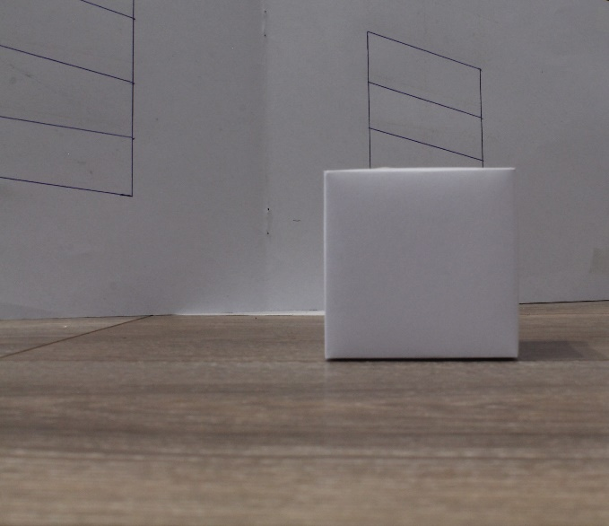
Re-enactment of the Ames Distorted Room
Ames Distorted Room re-enactment doesn’t work- the environment isn’t familiar

Slide 17
Conclusion
1st method
we can deceive human judgment of distance
moving bigger objects farther
2nd method
putting the camera at he same angle as cubes- more effective
3rd method
focusing of the farther object we blur the closer one-it seems bigger
The experiments confirms the theory

Slide 18
Literature
http://hyperphysics.phy-astr.gsu.edu/hbase/geoopt/lenseq
http://glasnost.itcarlow.ie/~powerk/GeneralGraphicsNotes/projection/perspective_projection

Slide 19
Thank you!
Team Croatia
Reporter: Luka Mikšić

Slide 20
The formula used-explanation
$y=\left(d+a1\right)×\left(\frac{x2}{x1}−1\right)$
Y-distance from smaller to bigger object
D- imagine value(distance behind the camera)
A1-distance from camera to smaller object
X1-talness of smaller object
X2-tallness of bigger object

