Slide 1
9. Bottle tone
Team Croatia
Reporter: Grgur Premec

Slide 2
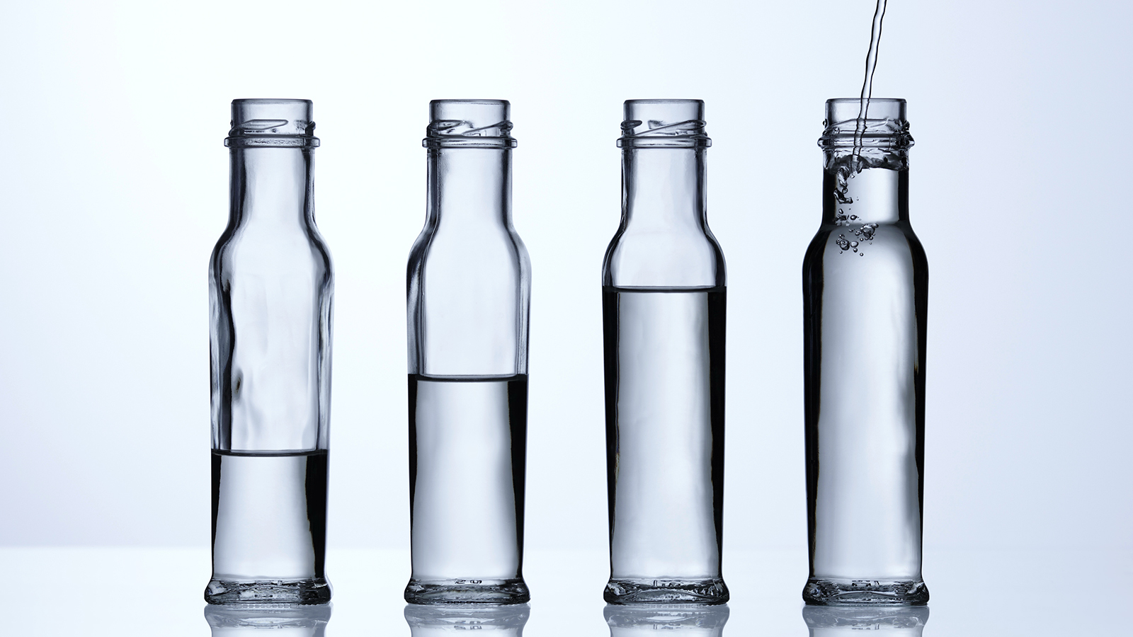
9. Bottle tone
Take an empty bottle and blow air across its mouth to produce a sound. Now fill the bottle with some water and study how the sound changes.

Slide 3
Outline
Theoretical introduction
Experiment
Results
Changing volume
Changing neck length
Results
Discussion and comparison
Parameters
Helmholtz resonance

Slide 4
Why a tone is produced
The bottle is effectively a Helmholtz resonator
The air in the neck acts as a weight
The air in the bottle acts as a spring
Losses: friction, heat, sound
The air blown over the bottle keeps the oscillations going

Slide 5
Quantitative description
Helmholtz resonator formula
k
c – speed of sound in air
A – neck cross-section
l_{eq} – neck equivalent length (neck length + 0.3 · diameter)
V – bottle volume

Slide 6
parameters
Volume of air in the bottle (V)
Neck dimensions (A, L)
Hard to measure accurately for most bottles
Speed of sound
Unchanged
Two bottles
Influence of different bottle necks
Experiment repeatability test

Slide 7
HYPOTHESES
The frequency will rise when water is added into the bottle
The frequency will be inversely proportional to the square root of the volume of the air in the bottle
The coefficient obtained from the first experiment will describe the frequency for different neck lengths reliably

Slide 8
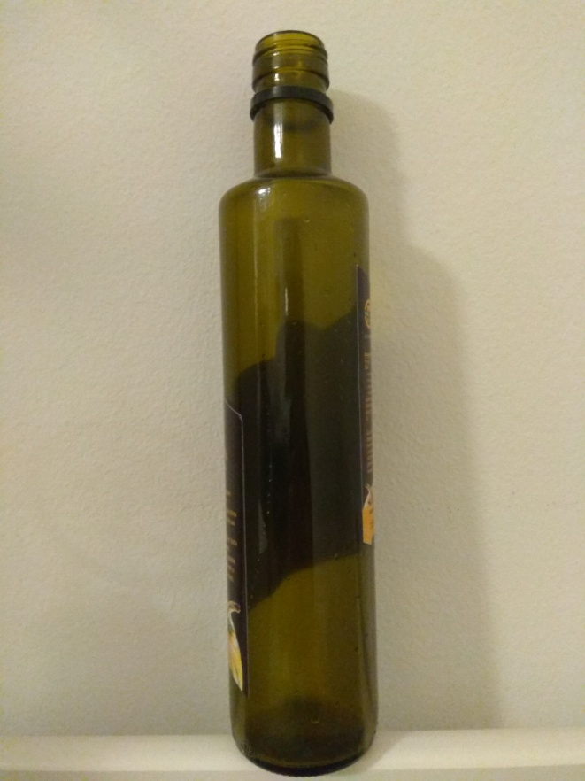
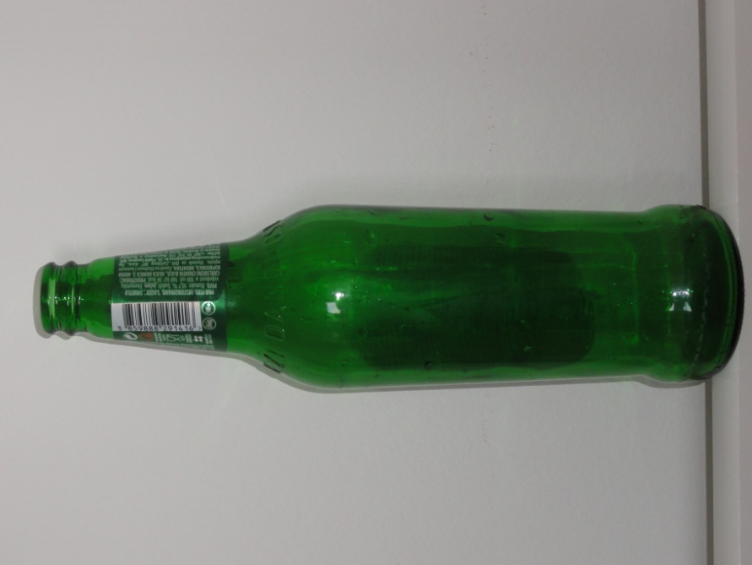
Experimental setup
Two glass bottles with a volume of 0.5 L
10 mL syringe
Ruler
Bottle A
Bottle B

Slide 9
Experimental setup
Digital calipers

Slide 10
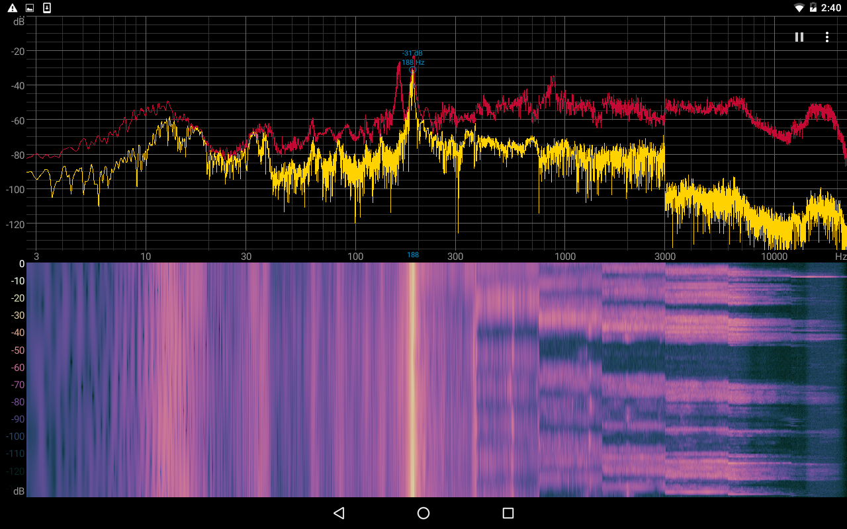
Experimental setup
Frequency peak
A tablet with the Spectroid application
±1 Hz accuracy, ±0.5 Hz precision

Slide 11
Measuring process
Water - 20 mL increments
Air blown over the bottle to produce a clean tone
Frequency didn’t depend on the blowing force
Measured on the tablet
Stopped measuring when a clean tone could no longer be produced
Bottle A - 420 mL
Bottle B - 440 mL
Mouth dimensions
Measured with the ruler and the calipers

Slide 12
Bottle dimensions
 | Bottle A | Bottle B
Mouth diameter/cm | 2.60 | 2.04
Mouth cross section/cm | 5.31 | 3.27
Neck length/cm² | 7.3 | 5.2
Equivalent neck length/cm | 8.08 | 5.81
Theoretical coefficient of proportionality/(cm^{3/2}/s) | 4400 | 4100
The bottles have the same volume, so bottle A is expected to produce higher frequencies
I was able to measure the neck of bottle B much more accurately

Slide 13
Measurement Results
A B
The points describe a curve nicely, no sudden changes

Slide 14
Discussion – bottle A
y=4400x^{-0.5}
Small error of the exponent (2%), large error of the coefficient (12.1%)

Slide 15
Discussion – bottle b
y=4100x^{-0.5}
Small error of the exponent (2%) and the coefficient (4.1%)

Slide 16
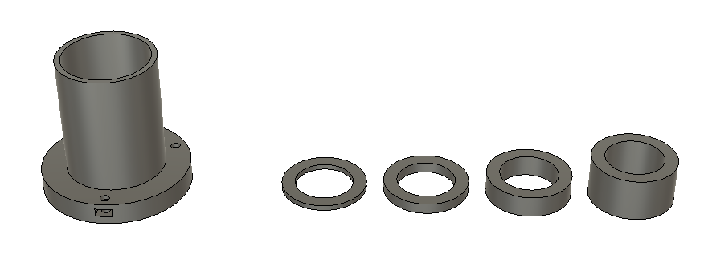
Neck length changing
3D printed neck extender
Designed in Autodesk Fusion 360
Disks for matching the neck diameter
Steps of 2 mm
5 measurements for each length

Slide 17
results
Excellent prediction using the coefficient from previous measurements (1.3% max error)

Slide 18
conclusion
The frequency will rise when water is added into the bottle
The frequency will be inversely proportional to the square root of the volume of the air in the bottle
The coefficient obtained from the first experiment will describe the frequency for different neck lengths reliably
The weak point is measuring the neck dimensions
It has an irregular shape on most bottles
If it has a regular shape, the results are very close to the theoretical expectations

Slide 19
Literature
http://www.sarazhandpans.com/handpan-resonance-and-wave-interference/
http://www.plastixportal.co.za/css_pages/nissei_asb.html
https://people.seas.harvard.edu/~jones/cscie129/nu_lectures/lecture3%20/ho_helmholtz/ho_helmholtz.html
https://newt.phys.unsw.edu.au/jw/Helmholtz.html
https://en.wikipedia.org/wiki/Helmholtz_resonance
Kulišić: Mehanika i toplina, 1988, Školska knjiga

Slide 20
Thank you!
Team Croatia
Reporter: Grgur Premec

Slide 21
Testing accuracy
Online tone generator (accuracy checked with oscilloscope)
Max 1 Hz error throughout the bottle frequency range

