Slide 1
1. Buffon‘s needle
Team Croatia
Reporter: Marko Šarić

Slide 2
1. Buffon‘s needle
Draw a series of parallel equally spaced lines on a horizontal surface. Pick a bunch of sticks (e.g. matches or needles) slightly shorter or longer than the separation between the lines, and randomly drop them on the surface. It is claimed that the number of times the sticks cross the lines allows estimating the constant π to a high precision. What accuracy can you achieve?

Slide 3
Demonstration of the phenomenon

Slide 4
Outline
Theoretical introduction
Experiment
Results
Probability of crossing the line
Equipment
Group vs. Single stick
Height testing
Comparison of results
Changing needle-track ratio
Program simulations

Slide 5
Probability of crossing the line
a= stick lenght
Two parallel lines$D_{1}$, $D_{2}$with distance b
$a<b, a=b,a>b$.
Probability of crossing one line x 2
Whether the stick cross the line depends of:
distance d
angle α
$$a\sin{\text{α}}$$

Slide 6
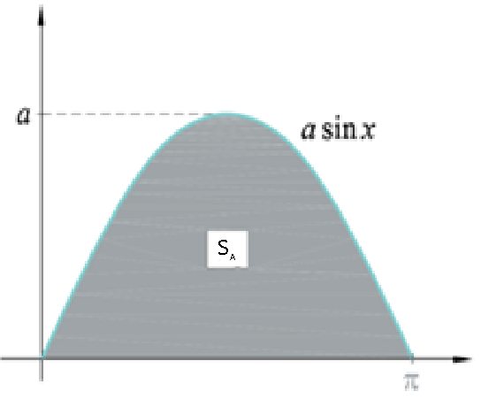
Probability of crossing the line
$$A=\left\{\left(\text{α},d\right):0≤\text{α}≤π,0≤d≤b,d<a\sin{x}\right\}$$
$$B=\left\{\left(\text{α},d\right):−π≤\text{α}≤π,0≤d≤b\right\}$$
$$α$$
$$d$$
2π
$$d$$
$$S_{A}$$
$$S_{B}$$
b
$$α$$
$$S_{B}=2πb$$
$$S_{A}=2a$$

Slide 7
Probability of crossing the line
Provided that $d<a\sin{\text{α}}$ stick will cross the line.
$S=\frac{S_{A}}{S_{B}}=\frac{2a}{2πb}=\frac{a}{πb} ⇒ 2S=\frac{2a}{πb}$
$$π=\frac{2na}{mb}$$
$$a\sin{\text{α}}$$
$$⇒ π=\frac{2na}{mb}$$
$n−total number of thrown sticks$
$m−the number of sticks crossing the line$
$a−lenght of the stick$
$b−the distance between the lines$

Slide 8
Hypotheses
1 Deviation will decrease by increasing number of throws.
Const.
$$n∈ ℕ$$
$$π=\frac{2a}{b}∙\frac{n}{m}$$
$$m∈\left[1, n\right]$$

Slide 9
Hypotheses
1 Deviation will decrease by increasing number of throws
2 Single stick throwing is better than group throwing
3 Height will not affect accuracy of results
4 Approximation accuracy will not depend of needle-track ratio (a/b)

Slide 10
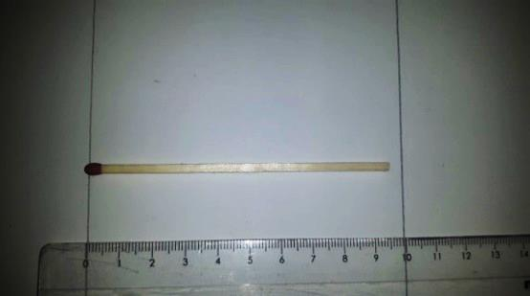
Experimental setup
2700 matches
one by one →40cm →parallel to the floor
a=9.5cm
b=10 cm, 9.5cm, 9 cm
Distance betwen lines (b=10cm)
Stick lenght (a=9,5cm)

Slide 11
Changing a:b ratio
$n−total number of thrown sticks$
$m−the number of sticks crossing the line$
$a−lenght of the stick$
$b−the distance between the lines$
$π=\frac{2na}{mb}$
X - deviation from $π$
ideally 0
$a<b$
$b=10cm$
$X=\text{0,}\text{148593}\text{...}$
$a>b$
$b=9cm$
$X=0,082011…$
$a=b⇒ π=\frac{2n}{m}$
$X=0,00023140…$

Slide 12
number of throws deviation
smallest deviation a=b
the biggest deviation a<b
Hypothesis 1

Slide 13
Smallest deviation → a=b
The biggest deviation → a<b
Simulation fits experimental results

Slide 14
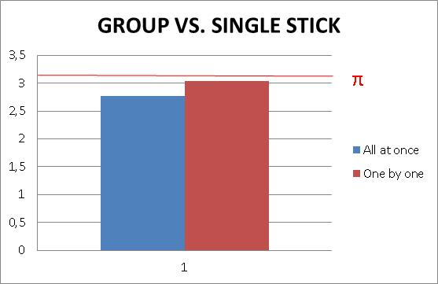
Group vs. Single stick
I thrown sticks all at once from height of 40 cm and compared results with throwing one by one.
Hypothesis 2

Slide 15
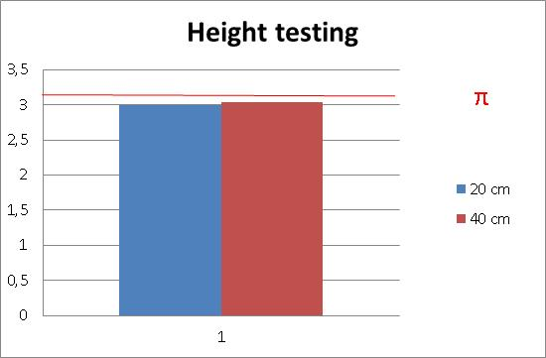
Height testing
Two heights→ 20 cm, 40 cm
Height does not affect accuracy of results

Slide 16
Hight equal to stick lenght
Height $≤$ stick lenght →inaccurate results
Then we are controling will stick cross the line or not.
Hypothesis 3

Slide 17
Dependance on the needle-track ratio (a/b)
The program variates the needle length
The track width is constant
Approximation accuracy will not depend of needle-track ratio (a/b).
a<b
a>b
Hypothesis 4

Slide 18
Conclusion
1 Deviation will decrease by increasing number of throws.
2 Single stick throwing is better than group throwing.
3 Height will not affect accuracy of results.
Height $≤$ stick lenght
Height $>$ stick lenght
4 Approximation accuracy will not depend of needle-track ratio (a/b).

Slide 19
Literature
http://www.mathematica-journal.com/issue/v11i1/contents/BuffonsNeedle/BuffonsNeedle.pdf (4.11.2017)
http://mis.element.hr/fajli/560/09-04.pdf (4.11.2017)
https://web.math.pmf.unizg.hr/nastava/uuv/files/ch5.pdf (4.11.2017)
https://www.cut-the-knot.org/fta/Buffon/buffon9.shtml (10.11.2017)

Slide 20
Thank you!
Team Croatia
Reporter:Marko Šarić

Slide 21
Additional slides (CODE #1)

Slide 22
Additional slides (CODE #2)

Slide 23
Way of throwing | Totalnumberofthrownsticks/n | Numberofstickscrossingtheline/m | $$x−\text{Estimate} π$$
All at once | 2700 | 1835 | 2.7715...
Oneby one | 2700 | 1693 | 3.0301...
Height | Totalnumberofthrownsticks/n | Numberofstickscrossingtheline/m | $$x−\text{Estimate} π$$
20 cm | 2700 | 1712 | 2.9965...
40 cm | 2700 | 1693 | 3.0301...
$a>b$
m$=1863$
$b=9cm$
$X=0,082011…$
$a=b⇒ π=\frac{2n}{m}$
$m=1719$
$X=0,00023140…$
$a<b$
m$=1714$
$b=10cm$
$X=\text{0,1114686}\text{...}$

Slide 24
Dependance on the number of throws
The program variates the number of throws of the needle
It repeats the experiment for 1, 5,10, 25, 50, 75, 100, 250, 500, 750 and1000 throws

Slide 25
Additional slides (CODE #3)

Slide 26
Programming
In order to completely randomize the fall of the needle, I devised a program in the programming language Python
The program randomises the position between two lines where the needle must fall and its orientation when it falls
These values manifest as the minimal distance of the needle from the line and the angle between the needle and the line
The action of falling is repeated a thousand times

