Slide 1
5.collision
Team Croatia
Reporter: Grgur Premec

Slide 2
Theory
A highly elastic super ball collides with a rigid surface. How can one determine the collision time? Propose various techniques and compare the experimental results.
Explore different measuring methods
Analyse the results
Compare the methods

Slide 3
Outline
Theoretical introduction
Experiment
Results
Collision theory
Accuracy and precision
Ball as a switch
Piezo element
Individual results
Comparison
Force sensor

Slide 4
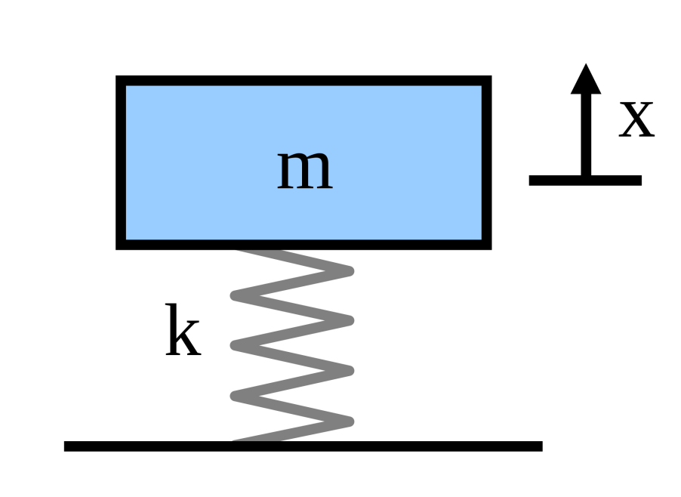
Theory
Mass on a spring
Collision time
Depends on the mass and the stiffness of the ball and the impact surface
Doesn’t depend on the velocity
m - mass
k - elasticity coefficient

Slide 5
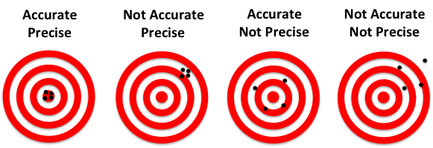
Measurement errors
Precision
The spread of individual data points
Accuracy
The difference of data points and the actual value

Slide 6
Hypotheses
1. For a given measuring method the data points won’t differ by much (parameters kept as constant as possible)

Slide 7
Hypotheses
1. For a given measuring method the data points won’t differ by much (parameters kept as constant as possible)
2. Different measuring methods may exhibit significant differences

Slide 8
Hypotheses
1. For a given measuring method the data points won’t differ by much (parameters kept as constant as possible)
2. Different measuring methods may exhibit significant differences
3. The DIY methods (electrical switch, piezo) will be less precise than the professional equipment (electronic dynamometer)

Slide 9
Equipment
Elastic bouncy ball (Super Ball)
Diameter = 42.5 mm
Mass = 36 g
Coefficient of restitution 0.9341 ± 0.0066
Measured on ceramic tiles

Slide 10
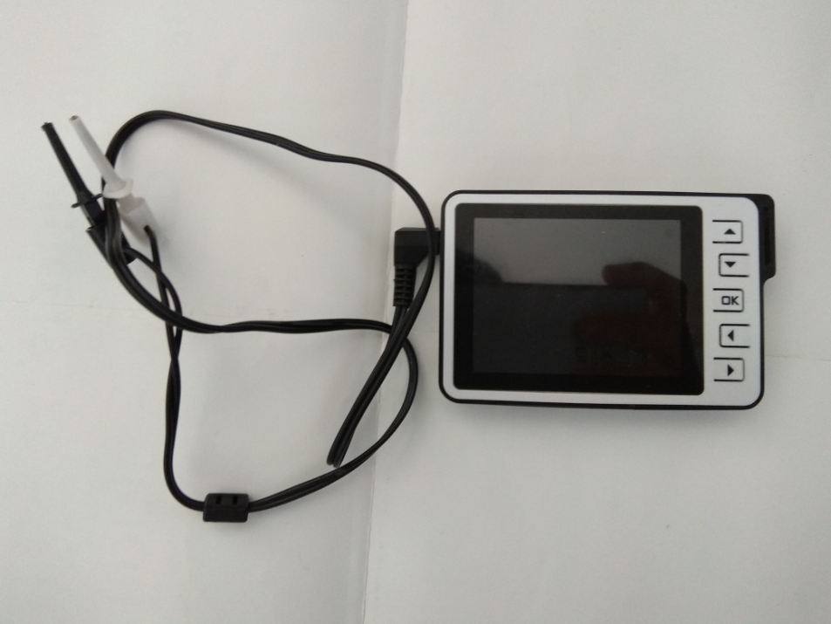
Equipment
DSO Nano V2 oscilloscope
For measuring impact duration
10 µs resolution

Slide 11
Equipment
Lego ball dropping mechanism
Constant height (75 mm)
Precise landing
Roller bearings

Slide 12
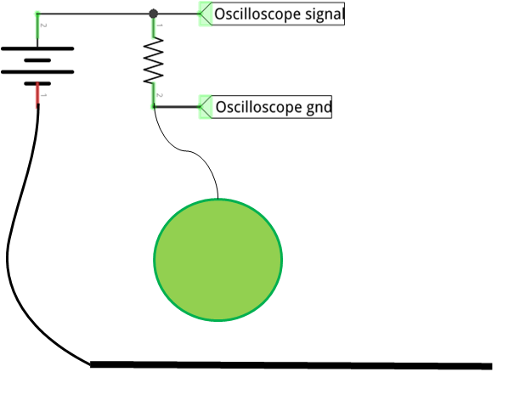
Method 1: conductive ball
Measuring the time interval during which the circuit is closed
Problem: the ball is not conductive
elastic ball
conductive plate
v

Slide 13
Method 1: fixing the problem
Ball as a switch
Wrapped in a thin strip of aluminum foil
Connected to the electrical circuit with 0.25 mm wire
Very small influence on the the collision

Slide 14
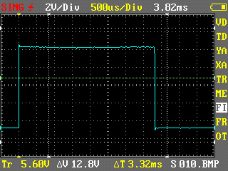
Method 1: measurement example
100 measurements
Impulses
Clean edges
Square shape
Oscilloscope screenshot

Slide 15
Method 1: results
Results
Mean: 3.89 ms
Standard deviation 0.106 ms

Slide 16
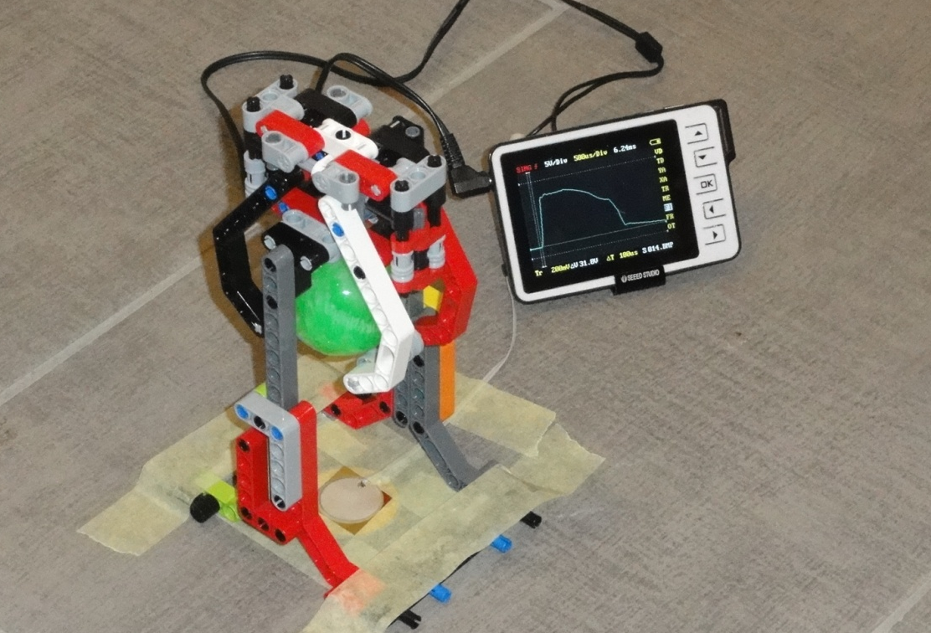
Method 2: experimental setup
Floor: ceramic tiles on concrete
Oscilloscope
Dropping mechanism
Piezo crystal

Slide 17
Method 2: experimental setup
Piezoelectric crystal
Taped to the floor and centered under the mechanism
Wires secured to the floor
Movement of wires deformes the crystal so voltage is induced

Slide 18
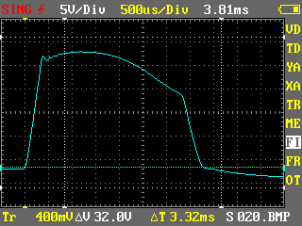
Method 2: measurement example
100 measurements
Impulses not as rectangular
Oscilloscope screenshot

Slide 19
Method 2: results
Results
Mean: 3.77 ms
Standard deviation: 0.07 ms
Narrower distribution

Slide 20
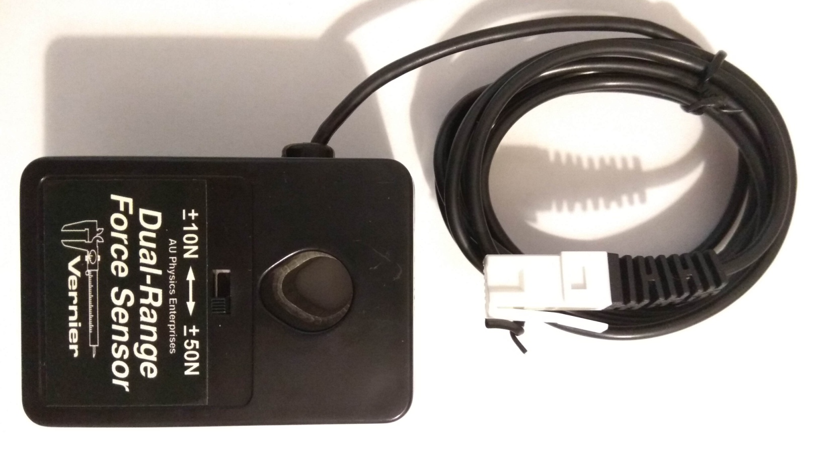
Method 3: force sensor
Vernier force sensor
Measuring force during collision
Professional equipment

Slide 21
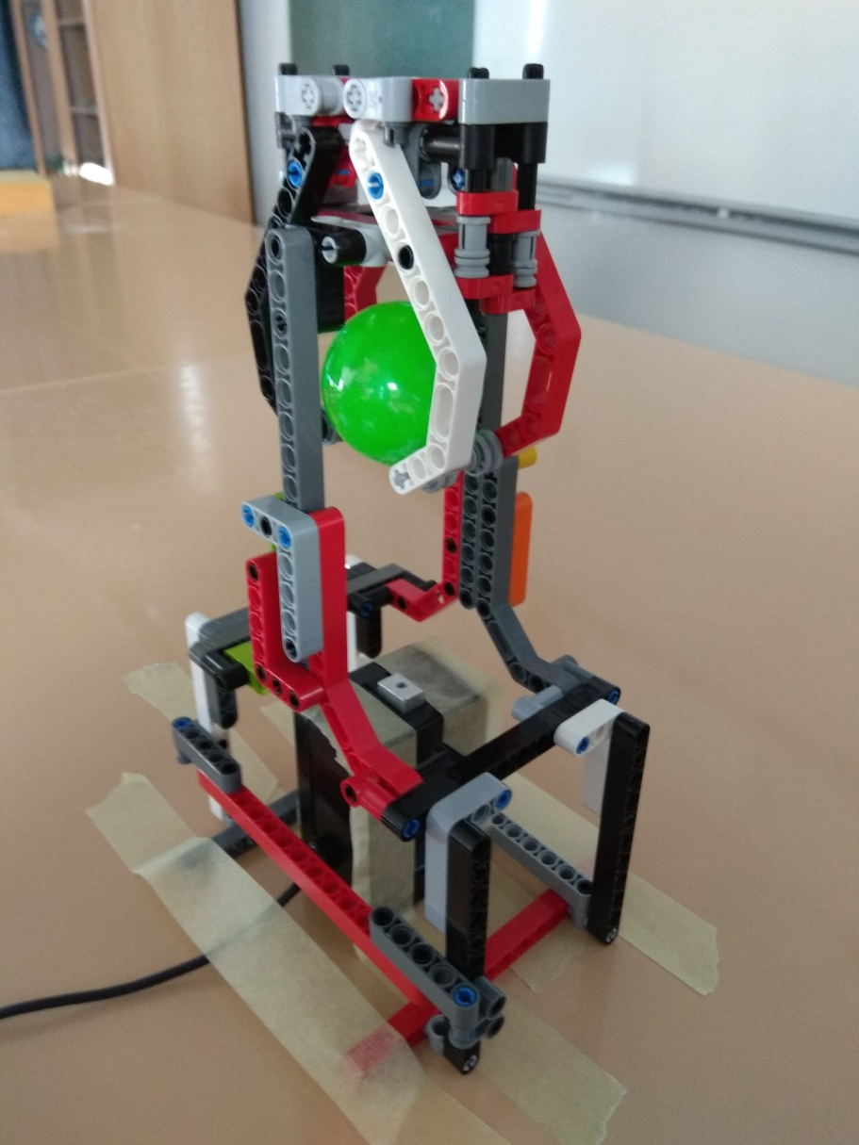
Method 3: experimental setup
Force sensor
Taped to the floor
Centered precisely under the ball
Modified ball dropping mechanism
Accomodate for additional sensor height

Slide 22
Method 3: results
Mean: 5.291 ms
Standard deviation: 0.143 ms
Wider distribution

Slide 23
Comparison
The piezo and the contact measuring methods give similar results, the force sensor is different
Force sensor is less rigid or accurate

Slide 24
Comparison
The piezo is the most precise (tightest distribution), followed by the contact sensor and than the force sensor

Slide 25
conclusion
For a given measuring method the data points won’t differ by much (parameters kept as constant as possible)
All of the methods have small standard deviations
Different measuring methods may exhibit significant differences
The force sensor has the widest distribution
The impact plate seem to have some flex that influences the impact duration
The DIY methods (electrical switch, piezo) will be less precise than the professional equipment (electronic dynamometer)
The piezo element was the most precise method

Slide 26
Literature
https://commons.wikimedia.org/wiki/File:Mass_spring.svg
Walker, Jearl (2011). Principles of Physics (9th ed.). Hoboken, N.J. : Wiley. ISBN 0-470-56158-0.
Thornton, Stephen T.; Marion, Jerry B. (2003). Classical Dynamics of Particles and Systems (5th ed.). Brooks Cole. ISBN 0-534-40896-6.
John R Taylor (2005). Classical Mechanics. University Science Books. ISBN 1-891389-22-X.
Grant R. Fowles; George L. Cassiday (2005). Analytical Mechanics (7th ed.). Thomson Brooks/Cole. ISBN 0-534-49492-7.
https://www.dnasoftware.com/our-products/copycount/precision-and-accuracy/

Slide 27
Thank you!
Team Croatia
Reporter: Grgur Premec

Slide 28
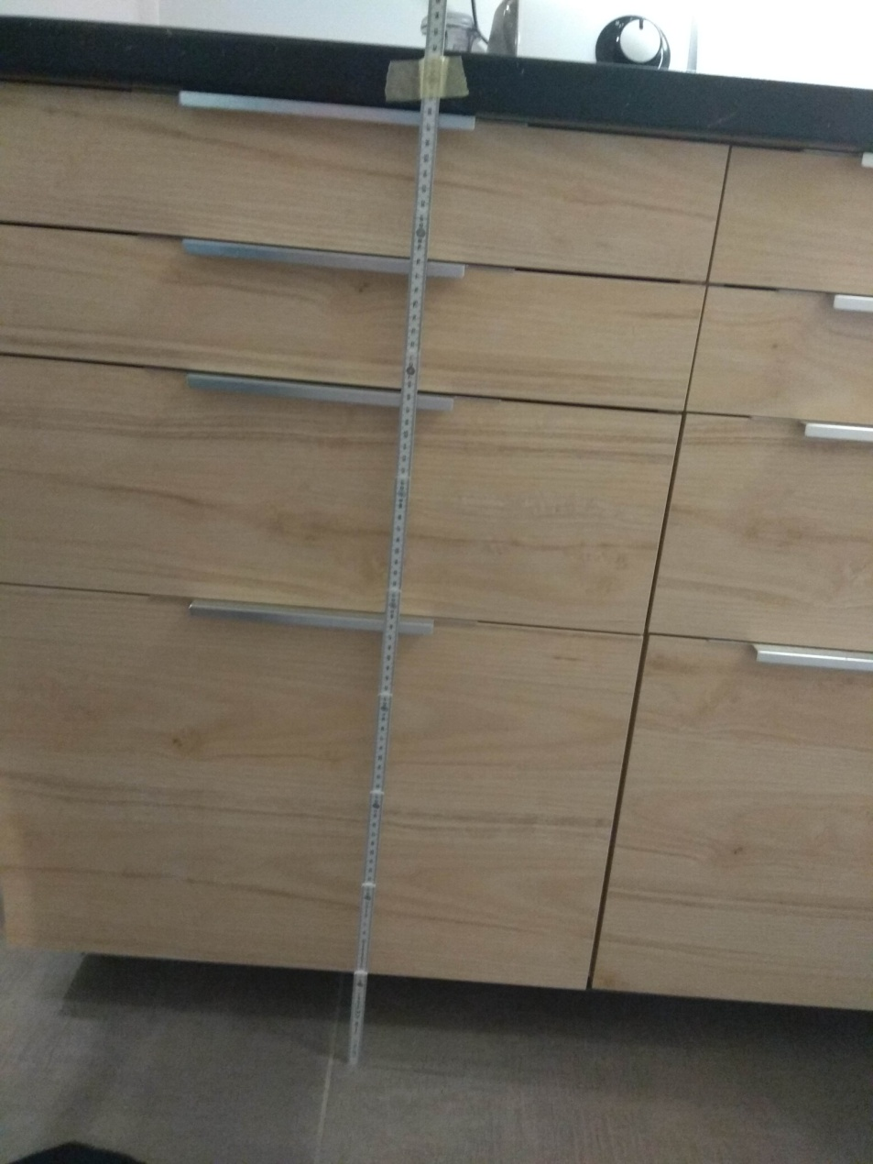
Coefficient of restitution
Measuring stick
Filmed in slow motion
120 fps using a phone
Dropped from the same height

Slide 29
Additional slides
Done some other cool stuff, but couldn’t put everything in the presentation?
The whole theory behind your problem can’t fit into five slides?
You have an idea what your opponent might ask?
Put it all in the additional slides!
Their number is unlimited :)

