Slide 1
26. Dominoes
Team Croatia
Reporter: Elena Lukačević

Slide 2
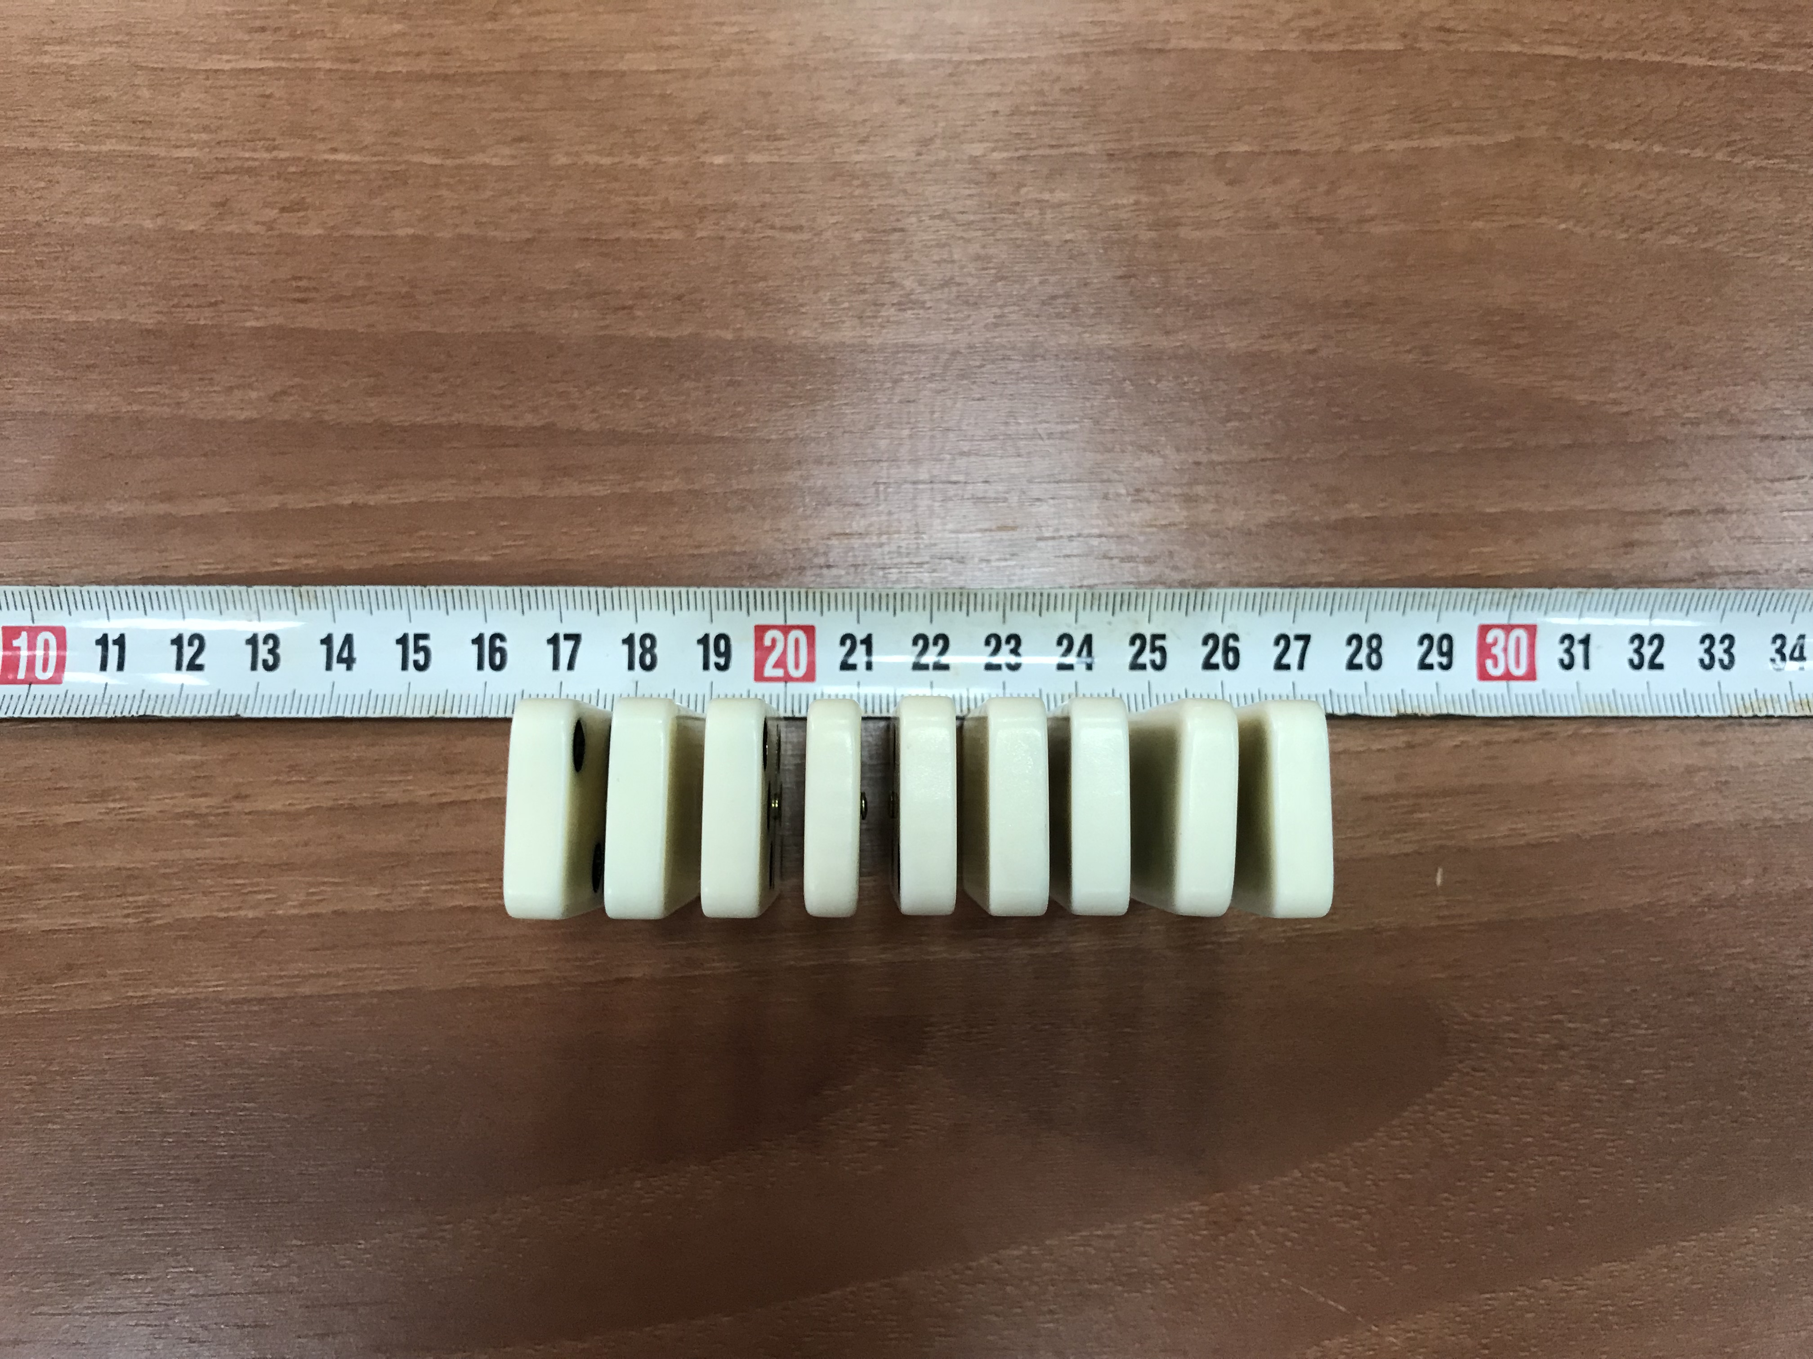
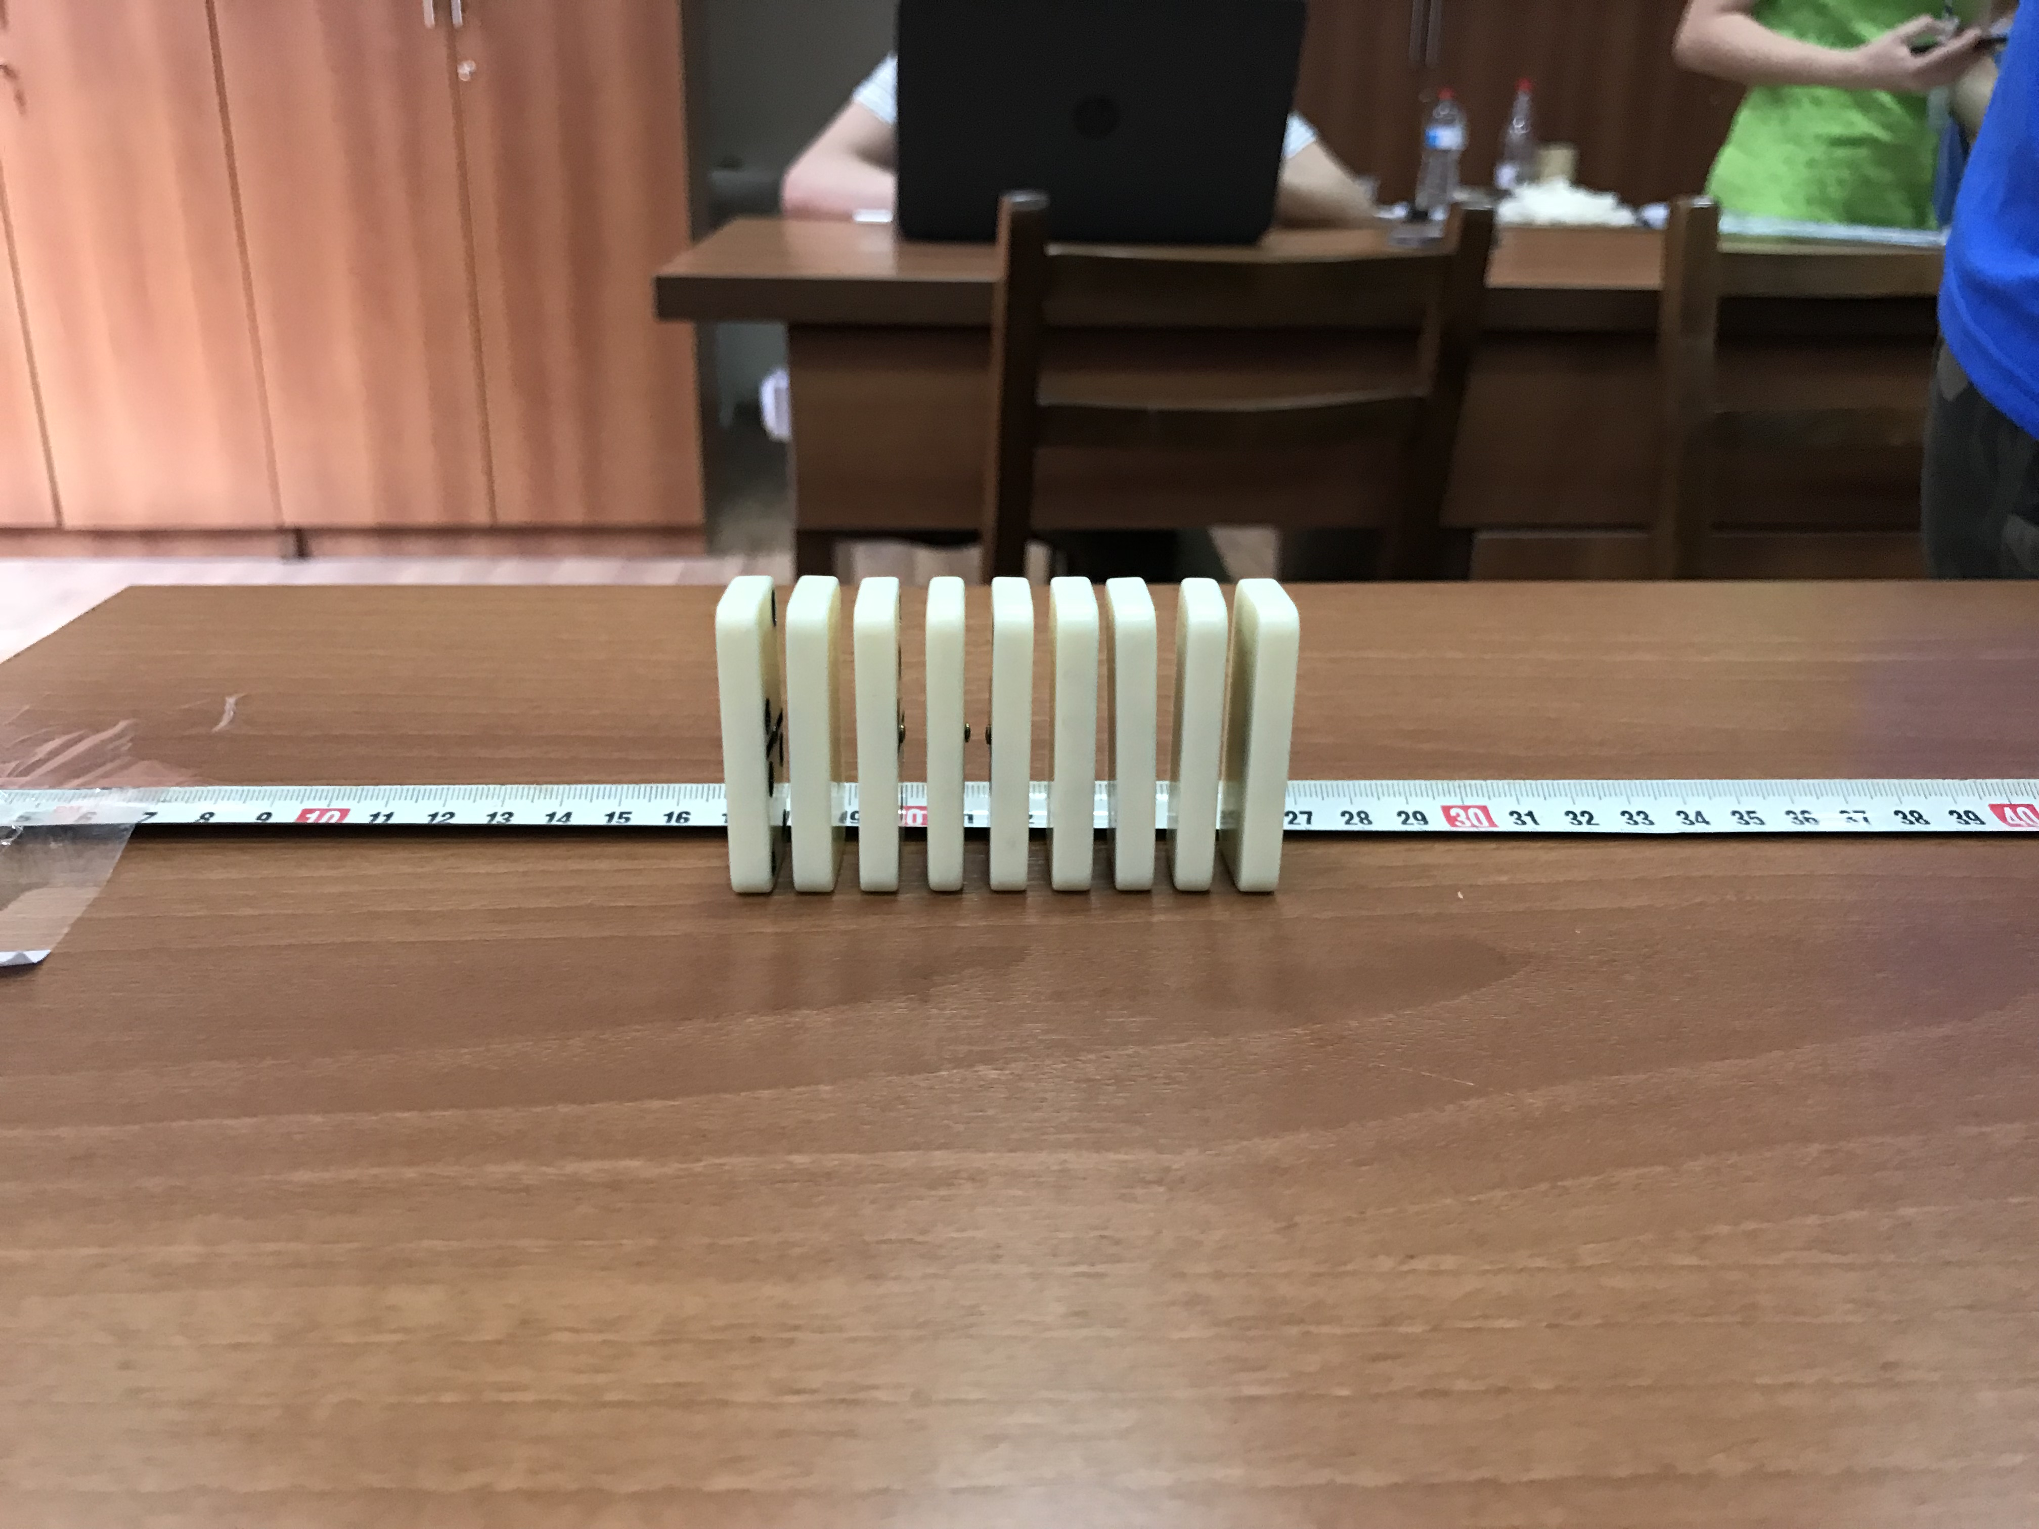
1. NAME OF THE PROBLEM
Stand a number of domino tiles in a long row and topple the first tile. Investigate the speed of toppling dominoes. Does it depend on the distance between the tiles?

Slide 3
Demonstration of the phenomenon

Slide 4
Outline
Theoretical introduction
Experiment
Results
Velocity calculation
Changing distance between the tiles
Result discussion

Slide 5
Theoretical Introduction
$$v=\frac{s[m]}{t[s]}$$
v – velocity [m/s]
s – distance of first and last domino [m]
t – time [s]

Slide 6
Hypothesis
Smaller distance → Bigger velocity

Slide 7
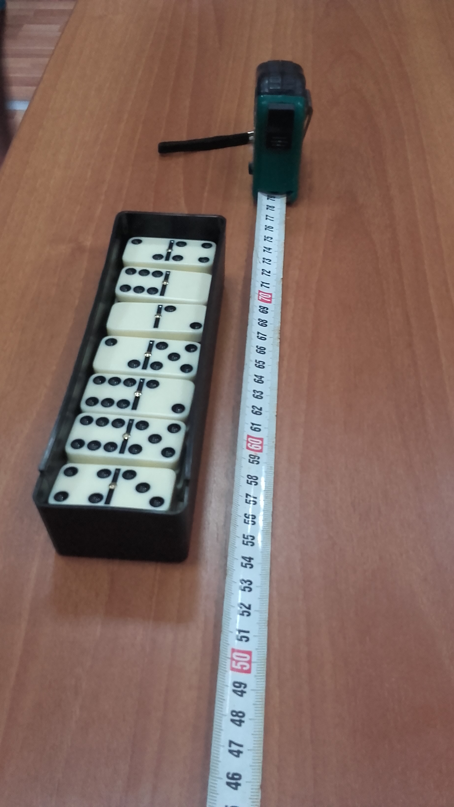
Experiment
20 dominos in a row
Distances: 2 cm, 2.5 cm, 3 cm, 3.5 cm
Measuring time with 5 stopwatches
Measurements repeated 3 times

Slide 8
Results

Slide 9
Results

Slide 10
Conclusion
We have investigated the speed of toppling dominoes.
By the bigger distance dominoes are toppling faster until the distance is bigger than domino tile’s height.

Slide 11
Thank you!
Team Croatia
Reporter: Elena Lukačević

Slide 12
Additional slides

