Slide 1
6. EYE Color
Team Croatia
Reporter: Ana Ćenan

Slide 2
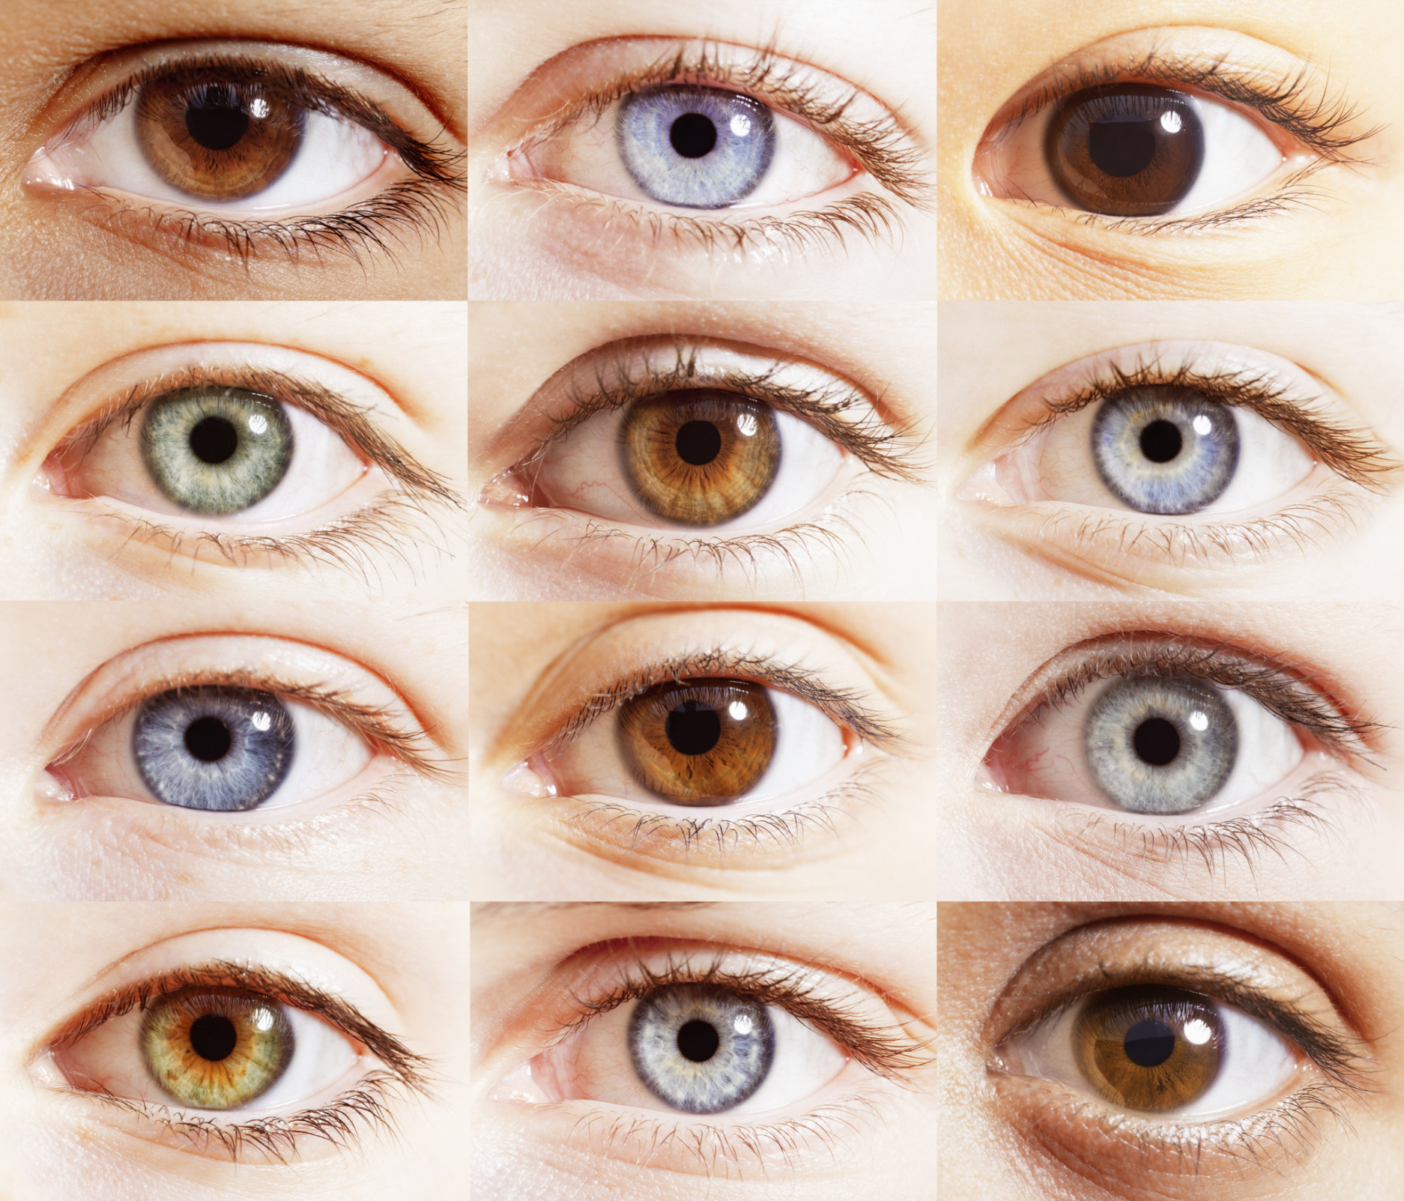
6. EYE COLOR
In certain human populations, genetics allows predicting inheritance of eye color among family members. In other populations of the present day World, nearly everyone has the same eye color. What information is it possible to determine about the eye colors in both distant and close ancestors, descendants, and relatives of one living person?

Slide 3
Outline
Theoretical introduction
Experiment
Results
Mendel's Laws
Basics about eye colour
Methods and measurements
Data processing
Conclusions

Slide 4
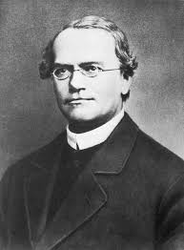
Mendel´s laws
Law of segregation
One allele we get from our mother and one from our father
Homozygous – identical pair of alleles
Heterozygous – two different alleles
Two types of alleles:
- dominant
- recessive

Slide 5
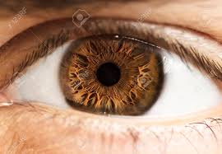
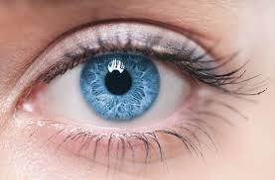
Eye color
Heritable characteristic determined by production of melanin in the iris
Blue eye color – recessive characteristic
Brown eye color – dominant characteristic

Slide 6
Genotype vs phenotype
AA Aa aa ➔ Genotype
brown blue ➔ Phenotype

Slide 7
hypoteses
Eye color is not determined by one gene only
Inheritance of eye color does not depend on the gender of a person

Slide 8
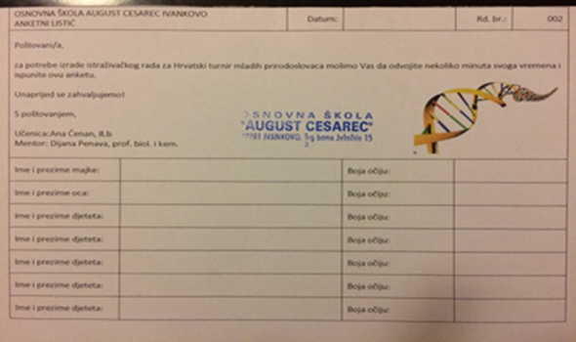
Methods and measurements
Questionnaire
5th to 8th grade students
One questionnare – one family
Categorized to three groups by parent´s eye color
questionnaire

Slide 9
Questionnare groups
blue-blue
blue-brown
brown-brown
questionnare sorted by categories

Slide 10
REsults
DESCRIPTION | TOTAL (n)
NUMBER OF QUESTIONNARS | 163
NUMBER OF CHILDREN | 475
NUMBER OF GIRLS | 215
NUMBER OF BOYS | 260

Slide 11
Results
percentage of children in different parental groups

Slide 12
BROWN-BROWN
AA x AA
Aa x Aa
A
A
A
A
A
a
A
a
AA
Aa
Aa
aa
AA
AA
AA
AA
AA x Aa
A
A
A
a
small possibility
AA
Aa
AA
Aa

Slide 13
Results: brown-brown
blue

Slide 14
BLUE-BROWN
aa x Aa
aa x AA
a
a
A
a
a
a
A
A
aa
Aa
Aa
Aa
Aa
aa
Aa
Aa

Slide 15
Results: blue-brown group

Slide 16
BLUE-BLUE
aa x aa
a
a
a
a
aa
aa
aa
aa

Slide 17
Results: blue-blue group

Slide 18
Is there any difference between gender?
Expected value
brown-brown | male | female | sum
brown | 59 58 | 70 71 | 129
blue | 15 16 | 21 20 | 36 | χ² = 0,1438
 | 74 | 91 | 165
Observed value
brown-blue | male | female | sum
brown | 79 72 | 81 88 | 160
blue | 40 47 | 65 58 | 105 | χ² = 3,1246
 | 119 | 146 | 265
Degrees of freedom: 1
there is no difference between males and females
blue-blue | male | female | sum
brown | 2 2 | 3 3 | 5
blue | 20 20 | 20 20 | 40 | χ² = 0
 | 22 | 23 | 45

Slide 19
Conclusion
Eye color does not depend on one gene
The inheritance of eye color does not depend on gender
For future research: determination of the genotype

Slide 20
Literature
http://www.genetika.biol.pmf.unizg.hr/pogl2.html (1. 12. 2017.)
http://www.genetika.biol.pmf.unizg.hr/pogl3.html (5. 12. 2017.)
Cochran, William G. (1952). "The Chi-square Test of Goodness of Fit". The Annals of Mathematical Statistics. 23: 315–345. doi:10.1214/aoms/1177729380. JSTOR 2236678

Slide 21
Thank you!
Team Croatia
Reporter: Ana Ćenan

Slide 22
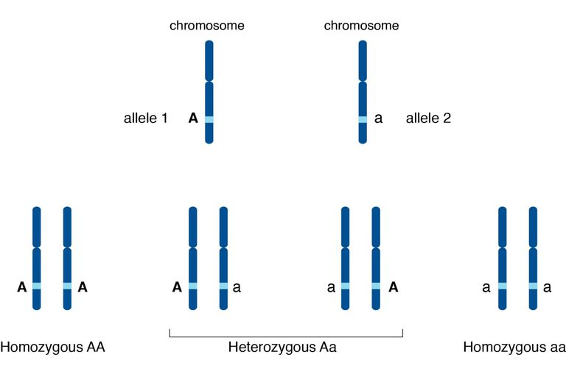
ALLELES
Genetic sequence
An alternative form of a gene
Located on a lokus of a chromosome

Slide 23
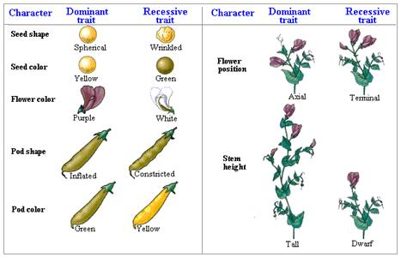
GREGOR MENDEL
Known as the "father of modern genetics„
Experimented with pea plants
Studying seven traits of pea plants
His paper was criticized at the time
It was later rediscovered

Slide 24
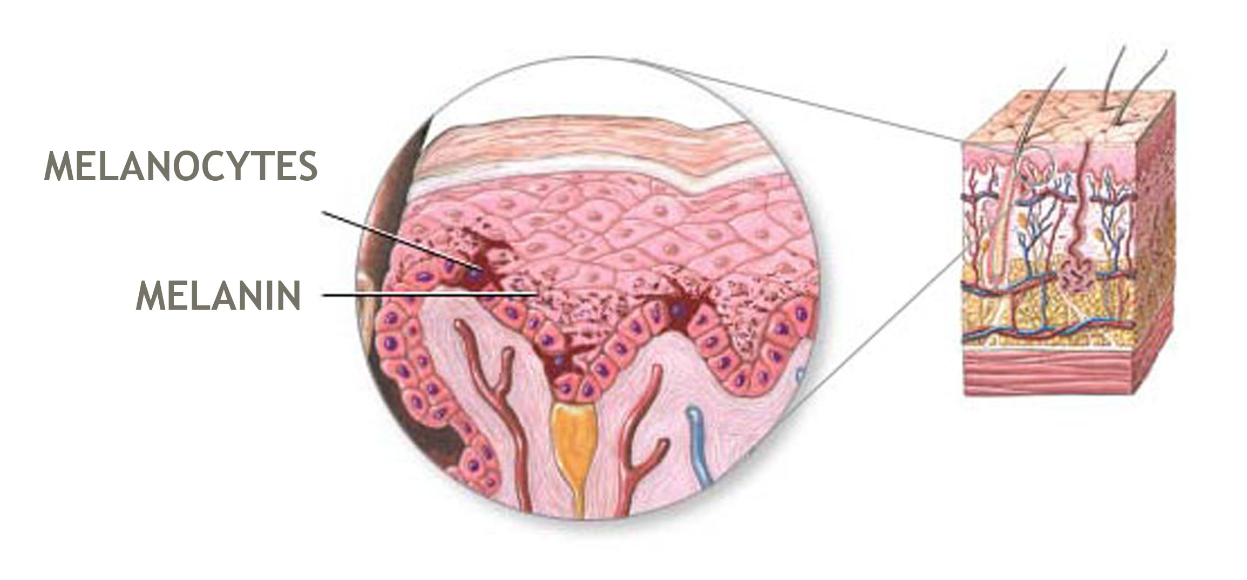
Melanin
Natural pigment
Found in nails, skin, iris and hair
Produced in melanocytes – the specialised group of cells

Slide 25
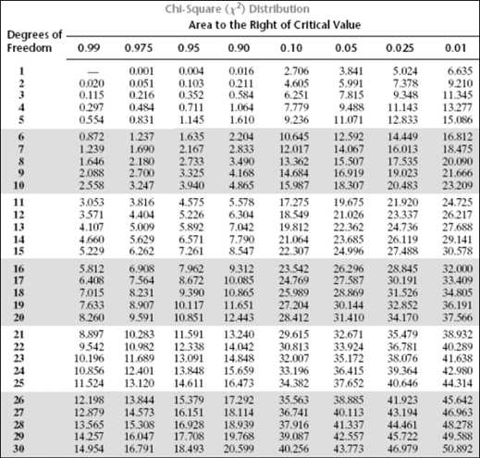
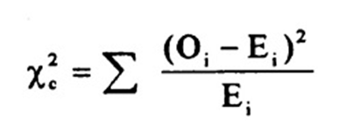
χ² test

