Slide 1
8. Fair coin
Team Croatia
Reporter: Marko Šarić

Slide 2
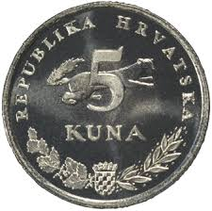
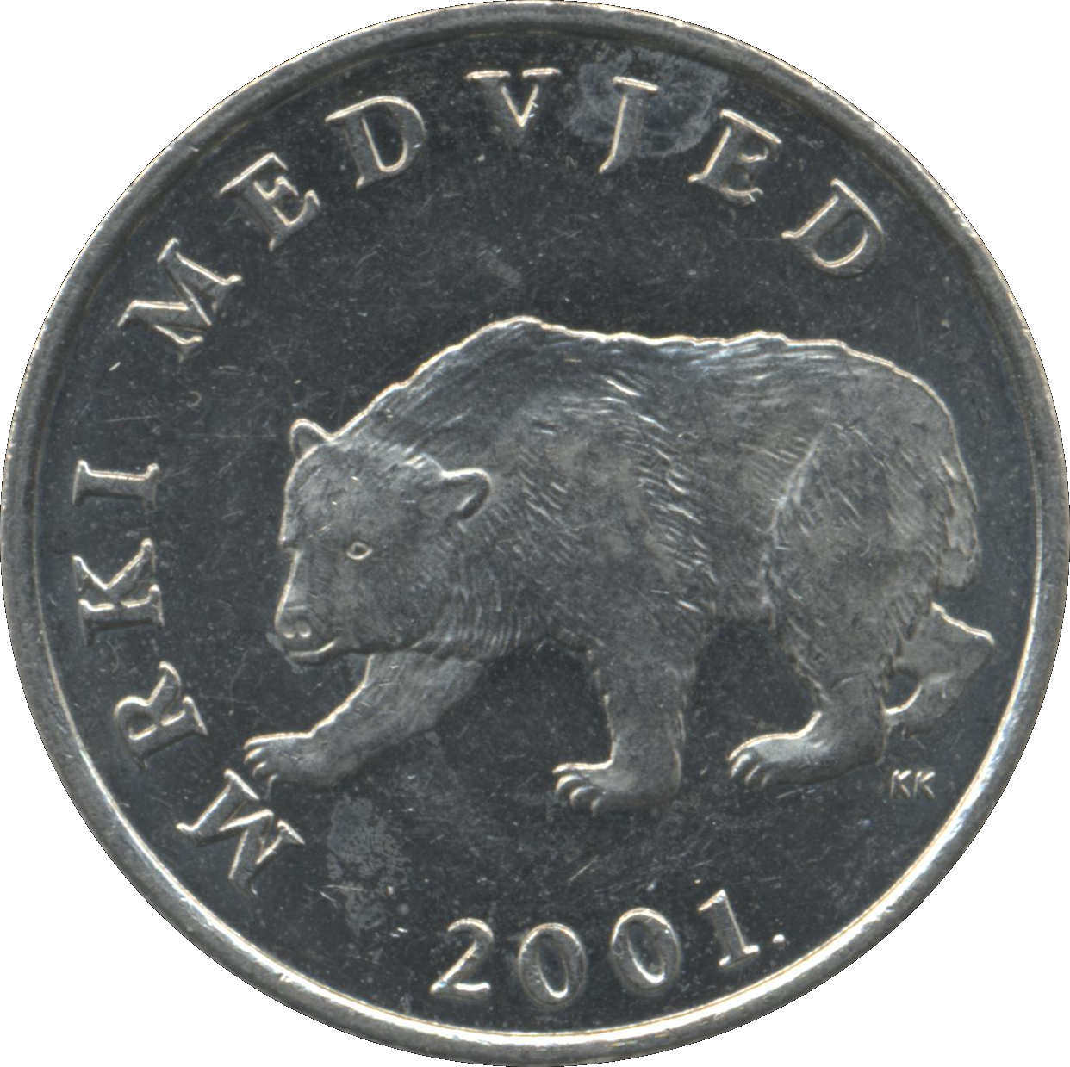
8. Fair coin
In many cases, disputes are resolved with a coin toss. It is presumed that this procedure gives equal chances of winning to both sides. Investigate how the chances depend on the tossing mechanism and the coin properties.

Slide 3
Demonstration of the phenomenon
https://dribbble.com/shots/3535524-Coin-Toss-Animation

Slide 4
Outline
Theoretical introduction
Experiment
Results
Bernoulli‘s distribution
Statistical test $χ^{2}$
Statistical test 𝜒^2
Equipment and setup
Changing parameters:
Height, Bulge, Hole
Throwing method

Slide 5
Bernoulli‘s distribution
x
used in modeling random features that can have exactly two values
p - probability of success
$$X=\left(\begin{matrix}0 & 1 \\ q & p\end{matrix}\right), p∈〈0,1〉$$
$$q=1−p$$

Slide 6
Statistical test $χ^{2}$
$$χ^{2}=\sum{\frac{{\left(f_{0}−f_{t}\right)}^{2}}{f_{t}}}$$
2 options →1° of freedom
D_{i} < 0,05 (5%) → $χ^{2}$ < 3,841
$f_{0}$ - observed frequency
$f_{t}$ - expected frequency
$χ^{2}$ - deviation of expected frequency

Slide 7
hypothesis
1 Tossing height is not important when tossing coins.
2 By increasing the number of throws the deviation will decrease.
3 When throw coins vertically chanses of winning will be closer to 50:50, than the horizontally tossing.
4 If the coin has a bulge on one side it will more often turn to the other side and if we toss a coin without the bulge the deviation will be smaller.
5 Hole in the middle will not have affect on chanses of winning for any side.

Slide 8
Experimental setup
1m
Three heights: 1m, 0.5 m, 0.25m
Free fall (tail facing up)
10 lipa coin → 1000 throws
0,5m
0,25m

Slide 9
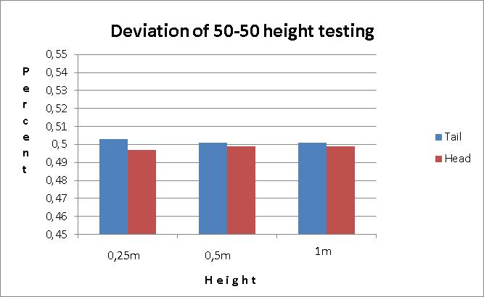
Height testing
Height does not affect chances of winning
Height testing
1m | $χ^{2}$=0,004 | $χ^{2}$<3,841
0,5m | $χ^{2}$=0,004 | $χ^{2}$<3,841
0,25m | $χ^{2}$=0,036 | $χ^{2}$<3,841

Slide 10
Very small height
10 lipa coin 20 mm in diameter
Free fall (head facing up)
100 throws → the head appeared 100 times
Hypothesis 1

Slide 11
Probability-toss number dependence
decreases to 0.5
By increasing the number of throws the deviation decreases.
Hypothesis 2

Slide 12
Way of throwing
10 lipa coin → 1000 throws → 0,5m
horizontally
vertically
tail

Slide 13
Horizontally vs vertically
Tail appeares more often
on horizontal toss
In horizontal throws side which is facing up is more probable to appear
Hypothesis 3 →
horizontally
$χ^{2}=$0,016 | $$χ^{2}<3,841$$
vertically
$χ^{2}=$0,004 | $$χ^{2}<3,841$$
>

Slide 14
Coin with a bulge vs symmetrical coin
quarter American dollar with a bulge on the head side (George Washington)
hundred Italian lira (from 1955 to 1989) without a bulge
0,5 m → 1000 throws

Slide 15
Coin with a bulge vs symmetrical coin
Head is heavier so the tail faces up more often
Symmetrical coin fals on both sides with the almost same frequency
vertically
$$χ^{2}=4,9$$ | $$χ^{2}>3,841$$
Hypothesis 4
Symmetrical coin
$$χ^{2}=0,004$$ | $$χ^{2}>3,841$$

Slide 16
Coin with a hole
five-crown Norwegian coin → hole in the middle
0,5 m → 1000 throws
horizontally (tail facing up)

Slide 17
Coin with a hole
Hole in the coin
does not affect the outcome
Hypothesis 5
Coin with a hole
$$χ^{2}=0,004$$ | $$χ^{2}>3,841$$

Slide 18
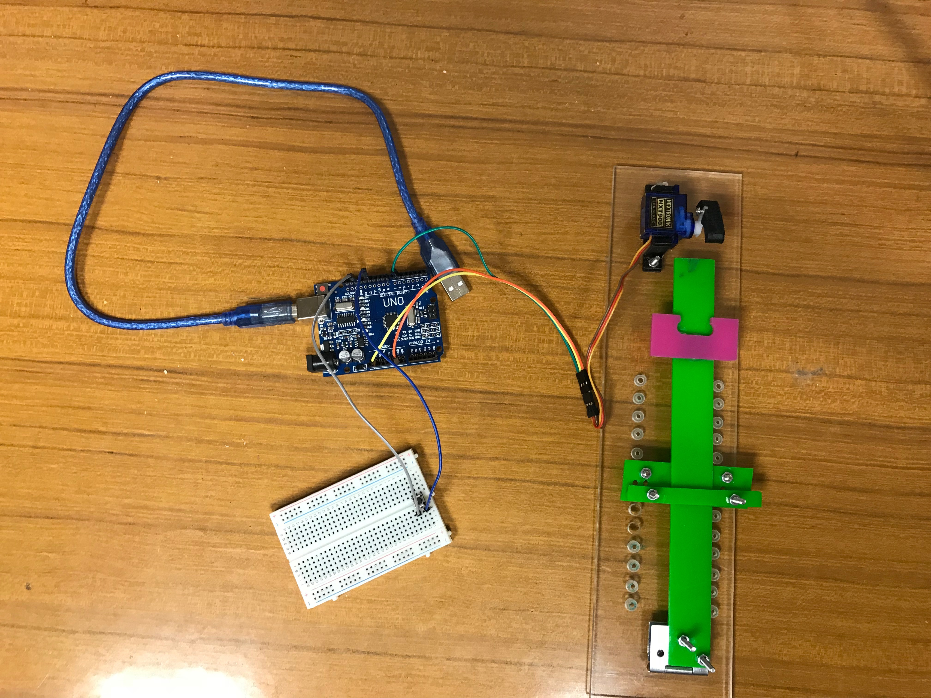
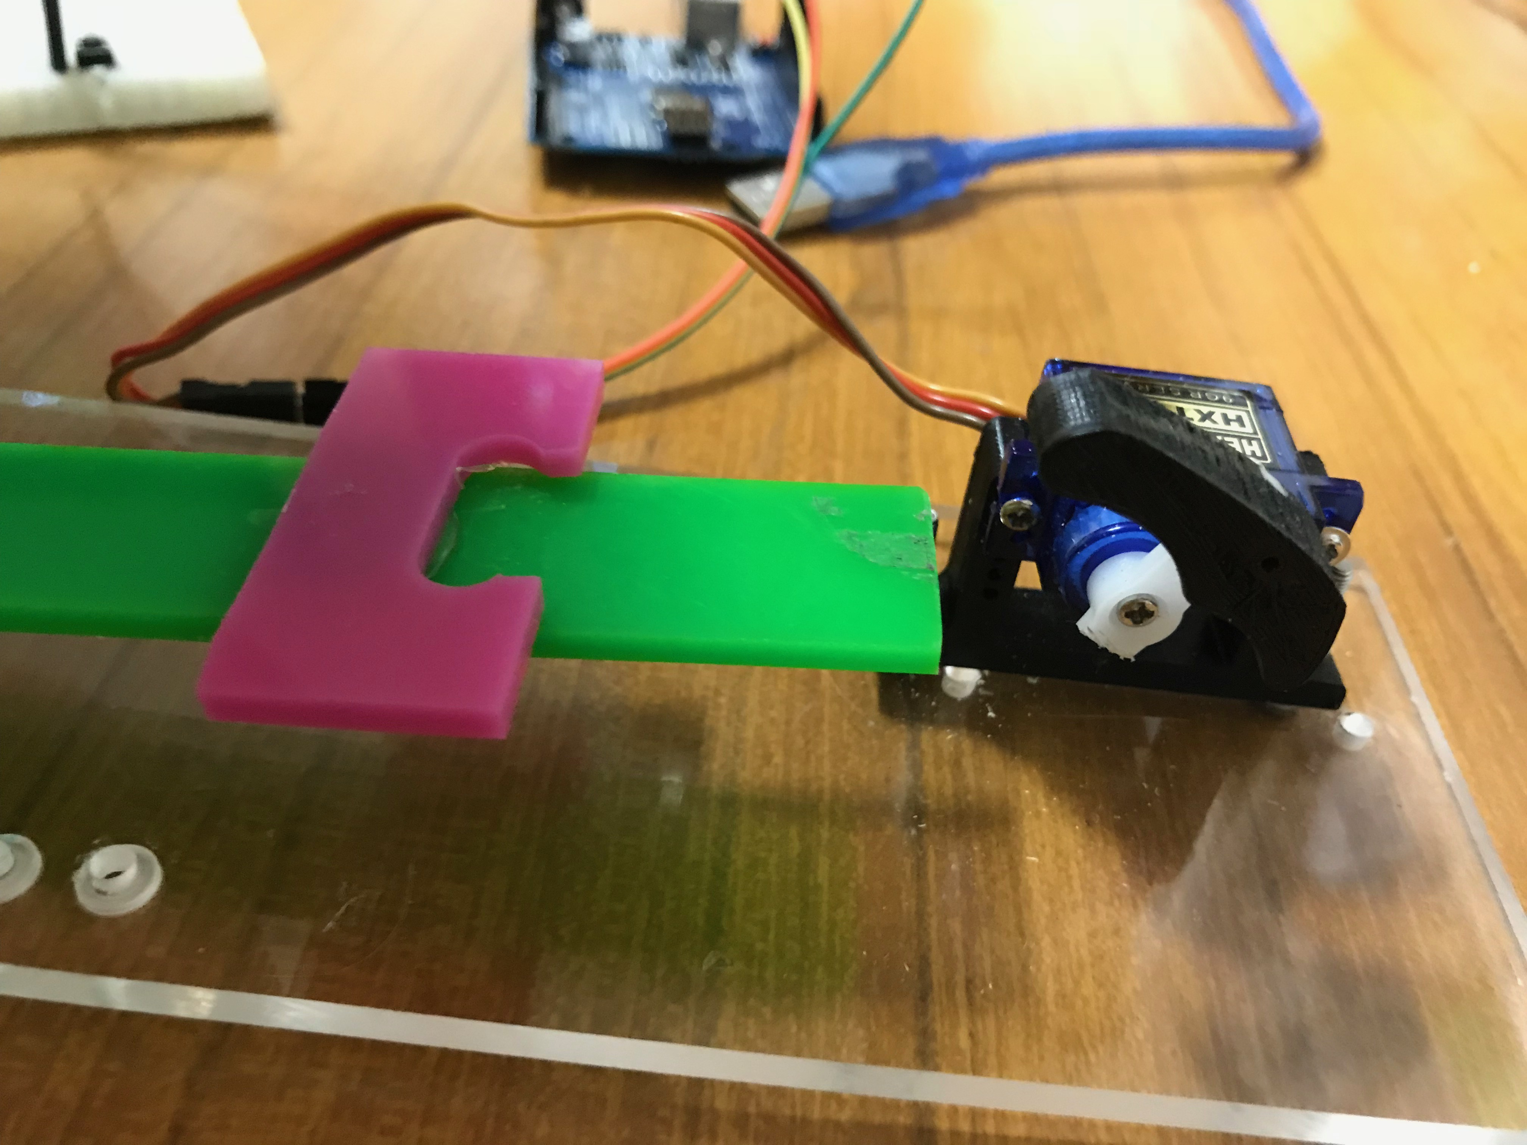
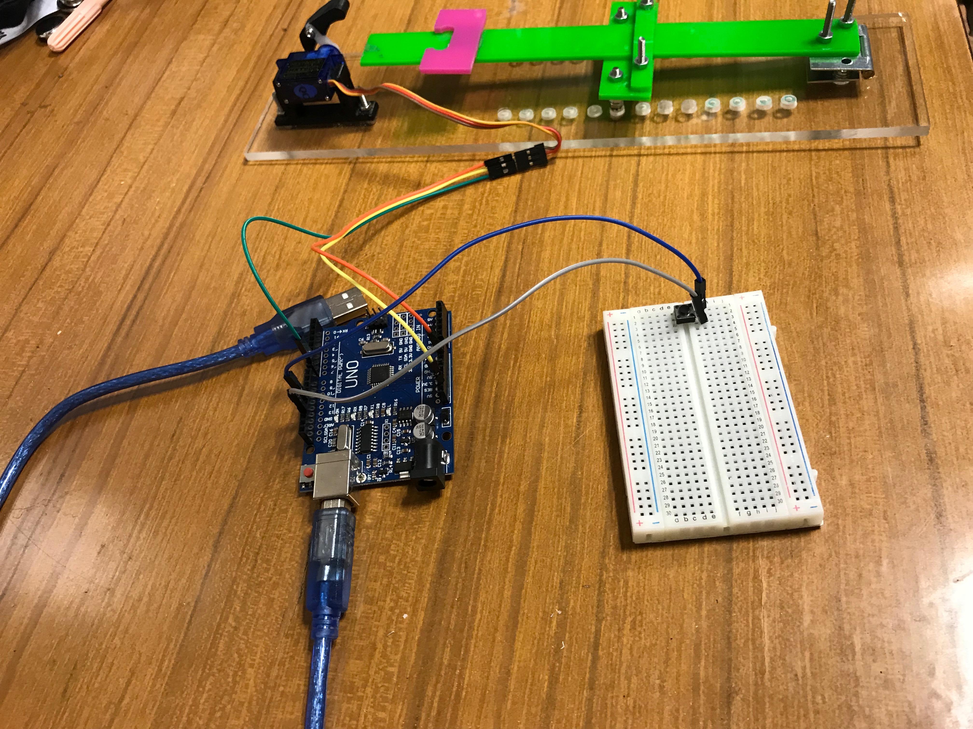
experimental setup
1kuna coin→ 500 throws
363-tail
137-head
Coin with a hole
$χ^{2}=$102,152 | $$χ^{2}>3,841$$
Notes:
Graf raspon 0,4 do 0,6 ---- naslov dolje

Slide 19
Deviation-angle dependence
By increasing the angle side which is facing down gets more probable to appear.
$3,38732°$→ chances of winning for this setup are 50:50

Slide 20
Conclusion
1-Tossing height is not important when tossing coins.
Height of throwing does not affect the result until it is smaller than coins diameter.
2-By increasing the number of throws the deviation will decrease.
3-When throw coins vertically chanses of winning will be closer to 50:50, than the horizontally tossing.

Slide 21
Conclusion
4-If the coin has a bulge on one side it will more often turn to the other side and if we toss a coin without the bulge the deviation of 50:50 will be smaller.
5-Hole in the middle will not have affect on chanses of winning for any side.
By increasing the angle of coin toss side which is facing down gets more probable to appear.

Slide 22
Literature
https://ldap.zvu.hr/~oliverap/VjezbeIzStatistike/8_Hi-kvadrat%20vje%C5%BEbe.pdf (1.3.2018.)
https://www.mathos.unios.hr/uvis/poglavlje2.pdf (30.1.2018.)

Slide 23
Thank you!
Team Croatia
Reporter: Marko Šarić

Slide 24
addition
Notes:
Zaokruži 3,841 crveno

Slide 25
Mass and size of a coin
 | Mass | Diameter
10 lipa | 3,25 g | 20 mm
1 kuna | 5 g | 22.5 mm
5 kuna | 7.45 g | 26.5 mm
5 kuna coin
1 kuna coin
10 lipa coin
1000 throws
vertically
0,5 m

Slide 26
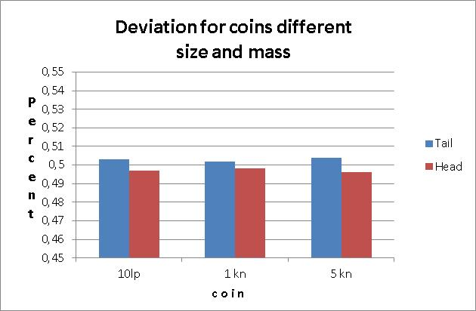
Mass and size of a coin
Mass and size of a coin do not affect the outcome
5kn
$$f$$ | $$f_{0}$$ | $$f_{1}$$ | $$\frac{{\left(f_{0}−f_{t}\right)}^{2}}{f_{t}}$$
Tail | 504 | 500 | 0.032
head | 496 | 500 | 0.032
 |  | $χ^{2}$: | 0.064
10lp
$$f$$ | $$f_{0}$$ | $$f_{1}$$ | $$\frac{{\left(f_{0}−f_{t}\right)}^{2}}{f_{t}}$$
Tail | 503 | 500 | 0.018
head | 497 | 500 | 0.018
 |  | $χ^{2}$: | 0.036
1kn
$$f$$ | $$f_{0}$$ | $$f_{1}$$ | $$\frac{{\left(f_{0}−f_{t}\right)}^{2}}{f_{t}}$$
Tail | 502 | 500 | 0.008
head | 498 | 500 | 0.008
 |  | $χ^{2}$: | 0.016

Slide 27
First height (0.25m)
$$f$$ | $$f_{0}$$ | $$f_{1}$$ | $$\frac{{\left(f_{0}−f_{t}\right)}^{2}}{f_{t}}$$
Tail | 503 | 500 | 0.18
Head | 496 | 500 | 0.18
 |  | $χ^{2}$: | 0.036
Third height (1m)
$$f$$ | $$f_{0}$$ | $$f_{1}$$ | $$\frac{{\left(f_{0}−f_{t}\right)}^{2}}{f_{t}}$$
Tail | 501 | 500 | 0.002
Head | 499 | 500 | 0.002
 |  | $χ^{2}$: | 0.004
Second height (0,5m)
$$f$$ | $$f_{0}$$ | $$f_{1}$$ | $$\frac{{\left(f_{0}−f_{t}\right)}^{2}}{f_{t}}$$
Tail | 501 | 500 | 0.002
Head | 499 | 500 | 0.002
 |  | $χ^{2}$: | 0.004

Slide 28
First way: Parallel to the floor
$$f$$ | $$f_{0}$$ | $$f_{1}$$ | $$\frac{{\left(f_{0}−f_{t}\right)}^{2}}{f_{t}}$$
Tail | 502 | 500 | 0.008
head | 498 | 500 | 0.008
 |  | $χ^{2}$: | 0.016
Second way: vertical to the floor
$$f$$ | $$f_{0}$$ | $$f_{1}$$ | $$\frac{{\left(f_{0}−f_{t}\right)}^{2}}{f_{t}}$$
Tail | 501 | 500 | 0.002
head | 499 | 500 | 0.002
 |  | $χ^{2}$: | 0.004

Slide 29
Coin with a bulge
$$f$$ | $$f_{0}$$ | $$f_{1}$$ | $$\frac{{\left(f_{0}−f_{t}\right)}^{2}}{f_{t}}$$
Tail | 535 | 500 | 2.45
head | 465 | 500 | 2.45
 |  | $χ^{2}$: | 4.9
Symmetrical coin
$$f$$ | $$f_{0}$$ | $$f_{1}$$ | $$\frac{{\left(f_{0}−f_{t}\right)}^{2}}{f_{t}}$$
Tail | 501 | 500 | 0.002
head | 499 | 500 | 0.002
 |  | $χ^{2}$: | 0.004

Slide 30
Angles
1,5840
1,7364
2,5554
3,393
3,775

