Slide 1
10. Greenhouse
Team Croatia
Reporter: Elena Lukačević

Slide 2
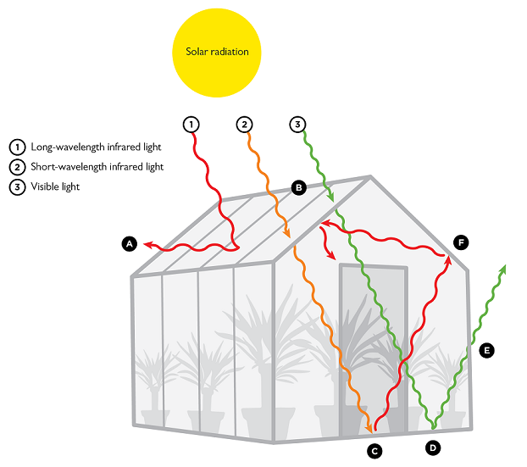
10. Greenhouse
A hot object placed in the open air would gradually cool down. We can slow down this process by containing the object in a greenhouse. Compare different mechanisms of heat loss by the object and explain how the presence of a greenhouse affects them.
Notes:
Dodati sliku cijelog postava

Slide 3
Outline
Theoretical introduction
Experiment
Results
What is heat and how it can be transfered?
Setup
Graphs
Conclusion
Newton’s law of cooling

Slide 4
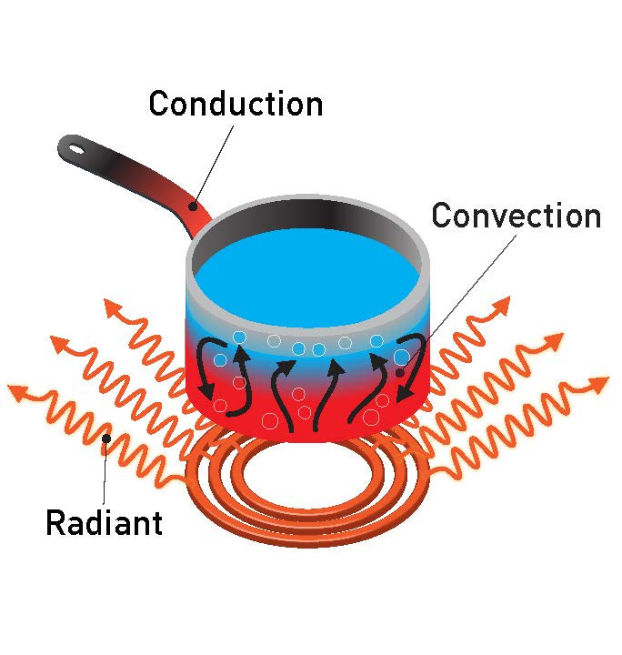
Types of heat loss
Radiation
Conduction
Convection

Slide 5
Radiation
${Q=A}_{t}∙ φ_{in,vis} ∙ \left(1−albedo\right)=h_{2} ∙A_{s} ∙(T_{p}−T_{0})$
$A_{t}$ - radiated surface
$φ_{in,vis}$ - radiation of visible and invisible spectre
$albedo$ – measure of diffuse radiation (0- black body)
$h_{2}$ - heat transfer coefficent
$A_{s}$- surface of object
$$Q∝∆T$$

Slide 6
Convection and conduction
Newton’s law of cooling:
While r is bigger, temperature is lower
$T_{env }$- temperature of environment
T(0) - initial temperature
r - time constant
t - time

Slide 7
Experiment - radiation
Aluminum foil
Hot object (roller 30g made of brass)
Glass bell
Sensors for temperature
Vacuum pump

Slide 8
Experiment - convection
Aluminum foil
Hot object (roller 30g made of brass)
Glass bell
Sensors for temperature
Vacuum pump

Slide 9
Experiment - conduction
Aluminum foil
Glass bell
Sensors for temperature
Aluminum plate
Hot object (roller 30g made of brass)
Vacuum pump

Slide 10
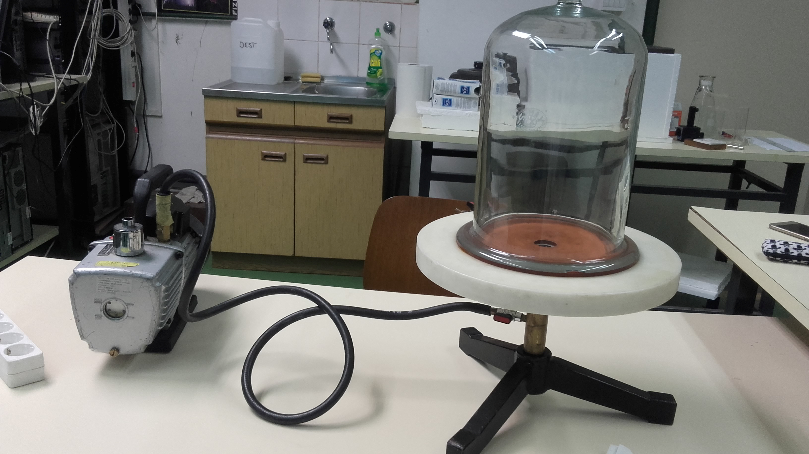
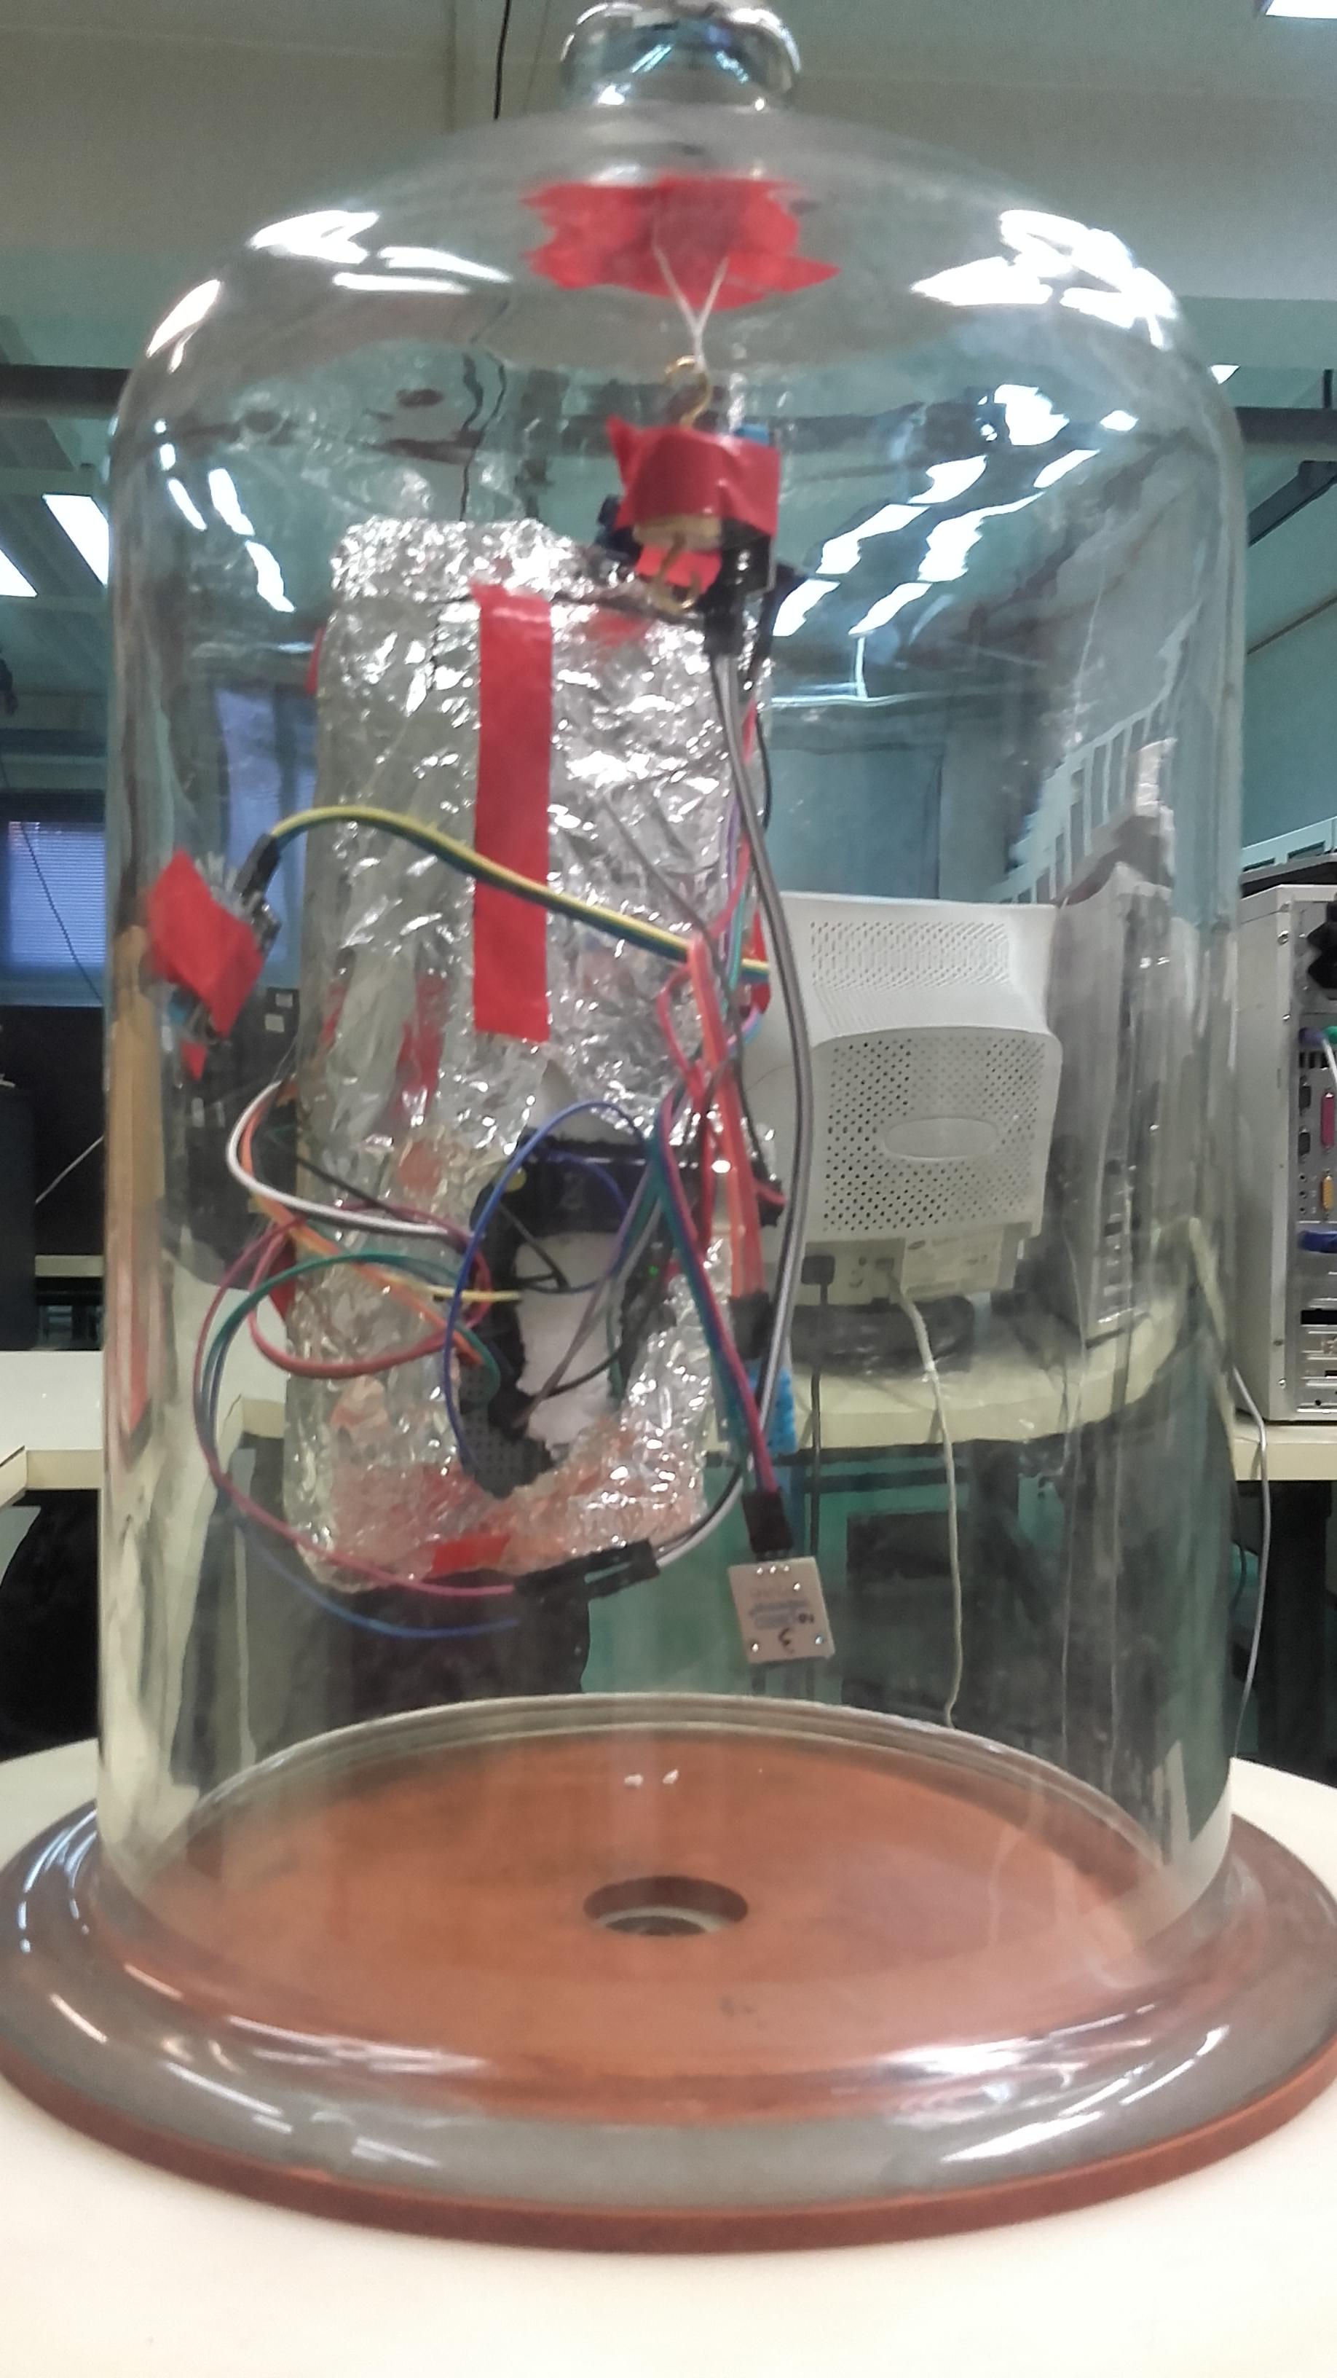
Experiment setup
If you have a short video of your experiment that is relevant, place it on this slide.
If the image or sketch did not fit on the previous slide, put it on this slide.

Slide 11
Conduction is the fastest type of heat loss because of touch while radiation is the slowest type of heat loss.

Slide 12
The object in a greenhouse is cooling slower than outside the greenhouse.

Slide 13
Conclusion
Radiation is the slowest type of heat transfer.
Greenhouse is making heat loss slower by preserving the infrared waves.

Slide 14
Literature
Frank Incropera; Theodore L. Bergman; David DeWitt; Adrienne S. Lavine (2007). Fundamentals of Heat and Mass Transfer (6th ed.) (11.5.2018.)
http://demonstrations.wolfram.com/NewtonsLawOfCooling/ (11.5.2018.)
Mladen Paić; Toplina i termodinamika (1994.), Zagreb (11.5.2018.)
Dubravko Horvat, Mehanika i toplina (2002.), Zagreb (11.5.2018.)
Notes:
Napisati literaturu (knjiga, pdf-ovi o toplini)

Slide 15
Thank you!
Team Croatia
Reporter: Elena Lukačević

Slide 16
