Slide 1
4. Making quark
Team Croatia
Reporter: Ana Ćenan

Slide 2
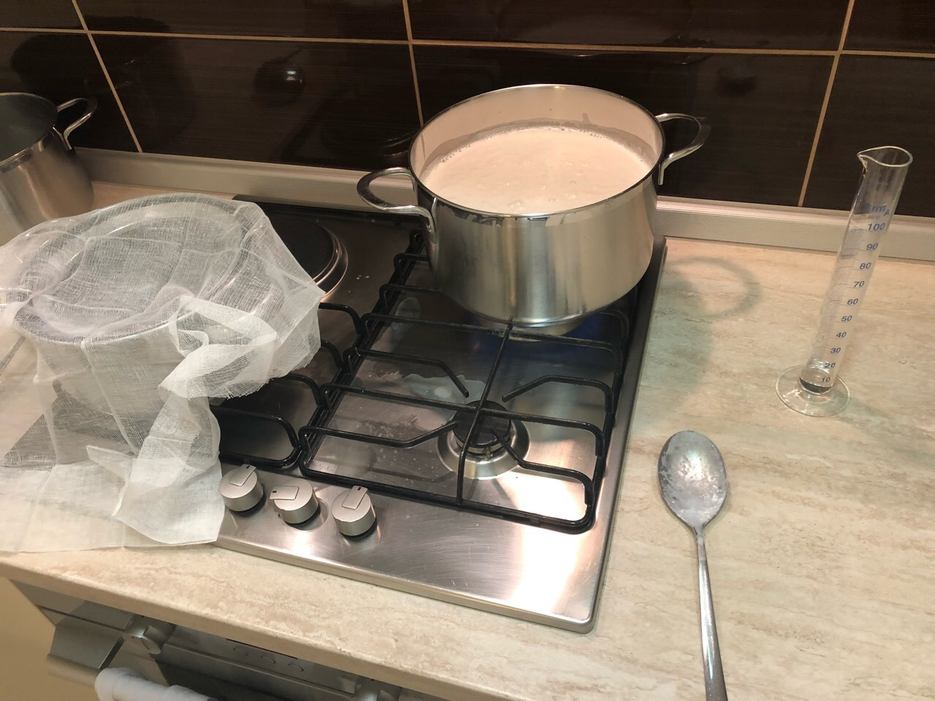
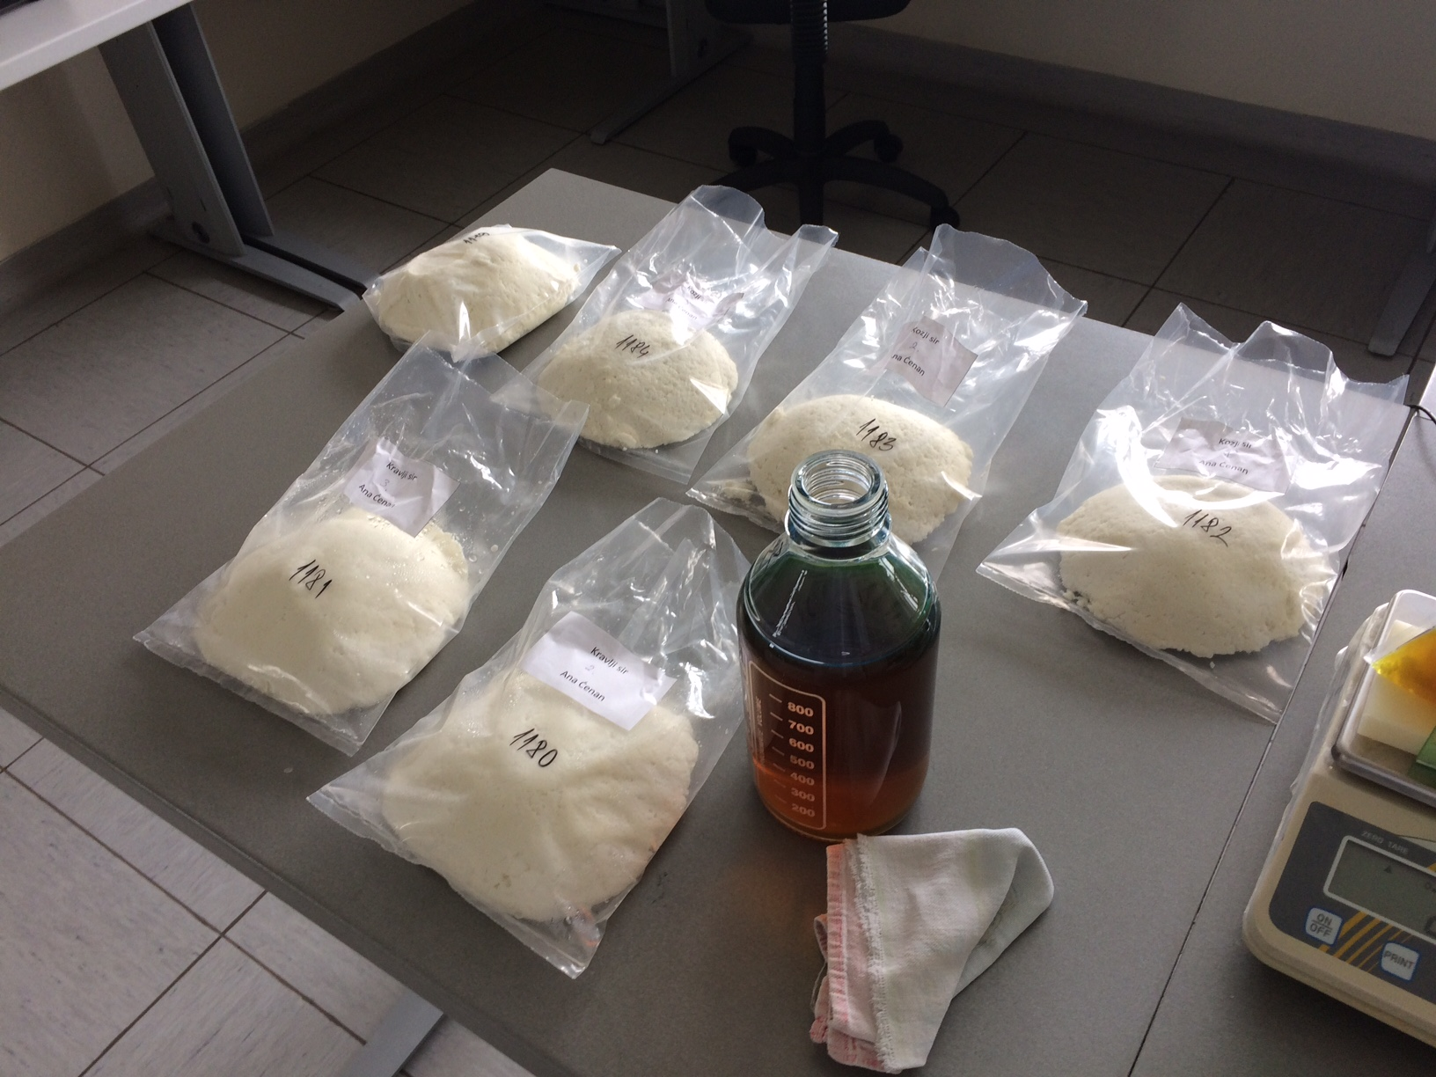
1. Making quark
Quark, cottage cheese, and similar varieties of white acid-set cheese can be produced from milk. Investigate this process experimentally and study the properties of the resulting product.

Slide 3
Outline
Theoretical introduction
Experiment
Results
Chemical composition
Making of cheese
Analysis
Chemical analysis
Microbiological analysis
Quark cheese

Slide 4
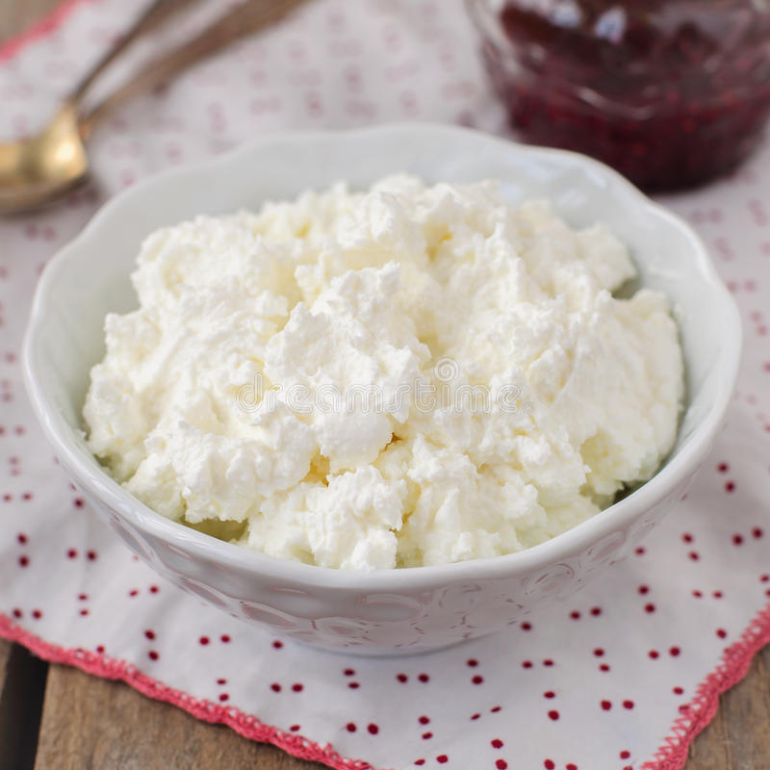
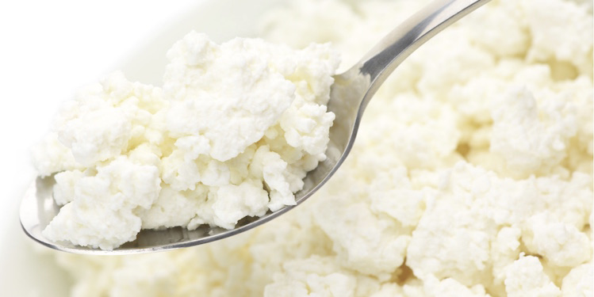
Quark cheese
Made out of milk
Soft in consistency
White color
Fresh cheese

Slide 5
Basic ingredients
cheese ingredients
water proteins (casein) carbohydrates (lactose) milk fat

Slide 6
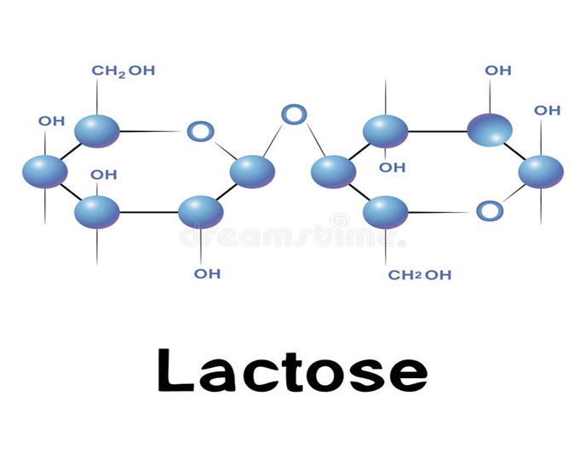
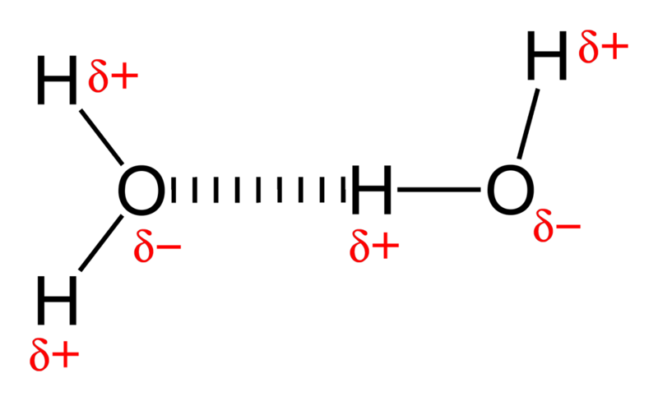
ingredients
globule of fat
water
Milk fat – globules
- flavour ingredients
- vitamins dissolved
Lactose - composed of glucose and galactose
- lactic acid
Protein (casein) - amino acid
- coagulation
Water – bounded
- unbounded
Hydrogen bond

Slide 7
Demonstration of the phenomenon
Cheese production - coagulation of protein (curdling):
- by the acid action (acetic acid) - sour curd
Native conformation
Protein denaturation
Coagulation

Slide 8
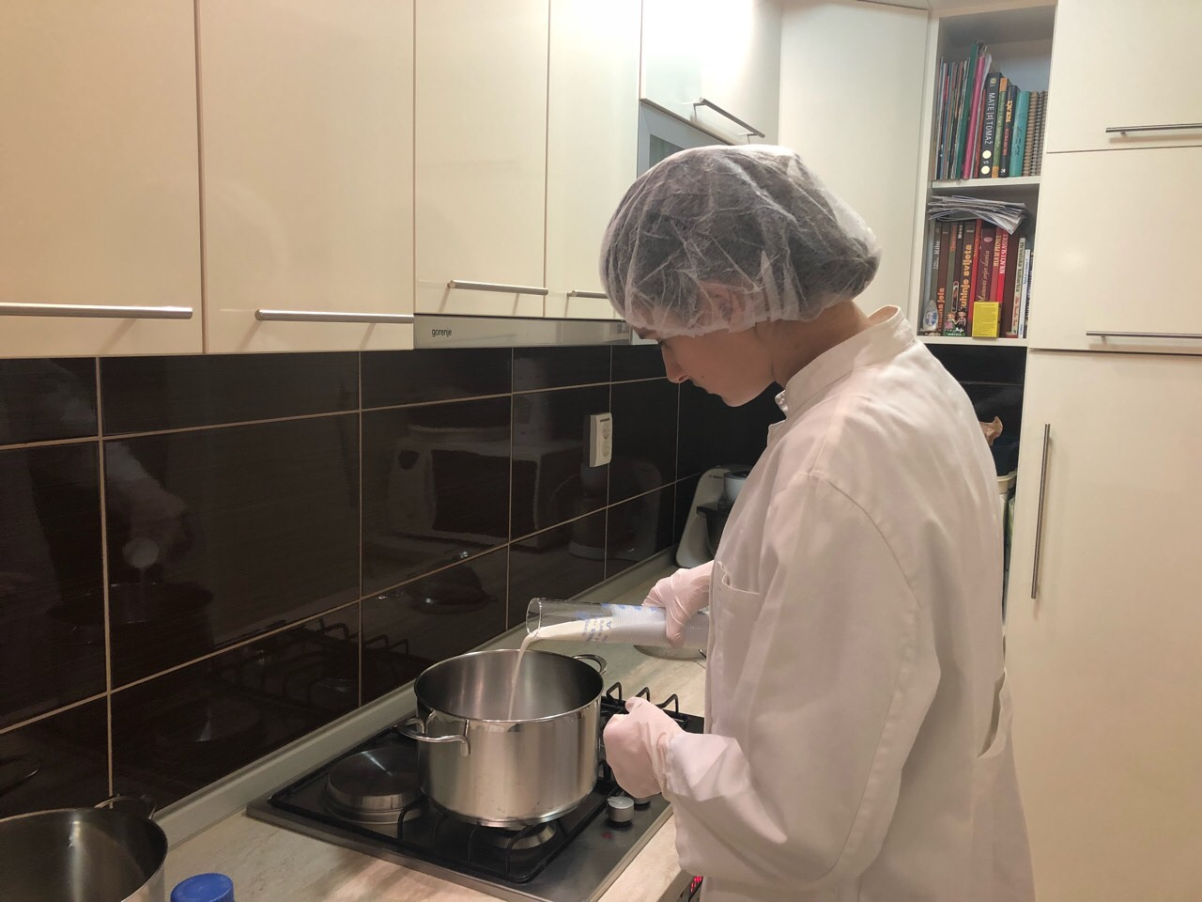
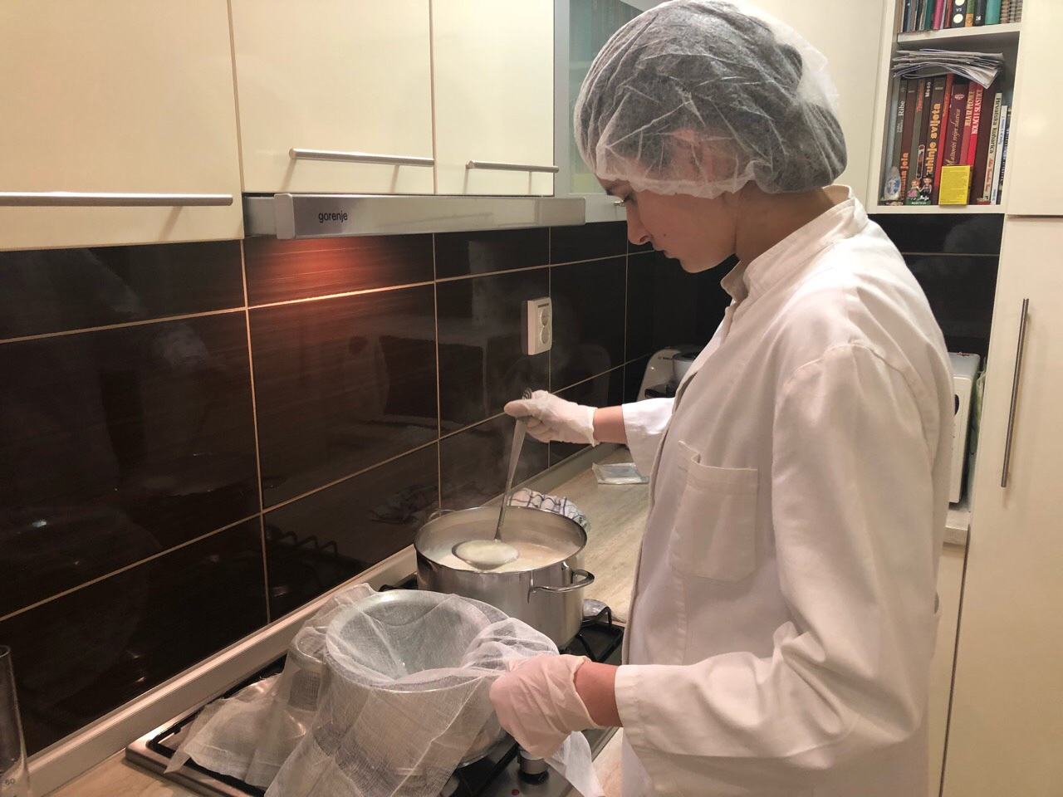
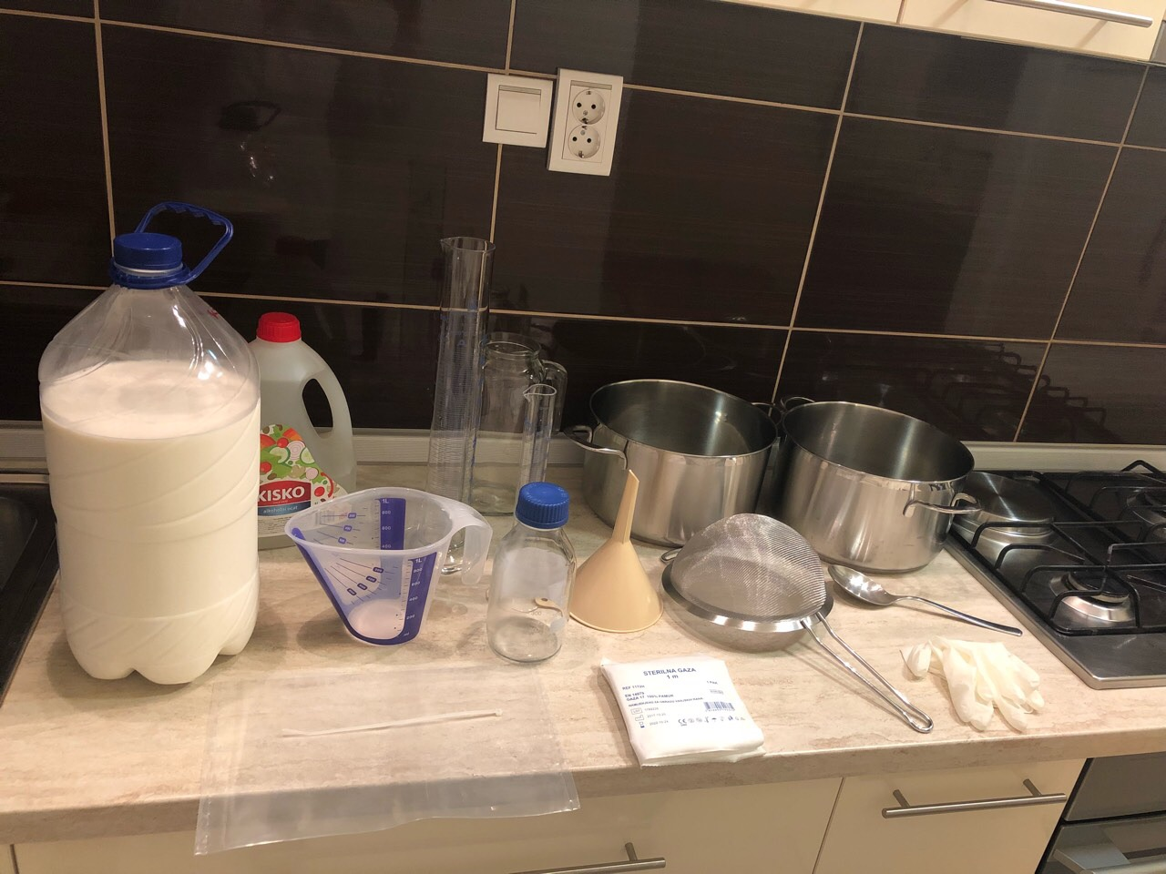
Making of cheese materials and methods
Three types of milk (cow, goat,
sheep)
V(milk) = 3.5 L
PROCEDURE:
Heated up to boiling point
30 ml of acetic acid (vinegar)
Whey was separated
Water squeezed out by applying weight

Slide 9
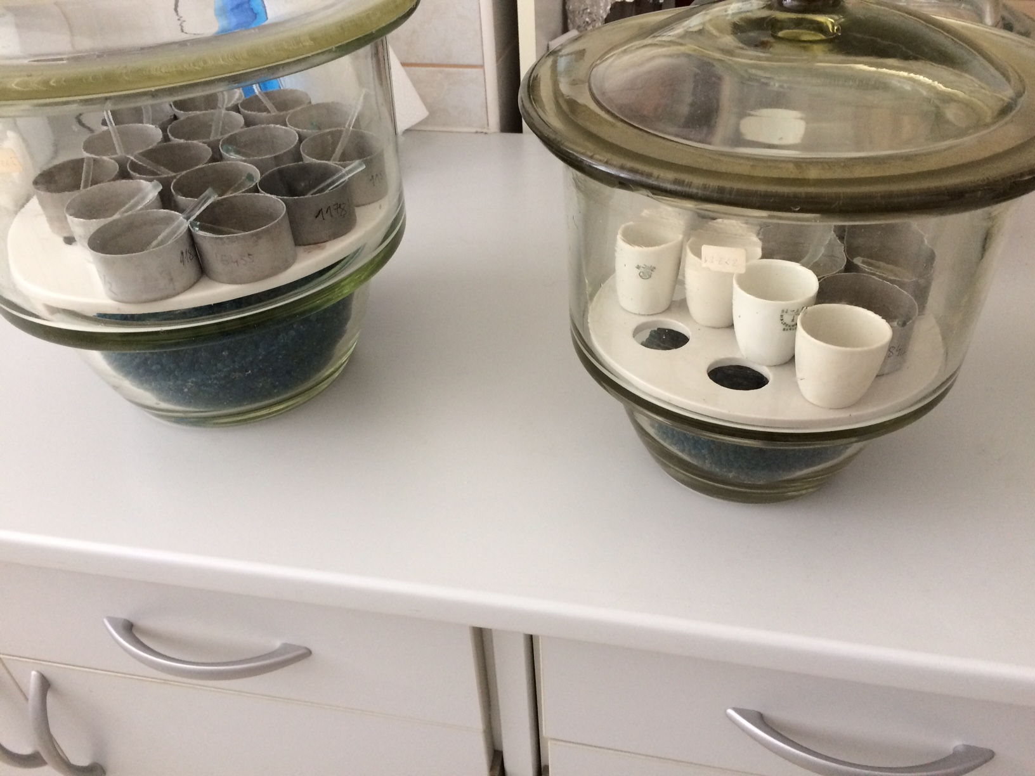
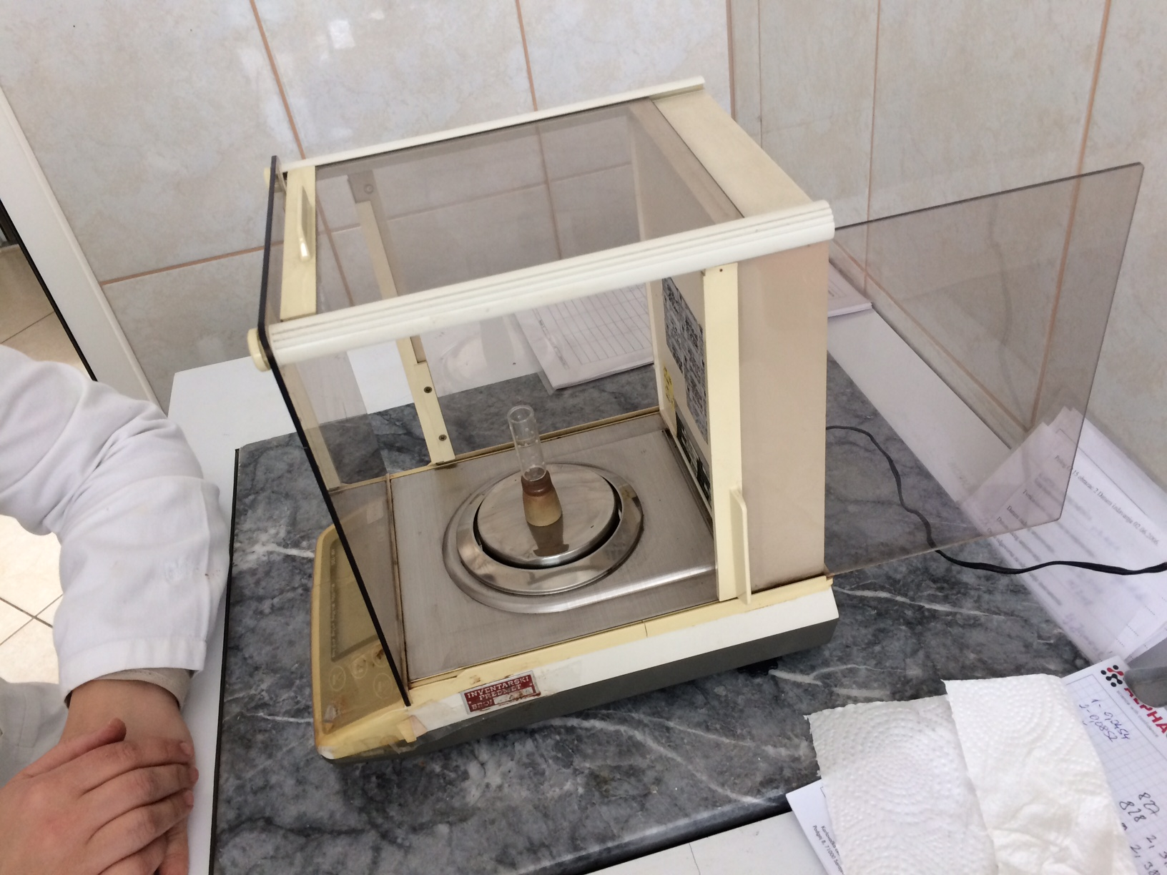
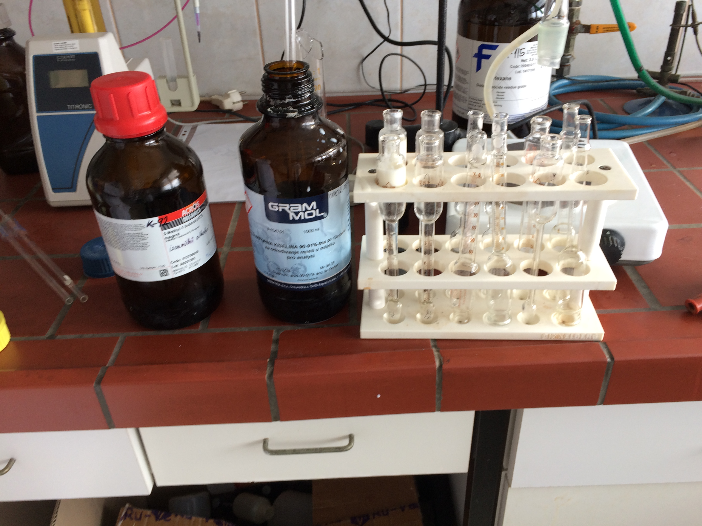
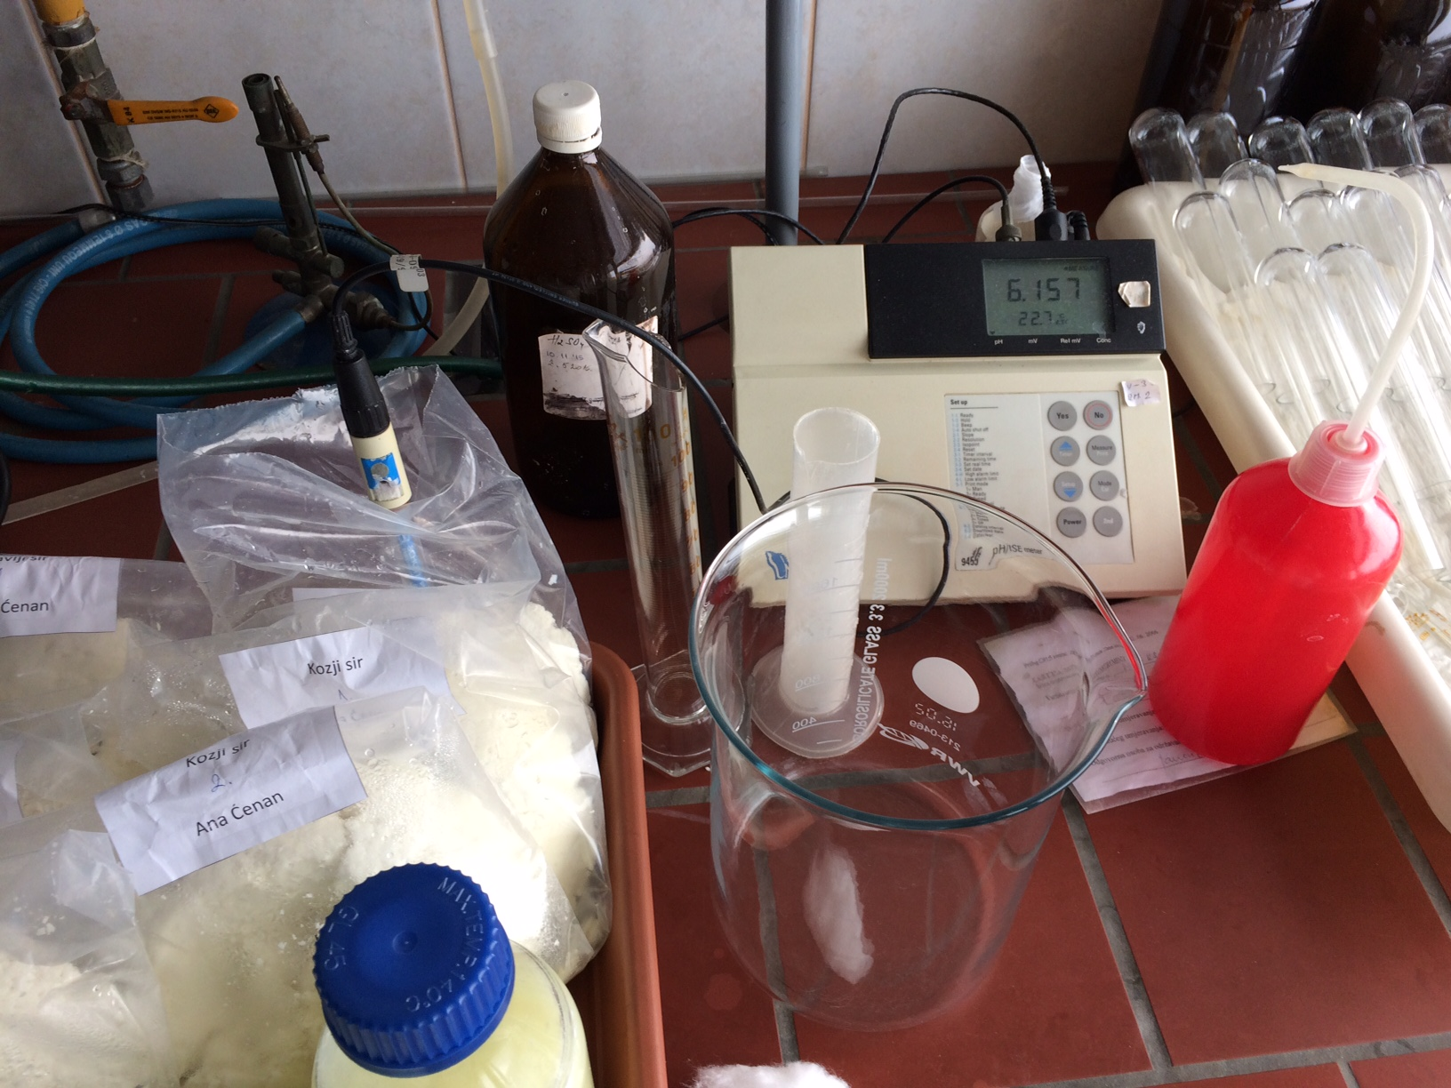
Analysis of chemical properties
Dry matter
Milk fat
pH
Proteins
desiccator
analytical scale
centrifuge
pH-meter
test tubes

Slide 10
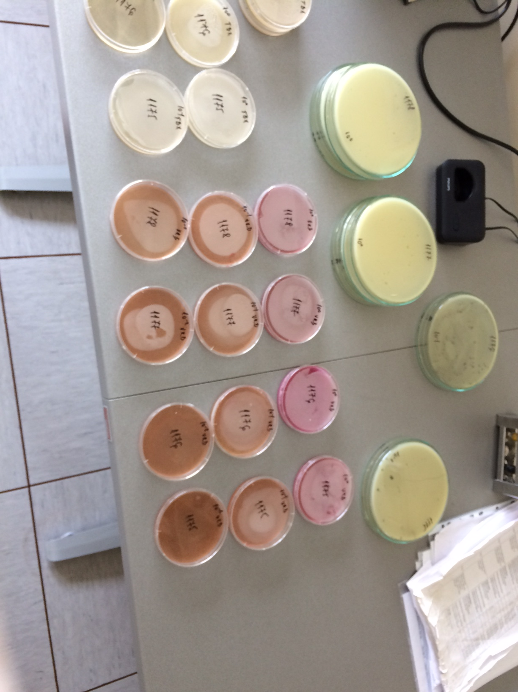
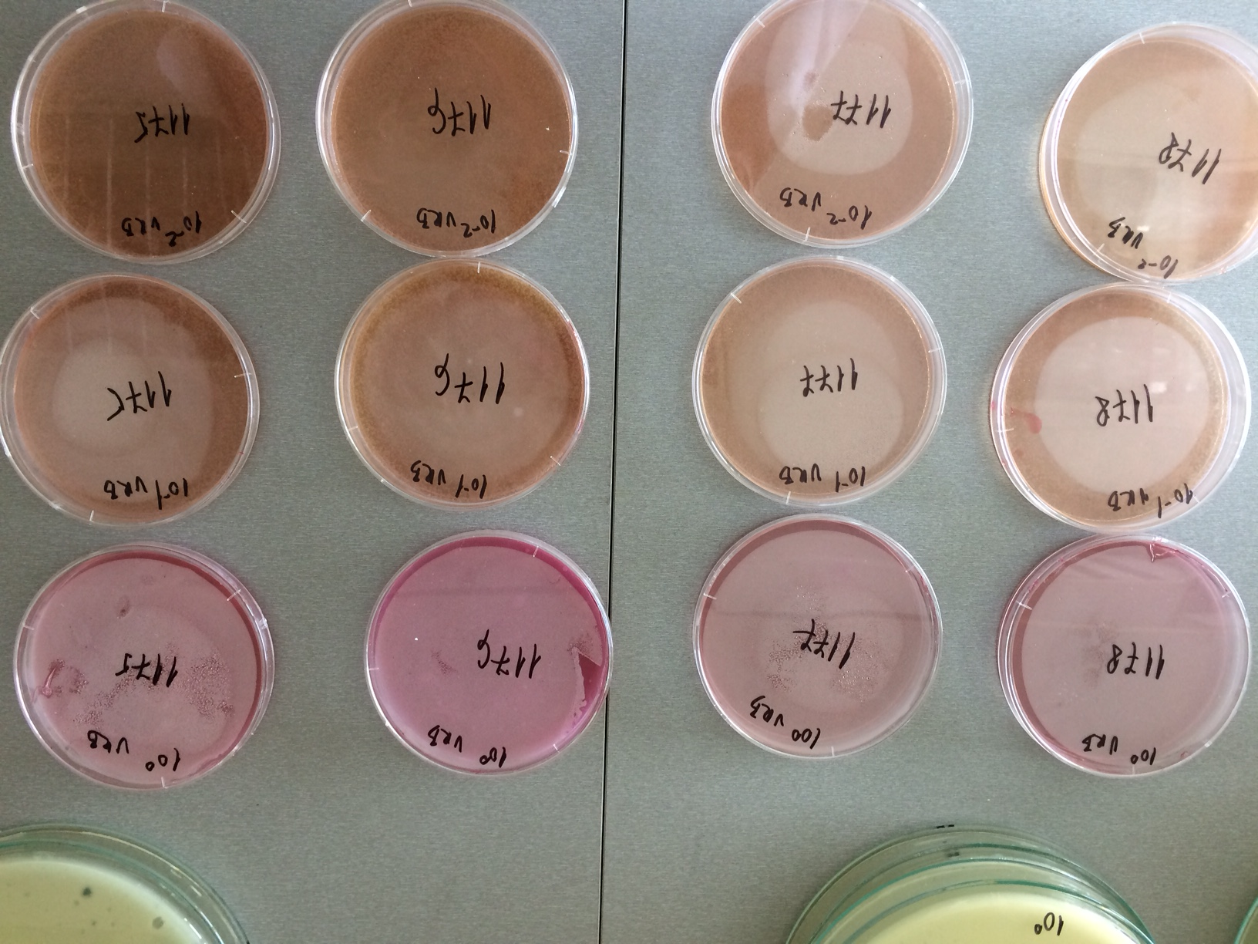
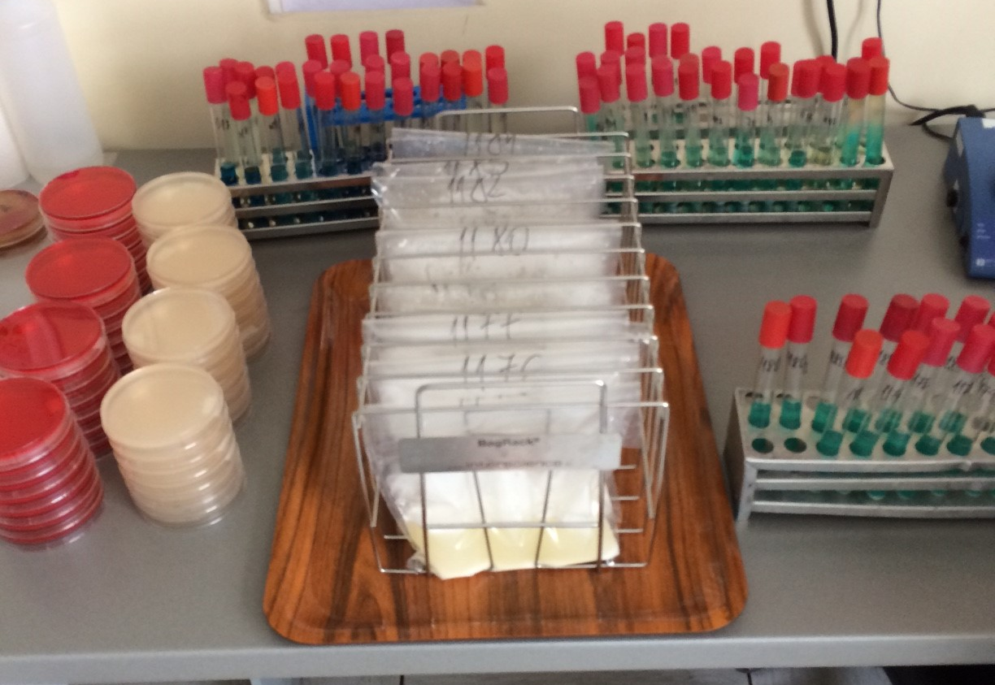
Microbiological analysis
Tested for:
Escherichia coli
Enterobacteria
Salmonella spp
Listeria monocytogenes
Staphylococcus aureus
Yeasts
Mold
old
medium for listeria and salmonella
petri dishes with samples

Slide 11
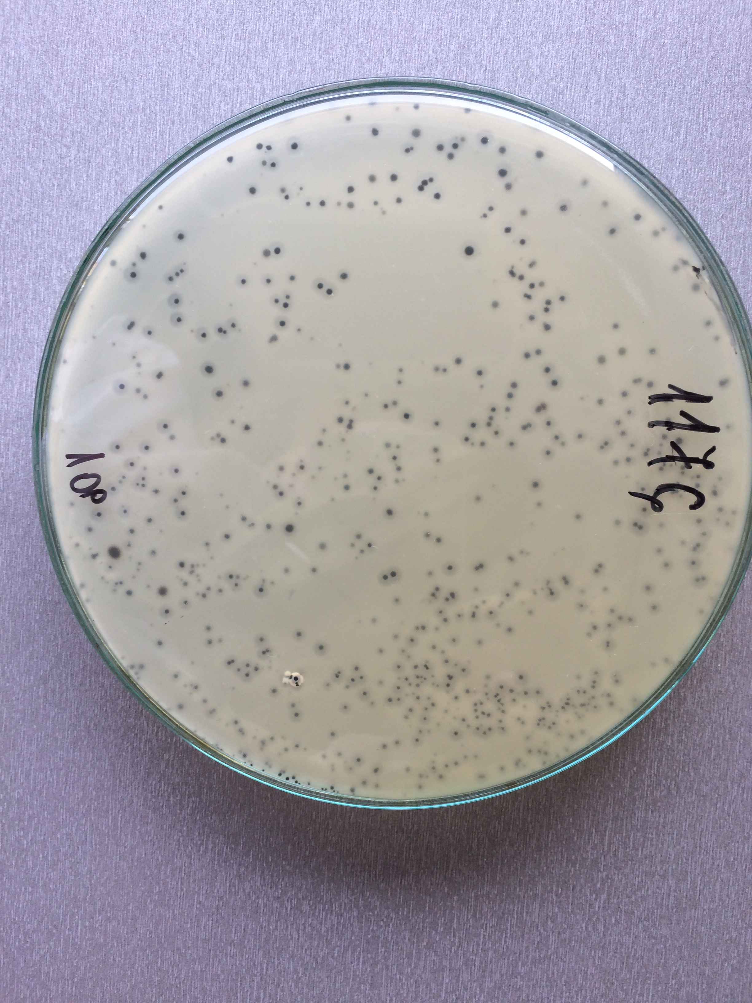
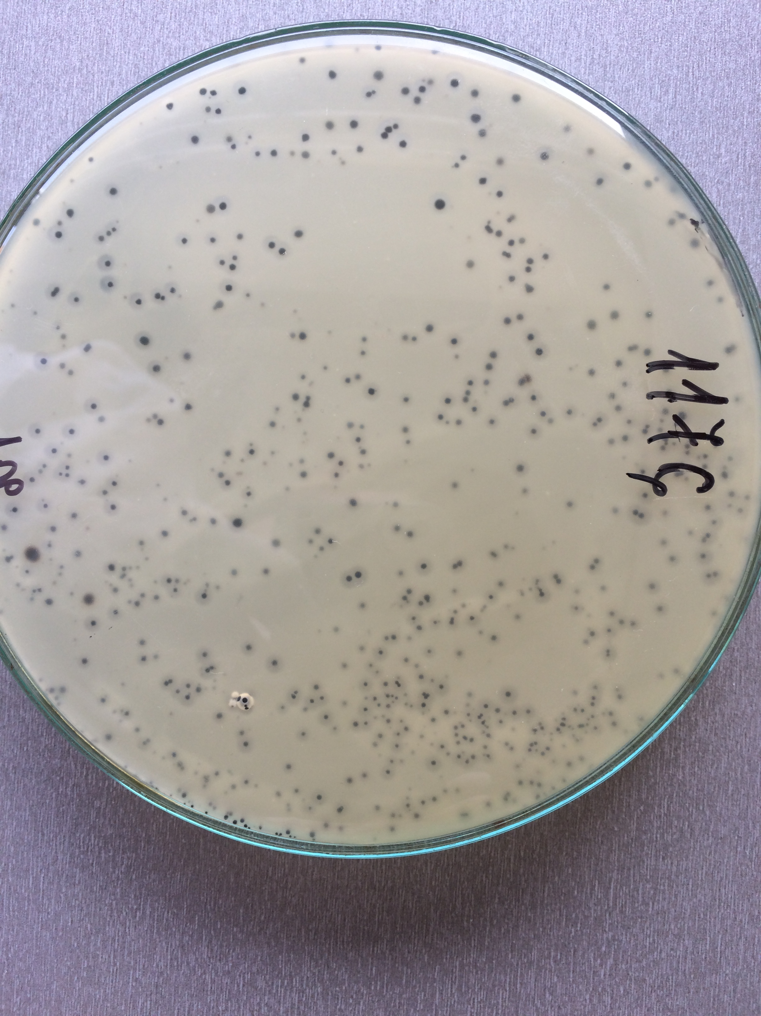
RESULTS - Microbiological analysis
Escherichia coli, Salmonella spp, Listeria monocytogenes, Staphylococcus aureus, yeast, mold – absent ☺
Enterobacteria – low quantities found in cow cheese (5.0x10²) ☹
According to rule food safety criteria regulations all of the cheeses except cow cheese were safe to eat
colonies of bacteria found in cow cheese

Slide 12
Results - whey volume and cheese mass

Slide 13
Results - chemical analysis
 | Dry matter | Milk fat | pH | Proteins
Cow cheese | 48,47% | 27% | 6,36 | 18.25%
Goat cheese | 49,21% | 26% | 6,15 | 20.16%
Sheep cheese | 49,55% | 13% | 6,09 | 21.34%

Slide 14
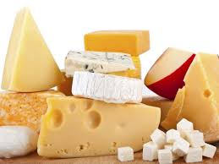
Conclusion
Cow cheese ➔ the most nutritious one
Sheep cheese has the most dry matter and proteins, but has a small amount of milk fat
Even a small amount of enterobacteria can be harmful
Pasteurization is necessary to avoid food poisoning
An image goes here (or a graph or a sketch).

Slide 15
Literature
Lj.Tratnik, R. Božanić (2012): Mlijeko i mliječni proizvodi. Udžbenik, Hrvatska mljekarska udruga, Zagreb
Stilinović B., Hrenović J. (2009): Praktikum iz bakteriologije. Kugler, Zagreb, p. 199.
Juretić, N., 2002: Osnove biljne virologije, Školska knjiga, Zagreb, 319 str.
Prescott, L.M., Harley, J.P., Klein, D.A., 1996: Microbiology. WCB McGraw Hill,Boston. Atlas, R. M., 1997: Principles of Microbiology. WBC McGraw-Hill, Boston.
Nester, E. W., Anderson, D. G., Roberts, C. E., Pearsall, N. N., Nester, M. T., 2001: Microbiology. McGraw-Hill, Boston.
Patrick F. Fox (February 28, 1999). Cheese: chemistry, physics and microbiology, Volume 1. Springer, 1999. p. 1. ISBN 978-0-8342-1338-8. Retrieved March 23, 2011.

Slide 16
Thank you!
Team Croatia
Reporter: Ana Ćenan

Slide 17
COAGULATION OF PROTEIN
The basic difference in cheese production process is in coagulation of protein (curdling):
By the acid action sour curd is formed:
By milk souring under the influence of mesophilic culture (lactic acid bacteria and fermentation)
By addition of acetic or citric acid
By the action of proteolytic enzymes (this is usually used in making semi-hard and hard cheeses)
By the action of heat from 90 °C to 95 °C to in production of whey cheese

Slide 18
Microbiological analysis
 | Cow milk | Goat milk | Cow whey | Goat whey | Cow cheese | Goat cheese
Escherichia coli | <1 | <1 | <1 | <1 | <10 | <10
Enterobacteriaceae | 1.6∙10² | 7.6∙10² | 1.6∙10¹ | <1 | 5.0∙10² | <10
Salmonella spp | absent | absent | absent | absent | absent | absent
Lichteria monocytogenes | absent | absent | absent | absent | absent | absent
Aerobic mesophilic bacteria | 1.9∙10² | 9.1∙10² | 2.3∙10² | 9 | 1.3∙10⁴ | <10
Staphylococcus aureus | 2.1∙10² |  | <1 |  | <10 | <10
Yeasts | 1.1∙10² | <1 | <1 | <1 | <10 | <10
Mold | <1 | <1 | <1 | <1 | <10 | <10

Slide 19
KJELDAHL method - proteins
method for the quantitative determination of nitrogen
Degradation: Sample + H2SO4 → (NH4)2SO4(aq) + CO2(g) + SO2(g) + H2O(g)
Liberation of ammonia: (NH4)2SO4(aq) + 2NaOH → Na2SO4(aq) + 2H2O(l) + 2NH3(g)
Capture of ammonia: B(OH)3 + H2O + NH3 → NH4+ + B(OH)4−
Back-titration: B(OH)3 + H2O + Na2CO3 → NaHCO3(aq) + NaB(OH)4(aq) + CO2(g) + H2O

Slide 20
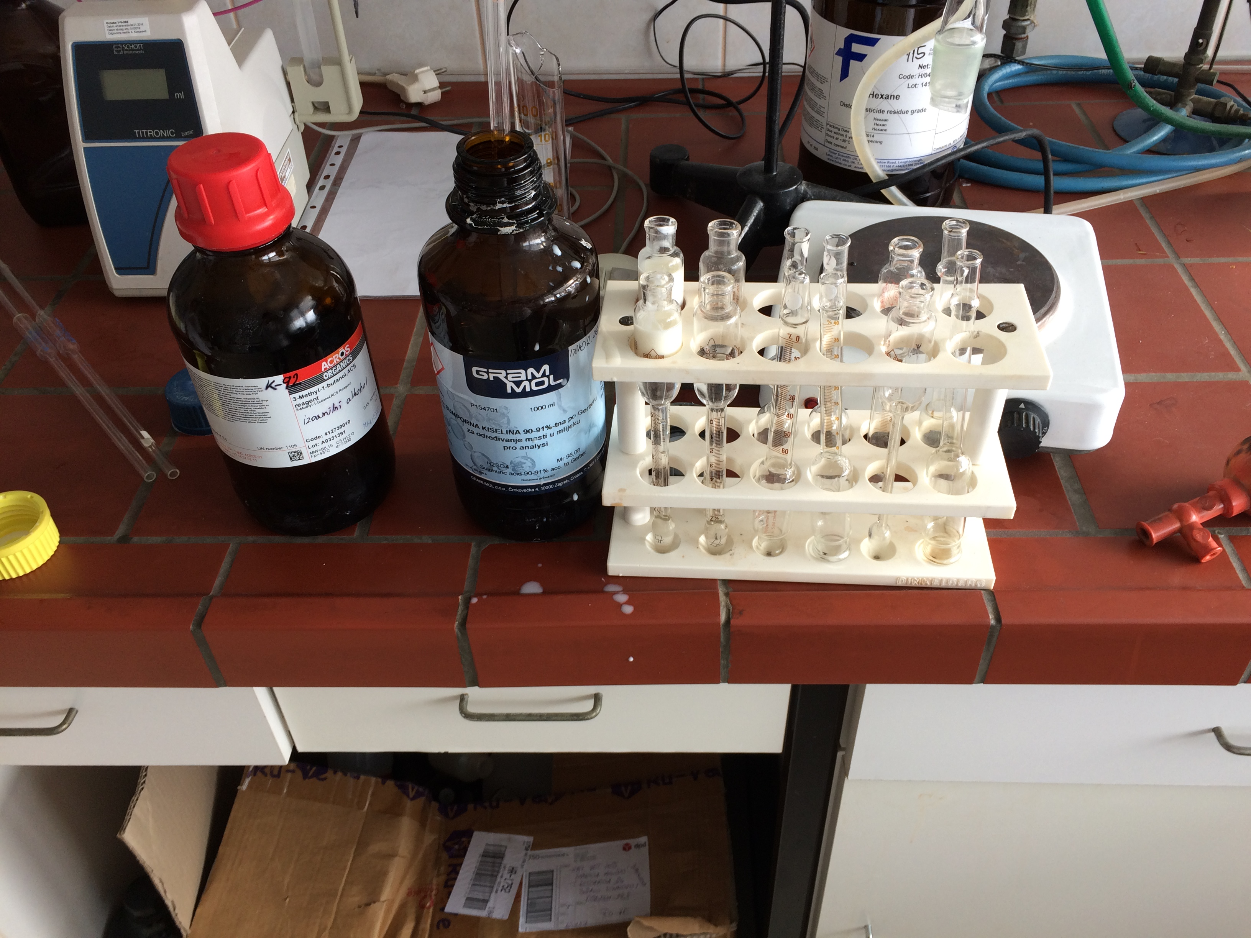
Process of determining milk fat
weighing 3 grams of each cheese
putting them in special test tubes with measures
adding isomeric alcohol and sulfuric acid
putting the sample in the centrifuge
separation of the milk fat

Slide 21
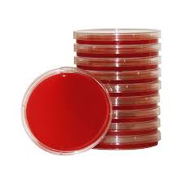
Bacterial growth medium
agar plates ➔ agar and nutrients
unicellular organisms, blood serum, ammonium salts or glucose can be added

Slide 22
Ph meter
Measures the concentration of hydroden ions in the sample

